Slide 1
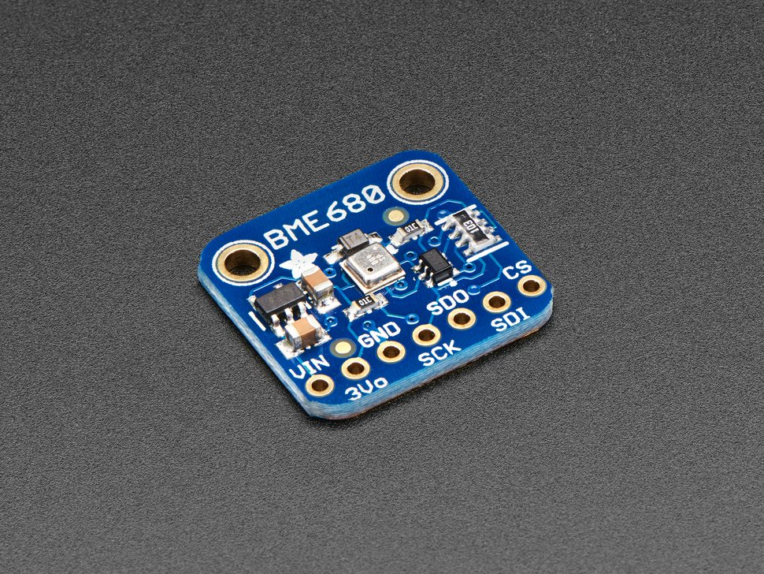
BME 680
Measurement of atmospheric pressure

Slide 2
What is a BME680?
Temperature, humidity, pressure and gas sensor
Produced by Bosch, Distributed by Adafruit Industries
Is higher-end than BME280 atmospheric sensor

Slide 3
Atmospheric pressure sensing capability
Measures barometric pressure to +- 1 millibar precision
300-1100 mb
182 Hz sampling rate

Slide 4
How does the BME measure pressure?
Modern microelectromechanical system (MEMS) technology
“Resistive” vs. “Capacitive”
A small, flexible membrane is exposed to the atmosphere on one side
A variable-capacitance material is attached to the opposite side and measures the force on the membrane

Slide 5
How does the BME measure pressure?
The resistance of the strain-measuring material changes as is it compressed by the membrane
The change in resistance is calibrated to relate to atmospheric pressure.
There is an optional IIR filter for pressure measurements
Eliminates short term fluctuations in pressure

Slide 6
References
https://cdn-shop.adafruit.com/product-files/3660/BME680.pdf
https://www.avnet.com/wps/portal/abacus/solutions/technologies/sensors/pressure-sensors/media-types/barometric/
https://www.hbm.com/en/7646/what-is-a-pressure-sensor/

