Slide 1
Electronic Veterinary Stethoscope
Adam Manaster, Divya Aggarwal, and Yaashnaa Singhal

Slide 2
Introduction (1)
Our group wants to measure the ruminal (stomach) contractions of large cattle.
We are looking for irregular patterns in the pressures/frequencies of these contractions in order to determine if a cow has an ailment or malformity.
Alternative methods to monitor the inner workings of a cow’s digestive system are costly and quite invasive (e.g. one method involves cutting out a massive hole in the cow’s side in order to access the stomach).
Our electronic veterinary stethoscope will hopefully have the potential to serve as an inexpensive, non-invasive instrument for pinpointing whether or not steer are suffering from an illness of some sort.

Slide 3
Introduction (2)
All cows have a four-compartment stomach, part of which is known as the rumen.
The rumen is where bacteria and other microorganisms reside, basically serving as a large fermentation vat where fibrous food and liquid constantly churn and mix.
Microbes in the rumen help break down feedstuff to aid in the digestive process.
An irregular pattern of ruminal contractions would suggest that the cow is perhaps ill and could potentially result in an increase in its overall methane production, which obviously would be detrimental to the environment.

Slide 4
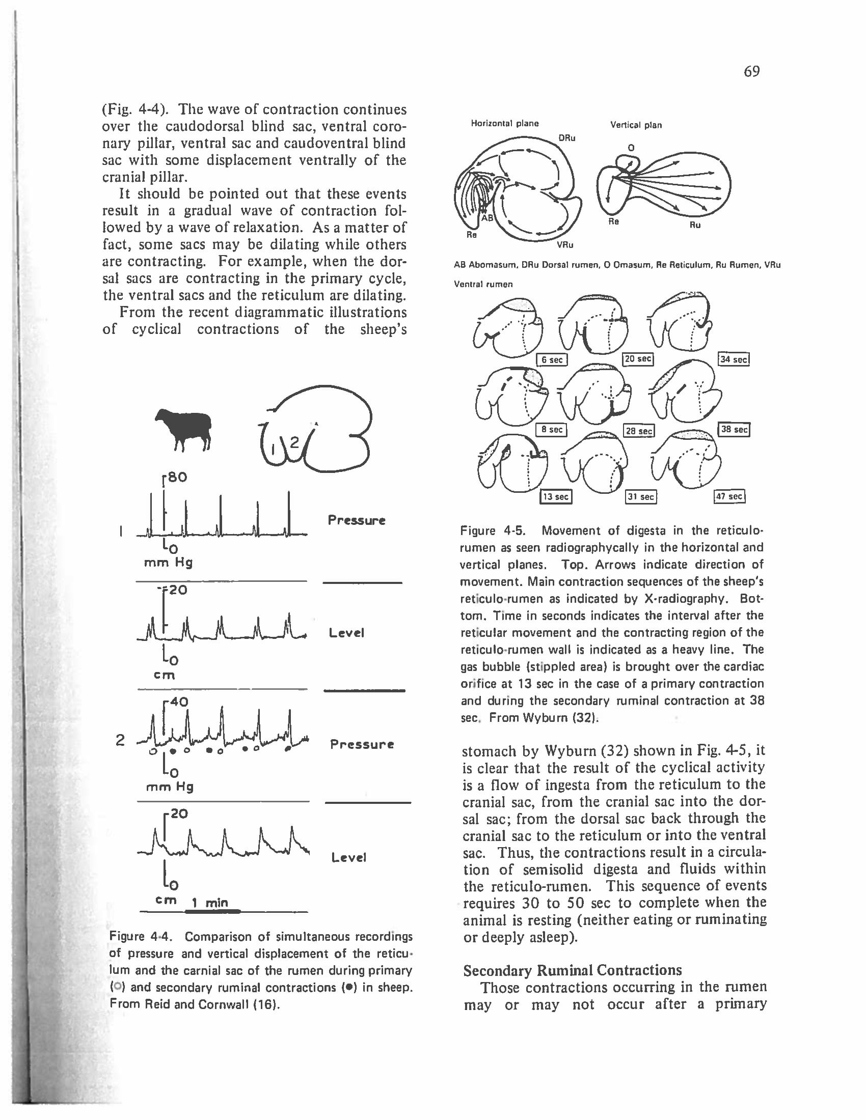
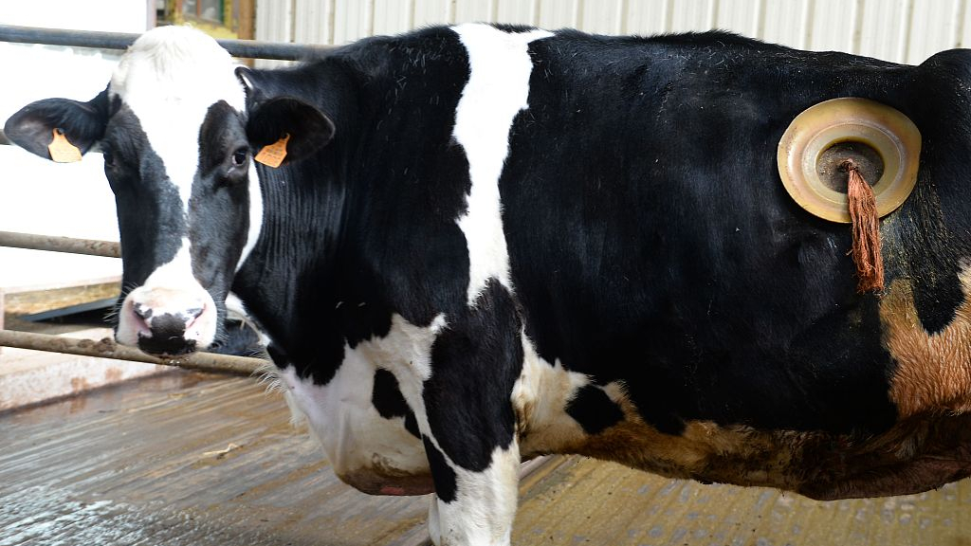
Cannulated cows: This research method of studying the rumen is highly invasive and costly since a proper surgery needs to be done. Furthermore, it is not practical for studying a huge number of animals.
A snapshot from the research paper we were given.

Slide 5
Instrumentation
Each of our breadboards and PCBs house the following components…
Keypad (for interacting with the system)
LCD (for displaying results)
BME680 (for measuring temperature and pressure)
Adafruit Electret Microphone (for measuring and recording sounds)
This is the most important instrument in our case!
INA219 Current Sensor (for determining the longevity of our batteries)
RTC (for timekeeping purposes)
MicroSD Card (for creating audio binary files from the microphone and other files to keep track of extraneous data such as the time, temperature, etc. while collecting data)

Slide 6
Data Acquisition
Our (tentative) plan for data acquisition is to utilize TWO microphones.
Because the noises we are monitoring are at such a low frequency, we need to block out as much background noise and static as we can in order to ensure that our results are as clear as possible.
To accomplish this, we are hoping to write a binary file that subtracts out the ambient noise using the secondary microphone (the one that will NOT be listening for contractions).
We plan to collect data for 10-15 minutes for multiple cows. The reason for such a long time window is so that we can hopefully establish some sort of “pattern” of the major contractions since those typically occur every 1-2 minutes.

Slide 7
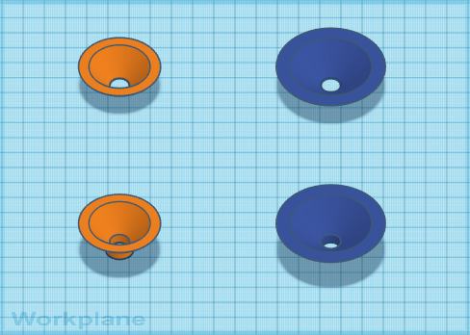
Initial Stethoscope Designs (Conical)

Slide 8
Breadboards
Adam: Breadboard is complete and could (hypothetically) be used to collect data.
Divya: Breadboard is complete as well.
Yaashnaa: Breadboard is complete as well.

Slide 9
PCBs
Adam: PCB is complete and ready to be used to collect data in the field.
Divya: Need to attach microphone(s) and capacitors.
Yaashnaa: PCB is complete but need to use it to collect data.

Slide 10
Our Plan
Our group has been in contact with Dr. Joshua McCann, an assistant professor at UIUC within the Department of Animal Sciences. He specializes in the influence of nutrition on metabolism and growth of feedlot cattle by characterizing ruminal fermentation and the gut microbiome.
We plan to go out to the UIUC cattle farm (otherwise known as the Beef and Sheep Field Research Laboratory) next week to take some real data!
This farm is located off campus.
4900 South Race St., Urbana , IL 61802

Slide 11
Data Analysis (1)
We ran several tests with our breadboards and then later with Adam’s PCB to record biological sounds from humans, cats (unsuccessfully), and a dog. The PCB appears to be much less “noisy” in terms of the sounds the microphone picks up from the surrounding environment. A reason for this could be that the connection with the PCB is cleaner than that of the breadboard.
We recorded heart sounds from our human subject, Adam, while he was resting and after he ran a couple laps around Loomis so that we could listen for and compare the microphone’s capabilities to detect different heart rates.
The cats proved to be too small a test subject or perhaps our microphone was not sensitive enough to pick up on any gastrointestinal/respiratory frequencies.

Slide 12
Data Analysis (2)
We collect the majority of our data from the microphone which is, in turn, written and saved onto the SD card in binary form.
We then convert the binary file into a .wav file to process the data. This is done using code Professor Gollin wrote and it is available on the course website.
We are using Python to visualize and analyze our data that is currently in .wav format.
Using libraries like Librosa and SciPy, we can begin to analyze and visualize our data.

Slide 13
Test Data

Slide 14
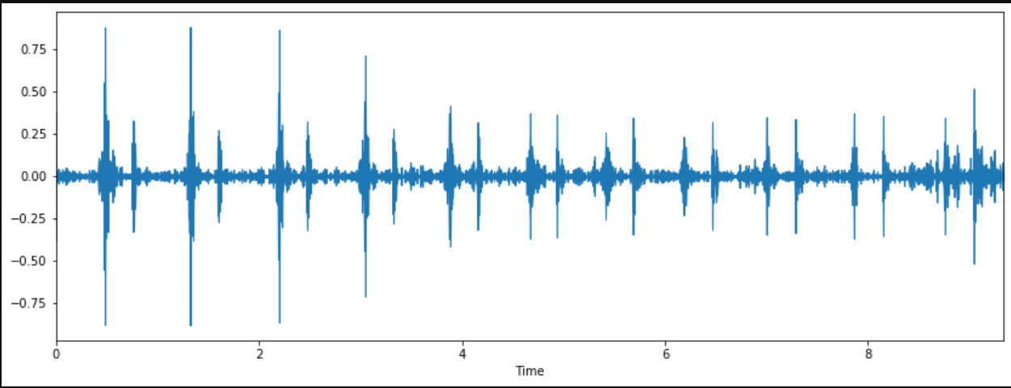
Visualizing Our Waveform

Slide 15
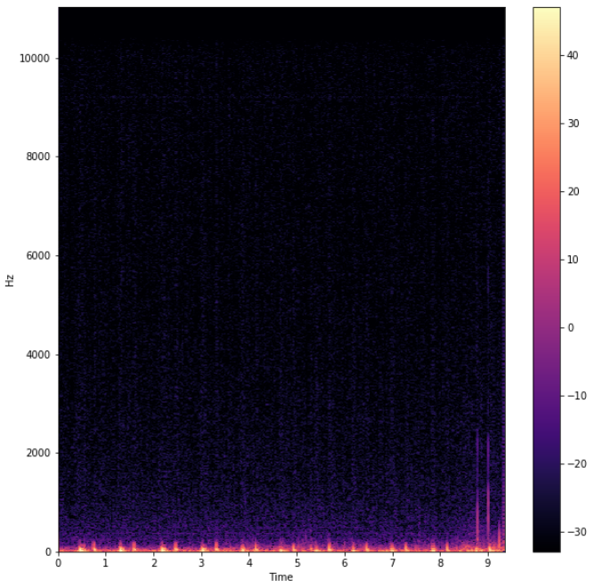
Visualizing Our Data as a Spectogram

Slide 16
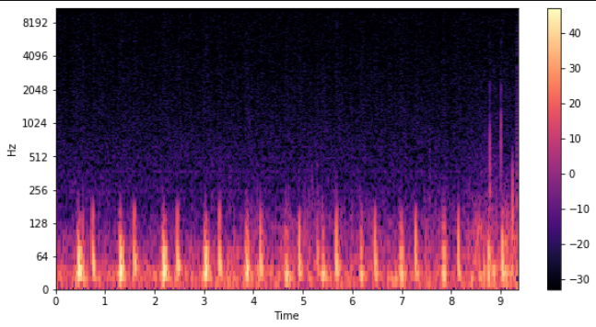
Changing the Frequency Axis to Logarithmic

Slide 17
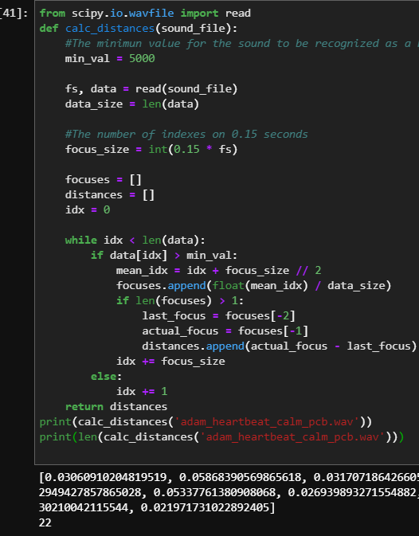
Next Step in Our Analysis...

Slide 18
Final Thoughts
After finalizing the microphones on our PCBs, we are going to move on to developing code to perform environmental noise cancellation to improve the quality of our data.
In terms of analysis, now that we can identify the peaks on our waveform, we can start working on identifying any abnormal sounds based on field data.
We plan to start testing on cows for gastric sounds and see if our project is feasible.
Perhaps the biggest issue we are faced with is whether or not the microphone we are currently using can properly pick up on the low frequencies that we are trying to observe. This is why we are considering this project to be a “feasibility study.” However, Dr. McCann confirmed that a standard stethoscope can be used to hear ruminal contractions, so this project has promise!

Slide 19
References
Ruckebusch, Y. “Motility of the Gastro-Intestinal Tract”
http://librosa.github.io/librosa/feature.html
https://www.scipy.org/docs.html
https://medium.com/@almeidneto/sound-pattern-recognition-with-python-9aff69edce5d

