Slide 1
Group 5 Progress Report
Jack Williams, David Gao, Chang Liu

Slide 2
Introduction and Motivation
We measure the air pollution levels in individual and commercial kitchens and try to find out which cooking or preparing methods and which ingredients cause highest level of air pollution (airborne particulate concentration).
This concerns our personal life as after the analysis and research we would know how much airborne particulate matters each cooking methods generates and if it could potentially harm our health, and we may choose to avoid those cooking methods.

Slide 3
Collaboration
How we divide responsibilities
David works on the data acquisition part (files and sd card)
Jack works on presenting the data with graphs (python and jupyter)
Chang works on his own hardware installment
We worked independently on our hardwares and codings
We tackle problems together (particulate matter sensor)

Slide 4
Collaboration
Weekly Meeting
Tuesday 3:00 at Loomis Laboratory
We discussed the detailed plans of collecting data
divided responsibilities of making presentations
shared problems each of us encountered

Slide 5
Sensors
BME680, measuring temperature, humidity, pressure, and gas (volatile organic compound)
Can measure humidity with ±3% accuracy, barometric pressure with ±1 hPa absolute accuracy, and temperature with ±1.0°C accuracy. Pressure can be used to calculate altitude
VOC gas sensor contains a heated metal oxide that changes resistance based on the VOC in the air, so it can be used to detect gasses & alcohols such as Ethanol, Alcohol and Carbon Monoxide and perform air quality measurements. VOC gas measurements have variability, and therefore may not be fully accurate.

Slide 6
Sensors
PMS5003, measuring airborne particulate matter
Laser scattering is used, i.e. using laser to radiate suspending particles in the air, then collecting scattered light at a certain angle, and finally obtaining the curve of scattering light change with time. In the end, equivalent particle diameter and the number of particles with different diameter per unit volume can be calculated by microprocessor based on MIE theory.
Reports number of particles over 0.3 μm, 0.5 μm, 1.0 μm, 2.5 μm, 5.0 μm, and 10.0 μm. It also reports PM1.0, PM2.5, PM10.0 concentration in μg/m3, which can be used to calculate AQI (Air Quality Index).

Slide 7
DAQ
Data acquisition software records all sensor readings from the two sensors, as well as date and time from the RTC, battery voltage from INA219, and calculated AQI. The data is then written into a SD card.

Slide 8
Breadboard status
Jack
Breadboard is in working order
Need to rewire for new keypad
Chang
All is done except INA219 testing and new keypad rewiring
David
Breadboard is fully functional, except for maybe a software tweak

Slide 9
PCB Status
Jack
PCB is soldered and complete
All that is needed is the 3D printed case
Chang
All of hardware installation is complete except battery
Need to test the PCB
Progress is behind because of desoldering
David
A majority of soldering work has been done, but except for the LCD screen, no hardware has been installed

Slide 10
Run Plan - Testing
Several test runs have been conducted, including at least two using the breadboard and at least one using the PCB.
More tests will be performed next week, including indoor and outdoor settings.
The system is fully functioning. Except a few software issues uncovered in the first test run, no other issues have been discovered during the test runs.
(Though there are hardware issues that emerged outside of test runs, e.g., Jack’s PCB was not functioning at first due to a faulty Arduino board.)

Slide 11
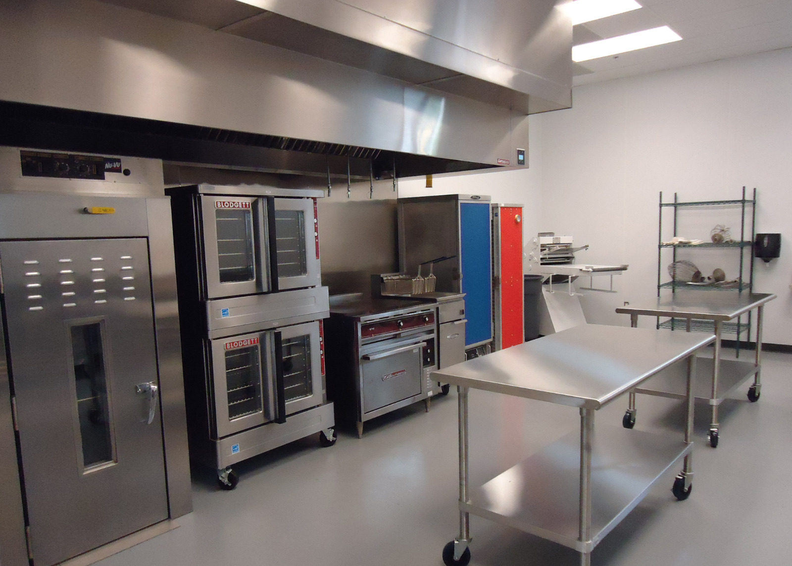
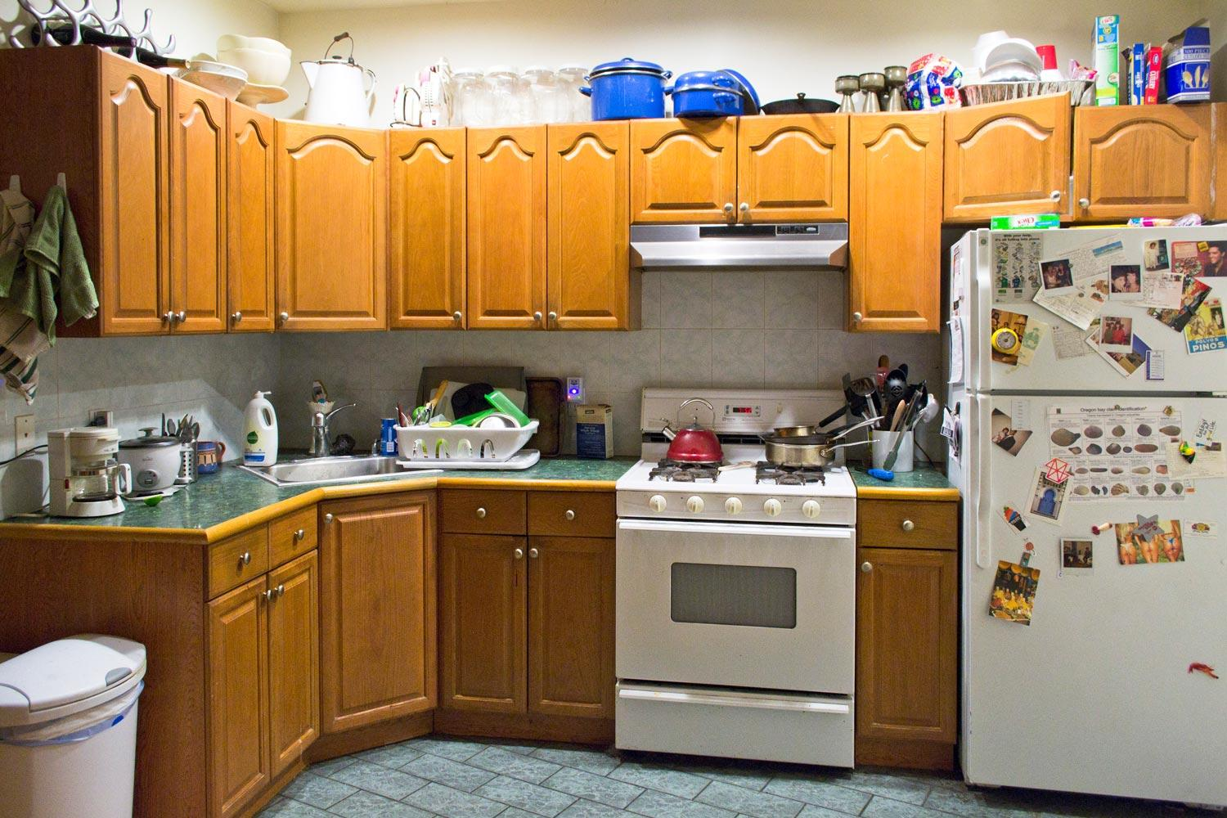
Run Plan - Follow Through
We will be collecting baseline room data to first compare all of our results to
We will be working with Bevier Cafe Kitchen Manager Carter Phillips to collect data from their commercial kitchen
We are hoping for 3 1-2 hour sessions in Bevier Cafe
They have many different cooking areas that we can take data from (Fry station, Bakery, etc.)
We will be doing a series of home cooks(Full Meal) to collect data from different cooking methods
(as well as cooking a menu item from Bevier to compare commercial and home kitchens)
It is imperative we keep a journal of events while we are recording data
V.S.

Slide 12
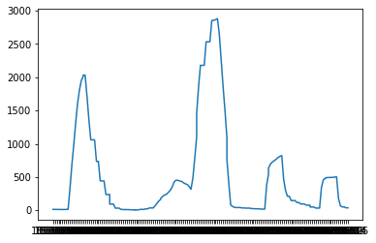
Data Analysis
We plan on exploring the particulate reading v.s. Time for our analysis
Using the tools numpy, pandas, and matplotlib we:
load data in from the SD Card
Plot the collected values against time
Eventually we end up with many graphs that look like this:
You can see from this test run that there is a clear baseline, and after the erasers stopped clapping, the reading returned to that base value.
Eraser Clap Test
PM > 2.5 (Particles/0.1L)
Time

Slide 13
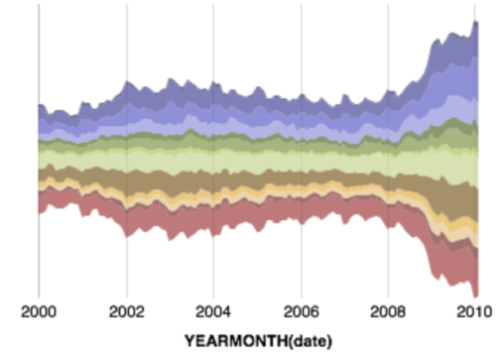
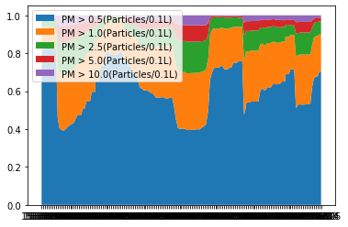
Data Analysis
These graphs are the basis we need for analysis...
We can make them more useful to us
Stack Plots
Stream Graphs
These will allow us to make better sense of the data
We still need an effective data cataloging method (in development)
Stream Graph example
Stack Plot we were able to generate

Slide 14
Final Report Thoughts
Our goal is to analyze the air quality in the kitchen as food is prepared and cooked
Our report will boil down to comparisons between types of cooking and baseline measures
Secondary part of report that outlines the differences we found between Bevier Cafe’s commercial kitchen and home cooking
We might also try to understand whether there are correlations between different measurements (height and distances)

