Slide 1
Effective Battery Energy Capacity
Group 2
Michael Ruscito
Mingshi Yang
Jinghan Huang
Tomas Pavydis

Slide 2
Introduction
What we are measuring:
Effective battery energy capacity as a function of temperature and discharge current
How will we measure it:
Test the time to fully discharge a battery in variable environments (cold, room-temp, hot)
Test differences of measurements under variable loads (10 ohms vs 1 ohm)
Why is this interesting:
We will be able to map the voltage output with respect to time of batteries dependent on their electrical load and the temperature of the environment they operate in
Using this data we can conclude the effective energy in the batteries based on the testing conditions
Testing multiple battery types and form factors allows us to analyze the effectiveness of each type in each testing environment and compare the results

Slide 3
Motivation
With the rise of electric vehicles, batteries operating in variable-temperature environments have become a common occurrence and measuring the effective energy of batteries under these conditions is crucial for accurate predictions of estimated range
For example, in the beginning of 2019, Tesla released an algorithm in its firmware in which vehicles began pulling the temperature from the local weather data to better calculate the estimated range left in its battery
Beyond just electric cars, you may have encountered a battery’s energy retention based on the environment’s temperature when you use your phone outside on a cold day it seemingly dies right away
Many studies have been performed on this topic with similar measurements taken, so we hope to produce similar results, but with a more comprehensive look at the effects that temperature and discharge current have on each type of battery being tested compared to each other (rather than a look at a single type of battery)

Slide 4
Background on Lithium Batteries
At low temperatures Lithium batteries suffer from Lithium plating of the anode causing a permanent reduction in capacity
At the upper extreme the active chemicals may break down destroying the battery
In between these limits the cell performance generally improves with temperature
This analysis on lithium batteries is why we are testing them in 3 environments hopeful to see data that agrees with this
We will also be testing on 2 different resistive loads to analyze the effects that discharging the batteries at higher currents than they are typically suited for will have on the effective energy of them

Slide 5
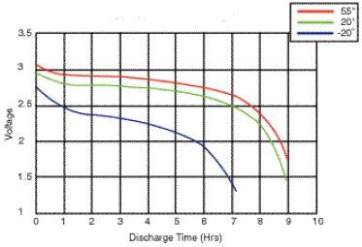
Example Results
From MPowerUK.com

Slide 6
Collaboration
For the most part, each member of the group is completing every part and responsibility of the project as we all have breadboards and PCBs that will take measurements
The background research on which types of batteries we will test and their rated capacity versus estimated capacity under our test conditions was conducted by Michael
A majority of the DAQ software was handled by Mingshi while the Data Analysis software is handled by Michael

Slide 7
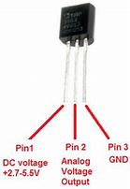
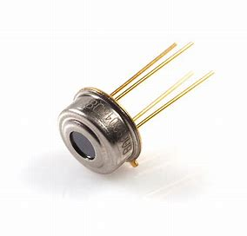
Instrumentation
Basic Set:
Arduino Mega 2560
INA 219, LCD display, Keypad, Pushbutton, Micro-SD writer
Additional Sensors:
TMP 36: a low voltage analog temperature sensor for reading ambient temperature
MLX 90614: A digital non-contact temperature sensor able to detect infrared radiation of an object and measure its temperature

Slide 8
TMP 36
Unlike many of the other temperature sensors, the TMP 36 a solid-state technique to determine the temperature
As temperature increases, the voltage across a diode increases at a known rate
By amplifying the voltage change, it generates an analog signal that is directly proportional to temperature meaning all the calculation is done in the sensor and it only returns the temperature
Because it has no moving parts — it is precise, never wears out, doesn't need calibration, works under many environmental conditions, is consistent between sensors and readings, and is very inexpensive
Operating range: -40°C to 150°C (-40°F to 302°F)
The downside to the TMP 36 is that it can only measure temperature through physical contact making it only useful for measuring ambient temperatures

Slide 9
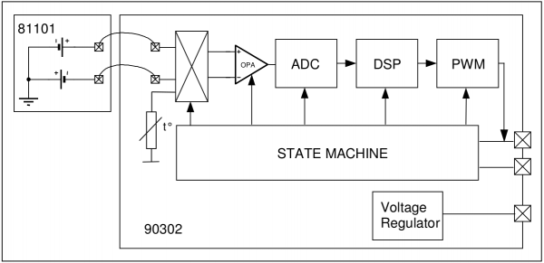
MLX 90614
Consists of internally: an infrared thermopile detector and a signal-conditioning application processor
Works because of the Stefan-Boltzmann law which states (basically) that any object not at absolute zero emits IR light directly proportional to its temperature
The infrared thermopile inside the MLX 90614 senses how much infrared energy is being emitted by materials in its field of view, and produces a proportional electrical signal which is processed before being sent to the Arduino across the I2C channels
Operating range: -70°C to 380°C (-94°F to 716) with resolution of 0.02°C

Slide 10
Additional Components
In order to protect the PCB and its peripherals, we also have an external circuit on Perma-protoboards connected to the PCB analog and I2C pins via ribbon cable
This external circuit consists of our battery holders and load resistors (two 5 ohm in series [10 ohms] and two 2 ohm in parallel [1 ohm]) connected to analog I/O, as well as the TMP 36 and MLX 90614 sensors to measure ambient and object temperatures
Types of batteries being tested:
AAA Non-rechargeable:
Alkaline
Lithium Primary
AAA Rechargeable:
Nickel Metal Hydride (NiMH)
Lithium Ion
Coin Cell
Lithium

Slide 11
Data Acquisition
Relatively straightforward DAQ software gets readings from sensors and writes to SD card every 0.5 seconds
Reads ambient temperature from TMP 36 (analog read), reads object temperature from IR sensor (digital I2C read), and reads voltage across battery (analog read)
To increase precision, battery voltage reading is taken 10 times consecutively (spaced 10ms apart) and the average is written to the SD card
In addition to writing to the SD card, the DAQ displays the data on the LCD display in order to allow monitoring while tests are being run and the keypad allows for control over the system (i.e. starting measurements, etc)

Slide 12
Breadboard Status
Michael:
Completely finished and has run tests to get sample data
Mingshi:
Completely finished and has run tests to get sample data
Tomas:
Completely finished and has run tests to get sample data
Johnson:
Completely finished and has run tests to get sample data

Slide 13
PCB Status
Michael:
PCB side is finished with ribbon cables, however still needs to finish external circuit by connecting sensors to perma-protoboard and connecting the finished battery protoboard to ribbon cables
Mingshi:
PCB side is finished with ribbon cables, however still needs to finish external circuit by connecting sensors to perma-protoboard and connecting the finished battery protoboard to ribbon cables
Tomas:
PCB side is finished (still need LED) with ribbon cables, however still needs to finish external circuit by creating a perma-protoboard and connecting the finished battery protoboard to ribbon cables
Johnson:
PCB side is finished with ribbon cables, however still needs to finish external circuit need to build a battery protoboard.

Slide 14
Run Plan
Test the 5 types of batteries, each under 2 resistive loads, each under 3 environmental temperatures (~0°C, ~22°C, ~50°C) totalling 30 test conditions
We only need to run 15 times since both resistive loads will be tested at the same time
Each run will last for 6 hours in order to give batteries enough time to completely discharge all of their stored energy (except coin cell which only needs to run <1 hour)
In order to control the environmental temperature, we will use water baths and place the external circuit into a plastic bag which will submerge enough to have the circuit below the waterline without the top of the bag being submerged
Water bath will be filled with ice for cold environment and heated using a sous vide for hot environment
SD card is written with ambient temperature, object temperature, battery voltage, and how long the test has been running (in order to graph results)

Slide 15
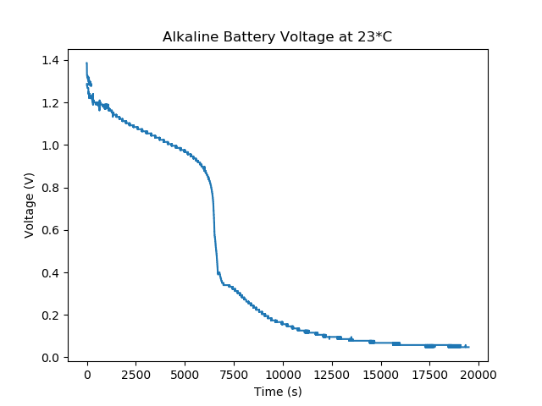
Field Testing

Slide 16
Data Analysis
Very straightforward data analysis using Python to import collected data and graph in order to compare results from each test.
Base code importing data and plotting is already written, but will be edited for each comparison/graph
Graph comparing each battery type in a single environment with a certain resistive load
Graph comparing the effects the temperature had on a single battery type
Graph analyzing the internal temperature of the battery/resistors under high/lower resistive loads
Once data is collected and graphed, the rest is done without a computer by simply analyzing the graphs to compare results

Slide 17
Thoughts on Project Report
Things we will likely show in our final report:
Each of the graphs mentioned before comparing how each battery compares to the others and how prominent the effects of the different resistive loads and environmental temperatures were on each battery’s effective energy
Analysis on the effective energy of each battery
Conclusions on which type of battery is most effective in each scenario
Possible analysis on where the energy is lost

