Slide 1
Characterization of Vibrato
Group 7
Sergi Castells, Stephen Elliott, Ramone Randle, Noah Rogers

Slide 2
What is Vibrato?
Oscillation of pitch (frequency) about a given note
Equivalent oscillation apparent among a note’s overtones
Present in all sung notes
Commonly used in vocals and stringed instruments
Stringed instruments tend to produce cleaner vibrato
Notes:
Sergi

Slide 3
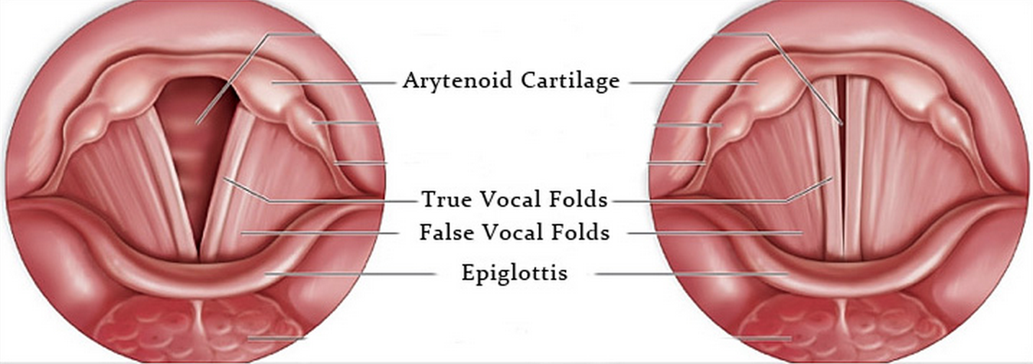
Background/Introduction
Modulations do not exceed a semi-tone
Sounds come from combination of vibrations of true and false vocal folds
Cricothyroid muscle responsible for controlling pitch
Natural vibration in cricothyroid muscle causes vibrato
Notes:
Sergi

Slide 4
Setup Hardware and DAQ
Hardware consisted of equipment tethered to breadboards and PCBs
Microphone was most important device used for this project
LCD, contrast setting potentiometer, keypad, microphone, microSD breakout board, INA219 current/voltage regulator, and battery pack were also used
DAQ contained within Arduino internal storage
DAQ activated/deactivated microphone on keypress and stored file to SD card
Notes:
Sergi

Slide 5
Data Sources
Hannah Nelson
Cello
6 years of experience
Mi Ran Choi
Cello
Bachelors in Music Performance
Davide Elliott
Voice
Went to UIUC for theater
Notes:
Stephen

Slide 6
Data Manipulation
In-person audio collection shifted to getting recordings remotely
Conversion to WAV from M4A and Binary Files
Needed WAV files for Scipy’s Fast Fourier Transforms (FFTs)
Notes:
Noah’s

Slide 7
Software
Basically three main sections for software:
Data Acquisition - Professor Gollin’s recording code on class website
Data Analysis - Python code using NumPy, SciPy, and Matplotlib libraries and Sonic Visualizer
Data Editing - Audacity
Notes:
Noah’s

Slide 8
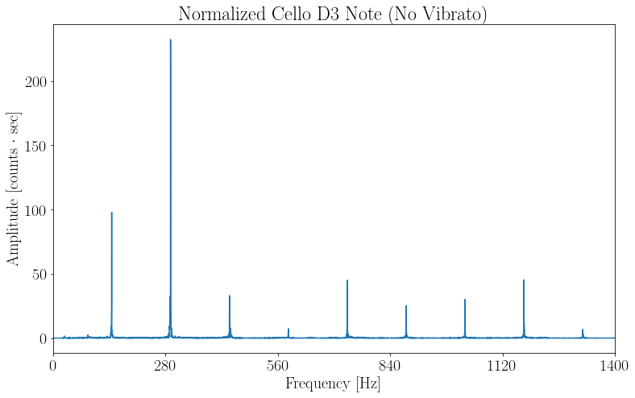
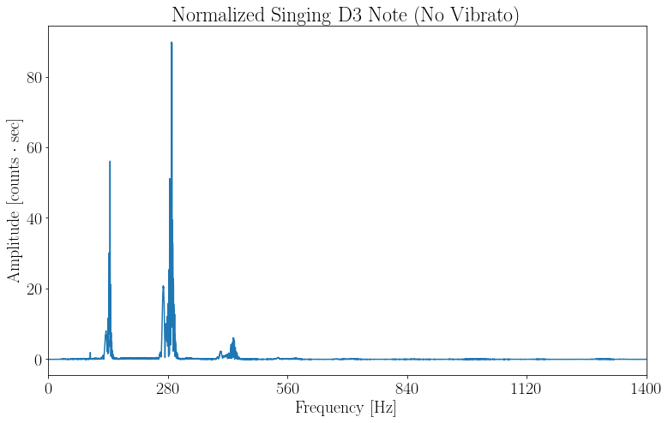
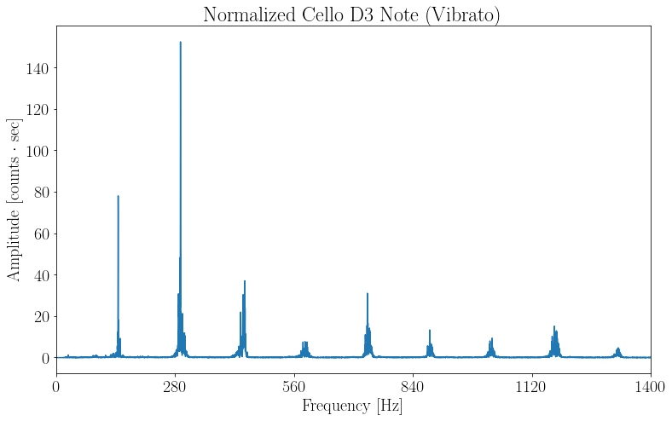
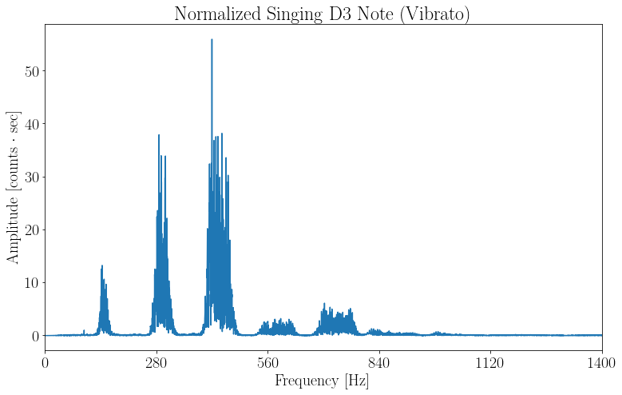
Fourier Transforms
Notes:
Noah’s

Slide 9
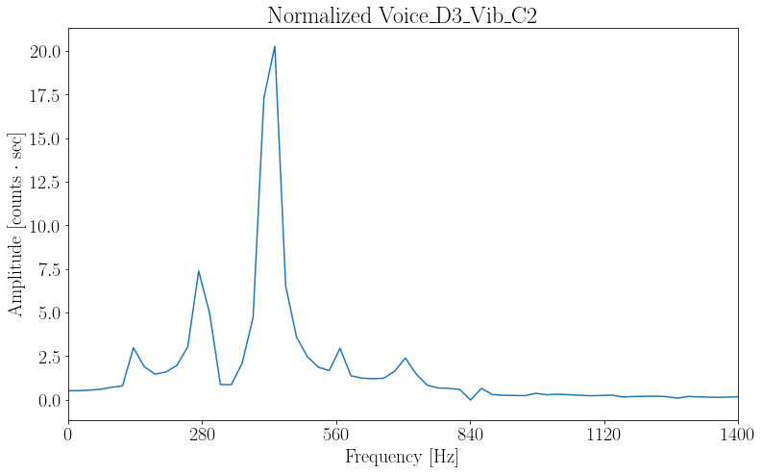
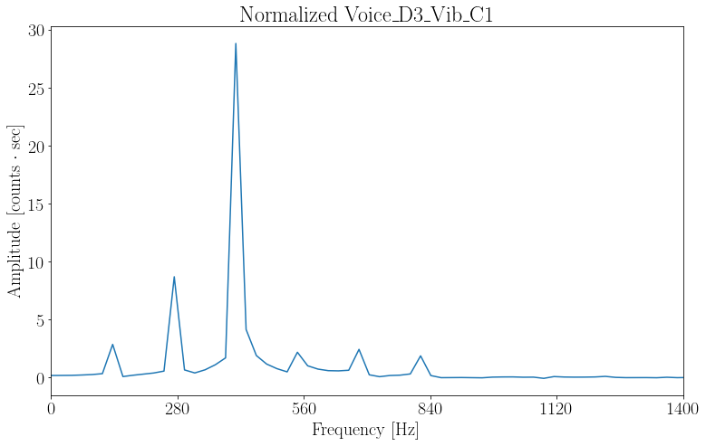
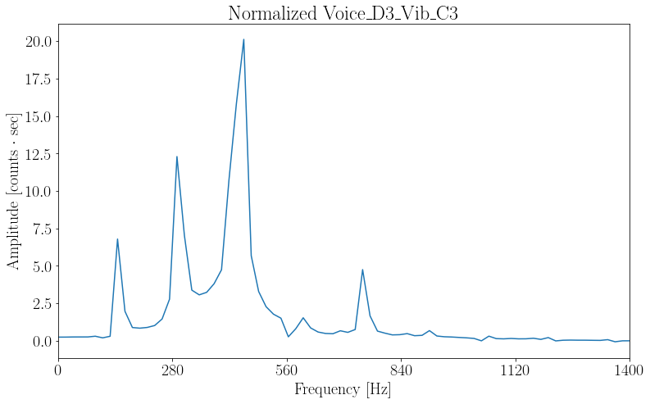
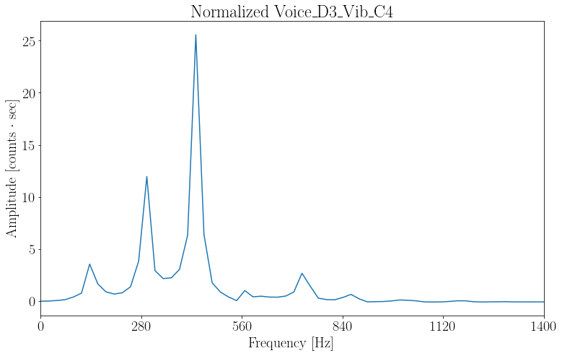
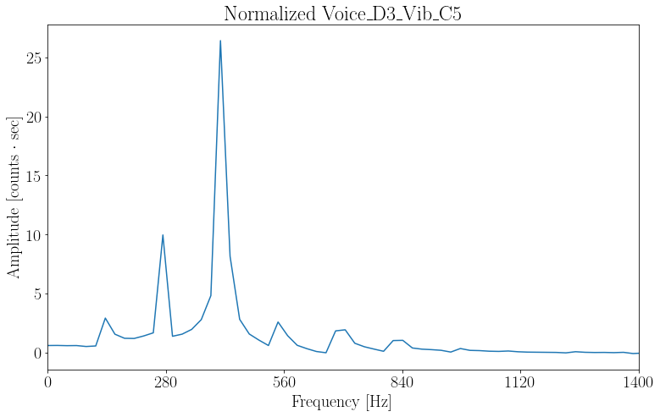
Fourier Transforms (Vocal Chunks)
Notes:
ramone

Slide 10
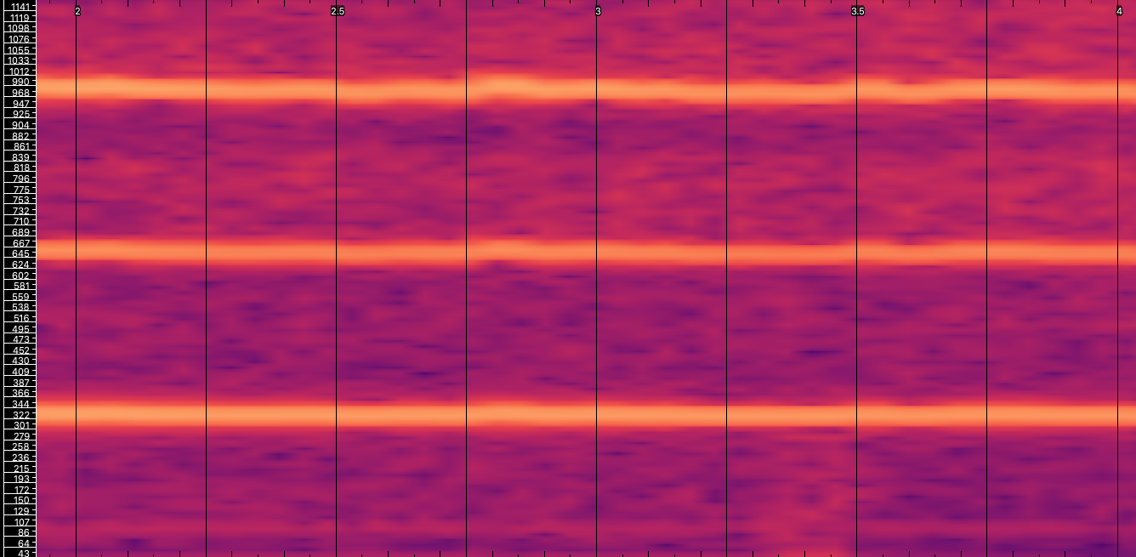
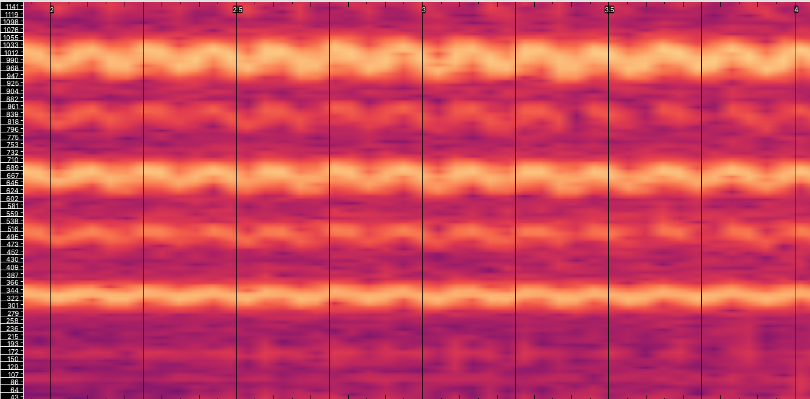
Spectrograms (Frequency vs Time)
Voice at E4 without vibrato Voice at E4 with vibrato
Notes:
Useful for seeing how frequency changes in time
How do you make a spectrogram?
ramone

Slide 11
Spectrograms
What is a spectrogram?
FFT is in the frequency domain but spectrograms are in the time domain
How to make a spectrogram?
FFTs in small cuts
Parameters
Notes:
ramone

Slide 12
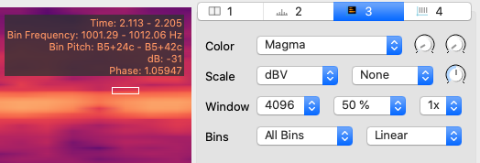
Spectrogram Parameters
Time Resolution=Window Size / Sample Rate= .093s Frequency Resolution= 1 / Time Resolution=10.766hz
Notes:
ramone

Slide 13
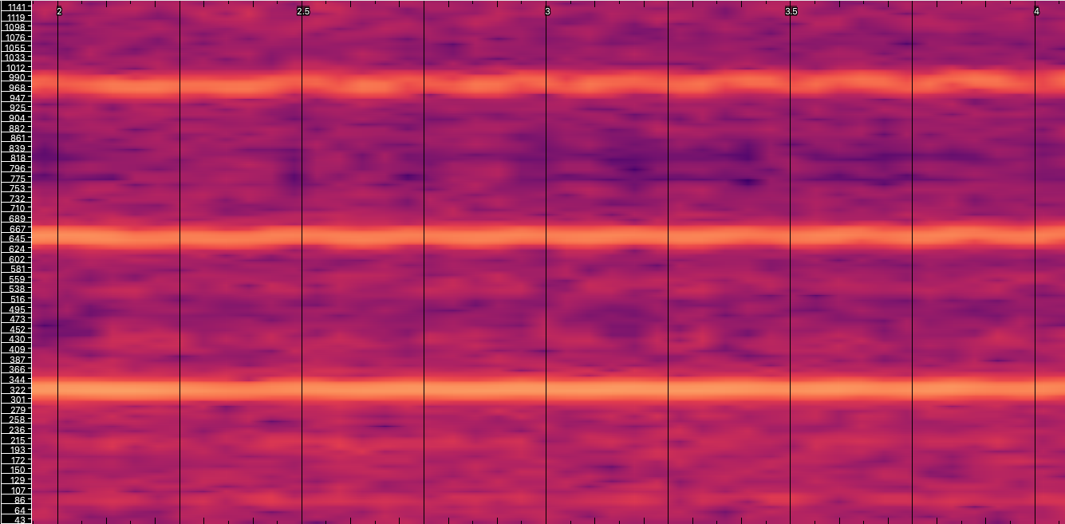
Spectrogram Comparison- Vibrato
Voice at E4 with vibrato Cello at E4 with vibrato
Notes:
ramone

Slide 14
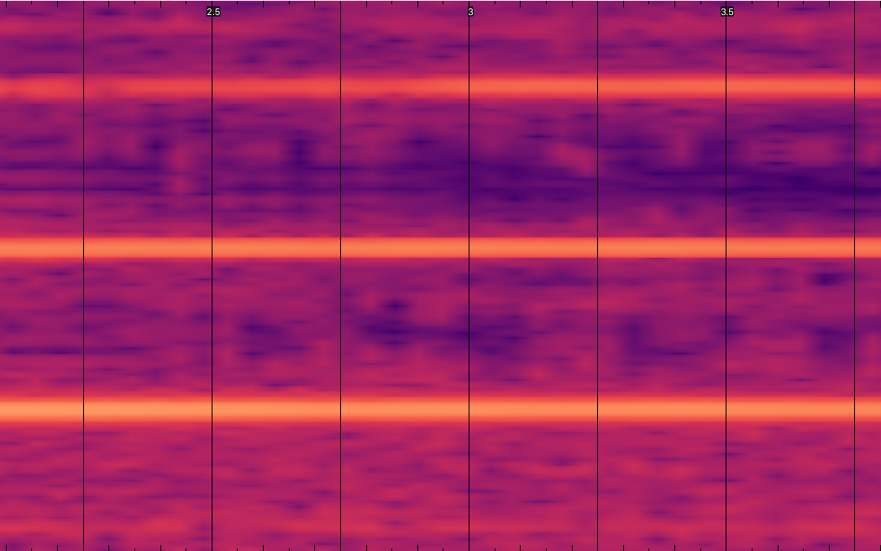
Spectrogram Comparison- No Vibrato
Voice at E4 without vibrato Cello at E4 without vibrato
Notes:
ramone

Slide 15
Results
Fourier transform
Voice and cello had range for vibrato and no vibrato
Voices range wider
Spectrograms
Easy to spot the change in frequency
Overtone carries similar modulation
Fourier transform chunk
Moving peak in short timeframe
Notes:
Stephen

Slide 16
Conclusion
Vibrato is detectable in vocals and stringed instruments
Fourier Transforms and spectrograms clearly show the presence, or lack thereof, of vibrato
Vocal notes have a wider base in frequency and oscillate with greater intensity than stringed instruments for both vibrato and non-vibrato samples
Stringed instrument notes fluctuate much less than vocals in all cases
Notes:
Sergi

Slide 17
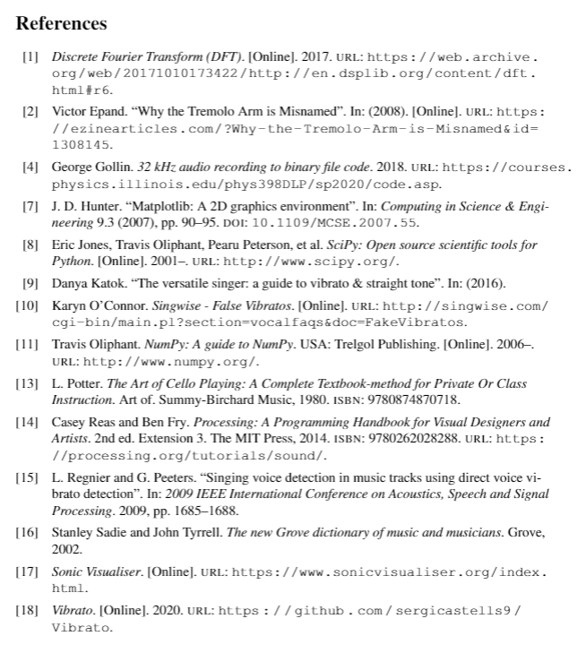
Notes:
Whoever is speaking at the time (so probably Sergi?)

Slide 18
Questions?

