Slide 1
Feasibility of Measuring Particulate Matter Concentrations in Home Kitchens
Jack Williams, Weichen Gao, Chang Liu

Slide 2
Background
Particulate Matter (PM):
Coarse PM (PM10); Fine PM (PM2.5)
Diverse chemical compositions and sources
Adverse health effects
Indoor PM concentration can be high during household activities

Slide 3
PM During Cooking
Previous research focused on the consuming of fuel
Burning of food and oil can generate PM
Aim: To establish feasibility of measuring PM concentrations and other air features during and after cooking processes.
Different PM sizes, decay processes
Future research: Controlled studies, effects of variables, commercial kitchens

Slide 4
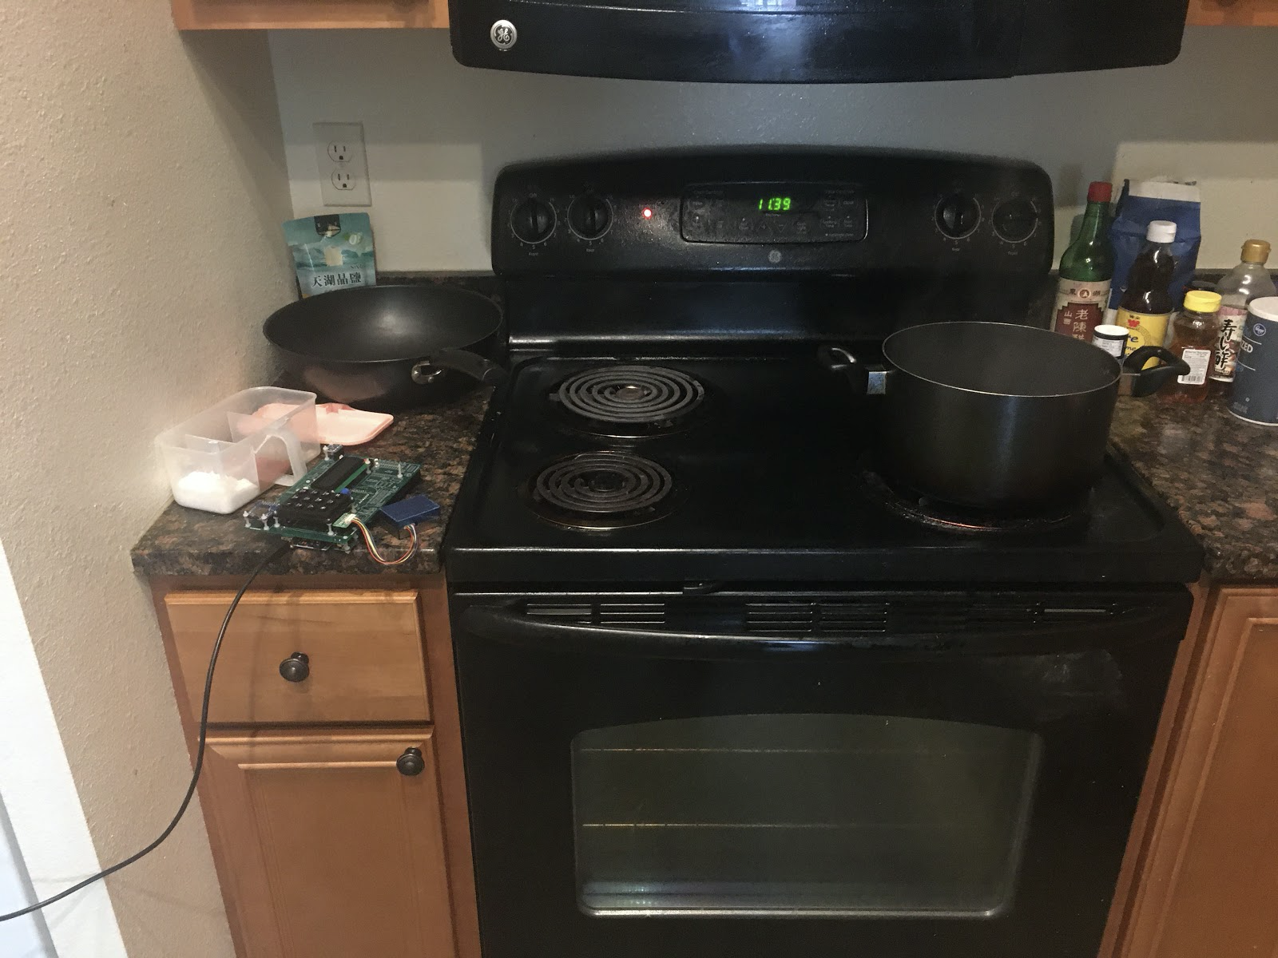
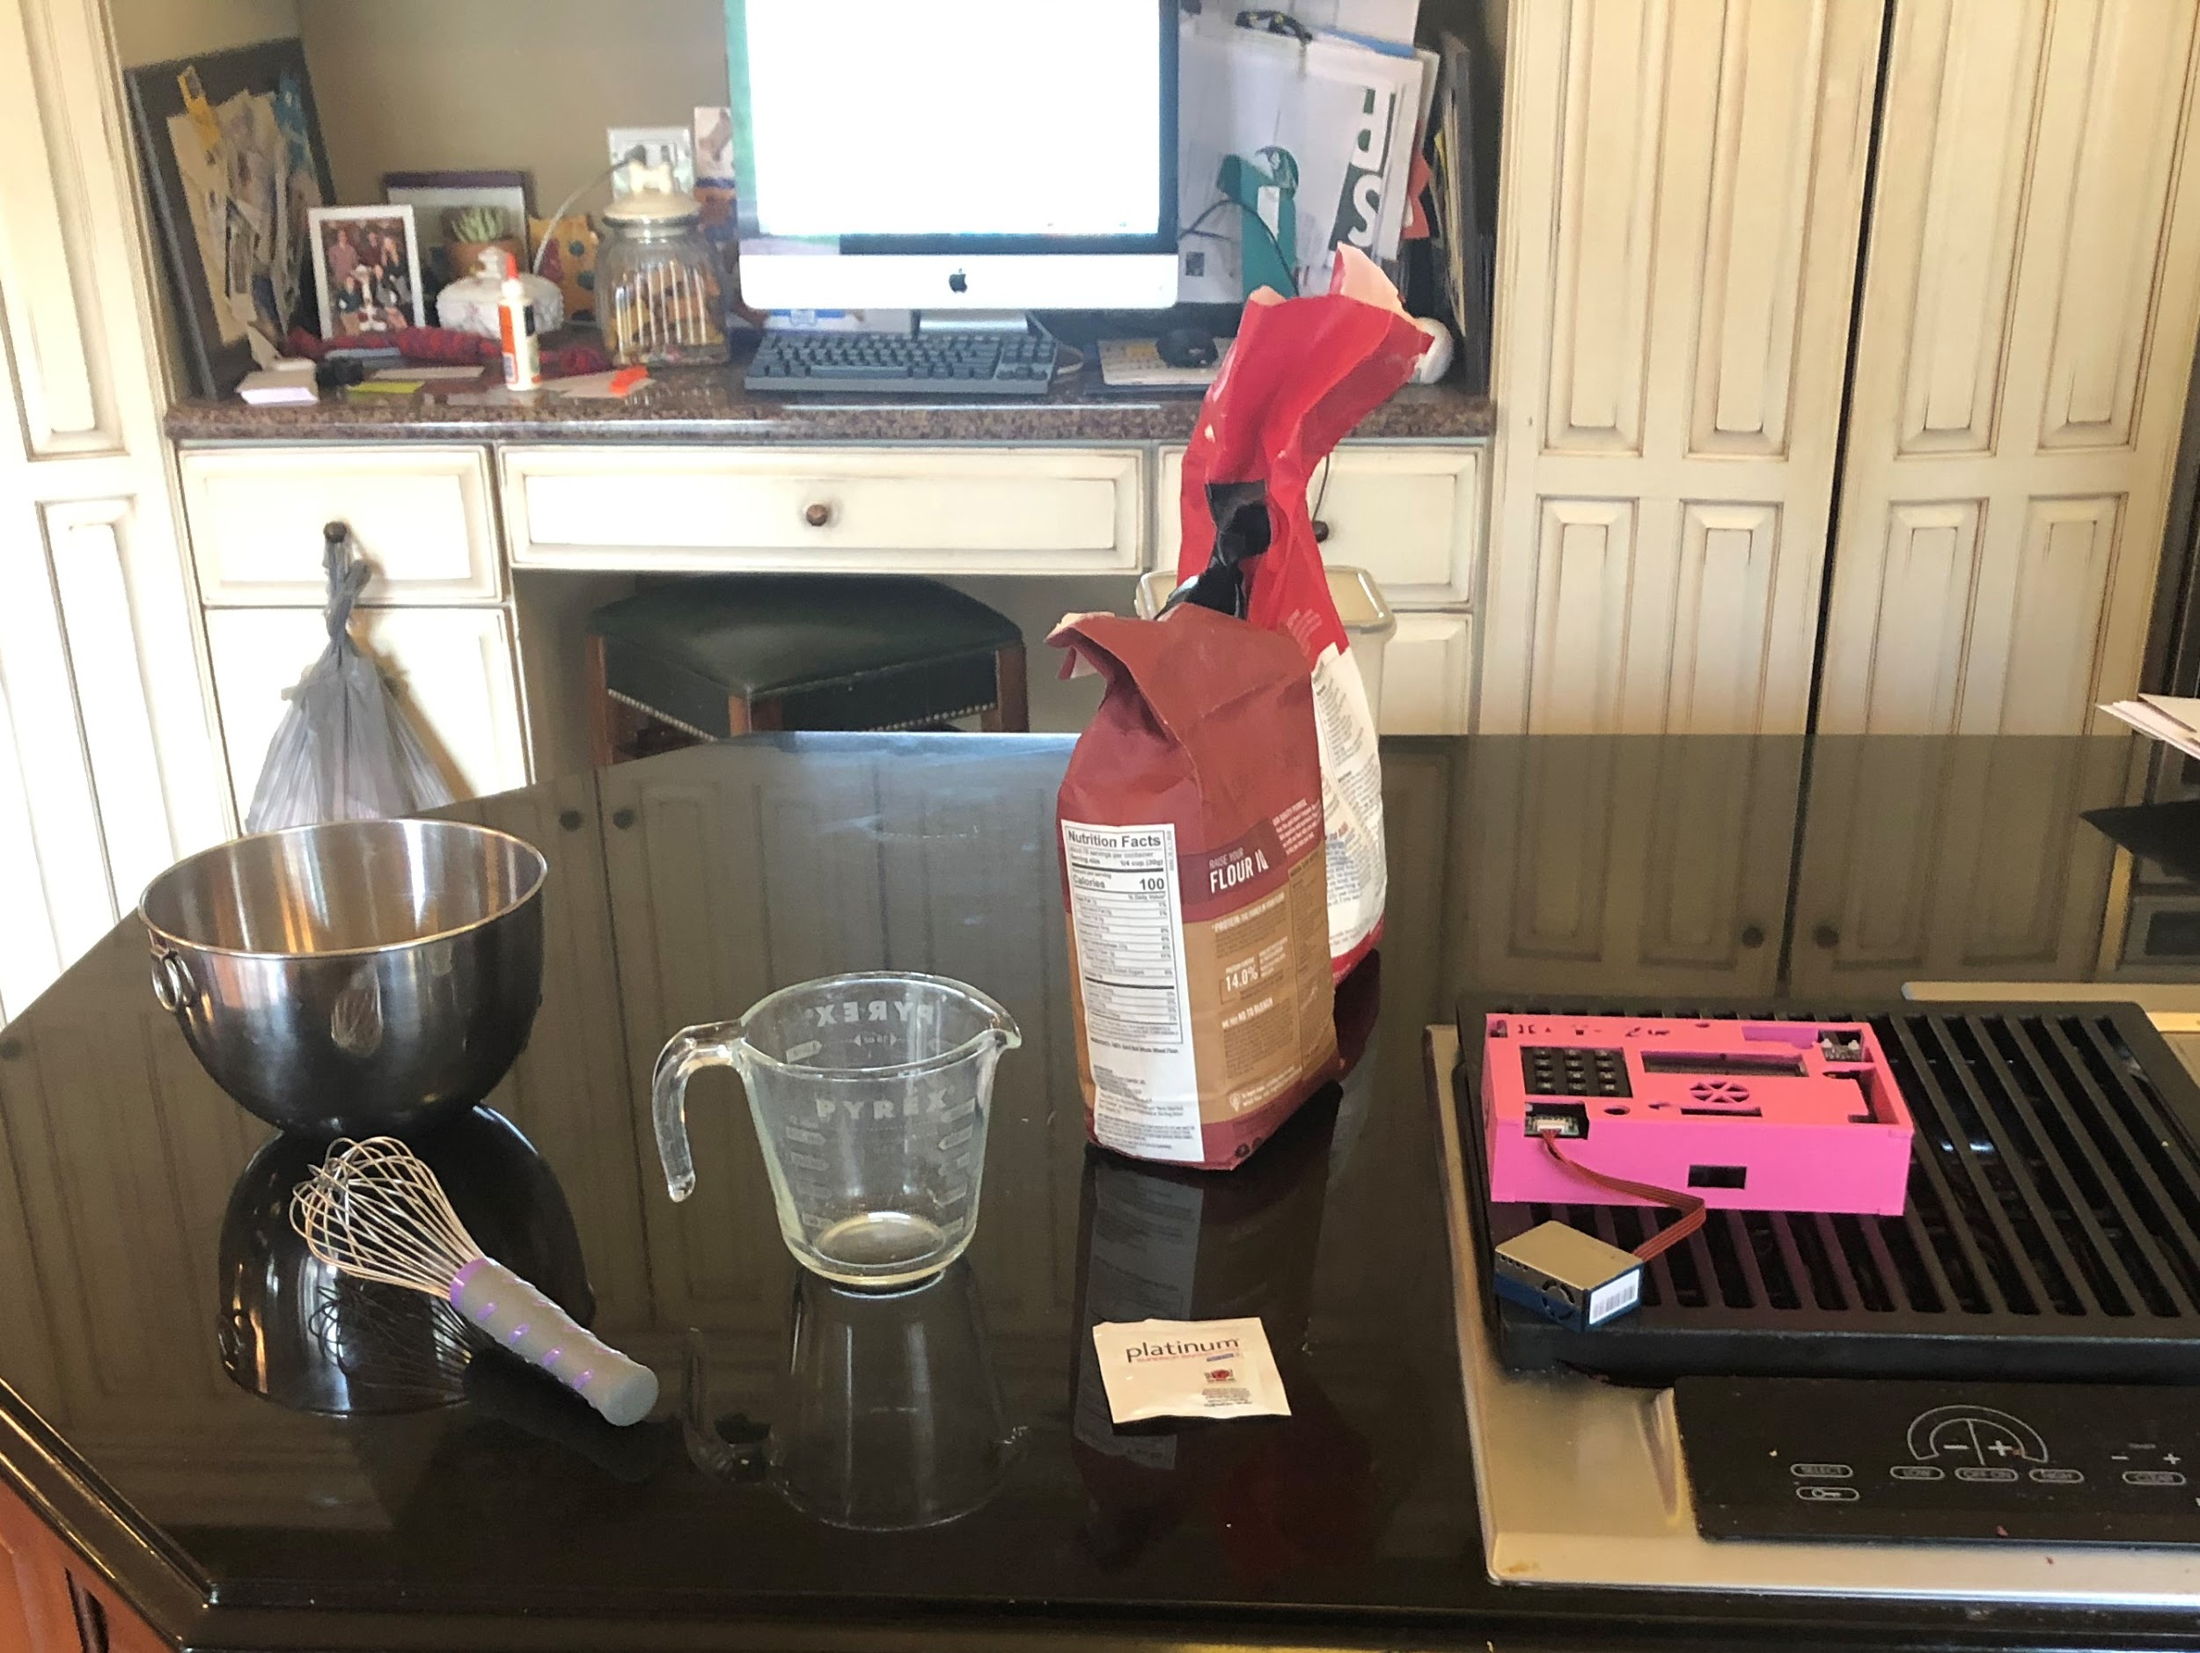
Our Kitchens

Slide 5
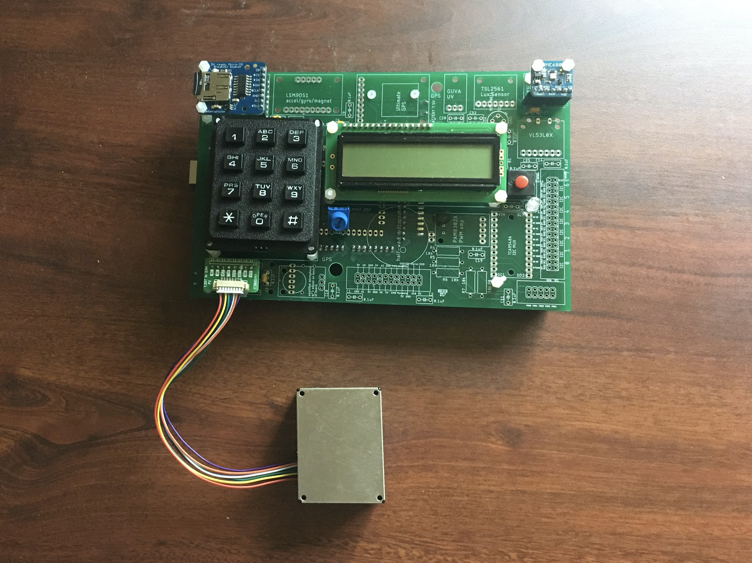
Data Collection Device (Front View)

Slide 6
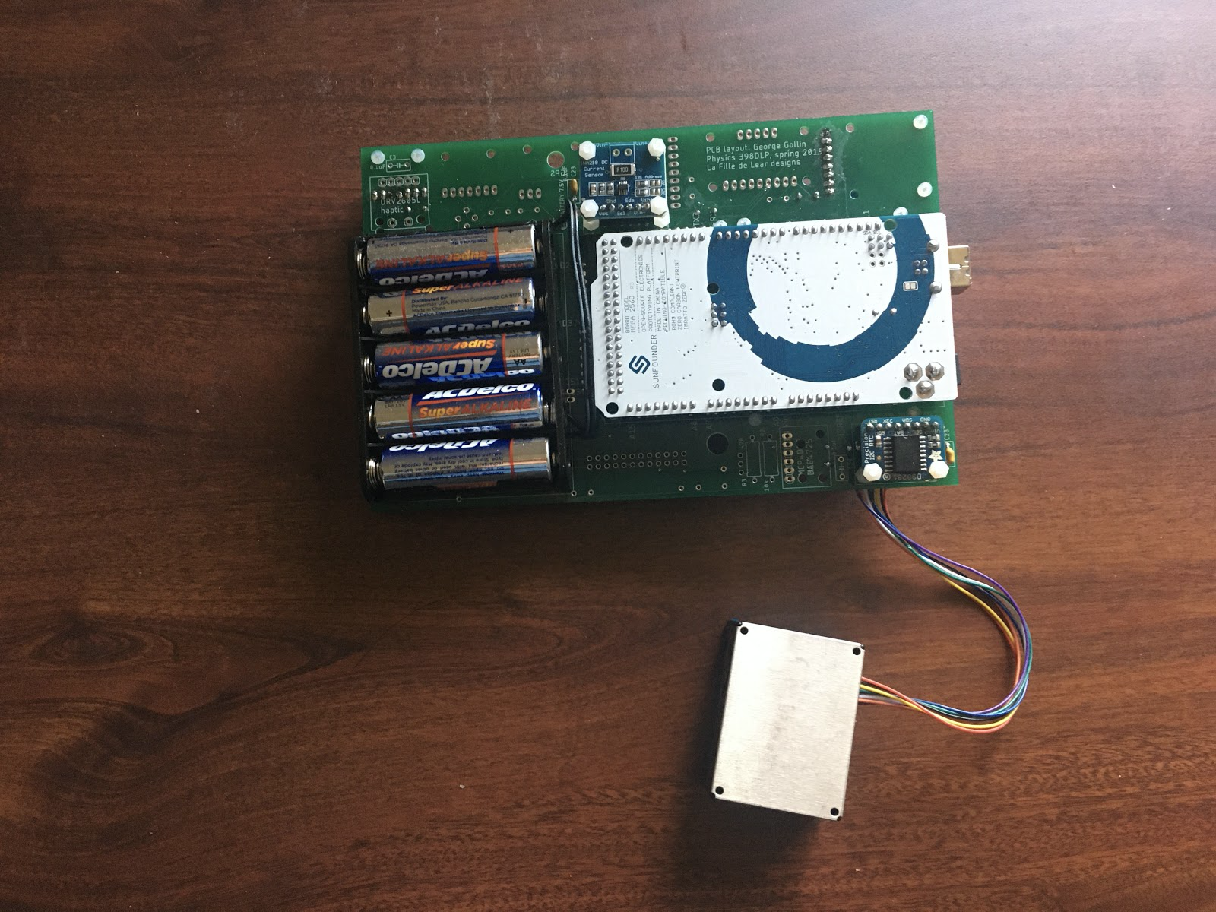
Data Collection Device (Back View)

Slide 7
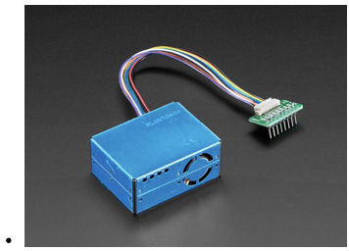
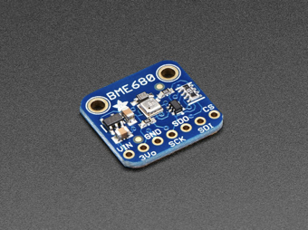
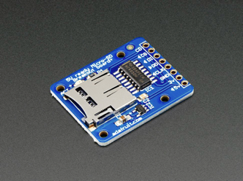
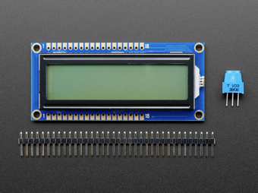
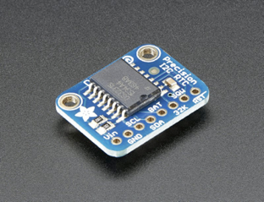
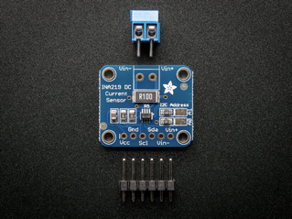
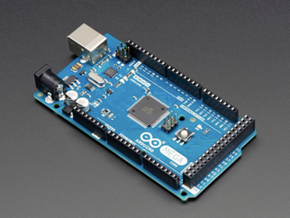
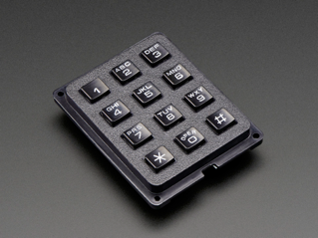
Components we used

Slide 8
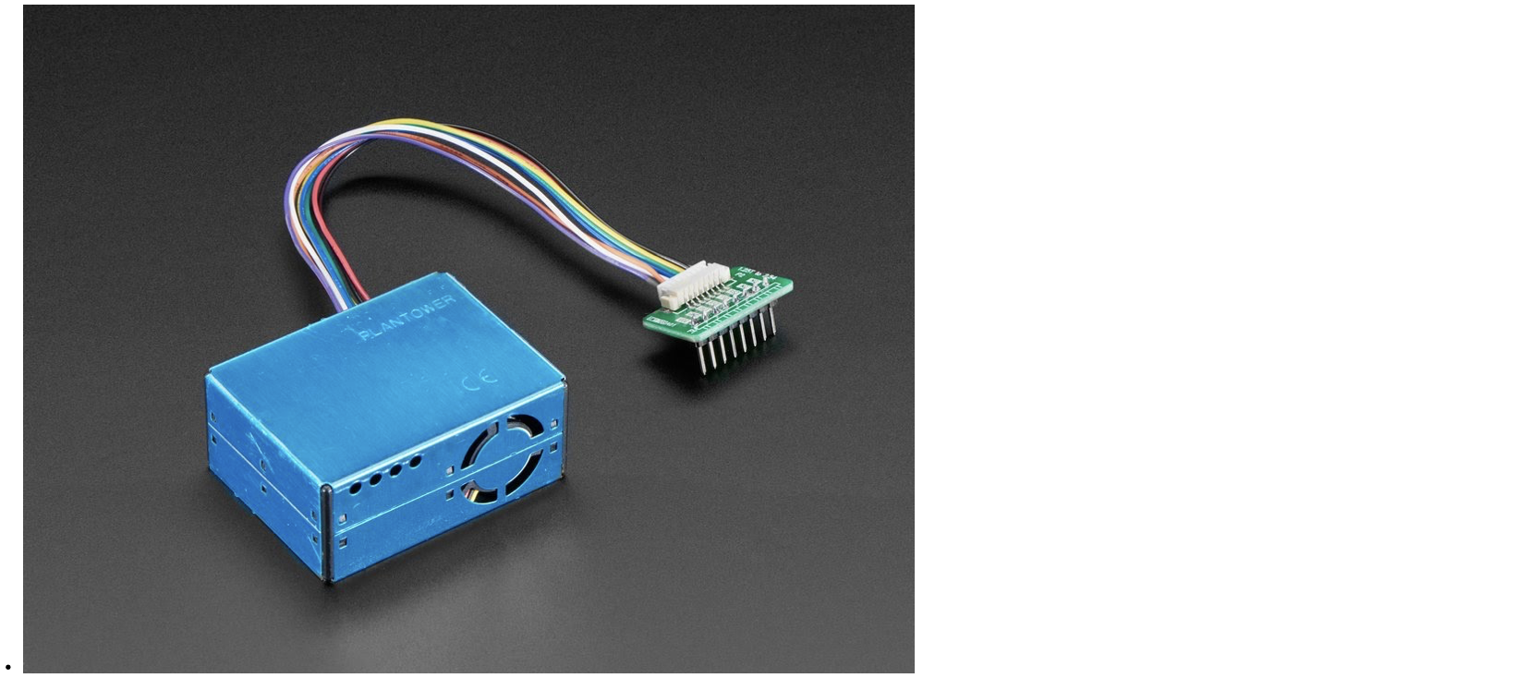
PMS5003 (Particulate Matter Sensor)

Slide 9
PMS5003 (Particulate Matter Sensor)
Concentrations of PM 1.0, 2.5, 10 (ug/m^3)
Categorized in 0.3 μm, 0.5 μm, 1.0 μm, 2.5 μm, 5.0 μm and 10.0 μm size bins
Help analyze trends of PM concentration growth and decay rate
Linear, exponential, logarithmic?
Concentration distributions among PM of different sizes
Laser Scattering

Slide 10
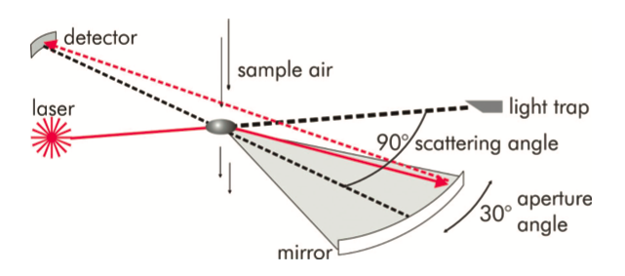

Slide 11
Mie theory (BME51 Lecture 5)
https://www.youtube.com/watch?v=ayI6W6-ypUM

Slide 13
Mie theory (BME51 Lecture 5)
https://www.youtube.com/watch?v=ayI6W6-ypUM

Slide 14
DAQ Software
setup(): Initializes BME, RTC, PMS, INA, LCD, and SD card reader.
loop(): Reads keypad instructions, reads data from sensors, calculates and formats the data, displays the data on the LCD screen, and, depending on the setting, writes data into the SD card.

Slide 15
DAQ Software: Auxiliary Functions and Methods
crteatefilename (formats the names of files written into the SD card)
initnewfile (searches for the next available file name, opens up the file, and writes in the header row)
clearscr (clears the LCD screen)
readPMSdata (reads and formats the data from the PMS sensor)
readkeypad (reads keypad instructions and sets current_mode and saving_data, and, in case the instruction is to start collecting data, calls initnewfile to initialize a CSV file)
AQI25 (calculates AQI based on PM2.5 data)
AQI100 (calculates AQI based on PM10 data)

Slide 16
Analysis Software

Slide 17
Data Collection Practices
Baseline level of concentration
10 mins before the cooking and 2-3 hours after cooking
Record cooking process with phone
Align video time and RTC time
Identify cooking events and establish connections
Wok: Heating pot, oil, vegetable, meat, stirring them, adding sauce, removing them
Bread: Mixing flour, kneading dough, letting dough rise, baking

Slide 18
Discussion
Exponential growth and decay rate
Same changing trends for particles of all sizes we measured
About the same distribution throughout the cooking process

Slide 19
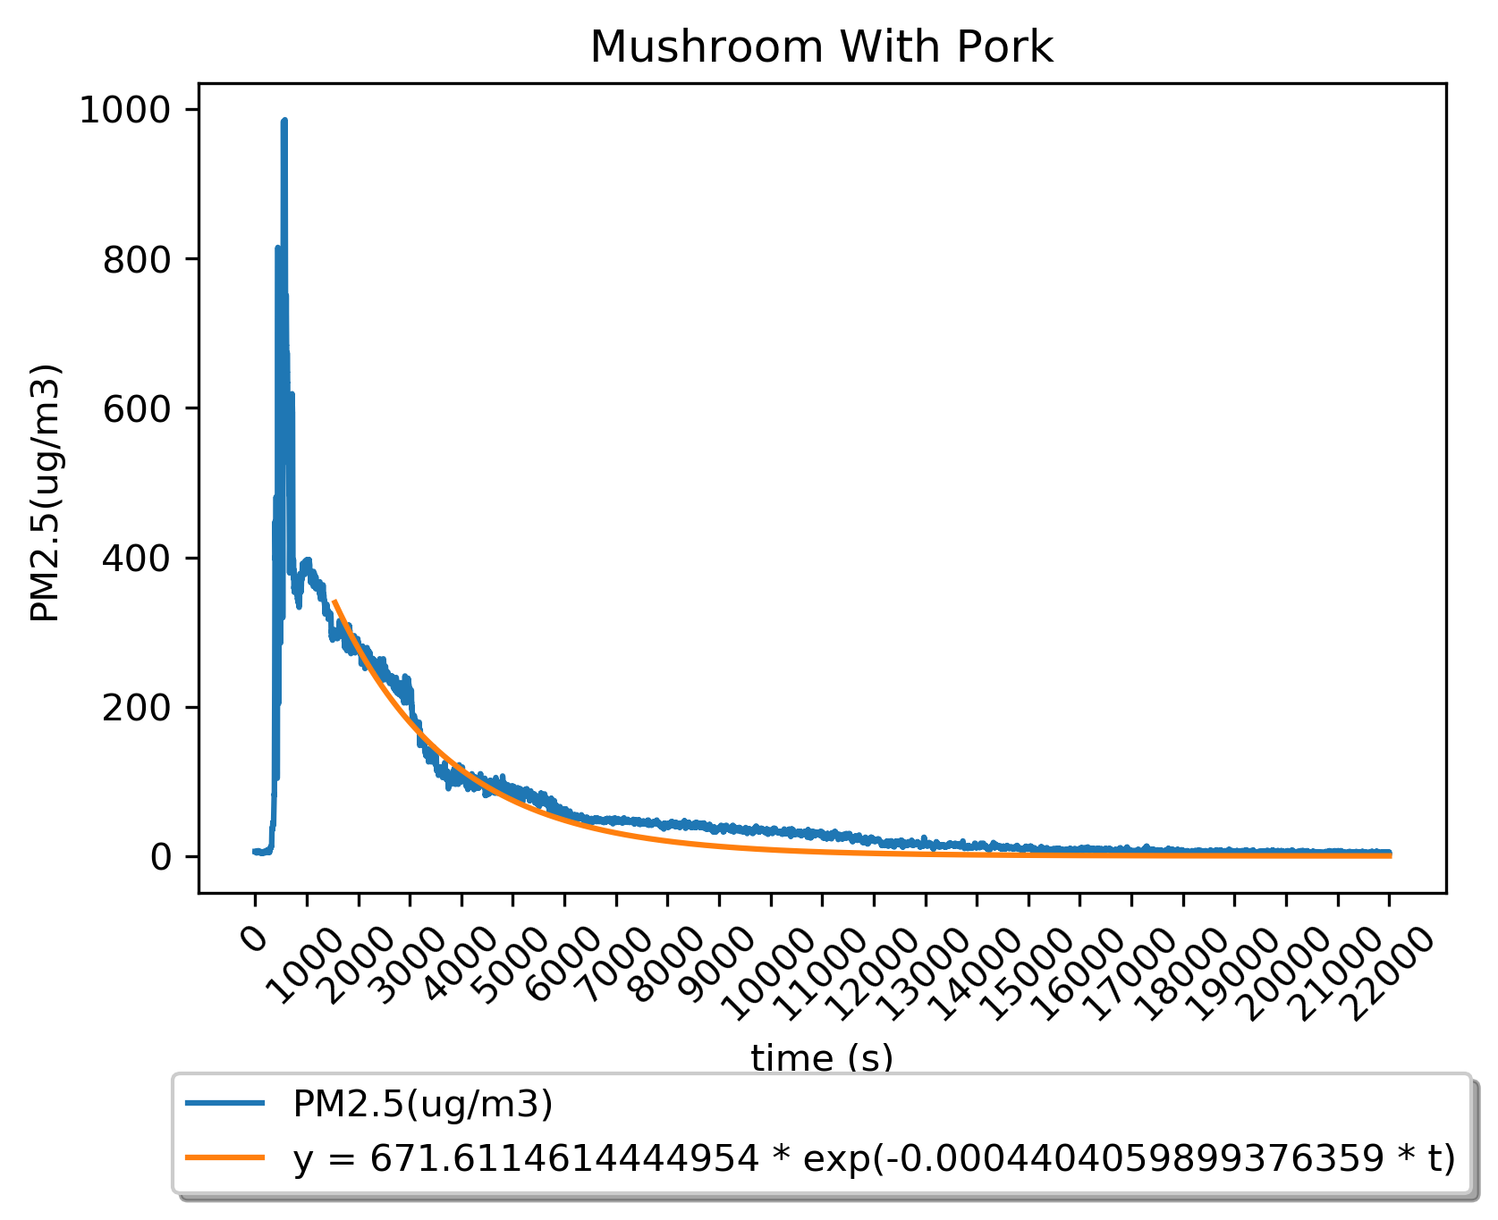
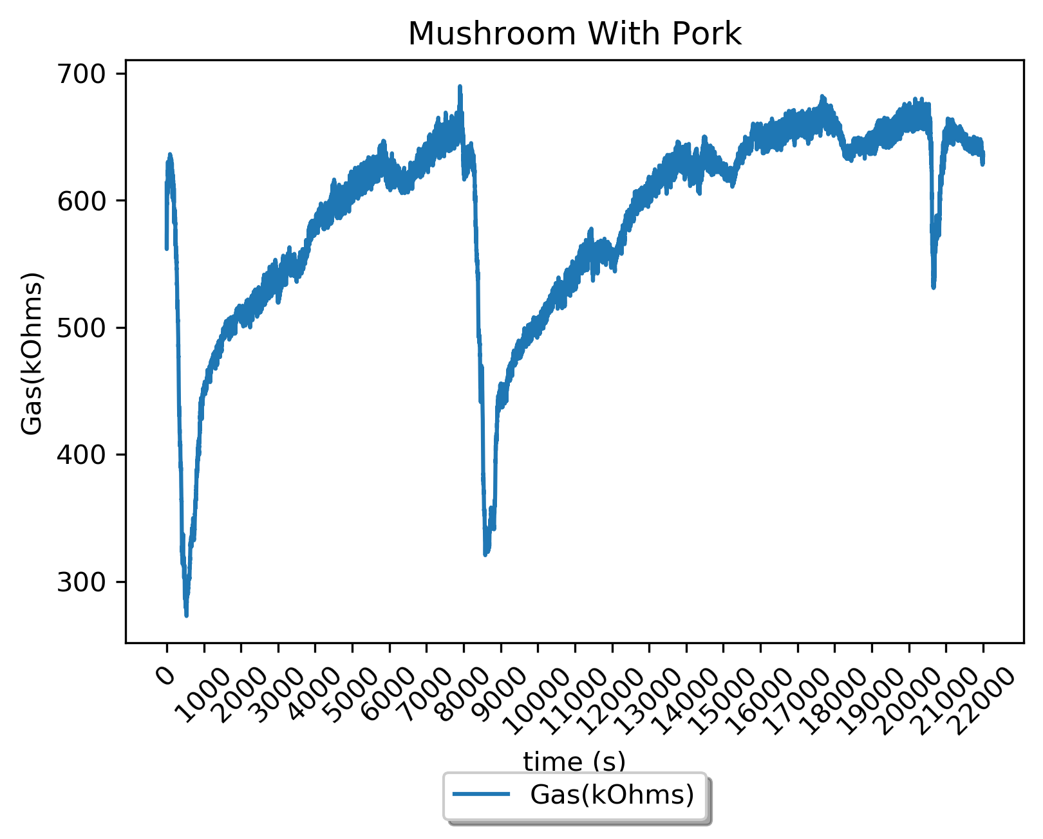
Analysis
Cooking with heat behaves as expected
PM concentration spikes when cooking begins
Decays exponentially
Smoke can drive PM concentrations very high
VOC Resistivity will spike with PM concentration
Run | Start Time | End Time | Mean | Median | Range
Mushroom PM2.5 | 71 | 788 | 306.51 | 354 | 982

Slide 20
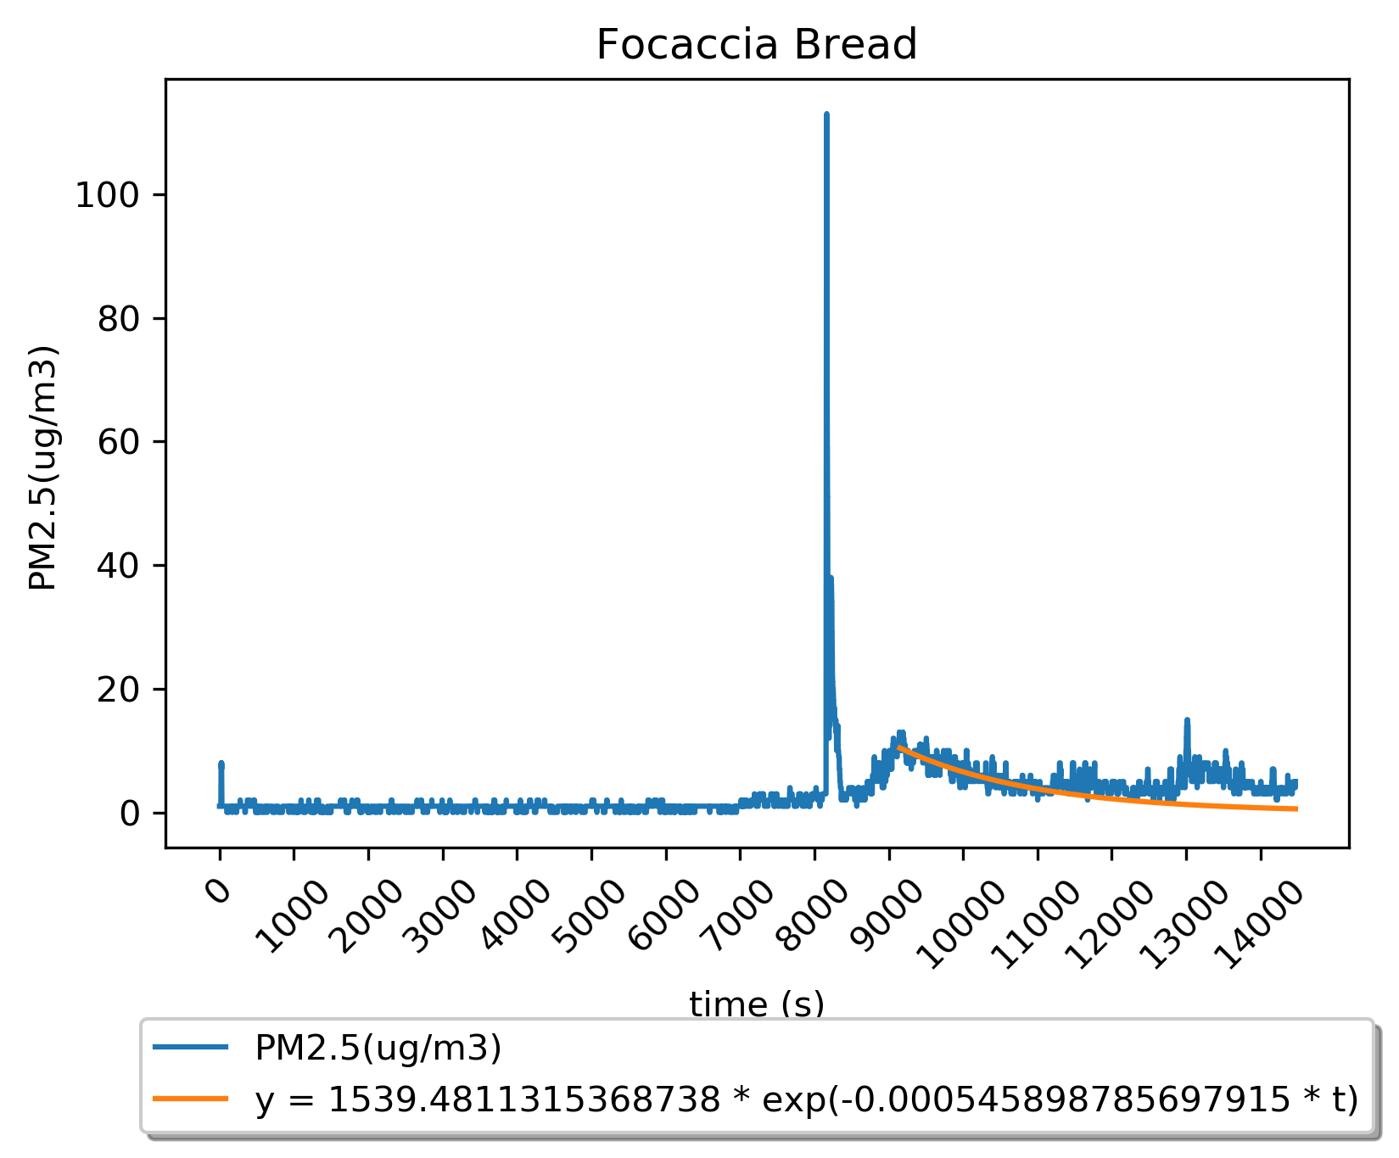
Analysis
PMS5003 does not register the flour
Non-stick cooking spray (oil based) is the only large spike visible in the bread making run

Slide 21
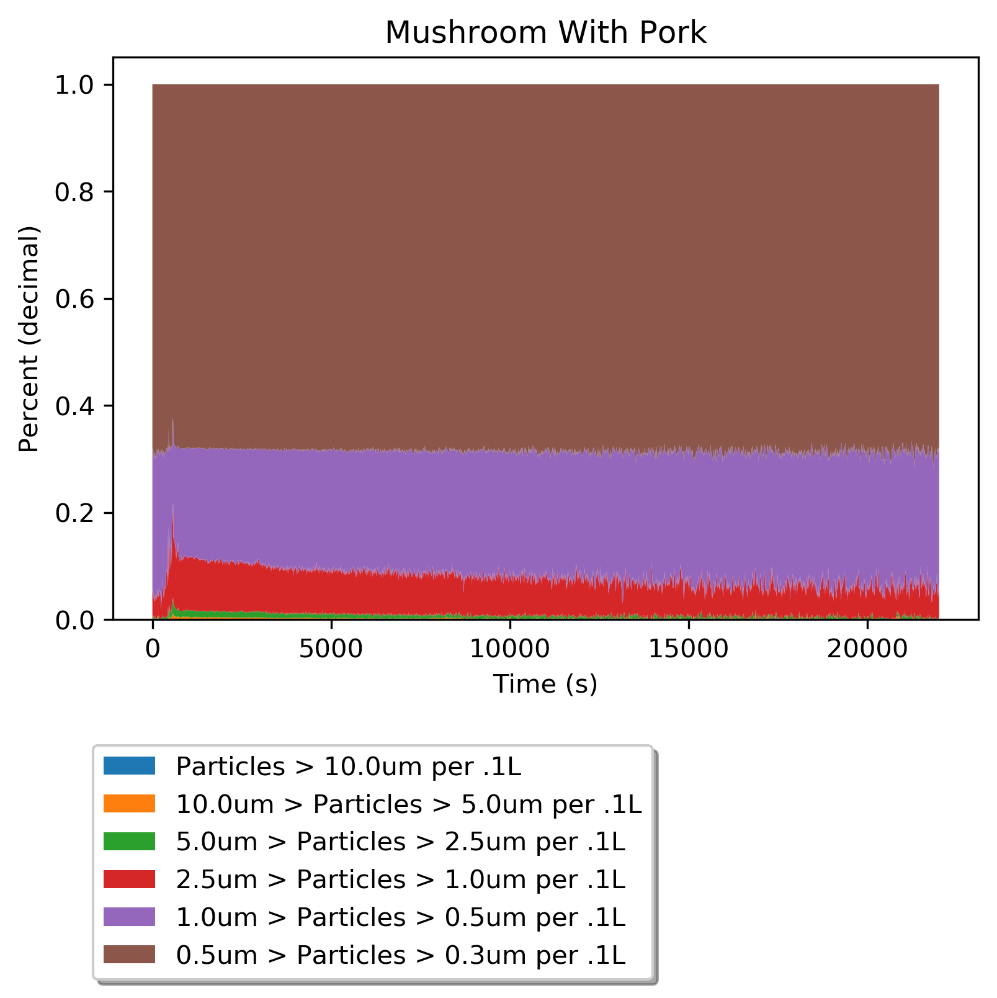
Analysis
Using PM counts we can differentiate counts by size
Distribution stays consistent
PM concentration spikes have an effect

Slide 22
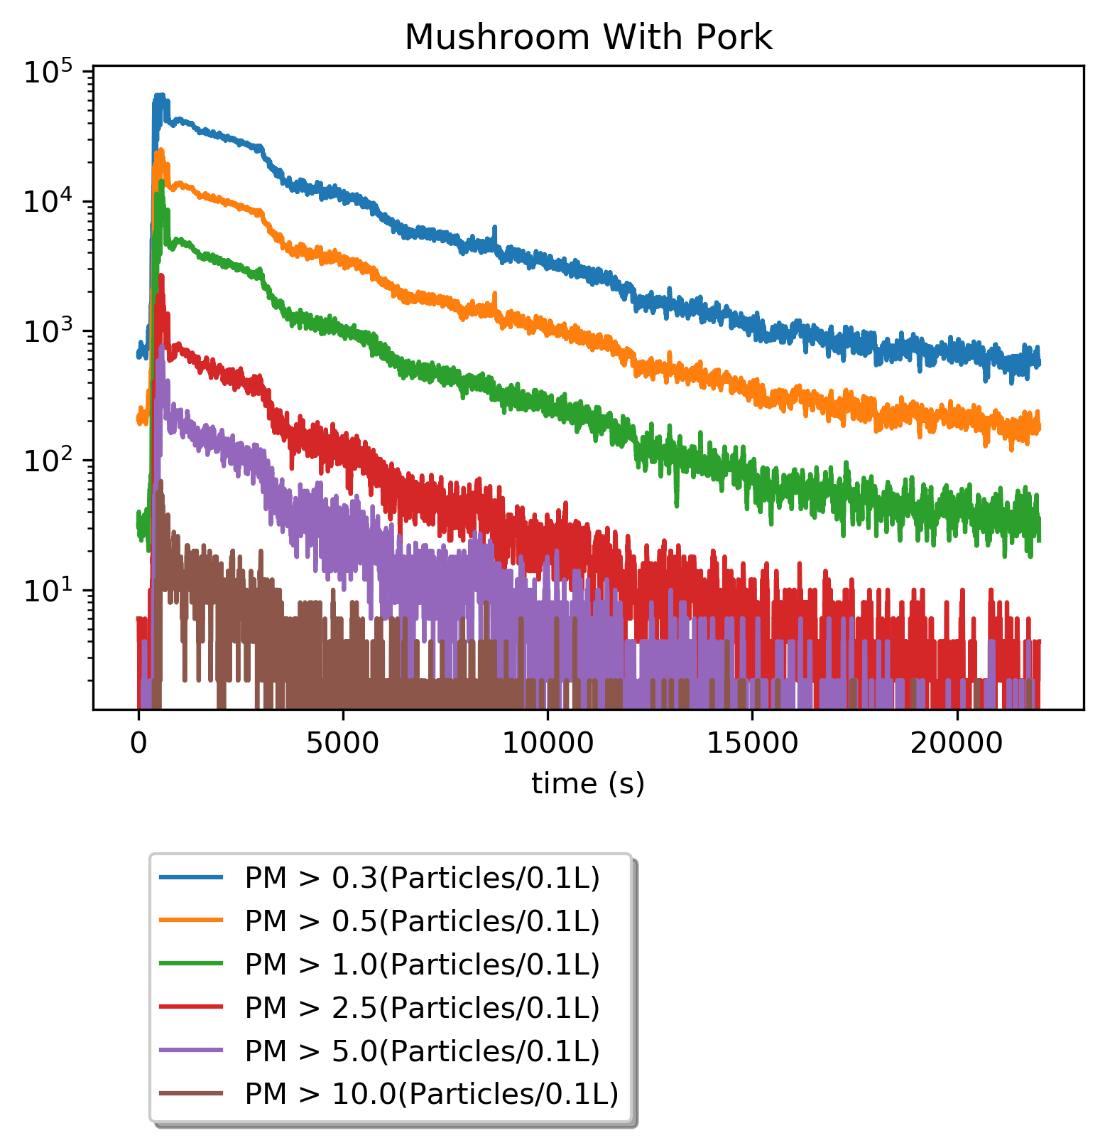
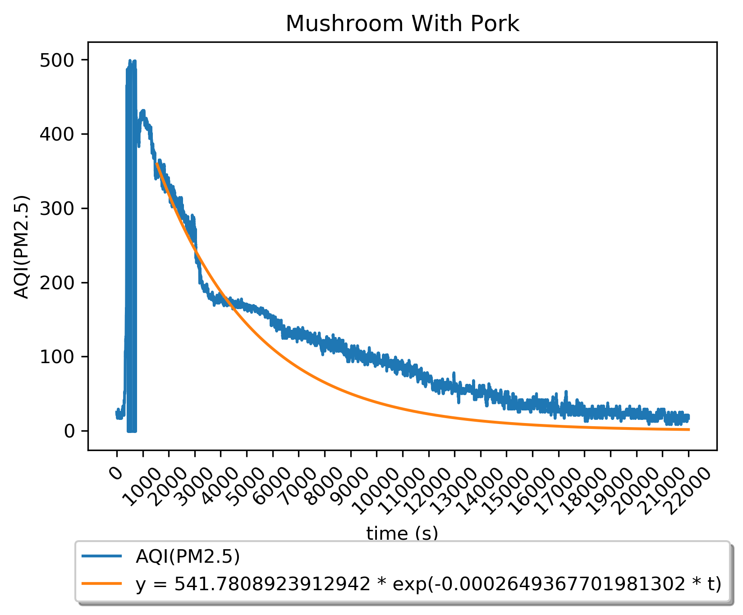
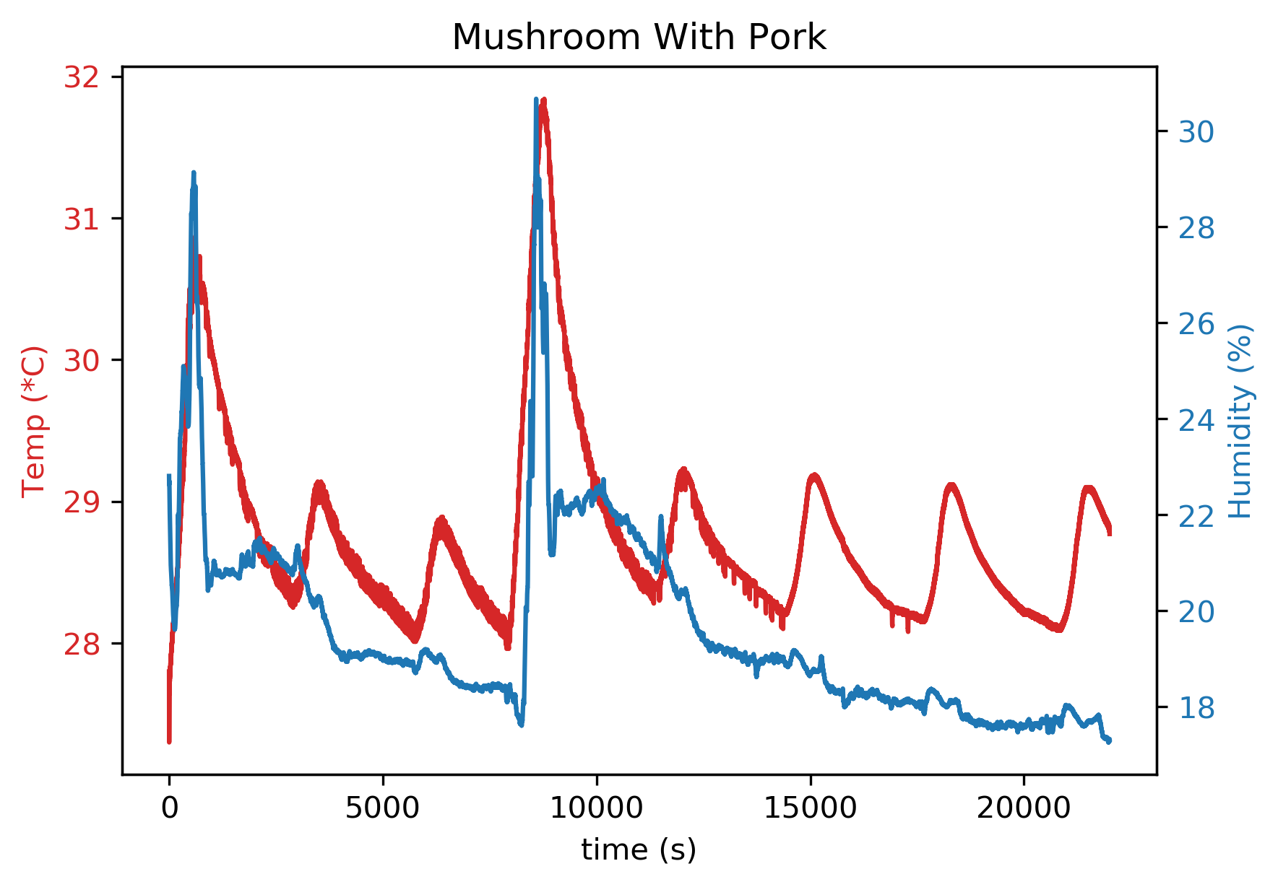
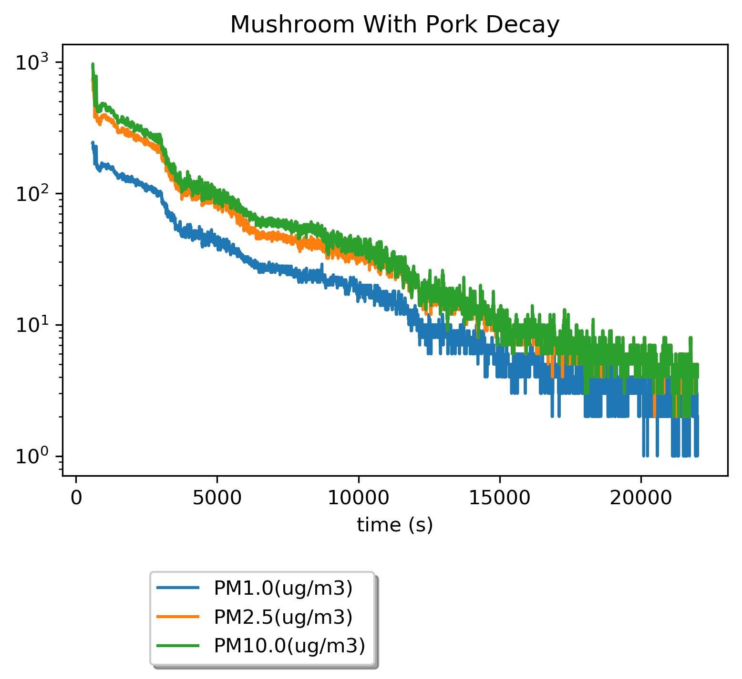
Analysis

Slide 23
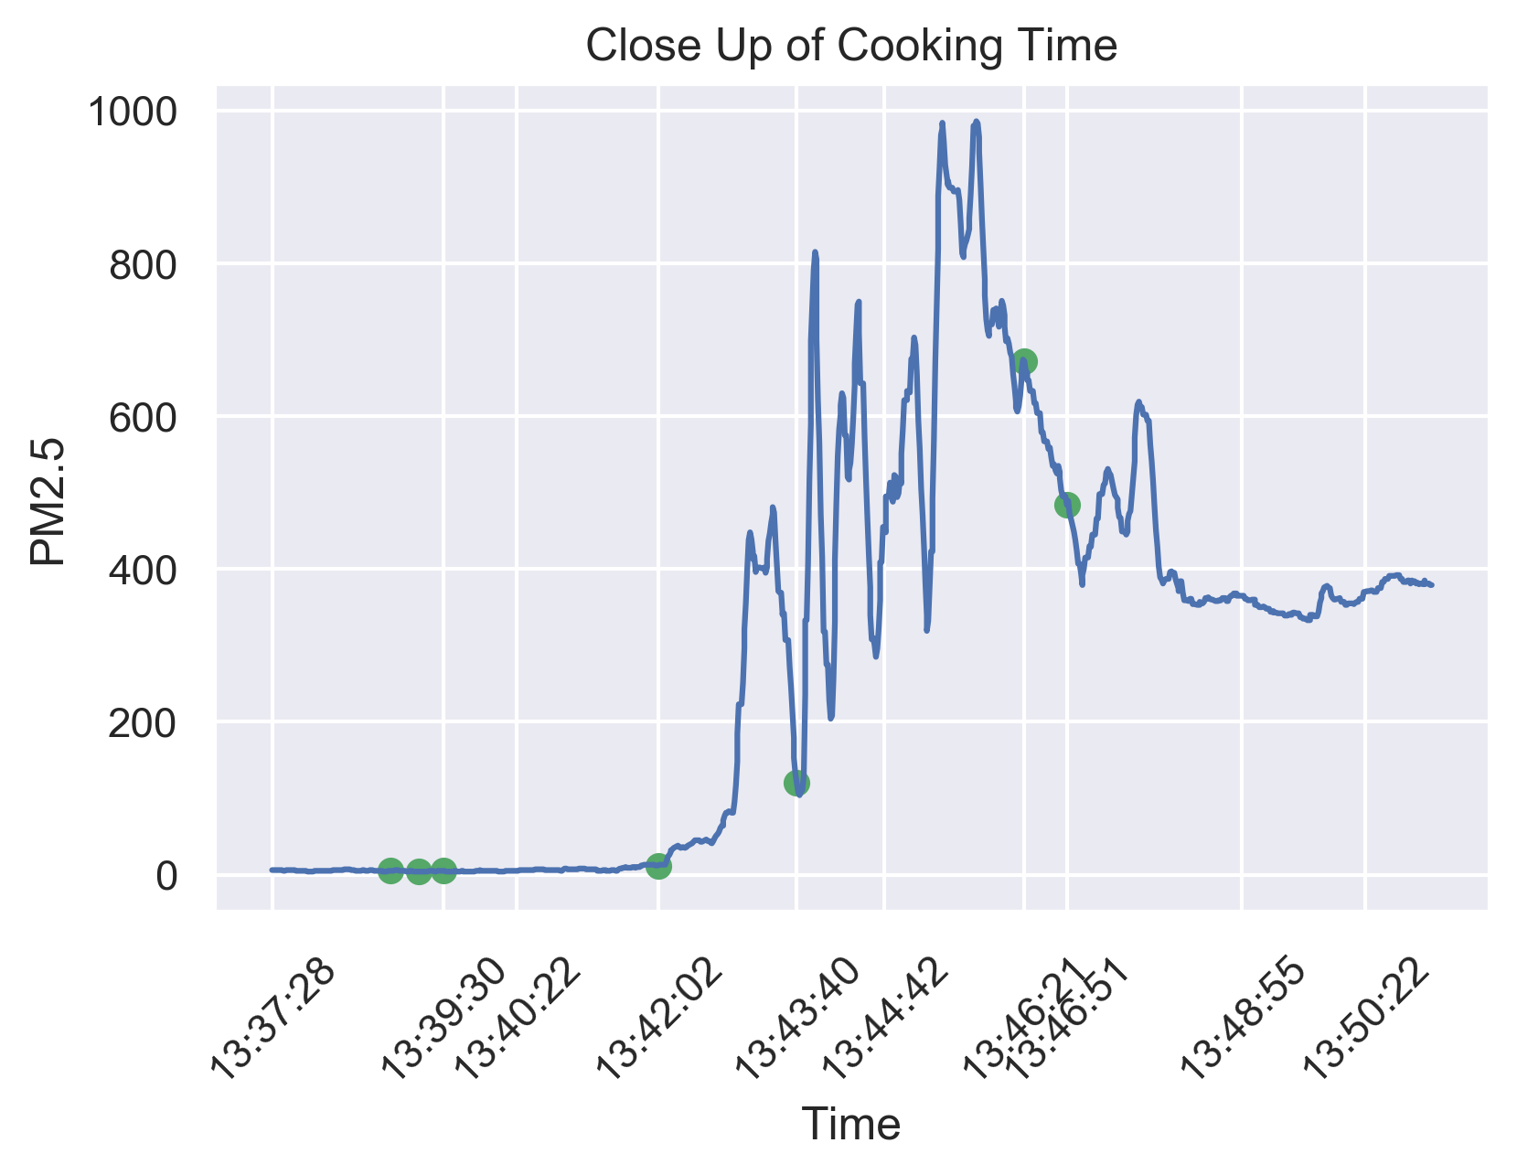
Looking Closer
Timestamp | Event
13:38:53 | Mushroom added to boiling water
13:39:13 | Pot removed from heat
13:39:30 | Pot put back on heat
13:42:02 | Oil added to pot
13:43:40 | Mushroom added to pot
13:46:21 | Sauce added to pot
13:46:51 | Cooked pork added to pot

Slide 24
Other Factors that Might Affect PM Concentrations
Other people using the kitchen before or after cooking
Baseline PM concentration
Use of ventilation
Environmental factors
Random fluctuations
Open fire

Slide 25
Limitations
One set of sensors
Distance from the stove
VOC gas data
Lack of data for commercial kitchens

Slide 26
 | PM2.5 (Average, μg/m3) | PM10 (Average, μg/m3)
Mushroom with Pork | 217.57 | 263.61
Pepper with Pork | 21.77 | 25.30
Focaccia Bread | 3.07 | 3.74
Broccoli with Pork | 66.79 | 77.83

Slide 27
 | PM2.5 (24-Hour Average, μg/m3) | PM10 (24-Hour Average, μg/m3)
Mushroom with Pork | 75.86 | 91.87
Pepper with Pork | 10.59 | 12.43
Focaccia Bread | 1.69 | 1.91
Broccoli with Pork | 24.93 | 28.61
NAAQS | 35 | 150

Slide 28
Is More Research Needed
Temperature
stove and pot
Control groups
cooking method and ingredients, ventilation, internal shape of the kitchen
PM effects on people
connections with health issues

Slide 29
Acknowledgments
George Gollin, Charlie Steiner, and Justin Languido for instructions, support and comments during the course
George Gollin for his offer to let us collect data on ramen making in his home
Bevier Cafe for their hospitality and offer to let us use their facilities for data collection

Slide 30
Works Cited
Adafruit Industries. “3 x 4 Phone-style Matrix Keypad.” Adafruit, www.adafruit.com/product/1824. Accessed 1 May 2020.
---. “Adafruit BME680 - Temperature, Humidity, Pressure and Gas Sensor.” Adafruit, www.adafruit.com/product/3660. Accessed 30 April 2020.
---. “Adafruit DS3231 Precision RTC Breakout.” Adafruit, learn.adafruit.com/adafruit-ds3231-precision-rtc-breakout/overview. Accessed 30 April 2020.
---. “INA219 High Side DC Current Sensor Breakout - 26V ±3.2A Max.” Adafruit, www.adafruit.com/product/904. Accessed 30 April 2020.
---. “MicroSD Card Breakout Board.” Adafruit, https://www.adafruit.com/product/254. Accessed 30 April 2020.
---. “PM2.5 Air Quality Sensor and Breadboard Adapter Kit - PMS5003.” Adafruit, www.adafruit.com/product/3686. Accessed 30 April 2020.
---. “RGB Backlight Positive LCD 16 x 2 + Extras - Black on RGB.” Adafruit, www.adafruit.com/product/398. Accessed 30 April 2020.

Slide 31
Works Cited
AirNow. AirNow, www.airnow.gov. Accessed 10 April 2020.
Arduino. Arduino, www.arduino.cc. Accessed 30 April 2020.
Bosch. “BME680 Low Power Gas, Pressure, Temperature & Humidity Sensor,” cdn-shop.adafruit.com/product-files/3660/BME680.pdf. Accessed 16 April 2020.
Kim, Ki-Hyun, Kabir, Ehsanul, and Shamin Kabir. “A Review on the Human Health Impact of Airborne Particulate Matter.” Environment International, vol. 74, 2015, pp. 136-143.
Kim, Hyungkeun, Kang, Kyungmo, and Taeyeon Kim. “Measurement of Particulate Matter (PM2.5) and Health Risk Assessment of Cooking-Generated Particles in the Kitchen and Living Rooms of Apartment Houses.” Sustainability, vol. 10, no. 3, 2018, pp. 843-855.
Occupational Safety and Health Administration. “Indoor Air Quality in Commercial and Institutional Buildings.” OSHA.gov, www.osha.gov/Publications/3430indoor-air-quality-sm.pdf. Accessed 28 April 2020.
---. “Limits for Air Contaminants.” 29 C.F.R. § 1910.1000 Table Z-1 (1989), www.osha.gov/laws-regs/regulations/standardnumber/1910/1910.1000TABLEZ1. Accessed 28 April 2020.

Slide 32
Works Cited
“PCB Layout.” Learn EMC, learnemc.com/pcb-layout. Accessed 28 April 2020.
Plantower Technology. “Digital Universal Particle Concentration Sensor – PMS5003 Series Data Manual,” cdn-shop.adafruit.com/product-files/3686/plantower-pms5003-manual_v2-3.pdf. Accessed 30 April 2020.
United States Environmental Protection Agency. “NAAQS Table.” EPA.gov, www.epa.gov/criteria-air-pollutants/naaqs-table. Accessed 10 April 2020.
---. “Technical Assistance Document for the Reporting of Daily Air Quality – the Air Quality Index (AQI).” EPA.gov, www3.epa.gov/airnow/aqi-technical-assistance-document-sept2018.pdf. Accessed 2 April 2020.

Slide 33
Thanks for listening!

