Slide 1
Noise Profiles in the Vicinity of Wind Turbines
Cecilia Abbamonte, Joseph Kim, Tirth Patel, Shoham Weiss

Slide 2
Production of Low Frequency Noise
Low frequency noise (LFN) is defined as sound with frequencies between 20Hz and 200 Hz
Three sources of LFN from a wind turbine:
Aerodynamic interference between blades and tower.
  1-30 Hz
Trailing edge noise from blades.
  500-1000 Hz
Turbulent air flow around the blades.
  10-200 Hz, Main source of LFN
Notes:
The premise of our research is to look at the LFN surrounding wind turbines.

Slide 3
Health Effects and Controversy
Supposed adverse health effects due to the LFN from wind turbines.
  “The Wind Turbine Syndrome” argues that wind turbine noise can cause a variety of serious symptoms (Bolin 2011).
  Most common health effect is sleep disturbance, but other health effects can include chronic disease, headaches, tinnitus, and undue tiredness (Pederson 2011).
Except for noise annoyance and self-reported sleep disturbance, these symptoms didn’t have consistent association with wind turbine exposure.
The wind farm that we recorded on had specific restrictions on how far away they must be from houses.

Slide 4
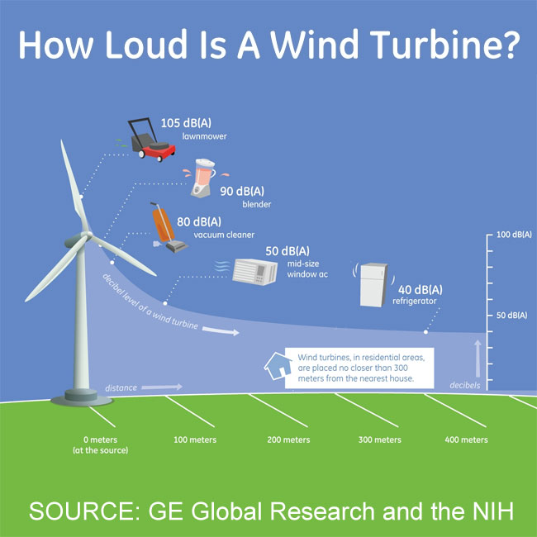
What was the goal of this experiment?
What were we looking for?
On site: We heard a constant low humming noise coming from the wind turbine.
Goal: Use Fourier transformed sound data to find a constant, low frequency sound that dissipates as distance from the turbine increases.
Frequency of the sound should be within the range of 10-200 Hz.
https://www.youtube.com/watch?v=Mk5zMxYVca0

Slide 5
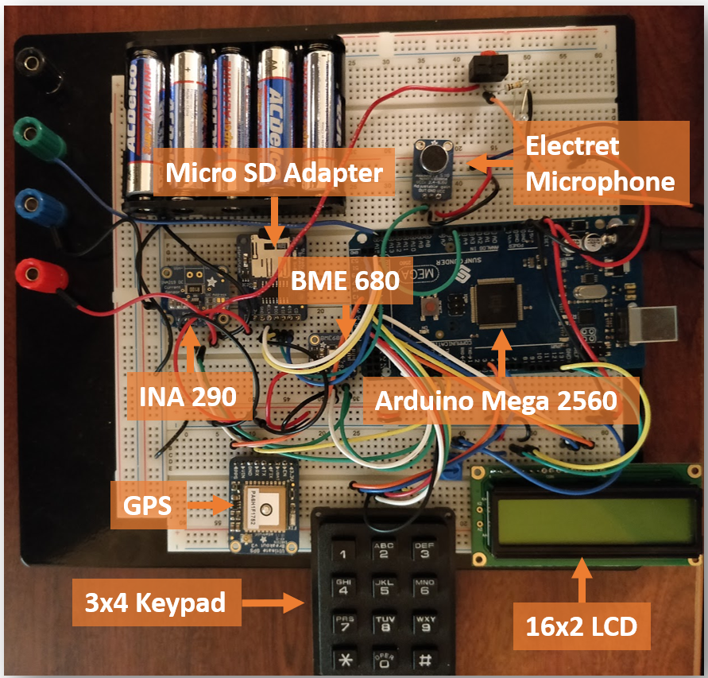
Measurement Device
Components on Breadboard
Arduino Mega 2560
Electret Microphone - Record sound
BME 680 - Measure temperature and pressure
GPS - Track location of each measurement
Anemometer - Measure wind speed

Slide 6
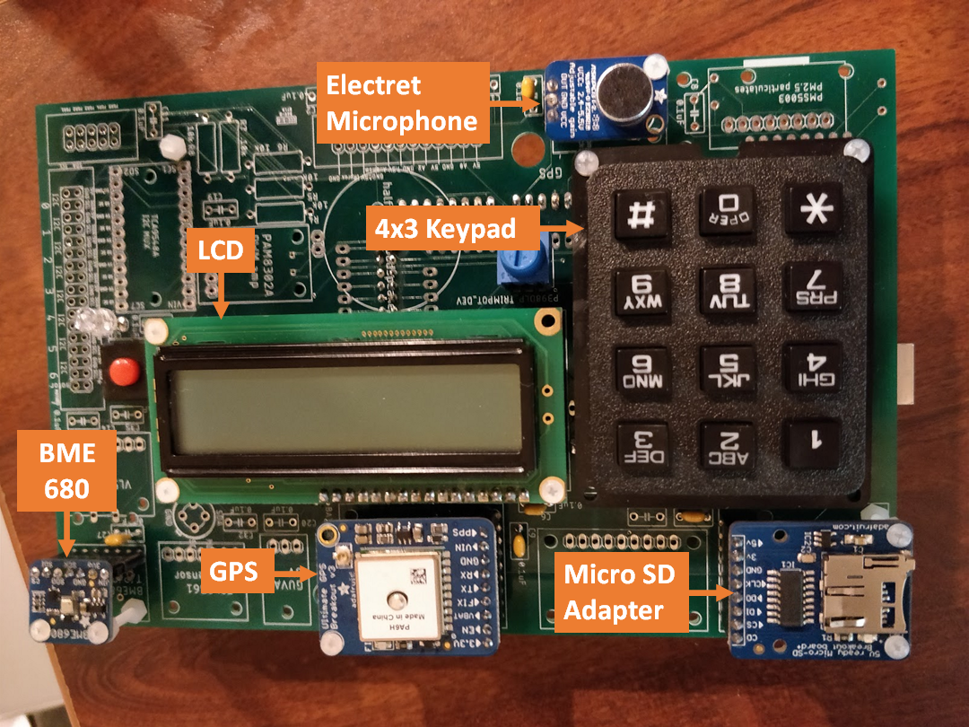
Measurement Device
Components on PCB
Arduino Mega 2560
Electret Microphone - Record sound
BME 680 - Measure temperature and pressure
GPS - Track location of each measurement

Slide 7
Data Acquisition Software
It is a software that we use to collect temperature, pressure, sound, GPS location, and wind speed data.
We used the Arduino IDE software to write, compile and upload our code to our devices.
Our software was divided into two parts,
a) For Sound recording
b) For Temperature, Pressure, GPS, Wind Speed recording.
Notes:
The main goal of the data acquisition (DAQ) software was to record the sound, temperature, pressure, sound, GPS location, and wind speed at different locations in the vicinity of a wind turbine. The DAQ would also organize that data recorded by each device.
We used Arduino IDE software to write, compile, and upload the code to the Arduino Mega 25-60. The data acquisition code was written in C++.
Our software was divided into two parts, one would collect just sound data and another one would collect temperature, pressure, GPS location, and wind speed data.
The reason behind dividing DAQ in two partes is that the sound recording software required buffer to store small piece of data temporarily so that it can write this data onto Micro-sd card because it takes more time to write data onto micro-sd card but our other part of DAQ does not required any buffer at all and it was little bit more challenging for us to integrate this to software into one code so we opt for running them separately on two separate drive.

Slide 8
Data Acquisition Procedure
Three groups of two devices (one for temperature & pressure data, one for sound recording).
Semi simultaneous recordings to reduce error from changes in wind speed.
Total of 32 data points.
Notes:
As I mentioned we used three groups “A”, “B”, and “C” of two devices in each group one for temperature, pressure data and one for sound recording.
Our procedure was simple setup group “A” at 50 ft. start recording than setup group “B” at 100 ft. from wind turbine and start recording than setup group “C” at 150 ft. and start recording. By this time group “A” would be done recording so we then setup group “A” at 200 ft. From wind turbine and start recording. And then setup group “B” at 250 ft. an so on.
We repeated this process until we were about 1350 ft. from wind turbine.
We also did a simultaneous recording of Group “A”, “B” and “C” at 0 ft mark and at about 1600 ft. mark from the wind turbine.
Which gives us about 32 data points in total.

Slide 9

Fourier Analysis
In Mathematics Fourier Analysis is the study of a way general function may be represented by sums of simple trigonometric function.
It is done using Fourier Transformation.
We used this analysis to determine the frequencies of the sound we recorded.
We used the inbuilt FFT function in Python library.
Notes:
In mathematics, Fourier analysis is the study of the way general functions may be represented or approximated by sums of simpler trigonometric functions.
It is done using Fourier transformation. It is transformation method that transform a time domain function into a frequency domain function. This is the formula of fourier transformation.
We used this analysis to determine the frequencies of the sound we recorded. So, that it can help us to understand our data properly.
We used inbuilt FFT function in Python library, which does lots of work for use it takes the List as input and run fourier transformation on it and returns a List containing all the frequencies which we than use to plot intensity vs frequency graph.

Slide 10
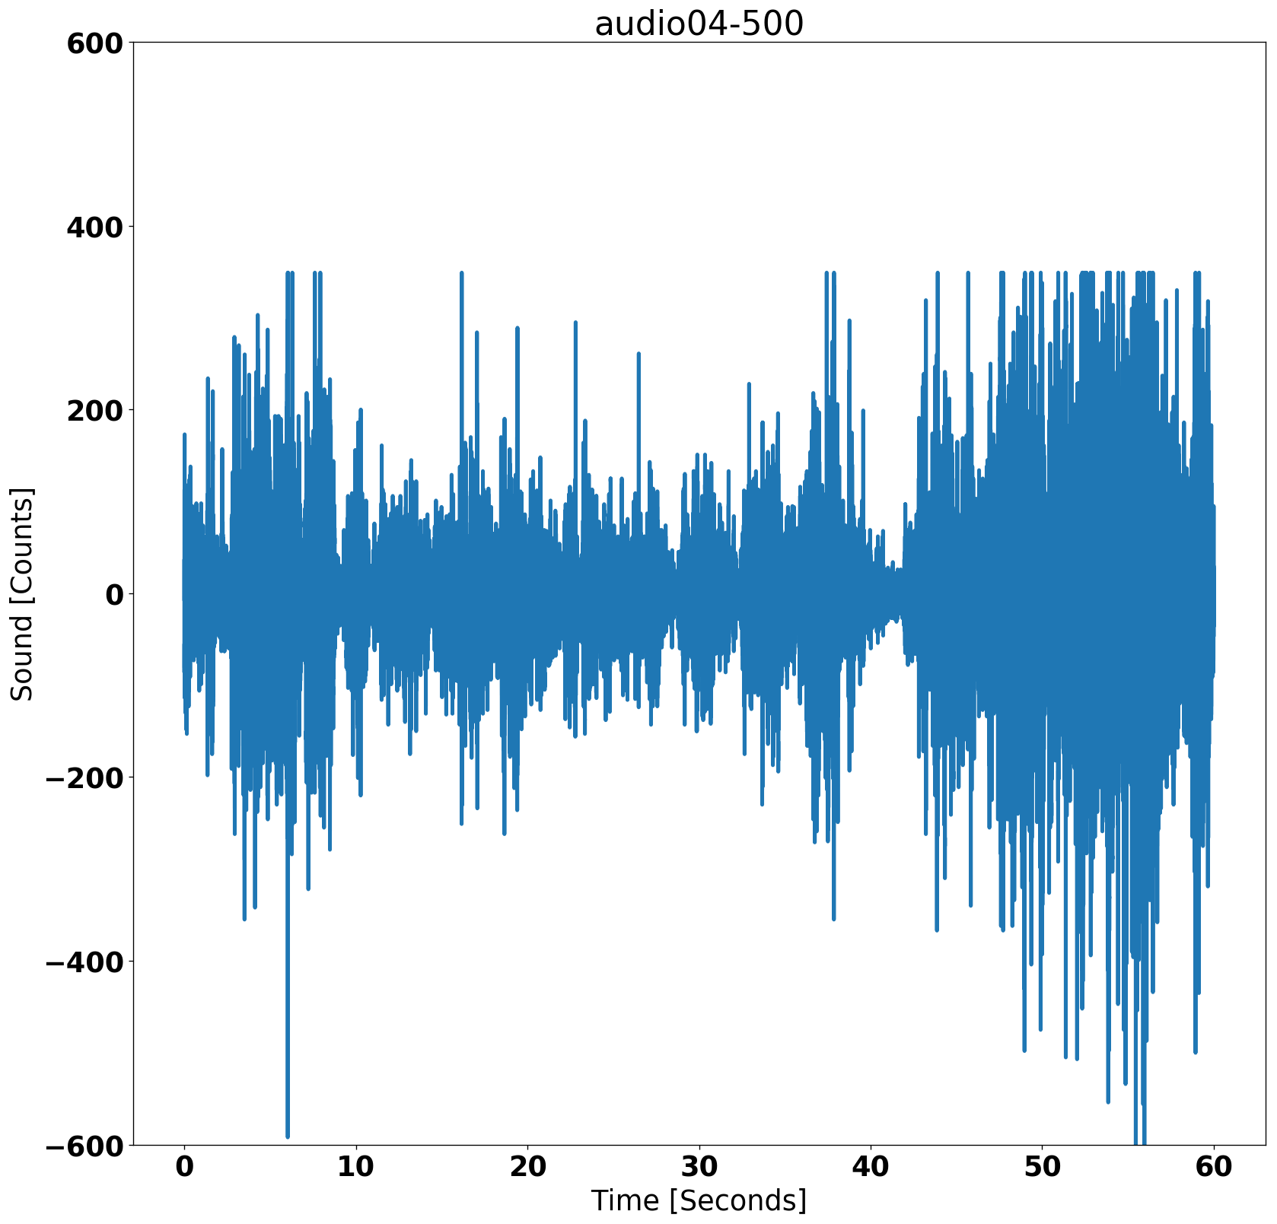
Data Representation
Microphone has the Arduino record ADC counts
The counts represent differences in pressure (a.k.a sound)
Graph sound profile as counts vs. time
Not very useful for detecting sound from a wind turbines

Slide 11
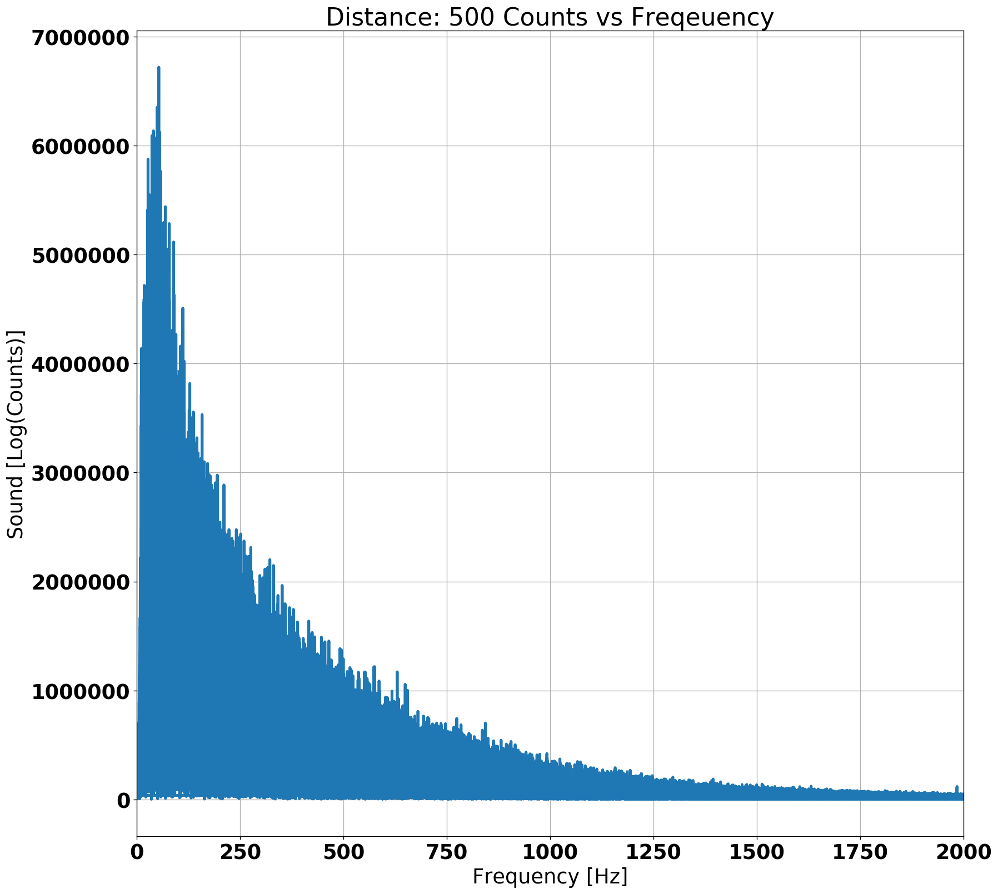
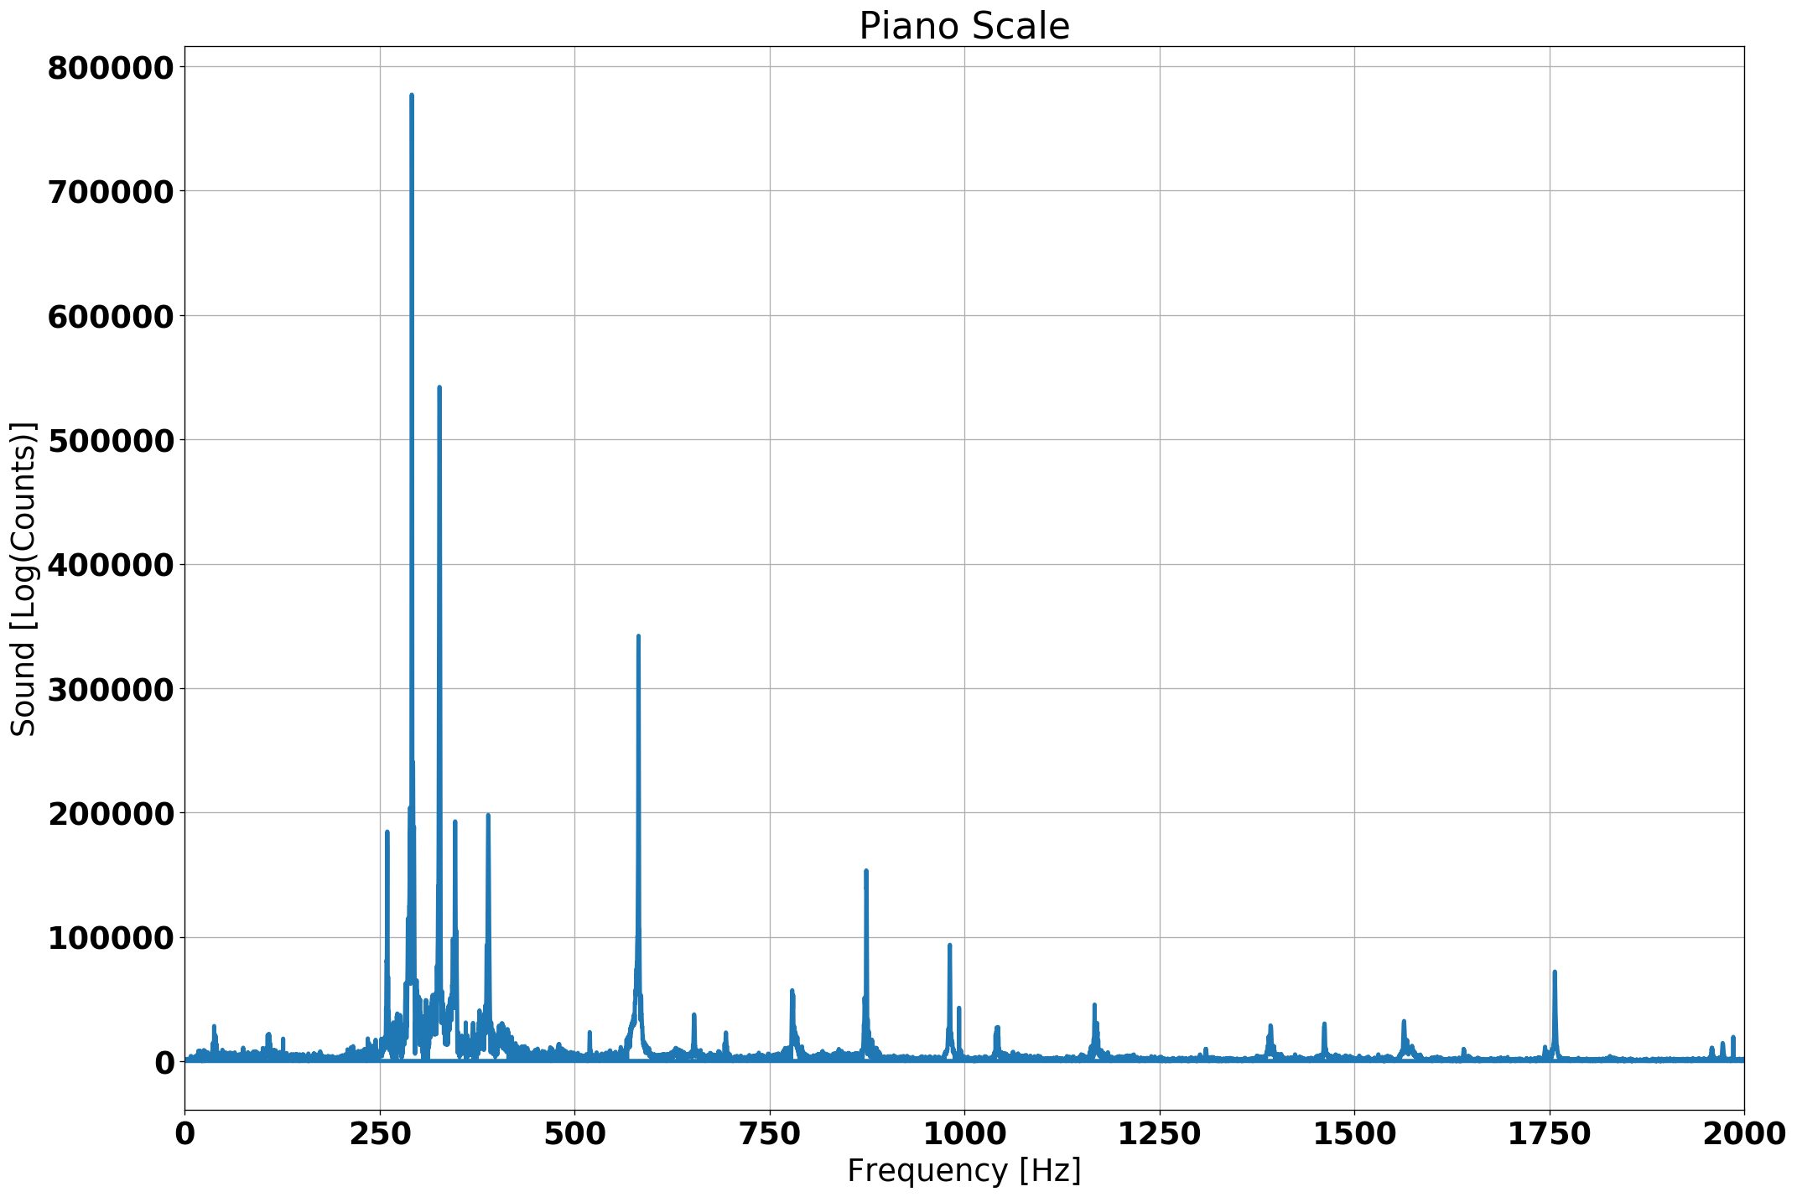
Data Representation
Fourier
Rotate to frequency-space using a Fourier transform to look at the counts vs. frequency sound profile
Can detect spikes for each sound made
Wind turbine could be making sound in the low frequency range and would show up as a peak
The wind makes our data fluffy

Slide 12
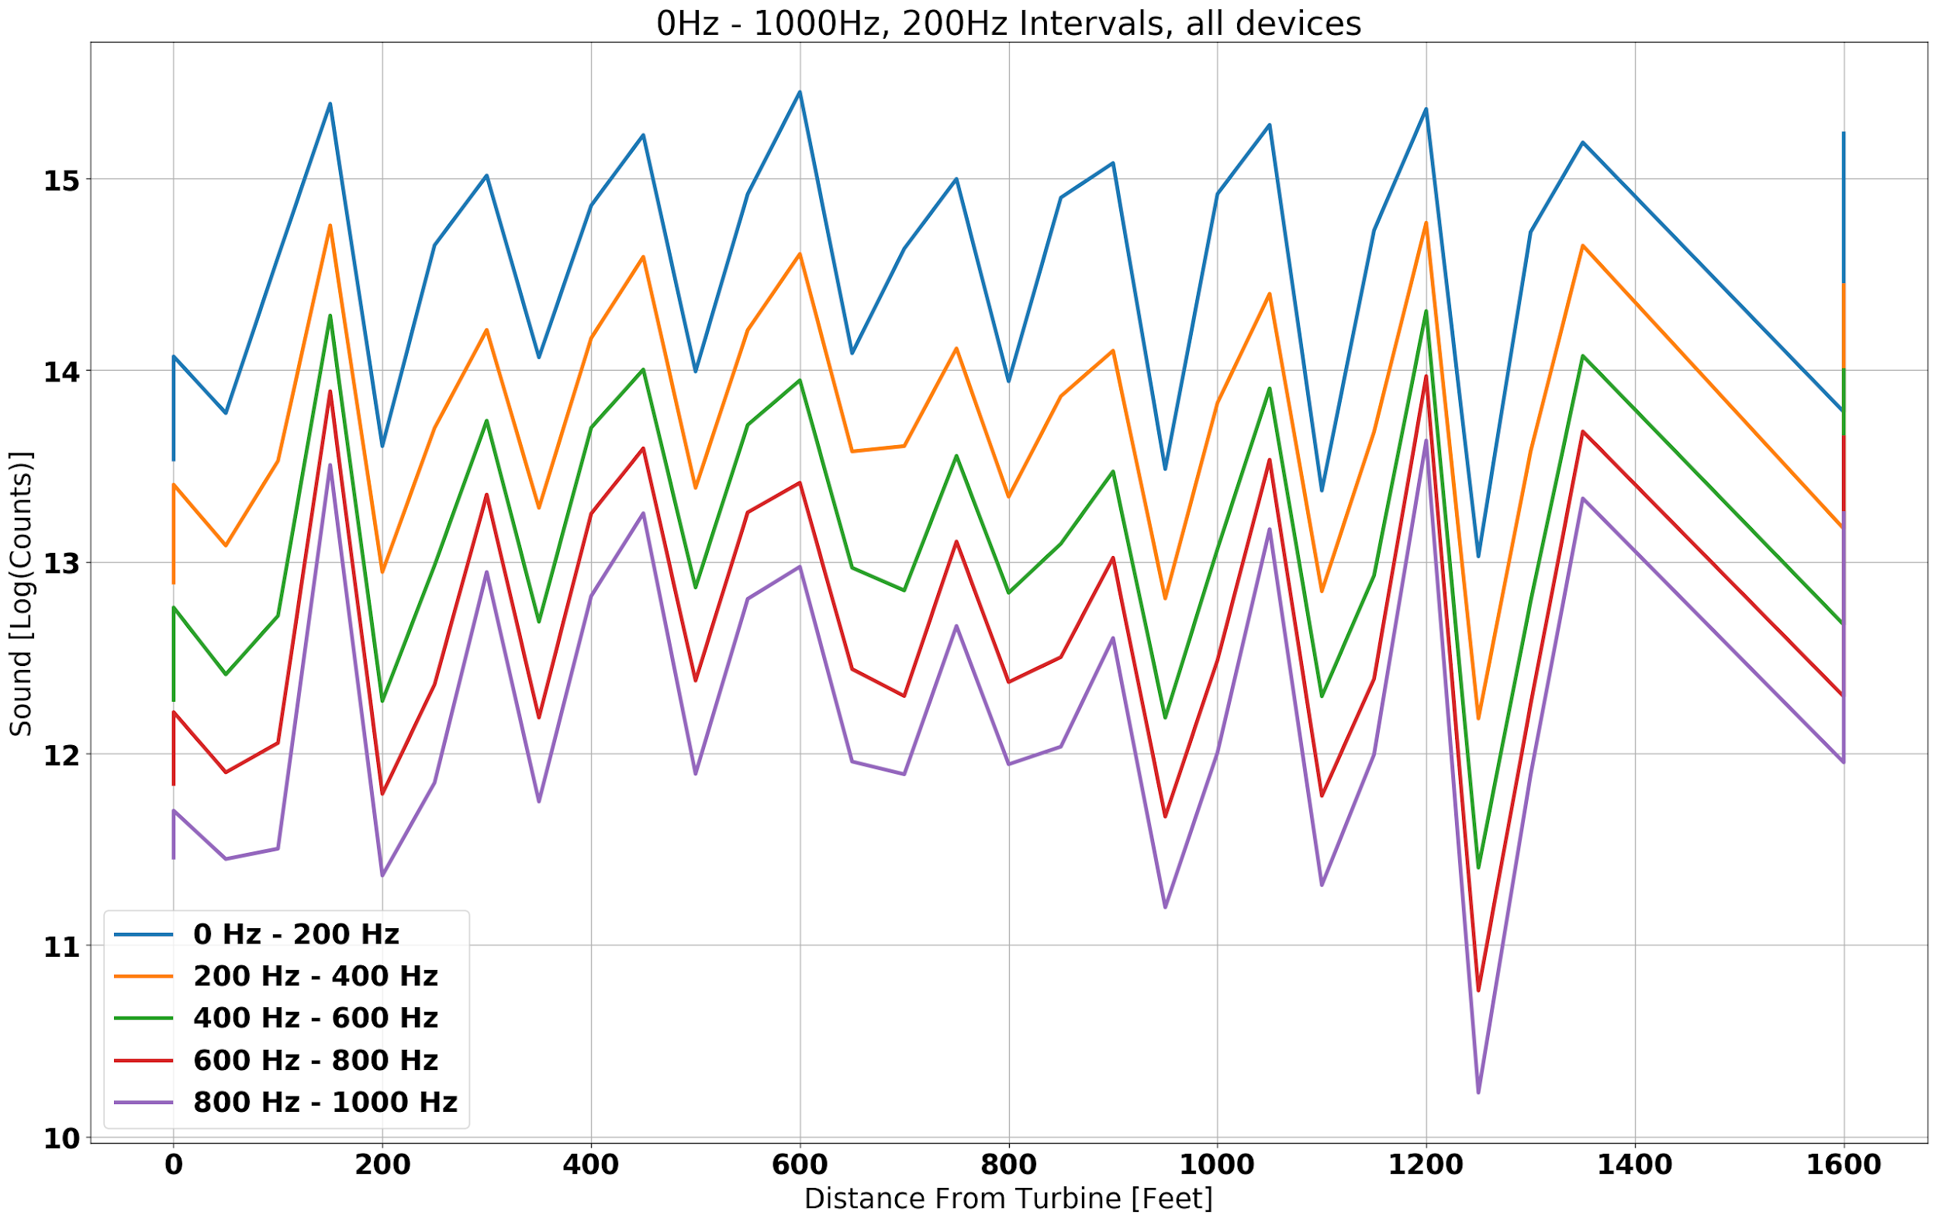
Results

Slide 13
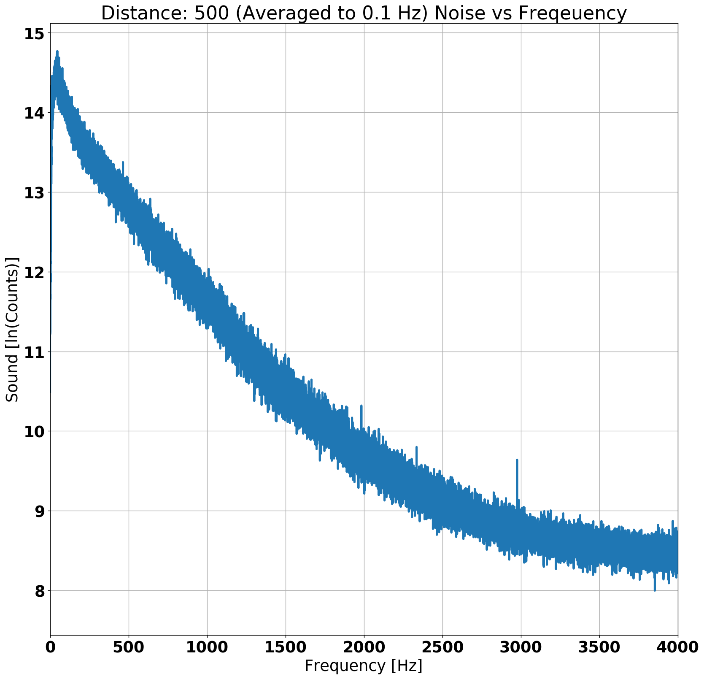
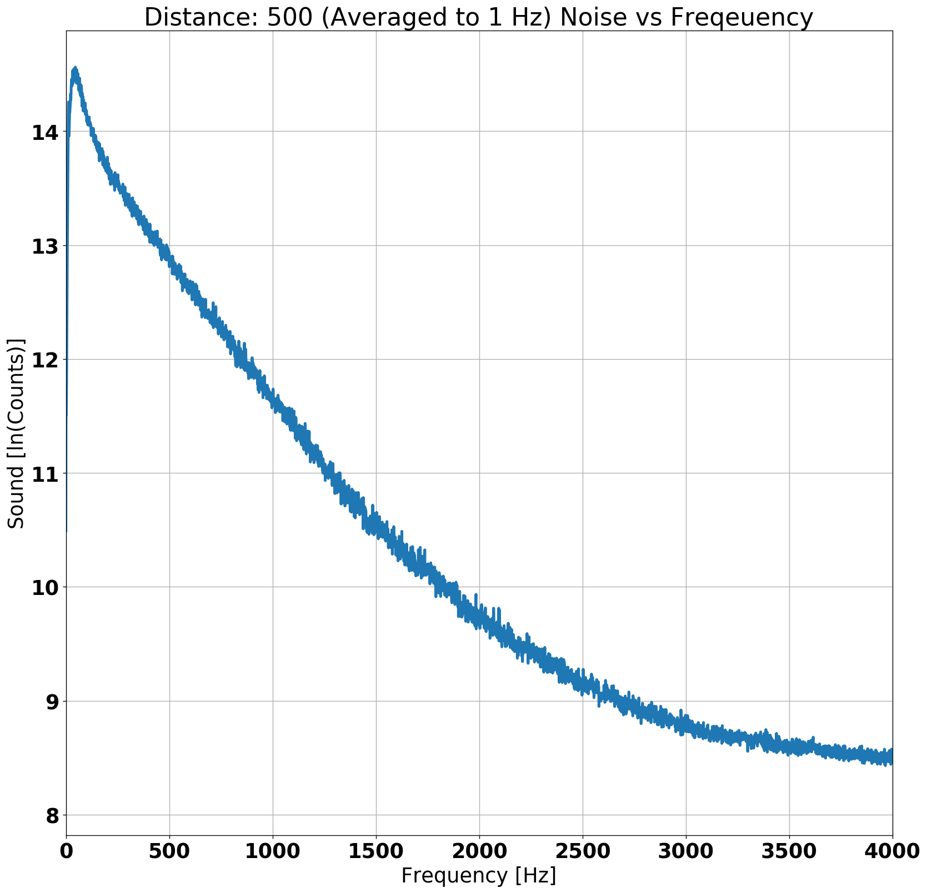
Data Representation - Frequency Profiles
Average every n bins to clear up the fluff
Take to log scale to decrease scale
Don’t average too much.
Look for spikes consistent in multiple graphs at low frequencies.
Compare profiles for different distances.

Slide 14
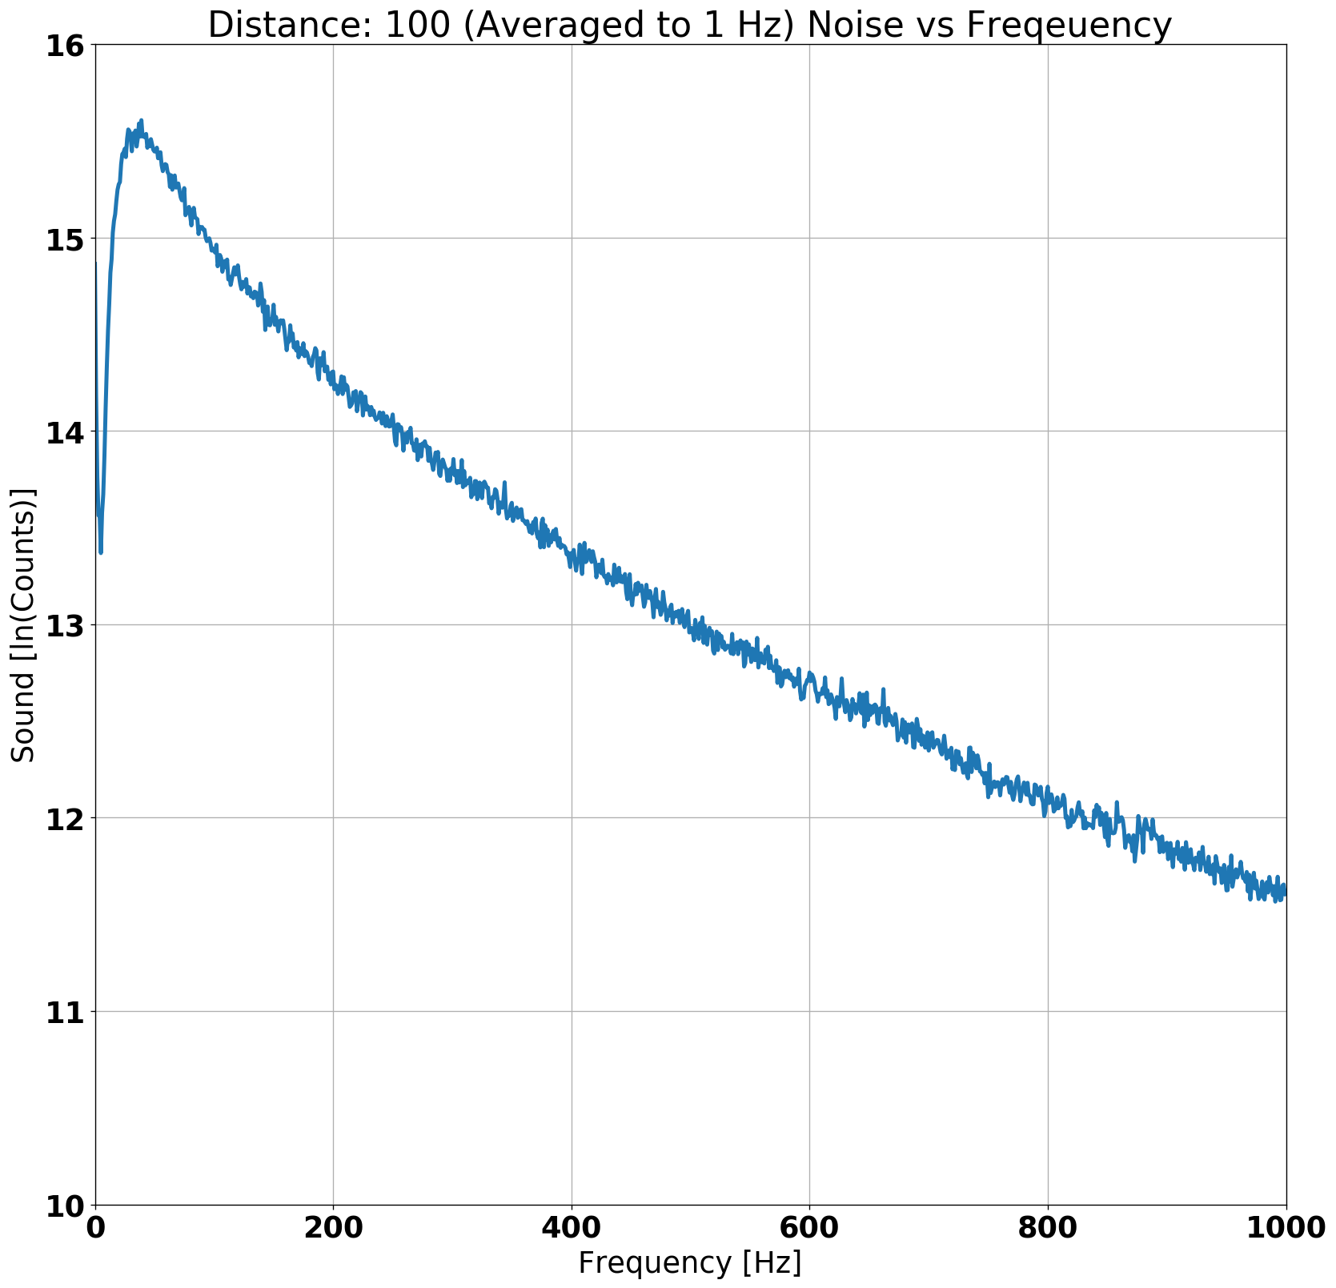
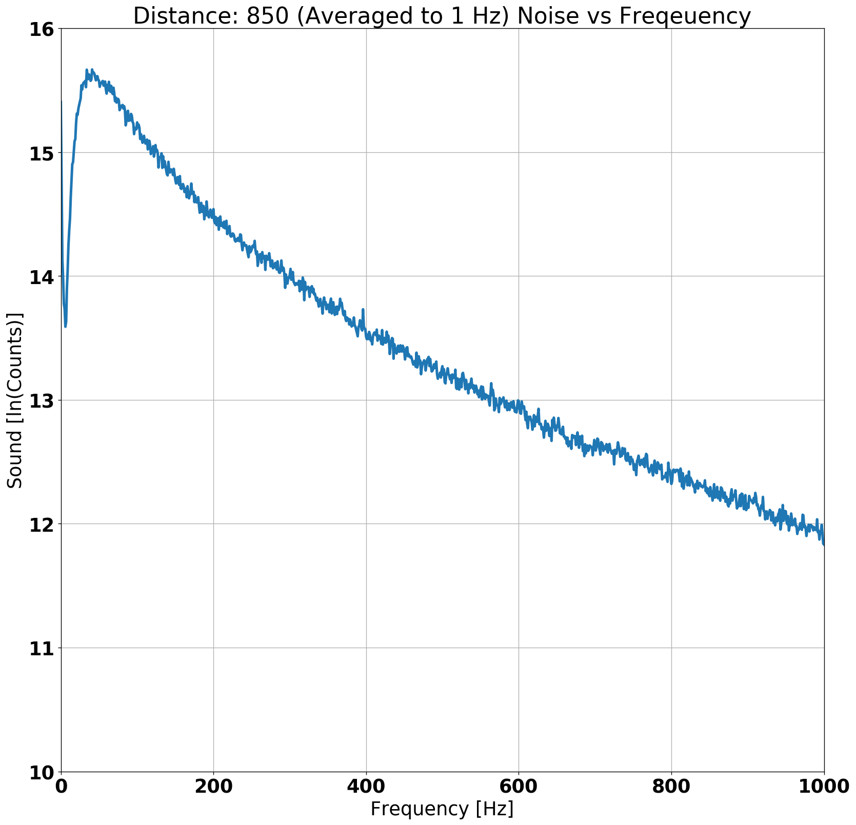
Frequency Profiles
Frequency profile was almost the same for every distance.
We have 32 recordings to compare from 3 devices

Slide 15
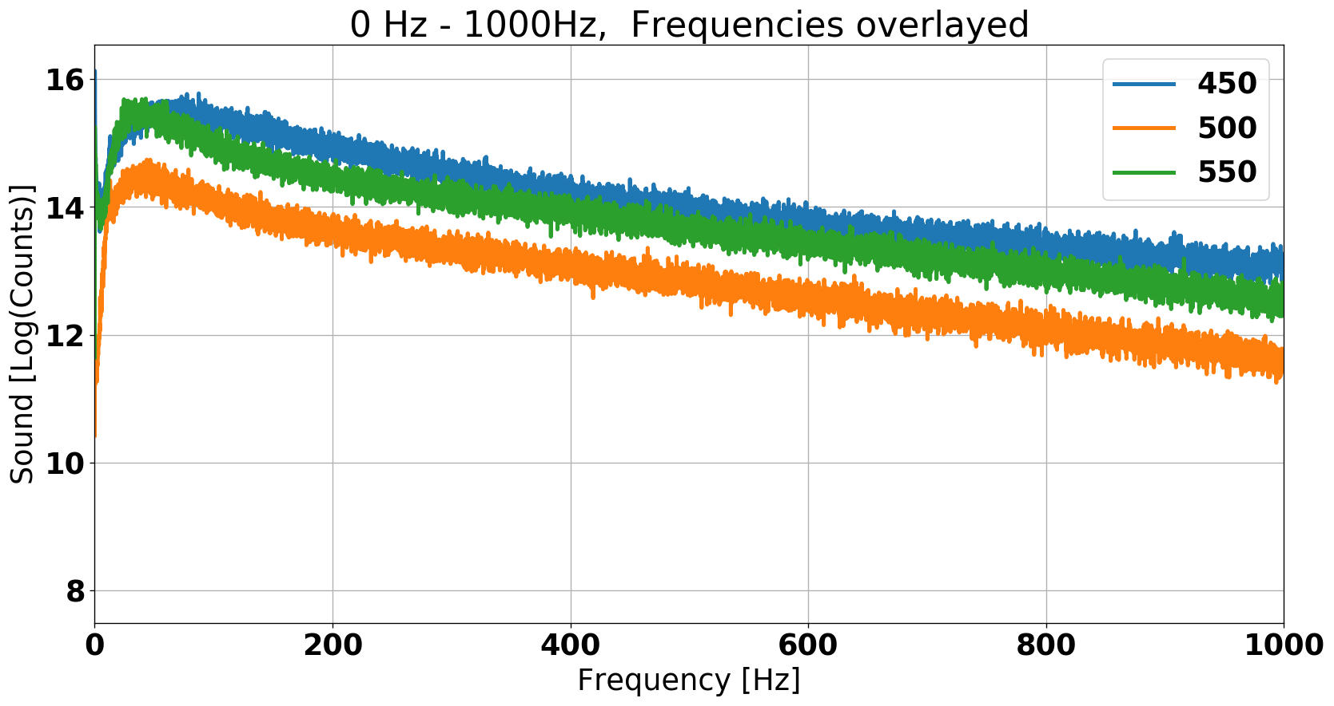
Data Representation Overlaid Graphs
Zoom in and put a couple of distances on the same graphs
Look for noticeable peaks on multiple graphs

Slide 16
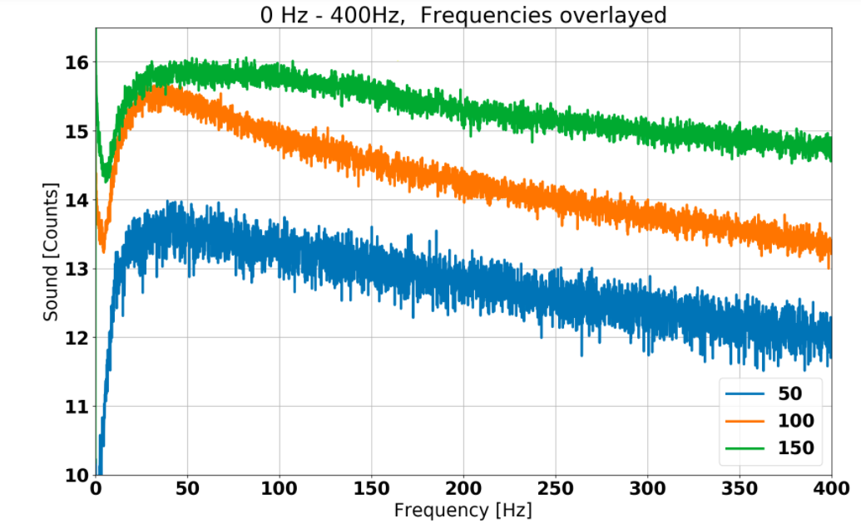
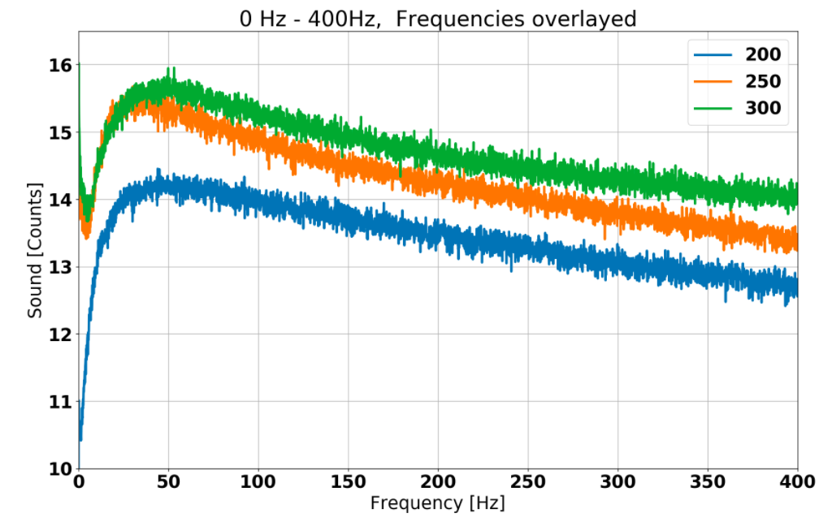
Overlaid Frequency Profiles
Overlaid frequency profiles for 50, 100, 150 feet, and 200, 250, 300 feet.

Slide 17
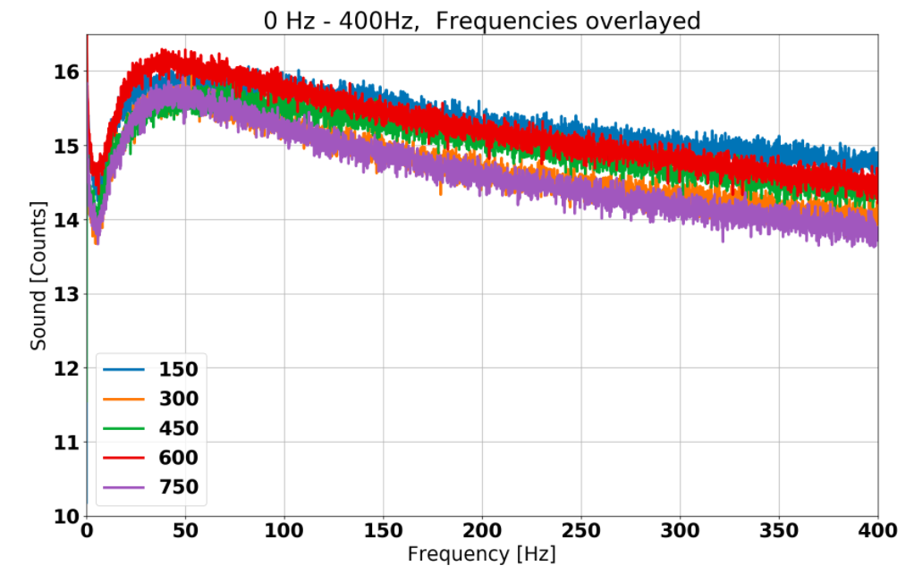
Overlaid Frequency Profiles
Overlaid frequency profiles for 150, 300, 450, 600, 750 feet (Device C only).
Maybe the sound was consistent in frequency but was not made all the time
Need to see counts, frequency and time all at once.

Slide 18
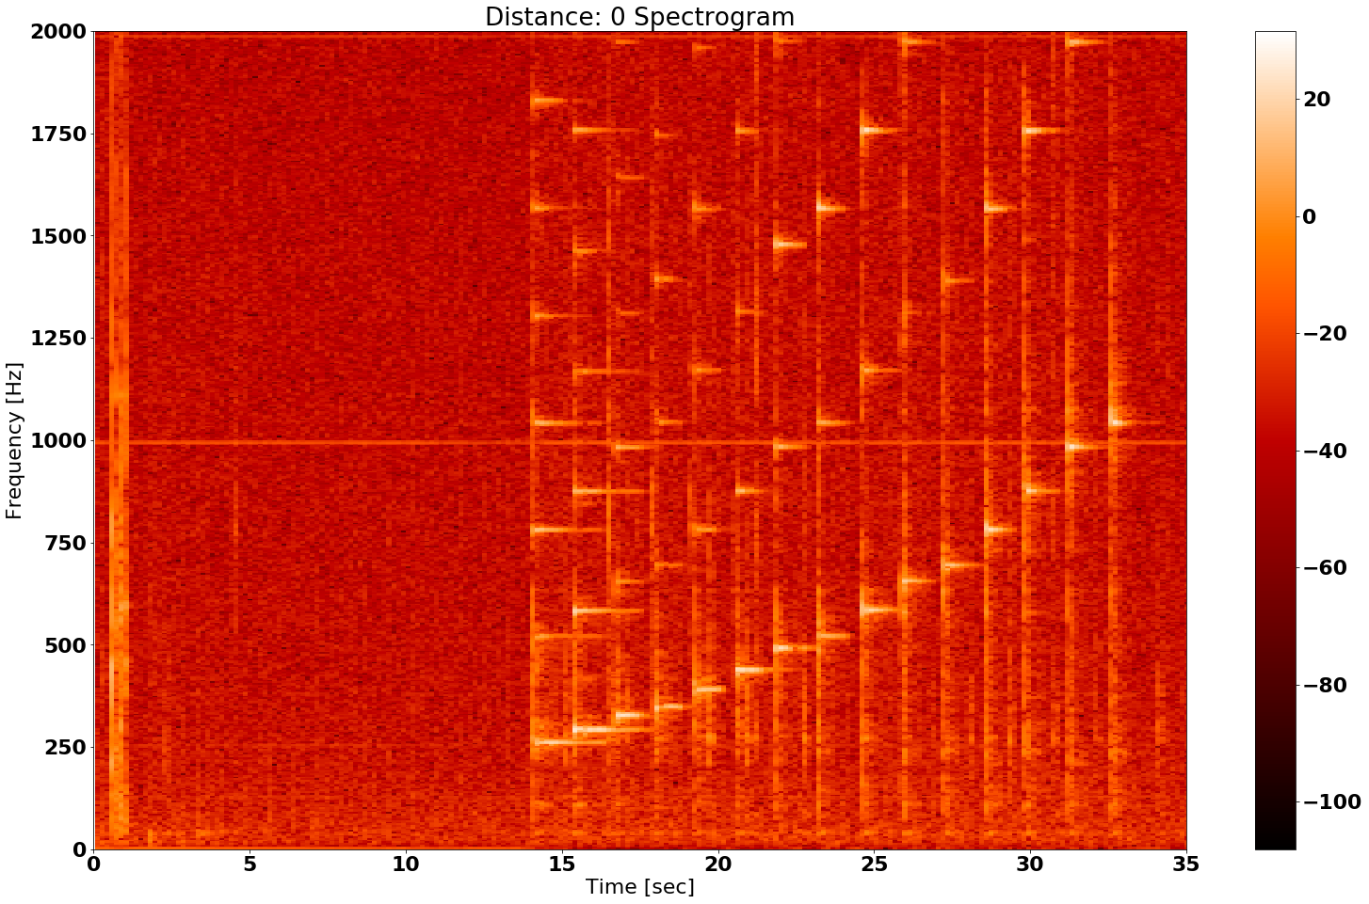
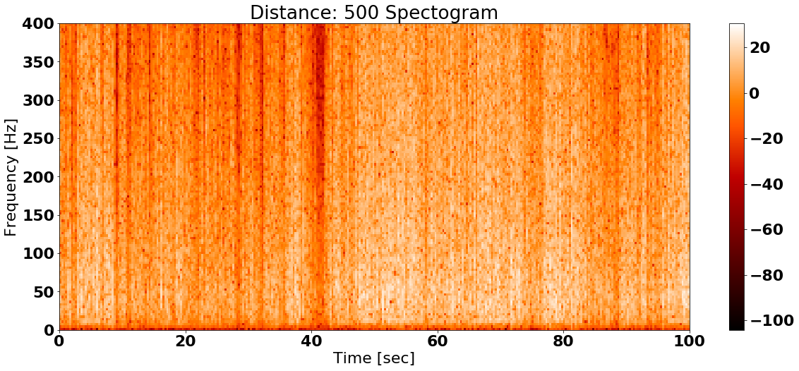
Data Representation - Spectrograms
What is a spectrogram?
Look for frequency ranges with peaks that repeat in time
We have 32 recordings
But cannot add another dimension

Slide 19
Spectrograms
What were we looking for?
Frequency peaks that are constant over time.
  Line of lighter color across the graph.
Frequency peaks that occur in regular time intervals.
  Small oscillations between lighter and darker colors within a certain frequency range.
These patterns were not detectable.

Slide 20
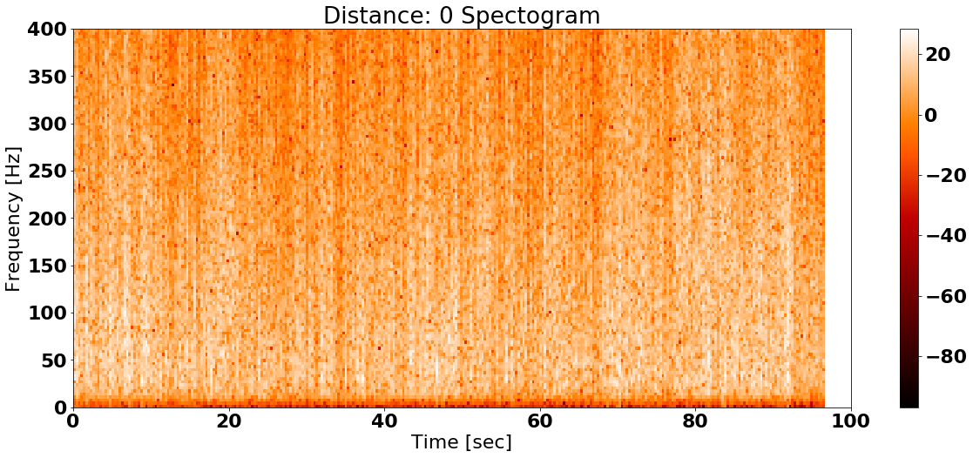
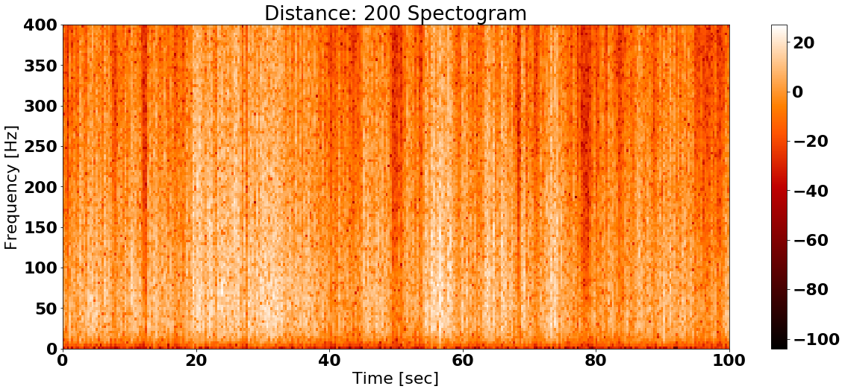
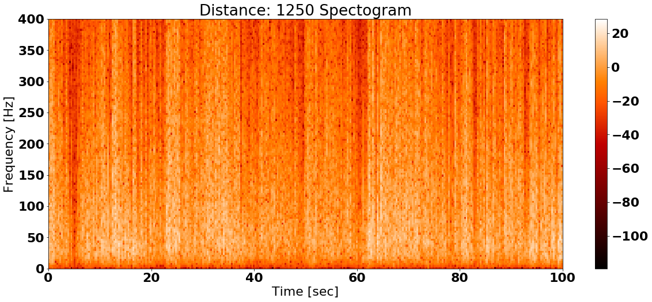
Spectrograms (only device A)

Slide 21
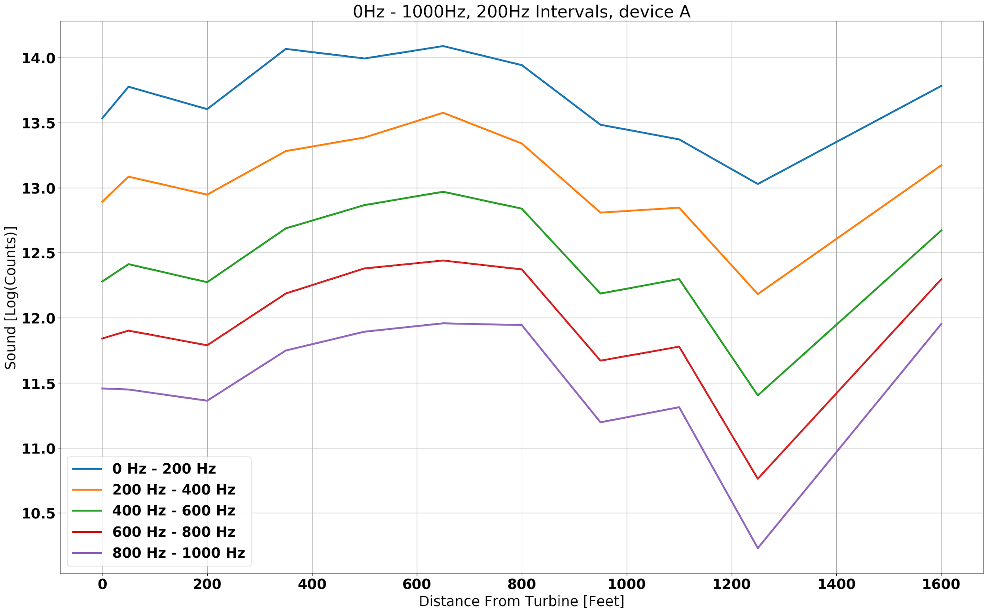
Data Representation - Distance Graphs
Sound of frequency range as a function of distance
Lowest frequency is the loudest
Can choose frequency ranges to look at and see all of the devices data at once
Should see a certain frequency range have sound that is decreasing with distance

Slide 23
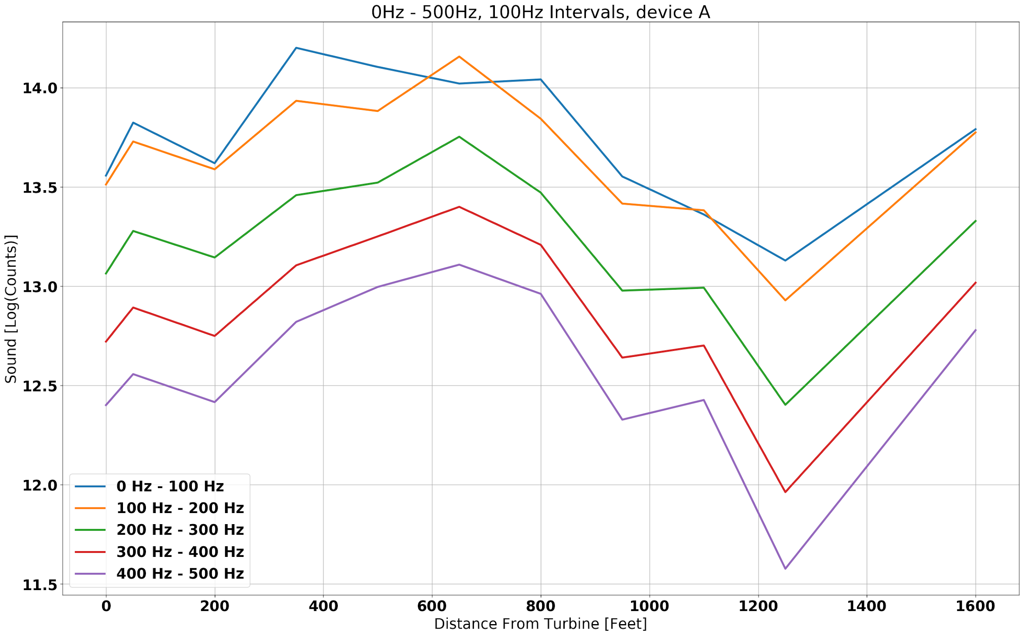
Distance Graphs

Slide 24
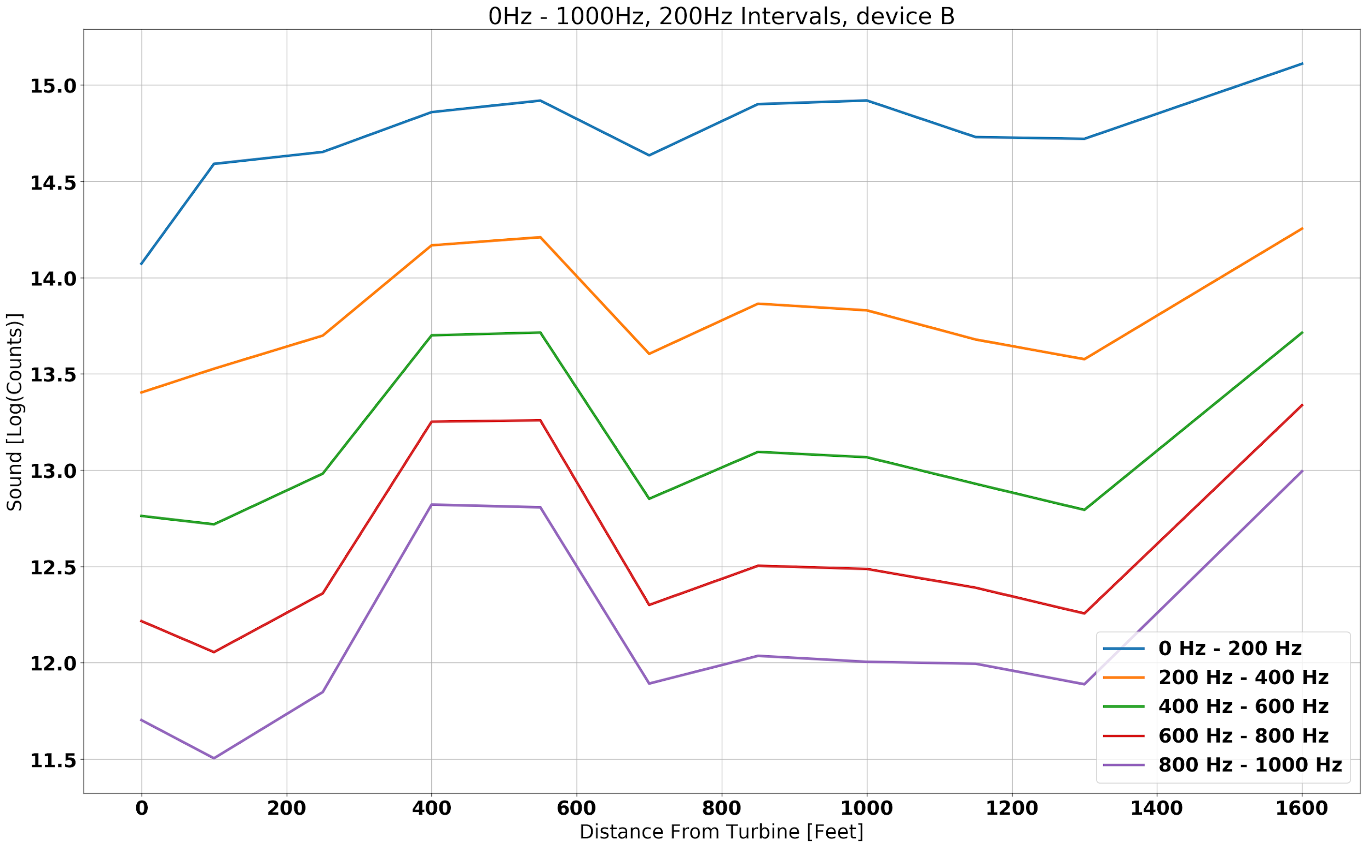
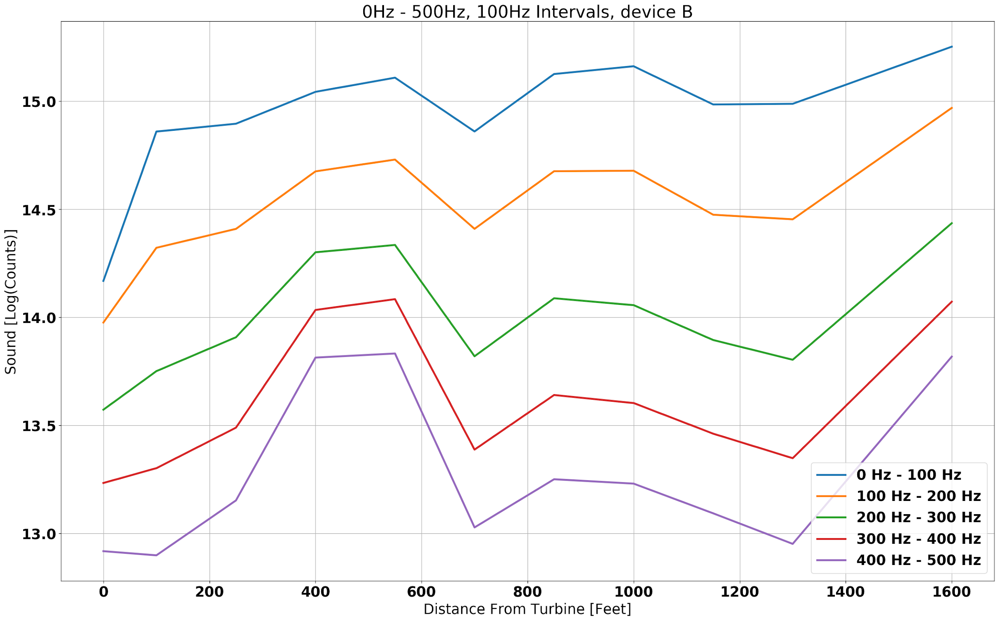
Distance Graphs

Slide 25
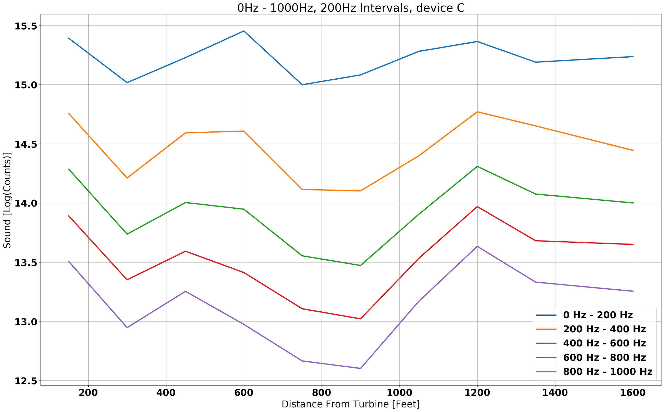
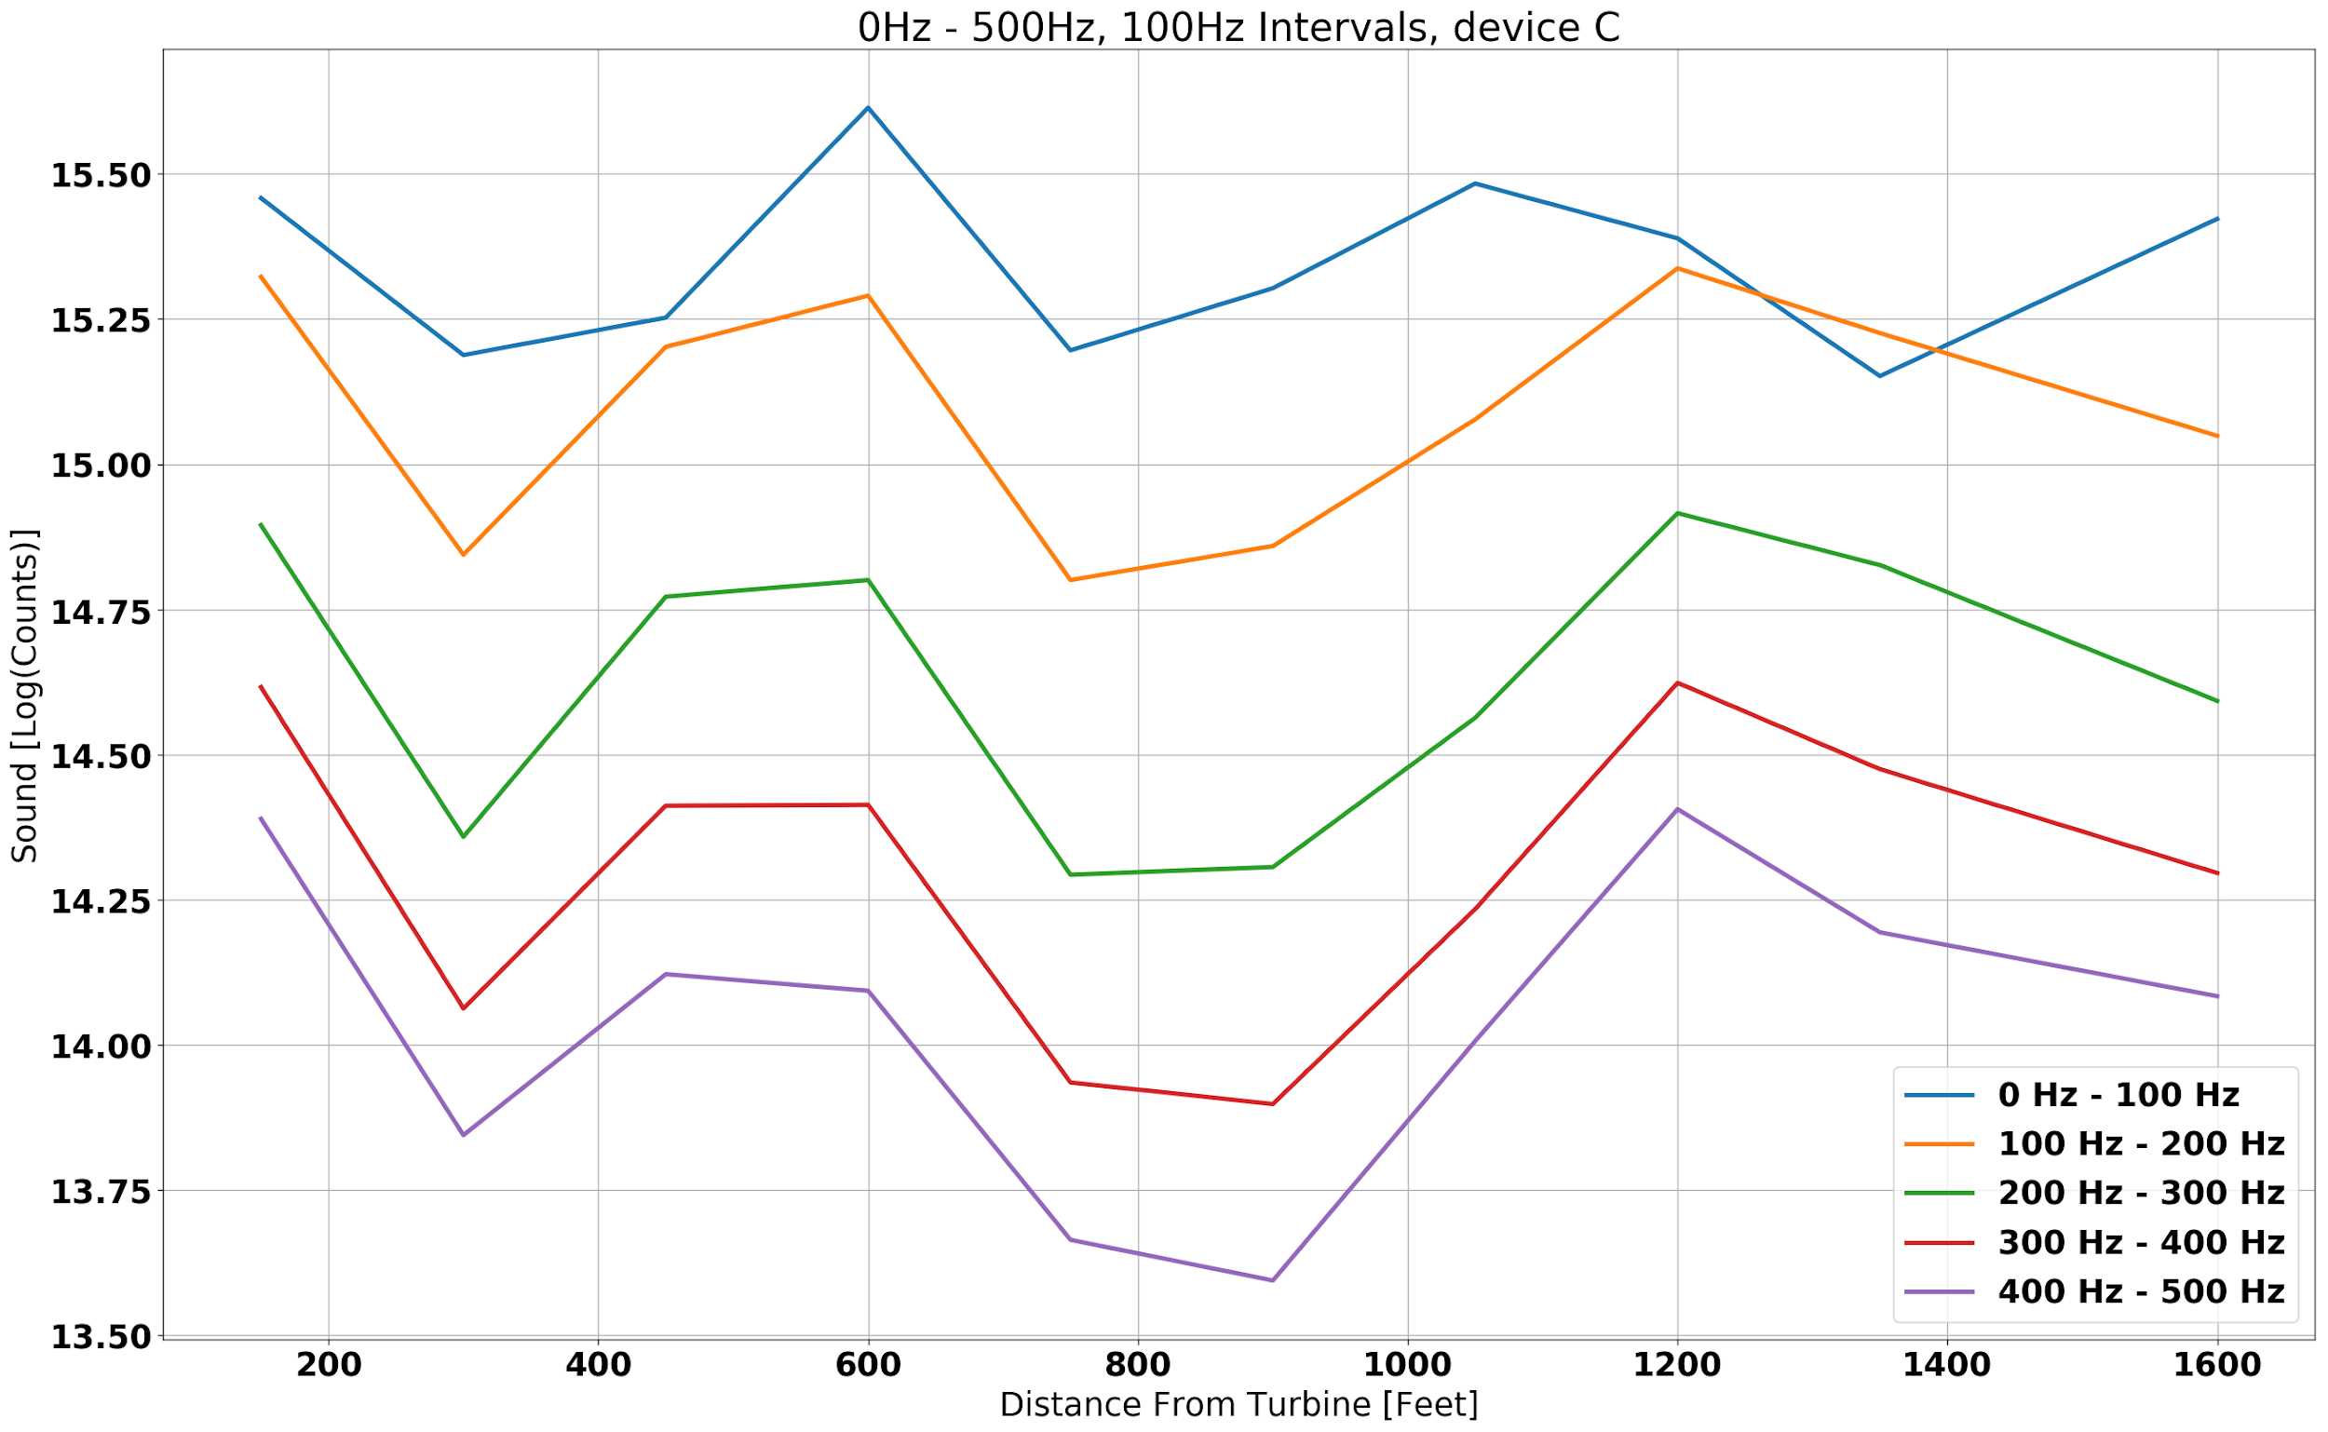
Distance Graphs

Slide 26
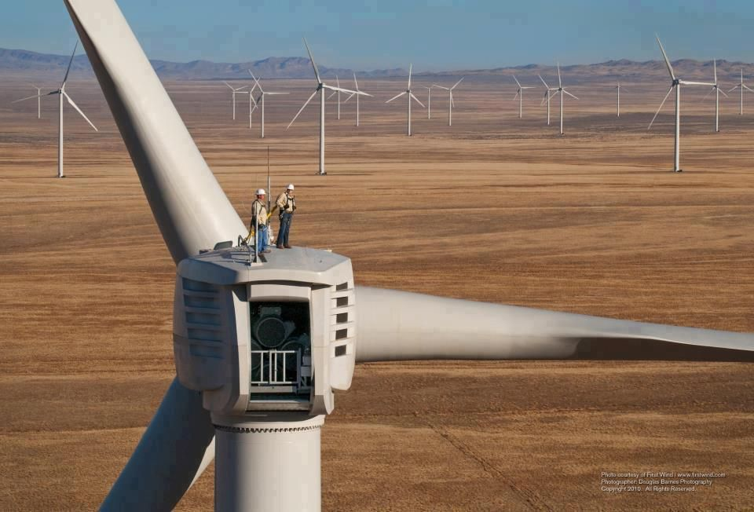
Conclusion

Slide 27
Conclusion
Too much wind to detect a wind turbine using our analysis methods.
  Sound from the wind turbine was drowned out by the wind noise.
Data was taken from the downwind side of the turbine.
  Noise has been shown to be louder on the upwind side.
Indication that wind turbine noise may not be a large concern for the people living near wind farms.
We gained a lot of information about sound measurements that will be useful for future projects.
Better way to execute this study?

Slide 28
Future Research
Add foam to microphone to block wind and hopefully not wind turbine noise.
Record when there is less wind.
Record when the wind turbine is facing you.
Use simultaneous recording at different distances with a timer.
Focus on sound data and less on temperature, pressure, GPS, etc.

Slide 29
Household Fan
Although we didn’t find any trends, but still it is possible to find data using our methods.
We did this using household fan.
We used same data acquisition process (we just measured sound).
We ran same data analysis process.
Results.
Notes:
Although we didn’t find any trends in the data recorded from wind turbine, but still we had an idea that our method of data acquisition and data analyzing will yield to some concrete results, in which we can find trends.
We conduct small experiment using household fan which can mimic same effect as a wind turbine but at smaller scale. We setup a fan in small room with all windows and door closed.
First we did a silent room recording just so that we can differentiate between frequency that are coming from fan. We did our recording at 3 different distance from fan on 3 different speed settings for fan at every location.
We ran same data analysis process on this 9 recording and found some results and we found some results.

Slide 30
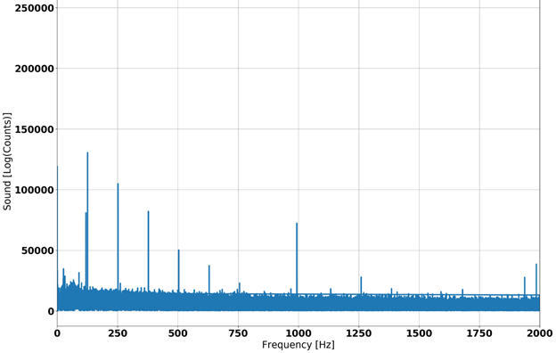
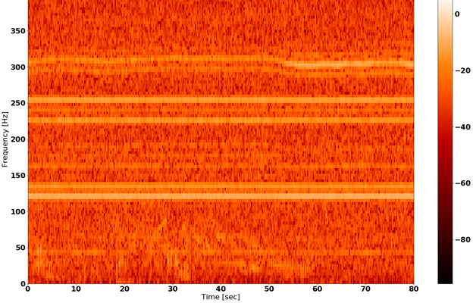
Household Fan
Notes:
As we can see here there is trend in the frequency graph from 0Hz to about 750Hz. The gap between each peak is about 125Hz.
Notice there is also a peak at 1000 Hz and 2000 Hz towards the end of the frequency graph this peaks also showed up in all of our frequency graphs including silent room recording, which is bit unusual, and what even more unusual is that this peaks were also in our original wind turbine data, hence we conclude that this was due to some electrical noise.
There is also some trend in frequencies in the spectrogram, which helped us to arrive at same result for all the recording that we took with fan.
Over all this experiment helped us to make sure that the process we were using for data acquiring and data analysing were capable of understanding data properly.

Slide 31
Sources
1. Bauer, Lucas and Matysik, Silvio . “Start.” 1,65 MW - Wind Turbine, 2020, en.wind-turbine-models.com/turbines/81-vestas-v82-1.65.
2. Bolin, Karl, et al. “Infrasound and Low Frequency Noise from Wind Turbines: Exposure and Health Effects.” IPO Science, 2011, iopscience.iop.org/article/10.1088/1748-9326/6/3/035103.
3. Brumleve, Will. “Wind-Farm Debate Picks up Steam in Ford County.” Ford County Record, 11 Sept. 2018, www.fordcountyrecord.com/news/wind-farm-debate-picks-up-steam-in-ford-county/article_740676ab-5508-57fb-b2fe-606791667a7c.html.
4. “Farm Facts.” Illinois | Twin Groves Wind Farm, twingroveswindfarm.com/.
5. Persson Waye, Kerstin. (2011). Noise and Health - Effects of Low Frequency Noise and Vibrations: Environmental and Occupational Perspectives. 10.1016/B978-0-444-52272-6.00245-2.
6. “Sound Power.” Wikipedia, Wikimedia Foundation, 25 Apr. 2020, en.wikipedia.org/wiki/Sound_power.

