Slide 1
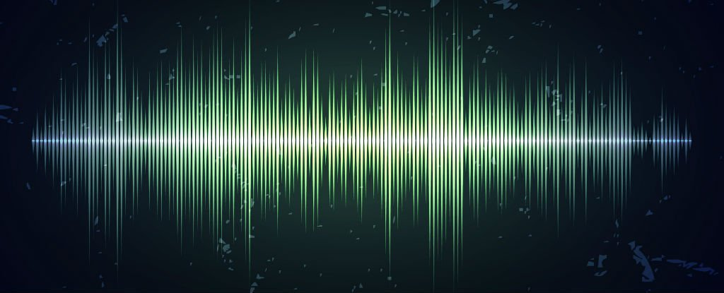
Psychoacoustics
Ritika Anandwade, Juliana Harr, Sneh Pandya, Brock Brendal

Slide 2
Introduction
Measuring: “Pitch recall and reproduction.” How good are people at recalling pitch? Discrepancy in frequency between what subject hears and what they recall
Why: Music heavily depends on the notes being accurate/pleasing to the ear. How much can artists get away with when instruments are out of tune or notes deviate from a scale? How subjective is perfect pitch? Does it make a difference whether or not the subject is musically trained?
Notes:
Brock

Slide 3
Roles
Sneh - plotting god, testing
Brock - testing, hardware god, prior music knowledge
Juliana - statistics god, prior music knowledge
Rithi - paper god, prior music knowledge
All - working together on the paper, presentations, visualizing our data, and getting our PCB’s together. Very much a group effort.

Slide 4
Motivation
Absolute pitch: hear a frequency and identify without reference note
Relative pitch: hear a frequency and identify with a reference note
Western music scale: C, C#, D, D#, E, F, F#, G, G#, A, A#, and B
Semitone: smallest frequency difference between those 12 notes, ratio of 12√2
Instruments: woodwind, string, piano, singing
ALL of the above factors considered in survey

Slide 5
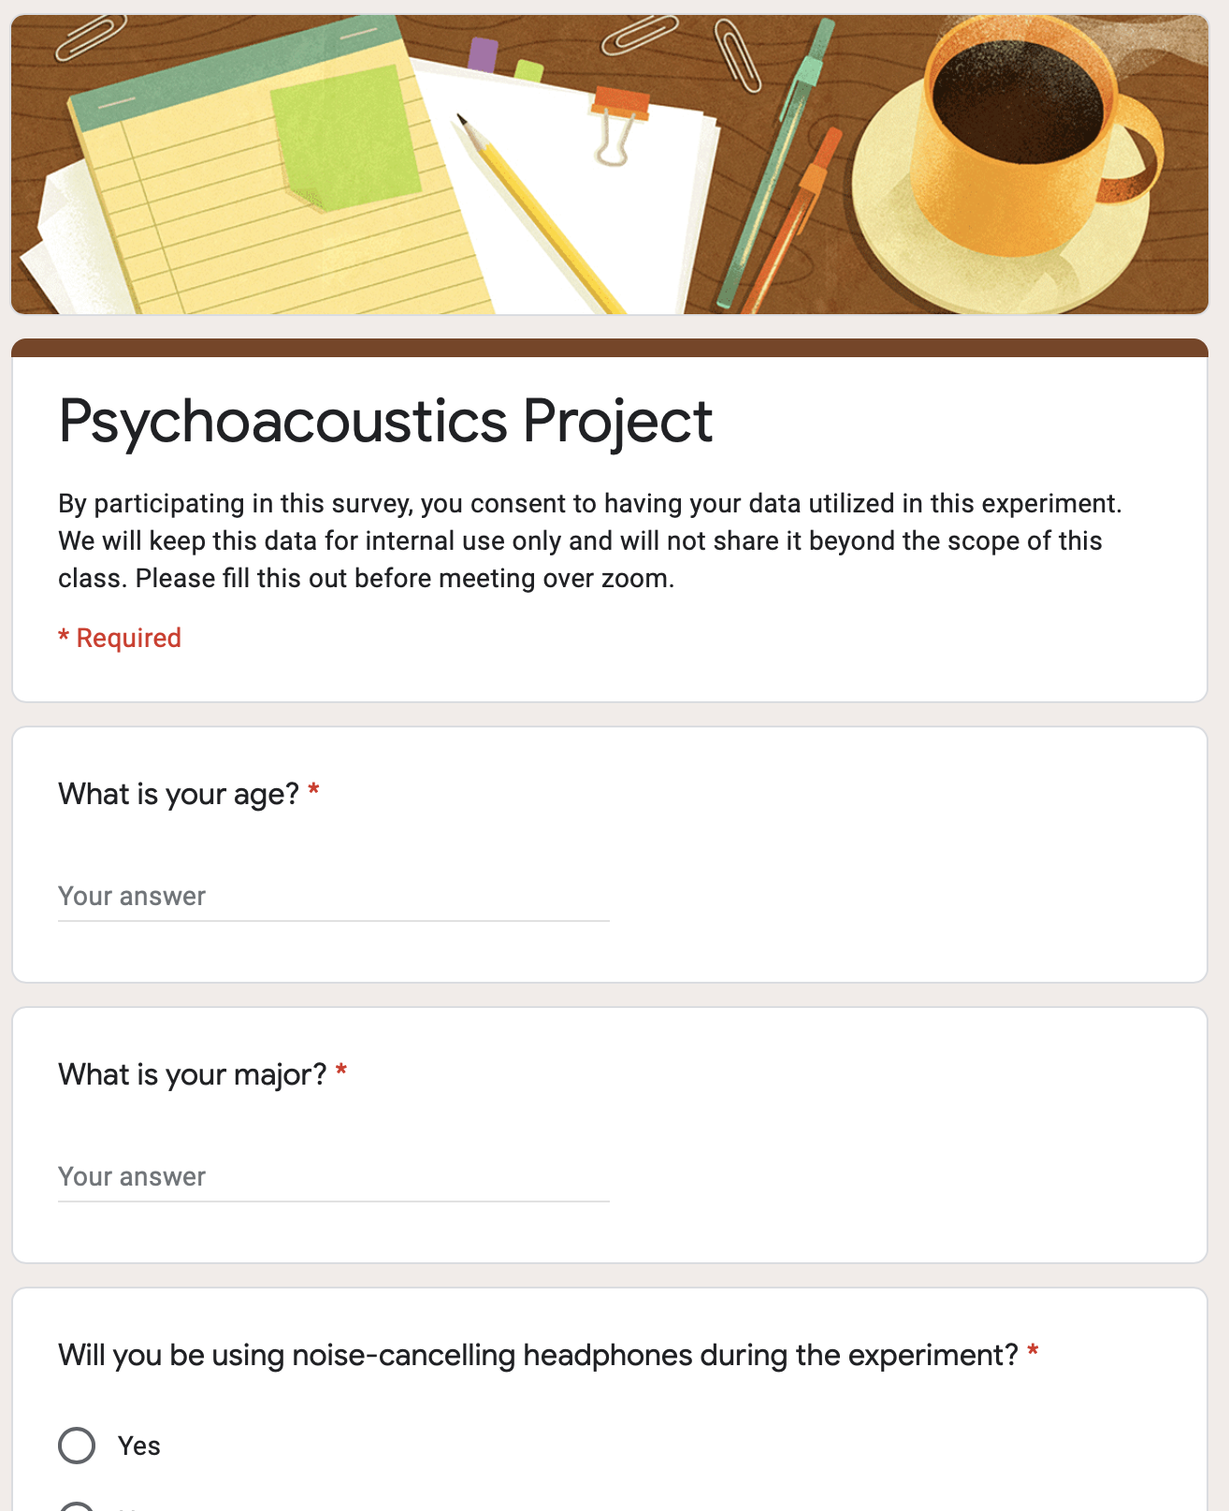
Survey
What is your age?
What is your major?
Will you be using noise-cancelling headphones during the experiment?
Do you sing?
If you answered yes, do you have formal training, or are you self-taught?
Do you play a musical instrument?
If yes, what instrument(s) do you play?
If yes, how long have you been playing this instrument?
If you answered yes, do you have formal training, or are you self-taught?
Do you have any hearing-related disabilities?
Do you sing along to songs as you listen to them?
What genre(s) of music do you listen to? Check all that apply.
Do you regularly watch musicals?
Do you play in a band?

Slide 6
Setup (pre-pandemic)
How do we do this?
Want to interview both musical and non-musical subjects
Location, location, location...where would these people be?
Have a questionnaire for the subjects to fill out
How musical are they? What are their musical preferences? ...any data is good data
Device for recording
PCB with Electret microphone
Notes:
Brick

Slide 7
Setup (pandemic)
How do we do this?
Want to interview both musical and non-musical subjects
ZOOM
Have a questionnaire for the subjects to fill out
How musical are they? What are their musical preferences? ...any data is good data
Device for recording
Cell phone mic/recording microphone

Slide 8
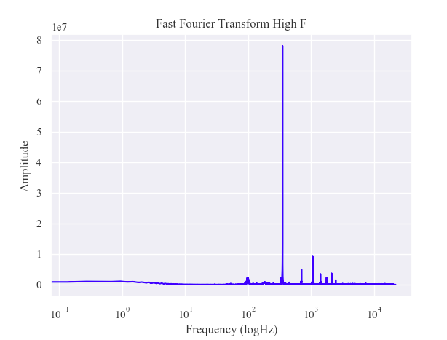
Data
Fourier transform Brock playing guitar for 6 notes--mid A, mid C, mid F, high A, high C, high F
Record top three frequencies
Second highest frequency is an octave up
Visualize waveform as sanity check

Slide 9
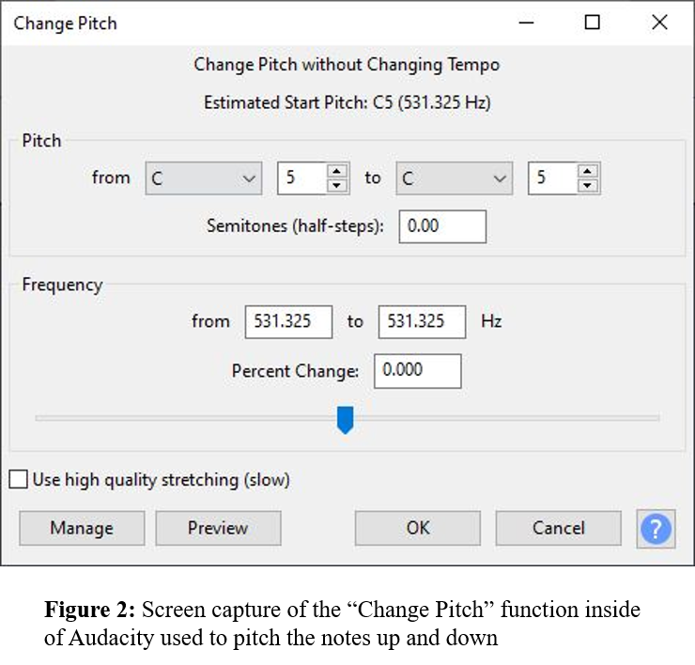
Audacity
Used Audacity to manipulate our audio
Played note 5x
One additional play during experiment
Changes done on scale of semitones
User can opt to change in bigger intervals
A little awkward to do over zoom

Slide 10
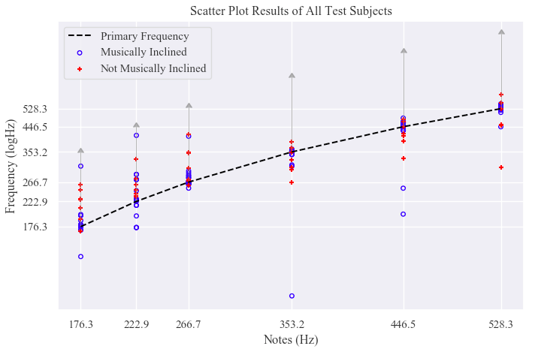
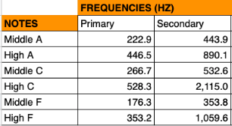
Overall Results
Gray line indicates one octave up.
Y-axis log scale

Slide 11
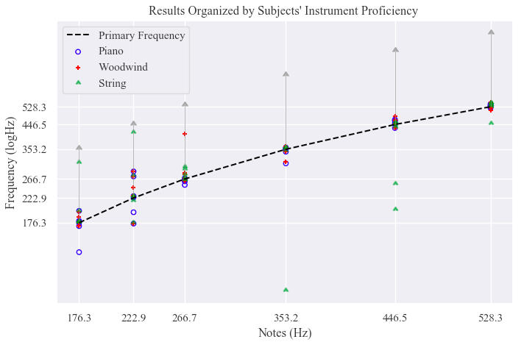
Results Based on Type of Instrument

Slide 12
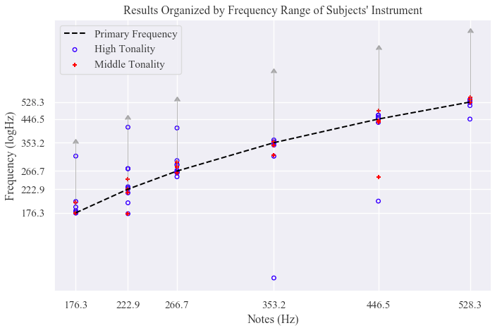
Results Based on Tone of Instrument

Slide 13
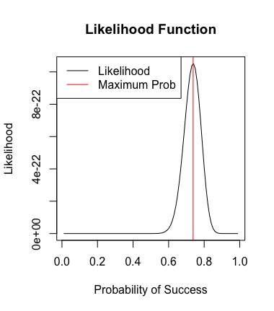
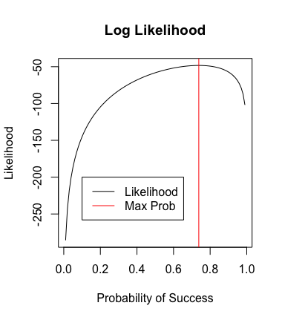
Statistics
Building a model
Choose appropriate parameters
Derive PMF
Test fit using likelihood

Slide 14
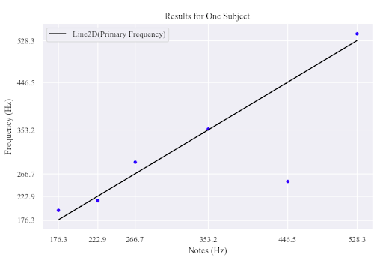
Case Study

Slide 15
Discussion
How has Zoom changed our experiment?
Less subjects than we would have liked
Internet/Audio/Video quality
Controlling how the frequency changed
Future goals
More instruments
Incorporating the factor of language

Slide 16
Final comments
Musically inclined performed better
Some factors not in our control
Memory played a role, would like to re-do with less memory factors
“walking in the dark, thinking you remembered the path, but realizing afterward that you had strayed far from it,” one person noted.

