Slide 1
Effective Battery Energy Capacity as a Function of Temperature and Discharge Current
Tomas Pavydis, Jinghan Huang, Michael Ruscito, Mingshi Yang
Tomas Pavydis, Jinghan Huang, Michael Ruscito, Mingshi Yang

Slide 2
Background/Intro
Goal: analyze the effects of varying temperature and discharge current on the effective energy capacity of common AAA batteries
Batteries with different chemical compositions were considered, including alkaline (, nickel-metal hydride, lithium, and lithium ion
Used an ATmega2560 microcontroller chip on an Arduino Mega 2560 board
Interfaced with a collection of sensors
Mapping voltage over time under various conditions (temperature, discharge current)

Slide 3
Experimental Design
3 environments: cold (around 0° C), room temperature (~20° C), and hot (~50° C)
Each environment has two circuits (1 Ohm & 10 Ohm)
Due to the need to place our batteries in a range of temperatures, we created sets of protoboards to house our batteries while data collection was taking place
Sometimes these would be submerged in cold/hot water so they were placed in ziploc bags
Batteries are usually no longer effective even before all charge is drained
For the purposes of this experiment, a battery was considered ‘dead’ @ 0.8V

Slide 4
Motivation
With the rise of electric vehicles, batteries operating in variable-temperature environments have become a common occurrence and measuring the effective energy of batteries under these conditions is crucial for accurate predictions of estimated range
For example, in the beginning of 2019, Tesla released an algorithm in its firmware in which vehicles began pulling the temperature from the local weather data to better calculate the estimated range left in its battery
Beyond just electric cars, you may have encountered a battery’s energy retention based on the environment’s temperature when you use your phone outside on a cold day and it seemingly dies right away

Slide 5
Experimental Design
Sensors/electronics used in our experiment
TMP36: analog signal temperature sensor with a measuring range of -40° C to 125° C
Used to measure environmental temperature
MLX90614: IR sensor which uses the I2C protocol
Used to monitor battery temperature (object temperature)
INA219: current/voltage sensor
Used to measure voltage of our tested batteries
LCD display
Used to monitor functionality of device and begin/stop collection of data
4x3 keypad
Used to issue commands to our instrument
MicroSD breakout board
Used to add external removable mass storage to provide a means of data storage
Sous vide
Used it to provide a constant temperature for our ‘hot’ and “room temperature” environments.

Slide 6
Data Acquisition
Analog measurements:
Voltage from TMP36 to calculate temperature
Voltage across resistive loads
Voltage is measured and averaged 10 times per 0.5 second, in order to reduce random fluctuation and create nicer graphs.
I2C measurements:
Temperature from MLX 90614 (IR sensor)
MicroSD output of Time elapsed, Temperatures, and Batteries’ voltages.
Python importation and calculation:
Calculate integrated energy output from V(t) by summing ∆E=(V^2/R)∆t where ∆t=0.5seconds .
Python graphing:
Plot of voltage across the resistor of batteries in each experiment run with respect to time.
Plot of environment temperature and battery’s body temperature with respect to time.
Plot of integrated energy output to the resistors with respect to time.

Slide 7
Results
Voltage over time graphs were plotted using python which converted our raw data into graphical representation
Graphs for low resistance results (1 Ohm) will be provided separately to provide a better look at the data
Also included graphs for ‘total energy output’ as a way to compare effective energy capacity

Slide 8
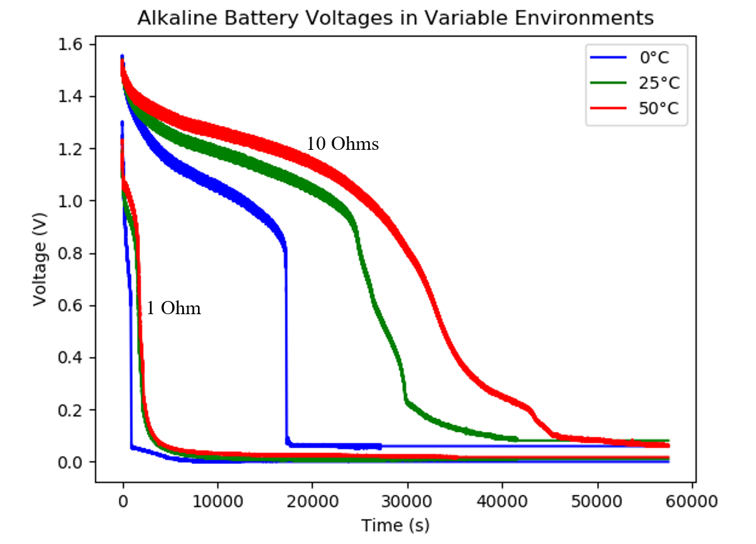
AAA Alkaline
It is clear from the graph that the temperature did impact the effective energy because the battery in the cold environment performed much worse than the room temperature battery while the hot temperature battery took the longest to reach the cutoff voltage.

Slide 9
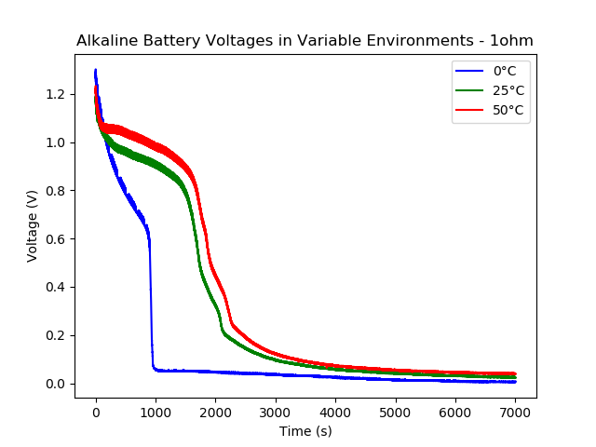
AAA Alkaline
This is the results of measurements of AAA Alkaline batteries zoomed in for displaying the voltage data under 1Ω load.
Similar to 10 Ω load.

Slide 10
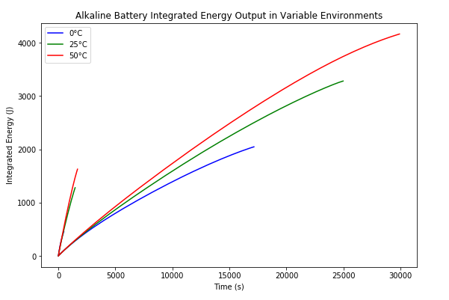
AAA Alkaline
This was achieved by taking an area integral of the voltage graphs until they reached 0.8V.
The curves of 1 ohm load are steeper than the curves of 10 ohm load.
The peak value for the hot temperature is greater than the peak values for room temperature which is still greater than the peak values for cold temperature.
This means that the effective energy is greatest in hotter environments for Alkaline batteries.

Slide 11
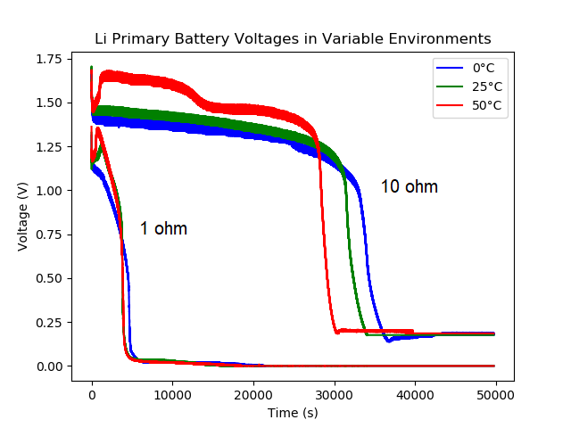
AAA Lithium Primary
This data shows that the colder temperatures performed better than the warmer ones.
The hot temperature batteries under both resistive loads start with higher voltage peaks, but drop sooner, whereas the cold environment has slightly lower initial voltages but last longer.

Slide 12
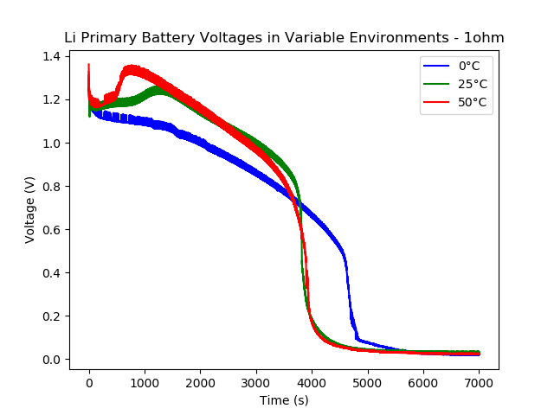
AAA Lithium Primary
The cold temperature lasted the longest due to the steepness of the initial voltage decay, all three conditions reach the cutoff voltage at around the same time.

Slide 13
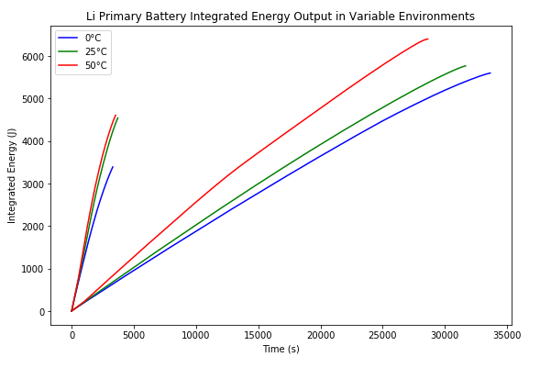
AAA Lithium Primary
The curves of 1 ohm load are steeper than the curves of 10 ohm load meaning that they give off energy at a substantially quicker rate.
Despite the colder temperature lasting longer than the hotter temperature as seen in figures 10a, the hotter temperature has a higher effective energy due to the higher initial voltages.

Slide 14
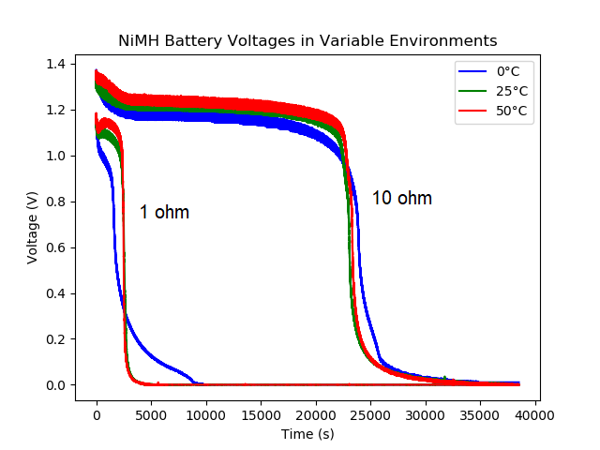
AAA Nickel-Metal Hydride
Unlike the other battery types, the NiMH batteries are barely affected by the change in temperature at 10ohms.

Slide 15
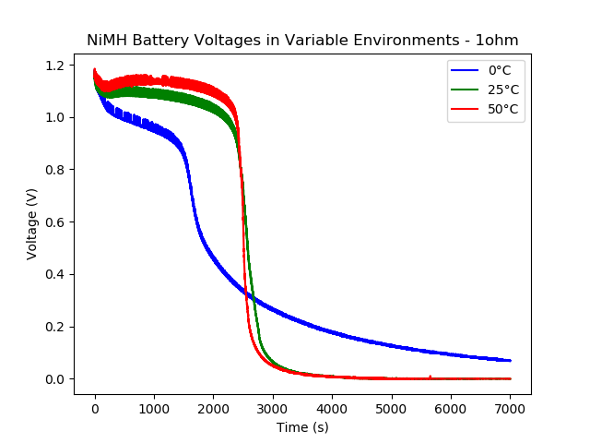
AAA Nickel-Metal Hydride

Slide 16
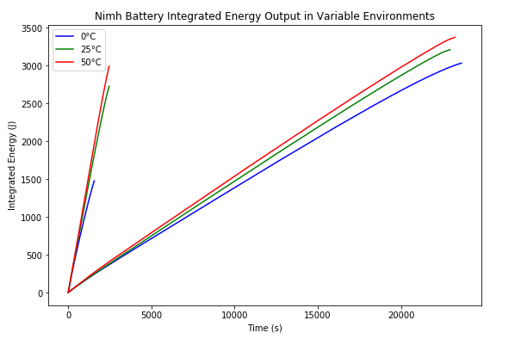
AAA Nickel-Metal Hydride
The battery in 0° C condition under 1ohm load has output significantly less energy compared to other conditions under the same load.

Slide 17
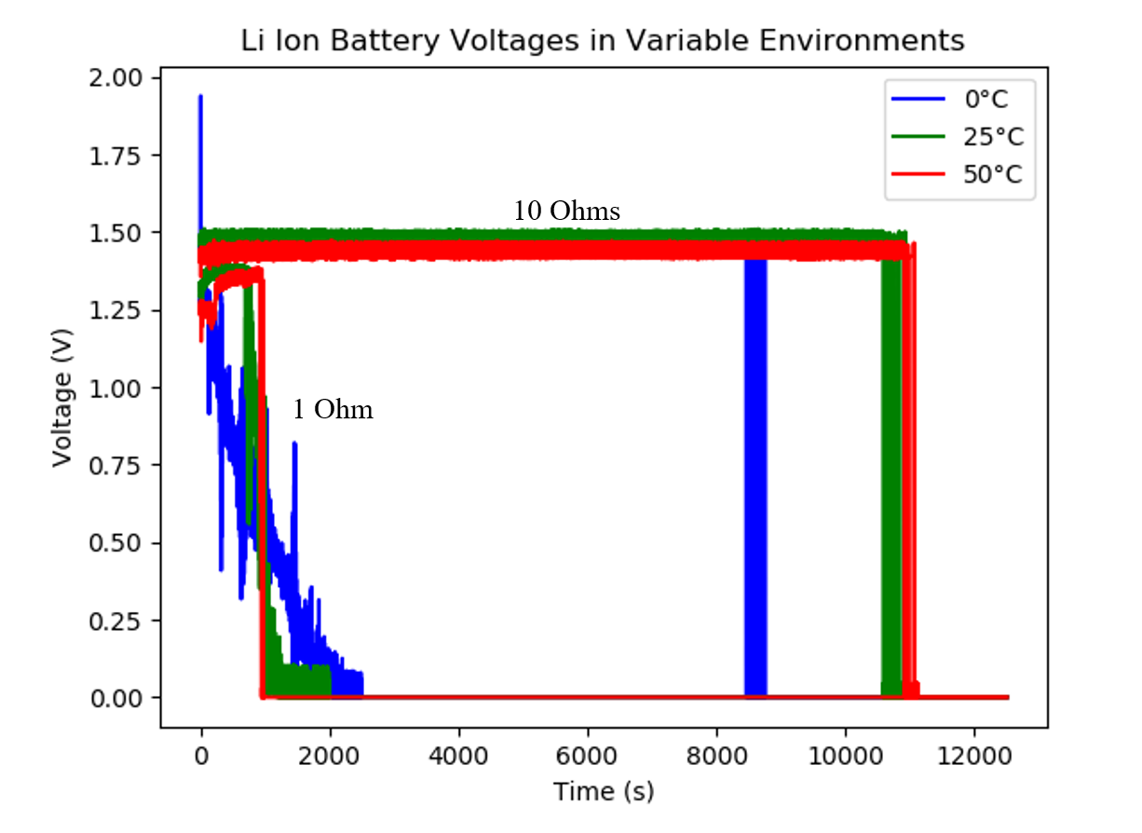
AAA Lithium Ion
The lithium ion batteries have a unique behavior in that under 10ohms, they maintain an extremely steady voltage with only minor variations as opposed to decaying over time like the other batteries.

Slide 18
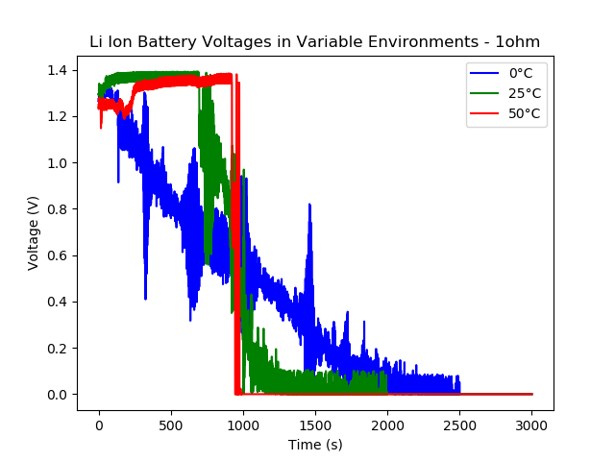
AAA Lithium Ion
These anomalies suggest that the internal circuitry of the lithium ion batteries cannot handle such a high discharge current.

Slide 19
AAA Lithium Ion

Slide 20
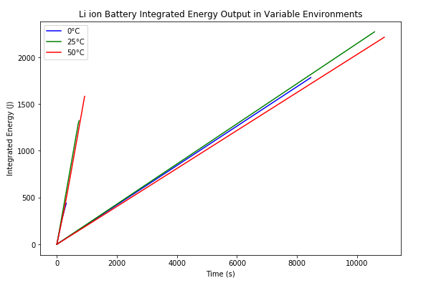
AAA Lithium Ion
The curves of 1 ohm load are steeper than the curves of 10 ohm load.

Slide 21
Lithium Coin Cell

Slide 22
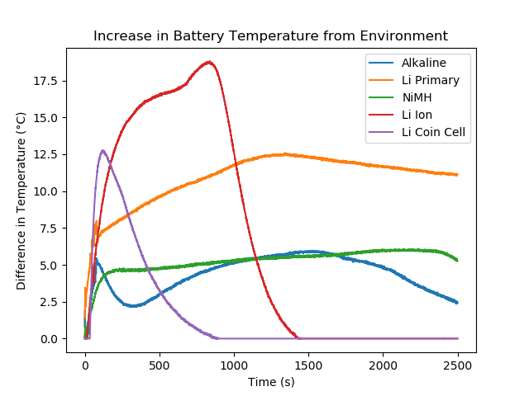
Battery temperature:

Slide 23
Discussion
The values of the ‘total energy output’ found by taking an area integral of our voltage graphs until V = 0.8 can be found below
10 Ohm data consistently led to higher values of energy output → discharge current has an effect
@ 1 ohm, the current is too high and leads to unstable and ‘worse’ battery performance
Cold data consistently led to significant lower values of energy output
Interestingly, hot environment leads to larger energy output but often less significant.
→ Deviation to cold environment has a more distinct effect on effective energy capacity than deviation to hot environment.

Slide 24
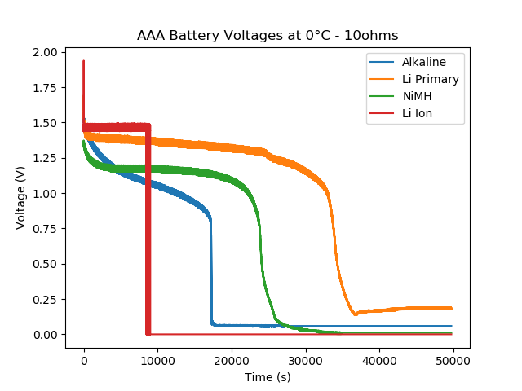
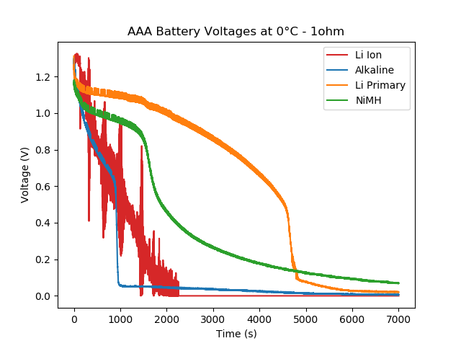
AAA Battery Voltages at 0°C

Slide 25
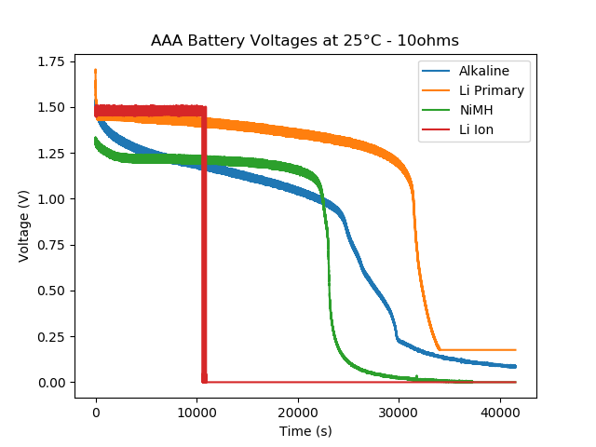
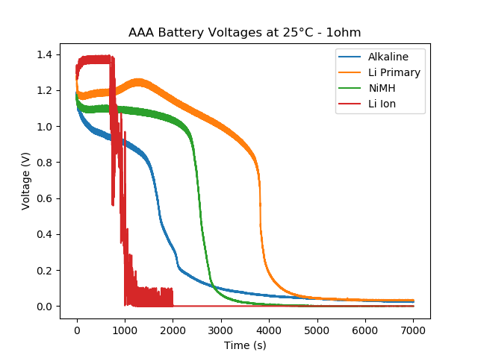
AAA Battery Voltages at 25°C

Slide 26
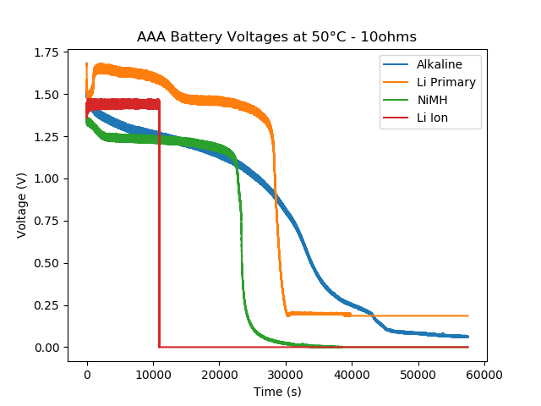
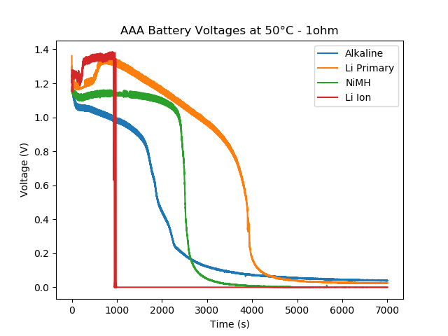
AAA Battery Voltages at 50°C

Slide 27
Coin Cell Batteries
Coin cell data unusable
Our circuits drew too much current → made the coin cell batteries unstable
Internal circuitry of batteries and battery structure made the Lithium-ION battery behaves weirdly by oscillating from 0 to maximum volts.
Extra heat made by resistances made the temperature unstable, especially under cold environment.

Slide 28
Conclusions
The effect of current:
Larger discharge currents consistently led to a lower measurable, starting voltage and faster overall drain. Less energy is outputted in our defined functional range of voltage.
Higher resistance would lead to a lower overall current draw and this would provide more optimal performance and efficiency as long as current draw is not too low.

Slide 29
Conclusions
The effect of Temperature:
In environments with lower temperature, the battery voltage drops faster and reaches lower voltage values much faster.
For alkaline batteries, lower temperature results in the sooner occurrence of the sharp drop; for lithium primary batteries, on the other hand, lower temperature postpones the occurrence of sharp drop; for nickel-metal hydride batteries, the influence is not significant.
The colder environment consistently led to lower total power outputted when compared with room temperature data.
Overall, the data seems to suggest that inefficiencies are more significant at lower temperature conditions and further away from the manufacturer specified current draws.

Slide 30
References
TMP36. (Analog Device). Retrieved April 01, 2020, from https://www.analog.com/en/products/tmp36.html
Digital Plug & Play Infrared Thermometer in a TO-Can.” Melexis, www.melexis.com/en/product/mlx90614/digital-plug-play-infrared-thermometer-to-can
Rengi, Donna, and C. Wilborn. “What Is a Thermopile?” WiseGEEK, Conjecture Corporation, 22 Mar. 2020, www.wisegeek.com/what-is-a-thermopile.htm
Graham, Christopher Fox, and Lindsay D. “What Is the Seebeck Effect?” WiseGEEK, Conjecture Corporation, 14 Apr. 2020, www.wisegeek.com/what-is-the-seebeck-effect.htm
Gudino, Miguel. “How Analog-to-Digital Converters (ADCs) Work.” Arrow.com, 17 Apr. 2018, www.arrow.com/en/research-and-events/articles/engineering-resource-basics-of-analog-to-digital-converters
AnalogRead().” Arduino Reference, www.arduino.cc/reference/en/language/functions/analog-io/analogread/

