Slide 1
ME170
Computer Aided Design
Engineering Drawing
Part A – Coordinate Dimensions and Tolerances
Instructor:
Mike Philpott
Emeritus Associate Professor of
Mechanical & Industrial Engineering

Slide 2
Contents
2D Drawing Principles
Coordinate Dimensioning & Tolerancing Standards
ANSI/ISO Tolerance Designation
ANSI/ISO Classification of Limits and Fits
Surface Properties
Economics of Tolerances/Surface properties
Geometric Dimensioning and Tolerancing (GD&T)
Part A
Part B
Attention to Detail
The engineering drawing is the specification for the component or assembly and is an important contractual document with many legal implications, every line and every comment is important.

Slide 3
Part and Assembly Drawings
Part Drawings:
Detail drawings completely describe a single part with multiview orthographic projections.
Should provide all the information necessary to economically manufacture a high quality part.
Assembly Drawings:
Assembly drawings are used to show the position and functional relationship of parts in an assembly, also via multiview orthographic projections.
Generally they have no dimensions on them.
Parts are 'balloon' identified and referenced to either detail drawing numbers or catalog numbers, via a Bill of Materials (BOM)

Slide 4
Orthographic Views
Preferred 3 views - form L shape
Rear
Top
Left
Right
Front
Top
Bottom
Rear
Left
Front
Right
Bottom
Title Block

Slide 5
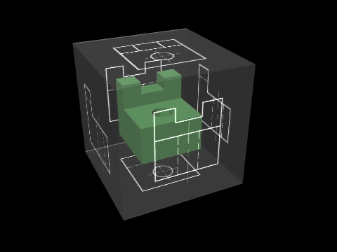
The Glass Box Concept

Slide 6
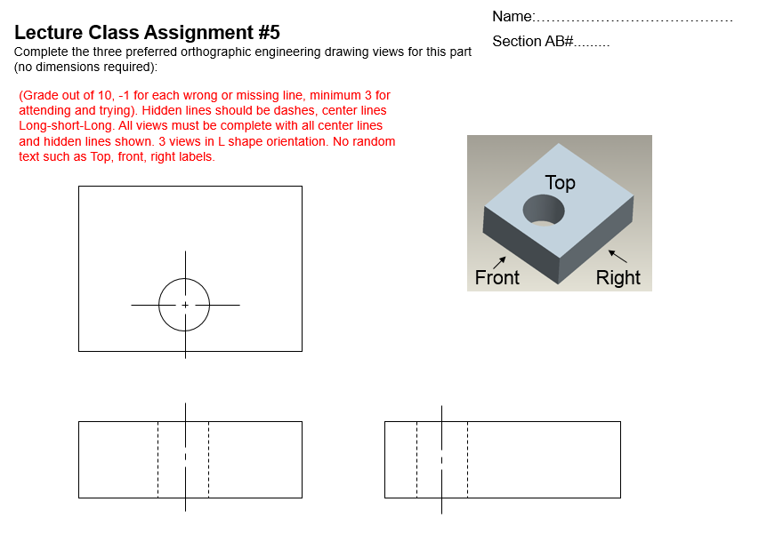

Slide 7
Line Types
Object Lines
Hidden Lines
Center Lines
Phantom Lines
Dimension Lines
Extension Lines
Leader Lines
Cutting Plane Line
Sections - Hatching
Break Lines
thick
thin
thin
thin
thin
thick
thin
thick

Slide 8
Dimensional Data can then be added to the drawing
There are 3 distinct line weights to be aware of:
  object lines are thick (approximately .030-.040” thick),
  hidden lines are a medium thickness (.015-.020”), and
  extension, dimension, and center lines are thin (.007-.010”).

Slide 10
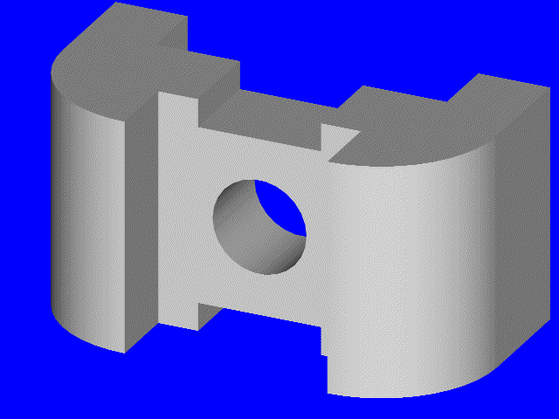
Complete the 3 view drawing (without dimensions for now). Begin by projecting all of the known information between the views.

Slide 11
Begin by projecting all of the known information between the views.

Slide 12
Heavy-up all of the object lines that depict visible object lines, and show surfaces that would not be visible in the specific orientation, using dashed/hidden lines.

Slide 13
Complete the right side view by projecting all of the relevant lines and points using a 45 degree miter line. Clean up the drawing.

Slide 14
Remove the final construction lines to see the finished drawing

Slide 15
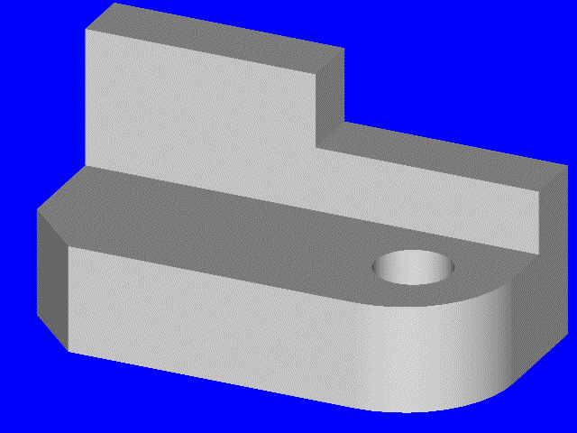

Slide 16
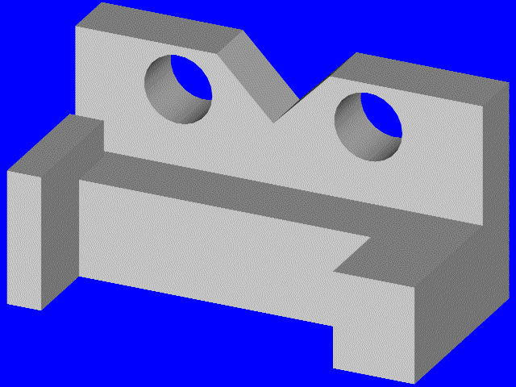

Slide 17
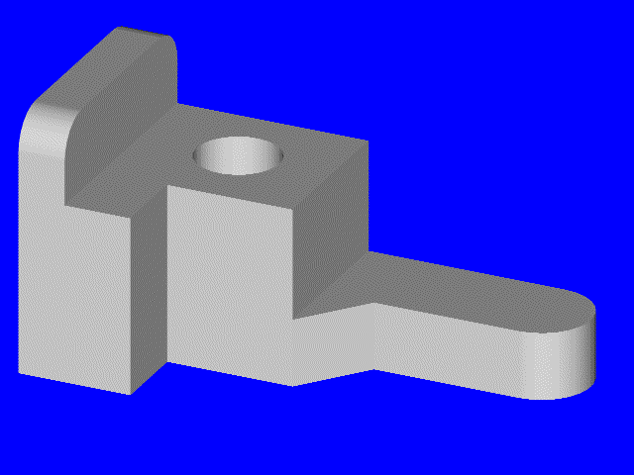

Slide 18
2. Coordinate Dimensioning and Tolerancing Standards
ANSI standard - ASME Y14.5M - 1994
The collective process of modeling, defining and describing geometric sizes and feature relationships, and providing all of the required technical information necessary to produce and inspect the part is called dimensioning and tolerancing.
The National Standard for dimensioning and tolerancing in the United States is ASME Y14.5M
DRAWN IN ACCORDANCE WITH ASME Y14.5M - 1994
REMOVE ALL BURRS AND SHARP EDGES
ALL FILLETS AND ROUNDS R .06 UNLESS OTHERWISE SPECIFIED
Geometric Dimensioning and Tolerancing (GD&T) : ASME Y14.5 - 2009

Slide 19
Dimensioning Scheme – deciding what, where, and how to add dimensions to the drawing
Overall dimensions should be shown
Dimension each feature in one view if possible: Size and Location together
20

Slide 20
Arrowheads
Arrowheads are used as terminators on dimension lines. The points of the arrowheads on leader lines and dimension lines must make contact with the feature object line or extension lines which represent the feature being dimensioned. The standard size ratio for all arrowheads on mechanical drawings is 3:1 (length to width).
200
R 8.5
Of the four different arrowhead types that are authorized by the national standard, ASME Y14.2M – 1994, a filled arrowhead is the highest preference.
1st
2nd
3rd
4th

Slide 21
Dimension Lines and Extension Lines
Extension lines overlap dimension lines (beyond the point of the arrowheads) by a distance of roughly 2-3mm
1.75
There should be a
visible gap (~1.5 mm)
between the object lines
and the beginning of
each extension line.
1.06
Dimensions should be placed outside the actual part outline. Dimensions should not be placed within the part boundaries unless greater clarity would result.

Slide 22
Placement of Linear Dimensions
Order of Preference
2.562
Arrows in / dimension in
1.250
Arrows out / dimension in
.750
Arrows in / dimension out
.500
Arrows out / dimension out
When there is not enough room between the extension lines to accommodate either the dimension value or the dimension lines they can be placed outside the extension lines as shown in the fourth example (use Flip Arrows in ProE).

Slide 23
NEVER Dimension to Hidden Lines
BAD
GOOD

Slide 24
NEVER Double Dimension
(Aka. Over Dimensioning)
The dimension of a feature should only appear once, and in one view on the drawing.
This rule also applies to derived dimensions, as shown in example below. Use Reference Dimensions to show a derived dimension or a dimension again on another view.
This rule is an important control mechanism to avoid mistakes when changes are made down the road in a project
Use of Reference Dimensions
Reference Dimension Symbol (X.XXX)
EXAMPLE
The use of reference dimensions on drawings should be minimized.
They are typically values that have been derived from other dimensions and therefore should not be used for calculation, production or inspection of parts.
Reference dimensions are used on drawings to provide support information only.
2.250
1.000
(.750)
.500
.500
1.250
.500
(.750)

Slide 25
Location of Dimensions
Shorter (intermediate) dimensions are placed closest to the outline of the part, followed by dimensions of greater length. Dimensions nearest the object outline should be at least .375 inches (10 mm) away from the object, and succeeding parallel dimension lines should be at least .250 inches (6 mm) apart.
.250 (6mm)
Minimum Spacing
4.375
1.438
1.250
.375 (10mm)
Minimum Spacing
1.000
1.875
.688
1.062
2.312
Dimensions should be placed outside the actual part outline

Slide 26
Basic Dimensioning – Good Practice
4.375
1.438
1.250
1.000
1.875
.688
1.062
2.312
Extension lines should not cross dimension lines if avoidable
1.438
1.250
In-line dimensions can share arrowheads with contiguous dimensions
1.000
1.875
.688
1.062
2.312
BETTER
4.375

Slide 27
Diameter Dimensions
Holes and cutouts
1.375
.625 THRU
.250
.62
.250
x .62 DP
1.375

Slide 28
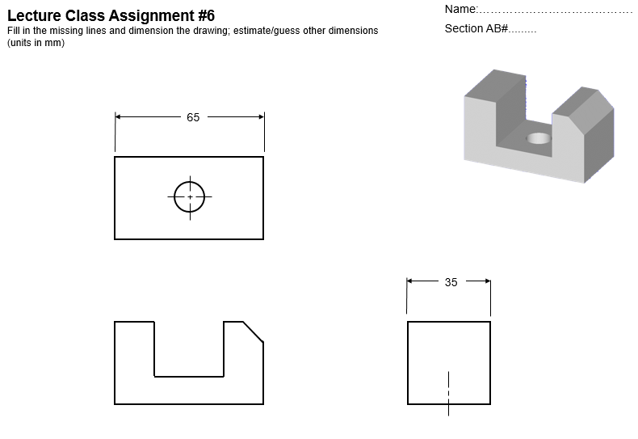

Slide 29
Diameter Dimensions
Shafts and Holes
Whenever it is practical to do so, external diameters are dimensioned in rectangular (or longitudinal) views. Cylindrical holes, slotted holes, and cutouts that are irregular in shape would normally be dimensioned in views where their true geometric shape is shown.
.25 THRU
1.25
.75
2.00

Slide 30
Placement with Polar Coordinates
To dimension features on a round or axisymmetric component
18º
18º
3X .562
6X .188
3.50
.875
18º
18º
18º
18º

Slide 31
Radial Dimensions
To indicate the size of fillets, rounds, and radii
R.312
R14.25
R.750
R.312
R.562

Slide 32
Angular Dimensions:
To indicate the size of angular details appearing as either angular or linear dimensions.
30º
2 x 2 or 2 x 45º
63º
Alternate

Slide 33
“Times” and “By” Symbol: X
8X .250 THRU
The X symbol can also be used to indicate the word “by”. For instance, when a slot that has a given width by a specified length, or a chamfer that has equal sides (.12 X .12).
When used to imply the word ‘by’, a space must precede and follow the X symbol.
If the same feature is repeated on the drawing (such as 8 holes of the same diameter and in a specified pattern), the number of times the instruction applies is called out using the symbol X.
.12 X 45º
CHAMFER
.375
.562 X 82º
CSK

Slide 34
Section Views
Section views are used to clarify internal detail and to avoid dimensioning to hidden lines
The are established by referencing a cutting plane
Cutting planes depict the exact location on the part from which the section view will be projected, and should have associated arrowheads, indicating the direction from which the section view will be observed.
Cutting planes are constructed as an integral feature of the parent view, and cutting plane arrowheads always indicate the direction for the observer’s line of sight.
A
A
SECTION A - A

Slide 35
Cutting Plane
Alpha Characters A - A, B - B, C – C*, etc., are used to designate the required section view. The characters are placed near the arrowheads and as a subtitle of the view. There is no “standard” for the location of the section designators, other than near the cutting plane arrowheads—as the examples below illustrate.
When the alphabet has been exhausted, use double characters AA - AA, BB - BB, CC – CC*, etc.
*Section Designators should NOT include the alpha characters I, O, or Q.
A
A
Cutting plane on reference view
Subtitle of actual view
SECTION A - A

Slide 36
Crosshatching Section Views
Crosshatching, is a repeating graphic pattern which is applied throughout all areas of the part that would be in contact with the cutting plane. Thus, the hole is not crosshatched.
The recommended angle for the standard crosshatch pattern is 45, 30, or 60 degrees with horizontal. Similarly, crosshatch lines should be neither parallel nor perpendicular to the outline of the feature in section—if avoidable (see the examples below).
Good Practice
Poor Practice
Poor Practice

Slide 37
Cross Hatch Standards
The general purpose cross hatch is used in most individual detail component drawings and in assembly applications where no confusion will result.
Each of the assembled components are depicted with a different crosshatch angle to assist in part differentiation.
Specific crosshatch symbols are sometimes used to represent each different material type.

Slide 38
Cross Hatch Symbols
Cast Iron (General Use)
White Metal (Zinc)
Sand
Steel
Magnesium, Aluminum
Titanium
Felt, Leather, & Fiber
Bronze, Brass, etc.
Concrete
Marble, Slate, Glass, etc.
Water, Liquids
Wood; Cross Grain
With Grain

Slide 39
Half Sections
Half section views are the result of cutting planes being positioned on parts in such a manner that only half of the resulting view or projection is shown in section.
Half sections are generally used on objects of symmetry, individual cylindrical parts, or assemblies of parts.

Slide 40
Half Sections
Shown without section:
Difficult to dimension without using hidden lines
Internal features – not as clear

Slide 41
Offset Sections
Offset sections allow us to provide greater breadth of detail with fewer section views. All of the features are aligned with the cutting plane.
D
D
SECTION D - D

Slide 42
Projected Section Views
A
A
SECTION A – A
ROTATED 30º CLOCKWISE

Slide 43
Drawing Notes
Notes should be concise and specific. They should use appropriate technical language, and be complete and accurate in every detail. They should be authored in such a way as to have only one possible interpretation.
General Notes
DRAWN IN ACCORDANCE WITH ASME Y14.5M - 1994
REMOVE ALL BURRS AND SHARP EDGES
ALL FILLETS AND ROUNDS R .06 UNLESS OTHERWISE SPECIFIED
Local Notes
4X 8.20 M10 X 1.25
82º CSK 10
1.5 X 45º CHAM

Slide 44
ASME/ANSI Hole Depth Symbol
Depth or Deep Symbol*
Features such as blind holes and counterbores, must have a depth called out to fully describe their geometry.
EXAMPLE
.625
.375
.625
OR
.375
* This symbol is currently not used in the ISO standard. It has been proposed.

Slide 45
ASME/ANSI Countersink Symbol
Countersink Symbol*
The symbol denotes a requirement for countersunk holes used to recess flathead screws. The height of the symbol is equal to the letter height on the drawing, and the included angle is drawn at 90º. Note that this symbol is not used in the ISO (international) standard.
EXAMPLE
.375
.562 X 90º
* This symbol is currently not used in the ISO standard. It has been proposed.

Slide 46
ASME/ANSI Counterbore Symbol
Counterbore Symbol*
This symbol denotes counterbored holes used to recess machine screw heads.
EXAMPLE
.312
.375
.562 .312
.562
.375
OR
* This symbol is currently not used in the ISO standard. It has been proposed.

Slide 47
Screw Threads
M 16 x 2
ISO specify metric only:
M 16 x 2 - 4h - 5H
Class of fit
of mating thread (optional)
ISO metric
designation
Nominal
Diameter
(mm)
Thread
Pitch(mm)
Class of fit
of this thread
(optional)
American Unified Threads:
3/4 - 10 - UNC
3/4 - 10 - UNC - 2A
Thread Type (optional)
A=External
B=Internal
Nominal
Diameter
(inches)
Threads
per inch
Thread Series
UNC = Unified Coarse
UNF = Unified Fine
Class of fit (optional)
Note: Use standard screw sizes only

Slide 48
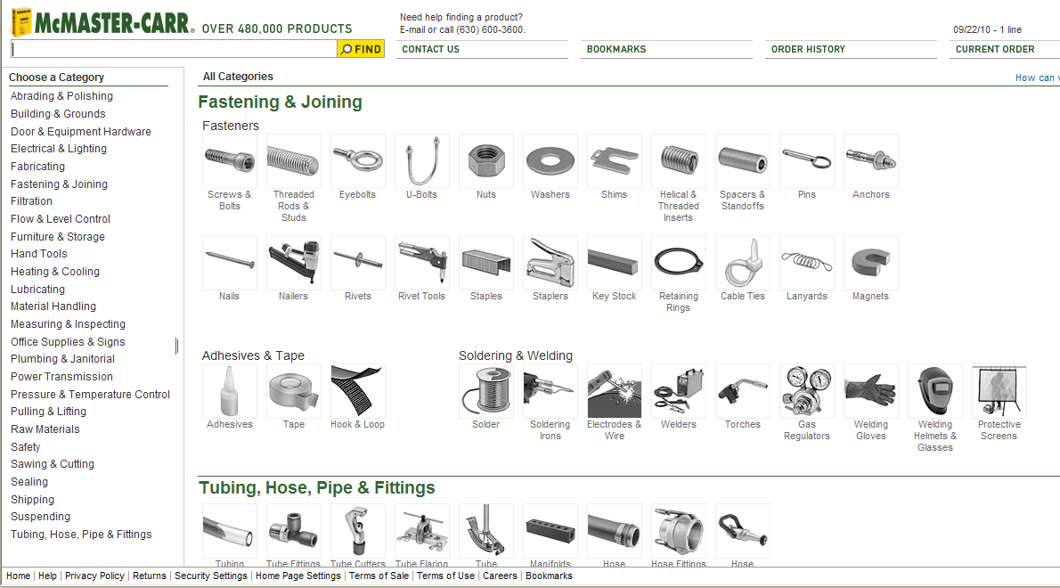
Fasteners etc
Many CAD models available on-line from standard catalogs
Good idea to use to ensure that you are using a readily available fastener
Click to go to McMaster-Carr online site

Slide 49
Threads and Screw Fastening
Example
Assembly

Slide 50
Threads and Screw Fastening (cont.)
Base
Detail

Slide 51
Threads and Screw Fastening (cont.)
3 Holes
φ
12.7 THRU
EQ SP on
φ
Lid
Detail
'A'
120 PD
Section 'A'-'A'
'A'

Slide 52
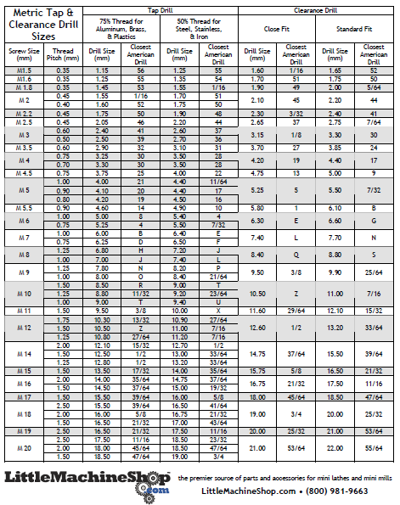
Standard Tap and Clearance Drill Sizes - Metric

Slide 53
Tolerances important to interchangeability and provision for replacement parts
It is impossible to make parts to an exact size. The tolerance, or accuracy required, will depend on the function of the part and the particular feature being dimensioned. Therefore, the range of permissible size, or tolerance, must be specified for all dimensions on a drawing, by the designer/draftsperson.
Nominal Size: is the size used for general identification, not the exact size.
Actual Size: is the measured dimension. A shaft of nominal diameter 10 mm may be measured to be an actual size of 9.975 mm.
General Tolerances:
In ISO metric, general tolerances are specified in a note, usually in the title block, typically of the form: "General tolerances ±.25 unless otherwise stated".
In English Units , the decimal place indicates the general tolerance given in the title block notes, typically:
Fractions = ±1/16, .X = ±.03, .XX = ±.01, .XXX = ±.005, .XXXX = ±0.0005,
Note: Fractions and this type of general tolerancing is not permissible in ISO metric standards.

Slide 54
Specific Tolerances
Specific Tolerances indicate a special situation that cannot be covered by the general tolerance.
Specific tolerances are placed on the drawing with the dimension and have traditionally been expressed in a number of ways:
+0.05
- 0.03
+0.04
40.05
39.97
40
40.01
-
Bilateral Tolerance
Unilateral Tolerance
Limit Dimensions
Limits are the maximum and minimum sizes permitted by the the tolerance. All of the above methods show that the dimension has:
a Lower Limit = 39.97 mm
an Upper Limit = 40.05 mm
a Tolerance = 0.08 mm
Manufacturing must ensure that the dimensions are kept within the limits specified. Design must not over specify as tolerances have an exponential affect on cost.

Slide 55
Limits and Fits
1. Clearance Fits
The largest permitted shaft diameter is smaller than the diameter of the smallest hole
Max.
Clearance
Max.
Min.
Max.
Hole
Hole
Shaft
Min.
Shaft
Min.
Clearance
SHAFT
HOLE

Slide 56
2. Interference Fits
The minimum permitted diameter of the shaft is larger than the maximum diameter of the hole
3. Transition Fits
The diameter of the largest allowable hole is greater than that of the smallest shaft, but the smallest hole is smaller than the largest shaft

Slide 57
Standard Limits and Fits -- ANSI
Extract from Table of Clearance Fits
RC 1 Close sliding fits are intended for the accurate location of parts which must assemble without perceptible play.
RC 2 Sliding fits are intended for accurate location, but with greater maximum clearance than class RC 1. Parts made to this fit move and turn easily but are not intended to run freely, and in the larger sizes may seize with small temperature changes.
RC 3 Precision running fits are about the closest fits which can be expected to run freely, and are intended for precision work at slow speeds and light journal pressures, but are not suitable where appreciable temperature differences are likely to be encountered.
RC 4 Close running fits are intended chiefly for running fits on accurate machinery with moderate surface speeds and journal pressures, where accurate location and minimum play are desired.
RC 5
RC 6
Basic hole system. Limits are in thousandths of an inch.
Medium running fits are intended for higher running speeds, or heavy journal pressures, or both.
Class RC 1
Class RC 2
Class RC 3
Class RC 4
Class RC 5
Class RC 6
Nominal
Size Range
in
Inches
Standard
Limits
Standard
Limits
Standard
Limits
Standard
Limits
Standard
Limits
Standard
Limits
Limits of
Clearance
Limits of
Clearance
Limits of
Clearance
Limits of
Clearance
Limits of
Clearance
Limits of
Clearance
Hole
H5
Shaft
g4
Hole
H6
Shaft
g5
Hole
H7
Shaft
f6
Hole
H8
Shaft
f7
Hole
H8
Shaft
e7
Hole
H9
Shaft
e8
0 - 0.12 0.1 + 0.2 - 0.1 0.1 + 0.25 - 0.1 0.3 + 0.4 - 0.3 0.3 + 0.6 - 0.3 0.6 + 0.6 - 0.6 0.6 + 1.0 - 0.6
0.45 - 0 - 0.25 0.55 - 0 - 0.3 0.95 - 0 - 0.55 1.3 - 0 - 0.7 1.6 - 0 - 1.0 2.2 - 0 - 1.2
0.12 - 0.24 0.15 + 0.2 - 0.15 0.15 + 0.3 - 0.15 0.4 + 0.5 - 0.4 0.4 + 0.7 - 0.4 0.8 + 0.7 - 0.8 0.8 + 1.2 - 0.8
0.5 - 0 - 0.3 0.65 - 0 - 0.35 1.12 - 0 - 0.7 1.6 - 0 - 0.9 2.0 - 0 - 1.3 2.7 - 0 - 1.5
0.24 - 0.40 0.2 + 0.25 - 0.2 0.2 + 0.4 - 0.2 0.5 + 0.6 - 0.5 0.5 + 0.9 - 0.5 1.0 + 0.9 - 1.0 1.0 + 1.4 - 1.0
0.6 - 0 - 0.35 0.85 - 0 - 0.45 1.5 - 0 - 0.9 2.0 - 0 - 1.1 2.5 - 0 - 1.6 3.3 - 0 - 1.9
0.40 - 0.71 0.25 + 0.3 - 0.25 0.25 + 0.4 - 0.25 0.6 + 0.7 - 0.6 0.6 + 1.0 - 0.6 1.2 + 1.0 - 1.2 1.2 + 1.6 - 1.2
0.75 - 0 - 0.45 0.95 - 0 - 0.55 1.7 - 0 - 1.0 2.3 - 0 - 1.3 2.9 - 0 - 1.9 3.8 - 0 - 2.2
0.71 - 1.19 0.3 + 0.4 - 0.3 0.3 + 0.5 - 0.3 0.8 + 0.8 - 0.8 0.8 + 1.2 - 0.8 1.6 + 1.2 - 1.6 1.6 + 2.0 - 1.6
0.95 - 0 - 0.55 1.2 - 0 - 0.7 2.1 - 0 - 1.3 2.8 - 0 - 1.6 3.6 - 0 - 2.4 4.8 - 0 - 2.8
1.19 - 1.97
1.97 - 3.15

Slide 58
ISO Tolerance Designation
The ISO system provides for:
21 types of holes (standard tolerances) designated by uppercase letters A, B, C, D, E....etc. and
21 types of shafts designated by the lower case letters a, b, c, d, e...etc.
These letters define the position of the tolerance zone relative to the nominal size. To each of these types of hole or shaft are applied 16 grades of tolerance, designated by numbers IT1 to IT16 - the "Fundamental Tolerances":
ITn = (0.45 x 3 D +0.001 D) Pn
where D is the mean of the range of diameters and Pn is the progression:1, 1.6, 2.5, 4.0, 6.0, 10, 16, 25......etc. which makes each tolerance grade approximately 60% of its predecessor.

Slide 59
For Example:
Experience has shown that the dimensional accuracy of manufactured parts is approximately proportional to the cube root of the size of the part.
Example:
A hole is specified as: φ30 H7
The H class of holes has limits of . i.e. all tolerances start at the nominal size and go positive by the amount designated by the IT number.
IT7 for diameters ranging 30- 50 mm:
+ x
+ 0
Tolerance for IT7 = (0.45 x 3 40 +0.001x 40) 16 = 0.025 mm
Written on a drawing as φ30 H7

Slide 60
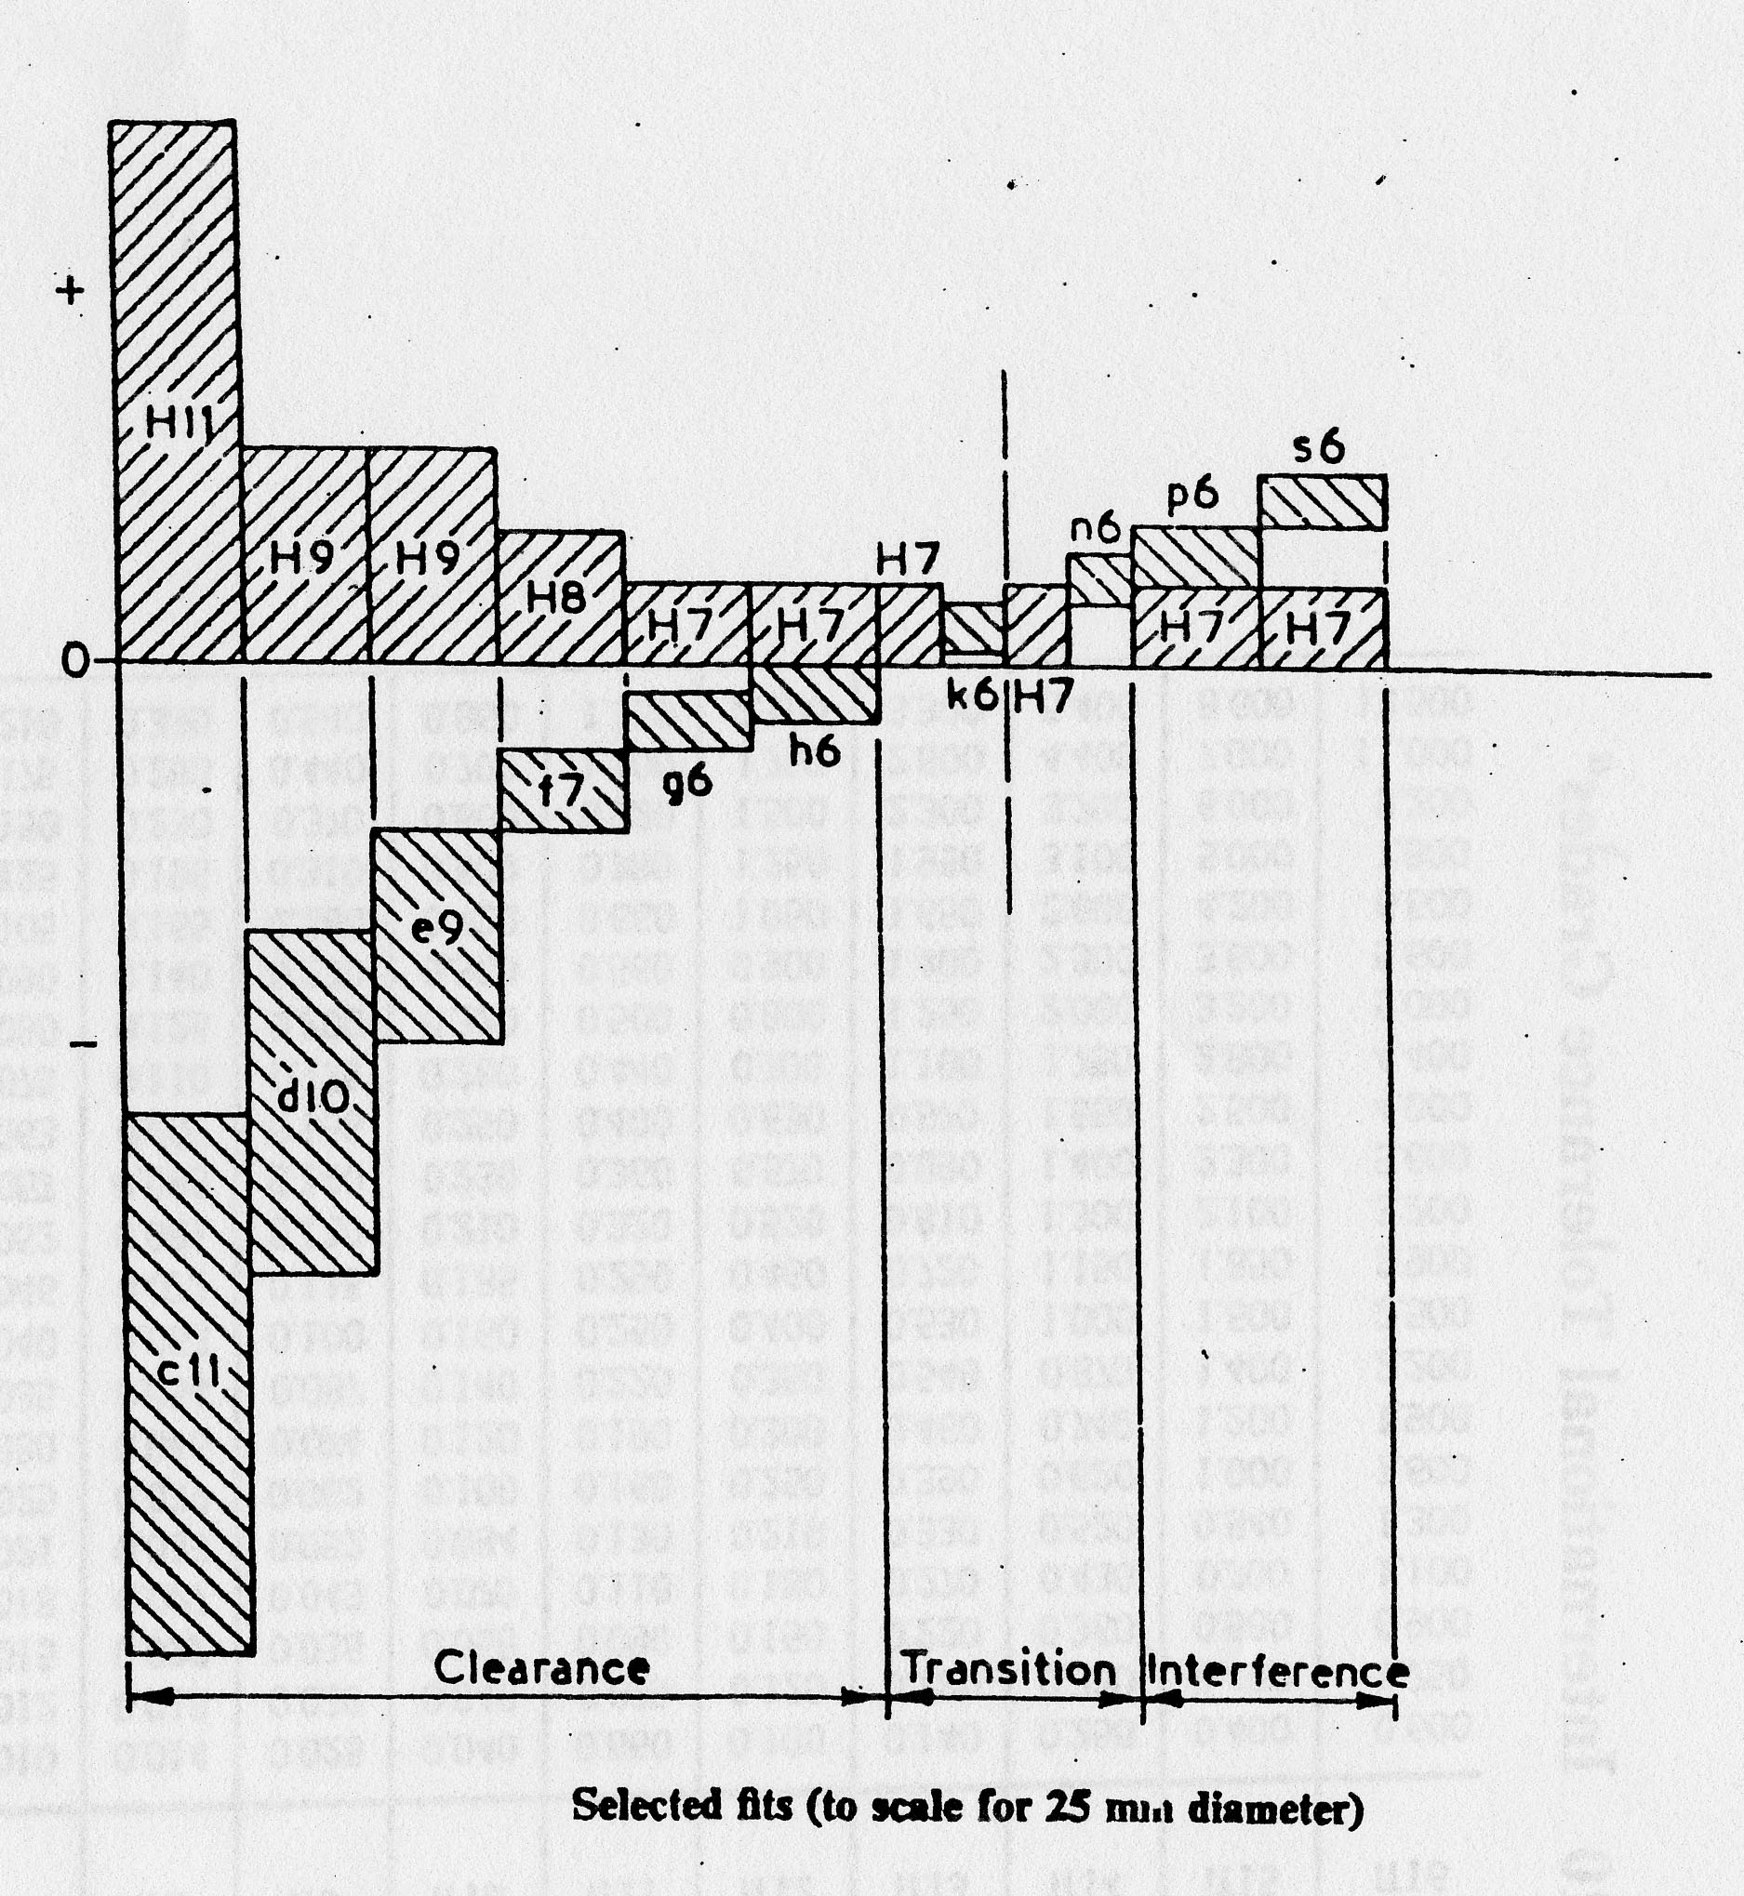
Graphical illustration of ISO standard fits
Hole Series – H hole Standard

Slide 61
Selection of Fits and the
ISO Hole Basis system
From the above it will be realized that there are a very large number of combinations of hole deviation and tolerance with shaft deviation and tolerance. However, a given manufacturing organization will require a number of different types of fit ranging from tight drive fits to light running fits for bearings etc. Such a series of fits may be obtained using one of two standard systems:
The Shaft Basis System:
For a given nominal size a series of fits is arranged for a given nominal size using a standard shaft and varying the limits on the hole.
The Hole Basis System:
For a given nominal size, the limits on the hole are kept constant, and a series of fits are obtained by only varying the limits on the shaft.
The HOLE SYSTEM is commonly used because holes are more difficult to produce to a given size and are more difficult to inspect. The H series (lower limit at nominal, 0.00) is typically used and standard tooling (e.g. H7 reamers) and gauges are common for this standard.

Slide 62
ISO Standard "Hole Basis"
Clearance Fits
Type of Fit
Hole
Shaft
Loose Running Fits
. Suitable for loose pulleys
H11
c11
and the looser fastener fits where freedom of
assembly is of prime importance
Free Running Fit.
Where accuracy is not
H9
d10
essential, but good for large temperature
variation, high running speeds, heavy journal
pressures
Close Running Fit.
Suitable for lubricated
H8
f7
bearing, greater accuracy, accurate location,
where no substantial temperature difference is
encountered.
Sliding Fits
. Suitable for precision location fits.
H7
g6
Shafts are expensive to manufacture since the
clearances are small and they are not
recommended for running fits except in
precision equipment where the shaft loadings
are very light.
Locational Clearance Fits
. Provides snug fit
H7
h6
for locating stationary parts; but can be freely
assembled and disassembled.

Slide 63
ISO Standard "Hole Basis”
Transition Fits
Type of Fit
Hole
Shaft
Locational Transition Fits
. for accurate
H7
k6
location, a compromise between clearance and
interference
Push Fits
. Transition fits averaging little or no
H7
n6
clearance and are recommended for location fits
where a slight interferance can be tolerated for
the purpose, for example, of eliminating vibration.
ISO Standard "Hole Basis"
Interference Fits
Type of Fit
Hole
Shaft
Press Fit
. Suitable as the standard press fit into
H7
p6
ferrous, i.e. steel, cast iron etc., assemblies.
Drive Fit
Suitable as press fits in
H7
s6
material of low modulus of elasticity such as
light alloys.

Slide 64
ISO Clearance Fits
Loose Running Fit
Free Running Fit
Close Running Fit
Sliding Fit
Locational Clearance

Slide 65
Locational Fit
Push Fit
Nominal Sizes
Tolerance
Over
To
H7
k6
H7
n6
mm
mm
0.001 mm
0.001 mm
0.001 mm
0.001 mm
––
3
+10
+6
+10
+10
0
+0
0
+4
3
6
+12
+9
+12
+16
0
+1
0
+8
6
10
+15
+10
+15
+19
0
+1
0
+10
10
18
+18
+12
+18
+23
0
+1
0
+12
ISO
Transition
Fits
18
30
+21
+15
+21
+23
0
+2
0
+15
30
40
+25
+18
25
+33
40
50
0
+2
0
+17
50
65
+30
+21
+30
+39
65
80
0
+2
0
+20
80
100
+35
+25
+35
+45
100
120
0
+3
0
+23
120
140
+40
+28
+40
+52
140
160
0
+3
0
+27
160
180
180
200
+46
+33
+46
+60
200
225
0
+4
0
+34
225
250
250
280
+52
-32
+52
+36
280
315
0
-
0
+4
315
355
+57
+40
+57
+73
355
400
0
+4
0
+37
400
450
+63
+45
+63
+80
450
500
0
+5
0
+40

Slide 66
Press Fit
Drive Fit
ISO
Interference
Fits

Slide 67
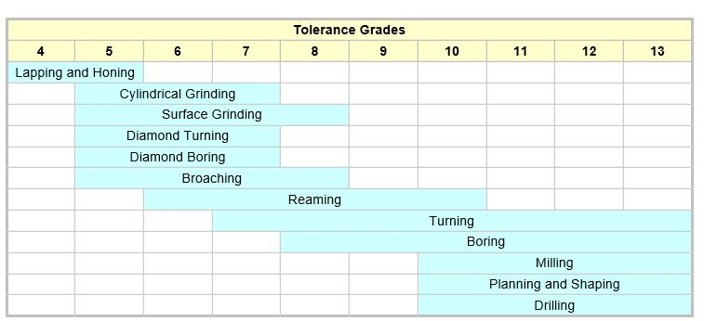
Typical IT tolerance capability by machining process

Slide 68
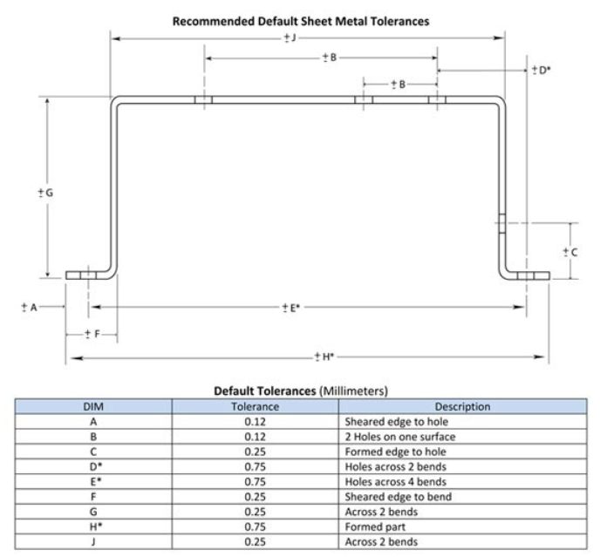
Sheet Metal Parts – Typical Tolerance Capability
http://www.vista-industrial.com/sheet-metal-tolerances.php

Slide 69
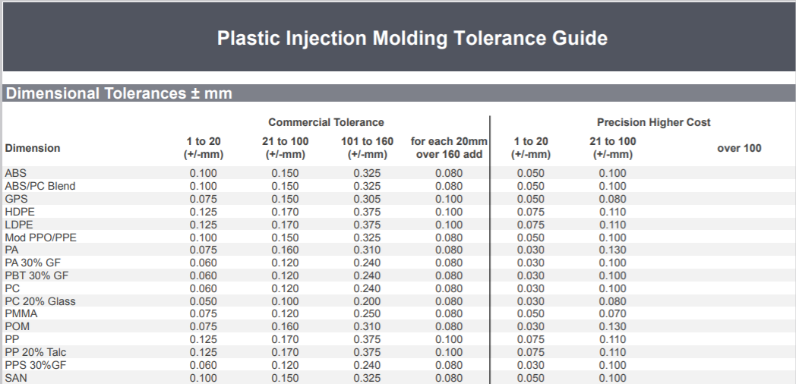
Injection Molding – Typical Tolerance Capability
Dimensional Tolerances
https://www.starrapid.com/wp-content/uploads/2016/11/Star-Rapid-Plastic-Injection-Molding-Tolerance-Guide.pdf

Slide 70
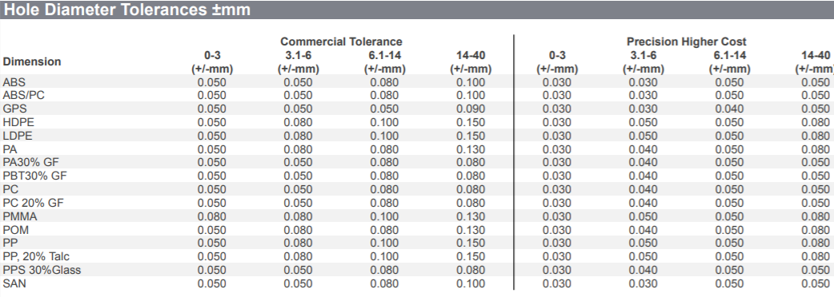
Injection Molding – Typical Tolerance Capability
Diameter of holes
https://www.starrapid.com/wp-content/uploads/2016/11/Star-Rapid-Plastic-Injection-Molding-Tolerance-Guide.pdf

Slide 71
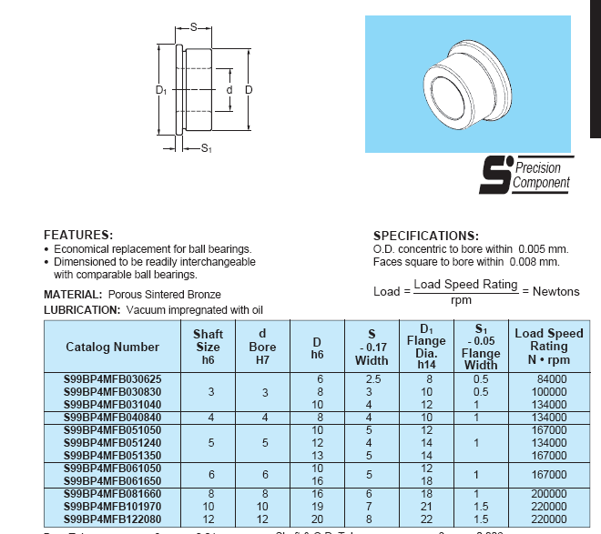
Flanged Sintered Bronze Plain Bearing

Slide 72
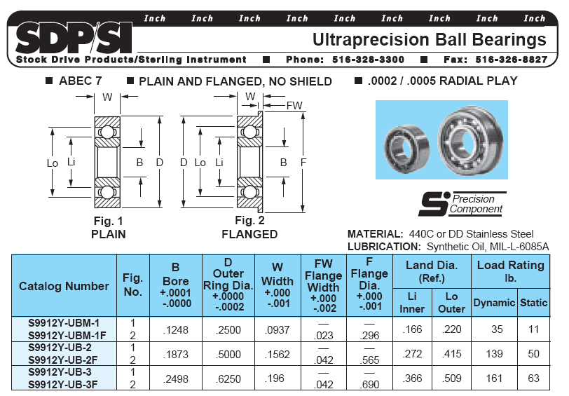

Slide 73
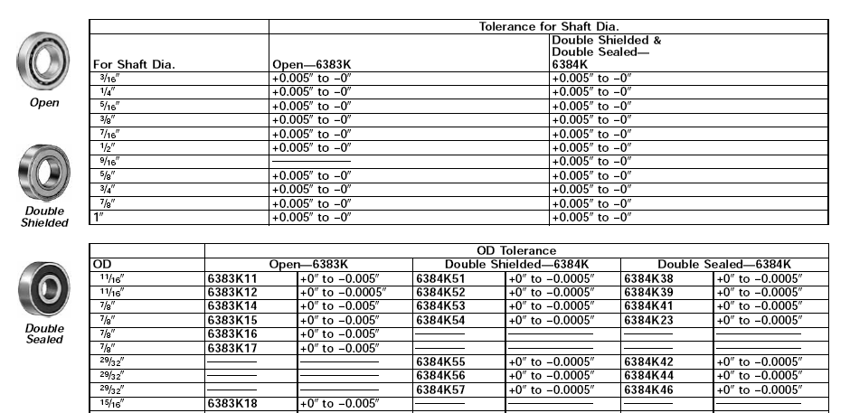
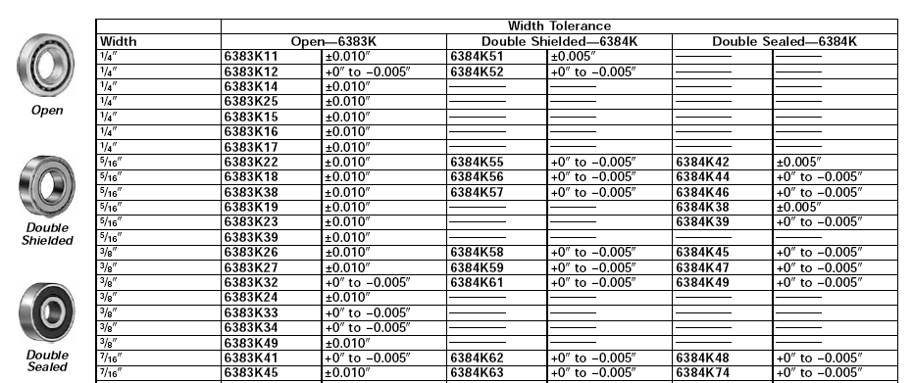
http://www.McMasterCarr.com

Slide 74
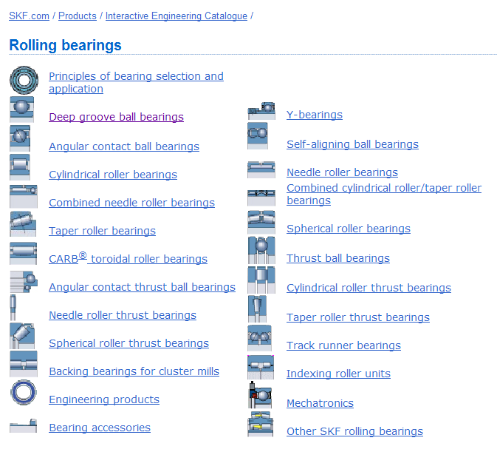
On-line Interactive Catalogs
http://www.skf.com/group/products/bearings-units-housings/product-tables.html

Slide 75
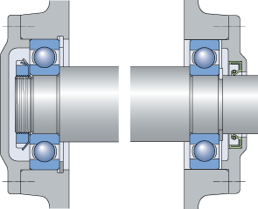
Ball Bearing Design Considerations
Allow float for thermal expansion and reduced axial tolerance requirements
Click on pic to select SKF catalog page

Slide 76
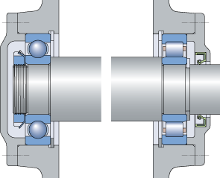
Roller Bearing Design Considerations
Roller Bearing provides float for thermal expansion and reduced axial tolerance requirements

Slide 77
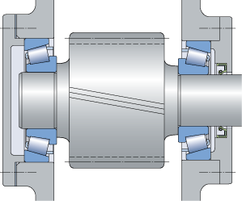
Taper Roller Bearings for high axial and radial loads
Preload to remove all axial clearance/play in the bearing

Slide 78
Tolerance Calculation - 'Worst Case Method'
for correct fit in all cases, if manufactured to specification
'Shaft in hole'
Terminology
Hole
Shaft

Slide 79
‘Worst Case’ Tolerance Example
Shaft in Hole
A
B
Clearance = Largest Hole Size (A) – Smallest Shaft Size (B)
Allowance = Smallest Hole Size (A) – Largest Shaft Size (B)
A
For example: If the nominal dimension is 10mm and general tolerance invoked i.e. feature A and B (Hole & Shaft) are both:
10
+ 0.125
- 0.125
(i.e. overall tolerance of 0.25 mm)
Then,
Clearance = 10.125 – 9.875 = 0.25
Allowance = 9.875 – 10.125 = - 0.25 *
* A negative in the result means interference
Lid on Box
General Tolerance +/- 0.125 unless otherwise specified
All units in mms
B

Slide 80
Use Specific Tolerances as required but keep overall tolerance as loose as possible for function/aesthetic
10
+ 0.125
- 0.000
10
+ 0.000
- 0.125
Clearance = Largest Hole Size (A) – Smallest Shaft Size (B)
Allowance = Smallest Hole Size (A) – Largest Shaft Size (B)
10
+ 0.125
- 0.000
So,
Clearance = 10.125 – 9.875 = 0.25
Allowance = 10 – 10 = 0
No negative therefore no interference even in ‘worst case’, so lid will fit on the box relatively easily in all designed conditions.
Lid on Box
10
+ 0.000
- 0.125
General Tolerance +/- 0.125 unless otherwise specified
All units in mms

Slide 81
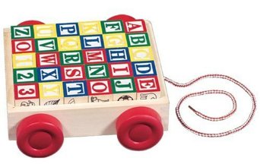
Lecture Class Assignment XXX- Worst Case Tolerance - Block and Carrier
Name: Solution
Blocks
A
B
+ 0.2
− 0.2
2
A
B
Carrier
Clearance = Largest Hole – Smallest Shaft
Allowance = Smallest Hole – Largest Shaft
Largest Hole = 4.8
Smallest Shaft = 1.8 + 1.8 = 3.6
Clearance = 4.8 – 3.6 = 1.2
Smallest hole = 4.4
Largest shaft = 2.2 + 2.2 = 4.4
Allowance = 4.4 – 4.4 = 0
+ 0.8
+ 0.4
A
B
4
A
B
1. What is the clearance between the between the blocks and the carrier _______1.2_____
2. What is the allowance between the blocks and the carrier ______0_____

Slide 82
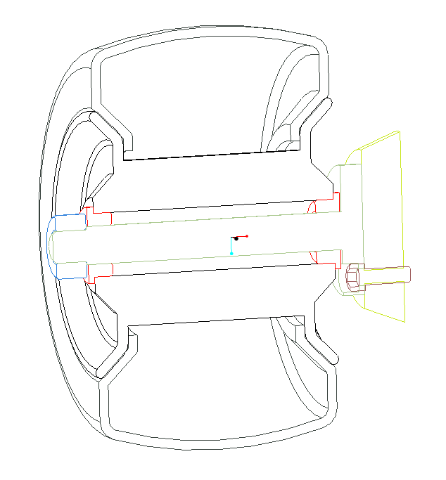
Lecture Class Assignment #12 Axial Tolerances, Fits and Limits
Note: This is the type of analysis I want you to do for your design projects
(See Design Project Appendix – 3. Tolerance Analysis)
Name:
Section:
Axial Fit - Tolerance Analysis
Allowance: the minimum allowable difference between mating parts
Clearance: the maximum allowable difference between mating parts
Axial Fit (gap)
Allowance = Smallest Hole – Largest Shaft
Clearance = Largest Hole – Smallest Shaft
Allowance:
Smallest Hole = _____
Largest Shaft = 1.5 + _____ + 1.5 = 83.83
= _____
Clearance:
Largest Hole = _____
Smallest Shaft = _____ + 80.50 + _____= _____
= _____
A
B
C
B
C
A
“Shaft”
“Hole”
A
B
C
1. What is the axial ‘allowance’ between the wheel subassembly and the shaft ___________
2. What is the axial ‘clearance’ between the wheel subassembly and the shaft ____________

Slide 83
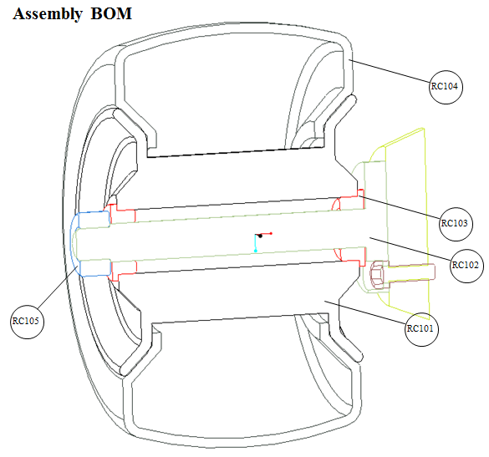
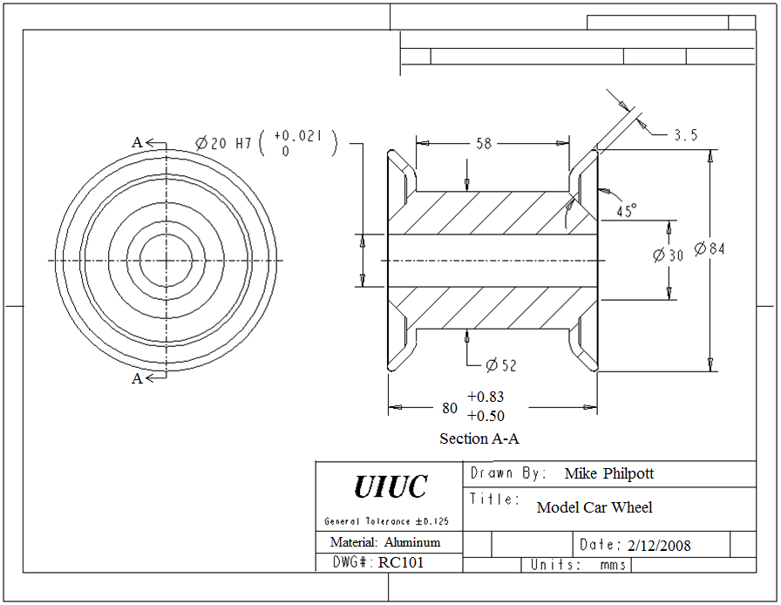
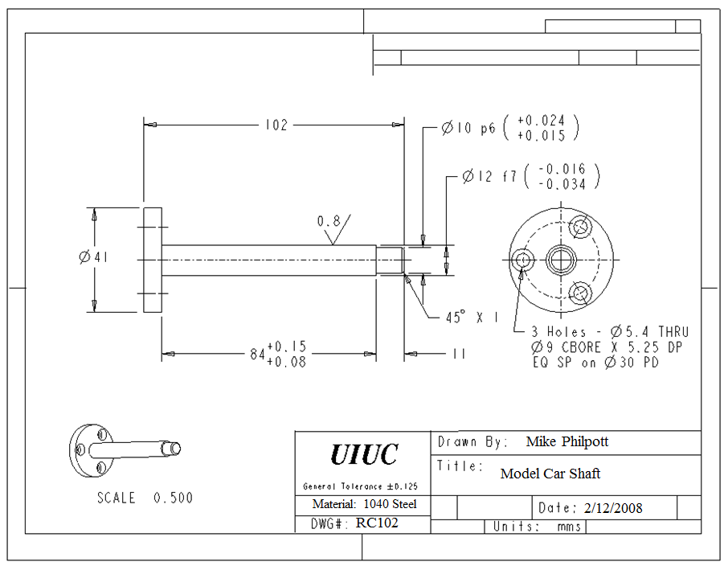
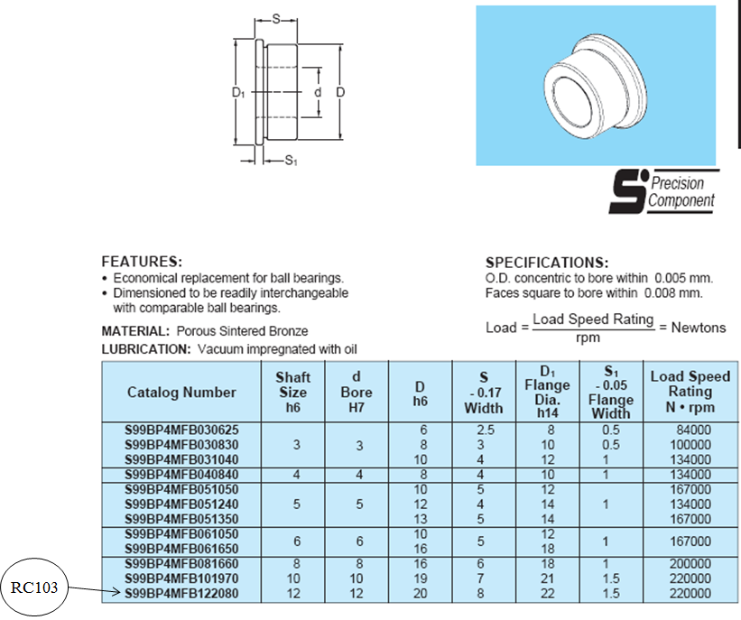

Slide 84
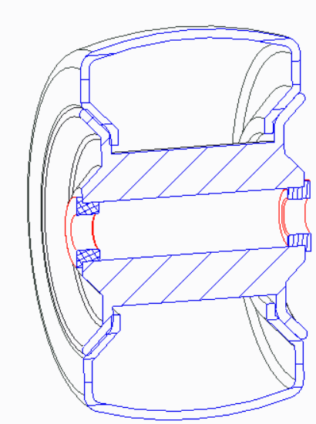

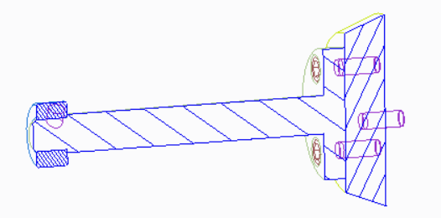
B
“Shaft” Dimension (A+B+C)
A & C
“Hole” Dimension

Slide 85
Comparative Roughness Values
Roughness Ra Typical Processes
25 µm (1000 µ”) Flame Cutting
12.5 µm (500µ”) Sawing, sand casting,
6.3 µm (250µ”) forging, shaping, planing
3.2 µm (125µ”) Rough machining, milling, rough turning, drilling, and die casting
1.6 µm (63µ”) Machining, turning, milling, die and investment casting, injection molding, and stamping
0.8 µm (32µ”) Grinding, fine turning & milling, reaming, honing, injection molding, stamping, investment casting
0.4 µm (16µ”) Diamond Turning, Grinding, lapping, honing
0.2 µm (8µ”) Lapping, honing, polishing
0.1 µm (4µ”) Superfinishing, polishing, lapping

Slide 86
Some Common Steel, Hardness and Surface Finish Specs.
Common
Types
Common Steel Specs: (10xx series: xx = % carbon)
Mild steel (low carbon = up to 30 %): Low cost general purpose applications, typ. hardening not required
Medium Carbon (up to 60%): requiring higher strength; e.g. gears, axles, con-rods etc.
High Carbon (> 60%): High wear, high strength; e.g. cutting tools, springs etc.
Ground Bearing Shaft Examples:
General Purpose
1060: Surface HDN to 55 HRC 0.125 mm deep min.; 0.4 µm (16 µ”)
303 Stainless: (natural surface hardness 5 HRC ); 0.4µm (16 µ”)
Better Finish, Longer Life
1020: Case HDN to 65 HRC 0.25 mm deep min.; 0.2µm (8 µ”)
440 Stainless: (natural circa 15 HRC); 0.2µm (8 µ”)
1020
1040,
1060
1080

Slide 87
Specifying Welds on Drawings
Width of weld

