Slide 1
GPS, Differential GPS, and Applications
to Drones
ECE 498 course lecture
Notes:
Thanks Romit for that generous introduction .. Hello everyone .. . I will be presenting our talk titled “xxx” .. The research is about estimating the orientation of drones using GPS sensors

Slide 2
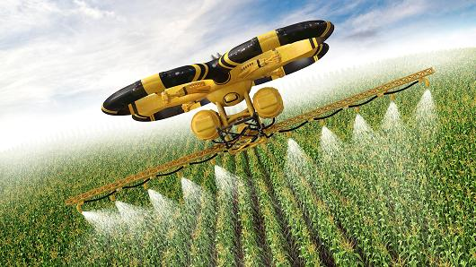
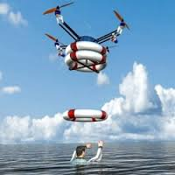
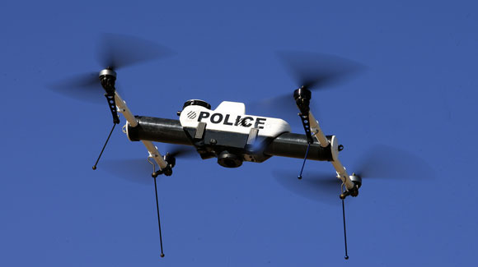
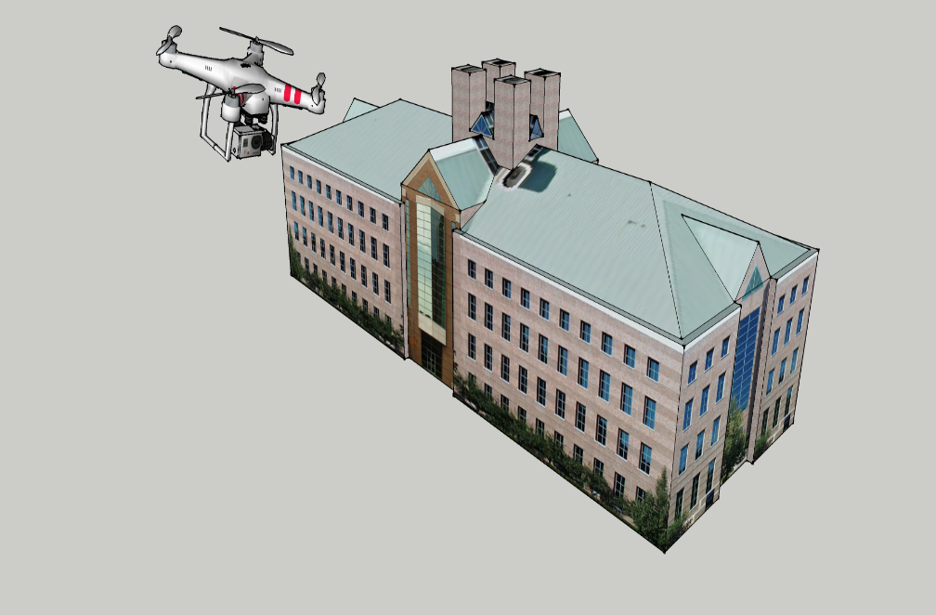
Tremendous excitement with drones
Notes:
Needless to emphasize, enormous and exciting applications are emerging in the world of drones

Slide 3
Despite the excitement …

Slide 4
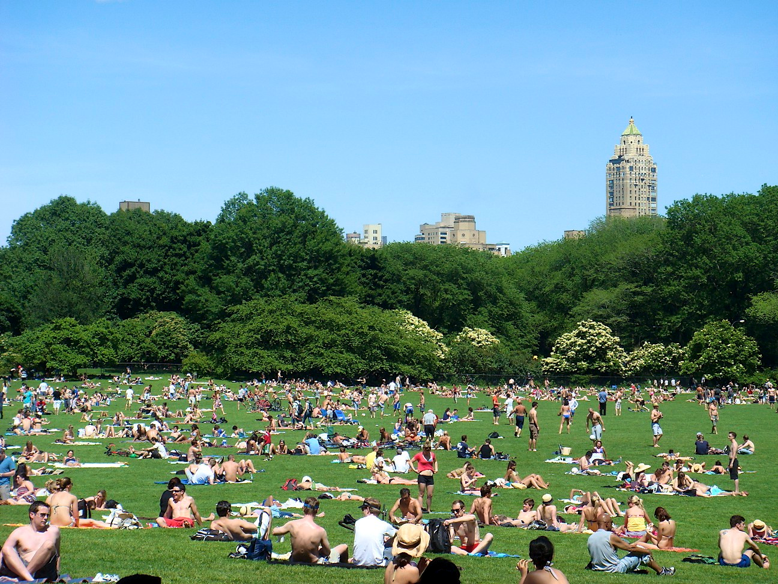
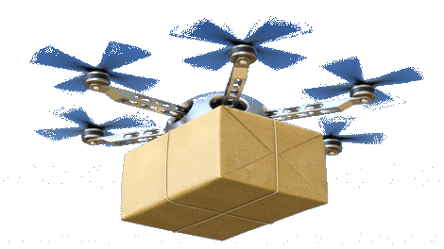
Drones still not ready for public places

Slide 5
Several instances of crashes and failure …
Notes:
Drone accidents are very common .. Severely threateninig life and property

Slide 6
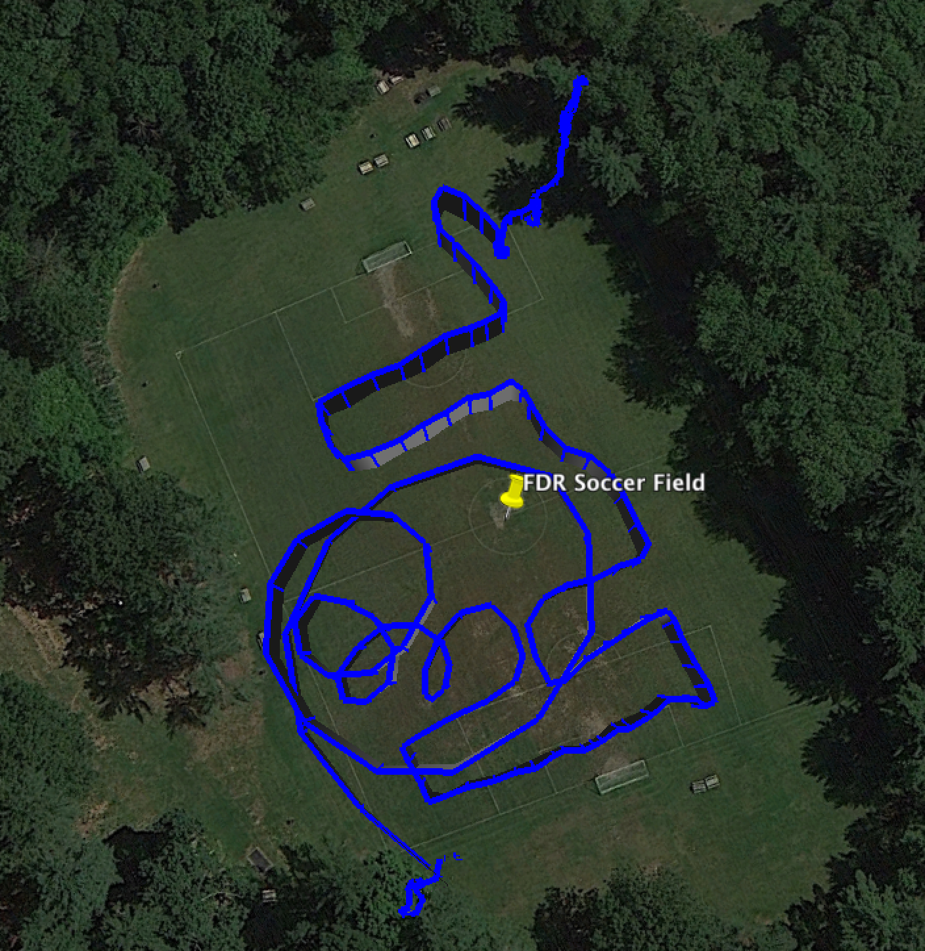

Slide 7
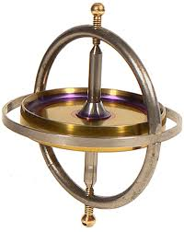
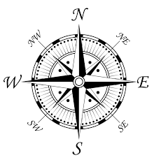
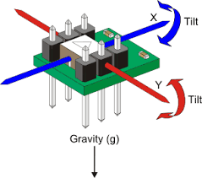
Primary reason: Inertial Measurment Unit (IMU)
Accelerometer
Gyroscope
Compass
Notes:
So .. Why do drones crash

Slide 8
Primary reason: Inertial Measurment Unit (IMU)
Accelerometer
Gyroscope
Compass
IMU crucial for tracking 3D orientation → stabilization, control
Notes:
One of the key reasons is the poor reliability of inertial sensors .. Inertial sensors like accelerometes, gyroscopes and compasses are used for tracking 3d orientation which is of prime importance for drone stabilization and control

Slide 9
Primary reason: Inertial Measurment Unit (IMU)
Accelerometer
Gyroscope
Compass
IMU crucial for tracking 3D orientation → stabilization, control
However, rotor vibration and magnetic interference derails
the sensors … causing correlated failures
Notes:
One of the key reasons is the poor reliability of inertial sensors .. Inertial sensors like accelerometes, gyroscopes and compasses are used for tracking 3d orientation which is of prime importance for drone stabilization and control

Slide 10
Question we want to ask:
Design a failsafe mechanism for IMU failures
so the drone can operate seamlessly
Basic Idea: Use multiple GPS to compute 3D orientation
Notes:
Hence we propose SafetyNet : a failsafe mechanism that can hold the drone under IMU failures .. If imu sensor fails .. We want to use gps ..

Slide 11
Basic Idea: Use multiple GPS to compute 3D orientation
Notes:
The key technique is simple .. We have a drone .. We mount multiple GPSes on them .. As the drone moves in space during it flight .. The orientations keeos changing continuously .. As the orientation changes the relative positions of gps will change and we can use this rel pos infor to get orientat

Slide 12
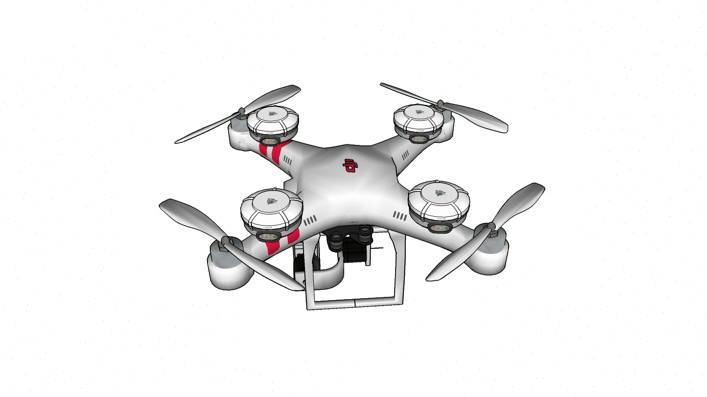
Basic Idea: Use multiple GPS to compute 3D orientation
Notes:
The key technique is simple .. We have a drone .. We mount multiple GPSes on them .. As the drone moves in space during it flight .. The orientations keeos changing continuously .. As the orientation changes the relative positions of gps will change and we can use this rel pos infor to get orientat

Slide 13
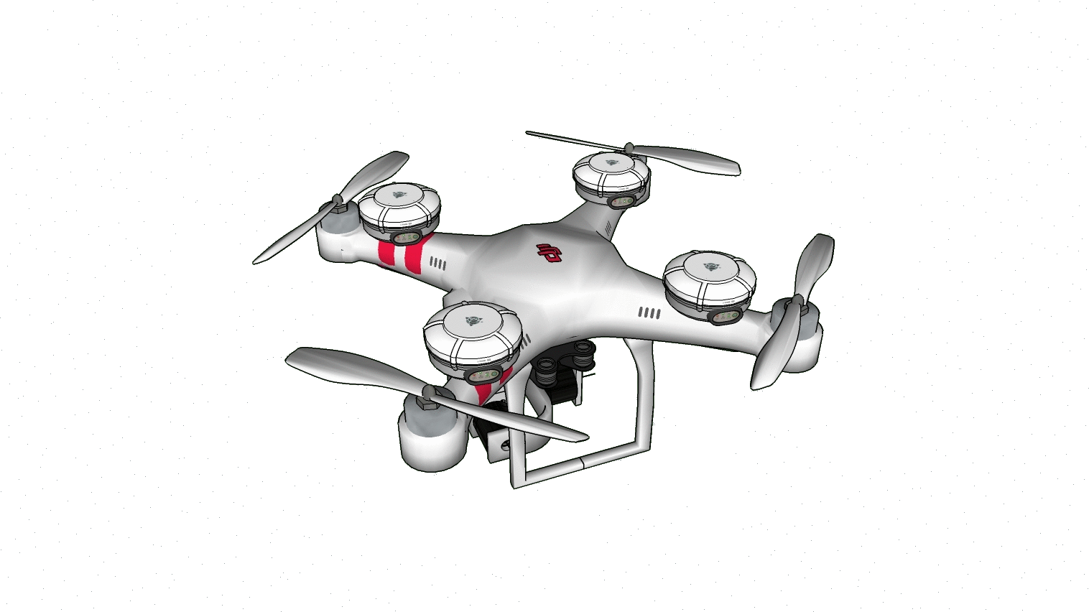
Basic Idea: Use multiple GPS to compute 3D orientation

Slide 14
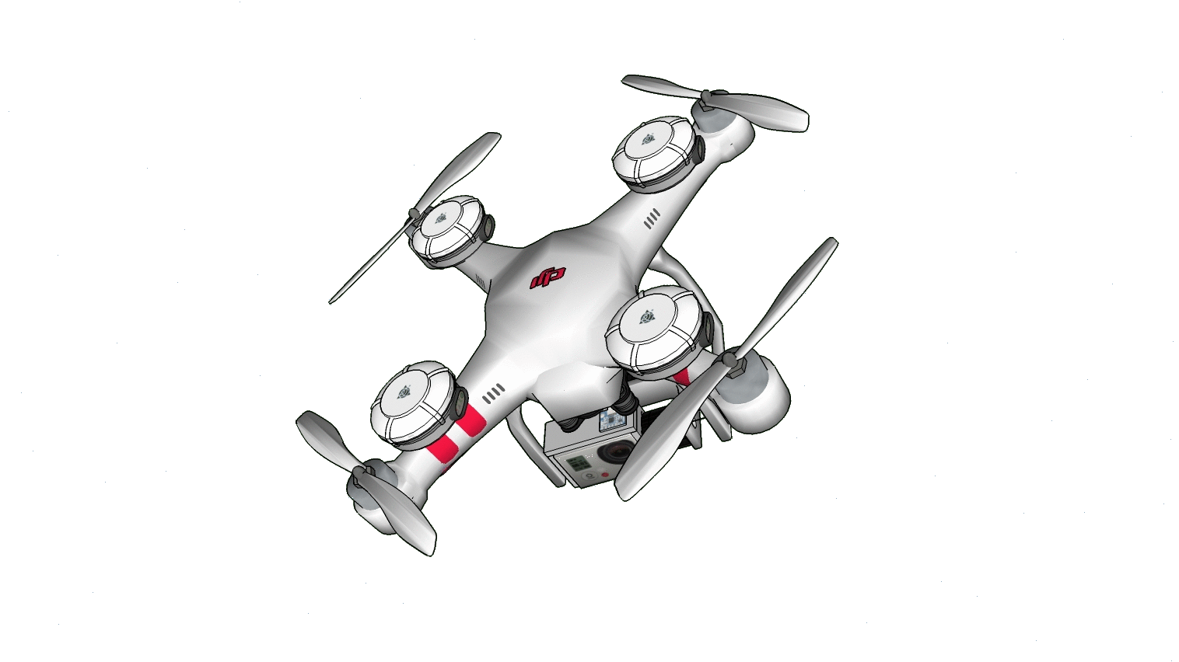
Basic Idea: Use multiple GPS to compute 3D orientation

Slide 15
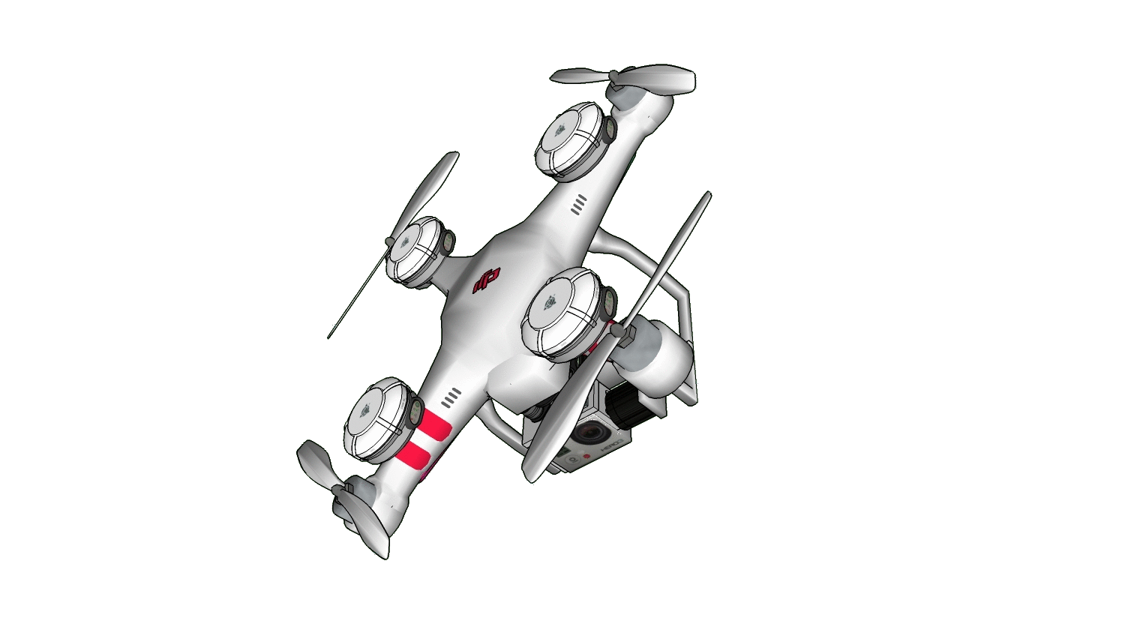
Basic Idea: Use multiple GPS to compute 3D orientation

Slide 16
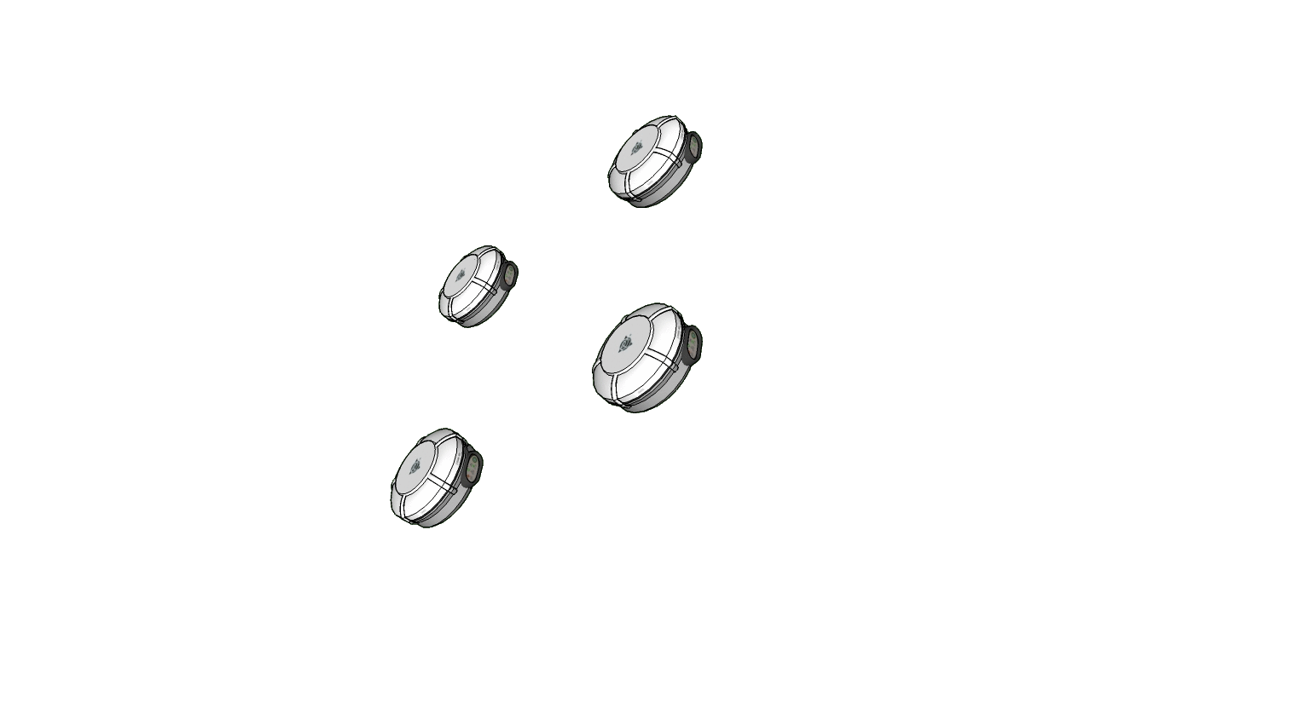
Basic Idea: Use multiple GPS to compute 3D orientation
Notes:
3 mins till here

Slide 17
Basic Idea: Use multiple GPS to compute 3D orientation
Key Challenges:
(1) Compute the relative vectors between GPS pairs
Notes:
3 mins till here

Slide 18
Basic Idea: Use multiple GPS to compute 3D orientation
Key Challenges:
(1) Compute the relative vectors between GPS pairs
(2) Translate to 3D orientation
Notes:
3 mins till here

Slide 19
Basic Idea: Use multiple GPS to compute 3D orientation
Key Challenges:
(1) Compute the relative vectors between GPS pairs
(2) Translate to 3D orientation
(3) Track orientation during (aggressive) flight
Notes:
3 mins till here

Slide 20
Basic Idea: Use multiple GPS to compute 3D orientation
Note: We need not compute absolute
location of each GPS receiver …
Rather we need precise relative locations
Key Challenges:
(1) Compute the relative vectors between GPS pairs
(2) Translate to 3D orientation
(3) Track orientation during (aggressive) flight
Notes:
3 mins till here for ex .. Consider a drone one feet .. For less than 2 deg err .. Cm accuracy .. Hence ,easuring ..

Slide 21
Some background on GPS
Basic satellite trilateration: 300km error
GPS Localization (phones): 1-3m error
Differential GPS (airplanes): 15cm error
For drone orientation (< $2^{∘}$ ): ~2cm error
Notes:
2:30 till here ..let me motivate goal again .. Plenty of research has been done in GPS literature which can achieve around 15cm of relative positioning accuracy .. However for a drone that is feet scale long .. We will need accuracy in the order of 2cm to estimate drone orientation ..

Slide 22
A brief review of GPS literature
(300 km to 15 cm)
Notes:
To be able to push envelope to 2cm .. 2:30 till here .. I will give you a quick overview of gps and diff gps literature before going into techniques for translating them into drone orientation ..

Slide 23
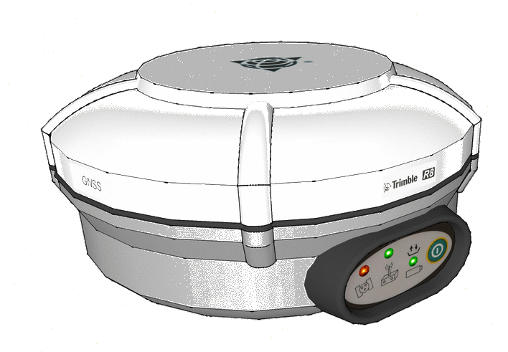
Basic GPS Localization
GPS Signal
.
Notes:
When a gps satellite transmits signals range is measured by multiplying reception and transmission time by speed of light .. Since location has 3 unknowns .. By measuring the rangr from 3 sats .. we can model the unknowns as a function of measured range and satellite geometry as follows .. Solving these .. weobtain the location .. However . If w e simply do this .. Huge erro because clocks are not synchronized ..

Slide 24
Basic GPS Localization
GPS Signal
.
However, 3D location needs 3 equations … hence, use 3 satellites
Notes:
Sat in sky called ts .. Called tr ..explain fully ..how do we get 3 eqns? Simple …… unfortunately sybch …. As you may know .. Require atleast 4 sat locks ..
When a gps signal transmits signals range is measured by multiplying reception and transmission time by speed of light .. Since location has 3 unknowns .. By measuring the rangr from 3 sats .. we can model the unknowns as a function of measured range and satellite geometry as follows .. Solving these .. weobtain the location .. However . If w e simply do this .. Huge erro because clocks are not synchronized ..

Slide 25
Basic GPS Localization
GPS Signal
.
However, 3D location needs 3 equations … hence, use 3 satellites
Notes:
When a gps signal transmits signals range is measured by multiplying reception and transmission time by speed of light .. Since location has 3 unknowns .. By measuring the rangr from 3 sats .. we can model the unknowns as a function of measured range and satellite geometry as follows .. Solving these .. weobtain the location .. However . If w e simply do this .. Huge erro because clocks are not synchronized ..

Slide 26
Basic GPS Localization
GPS Signal
.
.
However, 3D location needs 3 equations … hence, use 3 satellites
Satellite
Geometry
Matrix
$\left[\begin{matrix} & ⋯ & \\ ⋮ & ⋱ & ⋮ \\ & ⋯ & \end{matrix}\right]\left[\begin{aligned}X \\ Y \\ Z\end{aligned}\right]$ = $\left[\begin{aligned}R_{1} \\ R_{2} \\ R_{3}\end{aligned}\right]$
300 Km of error
due to unsynchronized clocks
Notes:
When a gps signal transmits signals range is measured by multiplying reception and transmission time by speed of light .. Since location has 3 unknowns .. By measuring the rangr from 3 sats .. we can model the unknowns as a function of measured range and satellite geometry as follows .. Solving these .. weobtain the location .. However . If w e simply do this .. Huge erro because clocks are not synchronized ..

Slide 27
Basic GPS Localization
GPS Signal
.
New unknown … use 4th satellite and estimate both location and
$\left[\begin{matrix} & ⋯ & \\ ⋮ & ⋱ & ⋮ \\ \begin{aligned} \\ \end{aligned} & \begin{aligned}⋯ \\ \end{aligned} & \begin{aligned} \\ \end{aligned}\end{matrix} \right]\left[\begin{aligned}X \\ Y \\ Z \\ δ_{clk}\end{aligned}\right]$ = $\left[\begin{aligned}R_{1} \\ R_{2} \\ R_{3} \\ R_{4}\end{aligned}\right]$
Satellite Geometry Matrix
$$\begin{matrix}c \\ c \\ \begin{aligned}c \\ c\end{aligned}\end{matrix}$$
1-3m error
Notes:
To handle this, today’s GPS receivers model the unknown clock error together with unknown location.. And now we have 4 unknowns .. Using the rnge data from 4 satellites .. And using the fllowing modek .. Location and time can be jointly estimated .. This is exactly why our GPS receivers need atleast 4 satellites to get a lock and this results in an error of 3m which is much more acceptable

Slide 28
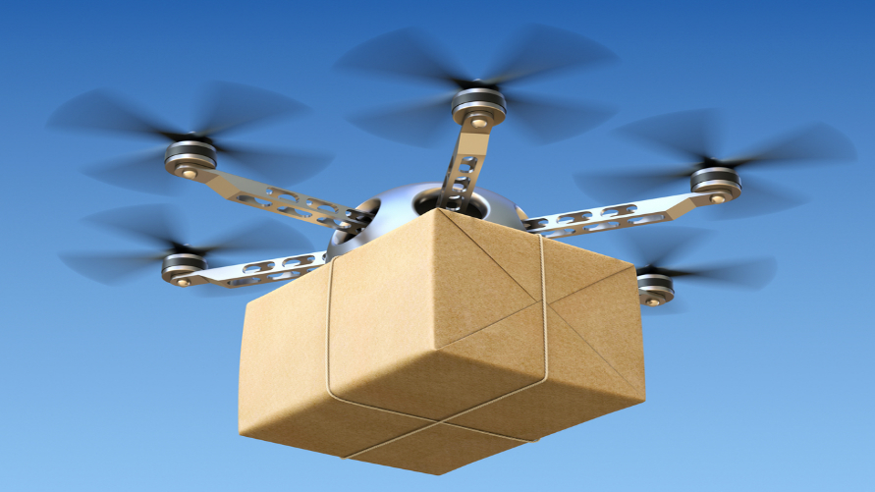
1-3m error acceptable to smartphones, car GPS
Drone orientation warrants cm level accuracy
Differential GPS
using phase of the signals
Notes:
1-3 m error is acceptable to wide number of applications like smartphones, car GPS, however orientation est on a small drone which is feet scale long warrantes cm scale accuracy .. Hence, we borrow techniques from DGPS community and apply probabilistic modeling techniques to translate that into drone orientation estimates ..

Slide 29
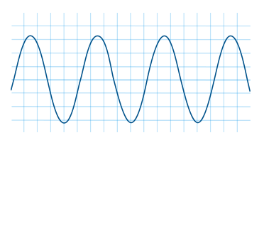
Differential GPS (using carrier phase)
Notes:
4:30 till here .. Now lets quickly explore some diff gps techniques usinh which we can achieve cm level accuracy

Slide 30
GPS Carrier Phase
GPS Satellite
True Range
Phase
GPS Carrier Wave
$$λ$$
GPS Receiver
$$λ$$
$$- λ$$
Possible to measure precisely
(2-5 mm error)
However, difficult to
estimate N

Slide 31
GPS Carrier Phase
GPS Satellite
True Range
Phase
GPS Carrier Wave
GPS Receiver
Real systems more difficult:
$$+ λ$$
However, since we only care about relative distances …
Possible to eliminate some errors by subtracting phase equations
across receivers, satellites, time, etc.
For example …

Slide 32
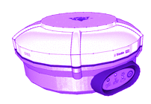
(I) Single Differential Across Receivers – Cancelling Satellite Errors
S
$$φ_{1}^{s}=R_{1}^{s}+λN_{1}^{s}+Clk^{s}+Clk_{1}+Del_{atm}$$
$$φ_{2}^{s}=R_{2}^{s}+λN_{2}^{s}+Clk^{s}+Clk_{2}+{Del}_{atm}$$
Range = $R_{j}^{s}$
$Δφ_{12}^{s}={ΔR}_{12}^{s}+λN_{12}^{s}+Δ{Clk}_{12}$
Range = $R_{i}^{s}$
$Δφ_{12}^{s}=R_{12}\hat{l_{s}}+λN_{12}^{s}+Δ{Clk}_{12}$
$$R_{12}$$
$Δφ_{12}^{s}={f(R}_{12},λN_{12}^{s}, {Clk}_{12}$)
2
1
Clock Errors can be eliminated further
Relative Position (Baseline)
Notes:
I have expressed cp equation for I and j with respect to satellite s .. We observe that some of the error terms here are correlated .. We get a measurement model of rel pos bw 2 rx .. With fewer error terms .. For the rest of the talk I am going to abstract the sing diff as follows for simplicity .. I am going to write the cp diff as a function of baseline .. Int ambiguityand clk errors .. So as we can see a function of clock erros still remains making it which can be eliminated by forming one more layer of diff as follows …

Slide 33
(II) Satellite Double Differential: Cancel Receiver Errors
S
K
$$R_{12}$$
2
1
R₁₂ = Relative vector (BaseLine) between two GPSs
Can be translated into Orientation
However, integer ambiguity remains
Notes:
So this is the sd equation again .. Lets from sd for diff sat same rx pair .. From these two equations we obs that the clock error terms of the common rx pair is correlated .. So wehwn we sub .. We get a meas model of rel pos of 2 rx where rx side errors are gone

Slide 34
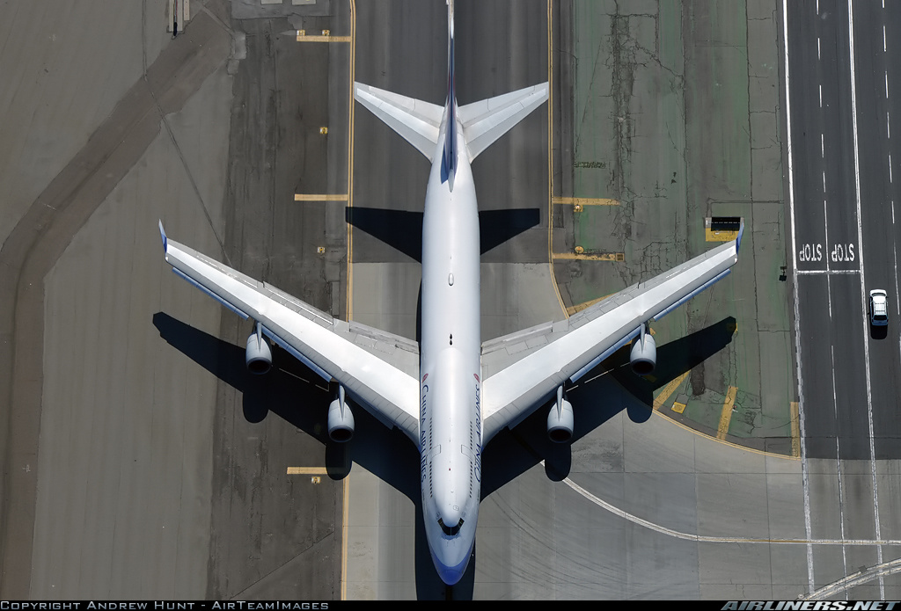
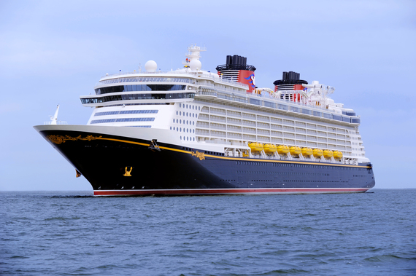
Differential GPS community has exploited such techniques to achieve orientation estimation on big planes, ships
For a small drone we need very high accuracy
Need to handle dynamic errors
Notes:
Diff gps community has exploited such techniques for accuracy est. on airplanes on drones .. However for a small drone we have a high acc requirement .. And

Slide 35
(III) Time Double Differentials
S
$$Δφ_{12}^{s}\left(t_{1}\right)=f(R_{12}(t_{1}),N_{12}^{s}\left(t_{1}\right),Clk_{12}(t_{1}))$$
$$Δφ_{12}^{s}\left(t_{2}\right)=f(R_{12}(t_{2}),N_{12}^{s}\left(t_{2}\right),Clk_{12}(t_{2}))$$
$$R_{1}^{s}{(t}_{1})$$
$$R_{2}^{s}{(t}_{1})$$
$$Δφ_{12}^{s}\left(t_{12}\right)=f(R_{12}\left(t_{1}\right)−R_{12}\left(t_{2}\right)$$
$$,Clk_{12}(t_{12}))$$
$$R_{1}^{s}{(t}_{2})$$
$$R_{12}{(t}_{1})$$
$$R_{2}^{s}{(t}_{2})$$
Change in orientation
$$R_{12}{(t}_{2})$$
No Integer Ambiguity
Notes:
This simply the single diff of two receivers at different times .. When we subtract them .. Integer ambiguity cancels out and we are left with a model for measuring changes in baselines over time .. More importantly .. We do not have integer ambiguities here ..

Slide 36
Two Observations on Orientation
Satellite Double Differentials
Time Double Differential
$$Δ$$
Drone Absolute Orientation, but polluted by Integer Ambiguity
Change in Orientation, but unpolluted by Integer Ambiguity
Analogous to compass and gyroscopes, but highly noisy
Naturally amenable to a process filtering model

Slide 37
Bayesian Filtering Approach
Transition
q
q
q
pitch, roll, yaw
pitch, roll, yaw
pitch, roll, yaw
Measurement
Notes:
We can model orientation as states that evolve in time and by using the two different perspectives, we can derive suitable transition and emission models as follows ..

Slide 38
Measurement Model
Trans.
q
q
q
Meas.
$$φ_{12}^{sk}=f(R_{12},N_{12}^{sk})$$
Satellite Double
Differentials
$$φ_{13}^{sk}=f(R_{13},N_{13}^{sk})$$
$$φ_{14}^{sk}=f(R_{14},N_{14}^{sk})$$
Notes:
We saw earlier that dd across rx pair is a function of baseline vector … however the combined such dds acrpss all rx pair can be treated as the measurement model of the orientation of the drone …

Slide 39
Measurement Model
Trans.
q
q
q
Meas.
$$φ_{ij}^{sk}=f(q,N_{ij}^{sk})$$
Satellite Double
Differentials
Integer Ambiguity ?

Slide 40
Transition Model
$$Δφ_{12}^{s}\left(Δt\right)=f({ΔR}_{12},Clk_{12})$$
$$Δφ_{13}^{s}\left(Δt\right)=f({ΔR}_{13},Clk_{13})$$
$$Δφ_{13}^{s}\left(Δt\right)=f({ΔR}_{14},Clk_{14})$$
Time Double
Differentials
Trans.
$$Δq$$
$$Δq$$
q
q
q
Meas.
40
Notes:
We saw dd across time can give change in baseline vector pair .. Similarly .. Change in baseline across multiple rx pair can give us delta of orientation ..

Slide 41
Bayesian Filtering Approach
$$Δφ_{12}^{s}\left(Δt\right)=f(Δq,Clk_{12})$$
Time Double
Differentials
Trans.
$$Δq$$
$$Δq$$
q
q
q
Meas.
41
Notes:
Hence dd measurements can be considered together as the transition model .. Hence cp measurements from 2 diff perspectives can be used to develop a Bayesian filtering framework for orientation estimation .. However integer ambiguity is still remaining .. Lets look at that

Slide 42
Bayesian Filtering Approach
$$Δφ_{12}^{s}\left(Δt\right)=f(Δq,Clk_{12})$$
Time Double
Differentials
Trans.
$$Δq$$
$$Δq$$
q
q
q
Meas.
$$φ_{ij}^{sk}=f(q,N_{ij}^{sk})$$
Satellite Double
Differentials
Integer Ambiguity ?
42
Notes:
Hence dd measurements can be considered together as the transition model .. Hence cp measurements from 2 diff perspectives can be used to develop a Bayesian filtering framework for orientation estimation .. However integer ambiguity is still remaining .. Lets look at that

Slide 43
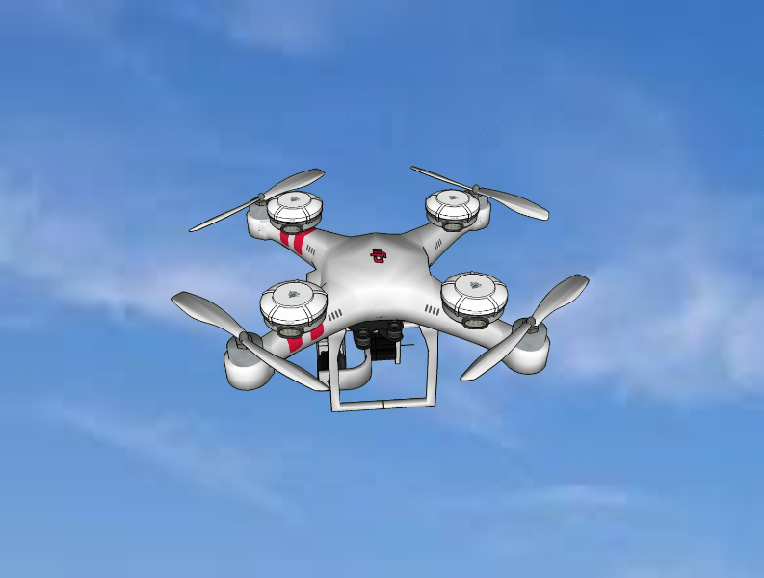
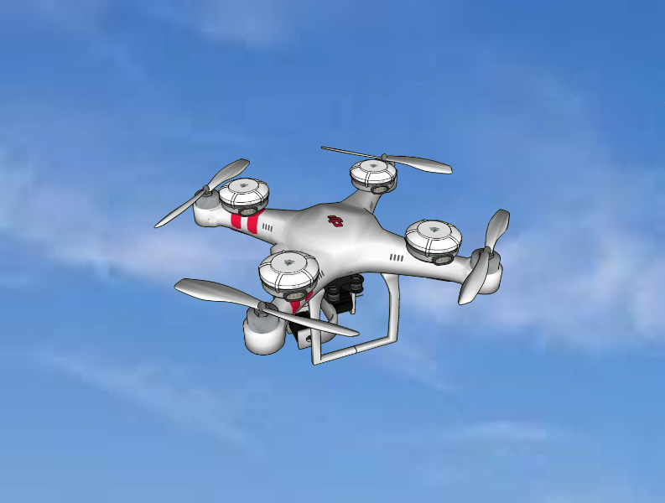
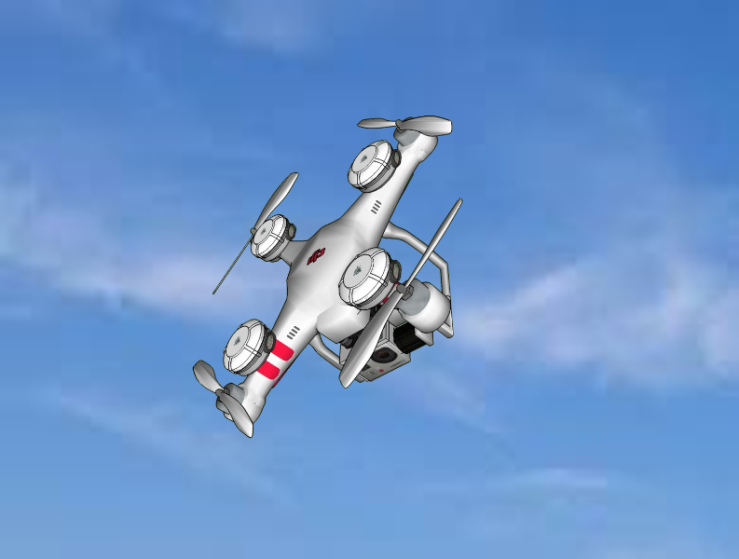
Integer Ambiguity Resolution depends on Flight Aggressiveness
Two regimes of aggressiveness
Low Dynamic Flights
Kalman Filter
Highly Aggressive flights
Particle Filter
Notes:
Under low dynamic flights .. The Bayesian filtering framework simplifies into a kalman filter .. And under highly aggressive flights .. We need to use pf to model dynamic errors ..

Slide 44
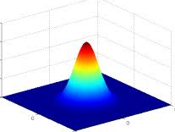
Orientation Estimation - Low Dynamic flights
$$\hat{q_{2}}=q1+Δq$$
$$\hat{q_{2}}$$
Pitch, Roll, Yaw
[$q_{1}$]
$$Δq$$
Pitch, Roll, Yaw
[$q_{2}$]
Pitch, Roll, Yaw
[$q_{3}$]
Trans.
Static Drone
Meas.
$$φ_{ij}^{sk}=f(q,N_{ij}^{sk})$$
$q_{1}$ known
$$\hat{N_{ij}^{sk}}=⌊f\left( ,φ_{ij}^{sk}\right)⌋$$
Kalman Filter
$$\tilde{q_{2}}=f\left(φ_{ij}^{sk},\hat{N_{ij}^{sk}}\right)$$
Notes:
Initiallu suppose the drone is static and we know its orientatin .. Then we can use trans to obtain dq and and it to q1 to get orientation at next time step … we can use qhat to estimate integer amb by substituting it in the measurement model .. Once we do that we can estimate of q2tilde … q2tilde and q2hat have Gaussian like error and we can use kalman filters to combine them

Slide 45
Highly Aggressive Flights: Cycle Slips
$$\hat{q_{2}}=q1+Δq$$
Pitch, Roll, Yaw
[$q_{1}$]
$$Δq$$
Pitch, Roll, Yaw
[$q_{2}$]
Pitch, Roll, Yaw
[$q_{3}$]
Trans.
Cycle Slips
Static Drone
Meas.
$$φ_{ij}^{sk}=f(q,N_{ij}^{sk})$$
$q_{1}$ known
Kalman filter derailed
$$\hat{N_{ij}^{sk}}=⌊f\left( ,φ_{ij}^{sk}\right)⌋$$
Kalman Filter
$$\hat{q_{2}}$$
$$\tilde{q_{2}}=f\left(φ_{ij}^{sk},\hat{N_{ij}^{sk}}\right)$$
Notes:
However .. Under aggressive flights transition model starts breaking ,, because of errors called cycle slips .. As a result the int amb estimations will be wrong .. Measurement functions will get derailed .. And the whole state estimation fails ..

Slide 46
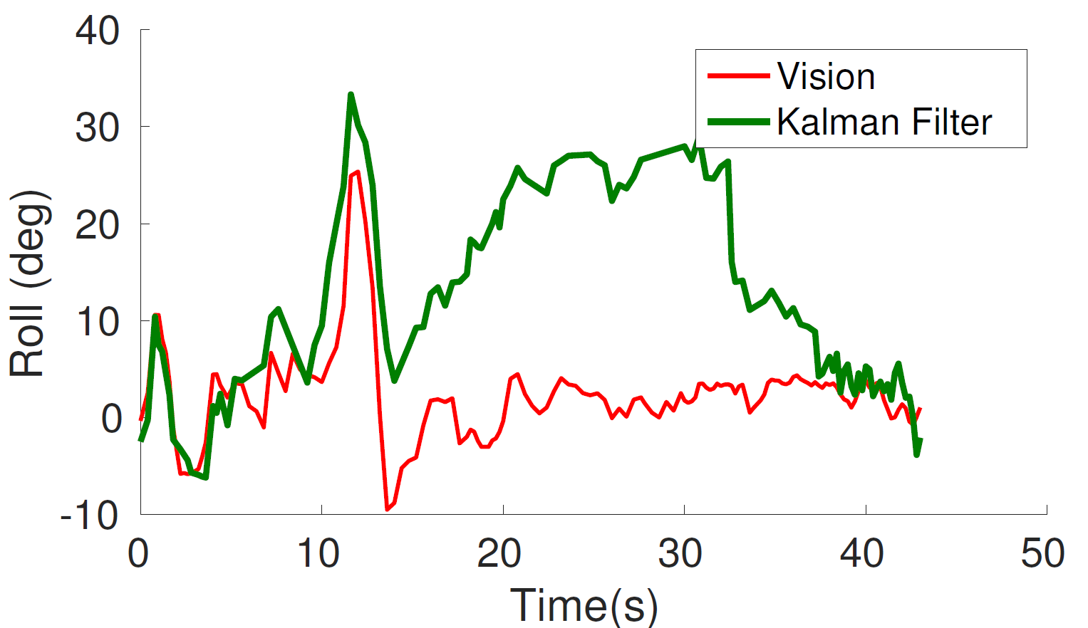
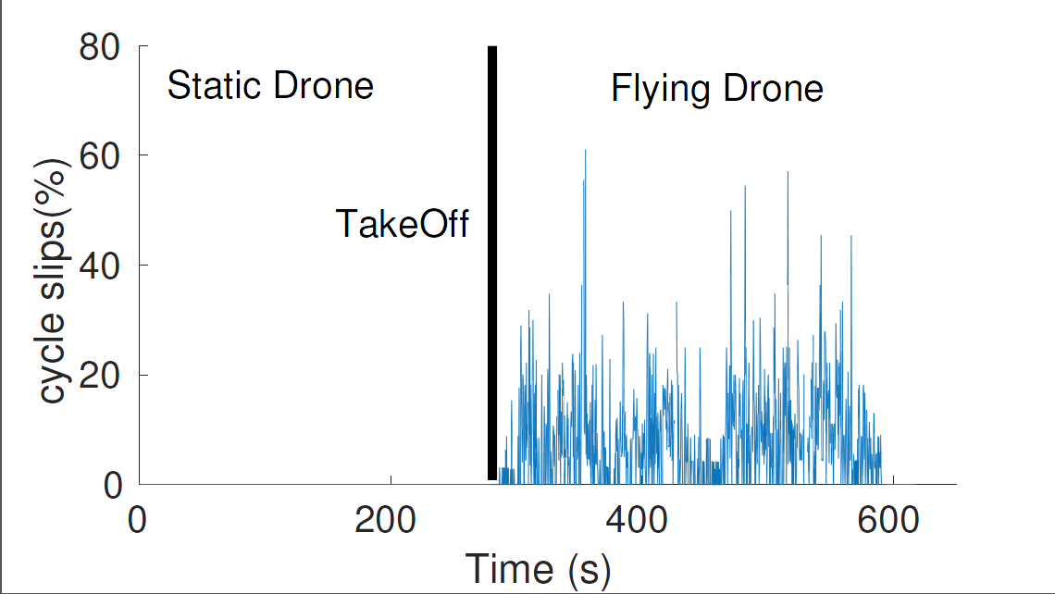
Divergence due to cycle slips
Cycle Slips trigger divergence
Several Cycle Slips during flight
Notes:
24 till here

Slide 47
Handling Aggressive Flights and Cycle Slips

Slide 48
Main Question
Kalman Filters are optimal under Gaussian error
When estimates of N incorrect, error no longer Gaussian
We need 2 solutions:
Identify when estimates of N are poor
Correct estimates in real time to prevent divergence
Notes:
In order to handle cycle slips .. We relax the model assumptions ..

Slide 49
1. Identifying Poor Estimates of N
Measurement Model
$$φ_{ij}^{sk}=f(q,N_{12}^{sk})$$
$$N_{ij}^{sk}=f(q,φ_{ij}^{sk})$$
$${cos⁡(2πN}_{ij}^{sk})=cos⁡(2πf\left(q,φ_{ij}^{sk}\right))$$
$$cosmetric(q)=Σ_{\{ij,sk\}}cos⁡(2πf\left(q,φ_{ij}^{sk}\right))$$
Correct Orientation → $cosmetric≈1$
Notes:
By slightly rearrging meas. Mode we can express int as a function of q and phases ..for correct orientation q it should truly give us integers .. Hecne multipl with 2pi and taking cosine .. So th etakeaway is that cosmetric can be 1 for correct orientation estimates and hence for a given orientation its cosmeric can be used as a confidence of its estimate

Slide 50
2. Correcting N via Particle Filters
Trigger Particle Filter
Keep doing
Kalman
Back to
Kalman
v
v
v
v
v
v
v
v
v
v
v
v
~
1
~
<
~
~
1
~
1
1
~
1
~
~
High Conf.
Low
Conf.
.
.
.
Notes:
So under high confidence

Slide 51
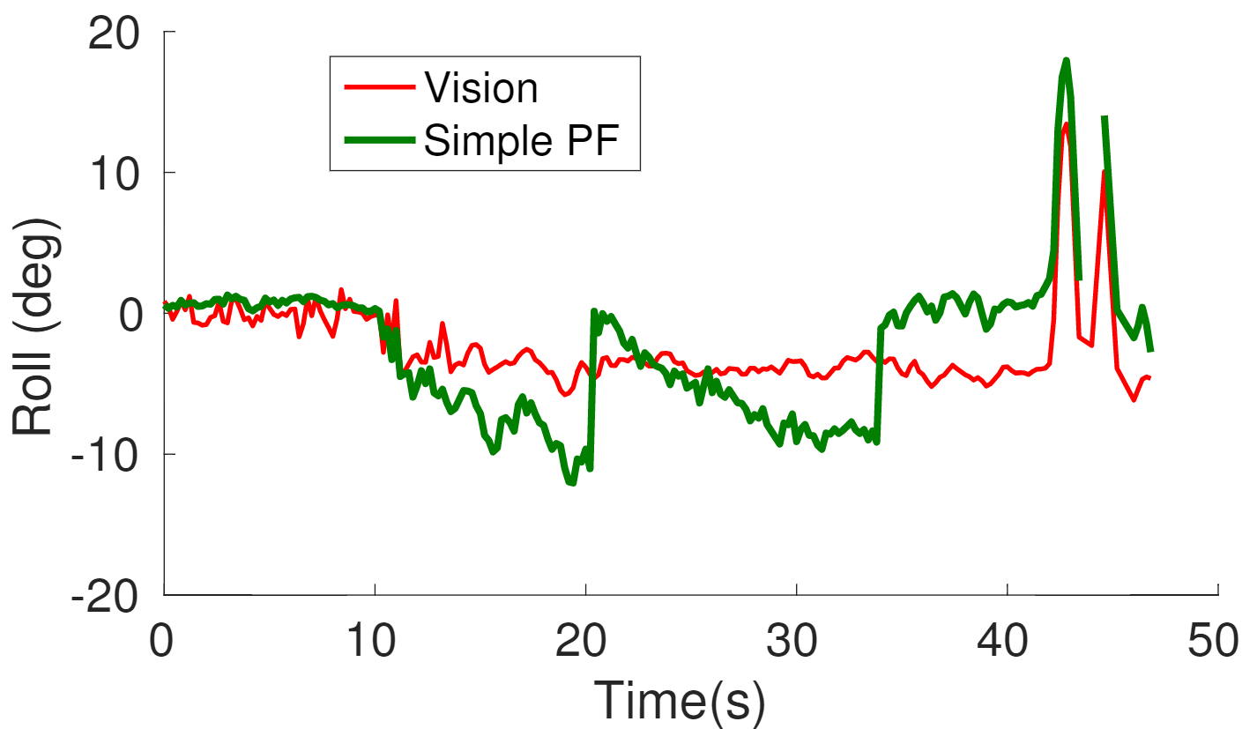
Simple Particle Converges slowly

Slide 52
Simple Particle Filter
$${time}_{0}$$
$${time}_{1}$$
Weigh and Propagate
$$Δq$$
Initial
Particles
Measurement (q)
Notes:
In a simple pf . The propagated states are transitioned asis and weighed with a conf. based on measurement function ..

Slide 53
Adjusted Particle Filter
Propagate the Adjusted State
$${time}_{0}$$
$${time}_{1}$$
$${time}_{2}$$
$$Δq$$
Provides near optimal combining for correct particles
Initial
Particles
Measurement (q)
Accelerates convergence with few particles
Combine Trans. And Meas. like Kalman Filter
Notes:
On the other hand .. We combine .. Trans and measured state explicitly ala KF and propagate the combined state instead .. This accelerates convergence with fewer particles

Slide 54
Adjusted Particle Tracks Well

Slide 55
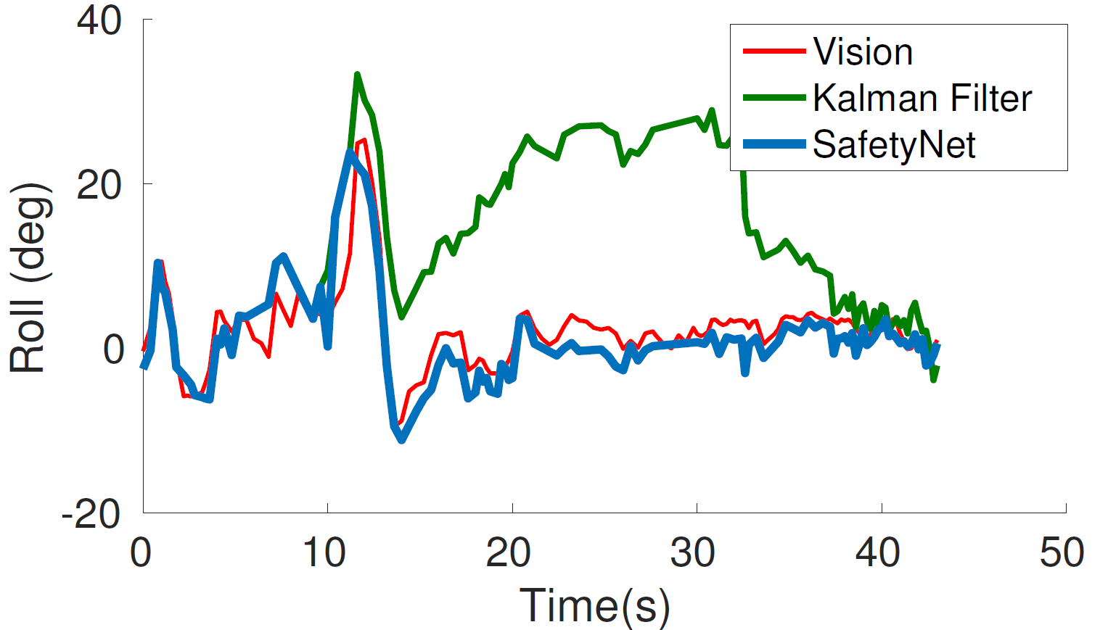
Adjusted Particle Tracks Well

Slide 56
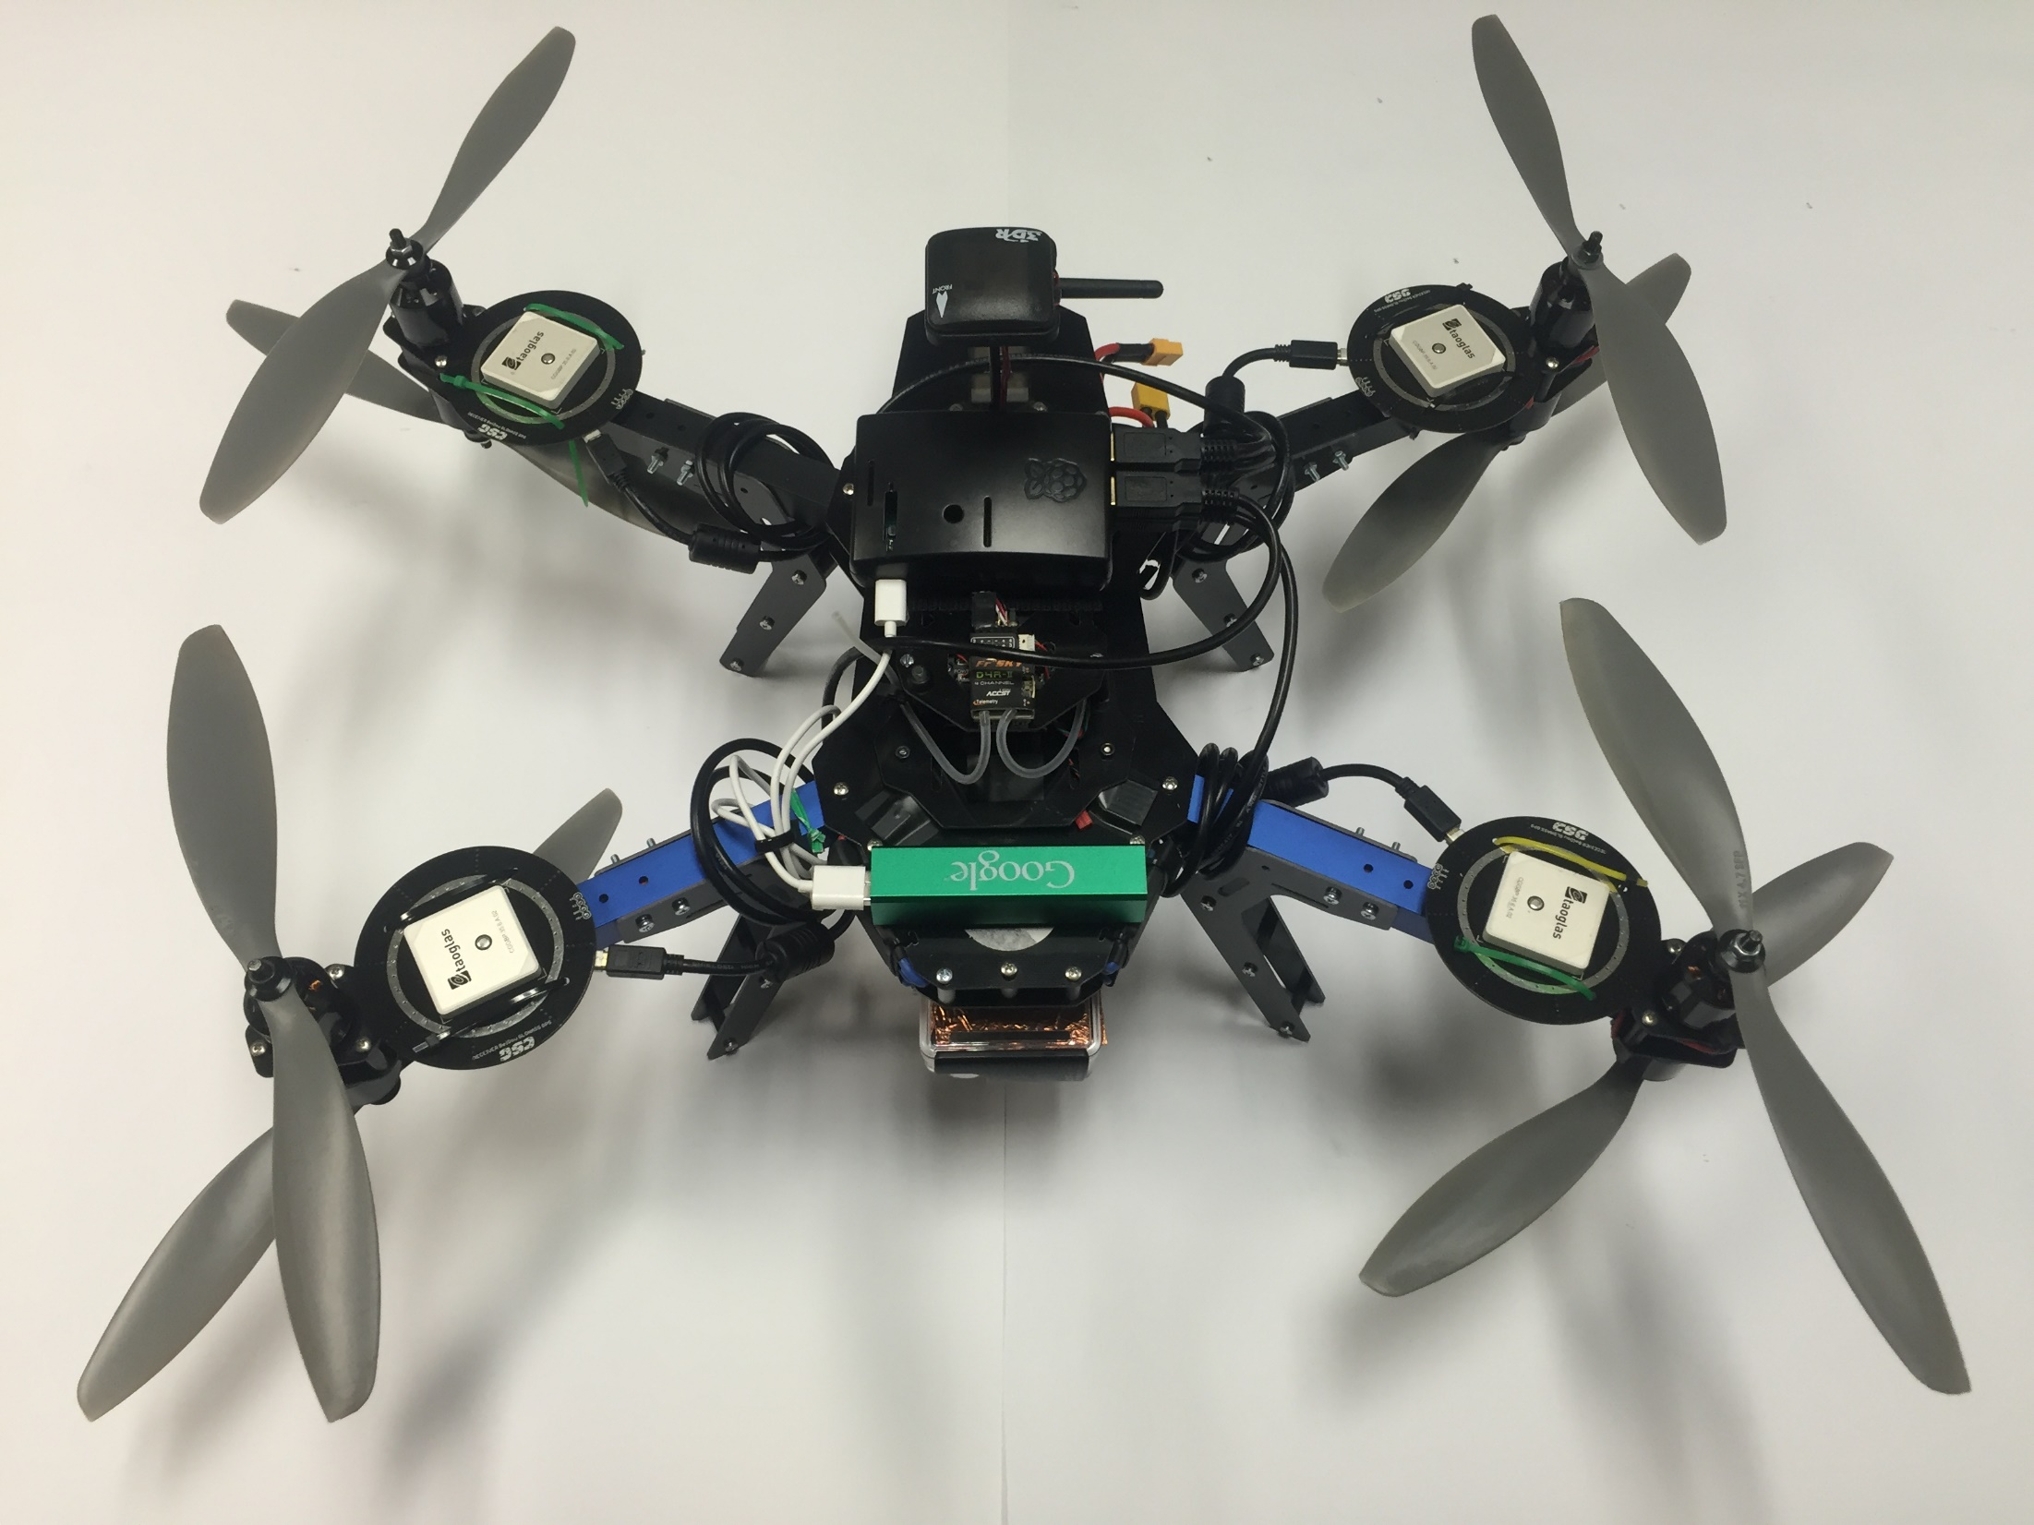
Evaluation Platform
Pi
GPS
IMU
GoPro

Slide 57
Peformance
Vision Ground Truth
GPS vs IMU

Slide 58
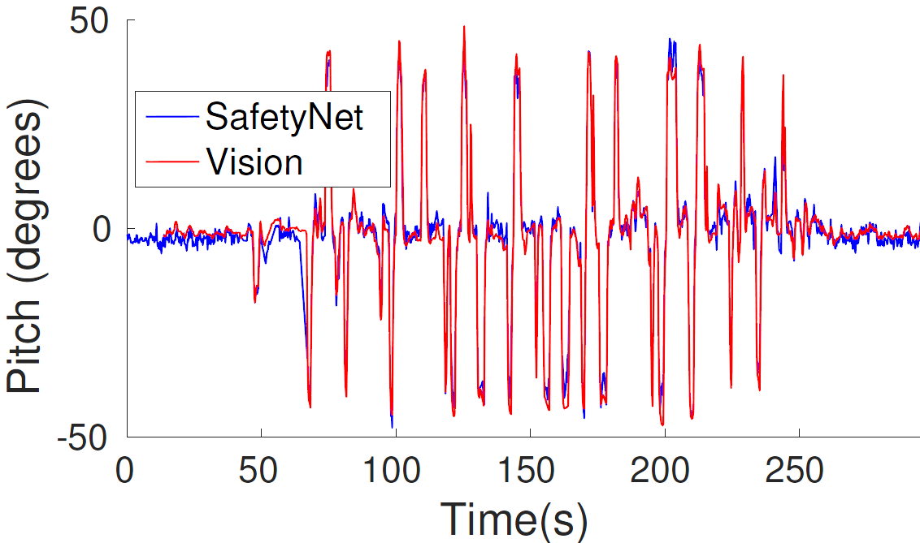
SafetyNet can track Aggressive Turns
Sharp Angles

Slide 59
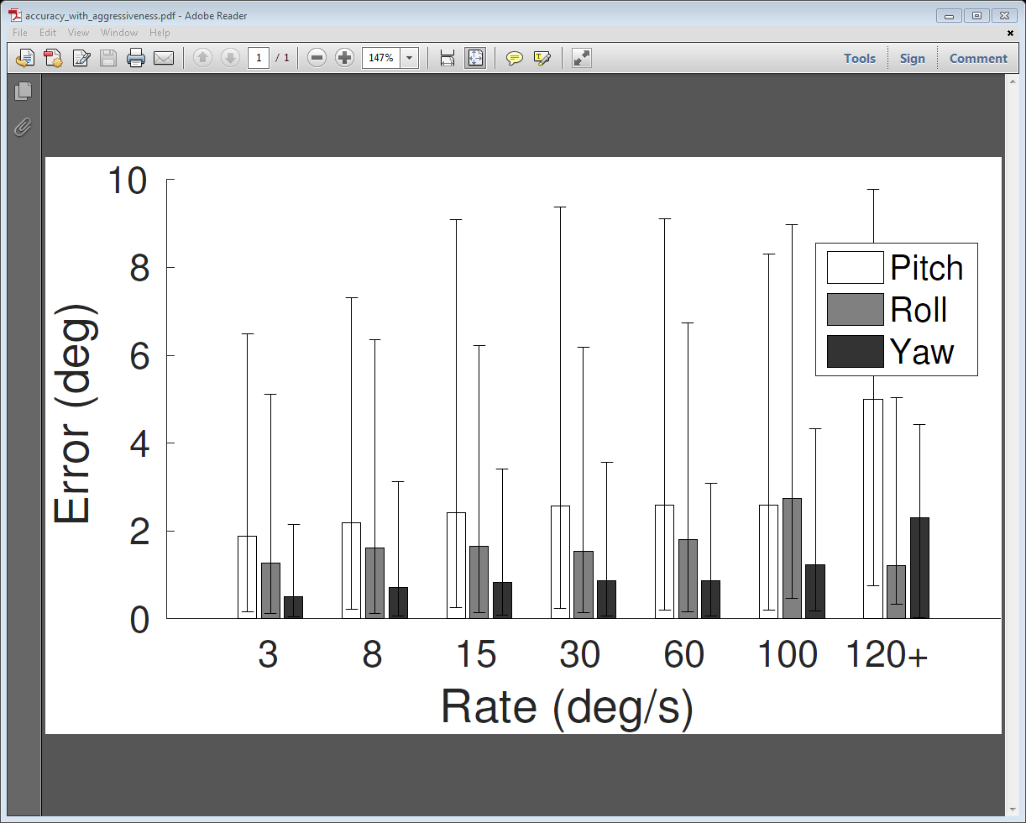
SafetyNet can track Aggressive Turns
Sharp Angles

Slide 60
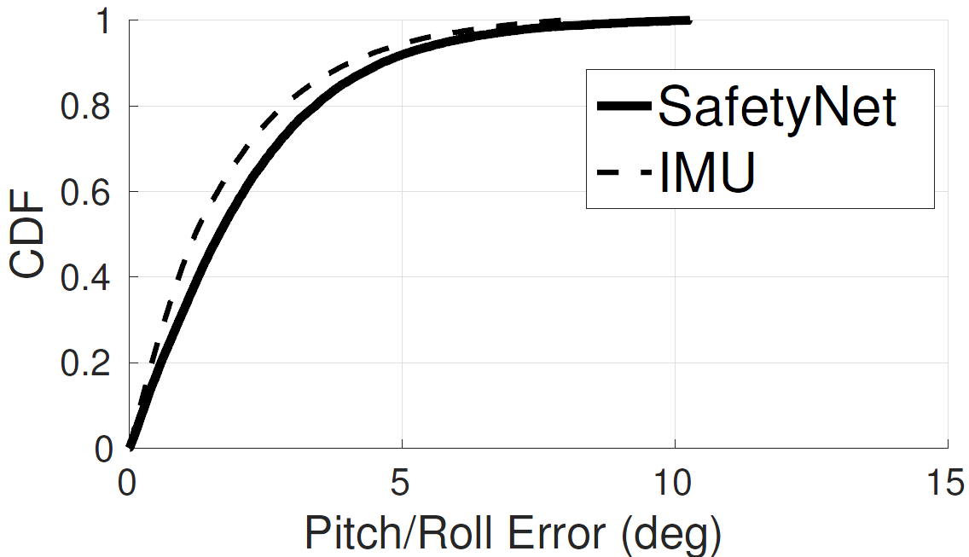
Comparison with IMU
Only 30% worse than IMU

Slide 61
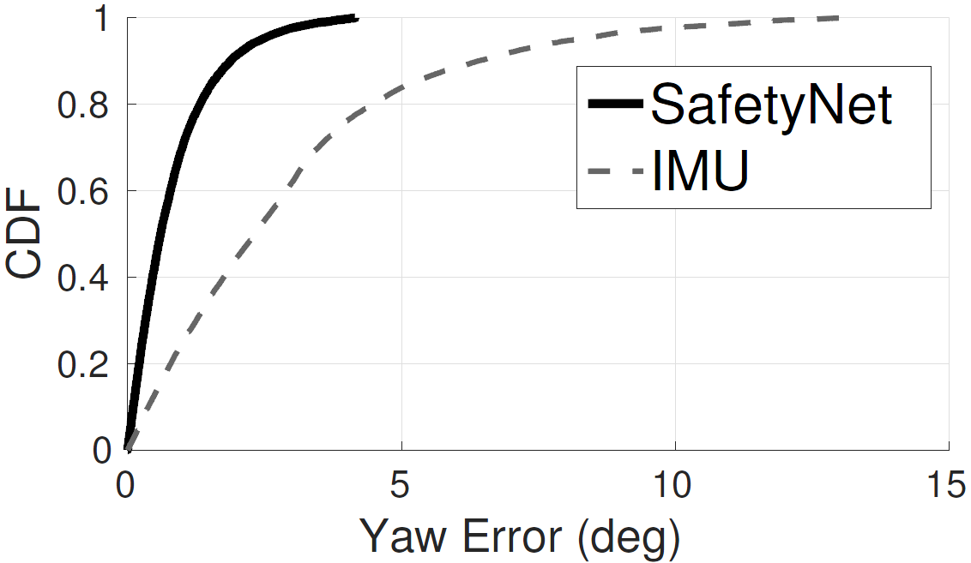
Comparison with IMU
4x better than IMU

Slide 62
Conclusion
Despite Excitement, poor relability is the show stopper for disruptive drone applications
We propose an orthogonal approach for drone state estimation using carrier phase GPS
We developed a Particle filter do systematically combine carrier phase data for orientation
Real Extensive flight tests achieve an accuracy comparable to IMU

Slide 63
Not Completely Solved Yet …
Cannot tolerate Jamming Attacks
Fusion of Carrier Phases with IMU can achieve better accuracy
Multipath decoupling can enable flying between buildings at low altitude
Orientation Estimation of Self Driving Cars can add to reliability

Slide 64
Thoughts?

