Slide 1
COIN-GPS: Indoor Localization from Direct GPS Receiving
Shahriar Nirjon
University of Virginia
Jie Liu, Gerald DeJean, Bodhi Priyantha,
Yuzhe Jin, and Ted Hart
Microsoft Research, Redmond

Slide 2
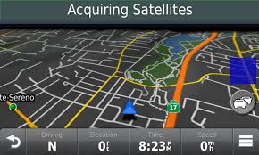
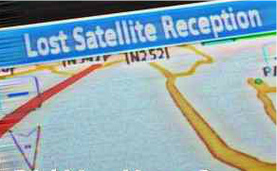
‘GPS does not work indoors’ - Everyone
Why?
Notes:
Everybody thinks that, the GPS system does not work indoors.
And perhaps, we all have seen the ‘acquiring satellites’ and/or the ‘lost satellite reception’ screen whenever a GPS receiver is inside a building or the line-of-sight between the receiver and a satellite is obstructed.
Let’s revisit why GPS does not work indoors.

Slide 3
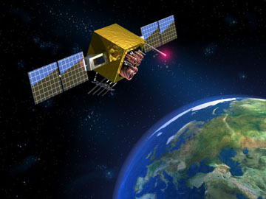
GPS Signal-Strength
500 W
1.4 x 10⁻¹⁶ W
Notes:
GPS signals are inherently weak from the source (25.6 W). The transmitted power before gain is comparable to a light bulb. The total radiated power from a GPS satellite is about 500 W (or 27 dBW).
And after traveling for more than 21,000 km, the received signal strength, in ideal conditions, of −155 dBW (or −125 dBm), which
is actually below the ambient RF noise floor (typically around −111 dBm).

Slide 4


GPS Signal-Strength Indoors
100 attowatts
1 to 10 attowatts
We cannot decode packets (e.g. time stamps, navigational data)
Notes:
Now, that was outdoors.
Indoors, building materials further reduce the signal strength by 10 to 100 times and there are multi-paths.

Slide 5

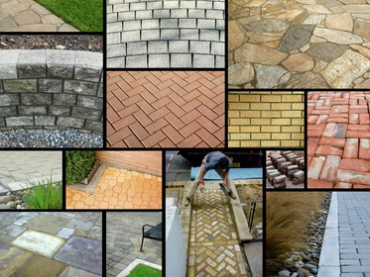
Heterogeneous Building Materials
Concrete
Wood
Glass
Steel
…

Slide 6
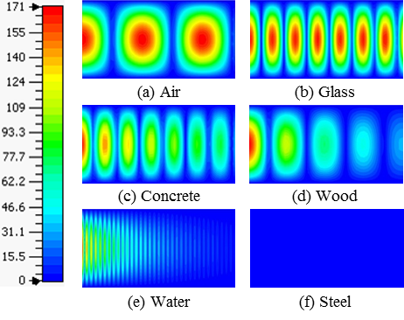
GPS Signals Thorough Building Materials
E⁺
E⁻
Good
Bad
2D electric field plots of a GPS signal propagating
through different materials
Notes:
We did a simulation based study on GPS signal’s attenuation through different building materials.
This figure shows the 2D electric field plot of a GPS signal passing through a 1 feet long wave guide. The blue color means the signal is totally lost.
We see that, materials like steel and water are extremely bad for GPS signals. Whereas, glass, concrete and wood let GPS signals penetrate the wall to some extent, but may not still be good enough to decode GPS packets.
So, these are the reasons why a standard GPS receiver does not work indoors.

Slide 7

Strategy and Leverages
Use no data from the GPS packets.
GPS
Opportunistically sample signals from multiple directions.

Slide 8


Strategy and Leverages
Leverage the slow movement of indoor receivers
Leverage the power of cloud computing

Slide 9
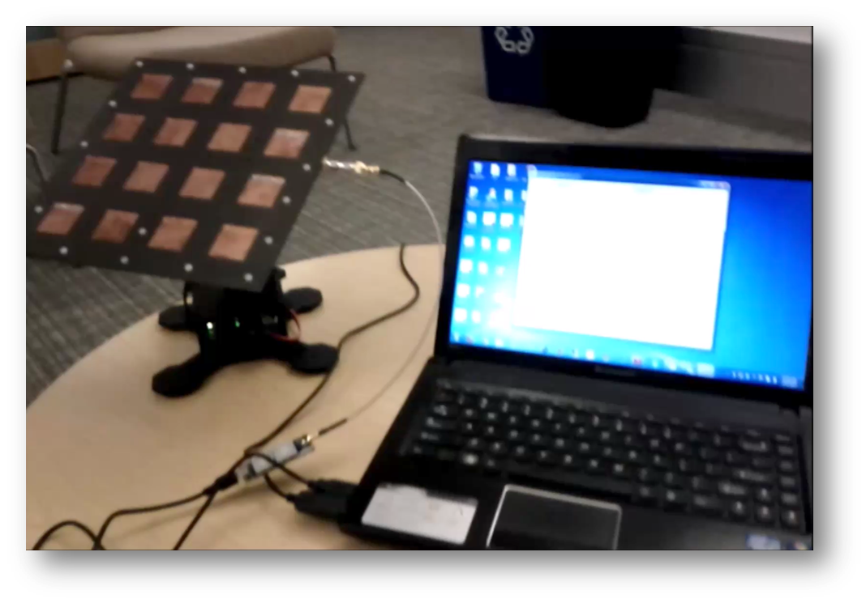
COIN-GPS: Cloud Offloaded Indoor GPS
We mechanically steer the antenna with a PC and collect GPS samples for offline processing
Notes:
With this goal in mind, we’ve built a Cloud-Offloaded Indoor GPS or COIN-GPS, in short.
The figure shows that an antenna is connected to a GPS receiver, using which we sample and store GPS packets. And later, the PC on its right, which is connected to a cloud service, computes the indoor location.
Let’s see the COIN-GPS in action.
We steer the antenna mechanically towards a fixed number of directions with the idea that, by combining GPS signals from one or more of the directions we would be able to compute the indoor location.

Slide 10
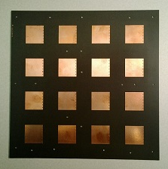
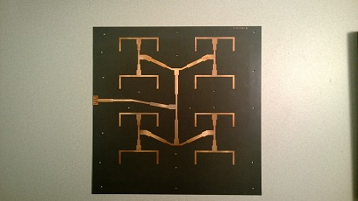
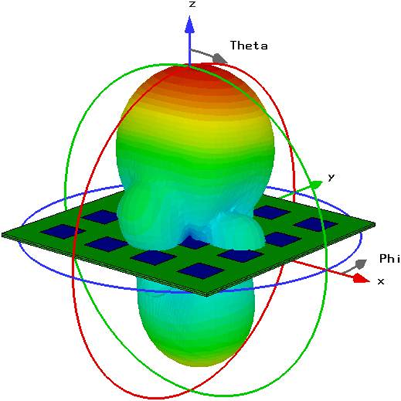
1. The Front End
We use a high-gain, directional antenna to get GPS signals from a certain direction.
Properties:
10 x 10 Sq. Inch
1575.42 MHz
12.3 dBi gain
Half power beam width: 35°
Notes:
This is the front and back side of the front-end antenna. On the right, we see the beam forming in simulation.
The antenna has dimensions of 10-by-10 inches, 12.3 dBi gain, half power beam width of 35degrees, and a broad side angle of almost 0*

Slide 11
2. The Back-End Processing
Satellite
Acquisition
From
Weak Signals
Location
Estimation
From
Inadequate
Satellites

Slide 12
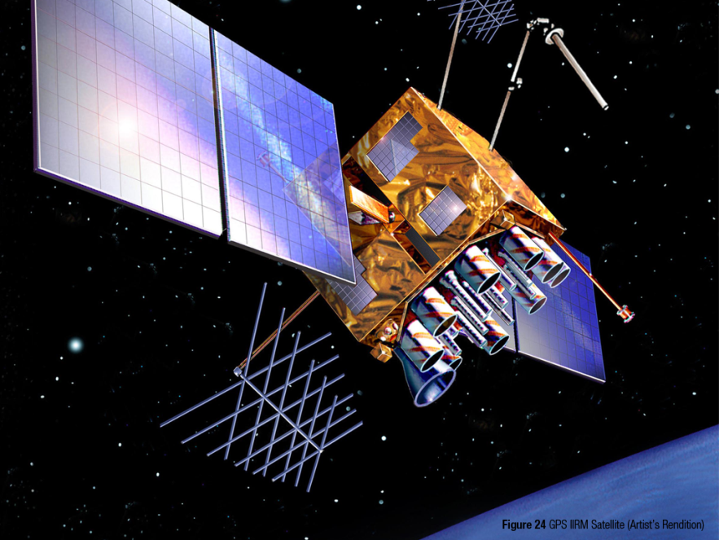
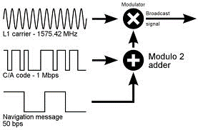
Acquiring Satellites
The standard acquisition process:
The Sender
Notes:
In standard satellite acquisition process, the navigational data from a satellite is first xored with the satellite specific C/A code and then modulated using the carrier frequency of 1.575 GHz.

Slide 13
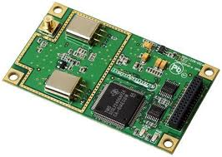
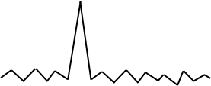


Acquiring Satellites (Instant GPS)
The standard acquisition process: (Instant GPS)
The Receiver
1 ms
demodulated GPS signals
Code Phase
Sat 01
*
…
Sat 32
*
Local C/A codes
Notes:
This slide shows what happens at the receiving end inside an Instant GPS.
The receiver, after demodulating the packets, takes ‘any’ 1 ms signal, and then it tries to find out which of the satellites are visible. The way it determines that is by taking each satellite specific C/A code and then computing correlation between the two. As we do not know the phase of the code, we have to circularly shift the C/A code and then keep taking correlations. The resultant are plots like these. Now, the plot tells us two things: (1) if there is a unique peak in the plot, then the satellite is visible/acquired, (2) the X- offset of the peak gives us the code-phase, which in tern, tells us the subMS part of the time.
Note: in an instant GPS, only the subMS part of the time is computed from the packet, as the MS part can be obtained from a nearby landmark (e.g. a cell tower or any other reference).

Slide 14
Satellite Acquisition from Weak Signals
The correlation plot in reality:
K = 1
Notes:
The correlation plot shown in previous slide was theoretical where there supposed to be only 1 unique peak. However, in practice, this is how a plot looks like. Now from this plot we might think that the highest peak is this one and the code-phase is like 25%.

Slide 15
Satellite Acquisition from Weak Signals
The correlation plot (integrated over multiple ms)
K = 1
K = 2
K = 4
K = 8
Notes:
But, if we consider more signals, and add-up multiple such plots, eventually we would see that the actual peak is somewhere near then end. So, this is one modification that we have done in satellite acquisition module in COIN-GPS. Instead of the theoretical 1 ms signal, we consider larger amount of signals and integrate correlations from multiple ms-s for robust satellite acquisition.

Slide 16
2. The Back-End Processing
Satellite
Acquisition
From
Weak Signals
Location
Estimation
From
Inadequate
Satellites

Slide 17
Required Satellites
How many satellites do we need?

Slide 18
Required Satellites (in Various Techniques)
How many satellites do we need?
Type | How Fast? | Unknowns
GPS | 30 sec
A-GPS | 6 sec
CTN | 1 ms
CO-GPS | 1 ms

Slide 19

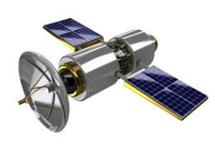


Required Satellites (in Various Techniques)
How many satellites do we need?
Type | How Fast? | Unknowns
GPS | 30 sec | X, Y, Z, B, C
A-GPS | 6 sec | X, Y, Z, B, C
CTN | 1 ms
CO-GPS | 1 ms
Fig. Common bias error

Slide 20



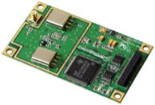
Required Satellites (in Various Techniques)
How many satellites do we need?
Actual
Wrong
Type | How Fast? | Unknowns
GPS | 30 sec | X, Y, Z, B, C
A-GPS | 6 sec | X, Y, Z, B, C
CTN | 1 ms | X, Y, Z, B, C
CO-GPS | 1 ms | X, Y, Z, B, C
800 m/s
C
dt
Fig. Coarse time error

Slide 21
Required Satellites (in Various Techniques)
How many satellites do we need?
Actual
Wrong
Type | How Fast? | Unknowns
GPS | 30 sec | X, Y, Z, B, C
A-GPS | 6 sec | X, Y, Z, B, C
CTN | 1 ms | X, Y, Z, B, C
CO-GPS | 1 ms | X, Y, Z, B, C
800 m/s
C
dt
Fig. Coarse time error
So… for instant GPS, we need 5 visible satellites

Slide 22
Acquired Satellites (Indoors)
How many satellites do we see indoors?

Slide 23
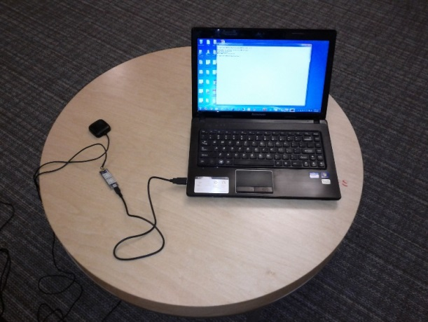
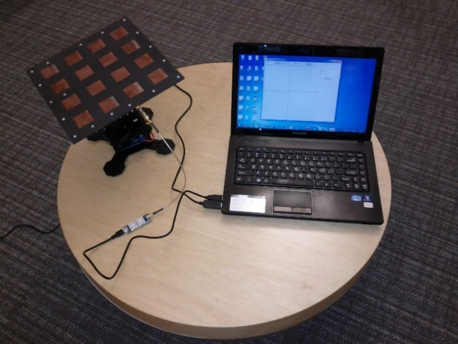
Acquired Satellites (Indoors)
How many satellites do we see indoors?
Garmin Antenna
Our Antenna

Slide 24
Acquired Satellites (Indoors)
How many satellites do we see indoors?
Garmin Antenna
%
N or more visible satellites
Our Antenna
But … 3 < 5

Slide 25
Handling Inadequate Satellites Problem
Our Approach: Receive, Wait and Receive again

Slide 26

Handling Inadequate Satellites Problem
Our Approach: Receive, Wait and Receive again
10:30.000 AM

Slide 27

Handling Inadequate Satellites Problem
Our Approach: Receive, Wait and Receive again
10:30.000 AM

Slide 28

Handling Inadequate Satellites Problem
Our Approach: Receive, Wait and Receive again
10:30.000 AM
10:30.500 AM

Slide 29
Handling Inadequate Satellites Problem
Our Approach: Receive, Wait and Receive again
10:30.000 AM
10:30.500 AM

Slide 30





Handling Inadequate Satellites Problem
Our Approach: Receive, Wait and Receive again
$$\left[\begin{aligned}E_{1} (x, y, z, b1, c1) \\ E_{2} (x, y, z, b1, c1) \\ E_{3} (x, y, z, b1,c1) \\ ? \\ ?\end{aligned}\right]$$
10:30.000 AM
$$\left[\begin{aligned}E_{4} (x, y, z, b2, c2) \\ E_{5} (x, y, z, b2, c2) \\ E_{6} (x, y, z, b2, c2) \\ E_{7} (x, y, z, b2, c2) \\ ?\end{aligned}\right]$$
10:30.500 AM

Slide 31

Handling Inadequate Satellites Problem
Our Approach: Receive, Wait and Receive again
$$\left[\begin{aligned}E_{1} (x, y, z, b1, c1) \\ E_{2} (x, y, z, b1, c1) \\ E_{3} (x, y, z, b1,c1) \\ ? \\ ?\end{aligned}\right]$$
$$\left[\begin{aligned}E_{1} (x, y, z, b1, c1,b2,c2) \\ E_{2} (x, y, z, b1, c1,b2,c2) \\ E_{3} (x, y, z, b1, c1,b2,c2) \\ E_{4} (x, y, z, b1, c1,b2,c2) \\ E_{5} (x, y, z, b1, c1,b2,c2) \\ E_{6} (x, y, z, b1, c1,b2,c2) \\ E_{7} (x, y, z, b1, c1,b2,c2)\end{aligned}\right]$$
10:30.000 AM
$$\left[\begin{aligned}E_{4} (x, y, z, b2, c2) \\ E_{5} (x, y, z, b2, c2) \\ E_{6} (x, y, z, b2, c2) \\ E_{7} (x, y, z, b2, c2) \\ ?\end{aligned}\right]$$
10:30.500 AM

Slide 32
Handling Inadequate Satellites Problem
The COIN-GPS formula:
For a stationary receiver, the required total number of visible GPS satellites for COIN-GPS is 2n + 3, where n is the number of independent readings and the same satellite acquired in different readings is considered different.
n | 2n+3
1 | 5
2 | 7
3 | 9
4 | 11

Slide 33





Experimental Setup
5 places
35 indoor locations
8 – 10 directions

Slide 34

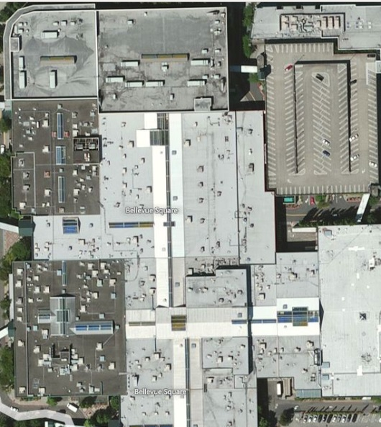
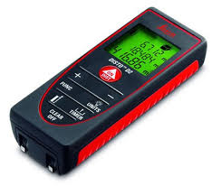
Experimental Setup
5 places
35 indoor locations
8 – 10 directions
Ground truth:
  Floor map
  Bing maps
  Laser pointer

Slide 35
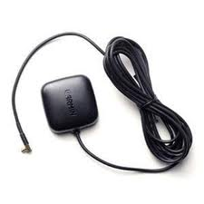
Experimental Setup
5 places
35 indoor locations
8 – 10 directions
Ground truth:
  Floor map
  Bing maps
  Laser pointer
Baseline:
  Garmin antenna with CO-GPS.
Garmin

Slide 36
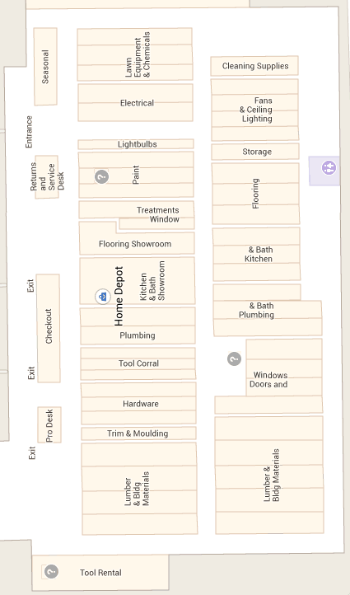
Results: Home Depot
A
System | Total Locations | Got Estimates
Garmin | 4 | None
Proposed | 4 | 4
B
D
C

Slide 37
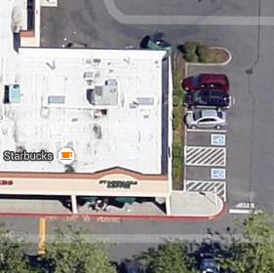
Results: Starbucks
System | Total Locations | Got Estimates
Garmin | 2 | None
Proposed | 2 | 2
A
B

Slide 38
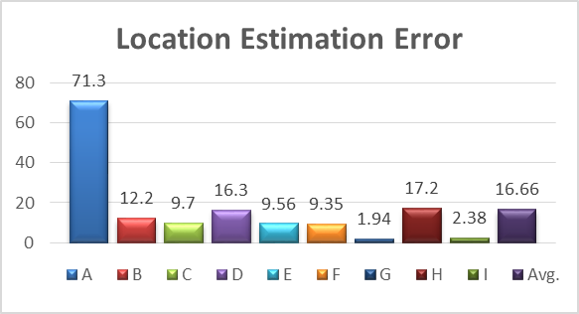
Results: Bellevue Square Mall
E
F
System | Total Locations | Got Estimates
Garmin | 16 | None
Proposed | 16 | 9
G
H
I
A
B
D
C

Slide 39
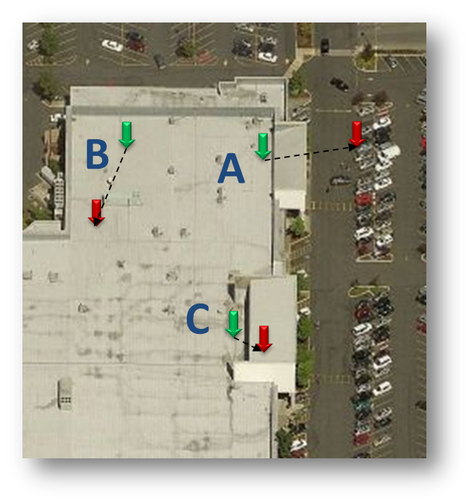
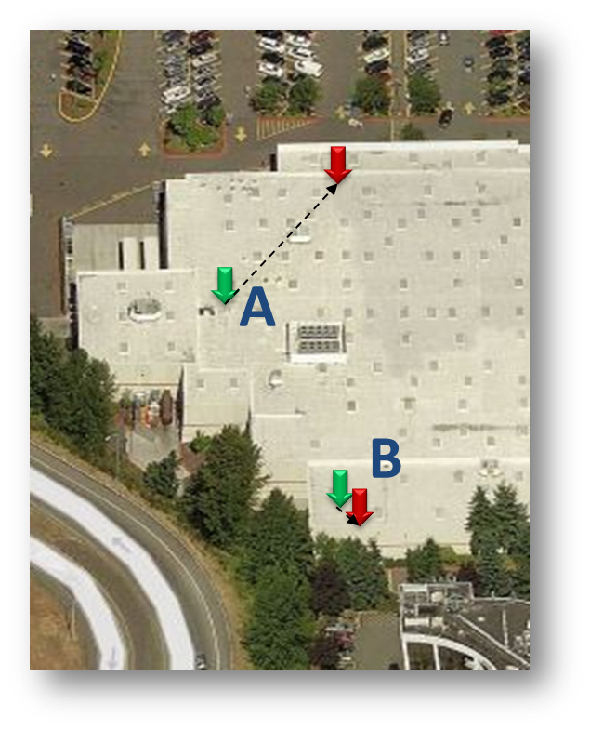
Results: Fred Meyer and Costco
System | Total Locations | Got Estimates
Garmin | 13 | None
Proposed | 13 | 5

Slide 40
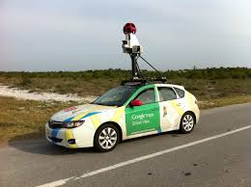
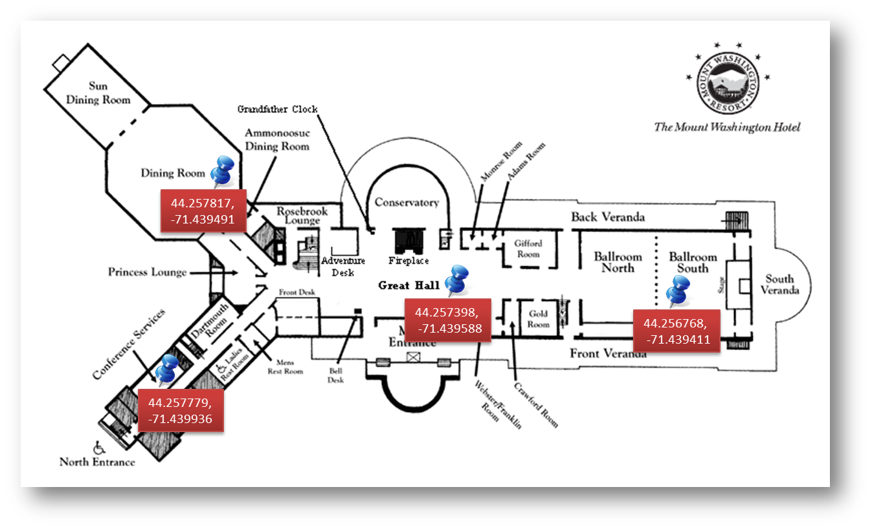
Concluding Remarks
If not for consumers, how about indoor profiling?

Slide 41
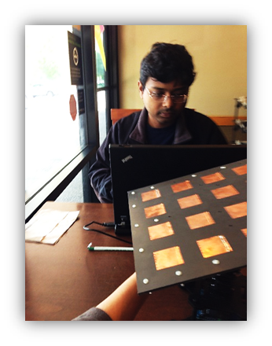
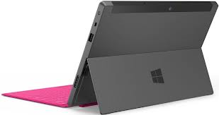
Concluding Remarks
Size does matter, if not phones – how about tabs?
Surface Pro Next ?

Slide 42
Thank You

