Slide 1
Lecture 3: Proof of Work and Nakamoto Consensus
Longest Chain Rule
Decentralized Identity, Ownership, Transfer
Variable difficulty mining
Private attack; security analysis

Slide 2
Blockchain with Merkle Trees
Block: Header + Data
Header: Pointer to previous block
= hash of the previous block header and Merkle root of data of previous block
Data: information specific to the block
Application: Centralized tamper evident information log with efficient proof of membership of any data entry
Head of the chain being known is enough to find tamper evidence in any internal block

Slide 3
Decentralized Blockchain
Block: Header + Data + Signature
Header: Pointer to previous block
= hash of the previous block header and Merkle root of data of previous block
Data: information specific to the block
Signature: one of the users signs the block (header+data)
List of signatures known ahead of time: permissioned blockchains
Questions:
How is this list known ahead of time?
Which user in this list gets to add which block?
Who polices this?
This is the topic of this lecture

Slide 4
Distributed Consensus
Question: Who maintains the ledger of transactions?
Distributed Consensus
Interactive Protocol
Allows distributed non-trusting nodes to come to agreement
Traditional area of computer science (Byzantine Fault Tolerance)
Bitcoin’s consensus protocol is vastly different
decentralized identity (permissionless setting)
less pessimistic network assumptions

Slide 5
Decentralized Identity
Public keys are used as identity
Single entity can create vast number of identities
Sybil
Cannot do majority or super-majority voting

Slide 6
Network Assumption
Any node can broadcast to all nodes into the network
fully connected network
Every broadcast message reaches every node
albeit with some delay
Bitcoin: ten minutes
This is the focus of Lecture 4

Slide 7
Oracle
Time is organized into slots
Oracle selects one of the nodes (public identities)
random
everyone can verify the unique winner
The selected node is the proposer in that slot
constitutes a block with transactions
validates transactions
includes hash pointer to previous block
signs the block

Slide 8
Proof of Work
Practical method to simulate the Oracle
Mining
cryptographic hash function creates computational puzzle
Hash(nonce, block-hash) < Threshold
nonce is the proof of work
include nonce inside the block
Threshold
chosen such that a block is mined successfully on average once in 10 minutes
a successfully mined block will be broadcast to all nodes in the network

Slide 9
Properties of Proof of Work Mining
Random miner selected at each time
Independent randomness across time and across miners
Probability of successful mining proportional to fraction of total hash power
Sybil resistance
Spam resistance
Tamper proof

Slide 10
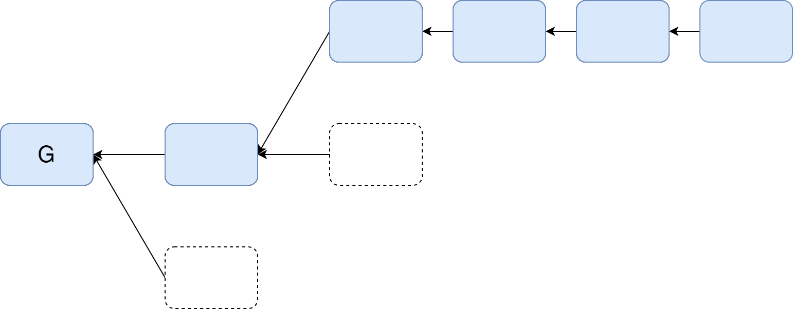
Longest Chain Protocol
Where should the mined block hash-point to?
Blockchain may have forks
because of network delays
because of adversarial action
Longest chain protocol
attach the block to the leaf of the longest chain in the block tree
what if two equal length chains? Discussed next
Notes:
Need a figure here. Show forks and point out the longest chain

Slide 11
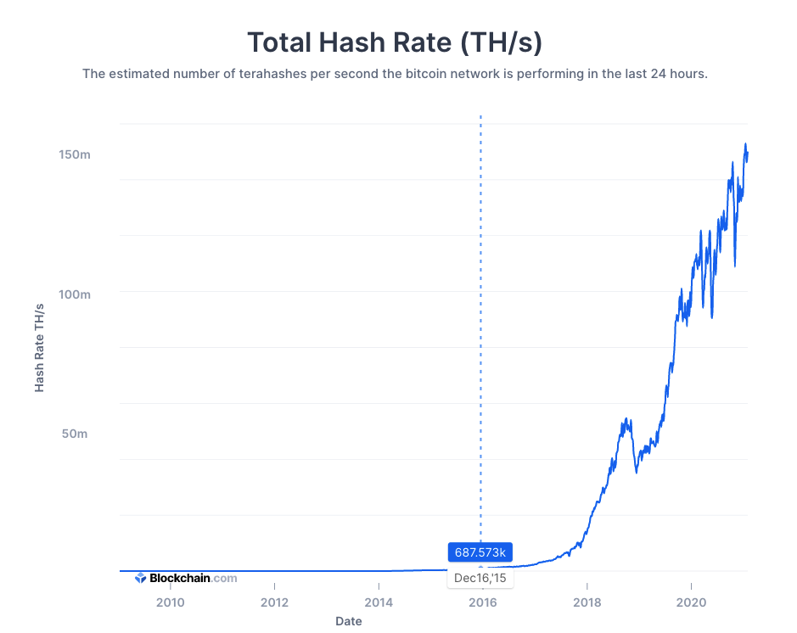
Why Variable Difficulty
Notes:
The mining power of Bitcoin increased exponentially by an astonishing factor of 10^14 during its decade of deployment.

Slide 12
Block Difficulty
As of March 2015, the mining target/threshold (in hexadecimal) is:
0000000000000000172EC0000000000000000000000000000000000000000000
So the hash of any valid block must be below this value.
In other words, only one in about 2^67 nonces that you try will work.
Difficulty of a block:
Block_difficulty = 1/mining_target

Slide 13
Bitcoin Rule
(a) The mining difficulty changes every 2016 blocks
next_difficulty = (previous_difficulty * 2016 * 10 minutes) / (time to mine last 2016 blocks)
(b) Adopt the heaviest chain instead of the longest chain
chain_difficulty = sum of block_difficulty
(c) Allow the difficulty to be adjusted only mildly every epoch
¼ < next_difficulty/previous_difficulty < 4
Notes:
2016 * 10 minutes = 2 weeks

Slide 14
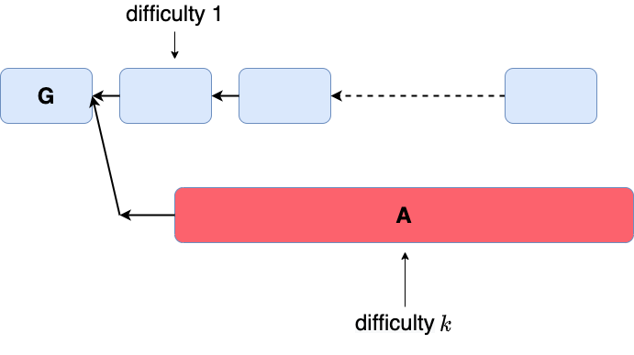
Alternate Bitcoin Rule (Only (b))
Let the miners choose their own difficulty and then use (b) the heaviest chain rule.
Notes:
Attack: The adversary tries to mine a "super" block that is as difficult as k honest block.
For the adversarial mining process, although the mean is the same, the variance is much high. If the adversary is "luck", he can mine this super block before honest nodes mine k blocks, the probability of which is a constant rather than exponentially decaying in 𝑘.

Slide 15
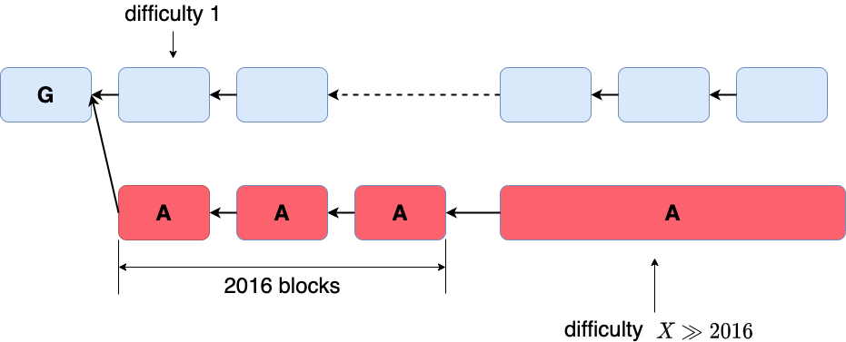
Alternate Bitcoin Rule ((a) + (b))
Difficulty rising attack
Notes:
The adversary creates an epoch filled with timestamps extremely close-together, so that the difficulty adjustment rule from (a) will set the difficulty extremely high for the next epoch, at which point, the adversary can utilize the high variance of the mining similar to the aforementioned attack.

Slide 16
Bitcoin Rule ((a) + (b) + (c))
Notes:
When the adversary completes one epoch in its private chain, the honest chain is much longer. The adversary can only rise the difficulty by 4. To catch up, he still needs to mine lots of blocks (some fraction of 2016), hence the variance is controlled.

Slide 17
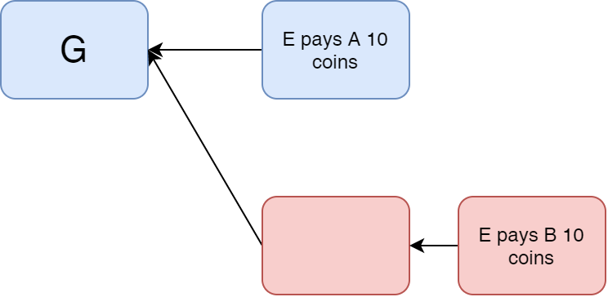
Security Analysis: Private Attack
Adversary can point its block to an older part of the chain
Duplicate transaction inserted
Plausible Deniability
network latency
an offline user will not know which block came earlier
blocks have no wall clock reference (time stamps).
Notes:
Figure to be drawn here of the double spend attack

Slide 18
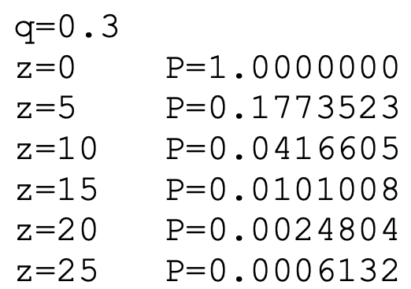
Security Analysis: k Deep Confirmation Rule
Satoshi’s Table
Notes:
Private attack in terms of voters over time. Need a better figure than this. Just focus on showing the private attack

Slide 19
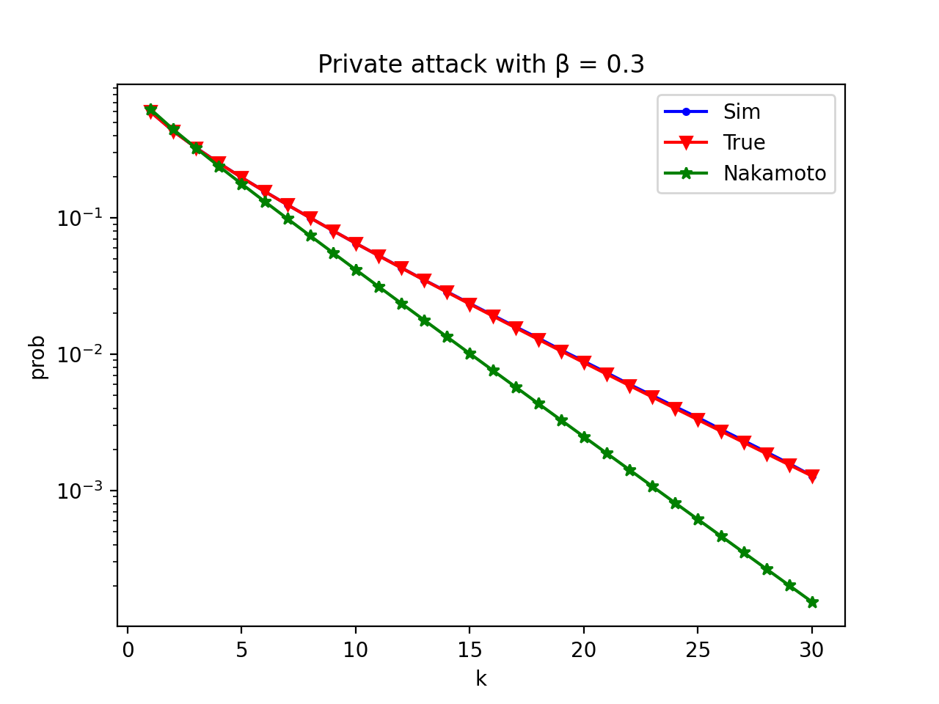
Security vs Latency with Private Attack

