Slide 1
ECE598PV Lecture 20 Blockchain Computer of Ethereum
Instructor: Prof. Pramod Viswanath
Lecture by Gerui Wang
April 6, 2021

Slide 2
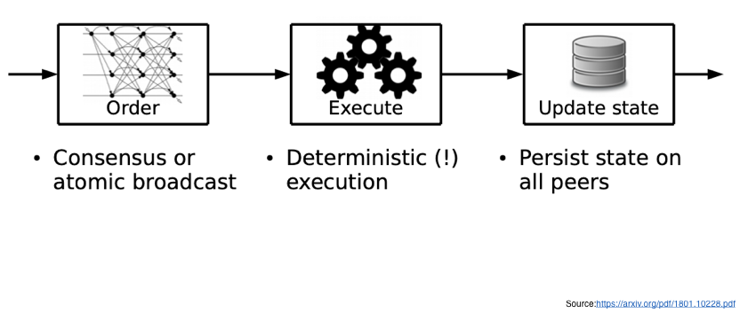
Order-Execute Structure

Slide 3
Order-Execute Structure

Slide 4
Persistent state storage (state db)
In the state of a payment system, account information includes:
address: identification
account-nonce: integer
balance: integer
In smart contract system like Ethereum,
address: identification
account-nonce: integer
balance: integer
code: a sequence of OPCODEs
account storage: <key: U256, value: U256>
Explained later

Slide 5
Persistent state storage (state db)
Hash Accumulator (Merkle Patricia Trie)
to compute the state root.
State root
Notes:
Source: https://ethereum.stackexchange.com/questions/268/ethereum-block-architecture

Slide 6
Persistent state storage (state db)
State root in
Block 1
State root in
Block 2

Slide 7
Creation of a contract
account-nonce: 0
balance: the value you payed (usually 0)
code: the OPCODEs you wrote (explained later)
account storage: empty
address: hash of your information and code.
What is OPCODEs and how to write them?

Slide 8
Order-Execute Structure

Slide 9
EVM OPCODE vs Solidity
Ethereum Virtual Machine Operation Code (EVM OPCODE)
Low level
Stack-based language
Similar to Machine Code/Assembly
Usually people write contracts in high level language like Solidity and compile them to OPCODE.
Solidity
High level
Solidity can be compiled to OPCODE
Similar to C++, Java, etc.

Slide 10
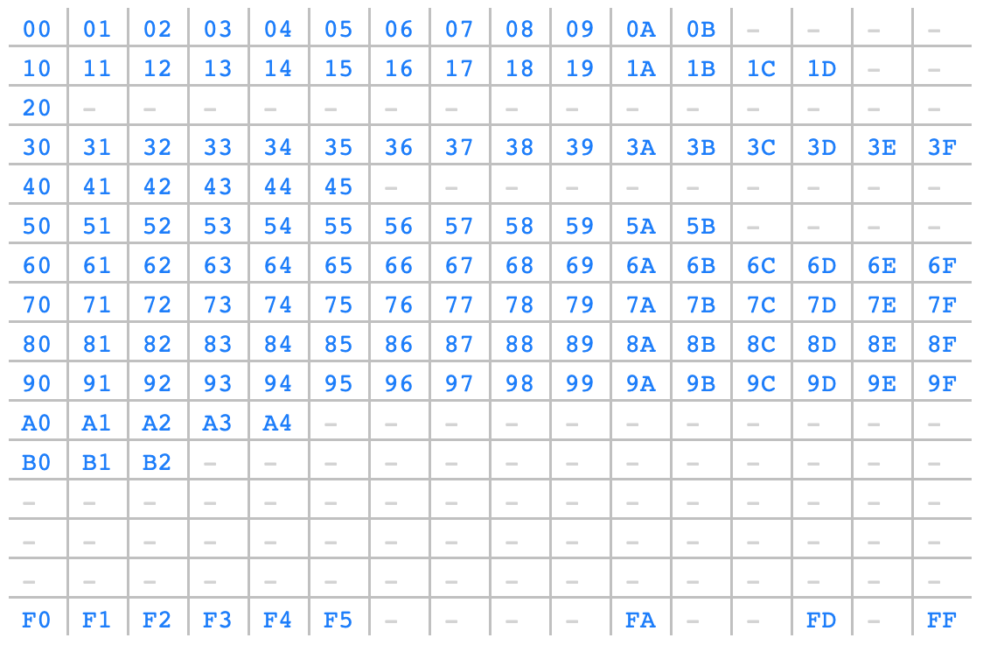
OPCODE
OPCODE is identified by a byte (00 - FF).
This is the current OPCODE in use.
Notes:
Source: https://ethervm.io/

Slide 11
Arithmetic Operations Comparison & Bitwise Logic Operations Keccak-256 hash Environmental Information Block Information Stack, Memory, Storage and Flow Operations Push Operations Duplication Operations Exchange Operations Logging Operations System operations
Notes:
Arithmetic Operations: Add, substract,
Comparison & Bitwise Logic Operations: less than, greater than, bitwise XOR
Keccak-256 hash
Environmental Information: this address, balance, caller address,
Block Information: block hash
Stack, Memory, Storage and Flow Operations: save word from stack to memory, vice versa, save word from stack to storage
Push Operations: push number to stack
Duplication Operations: duplicate item in stack
Exchange Operations: exchange item in stack
Logging Operations: create the log (log is a mechanism for users to keep track of what happens in the execution of a contract).
System operations: return, call other contract.

Slide 12
Stack-based language
During the execution, EVM keeps a (first in last out) stack. Stack item unit size is 256 bits (32 bytes). Stack maximum capacity is 1024.
OPCODEs insert/remove items to/from the stack.
Volatile, deleted after execution.

Slide 13
Example
(empty)
00...01
00...01
00...02
00...03
PUSH1 0x01
(push 0x01 and padding 0’s)
PUSH1 0x02
ADD
(add first & second item and push result in)

Slide 14
Memory
An array of bytes, addressed by an U256. Item unit size is one byte.
OPCODEs read/write the memory.
Volatile, deleted after execution.
Address: | 0x00...00 | 0x00...01 | 0x00...02 | …...
0x05 | 0x00 | 0x02 | 0x00 | …...

Slide 15
Storage
Key value storage. Key, value both 32 bytes.
OPCODEs read/write the storage.
Persistent.
Maintained in a hash accumulator.

Slide 16
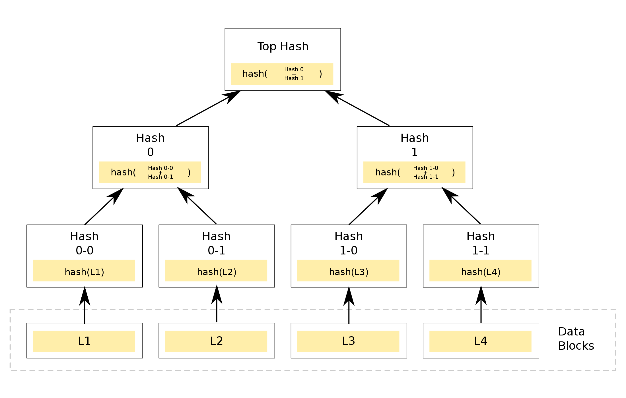
Stack vs Memory vs Storage
Stack (volatile)
Memory (volatile)
Storage (persistent)
32 bytes
32 bytes
…...
1 byte
1 byte
…...

Slide 17
What happens to Stack, Memory, Storage at execution?
Stack
Memory
Storage
Initialize a new instance of Stack & Memory
State DB
empty
empty
…...
…...

Slide 18
What happens to Stack, Memory, Storage at execution?
Stack
Memory
Storage
As contract runs, they are read/written...
As contract runs, storage is read/written...
State DB
0x00...13
...
0x14
0x50
…...

Slide 19
What happens to Stack, Memory, Storage at execution?
Stack
Memory
Storage
After exectuion
State DB
empty
empty
…...
…...

Slide 20
PC, contract, transaction, caller, etc information
Stack (volatile)
Memory (volatile)
Storage (persistent)
EVM initializes a program counter (pc: U256) pointing to the OPCODE to be executed, and increments as the contract runs.
EVM also requires information such as contract address, balance, transaction gas capacity, caller address, transaction call data, etc.
32 bytes
32 bytes
…...
1 byte
1 byte
…...

Slide 21
Example of executing OPCODE (not executing contract!)
Stack
Memory
Example OPCODE sequence:
PUSH1 0x01 PUSH1 0x02 ADD PUSH1 0x00 MSTORE PUSH1 0x20 PUSH1 0x00 RETURN
PC
empty
empty
…...
…...

Slide 22
Example of executing OPCODE (not executing contract!)
Stack
Memory
Example OPCODE sequence:
PUSH1 0x01 PUSH1 0x02 ADD PUSH1 0x00 MSTORE PUSH1 0x20 PUSH1 0x00 RETURN
PC
0x00...01
empty
…...
…...

Slide 23
Example of executing OPCODE (not executing contract!)
Stack
Memory
Example OPCODE sequence:
PUSH1 0x01 PUSH1 0x02 ADD PUSH1 0x00 MSTORE PUSH1 0x20 PUSH1 0x00 RETURN
PC
0x00...01
0x00...02
empty
…...
…...

Slide 24
Example of executing OPCODE (not executing contract!)
Stack
Memory
Example OPCODE sequence:
PUSH1 0x01 PUSH1 0x02 ADD PUSH1 0x00 MSTORE PUSH1 0x20 PUSH1 0x00 RETURN
PC
0x00...03
empty
…...
…...

Slide 25
Example of executing OPCODE (not executing contract!)
Stack
Memory
Example OPCODE sequence:
PUSH1 0x01 PUSH1 0x02 ADD PUSH1 0x00 MSTORE PUSH1 0x20 PUSH1 0x00 RETURN
0x00...03
0x00...00
empty
…...
…...
PC

Slide 26
Example of executing OPCODE (not executing contract!)
Stack
Memory
Example OPCODE sequence:
PUSH1 0x01 PUSH1 0x02 ADD PUSH1 0x00 MSTORE PUSH1 0x20 PUSH1 0x00 RETURN
empty
0x00
…...
…...
0x03
PC
32 bytes
Store value 0x00...03 to address 0x00...00 (to 32 bytes after)

Slide 27
Example of executing OPCODE (not executing contract!)
Stack
Memory
Example OPCODE sequence:
PUSH1 0x01 PUSH1 0x02 ADD PUSH1 0x00 MSTORE PUSH1 0x20 PUSH1 0x00 RETURN
0x00...20
0x00
…...
…...
0x03
32 bytes
PC

Slide 28
Example of executing OPCODE (not executing contract!)
Stack
Memory
Example OPCODE sequence:
PUSH1 0x01 PUSH1 0x02 ADD PUSH1 0x00 MSTORE PUSH1 0x20 PUSH1 0x00 RETURN
0x00...20
0x00...00
0x00
…...
…...
0x03
32 bytes
PC

Slide 29
Example of executing OPCODE (not executing contract!)
Stack
Memory
Example OPCODE sequence:
PUSH1 0x01 PUSH1 0x02 ADD PUSH1 0x00 MSTORE PUSH1 0x20 PUSH1 0x00 RETURN
0x00...20
0x00...00
0x00
…...
…...
0x03
32 bytes
Return value in memory from address 0x00...00 to address 0x00...20
PC

Slide 30
Example of executing OPCODE (not executing contract!)
Stack
Memory
Example OPCODE sequence:
PUSH1 0x01 PUSH1 0x02 ADD PUSH1 0x00 MSTORE PUSH1 0x20 PUSH1 0x00 RETURN
0x00...20
0x00...00
0x00
…...
…...
0x03
32 bytes
Return 0x00...03.
End of execution.
PC

Slide 31
Example of executing OPCODE (not executing contract!)
Stack
Memory
Try download and compile Open Ethereum evmbin package, and run
./target/release/openethereum-evm stats --code 600160020160005260206000f3
You will see output 0x0000000000000000000000000000000000000000000000000000000000000003
Example OPCODE sequence:
PUSH1 0x01 PUSH1 0x02 ADD PUSH1 0x00 MSTORE PUSH1 0x20 PUSH1 0x00 RETURN
0x00...20
0x00...00
0x00
…...
…...
0x03
32 bytes
Return 0x00...03.
End of execution.
PC

Slide 32
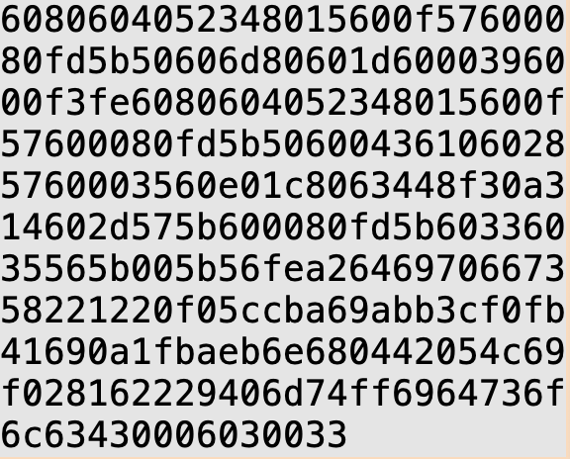
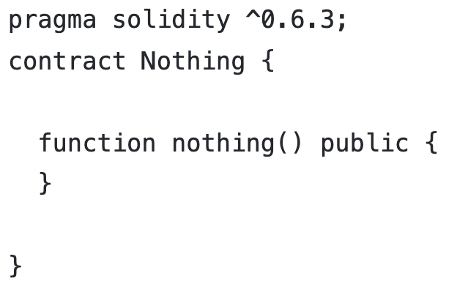
Creation of a contract
You can create a contract by a transaction. You provide the initialization OPCODE, which is usually provided by Solidity compiler.
Example: Initialization OPCODE:

Slide 33
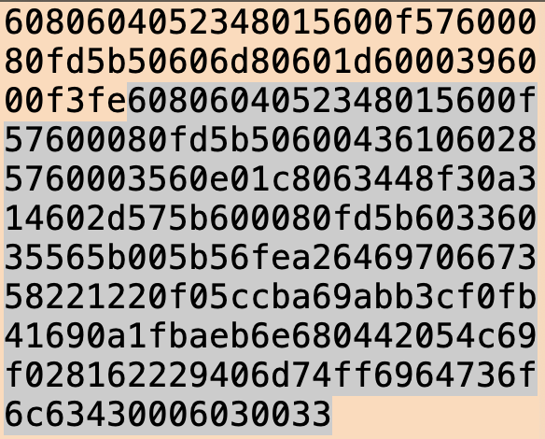
Creation of a contract
The initialization OPCODE basically does one thing: store the highlighted OPCODE into the newly created contract.

Slide 34
Creation of a contract
Now the contract is created:
account-nonce: 0
balance: the value you payed (usually 0)
code:
account storage: empty
address: hash of your information and code.

Slide 35
Calling/executing a contract
Now any address can call this contract with the contract address.
One can call this contract by providing:
contract address
call data
gas fee (similar to transaction fee in Bitcoin)
in a transaction.

Slide 36
Calling/executing a contract
Example:
contract address: the address just created
call data: 0x448f30a3
gas fee: doesn’t matter in private experiment
Hash of this function.

Slide 37
Stack
Memory
Storage
OPCODE:
call data: 0x448f30a3
State DB
empty
empty
…...
…...

Slide 38
How does contract know which function in a contract?
Stack
In the OPCODE, this sequence checks which function: CALLDATALOAD … PUSH4 0x448f30a3 EQ
call data: 0x448f30a3
empty

Slide 39
How does contract know which function in a contract?
Stack
In the OPCODE, this sequence checks which function: CALLDATALOAD … PUSH4 0x448f30a3 EQ
Call data is loaded into stack. (And do padding.)
call data: 0x448f30a3
0x00...448f30a3

Slide 40
How does contract know which function in a contract?
Stack
In the OPCODE, this sequence checks which function: CALLDATALOAD … PUSH4 0x448f30a3 EQ
Push 0x448f30a3 into stack.
call data: 0x448f30a3
0x00...448f30a3
0x00...448f30a3

Slide 41
How does contract know which function in a contract?
Stack
In the OPCODE, this sequence checks which function: CALLDATALOAD … PUSH4 0x448f30a3 EQ
Check whether two items are equal (answer is yes).
With “yes”, the contract can execute OPCODE that is for this function.
call data: 0x448f30a3
0x00...448f30a3
0x00...448f30a3

Slide 42
Features of OPCODE
There are OPCODEs that call other contracts, create new contracts, thus enabling recursion.
There are JUMP that controls pc, thus enabling if/else, for semantics in high-level languages.

Slide 43
Gas fee
Starting point: prevent someone writes and runs an infinite loop.
Gas cap: the maximum gas this transaction can use.
Gas usage: the gas fee incurred by executing OPCODEs and other operations.
Memory fee increases quadratically with usage.
Storage fee is much heavier than memory fee.
Base fee that every tx pays.
If gas usage > gas cap, execution aborted.
Gas price: decided by caller/sender. Actual fee = gas usage * gas price.

Slide 44
Gas fee
However, gas fee rule is not a perfect measurement for the cost of running contracts and has changed many times. (E.g., some OPCODE may have too high/low gas fee.)

Slide 45
How about payment to users?
Two types of account:
User
account-nonce balance code: empty all the time account storage: empty all the time address: hash of your public key.
You holds a key pair.
Contract
account-nonce: 0 all the time balance: usually 0 all the time code: OPCODE account storage: read/write from code address: hash of creator’s address and code.
No key pair.

Slide 46
How about payment to users?
Two types of transaction:
Pay to User
receiver: the user value gas capacity: set by sender gas price: set by sender call data: empty
The gas fee is a small constant.
Call a Contract
receiver: the contract value: usually 0 gas capacity: set by sender gas price: set by sender call data: the function and parameters, set by sender
The gas fee depends on the contract.

Slide 47
How about payment to users?
Also there is Create a Contract transaction, which is different from these two.
Two types of transaction:
Pay to User
receiver: the user value gas capacity: set by sender gas price: set by sender call data: empty
The gas fee is a small constant.
Call a Contract
receiver: the contract value: usually 0 gas capacity: set by sender gas price: set by sender call data: the function and parameters, set by sender
The gas fee depends on the contract.

Slide 48
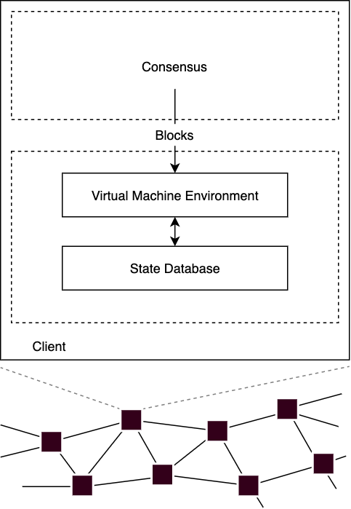
How does this fit into a blockchain client?
Virtual Machine Environment: Stack, memory, pc, etc.

Slide 49
References
Ethereum Yellow Book
Solidity website
https://ethervm.io/decompile

Slide 50
Q&A

