Slide 1
Lecture 17 Bootstrapping Blockchains
Bootstrapping PoW Blockchains
Bootstrapping PoS Blockchains
Bootstrapping via Layer 2 Methods

Slide 2
Bootstrapping PoW
Incentives
More rewards for early participants
Checkpointing
Hardfork
Litecoin for BTC and ETC for ETH
Proof of Burn
One way migration
Softfork
Partial upgrades
Notes:
Start demo:
launch network, how many AWS EC2 nodes
Show dashboard
Discuss plots: throughput, latency, forking performance

Slide 3
Bootstrapping via Incentives
Block Rewards
More rewards for early participants
Start at 50 BTC and halve every 210K blocks
Notes:
Start demo:
launch network, how many AWS EC2 nodes
Show dashboard
Discuss plots: throughput, latency, forking performance

Slide 4
Bootstrapping PoW
Incentives
More rewards for early participants
Checkpointing
Hardfork
Litecoin for BTC and ETC for ETH
Proof of Burn
One way migration
Softfork
Partial upgrades
Notes:
Start demo:
launch network, how many AWS EC2 nodes
Show dashboard
Discuss plots: throughput, latency, forking performance

Slide 5
Checkpointing
Use a trusted node to sign blocks on the longest chain
This is called checkpointing
Confirmation is now via checkpointed blocks
Security is from checkpointing node
Nakamoto was checkpointing Bitcoin until 2014
Transient stage of PoW is vulnerable to 51% mining attacks
Not all mining power is invested early on
Problem inherent to PoW blockchains
How to do checkpointing in a principled manner?

Slide 6
Bootstrapping via Checkpointing

Slide 7
New PoW blockchain
A->B:10
A->A’:10
$$β>0.5$$
Notes:
Block graph factorization scales computation and storage.
Coded Merkle tree scales communication.
Work virtualization creates incentivized Proof-of-Stake

Slide 8
Rely on an Honest node issuing checkpoints
Assume that there is an honest node
The honest node is authorized to “checkpoint” the PoW chain
Honest node runs a full node and checkpoints stable blocks
The consensus rule is changed to: Longest chain extending the latest checkpoint
Honest node assumption will be removed later

Slide 9
External checkpoint certificates
Checkpointing node issues checkpoint certificates
Checkpoint certificate = Sign(Checkpointed Blockhash)
Codebase accepts blocks only extending the checkpointed block
Checkpoint
Checkpointing node
(Nakamoto)

Slide 10
Checkpointed longest chain

Slide 11
Checkpointing
Import security
Checkpointed block cannot be reversed
Safety under a 51% mining adversary
A->B:10
A->B:10
A->A’:10
A->A’:10
Before checkpointing
After checkpointing

Slide 12
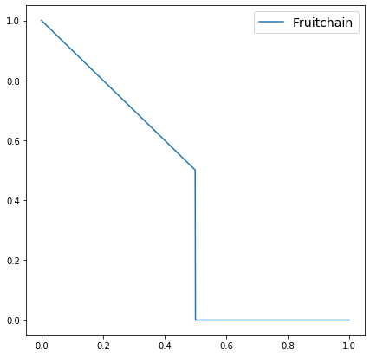
Liveness problem
Chain quality of blockchains is zero if $β≥0.5$ (Even for CQ optimizing chains such as Fruitchains)
Chain quality
Adversary fraction
Nakamoto checkpointing maintains
original CQ
Fruitchains
Fruitchains

Slide 13
Why is CQ important
Mining community of a PoW chain grows if new miners join and old miners do not leave
We need to ensure that honest miners are rewarded for their effort (inclusion of coinbase transactions in the ledger) even under an adversarial majority
Lack of a live checkpointing protocol creates an undesired spiral: Low honest participation -> Low honest miner rewards -> honest miners leaving (lower participation).

Slide 14
Solution 1: Introduce randomness with checkpoint
Introduce randomness with checkpoint certificate (certificate is placed on chain)
Honest nodes ensure that race between adversarial and honest chain restarts with every checkpoint
If inter-checkpoint interval (“epoch”) is small enough, the slower chain has a small probability to win (win ensures CQ>0)
$$β=0.6$$
$$γ=0.4$$
Prob>0.2

Slide 15
Internal checkpoint certificate
Checkpoint certificate = Sign(Checkpointed Blockhash)
Certificate is included in the chain, inttoduces randomness that restarts the race
Checkpoint
Checkpoint certificate
Checkpointing node

Slide 16
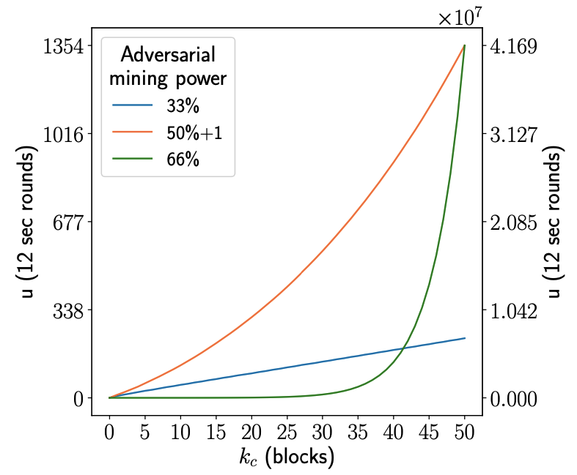
Solution 1: Introduce randomness with checkpoint
CQ degrades exponentially with epoch length

Slide 17
Advocate: Optimal CQ
Use checkpoint to include uncle blocks in the ledger
Honest checkpointing node includes references of uncle blocks in the checkpoint certificate

Slide 18
Advocate
0
Adversarial block
$$Chain Quality=1−β ∀ β$$
3
1
Honest block
Checkpointed block
5
2
0
1
Parent link
4
Ledger
2
Reference link
4
Checkpointing link
6
6
7
7
8
3
8
5
9
10
9

Slide 19
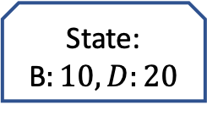
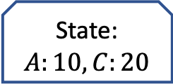
Advocate: Ledger sanitization
0
State:
$$A:10,C:20$$
1
2
4
$$tx: A→B:10$$
6
$$tx:C→D:20$$
7
Sanitization
8
3
$$tx:A→C:15$$
5
State:
B$:10,D:20$
9
Ledger

Slide 20
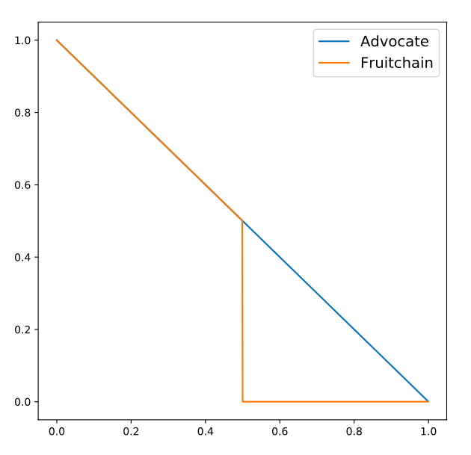
Advocate:CQ
Chain quality
Adversary fraction

Slide 21
Advocate using BFT-SMR
0
(0,0), Cert(0)
Committee based BFT_SMR replaces the honest checkpointing node
BFT-SMR is well established and can assumed to be supermajority honest
3
1
Main chain block
(1,1),(2,2),(3,1)
OBFT chain block
5
2
(4,3),(6,4)
Checkpointed block
4
Parent link
(5,2)
Inclusion link
6
(7,5), Cert(7)
Checkpointing link
Witness link
7
(8,6),(9,7)
8
(10,7)
10
9
BFT-SMR
Main chain

Slide 22
Extension to Prism
Proposer chain
Voter chains

Slide 23
Hard Fork
Use an existing blockchain ledger state to get started
This serves as the new genesis block
All coins and owners up to the fork also maintain their stakes in the new blockchain
Advantage: can siphon off existing users and miners from a successful blockchain
Bitcoin has led to many hard forks
Bitcoin Cash was a hard fork of Bitcoin, executed on 8/1/17

Slide 24
Proof of Burn
Convert coins in an existing blockchain into coins in a new blockchain
Send coins in existing blockchain to unusable destination addresses
The coin is said to be “burnt”
The proof of burnt coin is used to acquire coins in new blockchain
This is a method to migrate existing blockchain users into a new blockchain

Slide 25
SoftFork
Consensus works as usual but some nodes use added features
New features only work within those nodes that have upgraded
Old features work for everyone
Eg: Pay2HashKey script in Bitcoin
Strictly speaking this is not a new blockchain, but a “soft” new blockchain

Slide 26
Bootstrapping PoS Blockchains: Incentives
Incentives for new users
This time new coins and users needed in the genesis block
otherwise PoS doesn’t even begin to start off.
Compounding effect
Early stake means more chance of getting block rewards
This effect compounds dramatically; special to PoS and not there in PoW

Slide 27
Bootstrapping PoS Blockchains: Airdrop
Give stake for new users for free
Example: all users in Bitcoin are automatically given coins in new blockchain
Examples: Based on github activity
Popular way to bootstrap new blockchains
Old marketing ploy – giveaways and freebies to get new users enrolled

Slide 28
Bootstrapping via Layer 2 Methods
ERC20 Smart Contract
Smart contract on Ethereum
Has native token with local dynamics
Gas fees are in ETH, the global token
Many blockchains and tokens are simply built on Ethereum, the most popular, flexible platform (i.e., supports smart contracts).
Example: LINK
Examples: Initial Coin Offerings (ICOs). A way for businesses to raise capital for otherwise non-blockchain operations.
Bonding Curve
Combination of Proof of Burn and Airdrop
Notes:
Start demo:
launch network, how many AWS EC2 nodes
Show dashboard
Discuss plots: throughput, latency, forking performance

