Slide 1
Lecture 11: Extracting trust from the blockchain and scaling externally

Slide 2
Payment channels

Slide 3
Bitcoin Throughput
1MB size block every 10 mins: 1.7Kb/s
Average tx size: 250B
7 tx/s
Tx Fees Peaked at 35 USD/tx
Tx giving much lower tip will be ignored

Slide 4
How to improve capacity of bitcoin
Layer 1 changes
  Change parameters (Block size, block frequency)
  Change consensus algorithm
  Sharding
Layer 2 changes
  Payment networks
  Side chains

Slide 5
Layer 1: Change parameters
Make block size limit 1GB
  Good if miners are centralized
  Bad for decentralization as it hurts miners with weak network
  Bad for security due to wasted honest work
Decrease inter-block time
  Same cons as above

Slide 6
Layer 1: Consensus, Sharding
Change consensus algorithm to something faster (voting based BFT, Prism, etc)
  Still does full replication
Sharding: Split content in multiple parallel blockchains
  May eliminate need for full replication, some security hurdles
  Inter shard communication

Slide 7
Layer 2: Payment channels and sidechains
Sidechains:
  Small set of nodes(managers) maintain a blockchain pegged to bitcoin
  Resolve disputes on chain
Payment channels:
  Make payment off chain (participation only between parties involved in the transaction(and some others))
  Only post transaction on-chain to start the channel and handle a dispute
Alice
6 4
Bob
10BTC

Slide 8


Payment channels: One-way example
Use a bike sharing service: $0.1 per minute
$0.1
$15
$0.1
30mins
$0.1
$12
What if the user does not trust the bike to send back $12?
You need a collateral?

Slide 9


Locking and unlocking script: Pubkeyhash
<sig>
<pubkey>
---------------
OP_DUP
OP_HASH160
<pubkeyhash?>
OP_EQUALVERIFY
OP_CHECKSIG
Redeeming transaction (Unlocking)
Referenced output transaction
(UTXO input) (Locking)
Input
Output
1 BTC from Alice
1 BTC to holder of pubkeyhash
Signature from holder of pubkeyhash
------------------------

Slide 10
Multisig
Locking transaction has to be signed by k out of n pubkeys.
Example: Requires transaction by Bob and Carol to unlock (2 out of 2)
  Cannot be unlocked by signature of Bob or Carol alone

Slide 11
Hashlock
Can be unlocked by the owner of a public key(Bob) and a secret
Locking transaction has: Hash(secret) + pubkey
Unlocking transaction should have secret and a signature by Bob

Slide 12
Timelock
CLTV(CheckLockTimeVerify)
  Pay to Bob after a certain blockheight
CSV(Check sequence Verify)
  Specific blocks after a CSV output is recorded in the blockchain

Slide 13
One-way payment channel
Funding transaction
  Creates the channel and is broadcast on the blockchain
Commitment transactions
  Intermediate transaction not typically posted on blockchain
Closing transaction
  Closes the channel, posted on blockchain
  Cooperative or non-cooperative

Slide 14
Funding transaction
10BTC
2 of 2 Multisig (Alice and Bob)
Or
1-week timelock Alice
10 BTC signed by Alice
Posted on blockchain
Alice
Bob
10BTC
O BTC

Slide 15
Commitment transactions
9 BTC
To Alice
8 BTC
To Alice
10 BTC signed by Alice and Bob
10 BTC signed by Alice and Bob
1 BTC
To Bob
2 BTC
To Bob
Not posted on blockchain
Held by Bob, signed by Alice
Not posted on blockchain
Held by Bob, signed by Alice

Slide 16
Closing transaction - cooperative
0 BTC
To Alice
10 BTC signed by Alice and Bob
10 BTC
To Bob
Bob posts on blockchain

Slide 17
Closing transaction – Non cooperative
Bob is offline (non cooperative)
10BTC
2 of 2 Multisig (Alice and Bob)
Or
1-week timelock Alice
10 BTC
To Alice
10 BTC signed by Alice
10 BTC signed by Alice after a week
0 BTC
To Bob
Funding transaciton
Alice posts on blockchain
Bob has to redeem before a week

Slide 18
Two-way payment channel
Alice
Bob
Opening transaction
5BTC
5BTC
5 BTC signed by Alice
10BTC
2 of 2 Multisig (Alice and Bob)
5 BTC signed by Bob
Create secret and exchange hash(secret)
Not posted on blockchain
Not signed by both yet

Slide 19
Commitment transaction
5 BTC
1 week timelock (CSV) Bob or
Alice if she knows Bob’s secret
5 BTC
1 week timelock (CSV) Alice or
Bob if he knows Alice’s secret
10 BTC signed by Alice and Bob
10 BTC signed by Alice and Bob
5 BTC
To Alice
5 BTC
To Bob
Half signed by Alice, held by Bob
Half signed by Bob, held by Alice

Slide 20
Opening transaction broadcast
On receiving half-valid commitment transactions, post the opening transaction, post the opening transaction on blockchain
There is a way out if the other party does not cooperate
Neither Alice nor Bob gain anything by posting commitment transactions

Slide 21
Commitment transactions
Older secrets are exchanged, and new secrets are created (Why?)
Let's say Alice wants to send 1 BTC to Bob
6 BTC
1 week timelock (CSV) Bob or
Alice if she knows Bob’s secret
4 BTC
1 week timelock (CSV) Alice or
Bob if he knows Alice’s secret
10 BTC signed by Alice and Bob
10 BTC signed by Alice and Bob
4 BTC
To Alice
6 BTC
To Bob
Half signed by Alice, held by Bob
Half signed by Bob, held by Alice
Ideally neither sign and broadcast your half of the transaction at all.

Slide 22
Commitment transaction
Older secrets are exchanged, and new secrets are created (Why?)
Let's say Bob wants to send 1 BTC to Alice
5 BTC
1 week timelock (CSV) Bob or
Alice if she knows Bob’s secret
5 BTC
1 week timelock (CSV) Alice or
Alice if he knows Alice’s secret
10 BTC signed by Alice and Bob
10 BTC signed by Alice and Bob
5 BTC
To Alice
5 BTC
To Bob
Half signed by Alice, held by Bob
Half signed by Bob, held by Alice

Slide 23
Closing transaction
Close the channel by revealing any one of the commitment transaction (non cooperative)
Cooperative, create a transaction sending the settled balance to each party

Slide 24
ACeD: Scalable Data Availability Oracle

Slide 25
Trust from Trusted Blockchain
Safe and live for a long time
Poor performance
Trusted Blockchains
  Bitcoin, Ethereum
New Blockchains
  Ouroboros, Prism
Layer 2 method
  Payment/State channels
Side Blockchains
  Derive trust from trusted blockchains
  Commit hashes periodically
High performance
Wholesale change
Limited application
Same layer 1 structure
Simple, efficient and practical

Slide 26

Data Availability Attack
Side Blockchains
  Order of blocks ← order of hashes
  Attack: not transmit the block to others

Slide 27
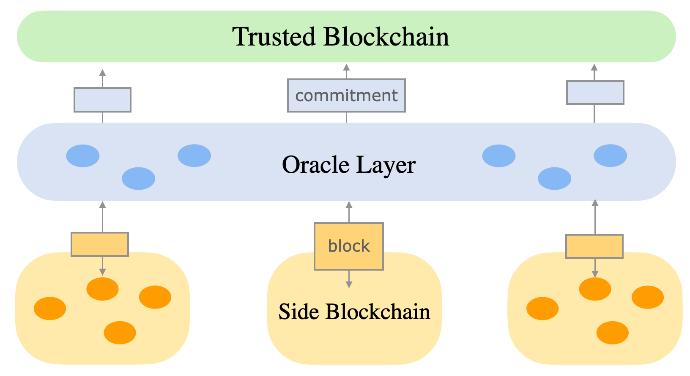
Data Availability Oracle
2. Push commitments
Oracle nodes
1. Accept blocks
3. Return blocks

Slide 28
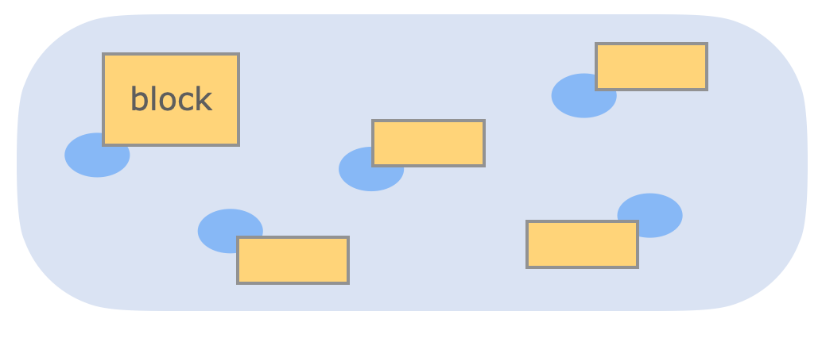
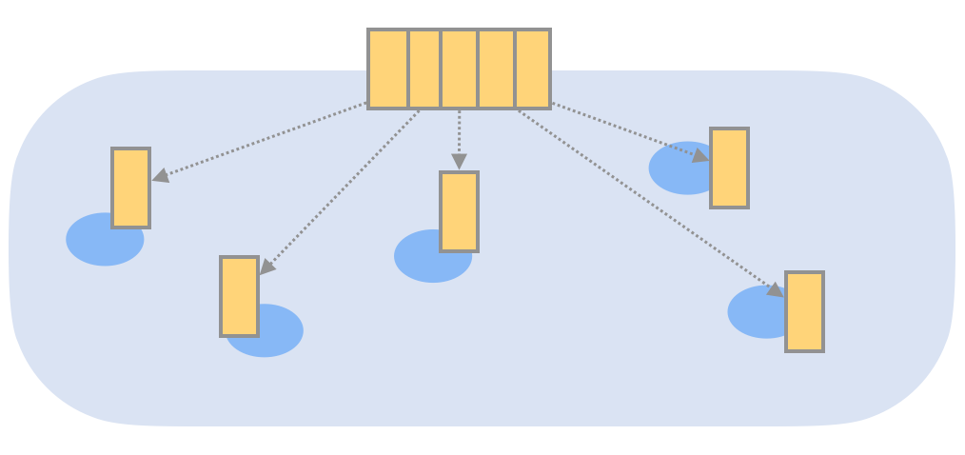

Repetition and Dispersal
√ secure
X efficient
Repetition
Dispersal
√ efficient
X secure
……
Securely and efficiently

Slide 29
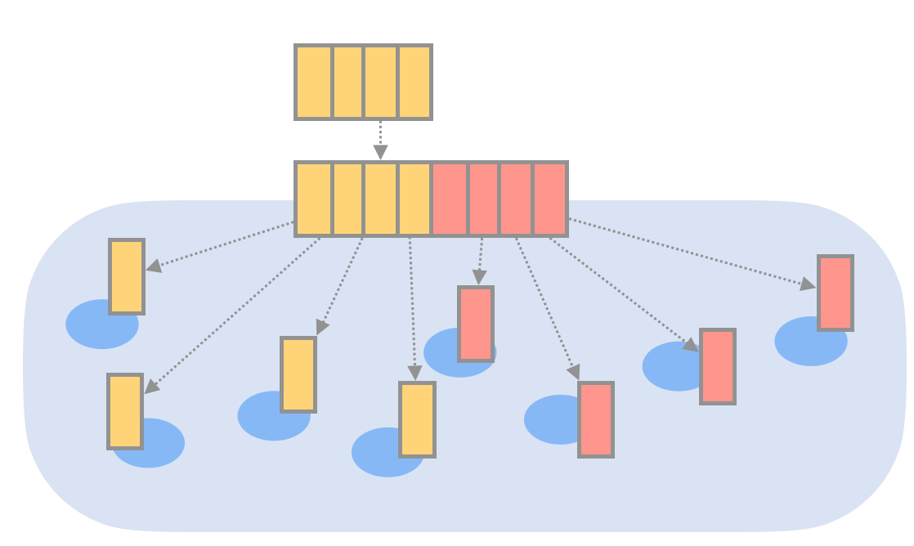
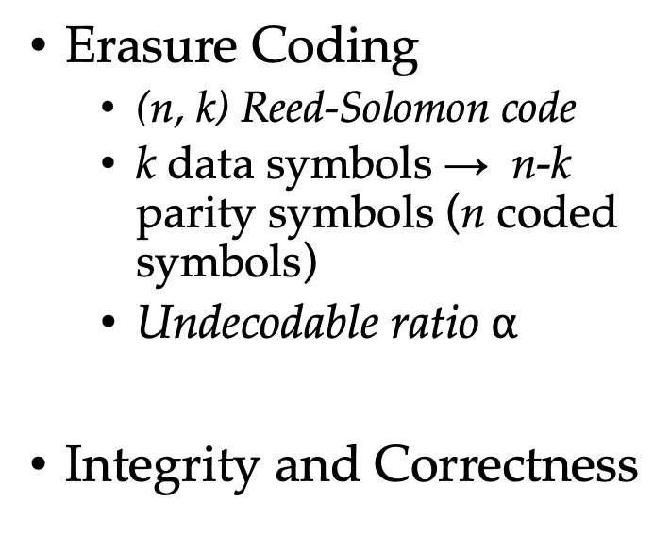

Coded Dispersal
Erasure Coding
  (n, k) Reed-Solomon code
  k data symbols → n-k parity symbols (n coded symbols)
  Undecodable ratio $α$
Integrity and Correctness
Dispersal
$$α=1/2$$
Coded Dispersal

Slide 30
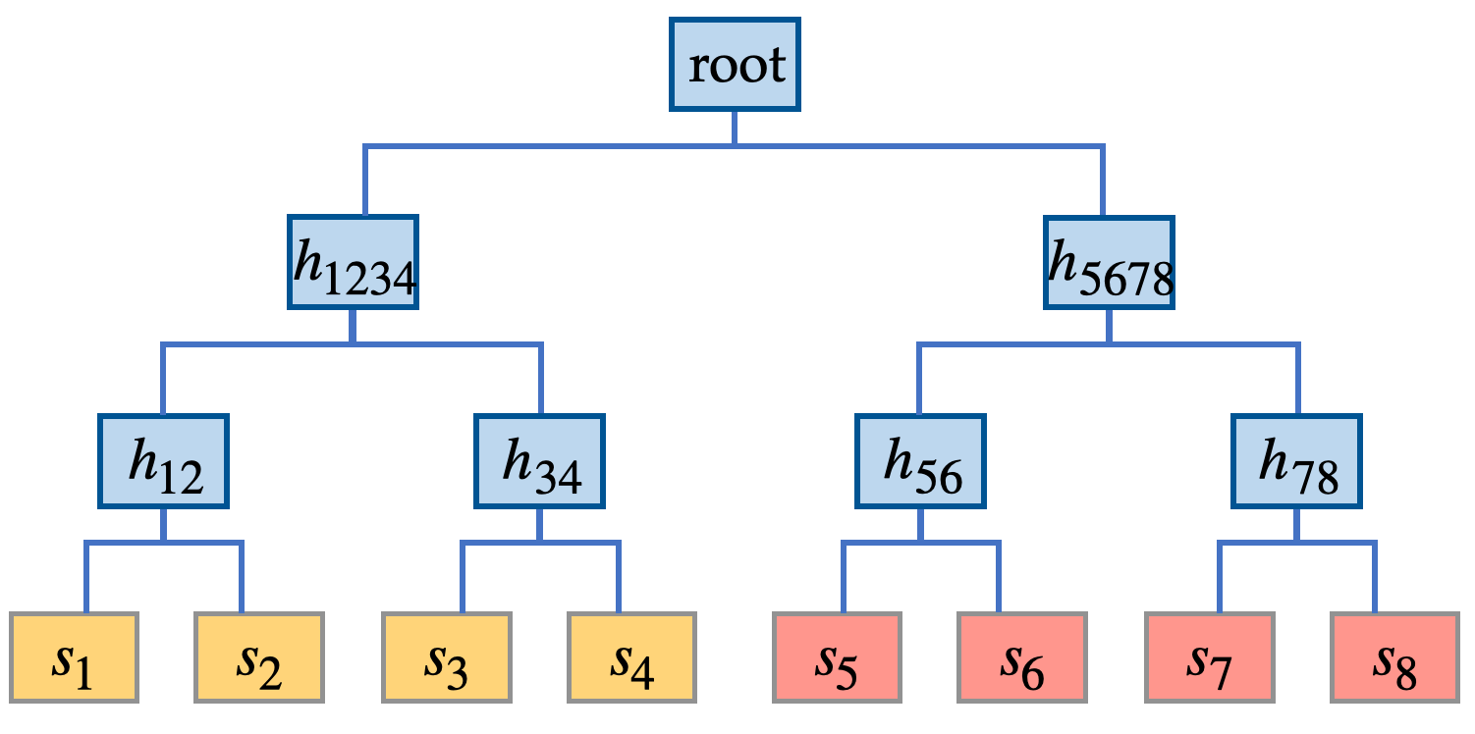
Incorrect-coding Attack
Integrity: Merkle tree
Correctness: incorrect-coding attack
@#$
#$%
$%&
%&*
Original block
Decoder: ???

Slide 31
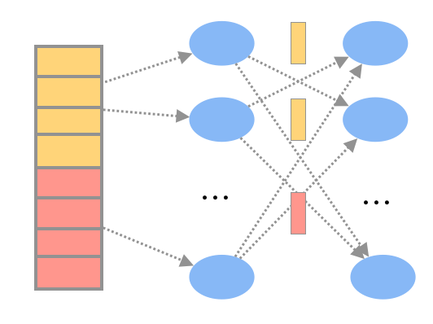
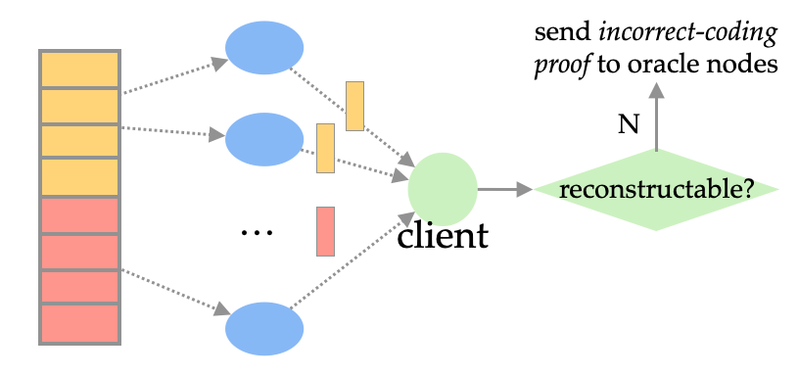
Solutions to Incorrect-coding Attack
AVID^{[1]}: broadcast and download
Incorrect-coding proof
[1] Asynchronous veriﬁable information dispersal. Cachin, C., Tessaro, S.

Slide 32
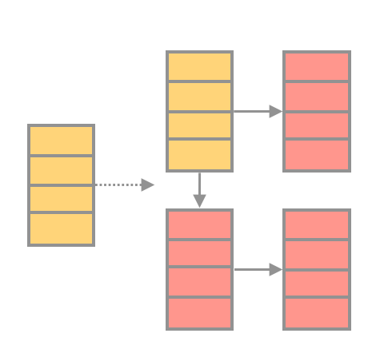
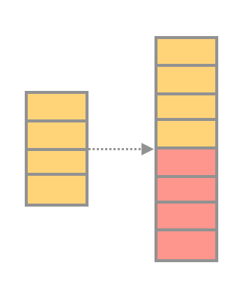
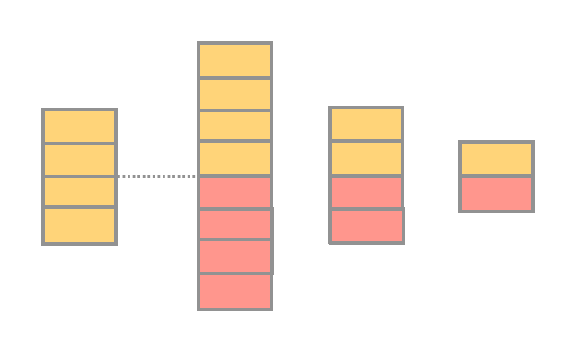
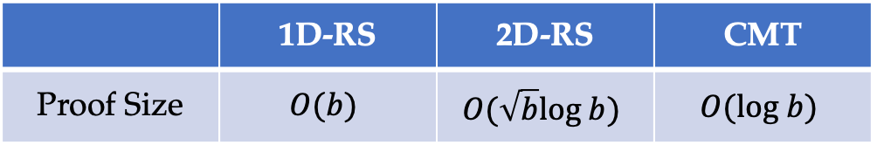
Incorrect-coding Proof
1D-RS
2D-RS^{[1]}
CMT^{[2]}
 | 1D-RS | 2D-RS | CMT
Proof Size | $$O(b)$$ | $$O(\sqrt{b}log b)$$ | $$O(log b)$$
[1] Fraud and data availability proofs: Maximising light client security and scaling blockchains with dishonest majorities. Al-Bassam, M et al
[2] Coded merkle tree: Solving data availability attacks in blockchains. Yu, M et al (FC’20)

Slide 33
Authenticated Coded Dispersal

Slide 34
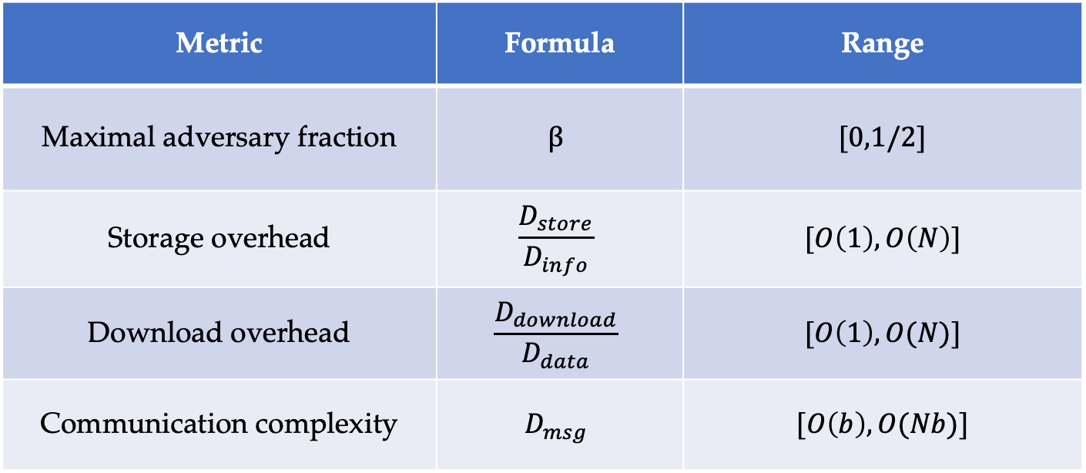
Performance Metrics
Metric | Formula | Range
Maximal adversary fraction | $$β$$ | $$[0,1/2]$$
Storage overhead | $$\frac{D_{store}}{D_{info}}$$ | $$[O\left(1\right), O\left(N\right)]$$
Download overhead | $$\frac{D_{download}}{D_{data}}$$ | $$[O\left(1\right), O(N)]$$
Communication complexity | $$D_{msg}$$ | $$[O\left(b\right), O(Nb)]$$

Slide 35
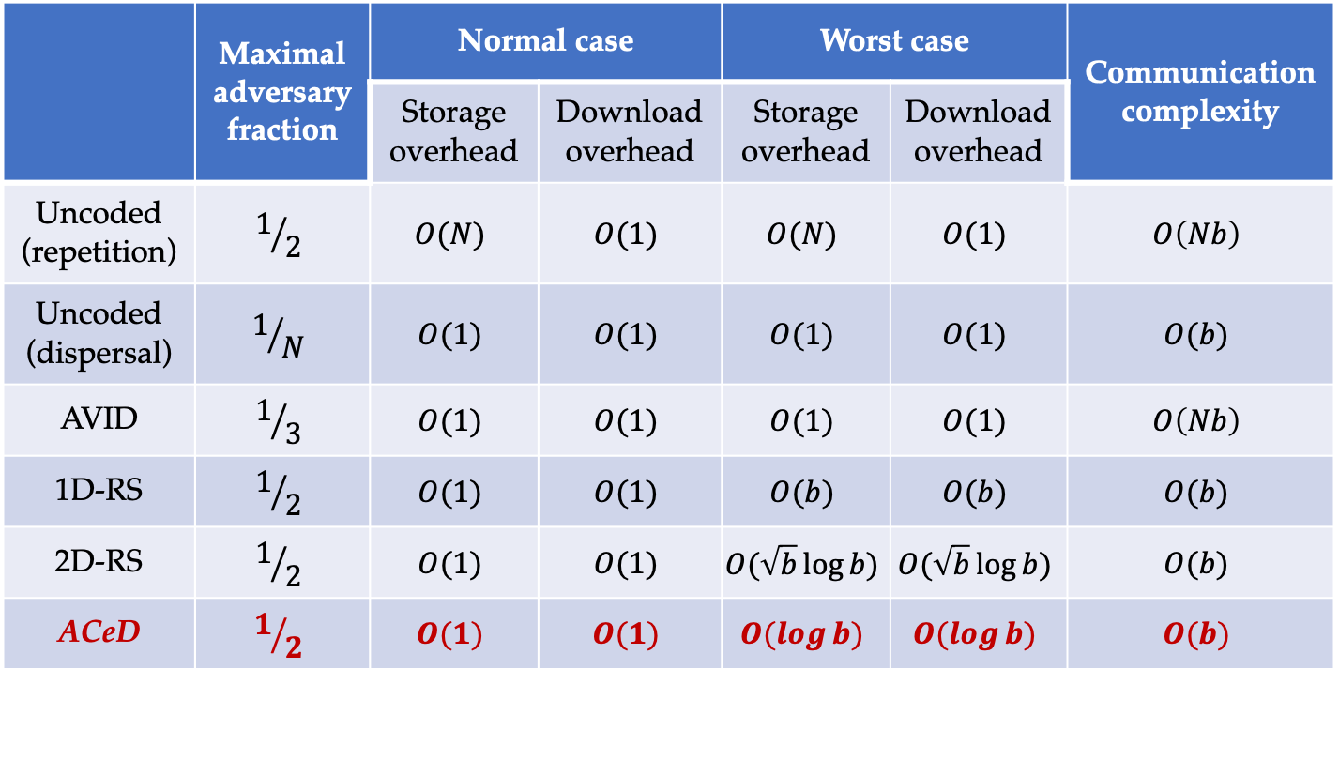
Our Results
 | Maximal adversary fraction | Normal case |  | Worst case |  | Communication complexity
 |  | Storage overhead | Download overhead | Storage overhead | Download overhead
Uncoded (repetition) | $$1/2$$ | $$O(N)$$ | $$O(1)$$ | $$O(N)$$ | $$O(1)$$ | $$O\left(Nb\right)$$
Uncoded (dispersal) | $$1/N$$ | $$O(1)$$ | $$O(1)$$ | $$O(1)$$ | $$O(1)$$ | $$O(b)$$
AVID | $$1/3$$ | $$O(1)$$ | $$O(1)$$ | $$O(1)$$ | $$O(1)$$ | $$O\left(Nb\right)$$
1D-RS | $$1/2$$ | $$O(1)$$ | $$O(1)$$ | $$O(b)$$ | $$O(b)$$ | $$O(b)$$
2D-RS | $$1/2$$ | $$O(1)$$ | $$O(1)$$ | $$O(\sqrt{b}\log{b})$$ | $$O(\sqrt{b}\log{b})$$ | $$O(b)$$
ACeD | $$1/2$$ | $$O(1)$$ | $$O(1)$$ | $$O(\log{b})$$ | $$O(\log{b})$$ | $$O(b)$$

Slide 36
From CMT to CIT
Pull model
Push model
Block proposer
Block proposer
Coded Interleaving Tree:
Coded Commitment Generator
Coded Merkle Tree:
Coded Commitment Generator
Dispersal Protocol
Random Sampling
Request
Response
Broadcast fraud proof
No
Oracle nodes
Reconstruct-able?
Full node
Side blockchain node
Light nodes

Slide 37
From CMT to CIT
Information cascade
Pull model
Push model
Incentive compatible
CMT
CIT
Anonymous network
Random sampling
Deterministic dispersal
No anonymity

Slide 38
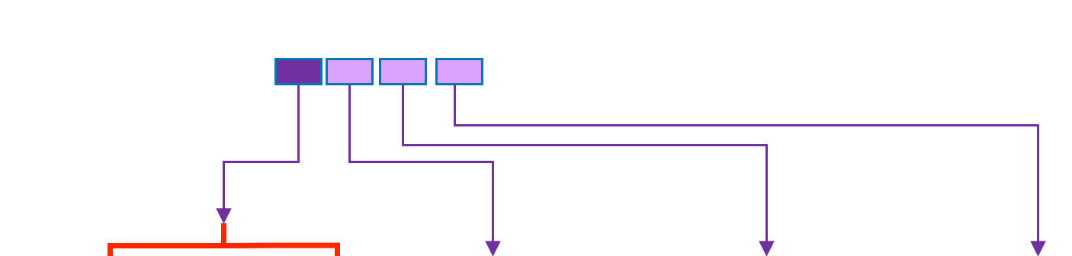
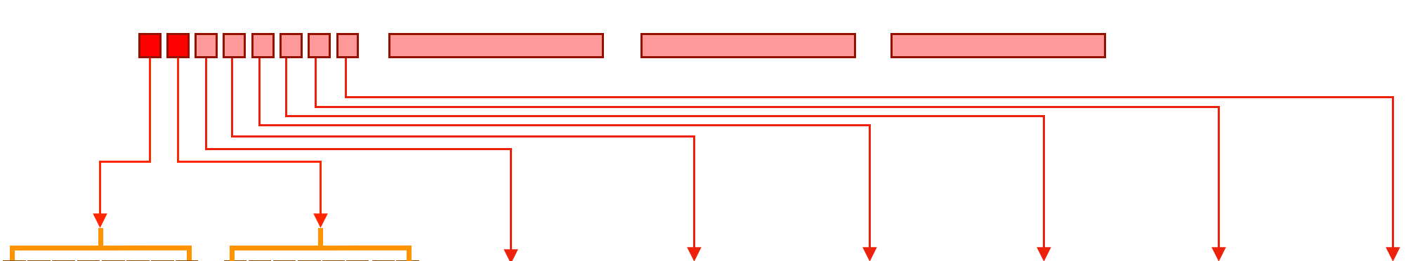
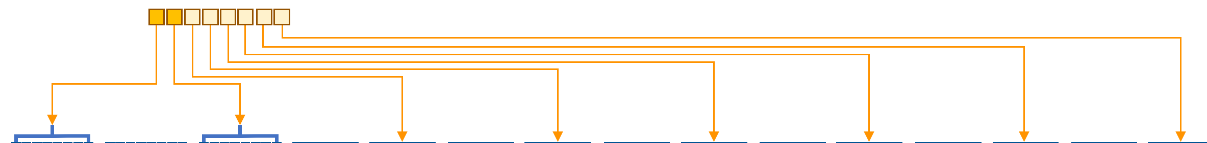

Coded Interleaving Tree
11 % 4 = 3
15 % 4 = 3
19 % 4 = 3
23 % 4 = 3
Aggregating rule: parent id $=i mod \#data symbols in parent layer$

Slide 39







Coded Interleaving Tree
commitment
15 % 3 = 0
15 % 6 = 3
15 % 12 = 3
Coded symbols
$p\left(i\right)$-th data symbol (base 0)
$$p\left(i\right)=i mod \#data symbols$$
POM
$$p(i)$$
$$e(i)$$
$e\left(i\right)$-th parity symbol (base 0)
$$e\left(i\right)=i mod \#parity symbols$$

Slide 40






Properties of CIT
Efficiency: Sibling property
$$…$$
$${≥ηM}_{l−2}$$
$${≥ηM}_{l−1}$$
$${≥ηM}_{l}$$
Security:
Reconstruction property
POM
$$p(i)$$
$$e(i)$$

Slide 41
Protocol Overview

Slide 42
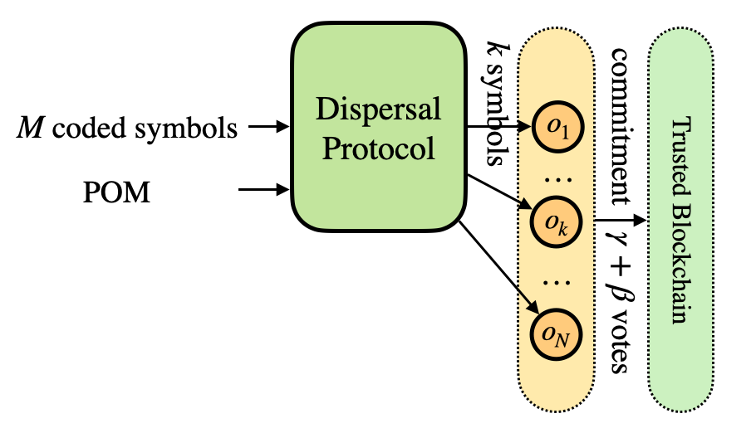

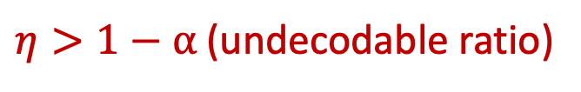
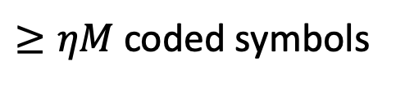
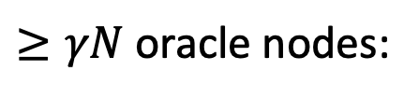
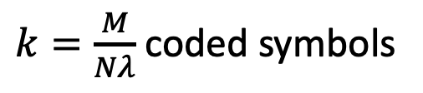
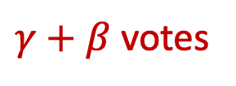
Dispersal Protocol
Each node:
$k=\frac{M}{Nλ}$ coded symbols
N oracle nodes
$≥γN$ oracle nodes:
$γ+β$ votes
$≥ηM$coded symbols
$η>1−α$(undecodable ratio)

Slide 43
Protocol Overview

Slide 44
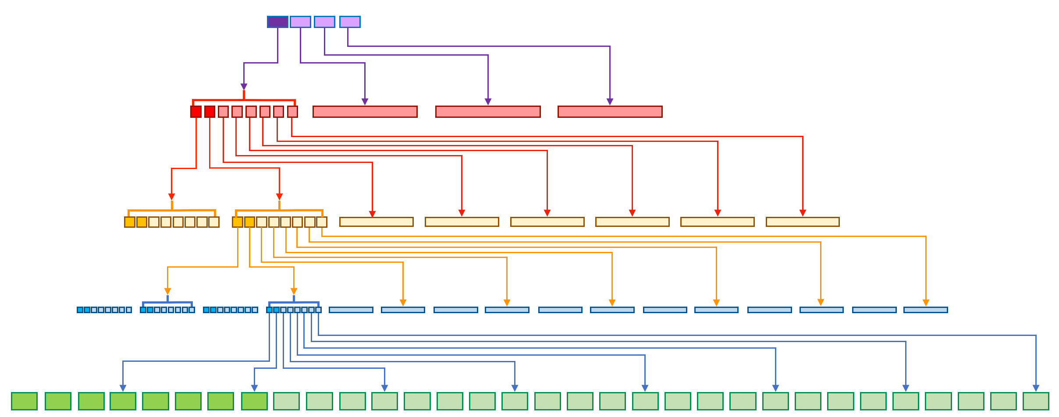
Block Peeling Decoder
Incorrect-coding proof → trusted blockchain

Slide 45
System Modules
Trusted Blockchain (Ethereum Testnet)
https://github.com/simplespy/ACeD

Slide 46
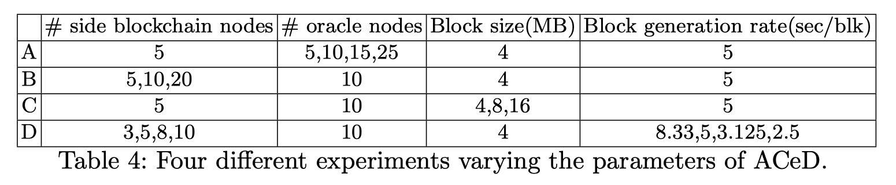
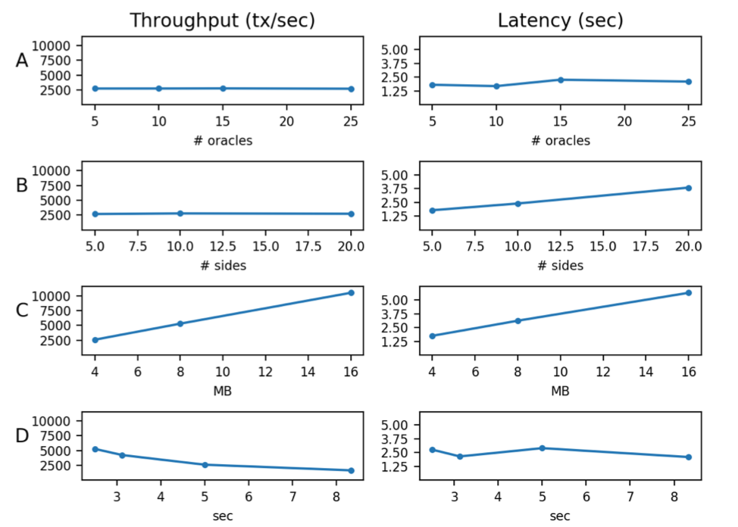
Evaluations
Variable
# Oracle nodes
# Side blockchain nodes
Block size (MB)
Block generation rate (sec/blk)
Throughput: 10,000 tps
Gas cost: 6000x reduction

Slide 47
Thanks!

