Slide 1
Network privacy leakage
Scaling network anonymity
Lecture 22: Network Privacy

Slide 2
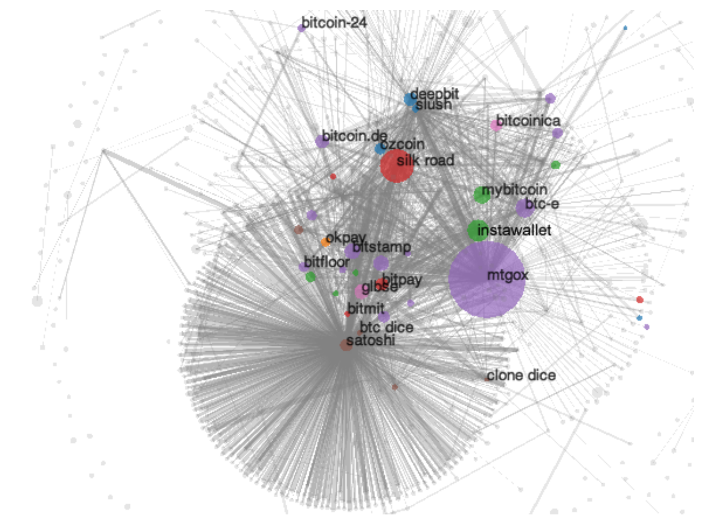
How can users be deanonymized?
Entire transaction histories
can be compromised.
Blockchain
Meiklejohn et al., 2013
Notes:
Make the transition more gentle (mention there are solutions to blockchain, but these won’t inherently address p2p network problems)

Slide 3
What about the peer-to-peer network?
Public Key
IP Address

Slide 4

Our Work
Analysis
Redesign
$$Pr(detection)$$
Dandelion
ACM Sigmetrics
2017, 2018
NIPS 2017
Notes:
Lightweight statistical methods

Slide 5
Model
Assumptions and Notation

Slide 6
Attacks on the Network Layer
Eavesdropper
Biryukov et al., 2014
Koshy et al., 2014
Alice

Slide 7
What can go wrong?
Eavesdropper
Alice

Slide 8
What the eavesdropper can do about it
1
2
3
Alice

Slide 9
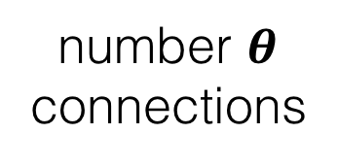

Summary of adversarial model
Eavesdropper
number $θ$
connections
fraction p
nodes being
eavesdropped
$$θ=2$$

Slide 10


$$∞$$
Part II
Redesign
Botnet
Part I
Analysis
Connections
to adversary
$$θ$$
Eavesdropper
1
0
p
1
Fraction of Spies

Slide 11
Analysis
How bad is the problem?

Slide 12
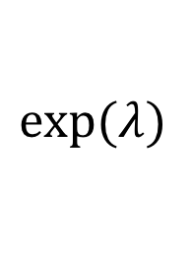
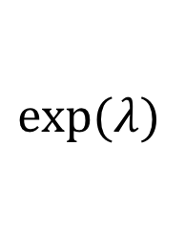
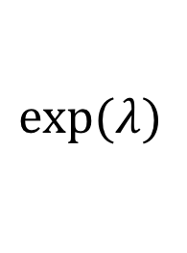
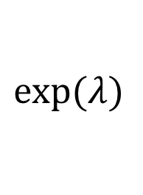
Flooding Protocols
Trickle (pre-2015)
Diffusion (post-2015)
(4)
(1)
$$exp⁡(λ)$$
$$exp⁡(λ)$$
(2)
(3)
$$exp⁡(λ)$$
$$exp⁡(λ)$$

Slide 13
Does diffusion provide stronger anonymity than trickle spreading?

Slide 14
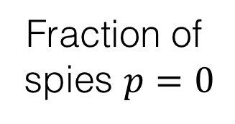
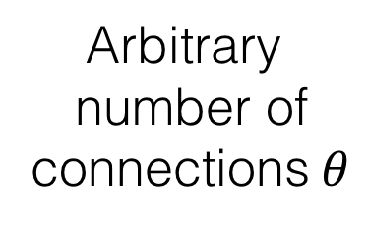
d-regular trees
Eavesdropper
Fraction of
spies $p=0$
Arbitrary
number of
connections $θ$

Slide 15
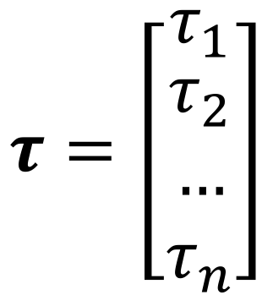

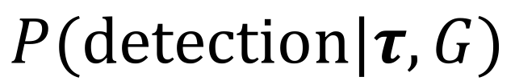




Anonymity Metric
timestamps
$$P(detection|τ,G)$$
graph
$$τ_{4}=0.3$$
$$τ_{1}=2.0$$
$$τ=\left[\begin{matrix}τ_{1} \\ \begin{aligned}τ_{2} \\ … \\ τ_{n}\end{aligned}\end{matrix}\right]$$
$$τ_{0}=0.7$$
$$τ_{3}=1.5$$
$$τ_{2}=1.1$$

Slide 16
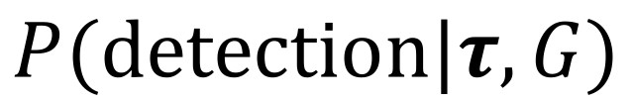
Estimators
timestamps
$$P(detection|τ,G)$$
graph
$$τ_{4}=0.3$$
$$τ_{1}=2.0$$
$$τ_{0}=0.7$$
Maximum-
Likelihood
First-Spy
$$τ_{3}=1.5$$
$$τ_{2}=1.1$$

Slide 17
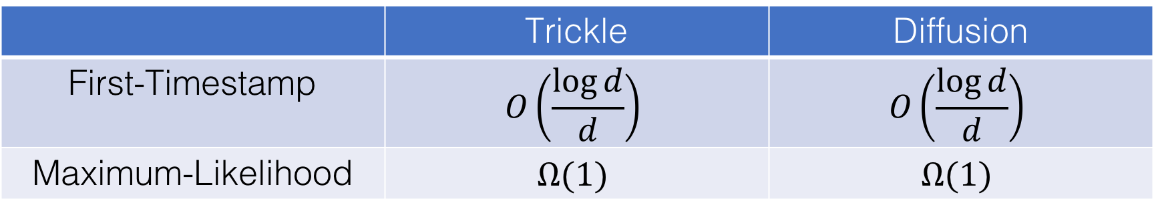
Detection Probability: d-Regular Trees
 | Trickle | Diffusion
First-Timestamp | $$O\left(\frac{\log{d}}{d}\right)$$ | $$O\left(\frac{\log{d}}{d}\right)$$
Maximum-Likelihood | $$Ω(1)$$ | $$Ω(1)$$
Intuition: Symmetry outweighs local randomness!
Probability
of Detection
Maximum-Likelihood
First-timestamp
Degree, d
Notes:
Main points: (a) first spy is bad as degree gets large. (b) but fancy estimators looking at the whole graph can do very well – infact high degree means high detection chance. (3) both trickle and diffusion have similar performance, although different ML estimators. (4) our results for detection probability for ML are fundamental, although there are computationally simple ML approximations that work well in practice.

Slide 18
Results: Bitcoin Graph
Trickle
Diffusion
Probability of Detection
Number of Eavesdropper Connections
Notes:
Roughly 5000 nodes. Shapshot of the graph measured in 2016. Graph discovery from tx propagation measurement is also an interesting problem in itself. Sparse random graph – locally tree like and our estimators work very well.

Slide 19
Diffusion does not have (significantly) better anonymity properties than trickle.

Slide 20
Redesign
Can we design a better network?

Slide 21
Botnet adversarial model
observe all
metadata
identities
unknown
spies
collude
fraction p
of spies
honest-
but-curious
Notes:
Mention that eavsdropper and spy are mathematically identical. Define spy

Slide 22
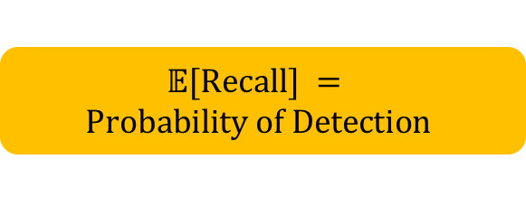
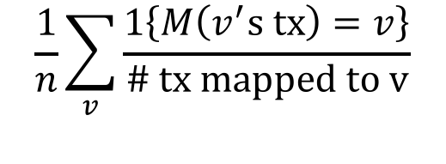
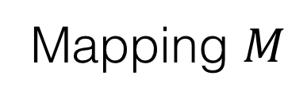
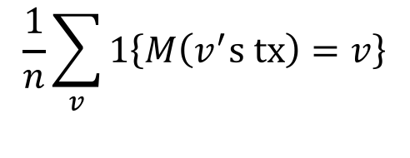
Metric for Anonymity
Transactions
Users
Recall
Precision
$$\frac{1}{n}\sum_{v}{1\left\{M\left(v^{′}s tx\right)=v\right\}}$$
$$\frac{1}{n}\sum_{v}{\frac{1\left\{M\left(v^{′}s tx\right)=v\right\}}{\# tx mapped to v}}$$
Mapping
Number
honest
users
User
$$𝔼[Recall] =$$
$$Probability of Detection$$
Mapping $M$

Slide 23
Goal:
Design a distributed flooding protocol that minimizes the maximum precision and recall achievable by a computationally-unbounded adversary.

Slide 24
Fundamental Limits
1
Thm: Maximum recall $≥p$.
Precision
Thm: Maximum precision $≥p^{2}$.
Fraction
of spies
p²
0
p
Recall
1
Notes:
Mention why you can’t have high precision-low recall and vice versa

Slide 25
Performance: Achievable Region
1
Flooding
Precision
Diffusion
DANDELION
p²
0
p
1
Recall

Slide 26
What are we looking for?
Asymmetry
Mixing
1
2
3
4
spy

Slide 27
What can we control?
Spreading
Protocol
Topology
Dynamicity
Approximately
regular
Dynamic
Diffusion
Static
Given a graph, how
do we spread content?
What is the underlying
graph topology?
How often does the
graph change?

Slide 28
Spreading Protocol: Dandelion

Slide 29
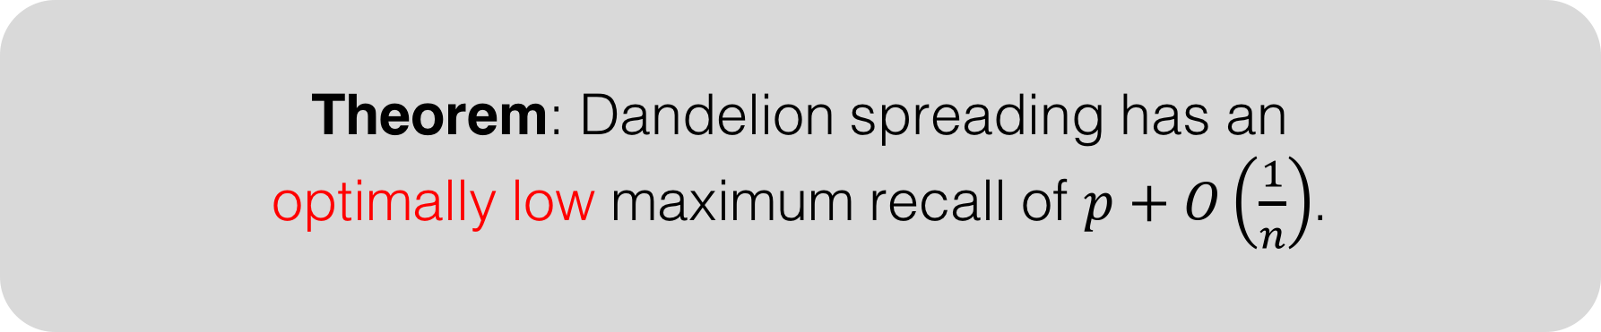
Why Dandelion spreading?
Theorem: Dandelion spreading has an
optimally low maximum recall of $p+O\left(\frac{1}{n}\right)$.
Theorem: Fundamental lower bound = p
fraction
of spies
number of
nodes

Slide 30
Graph Topology: Line
tx1
Anonymity graph
tx2
“Regular” graph
Notes:
Hint at sparse regular graphs coming up

Slide 31
Dynamicity: High
Change the anonymity
graph frequently.

Slide 32
DANDELION Network Policy
Spreading
Protocol
Topology
Dynamicity
Dandelion
Spreading
Line
graph
Dynamic
Static
Given a graph, how
do we spread content?
What is the anonymity
graph topology?
How often does the
graph change?

Slide 33
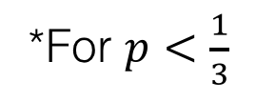
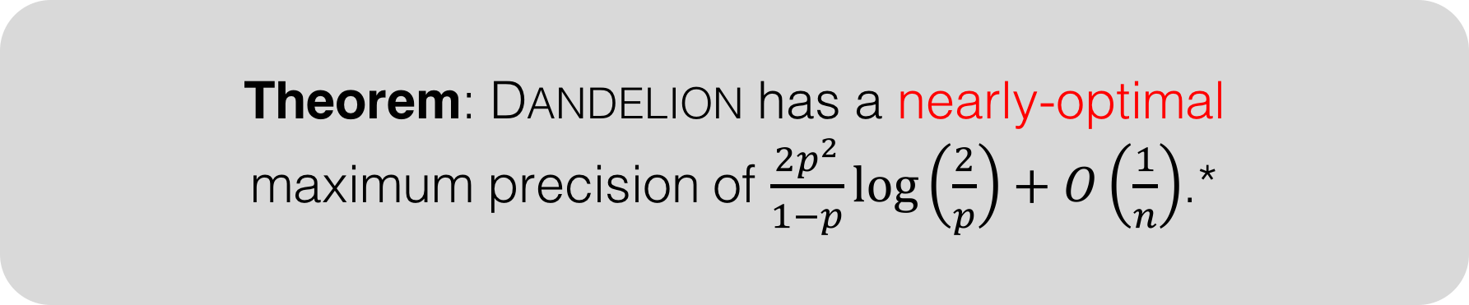
Theorem: Fundamental lower bound = p²
Theorem: DANDELION has a nearly-optimal
maximum precision of $\frac{2p^{2}}{1−p}\log\left(\frac{2}{p}\right)+O\left(\frac{1}{n}\right)$.*
fraction
of spies
number of
nodes
*For $p<\frac{1}{3}$

Slide 34
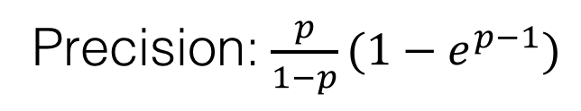
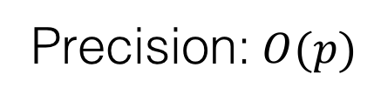
Why is DANDELION good?
Strong mixing properties.
Tree
Complete graph
Too many leaves
Too many paths
Precision: $O(p)$
Precision: $\frac{p}{1−p}(1−e^{p−1})$

Slide 35
Why not alternative solutions?
Connect through Tor
I2P Integration (e.g. Monero)
Tor

Slide 36
Empirical Delay Distribution
Time to reach 10% of nodes (sec)

Slide 37
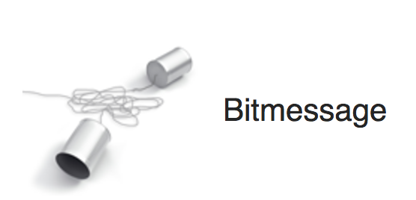

Strength of
Guarantees
Dandelion
Date of Invention
Narayanan and Möser, 2017

Slide 38
Take-Home Messages
Bitcoin’s P2P network has poor anonymity.
Moving from trickle to diffusion did not help.
DANDELION may be a lightweight solution for certain classes of adversaries.
https://github.com/gfanti/bitcoin

