Slide 1
Lecture 17: Proof of Stake
PoW: energy inefficient
PoS: Energy efficient alternative
PoS version of longest-chain protocol

Slide 2
Thus Far
Bitcoin
PoW
longest chain protocol
throughput/latency limited because of
security
Scaling Bitcoin: Prism
Throughput physical limits
Latency
But still: PoW

Slide 3
This lecture
Proof of Stake (PoS)
energy efficient alternative
replacement to PoW
Simple way to implement PoS
within the longest chain protocol
Vulnerabilities
nothing at stake (NaS) attack
security analysis

Slide 4
Proof of Work
Find nonce such that
Hash(hash(parent.header), Merkle root of tx, nonce)
< threshold
Finding entails work
Nonce is the proof
Doing this work allows miners to participate meaningfully in the protocol
proposing a block

Slide 5
Proof of Stake
Allow meaningful participation based on stake
block proposers own coins
Level of participation proportional to stake
higher probability of being a proposer
Doing work is replaced by owning coins
energy efficient
capital efficient -- no need for mining hardware

Slide 6
First Idea
PoW
Hash(hash(parent.header), Merkle root of tx, nonce)
< threshold
PoS_Idea1
Hash(hash(parent.header), Merkle root of tx)
< threshold x stake

Slide 7
Limitations
Hash(hash(parent.header), Merkle root of tx)
< threshold x stake
Limitation 1: Liveness
just one trial to form a block
unlike PoW where nonce can be tried at will
Limitation 2: Grinding
can try different set of tx such that Merkle root of tx works out “correctly”
so probability not purely proportional to stake

Slide 8
Second Idea
PoS_Idea1
Hash(hash(parent.header), Merkle root of tx)
< threshold x stake
PoS_Idea2
Hash(hash(parent.header), time) < threshold x stake
Time is discrete
allows liveness

Slide 9
PoS Longest Chain
PoS_LC
Hash(hash(parent.header), time) < threshold x stake
Longest chain rule
parent is tip of longest chain
No validation of transactions
block content is arbitrary
consensus refers to ordered sequence of blocks
decoupling is similar to Prism

Slide 10
Nothing at Stake
Hash(hash(parent.header), time) < threshold x stake
Longest chain rule
parent is tip of longest chain
Adversary deviates
can grow on all blocks (even Genesis)
No computation limit to deviation
unlike PoW
Nothing at Stake (NaS)

Slide 11
NaS Capability
Honest participants
grow chain as a Poisson process
growth rate linear in time
Adversary
grows a tree of blocks
number of blocks grows exponentially in time
NaS
allows adversary to compete with honest participants unevenly

Slide 12

PoW Longest Chain Growth
PoW chain
G
Expected number of
Blocks in time T
Notes:
Private attack in terms of voters over time.

Slide 13
NaS Tree
Honest participants
grow chain as a Poisson process
growth rate linear in time
Adversary
grows a tree of blocks
number of blocks grows exponentially in time
NaS
allows adversary to compete with honest participants unevenly

Slide 14
NaS Tree and Longest Chain
NaS Tree
Longest chain
G
A scalable PoS blockchain in the open setting, Fan and Zhou, 2016
Notes:
Private attack in terms of voters over time.

Slide 15
Security of PoS Longest Chain
Honest participants
grow chain as a Poisson process
growth rate linear in time
Adversary
grows a NaS tree in private
longest chain length
Security against Private attack
or

Slide 16
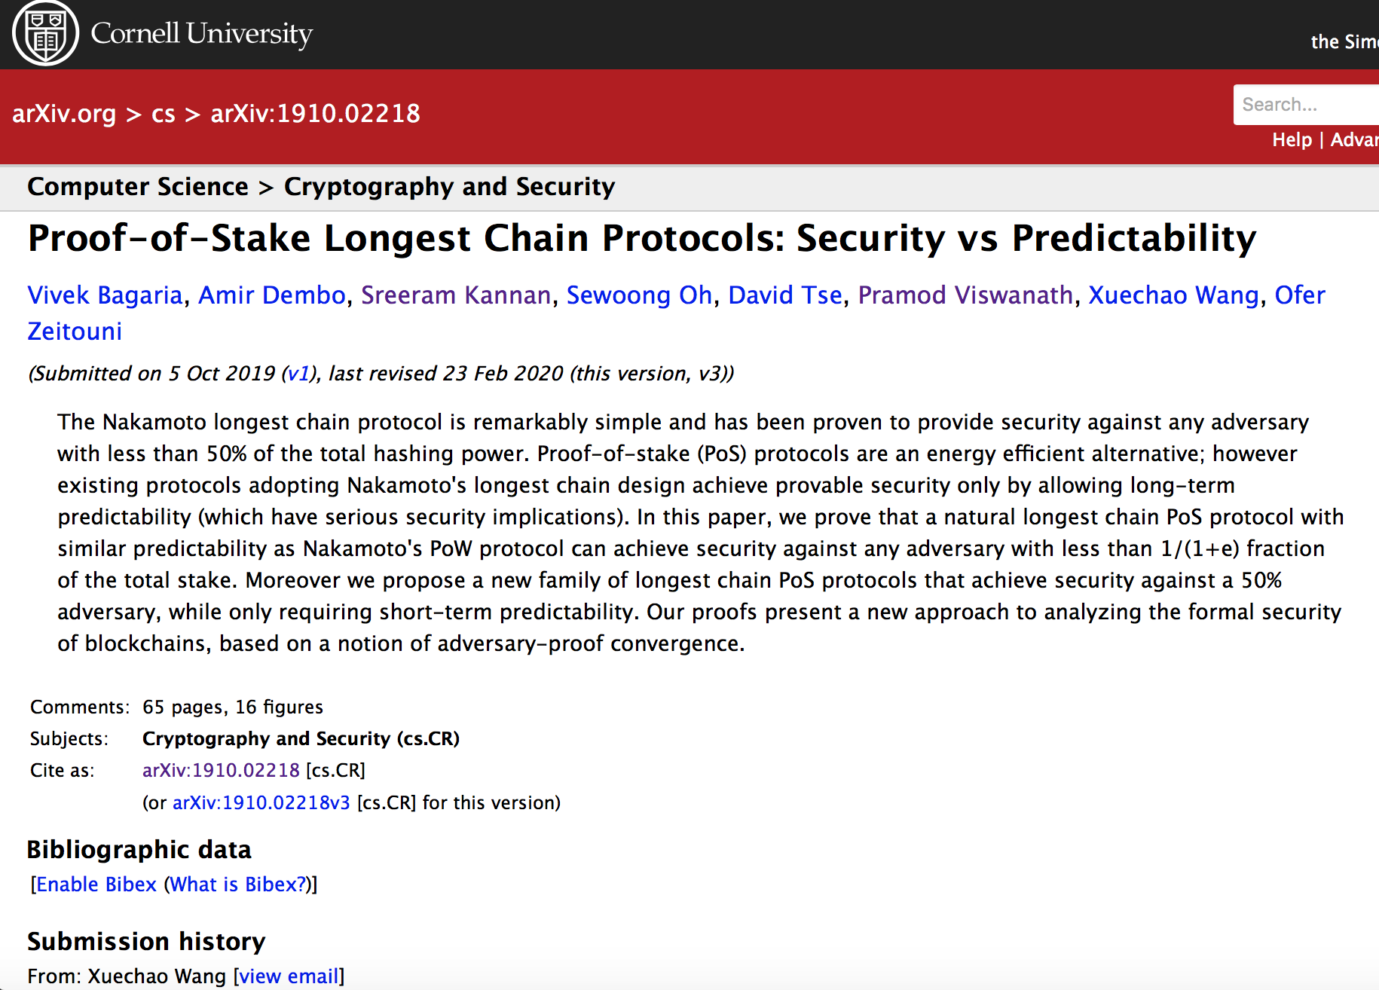
Security
Security against Private attack
Secure against all attacks

