Slide 1
Yazdi, … , Milenkovic, DNA-Based Storage: Trends and Methods, IEEE TMBMSC, 2015

Slide 2
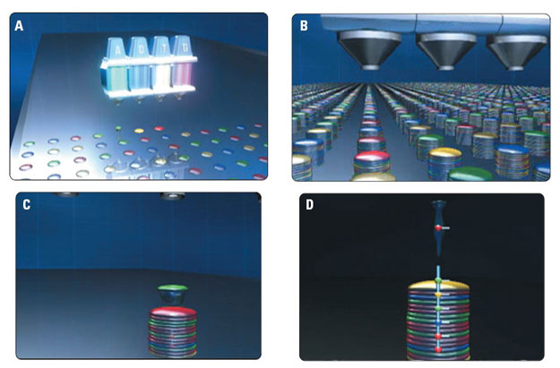
Credit: DNA Inkjet
Information-bearing DNA strings (oligos) synthesized in parallel on many different ”microarray spots”
Periodic (ATGC)^{n} synthesis protocol requires 4n cycles, where n is the length of the strings to be synthesized

Slide 3

Synthesis cost
Company | Length (bps) | #Oligos | Concentration | Price
Custom Array | 10-79 | 92,918 | 1 fmol | $4,000
Twist Bio | 1-120 | 600,000 | 0.25 fmol | $59,160
ThermoFisher | 5-40 | 24 | 25 nmol | $5.5
Operon | 20 | 96 | 4 nmol | $115
IDT | 20 | 1 | 25 nmol | $7.5
Synthesis is (currently) an inherently sequential process
Adding one base ( 2 bits) takes of the order of seconds and is expensive
Lengths of strands is limited (pools: ~200 b, gblocks: ~2000 b)
Process creates potentially toxic byproducts
$$≤$$

Slide 4
https://www.idtdna.com/pages
https://www.idtdna.com/pages/products/custom-dna-rna/dna-oligos/custom-dna-oligos?utm_source=google&utm_medium=cpc&utm_campaign=00588_1i_03&utm_content=search&gclid=CjwKCAiA0JKfBhBIEiwAPhZXD_Q9A5dV8PoPYGKXPHV8p0s0_9iK0-l2hh-pv9DGC6uViHAgeb4cFhoCMvkQAvD_BwE
GeneBlocks
https://www.genscript.com/gene_synthesis.html?src=google&gclid=EAIaIQobChMIyqDZu5ST_QIVSv_jBx3NUQxKEAAYASAAEgJ4y_D_BwE
https://www.idtdna.com/site/order/gblockentry
ACGGGGGTTCGTAACCCCGACGGGGGGGGAATATATATAACGGGGGTTCGTAACCCCGACGGGGGGGGAATATATATACCCCAAAAAAAGGGGTTCGTAACCCCGACGGGGAACACACACACACA

Slide 5
Denied - High Complexity (Scores of 10 or greater)
The identified complexities prevent manufacturing of this sequence.
Total Complexity Score: 99.2
Complexity Description
Score
EDIT
One or more repeated sequences greater than 8 bases comprise 90.4% of the overall sequence. Solution: Redesign to reduce the repeats to be less than 40% of the sequence.
20.2
EDIT
A repeat with the sequence ACGGGGGTTCGTAACCCCGACGGGGGGGGAATATATATA exists at the following locations: 40, 1. Solution: Modify the sequence to reduce the length of these repeats to less than 11 bases.
19.6
EDIT
A repeat with the sequence GGGGTTCGTAACCCCGACGGGG exists at the following locations: 4,43. Solution: Modify the sequence to reduce the length of these repeats to less than 14 bases.
16
EDIT
The repeated sequence ACGGGGGTTCGTAACCCCGACGGGGGGGGAATATATATA constitutes 62.4% of the overall sequence. Solution: Redesign to reduce the overall repeat percentage to be below 15%.
11.5
EDIT
Greater than 90% of the bases within a 70 base window starting at position 1 are part of repeats more than 8 bases long within the entire sequence. Solution: Redesign to reduce or eliminate the density of repeats within this window.
11
EDIT
The repeated sequence GGGGTTCGTAACCCCGA exists at the following locations: 4, 43, 90.Solution: Redesign to disrupt instances of the repeat near the terminal end(s) or add extra bases to push the repeat internally.
10
EDIT
The repeated sequence CACACACACA exists at the following locations: 114, 116.Solution: Redesign to disrupt instances of the repeat near the terminal end(s) or add extra bases to push the repeat internally.
10
EDIT
A region of 9 bases composed of 88.9% 'G' bases is present starting at base 22. Solution: Reduce the length of this region equal to or less than 8 bases or reduce the percentage 'G' base composition to be less than 80%.

Slide 6
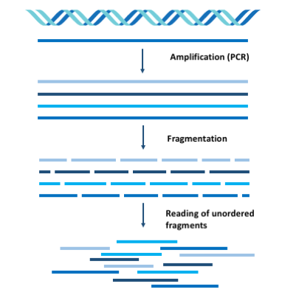
Shotgun Sequencing
“Restriction enzymes, also called restriction endonucleases, recognize a specific sequence of nucleotides in double stranded DNA and cut the DNA at a specific location. They are indispensable to the isolation of genes and the construction of cloned DNA molecules.”

Slide 7
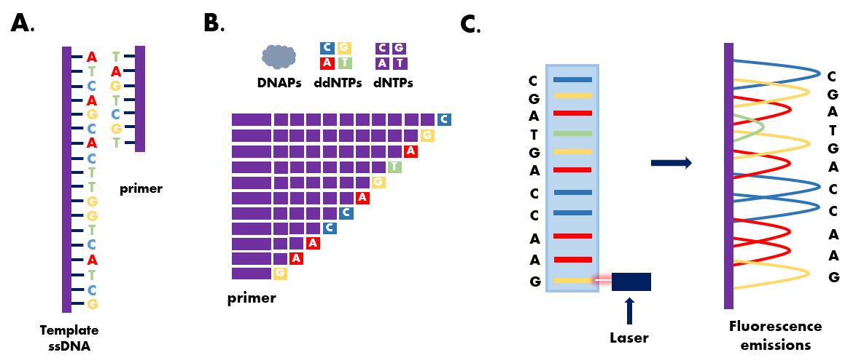
Sanger Sequencing

Slide 8
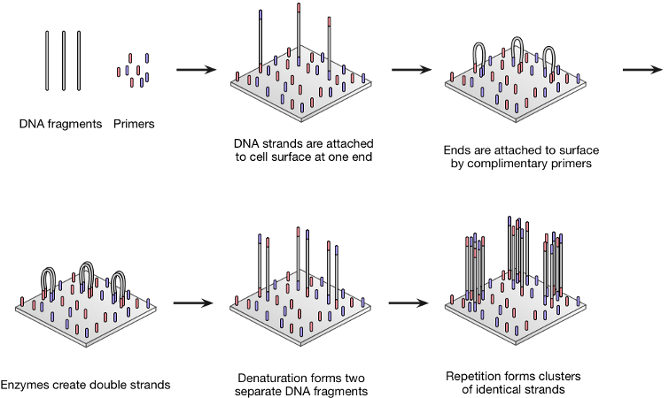
Illumina (NGS) Sequencing
Illumina MiSeq
Bridge Amplification

Slide 9
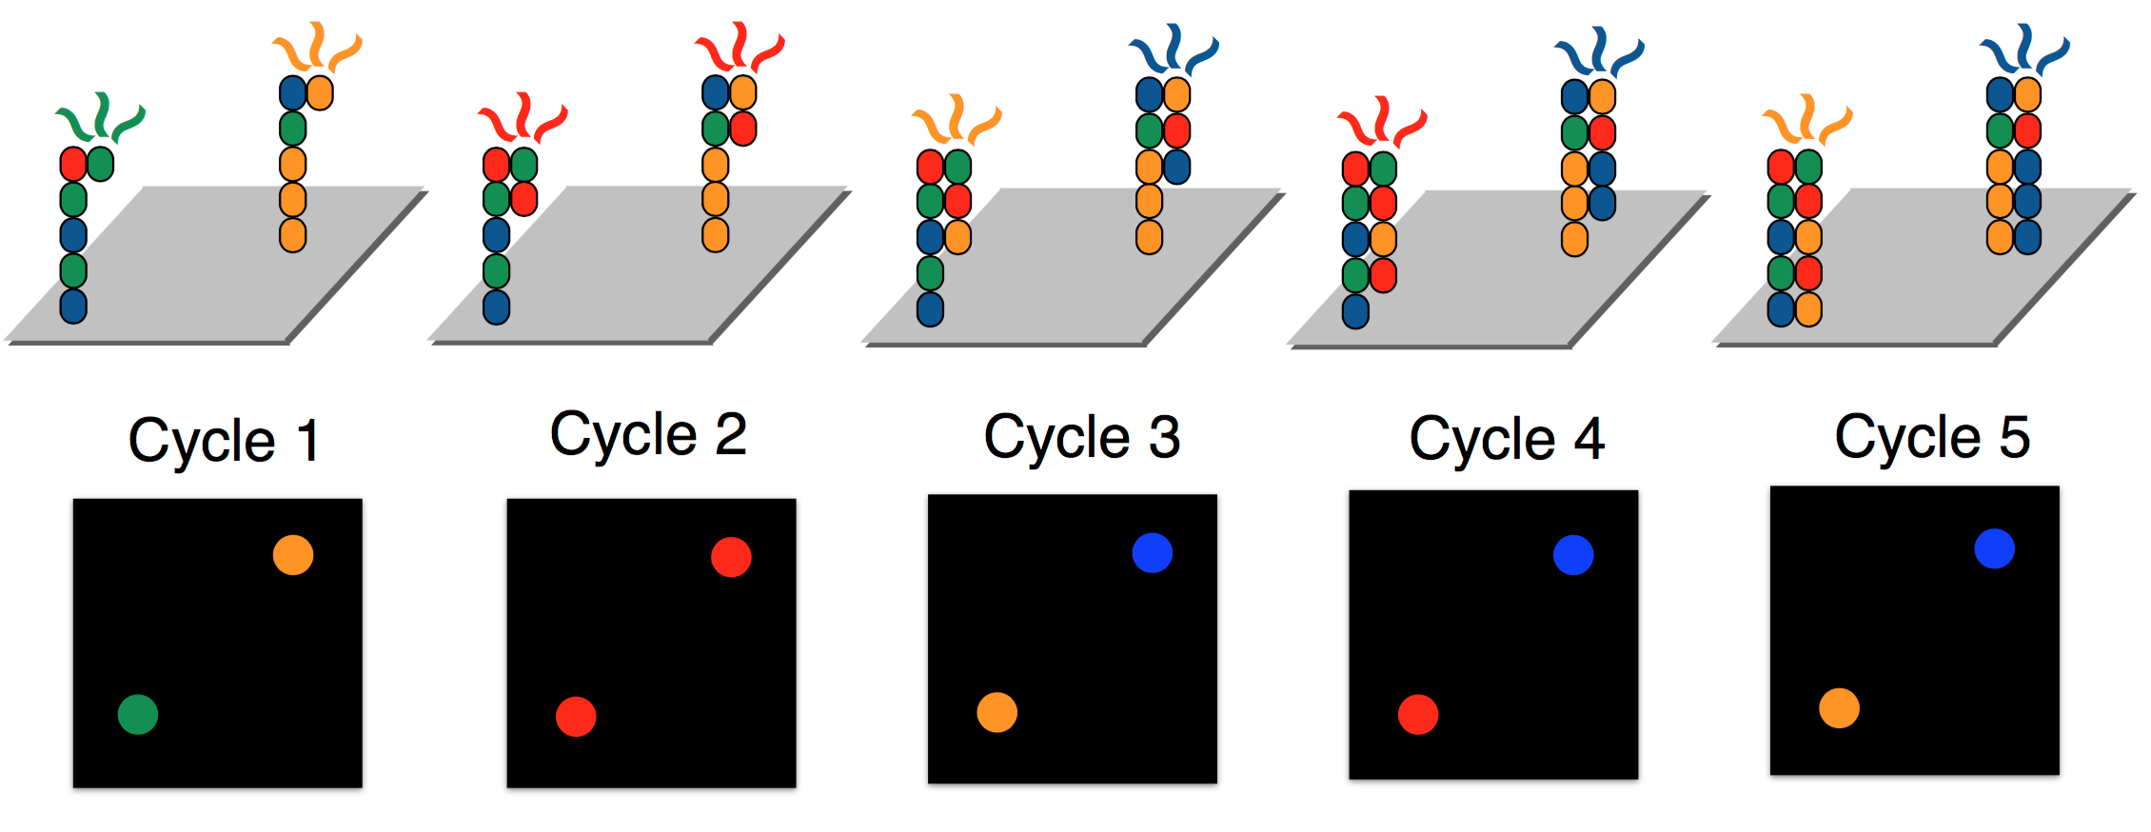
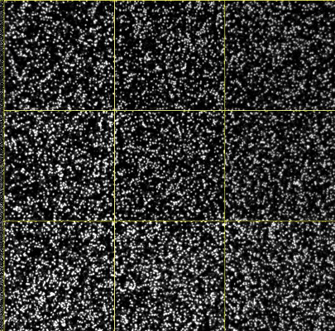
.tiff files, one image per base per cycle = 4n images per DNA string of length n
Credit: Data Science for HTS

Slide 10
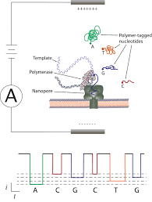
Nanopore (Third Generation) Sequencing
Oxford Nanopore Technology MinION

Slide 11
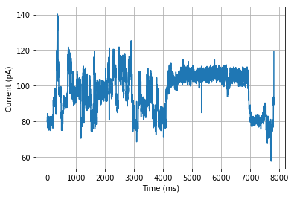
Oxford Nanopore Technology MinION
Analog signals of “raw ion currents” capturing the degree of blockage of pore and hence chemical structure and charge of base needed for calling

Slide 13
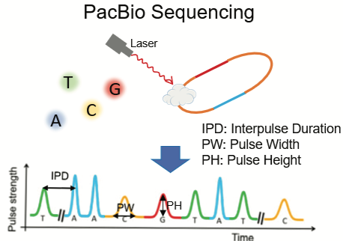
PacBio (Third Generation) Sequencing
Pacific Biotechnology
(PacBio)

Slide 14
(Tandem) Mass Spectrometers

Slide 15
(Tandem) Mass Spectrometers: Ion Series

Slide 16
Mathematical problems to be discussed:
DNA synthesis
The longest common subsequence problem
http://i.stanford.edu/pub/cstr/reports/cs/tr/75/477/CS-TR-75-477.pdf
Scheduling
Batch Optimization for DNA Synthesis
Authors
Konstantin Makarychev, Miklós Z Rácz, Cyrus Rashtchian, Sergey Yekhanin
Repeat removal
Unique Reconstruction of Coded Sequences from Multiset Substring Spectra
Gabrys and Milenkovic
https://ieeexplore.ieee.org/abstract/document/8437909?casa_token=ntC3MHS7LRsAAAAA:L_IWO27uMz1MZwQin3-QoWBJMLlMiqNIFlgVPWJ4KR4Vx5uhWYJQe1UMiVNNH7lFnQs6oUnYcmE

Slide 17
Mathematical problems to be discussed:
DNA sequencing
DNA Assembly and deBruijn graphs
Repeat removal and coding for unique assembly

