Slide 1

DNA Punch-Cards: Implementations and Coding-Theoretic Questions
Olgica Milenkovic
Department of Electrical and Computer Engineering
University of Illinois at Urbana-Champaign
April 23, 2019

Slide 2
DNA Punch-Cards
Part I ：Motivation and Background
Part II ： A New System Implementation
Part III： Experimental Results
Part IV：Coding-Theoretic Problems
Future Directions

Slide 3
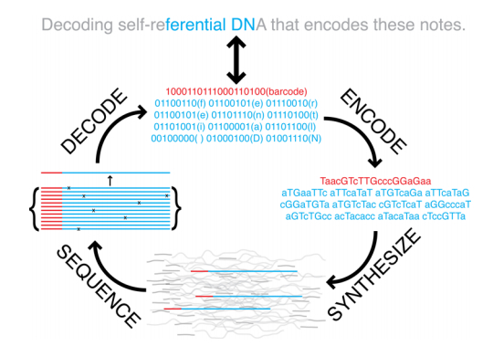
Motivation
DNA-Based Data Storage:
Church et al., 2012.
Goldman et al., 2013.

Slide 4
Motivation
DNA-Based Data Storage:
Church et al., 2012.
Goldman et al., 2013.
IDT, Twist, Agilent

Slide 5
Motivation
DNA-Based Data Storage:
Church et al., 2012.
Goldman et al., 2013.
Illumina, OxfordNP
IDT, Twist, Agilent

Slide 6
Motivation
DNA-Based Data Storage:
Church et al., 2012.
Goldman et al., 2013.
Enable random access, portability, error-correction: UIUC team, 2015-
Increase density: Fountain codes, Erlich et al, 2017;
Increase file size: Microsoft Research, 2016.
Illumina, OxfordNP
IDT, Twist, Agilent

Slide 7
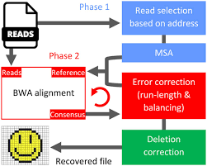
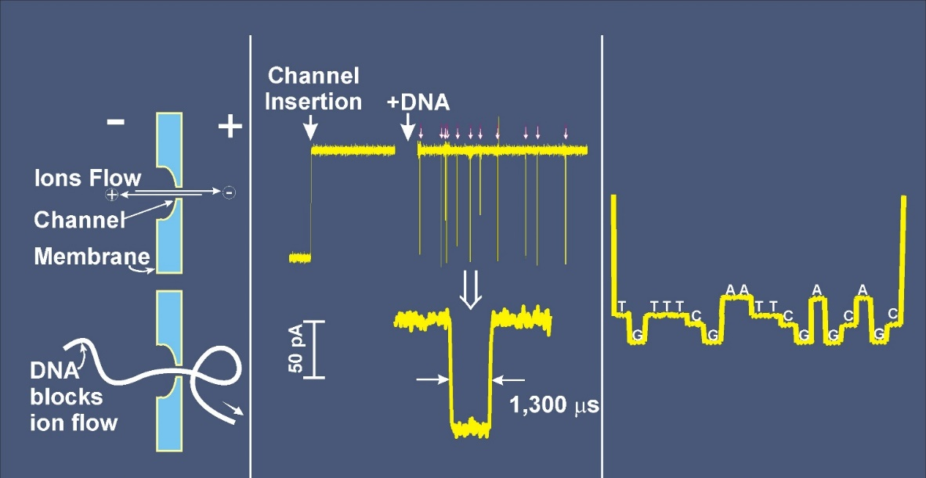
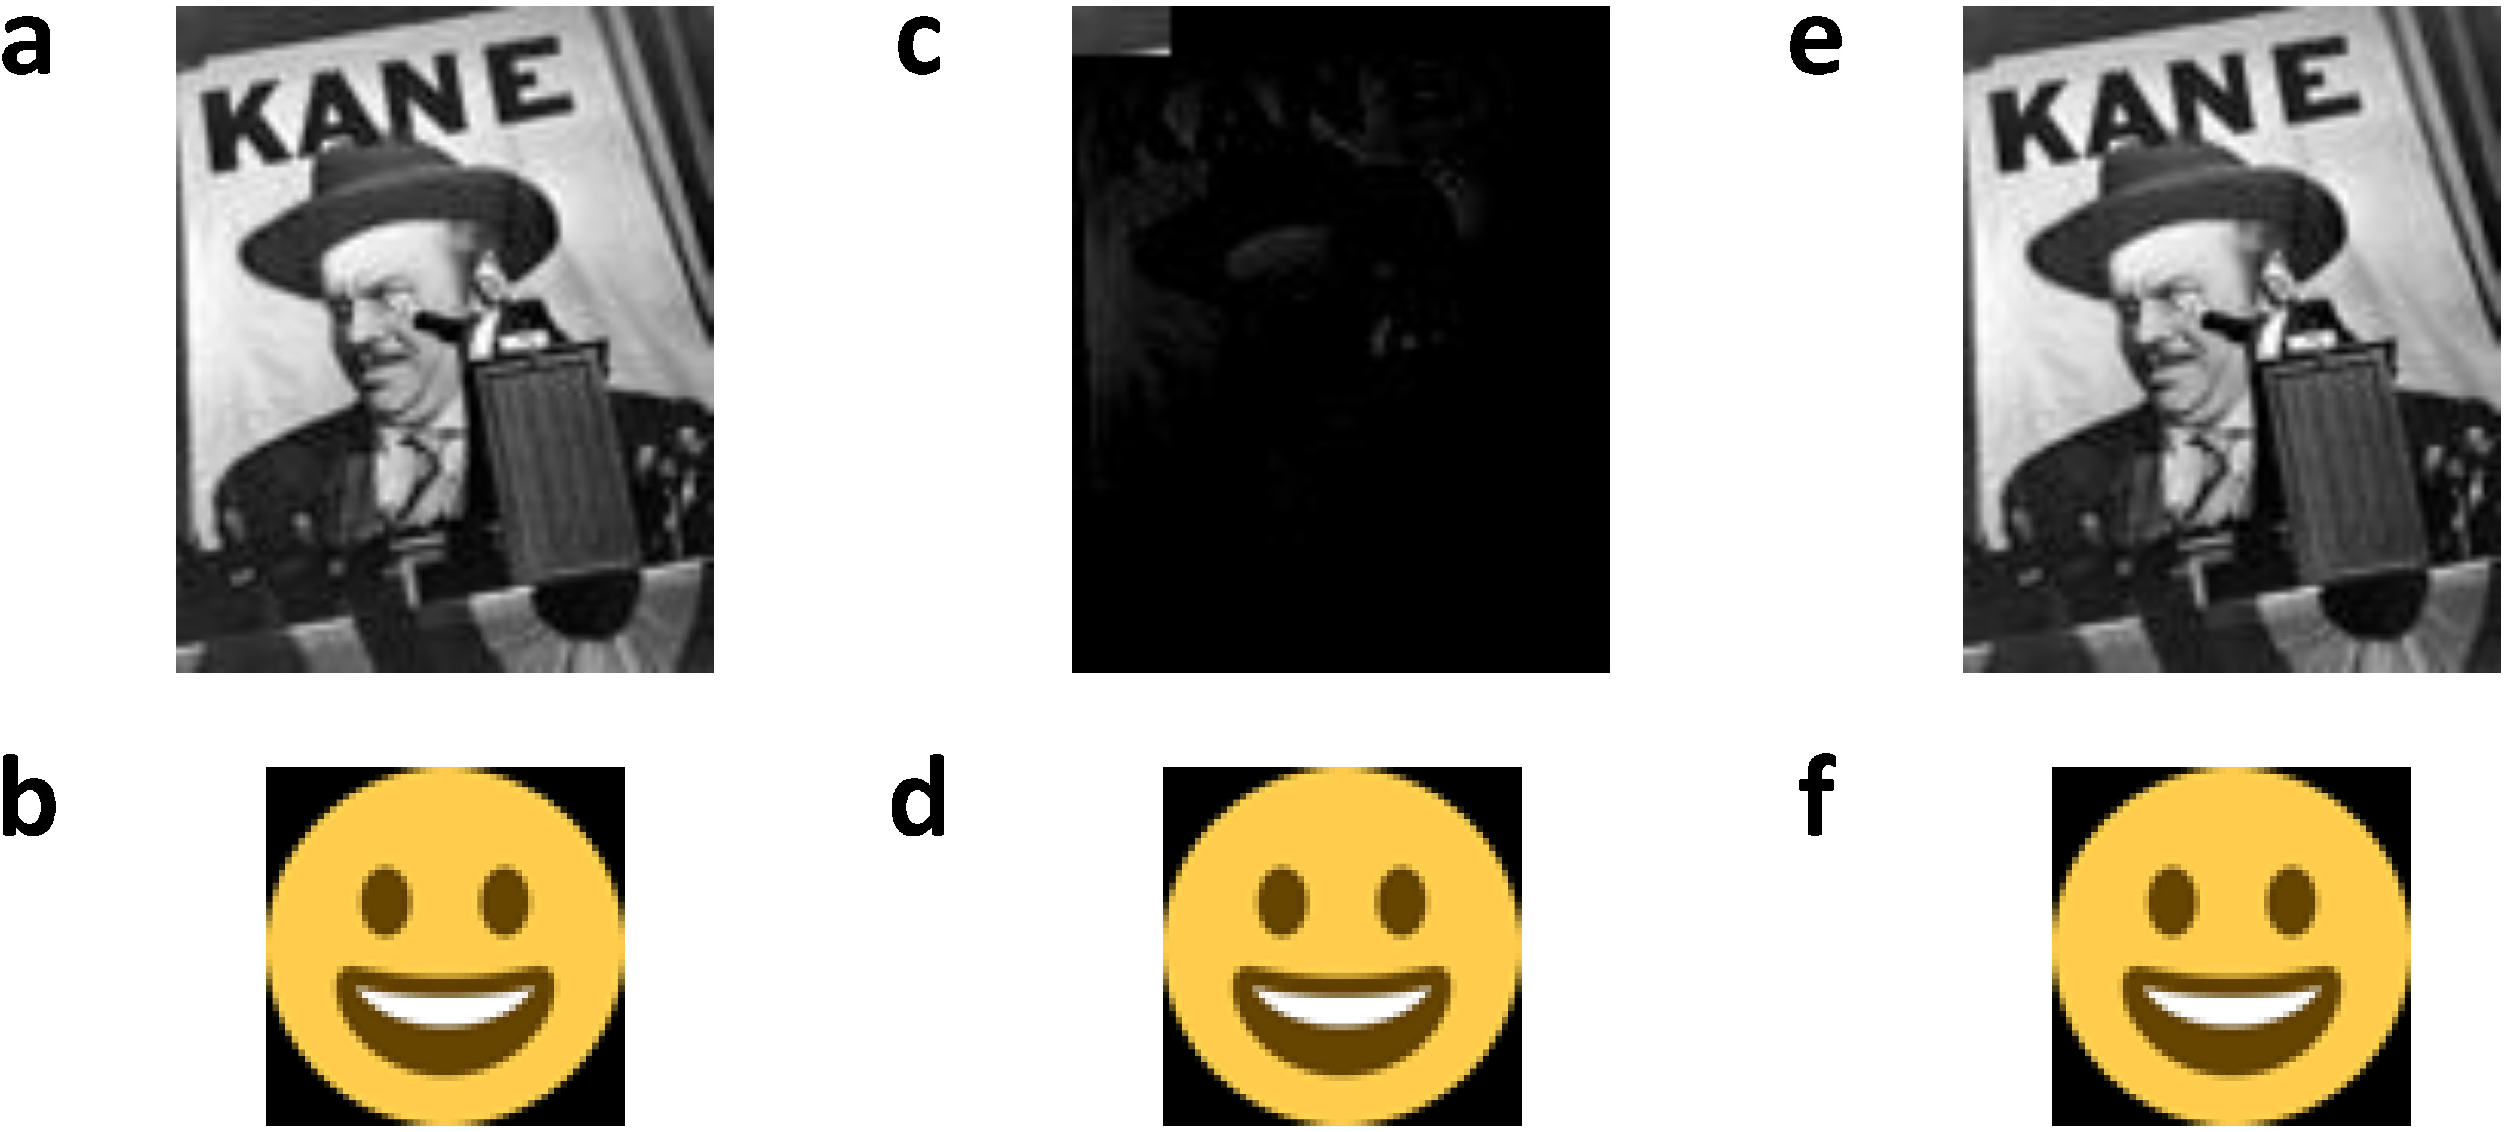
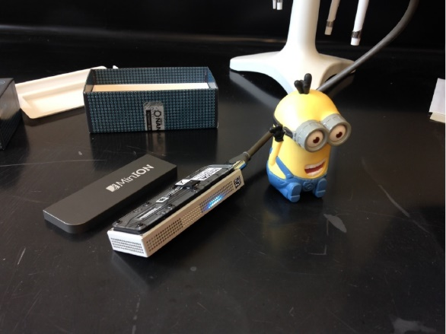
Motivation
DNA-Based Data Storage:
Church et al., 2012.
Goldman et al., 2013.
Enable random access, portability, error-correction: UIUC team, 2015-
Increase density: Fountain codes, Erlich et al, 2017;
Increase file size: Microsoft Research, 2016.
Illumina, OxfordNP
IDT, Twist, Agilent

Slide 8
Cost? Synthesis Delay?
Company | Length (bps) | #Oligos | Concentration | Price
Custom Array | 10-79 | 92,918 | 1 fmol | $4,000
Twist Bio | 1-120 | 600,000 | 0.25 fmol | $59,160
Thermo Fisher | 5-40 | 24 | 25 nmol | $5.5
Operon | 20 | 96 | 4 nmol | $115
IDT | 20 | 1 | 25 nmol | $7.5

Slide 9
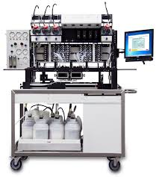
Cost? Synthesis Delay?
Company | Length (bps) | #Oligos | Concentration | Price
Custom Array | 10-79 | 92,918 | 1 fmol | $4,000
Twist Bio | 1-120 | 600,000 | 0.25 fmol | $59,160
Thermo Fisher | 5-40 | 24 | 25 nmol | $5.5
Operon | 20 | 96 | 4 nmol | $115
IDT | 20 | 1 | 25 nmol | $7.5
In house synthesizers (BioLytics, BioXP): ~100bps.

Slide 10
Cost? Synthesis Delay?
Company | Length (bps) | #Oligos | Concentration | Price
Custom Array | 10-79 | 92,918 | 1 fmol | $4,000
Twist Bio | 1-120 | 600,000 | 0.25 fmol | $59,160
Thermo Fisher | 5-40 | 24 | 25 nmol | $5.5
Operon | 20 | 96 | 4 nmol | $115
IDT | 20 | 1 | 25 nmol | $7.5
In house synthesizers (BioLytics, BioXP): ~100bps.
Inherently slow as symbols are added sequentially!

Slide 11
DNA is Everywhere, so why Overpay for Synthesis?
Free: Colored TEM of a plasmid of bacteria.

Slide 12
DNA is Everywhere, so why Overpay for Synthesis?
Free: Colored TEM of a plasmid of bacteria
Free: Human DNA organized in chromosomes.

Slide 13
DNA is Everywhere, so why Overpay for Synthesis?
Free: Colored TEM of a plasmid of bacteria.
Free: Human DNA organized in chromosomes.
BioTeke DNA extraction toolkit
$100.

Slide 14
Unfortunately, Information is Hardwired…

Slide 15
Unfortunately, Information is Hardwired…
So how do we ”record” our desired information?

Slide 16
DNA Punch-Cards
Part I ：Motivation and Background
Part II ： A New System Implementation
Part III： Experimental Results
Part IV：Coding-Theoretic Problems
Future Directions

Slide 17
DNA Editing: The Big Breakthrough
CRISPR-Cas9: “A Bacterial Immune System”
Mojica, Bolotin, …, Charpentier, Doudna, Zhang...

Slide 18
DNA Editing: The Big Breakthrough
CRISPR-Cas9: “A Bacterial Immune System”
Mojica, Bolotin, …, Charpentier, Doudna, Zhang...
LESSON: Changing content is hard, but “cutting” is easy and cheap!

Slide 19
How to Cut/Nick to Store?

Slide 20
How to Cut/Nick to Store?

Slide 21
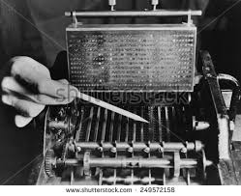
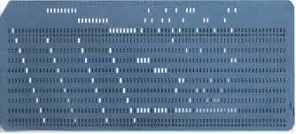
How to Cut/Nick to Store?

Slide 22
The Advantages of Nicking

Slide 23
The Advantages of Nicking
Can “cut” (nick) neither, sense or antisense strand (ternary alphabet). Nicks ~25bps apart.

Slide 24
The Advantages of Nicking
Can “cut” (nick) neither, sense or antisense strand (ternary alphabet). Nicks ~25bps apart.
Do not need to do anything to record 0s.

Slide 25
The Advantages of Nicking
Can “cut” (nick) neither, sense or antisense strand (ternary alphabet). Nicks ~25bps apart.
Do not need to do anything to record 0s.
Can do nicking fully in parallel.

Slide 26
The Advantages of Nicking
Can “cut” (nick) neither, sense or antisense strand (ternary alphabet). Nicks ~25bps apart.
Do not need to do anything to record 0s.
Can do nicking fully in parallel.
With PfAgo (DNA guide) instead of Cas9 (RNA guide), can reuse one molecule for 100s of nicks.

Slide 27
The Advantages of Nicking
Can “cut” (nick) neither, sense or antisense strand (ternary alphabet). Nicks ~25bps apart.
Do not need to do anything to record 0s.
Can do nicking fully in parallel.
With PfAgo (DNA guide) instead of Cas9 (RNA guide), can reuse one molecule for 100s of nicks.
When nicked/toeholded, DNA can be used for in-memory computing via strand displacement.

Slide 28
The Advantages of Nicking
Can “cut” (nick) neither, sense or antisense strand (ternary alphabet). Nicks ~25bps apart.
Do not need to do anything to record 0s.
Can do nicking fully in parallel.
With PfAgo (DNA guide) instead of Cas9 (RNA guide), can reuse one molecule for 100s of nicks.
When nicked/toeholded, DNA can be used for in-memory computing via strand displacement.
Nicked DNA can be mixed (think of an adder channel!) and read via nanopores.

Slide 29
The Advantages of Nicking
Four orders of magnitude lower cost per bit (replica)!
Comes at the cost of 30 times smaller density (if nicks placed 25bps; otherwise, loss much smaller).
Can do in memory computing (counting), not possible with any other technology!

Slide 30
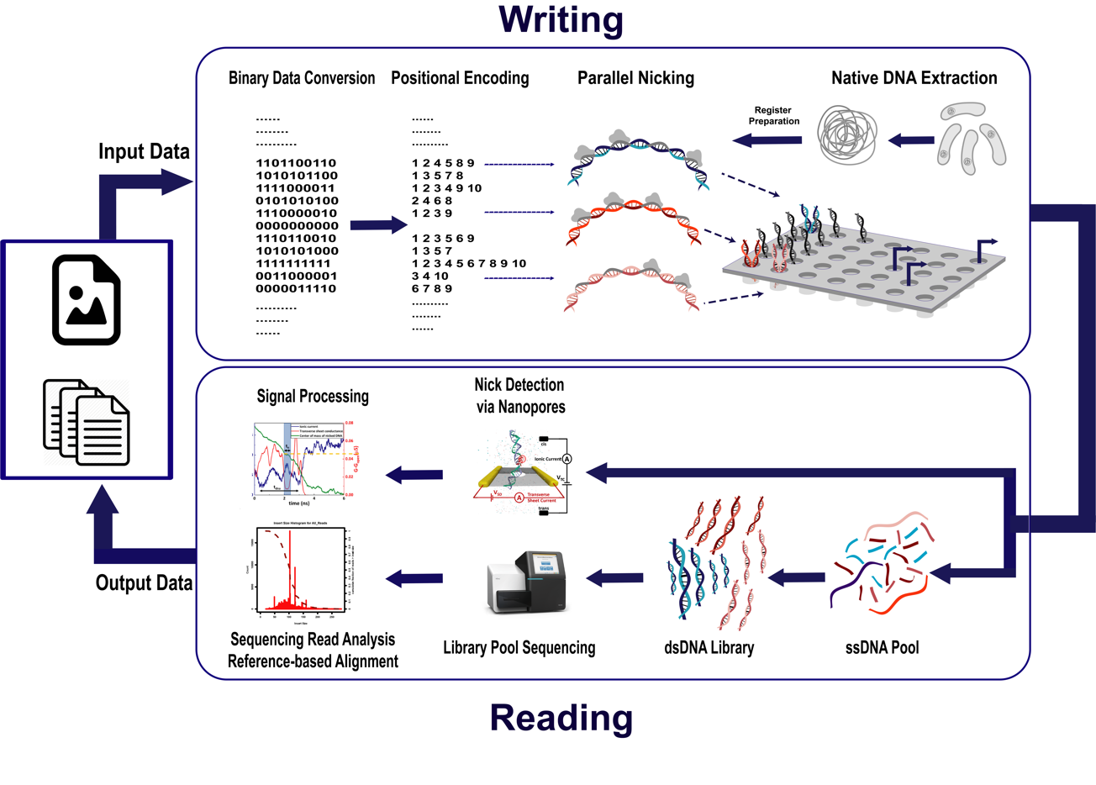
System Implementation

Slide 31
Some Bioinformatics
How do we choose nicking substrates and nicking sites? Main criteria is ”guide similarity”.

Slide 32
Some Bioinformatics
How do we choose nicking substrates and nicking sites? Main criteria is ”guide similarity”.
Organism | Genome length in bps | Unique length
Streptomyces coelicolor A3(2) (Gram+) | 9,054,847 | 2,621
Mycxococcus xanthus DK 1622/ E. Coli K12 MG1655 (Gram-) | 9,139,763/4,641,652 | 2,817/2,816
Noctos punctiforme PCC 73102 | 9,059,191 | 5,569

Slide 33
Some Bioinformatics
How do we choose nicking substrates and nicking sites? Main criteria is ”guide similarity”.
Organism | Genome length in bps | Unique length
Streptomyces coelicolor A3(2) (Gram+) | 9,054,847 | 2,621
Mycxococcus xanthus DK 1622/ E. Coli K12 MG1655 (Gram-) | 9,139,763/4,641,652 | 2,817/2,816
Noctos punctiforme PCC 73102 | 9,059,191 | 5,569
E. Coli K12 MG1655 (Gram-)
Shortest length for which a substring is missing: 7 (only one!)
Number of distinct substrings of length 13: 4,170,362.

Slide 34
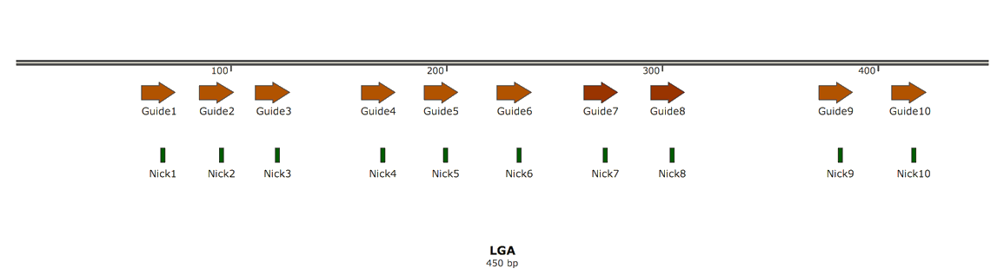
Some Bioinformatics
How do we choose nicking substrates and nicking sites? Main criteria is ”guide similarity”.
Organism | Genome length in bps | Unique length
Streptomyces coelicolor A3(2) (Gram+) | 9,054,847 | 2,621
Mycxococcus xanthus DK 1622/ E. Coli K12 MG1655 (Gram-) | 9,139,763/4,641,652 | 2,817/2,816
Noctos punctiforme PCC 73102 | 9,059,191 | 5,569
E. Coli K12 MG1655 (Gram-)
Punch Card Desiderata:
Length 16, nonrepeating up to Hamming distance three.
AT content between 40-60%.
No long runs of Gs.
Shortest length for which a substring is missing: 7 (only one!)
Number of distinct substrings of length 13: 4,170,362.

Slide 35
Reading the Recorded Data
Denaturation
Library Preparation
MiSeq Sequencing

Slide 36
Reading the Recorded Data
Denaturation
Library Preparation
Reference alignment
MiSeq Sequencing

Slide 37
Reading the Recorded Data
Insert size distribution plot
Denaturation
Library Preparation
Coverage plot
Reference alignment
MiSeq Sequencing

Slide 38
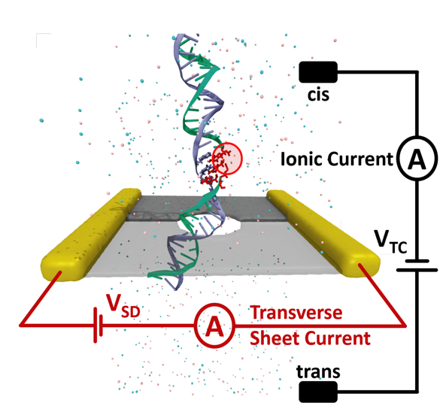
Reading the Data Faster
Nanopores?

Slide 39
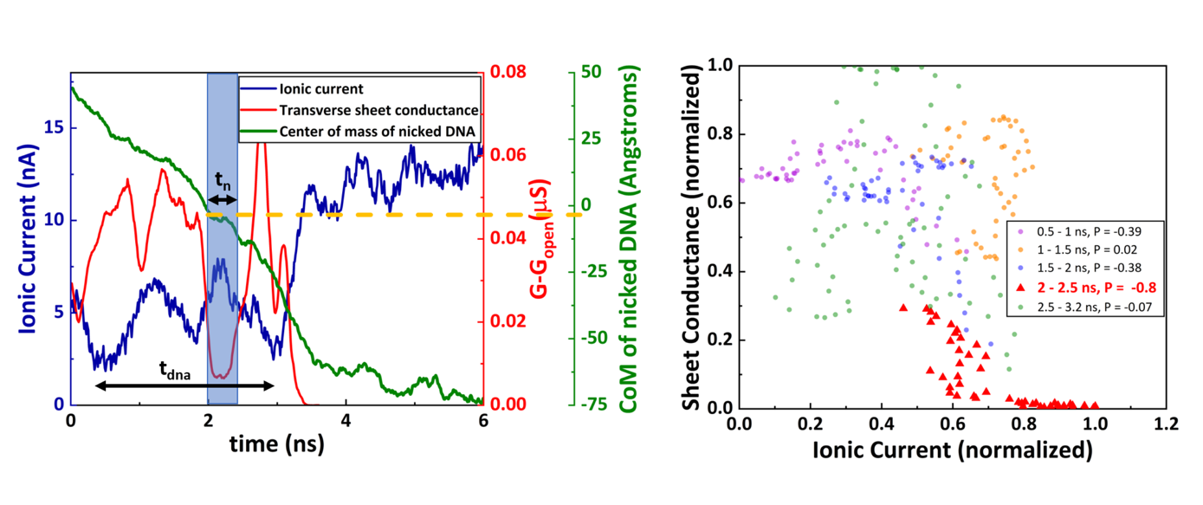
Reading the Data Faster
Nanopores?

Slide 40
Reading the Data Faster
Nanopores?

Slide 41
DNA Punch-Cards
Part I ：Motivation and Background
Part II ： A New System Implementation
Part III： Experimental Results
Part IV：Coding-Theoretic Problems
Future Directions

Slide 42
How does This Works in Practice?
384 well plate
Echo machine

Slide 43
How does This Works in Practice?
384 well plate
Echo machine

Slide 44
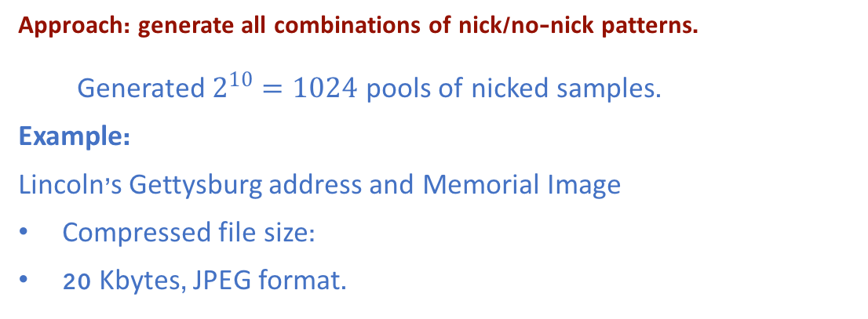
How does This Works in Practice?
384 well plate
Approach: generate all combinations of nick/no-nick patterns.
  Generated $2^{10}=1024$ pools of nicked samples.
Example:
Lincoln’s Gettysburg address and Memorial Image
Compressed file size:
20 Kbytes, JPEG format.

Slide 45
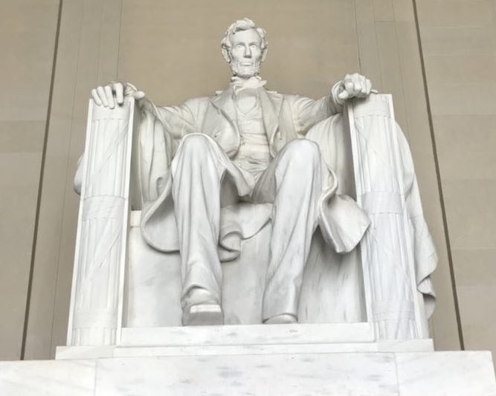
Experimental Readouts
0011001100
1111010010
1111111111

Slide 46
Increasing the Density: Sense-Anti Sense Nicking

Slide 47
Increasing the Density: Sense-Anti Sense Nicking

Slide 48
Increasing the Density: Sense-Anti Sense Nicking

Slide 49
Increasing the Density: Orthogonal Registers

Slide 50
Increasing the Density: Orthogonal Registers

Slide 51
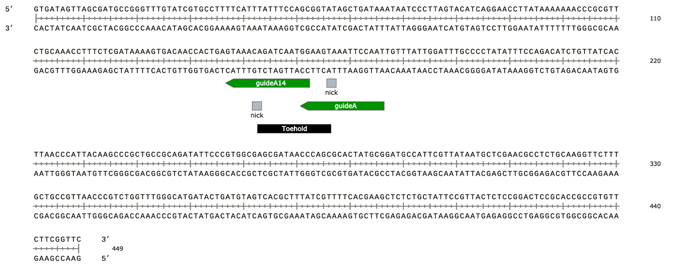
Toeholds and Non-Destructive Bitwise RA
14nt

Slide 52
Toeholds and Non-Destructive Bitwise RA
14nt

Slide 53
Things we do not have Time to Discuss…
Strand displacement – Nick displacement.

Slide 54
Things we do not have Time to Discuss…
In memory computations and error-correction:
Counters;
Rule110;
Hamming code error-correction;
Concentration based computations;
Register mixing and the adder channel – Lindstrom’s code.
1 1 2 2
Strand displacement – Nick displacement.

Slide 55
DNA Punch-Cards
Part I ：Motivation and Background
Part II ： A New System Implementation
Part III： Experimental Results
Part IV：Coding-Theoretic Problems
Future Directions

Slide 56
Some New Coding Problems
The issue of “balancing” nicks on both strands to prevent uncontrolled disassociation:

Slide 57
Some New Coding Problems
The issue of “balancing” nicks on both strands to prevent uncontrolled disassociation:

Slide 58
Some New Coding Problems
The issue of “balancing” nicks on both strands to prevent uncontrolled disassociation:
blocks
is

Slide 59
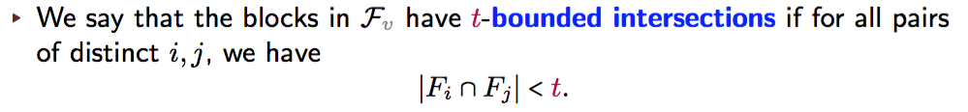
Some New Coding Problems
The issue of “balancing” nicks on both strands to prevent uncontrolled disassociation:
blocks
is

Slide 60
Set and Code Discrepancy

Slide 61
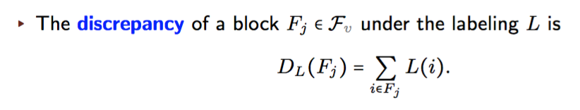
Set and Code Discrepancy

Slide 62


Set and Code Discrepancy
Goal: Find the largest collection of sets, of size , for which there exists
a labeling L such that for all j,
.

Slide 63
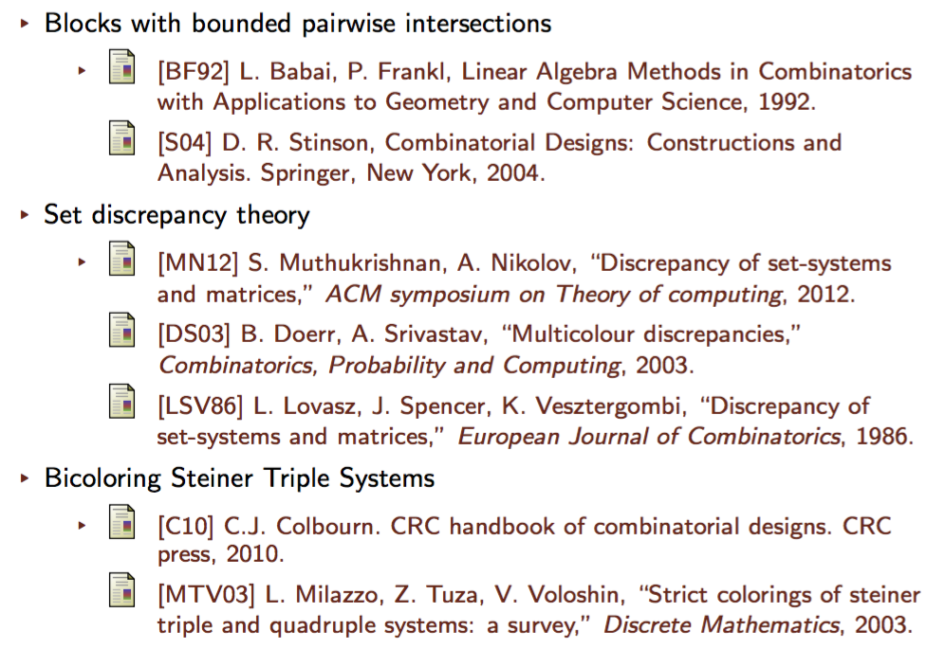
Prior Work?

Slide 64
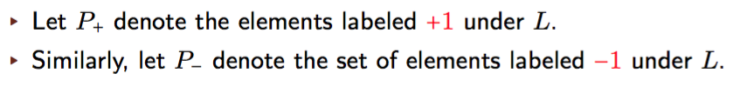
Intersecting Code Discrepancy: An Example

Slide 65

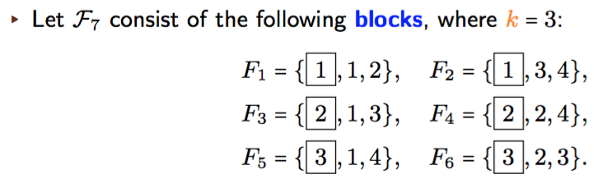
Intersecting Code Discrepancy: An Example
.

Slide 66
Intersecting Code Discrepancy: An Example
.
imbalance

Slide 67
Intersecting Code Discrepancy: Some Results
Recall: stands for the largest family of sets over the ground set [v] and of cardinality k, intersecting in <t elements, and with discrepancy in {0,+1,-1}.

Slide 68

Intersecting Code Discrepancy: Some Results
Recall: stands for the largest family of sets over the ground set [v] and of cardinality k, intersecting in <t elements, and with discrepancy in {0,+1,-1}.

Slide 69
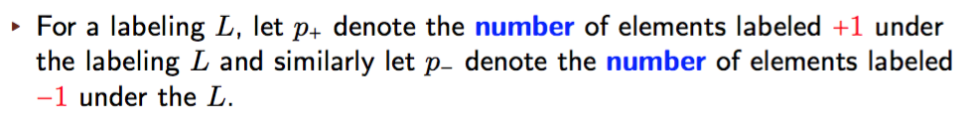
Intersecting Code Discrepancy: Some Results
Recall: stands for the largest family of sets over the ground set [v] and of cardinality k, intersecting in <t elements, and with discrepancy in {0,+1,-1}.

Slide 70
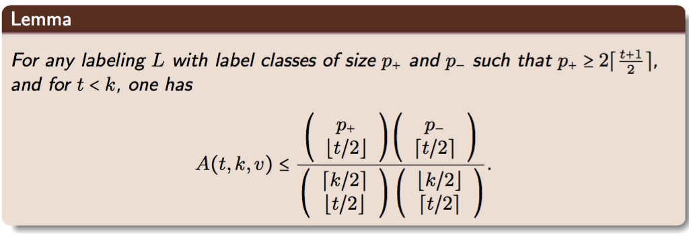
Intersecting Code Discrepancy: Some Results
Recall: stands for the largest family of sets over the ground set [v] and of cardinality k, intersecting in <t elements, and with discrepancy in {0,+1,-1}.

Slide 71
Intersecting Code Discrepancy: Some Results
Recall: stands for the largest family of sets over the ground set [v] and of cardinality k, intersecting in <t elements, and with discrepancy in {0,+1,-1}.

Slide 72

Intersecting Code Discrepancy: Some Results
Recall: stands for the largest family of sets over the ground set [v] and of cardinality k, intersecting in <t elements, and with discrepancy in {0,+1,-1}.
Also, let stand for the largest Steiner System over the ground set [v] and of cardinality k, with no two blocks containing t elements in common.

Slide 73
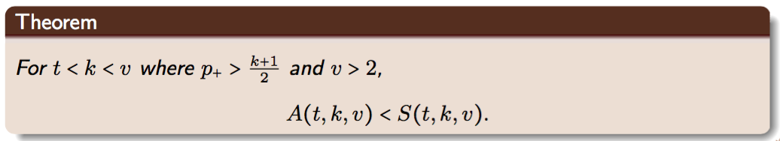
Intersecting Code Discrepancy: Some Results
Recall: stands for the largest family of sets over the ground set [v] and of cardinality k, intersecting in <t elements, and with discrepancy in {0,+1,-1}.
Also, let stand for the largest Steiner System over the ground set [v] and of cardinality k, with no two blocks containing t elements in common.

Slide 74
Code Construction: Meeting the Upper Bound for k=3
1-Factorizations of graphs:
A factor of a graph is a spanning subgraph;
A s-factor is a s-regular factor;
A s-factorization is a partition of the edges into disjoint s-factors.

Slide 75
Code Construction: Meeting the Upper Bound for k=3
1-Factorizations of graphs:
A factor of a graph is a spanning subgraph;
A s-factor is a s-regular factor;
A s-factorization is a partition of the edges into disjoint s-factors.
A graph is s-factorable if it has a valid s-factorization. Note that a 1-factor is a perfect matching.

Slide 76
Code Construction: Meeting the Upper Bound for k=3
1-Factorizations of graphs:
A factor of a graph is a spanning subgraph;
A s-factor is a s-regular factor;
A s-factorization is a partition of the edges into disjoint s-factors.
A graph is s-factorable if it has a valid s-factorization. Note that a 1-factor is a perfect matching.
Petersen graph (Wiki)
Desargues graph (Wiki)

Slide 77
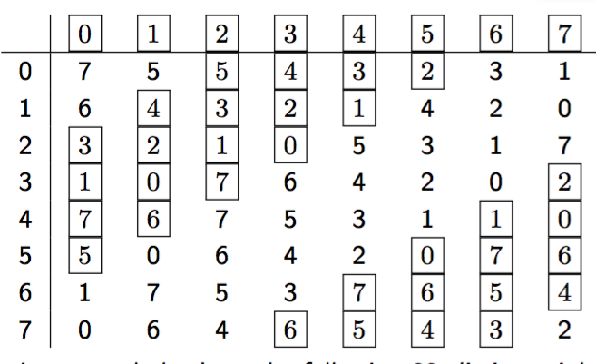
Code Construction: Constrained Partial Latin Rectangles

Slide 78
Future Directions:
In-memory computing and error-correction.

Slide 79
Future Directions:
In-memory computing and error-correction.
Nanopore “obsessions”: detecting methylation, chemically modified nucleotides, HachiMoji DNA etc.

Slide 80
Future Directions:
In-memory computing and error-correction.
Nanopore “obsessions”: detecting methylation, chemically modified nucleotides, HachiMoji DNA etc.
Combining DNA punch-cards with synthetic data storage platforms (metadata, watermarks, controlling PCA).

Slide 81
Future Directions:
In-memory computing and error-correction.
Nanopore “obsessions”: detecting methylation, chemically modified nucleotides, HachiMoji DNA etc.
Combining DNA punch-cards with synthetic data storage platforms (metadata, watermarks, controlling PCA).
Theoretical work on:
    Trace reconstruction for nanopore sequencing. Coded trace reconstruction.
    Codes for chemically modified DNA.
    And many other…

