Slide 1
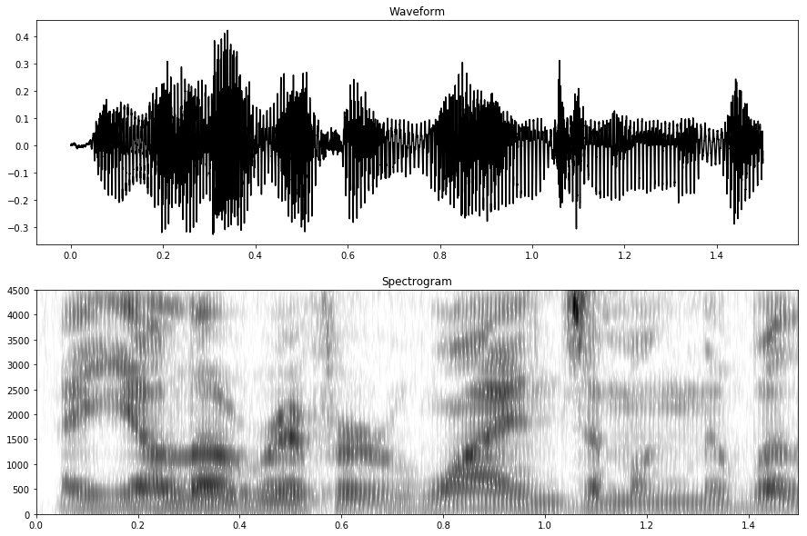
A
the
Yellow
Yell oh
Roofer
river
Winds
oinks
Anon
along
Duh
the
/e/
/ɛ/
/ɪ/
/ə/
/e/
/ɛ/
/l/
/ʊ/
/u/
/ə/
/r/
/ʊ/
/ʌ/
/ə/
F
/f/
/th/
/ʊ/
/u/
/ɔ/
/j/
/e/
/ɛ/
F
SR
/ə/
/e/
/ɛ/
N
/l/
/ɑ/
/o/
/ɔ/
N
/l/
S
/ə/
/æ/
/w/
S
F
/ʊ/
/o/
/ɔ/
/j/
/w/
S
/3r/
/ɑr/
/or/
N
/l/

Slide 2
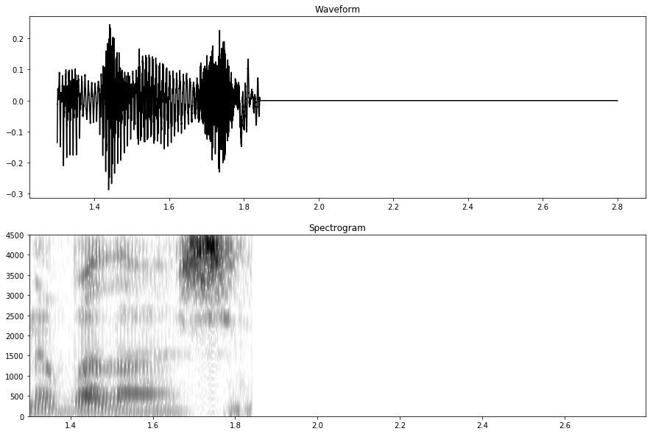
willows
/w/
S
F
/ʊ/
/o/
/ɔ/
N
/l/
/ʊ/
/o/
/ʌ/
F
/s/
/z/

