Slide 1
Zipf's law suggests a three-pronged approach to inclusive speech recognition
Mark Hasegawa-Johnson
12/9/2022

Slide 2
Outline
How ASR solved Zipf’s Law: frequent, infrequent, and OOV words
The power-law distribution of languages and dialects
  Early success: monolingual pre-training
  Knowledge transfer: multilingual training
  Paradigm shift: unsupervised ASR
Inclusive speech recognition
The power-law distribution of disability

Slide 3
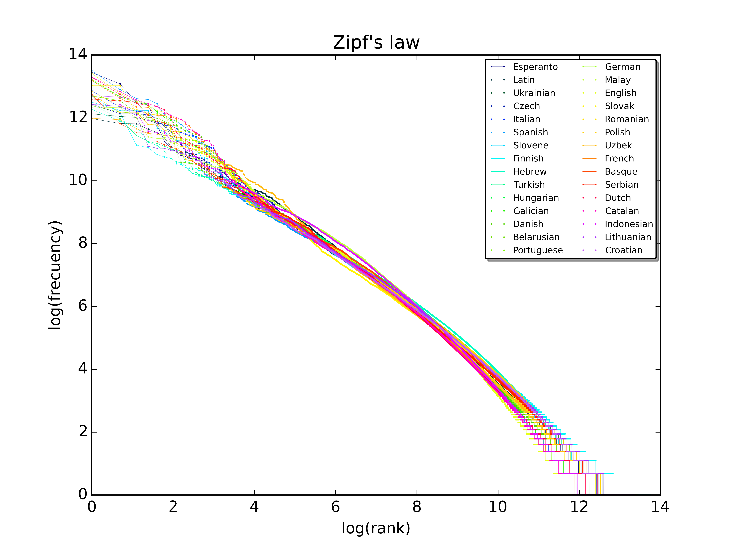
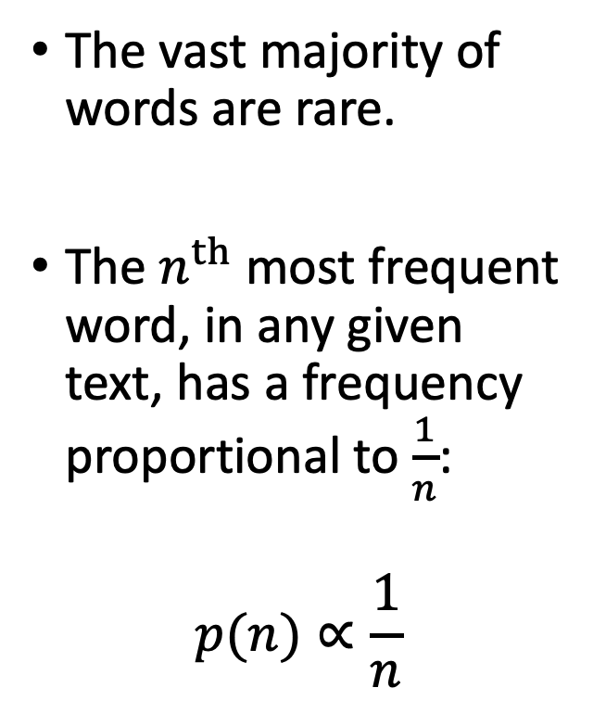
Zipf’s Law
The vast majority of words are rare.
The $n^{th}$ most frequent word, in any given text, has a frequency proportional to $\frac{1}{n}$:
$$p(n)∝\frac{1}{n}$$
Image CC-SA 4.0, Sergio Jimenez, 2015, https://commons.wikimedia.org/wiki/File:Zipf_30wiki_en_labels.png

Slide 4
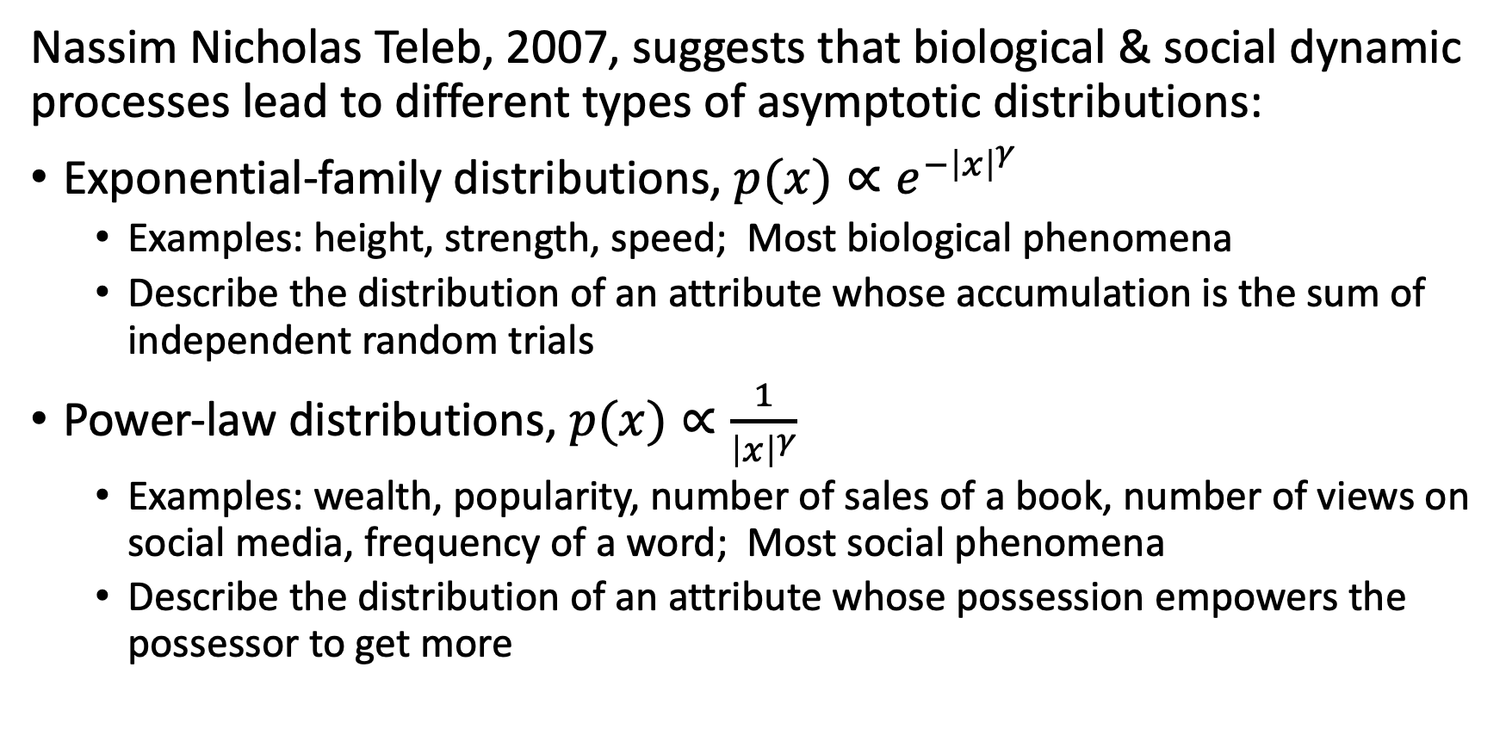
What Causes Zipf’s Law?
Nassim Nicholas Teleb, 2007, suggests that biological & social dynamic processes lead to different types of asymptotic distributions:
Exponential-family distributions, $p(x)∝e^{−{\left|x\right|}^{γ}}$
  Examples: height, strength, speed; Most biological phenomena
  Describe the distribution of an attribute whose accumulation is the sum of independent random trials
Power-law distributions, $p(x)∝\frac{1}{{\left|x\right|}^{γ}}$
  Examples: wealth, popularity, number of sales of a book, number of views on social media, frequency of a word; Most social phenomena
  Describe the distribution of an attribute whose possession empowers the possessor to get more

Slide 5
What does Zipf’s Law mean for Machine Learning?
Authors such as Mitch Marcus have pointed out that Zipf’s law makes some problems easy, some problems hard, and some problems impossible:
Frequent words: Early success
Infrequent words: Knowledge transfer
Out-of-vocabulary (OOV) words: Paradigm shift

Slide 6
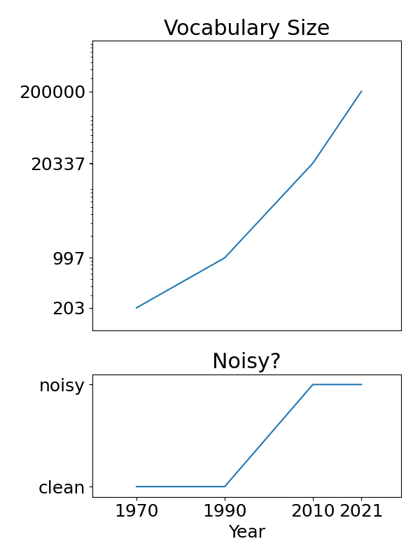
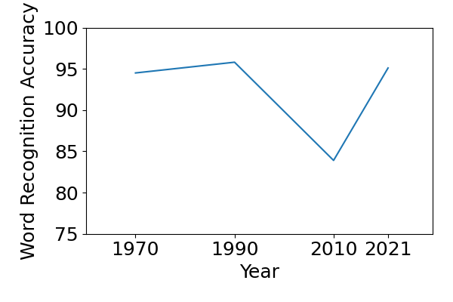
Zipf’s law for Automatic Speech Recognition

Slide 7
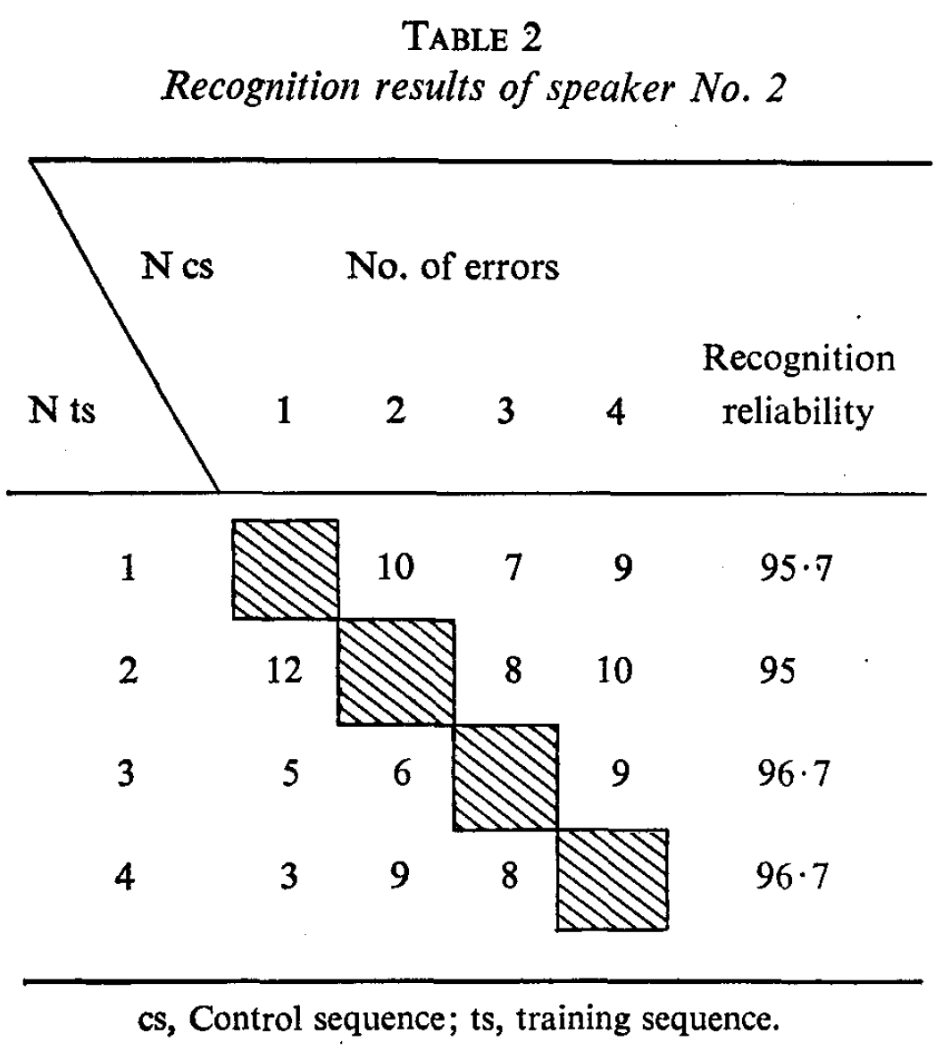
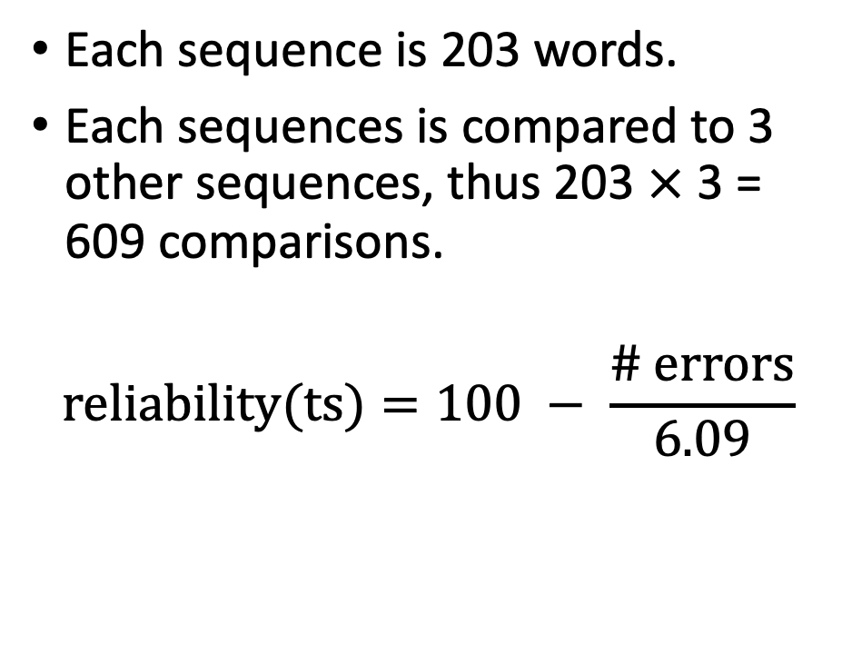
1. Early success: Dynamic Time Warping
Each sequence is 203 words.
Each sequences is compared to 3 other sequences, thus 203 $×$ 3 = 609 comparisons.
$$reliability(ts)=100 − \frac{\# errors}{6.09}$$
Velichko & Zagoruyko, “Automatic Recognition of 200 Words,” 1970

Slide 8
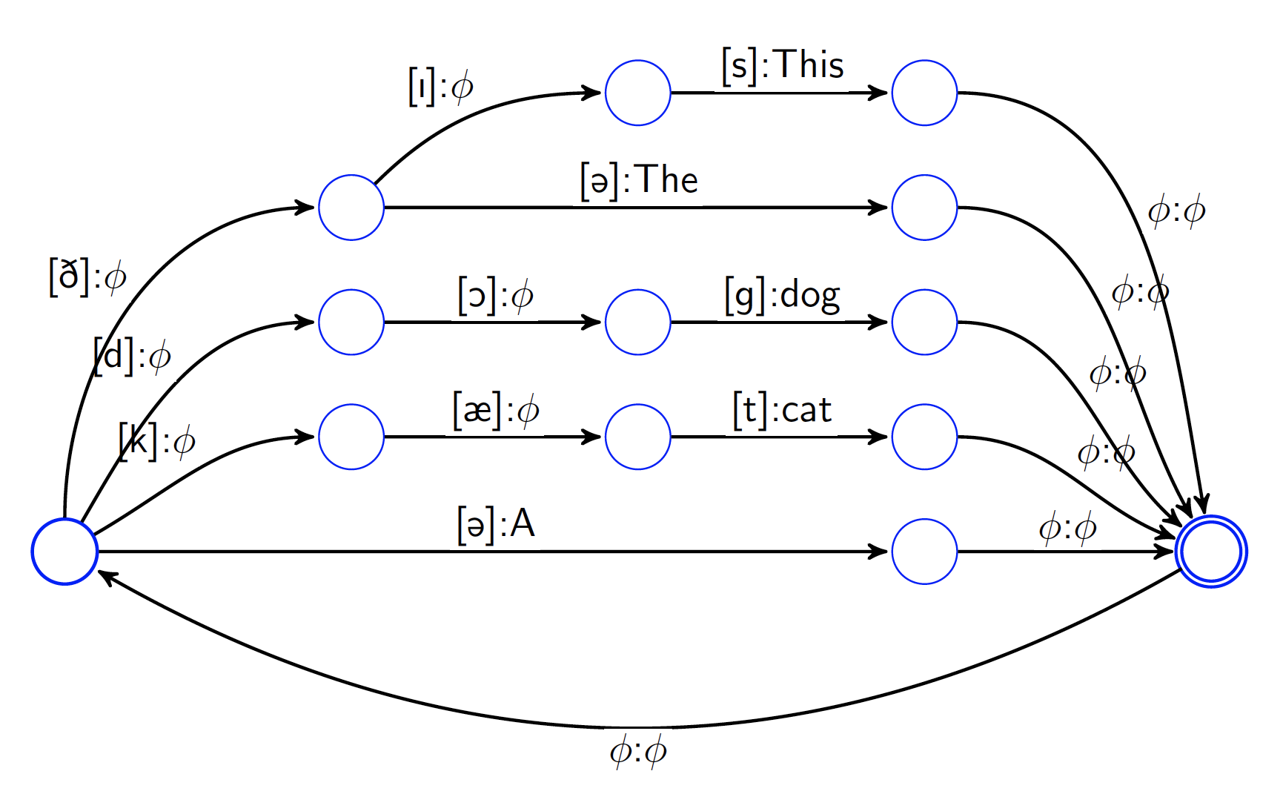
2. Knowledge transfer: HMMs & Sub-word units
Hidden Markov models: effective use of many training examples
Sub-word units: sharing data across words permits effective modeling of infrequent words
A lexical transducer maps from subword units (phones) to words
CC-BY 4.0, 2022

Slide 9
3. Paradigm shift: why recognize words?
Zipf’s law means that the test corpus will always contain words that weren’t in the training corpus.
It is impossible to recognize those words as words.
The only solution is to re-frame the problem. For example, in speech recognition:
  Frequent words, and some infrequent words, are recognized as words,
  OOV words are recognized using a subword language model.
Expansion of an English sentence into a sequence of words and subwords for subword language modeling,
Mikolov et al., “Subword Language Modeling with Neural Networks,” 2012

Slide 10
Outline
How ASR solved Zipf’s Law: frequent, infrequent, and OOV words
The power-law distribution of languages and dialects
  Early success: monolingual pre-training
  Knowledge transfer: multilingual training
  Paradigm shift: unsupervised ASR
Inclusive speech recognition
The power-law distribution of disability

Slide 11

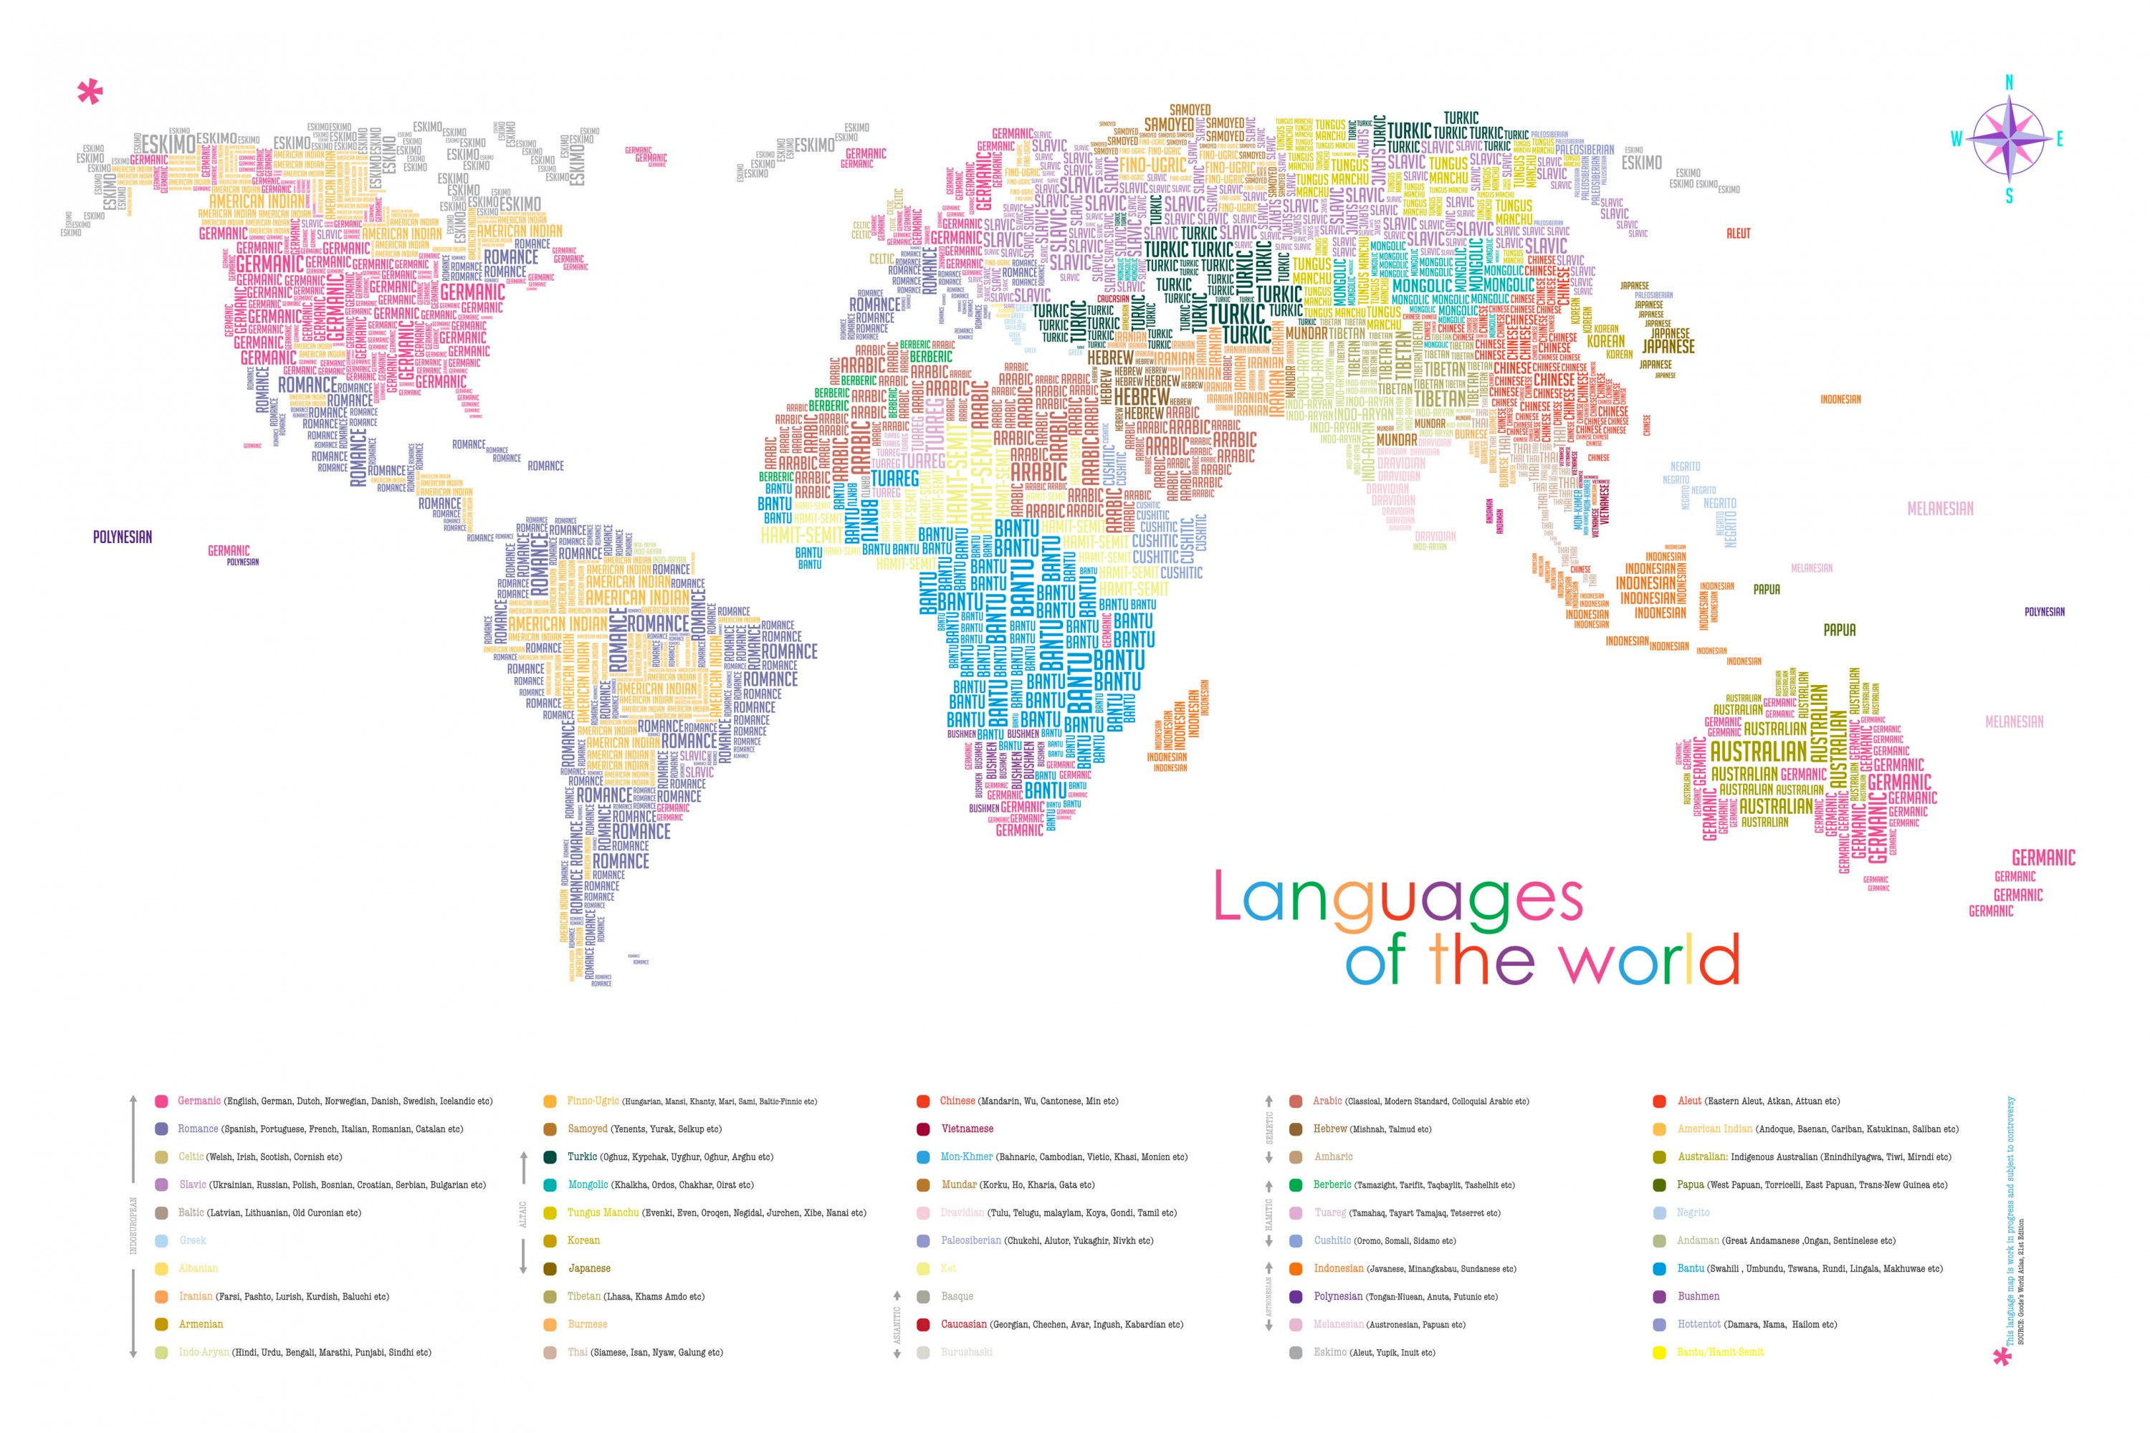
What do we mean by “multilingual”?
Ethnologue: there are 7000 languages in the world
Ethnologue: about 4000 of them have a writing system (2000 have published phone sets)
Wilderness corpus: transcribed speech (New Testament) exist for 700.
LREMap: Speech and/or NLP articles have been written about 97 languages (including classical and sign languages).
Globalphone: ASR with error rate < 50% exists for about 22.

Slide 12
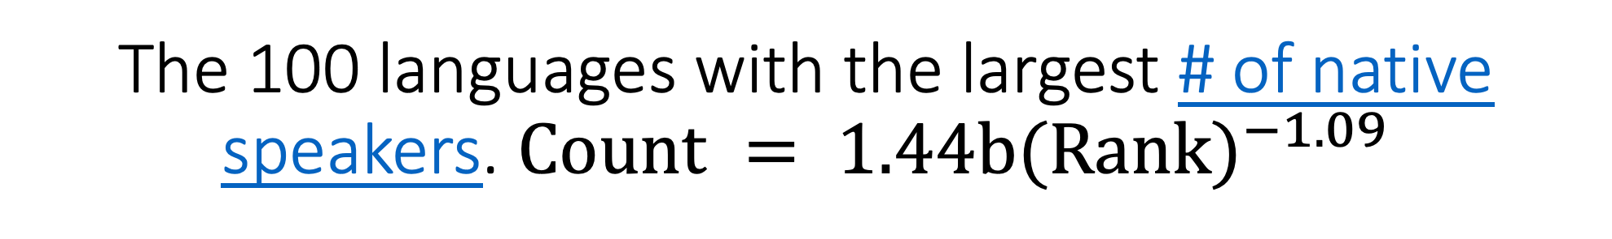
The 100 languages with the largest # of native speakers. $Count = 1.44b{(Rank)}^{−1.09}$

Slide 13
What do we mean by “multilingual”?
Monolingual supervised methods may work for ~25 languages (those with > 50m native speakers, or lots of money).
Multilingual supervised methods may work for up to 700 languages (those with transcribed speech data).
Cross-lingual supervised methods may work for up to 4000 languages (those with writing systems).
Unsupervised methods, if they can be made to work, would work for all languages.

Slide 14
Outline
How ASR solved Zipf’s Law: frequent, infrequent, and OOV words
The power-law distribution of languages and dialects
  Early success: monolingual pre-training
  Knowledge transfer: multilingual training
  Paradigm shift: unsupervised ASR
Inclusive speech recognition
The power-law distribution of disability

Slide 15
Experimental setup
Pre-training procedure: wav2vec 2.0 in three settings:
  Open-source English model
  Open-source XLSR-53 model
  Model that we pre-train
Pre-training language:
  Multilingual (XLSR-53)
  Cross-lingual (Open-source English, applied to another language)
  Monolingual (Model that we pre-train)
Fine-tuning:
  Monolingual (fine-tuned on the right language)
  Cross-lingual (fine-tuned on the wrong language)

Slide 16
Datasets for pre-training and fine-tuning
Language | Pre-train | Fine-tune
English (en) | MLS (36kh) | Librilight (10h)
Standard Arabic (ar) | UN Proceedings (1kh) | GALE BN (120h)
Bulgarian (bg) | VoxPopuli (2.7kh) | Globalphone (20h)
Japanese (ja) | LabroTV (2kh) | CSJ (661h)
Russian (ru) | UN Proceedings (1kh) | MLS (100h)
Mandarin (zh) | UN Proceedings (1kh) | Globalphone (20h)

Slide 17
Open-source pre-training vs Our pre-training
Pre-train, Fine-tune, and Test on English
Pre-train | Fine-tune | Dev Character Error Rt (CER: %) | Dev Word Error Rate (WER: %) | Test Character Error Rt (CER: %)
Open Source | Ours | - | 10.9 | -
Ours | Ours | 3.51 | 9.87 | 2.97

Slide 18
Multilingual vs Monolingual vs Cross-lingual Pre-training
 | Multilingual (XLSR) |  | Cross-Lingual (English Pretrain) |  | Monolingual Pretraining
Language | Dev CER | Test CER | Dev CER | Test CER | Dev CER | Test CER
English (en) | 1.91 | 1.91 |  |  | 3.51 | 2.97
Arabic (ar) | 4.67 | 4.58 | 6.49 | 5.47 | 3.62 | 3.45
Bulgarian (bg) | 2.67 | 2.70 | 3.48 | 3.47 | 1.85 | 1.89
Japanese (ja) | 14.67 | 14.35 | 16.08 | 16.33 | 10.38 | 9.91
Russian (ru) | 5.84 | 4.84 | 5.57 | 5.59 | 5.57 | 6.98
Mandarin (zh) | 14.15 | 14.56 | 15.20 | 15.41 | 10.43 | 10.60

Slide 19
Outline
How ASR solved Zipf’s Law: frequent, infrequent, and OOV words
The power-law distribution of languages and dialects
  Early success: monolingual pre-training
  Knowledge transfer: multilingual training
  Paradigm shift: unsupervised ASR
Inclusive speech recognition
The power-law distribution of disability

Slide 20
Monolingual, Multilingual, & Cross-Lingual
Speech Recognition
Zelasko, Moro-Velasquez, Hasegawa-Johnson, Scharenborg & Dehak, Interspeech 2020
Feng, Zelasko, Moro-Velasquez, Abavisani, Hasegawa-Johnson, Sharenborg & Dehak, 2021
Monolingual: Train on one language, test on the same language
Multilingual: Train on 13 languages, test on one of those 13
Cross-lingual: Train on 12 languages, test on the 13th (cross-validation)

Slide 21
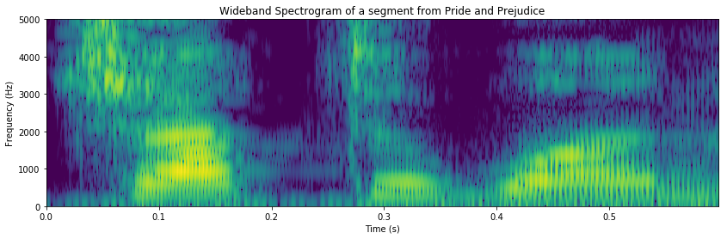
Architectures
Hybrid DNN-HMM
Transformer
/ʃɻ̍ tə mek/
/ʃɻ̍ tə mek/
HMM (3 transducers)
Decoder (1 layer)
bLSTM (N layers)
Self-Attention (P layers)
CNN (M layers)
Encoder (M layers)

Slide 22
Basic methodology
Two types of data were used:
  Globalphone (5 languages): very clean read speech, 11-24 hrs/language
  Babel (8 languages): noisy broadcast audio, 39-127 hrs/language
Convert training transcripts from text into international phonetic alphabet (IPA): LanguageNet finite state transducers
Replicate published Babel training & test scripts, modify to use IPA

Slide 23
Key experimental findings
Hybrid is much better than transformer in the monolingual case (data size: 11.5hrs Spanish to 127hrs Cantonese)
Transformer, but not hybrid, is dramatically improved by multilingual training
None of the systems do well in the cross-lingual case
Type of Speech | Language | Hybrid (PER, %) |  |  | Transformer (PTER, %)
 |  | Mon | Multi | Cross | Mon | Multi | Cross
Read (Global Phone) | Czech | 8.6 | 11.0 | 70.5 | 26.4 | 8.1 | 65.8
 | French | 13.0 | 14.4 | 64.1 | 29.5 | 11.0 | 61.7
 | Spanish | 10.7 | 11.0 | 64.6 | 27.6 | 9.1 | 76.3
 | Mandarin* | 17.6 | 20.4 | 89.8 | 46.3 | 17.2 | 85.9
 | Thai* | 18.8 | 27.2 | 88.7 | 46.0 | 18.1 | 76.2
Read and Conversed (Babel) | Cantonese | 34.8 | 39.1 | 91.0 | 36.6 | 29.8 | 76.9
 | Bengali | 41.0 | 44.5 | 81.3 | 41.2 | 34.6 | 81.4
 | Vietnam* | 41.6 | 45.8 | 91.1 | 52.3 | 35.4 | 75.0
 | Lao* | 39.8 | 45.1 | 86.0 | 58.6 | 34.1 | 77.9
 | Zulu | 40.5 | 45.3 | 82.3 | 41.7 | 35.8 | 77.3
 | Amharic | 32.7 | 39.2 | 81.0 | 52.1 | 33.9 | 75.2
 | Javanese | 45.3 | 53.3 | 85.0 | 53.0 | 41.0 | 99.6
 | Georgian | 39.1 | 38.8 | 80.0 | 43.9 | 32.4 | 76.4

Slide 24
Outline
How ASR solved Zipf’s Law: frequent, infrequent, and OOV words
The power-law distribution of languages and dialects
  Early success: monolingual pre-training
  Knowledge transfer: multilingual training
  Paradigm shift: unsupervised ASR
Inclusive speech recognition
The power-law distribution of disability

Slide 25
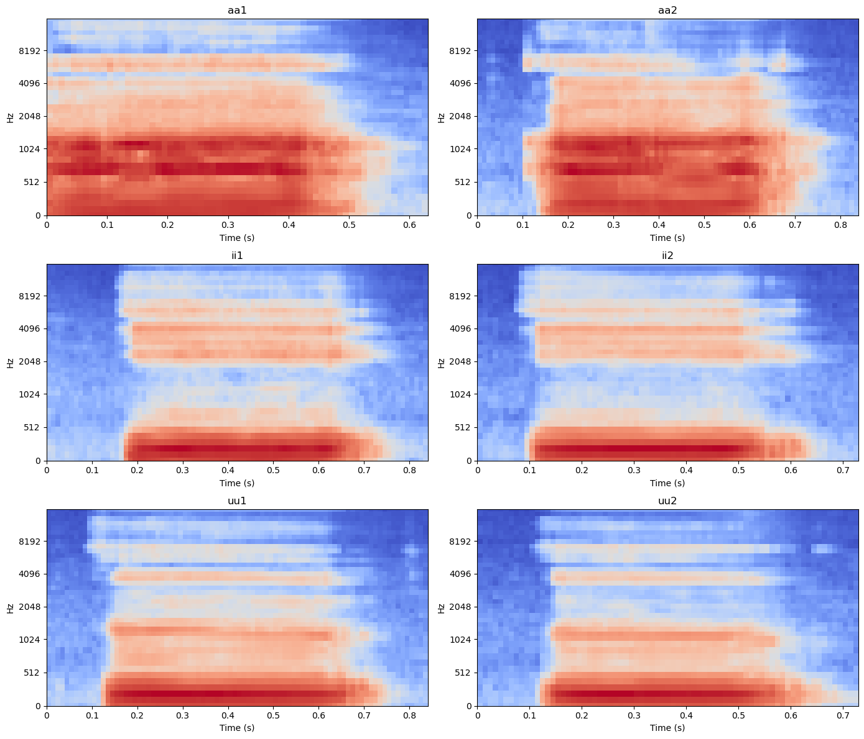
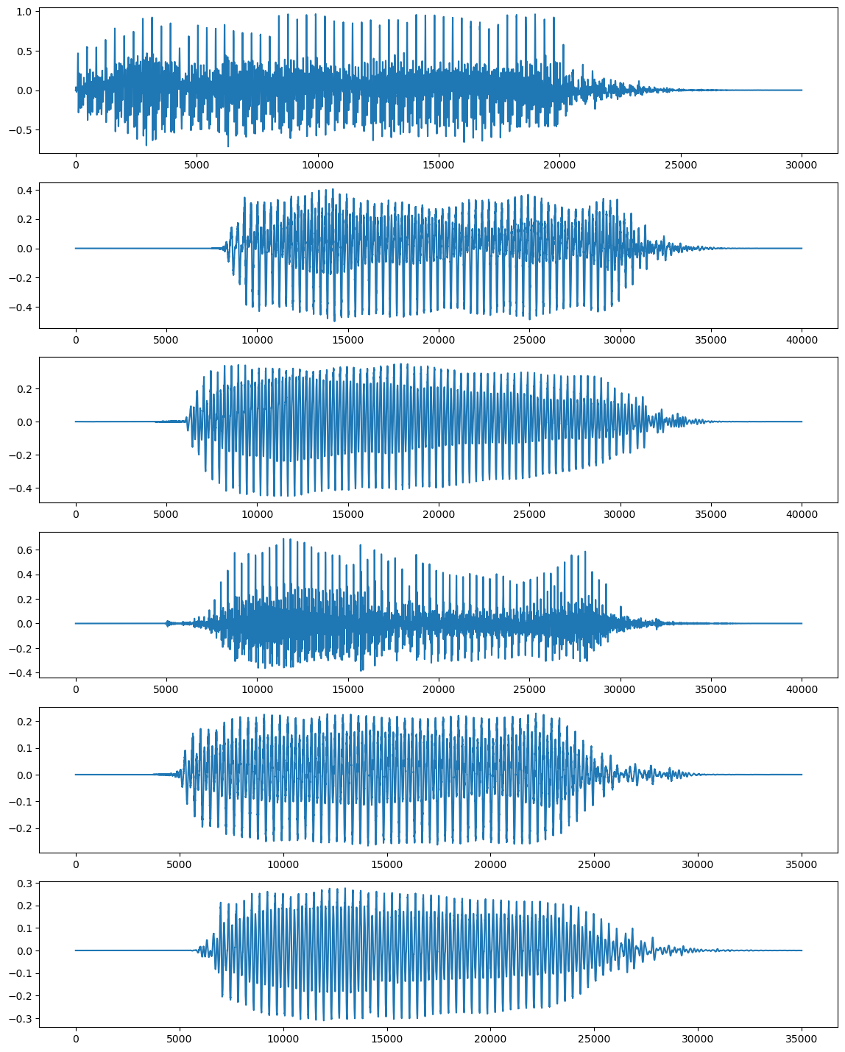
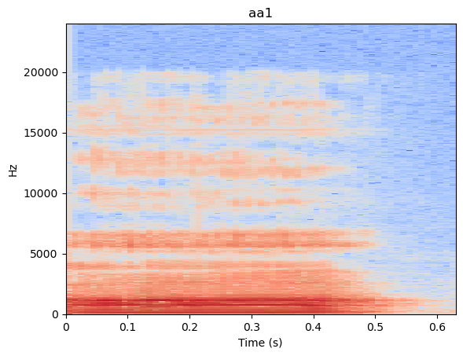
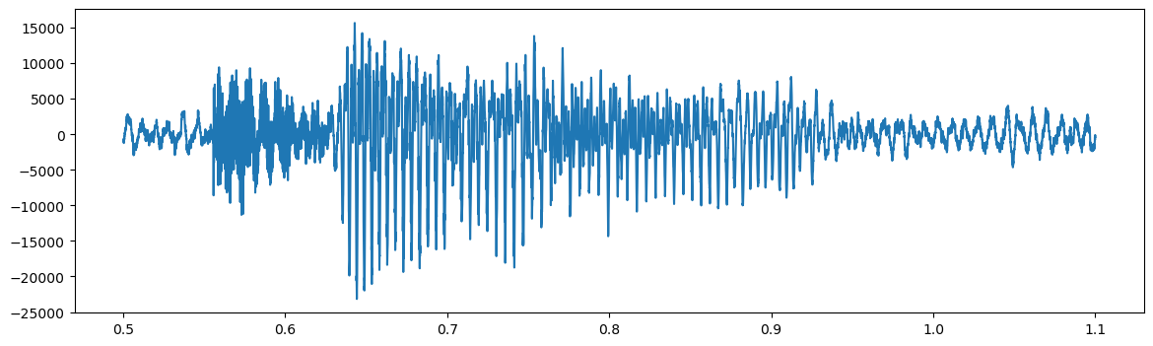
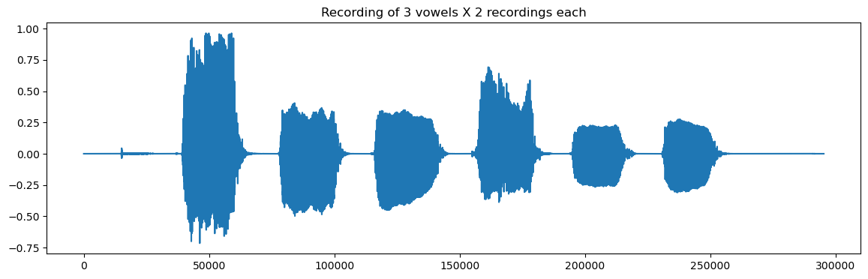
Unsupervised ASR
Training
ASR
Pseudo-Text
Discriminator
Text
four score and seven…
or abridging the freedom of speech
my bronze-pounded chest
the foundation of freedom, justice and peace
I’se been a climbin-on

Slide 26
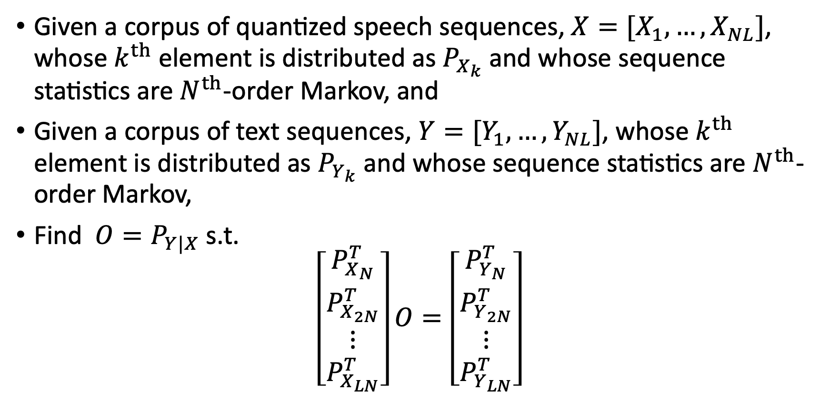
Unsupervised ASR
(Wang et al, in preparation)
Given a corpus of quantized speech sequences, $X=[X_{1},…,X_{NL}]$, whose $k^{th}$ element is distributed as $P_{X_{k}}$ and whose sequence statistics are $N^{th}$-order Markov, and
Given a corpus of text sequences, $Y=[Y_{1},…,Y_{NL}]$, whose $k^{th}$ element is distributed as $P_{Y_{k}}$ and whose sequence statistics are $N^{th}$-order Markov,
Find $O=P_{Y|X}$ s.t.
$$\left[\begin{matrix}P_{X_{N}}^{T} \\ \begin{matrix}P_{X_{2N}}^{T} \\ ⋮\end{matrix} \\ P_{X_{LN}}^{T}\end{matrix}\right]O=\left[\begin{matrix}P_{Y_{N}}^{T} \\ \begin{matrix}P_{Y_{2N}}^{T} \\ ⋮\end{matrix} \\ P_{Y_{LN}}^{T}\end{matrix}\right]$$

Slide 27
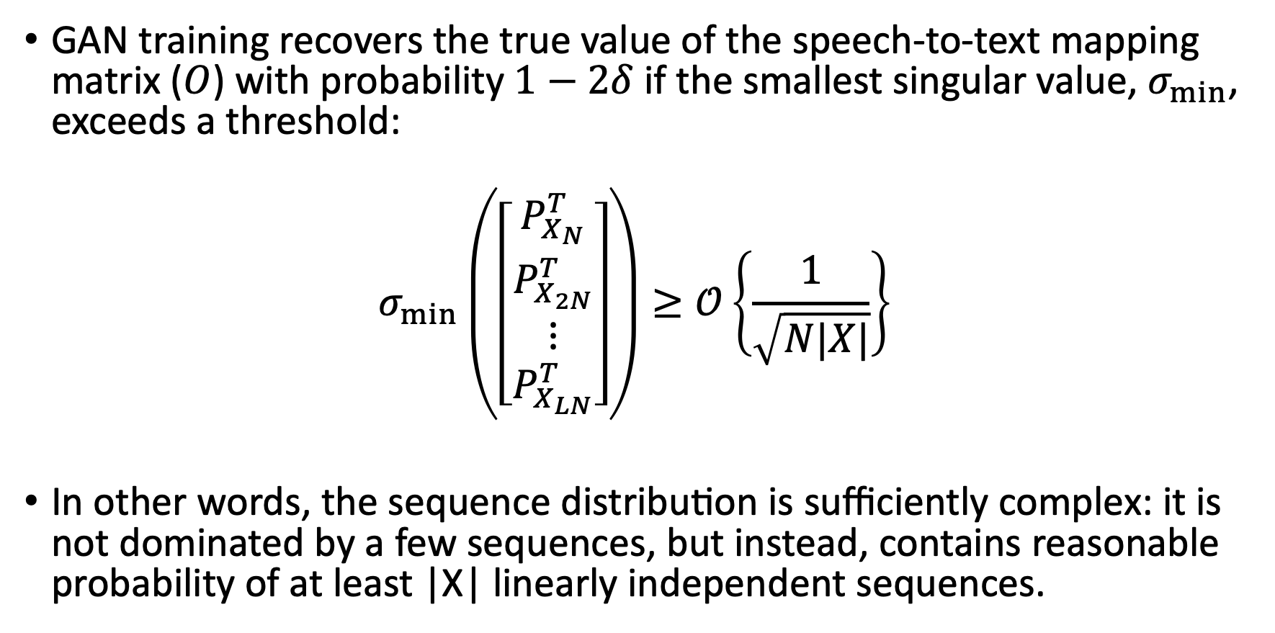
Unsupervised ASR
(Wang et al, in preparation)
GAN training recovers the true value of the speech-to-text mapping matrix ($O$) with probability $1−2δ$ if the smallest singular value, $σ_{min}$, exceeds a threshold:
$$σ_{min}\left(\left[\begin{matrix}P_{X_{N}}^{T} \\ \begin{matrix}P_{X_{2N}}^{T} \\ ⋮\end{matrix} \\ P_{X_{LN}}^{T}\end{matrix}\right]\right)≥𝒪\left\{\frac{1}{\sqrt{N|X|}}\right\}$$
In other words, the sequence distribution is sufficiently complex: it is not dominated by a few sequences, but instead, contains reasonable probability of at least |X| linearly independent sequences.

Slide 28
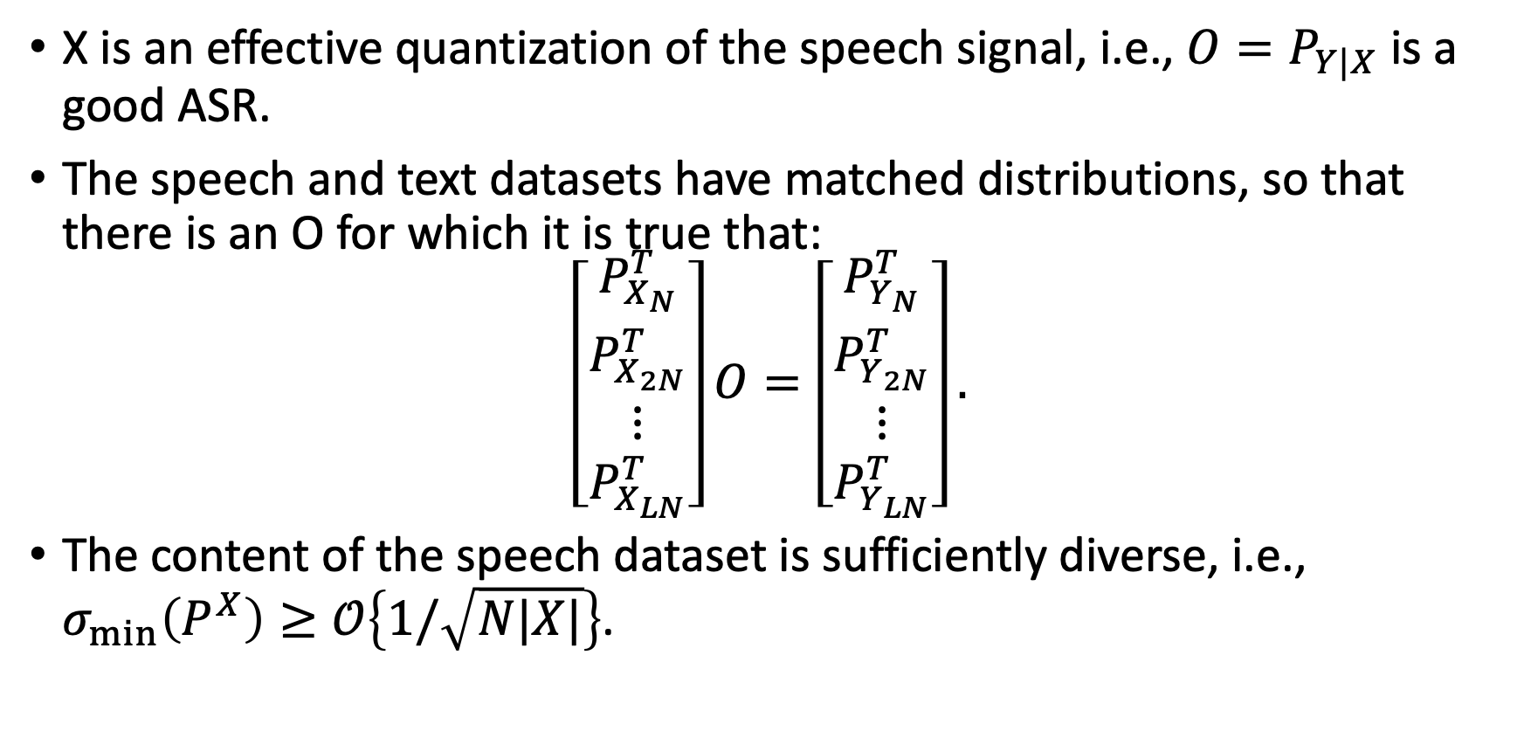
Implications: GAN-based Unsupervised ASR recovers a good ASR if…
X is an effective quantization of the speech signal, i.e., $O=P_{Y|X}$ is a good ASR.
The speech and text datasets have matched distributions, so that there is an O for which it is true that:
$$\left[\begin{matrix}P_{X_{N}}^{T} \\ \begin{matrix}P_{X_{2N}}^{T} \\ ⋮\end{matrix} \\ P_{X_{LN}}^{T}\end{matrix}\right]O=\left[\begin{matrix}P_{Y_{N}}^{T} \\ \begin{matrix}P_{Y_{2N}}^{T} \\ ⋮\end{matrix} \\ P_{Y_{LN}}^{T}\end{matrix}\right].$$
The content of the speech dataset is sufficiently diverse, i.e., $σ_{min}\left(P^{X}\right)≥𝒪\left\{1/\sqrt{N|X|}\right\}$.

Slide 29
Will GAN-based Unsupervised ASR work in a language that has never been studied before?
Yes, if we can find:
Diverse audio
Diverse text
The distribution of audio and text sequences is matched. Some experiments suggest that this goal can be achieved by collecting sufficiently large and diverse corpora from sufficiently similar domains.
If those conditions are hard to meet, is it better to just get community involvement in a massive speech transcription effort? We don’t know yet.

Slide 30
Outline
How ASR solved Zipf’s Law: frequent, infrequent, and OOV words
The power-law distribution of languages and dialects
  Early success: monolingual pre-training
  Knowledge transfer: multilingual training
  Paradigm shift: unsupervised ASR
Inclusive speech recognition
The power-law distribution of disability

Slide 31




Inclusive ASR: Problem statement
I need some information
I need some information
Let me help you.
Let me help you.
ASR is a useful productivity tool
If ASR works for you, it gives you a socioeconomic advantage, compared to somebody for whom ASR fails
The people for whom ASR fails are often those who are already socioeconomically disadvantaged
Success
Success
I don’t know what you are saying.
I need some information
Smaller
Success

Slide 32
Automatic Speech Recognition Word Error Rates (WER)
Gender:
  Women > Men (51% > 38%: Tatman, 2017, YouTube captioning)
  Women > Men (61% > 47%: Garnerin et al., 2019, European broadcast news)
  Black Men > Black Women (41% > 30%: Koenecke et al., 2020)
Dialect:
  Scottish > American (53% > 42%: Tatman, 2017)
  American Deep South > General American (Picone, 1991)
Race:
  Black > White (35% > 19%: Koenecke: avg of Amazon, Apple, Google, IBM, Microsoft)
Disability:
  People w/Cerebral Palsy > People w/o (Sari et al, 2021)
Age:
  Teenage (<20)) > Old (>70) > Adult (Feng & Scharenborg, 2020)
  Old adult (50-70) < Young adult (20-30) (Sari et al., 2021)

Slide 33
Why does ASR fail?
I need some information
I need some information
Let me help you.
Let me help you.
Reasons it may fail for a group:
Under-representation: The training corpus doesn’t have enough examples
Inter-group variance: The group speaks differently from other groups
Intra-group variance: Members of the group all speak differently from one another
Intra-individual variance: Members of the group speak less precisely
Success
Success
I don’t know what you are saying.
I need some information
Smaller
Success

Slide 34
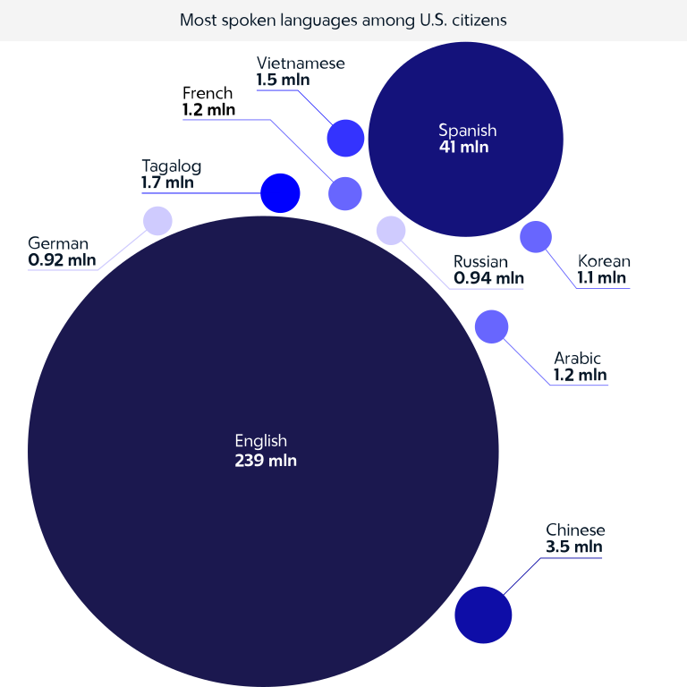
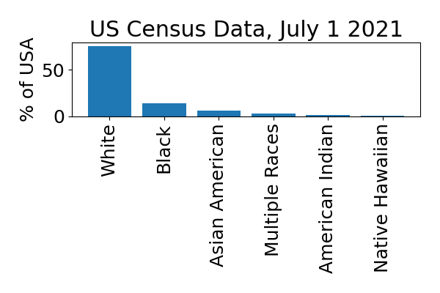
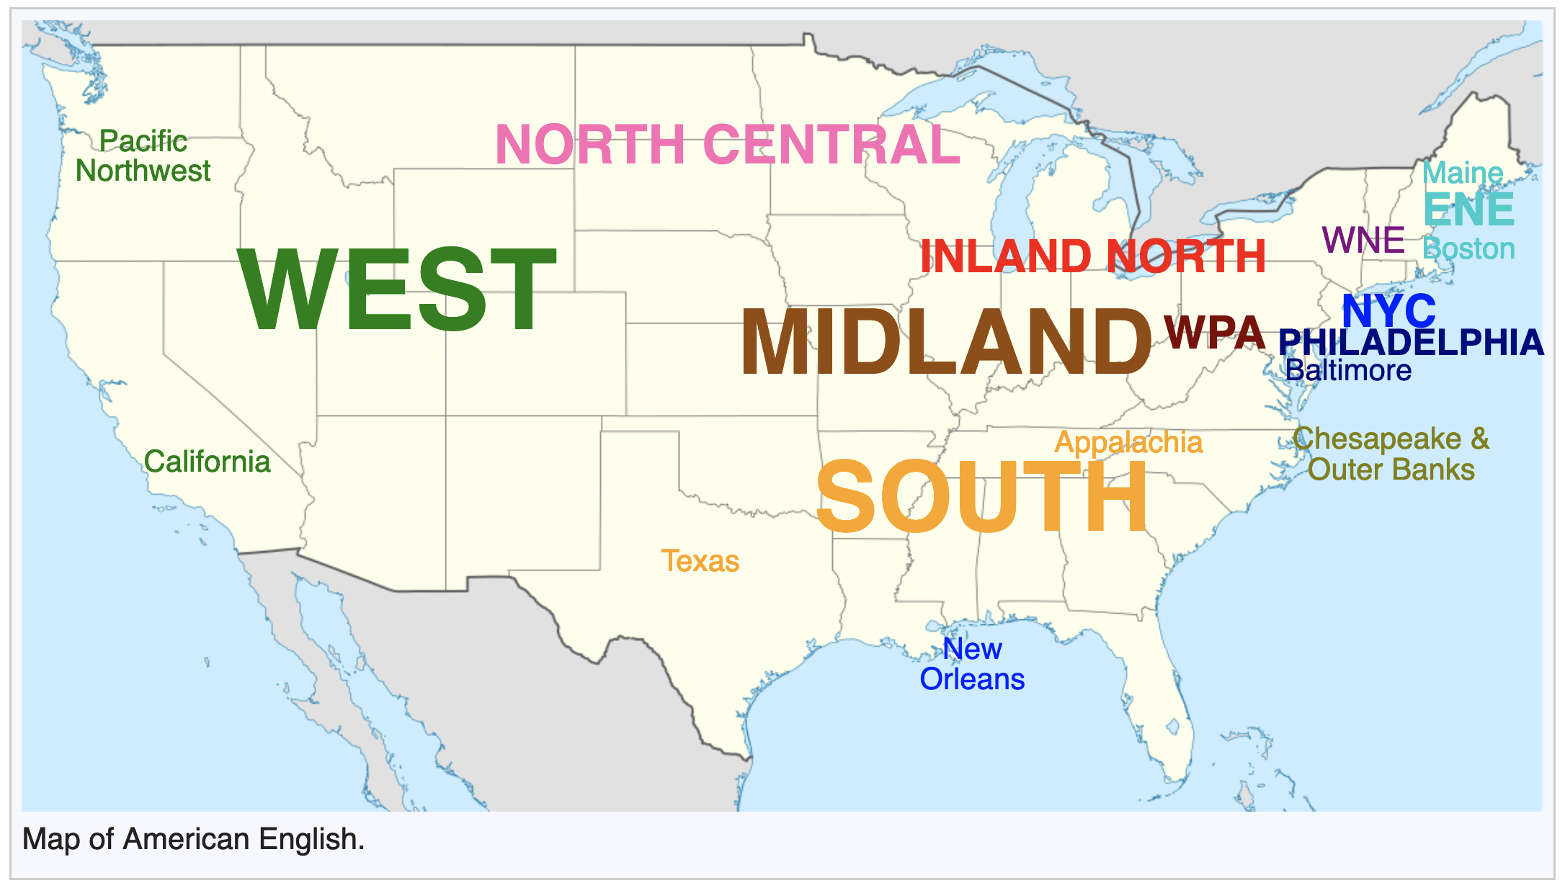
Under-representation is unavoidable because of power-law distributions
CC-SA 4.0, 2021,
https://commons.wikimedia.org/wiki/
File:Languages_cp-02.svg
GFDL, 2008, https://en.wikipedia.org/wiki/List_of_dialects_of_English

Slide 35
Zipf's law suggests a three-pronged approach to inclusive speech recognition
Early success: ASR now works pretty well for people who speak like audiobook narrators
Knowledge transfer:
  How do the hard domains differ from the easy domain?
  How can we model the difference in a way that permits knowledge transfer?
Paradigm shift:
  Which of our initial assumptions turn out to be unnecessary?
  How can the alternative assumption be made competitive?

Slide 36
Outline
How ASR solved Zipf’s Law: frequent, infrequent, and OOV words
The power-law distribution of languages and dialects
  Early success: monolingual pre-training
  Knowledge transfer: multilingual training
  Paradigm shift: unsupervised ASR
Inclusive speech recognition
The power-law distribution of disability

Slide 37
Abilities that are financially important in modern society
Bench-press 225 pounds (weight of a washing machine)
Rap 200 words/minute
Differentiate a softmax w.r.t. the Fourier transform of its input
Debug an operating system
Deliver an oratory that motivates thousands
Conceptualize deliveries for a 200-component just-in-time assembly

Slide 38
What is disability?
A disability is any condition of the body or mind (impairment) that makes it more difficult for the person with the condition to do certain activities (activity limitation) and interact with the world around them (participation restrictions). - CDC
Why is disability a social construct?
The following things are socially constructed:
How to do an activity
How to interact with the world

Slide 39
The power-law distribution of disability (example)
Americans without Parkinson’s: 330 million
Americans with Lewy Body Dementia: 1.4 million
Americans with Parkinson’s (cell death in midbrain): 1 million
Americans with Multiple Systems Atrophy (oligodendroglia cell death): 50,000
Americans with Progressive Supranuclear Palsy (cell death in brainstem): 20,000

Slide 40
Zipf's law suggests a three-pronged approach to inclusive speech recognition
Early success: ASR now works pretty well for people who speak like audiobook narrators

Slide 41
Knowledge transfer
How do the hard domains differ from the easy domain?
How can we model the difference in a way that permits knowledge transfer?

Slide 42
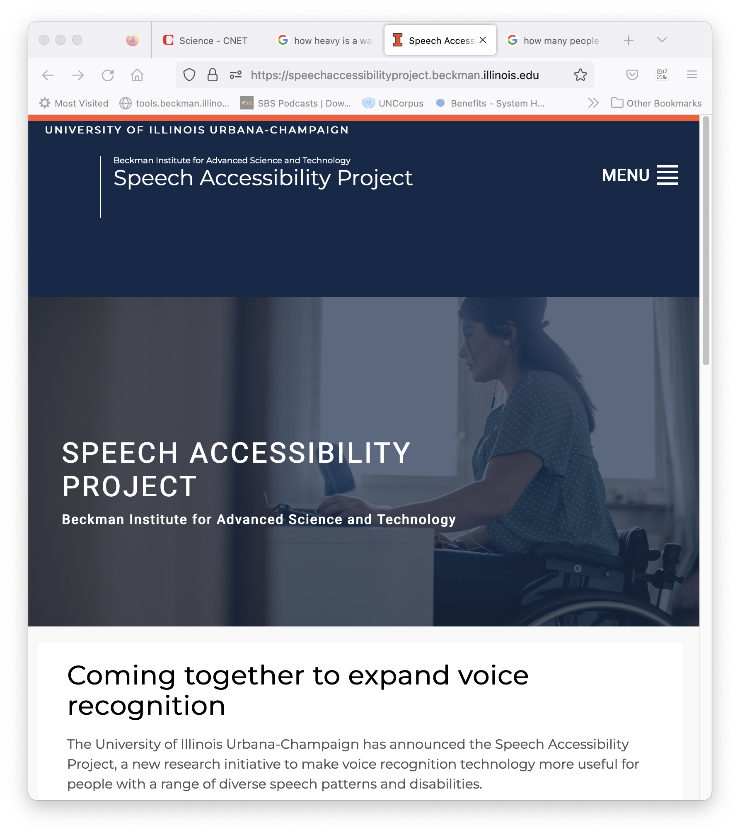
The Speech Accessibility
Project
The Speech Accessibility Project aims to make voice recognition technology more useful for people with a range of diverse speech patterns and disabilities.
Primary goal of the project: provide incentives, mentoring, and appropriate privacy guarantees that encourage people with disabilities to contribute speech to a community resource.
The community resource will be available to any project with the potential to improve life for people with disabilities, and with the ability to sign a data use agreement guaranteeing the protection of participant privacy.

Slide 43
Results so far
Contributor interface will be open source.
Prompt lists, where original to this project, will be shared under a license at least as free as Creative Commons Attribution.
  Command and control phrases
  Prompts for spontaneous speech
Terms of the IRB are being shared with other projects, and most terms will be announced publicly and in publications.
Advocacy organizations for Parkinson’s Disease and ALS have committed support to the project (and we are meeting with them almost weekly).

Slide 44
The future
With:
  200 hours of speech from people with Parkinson’s disease
  200 hours of speech from people with ALS
… can we make ASR that works as well for them as it does for audiobook narrators?

Slide 45
Conclusions
Early success
  203-word speech recognition
  Monolingual pre-training
  Inclusive speech recognition: Groups that society calls “normally abled”
Knowledge transfer
  Sub-word acoustic models
  Multilingual phone models
  Inclusive speech recognition: The Speech Accessibility Project
Paradigm shift
  Sub-word language models
  Unsupervised ASR
  Inclusive speech recognition: ??

