Slide 1
An LSTM-Based Autonomous Driving Model using Waymo Open Dataset
Presented by Peter Du

Slide 2
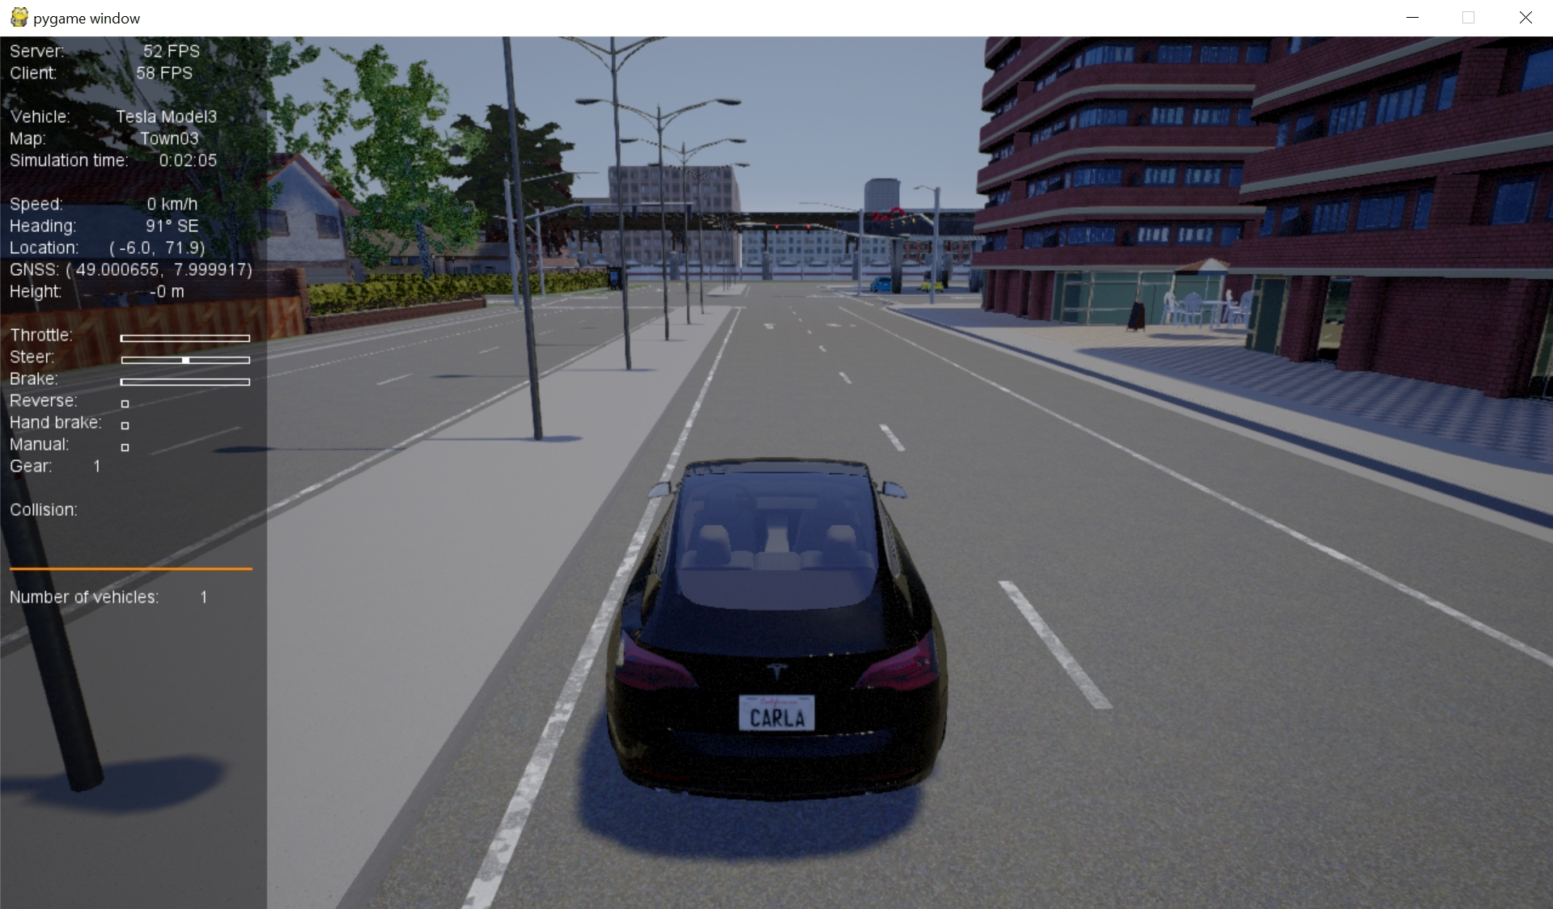
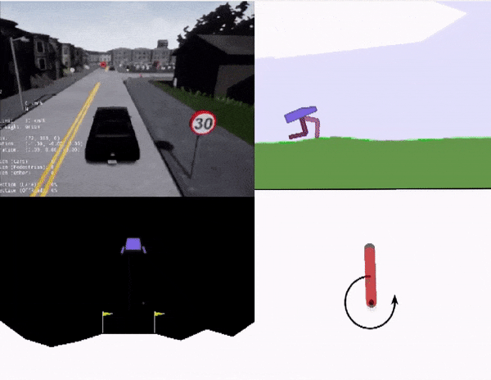
Motivation
Development of robust and reliable autonomous policies is an open problem
Significant interest in area of autonomous vehicles (AVs)
Advances in in computation/simulation has made simulation-based AV research popular
LGSVL, Carla, OpenAI Gym
Increase in demand for accurate driver, pedestrian, and AV models
Carla
OpenAI Gym

Slide 3
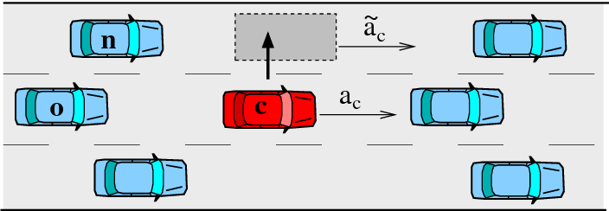
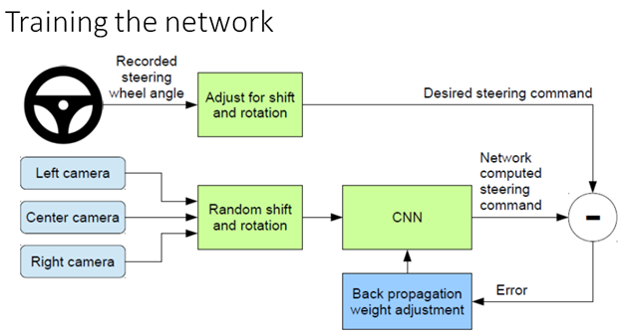
Modelling AVs & Environments
Physics based models
Intelligent Drivers Model
MOBIL
Rule based models
Responsibility Sensitive Safety
Learning based
RNN-based pedestrian prediction
Behaviour cloning (e.g. Nvidia CNN-based driving policy)

Slide 4
Modelling AVs
Existing AV test fleets are proprietary and unavailable to researchers
Various assumptions on AV behaviour may not represent realistic interactions in simulation-based research
Safety validation
Multi-agent decision making
Reachability analysis

Slide 5
Modelling AVs
Precise models are unavailable but data on AV behaviour is available
Learn a model of proprietary AV behaviour using sensor data
Waymo Open Dataset
Adapt an LSTM model previously used for pedestrian trajectory prediction to imitate behaviour of Waymo’s AV model

Slide 6
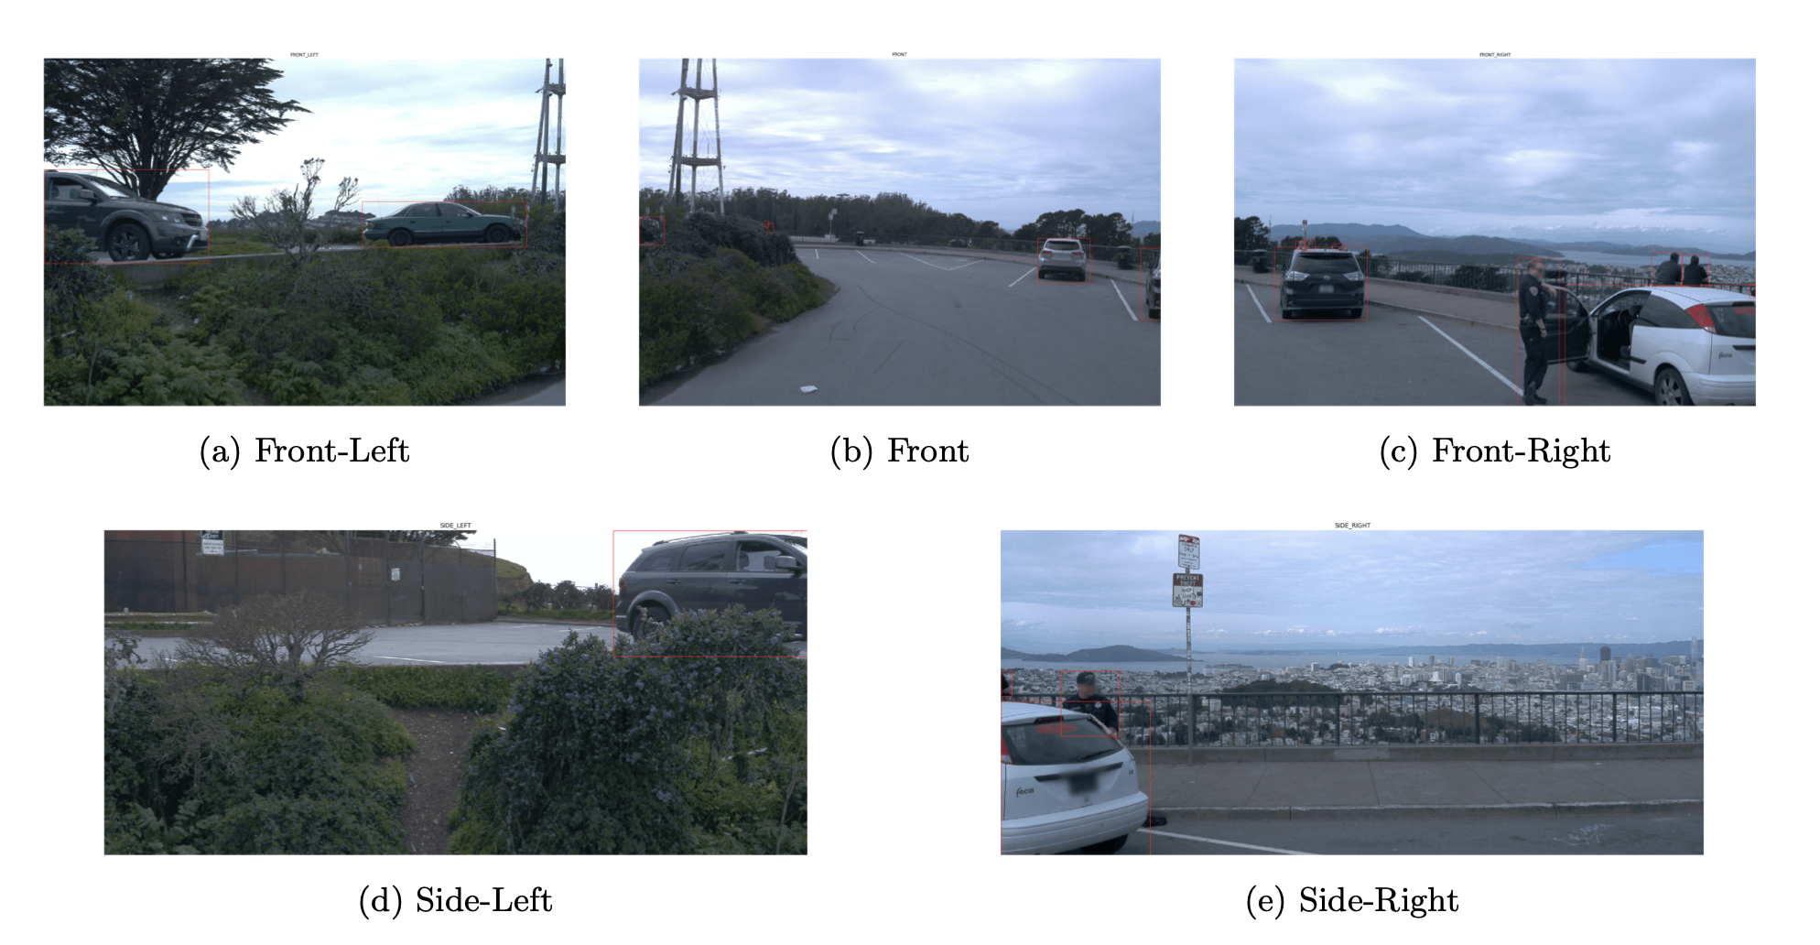
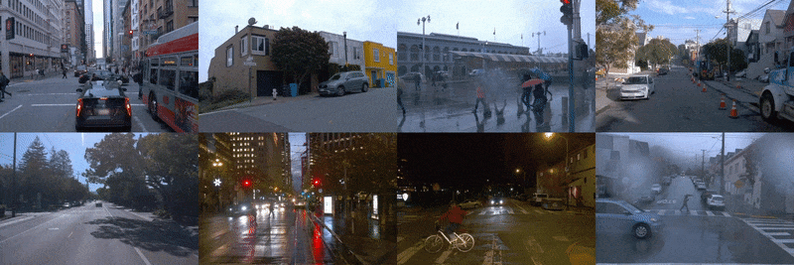
Waymo Open Dataset
Publicly available dataset with rich set of diverse AV behaviours
Collected from Waymo L4 vehicles
~45000 video segments
Contains lidar, radar, camera data
Labels include object types, bounding boxes, velocities/accelerations

Slide 7
Predicting Acceleration
Learn a model for lateral/longitudinal acceleration
Basic features (12 dimensional):
Vehicle position in global frame $(p_{x},p_{y},p_{z})$
Lead vehicle velocity $\left(v_{x}, v_{y}, v_{z}\right)$
Lead vehicle acceleration $(a_{x}, a_{y}, a_{z})$
Lead vehicle relative distance $(d_{x}, d_{y})$
Number of vehicles present ${(n}_{v})$
Additional features using image embedding and data from cameras

Slide 8
LSTM Prediction Network
Basic model adapts an LSTM “encoder-decoder” network previously used for pedestrian trajectory prediction
10 frames are stacked together
Output is acceleration for next 5 frames

Slide 9
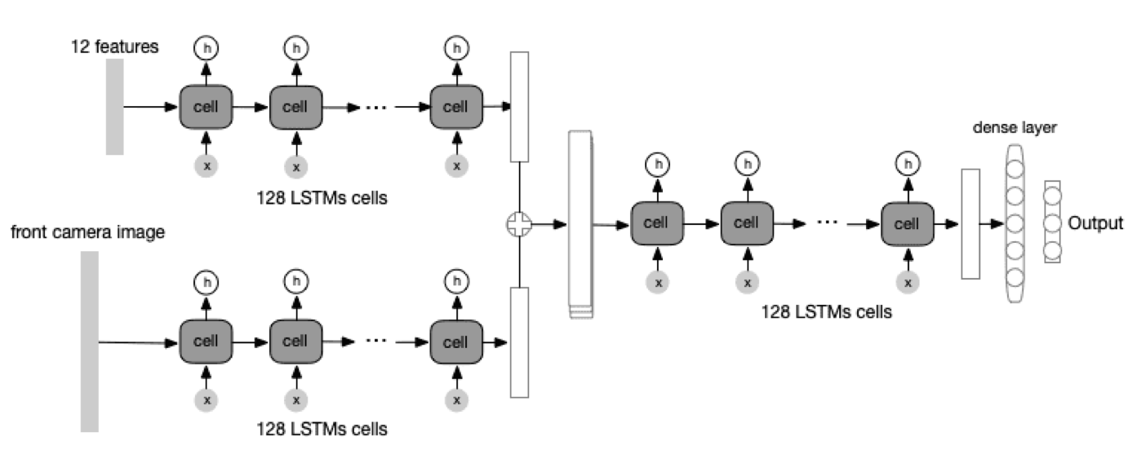
LSTM Prediction Network
Basic model is augmented with image inputs
Each camera feed is preprocessed with pretrained ResNetV2 to create image embedding

Slide 10
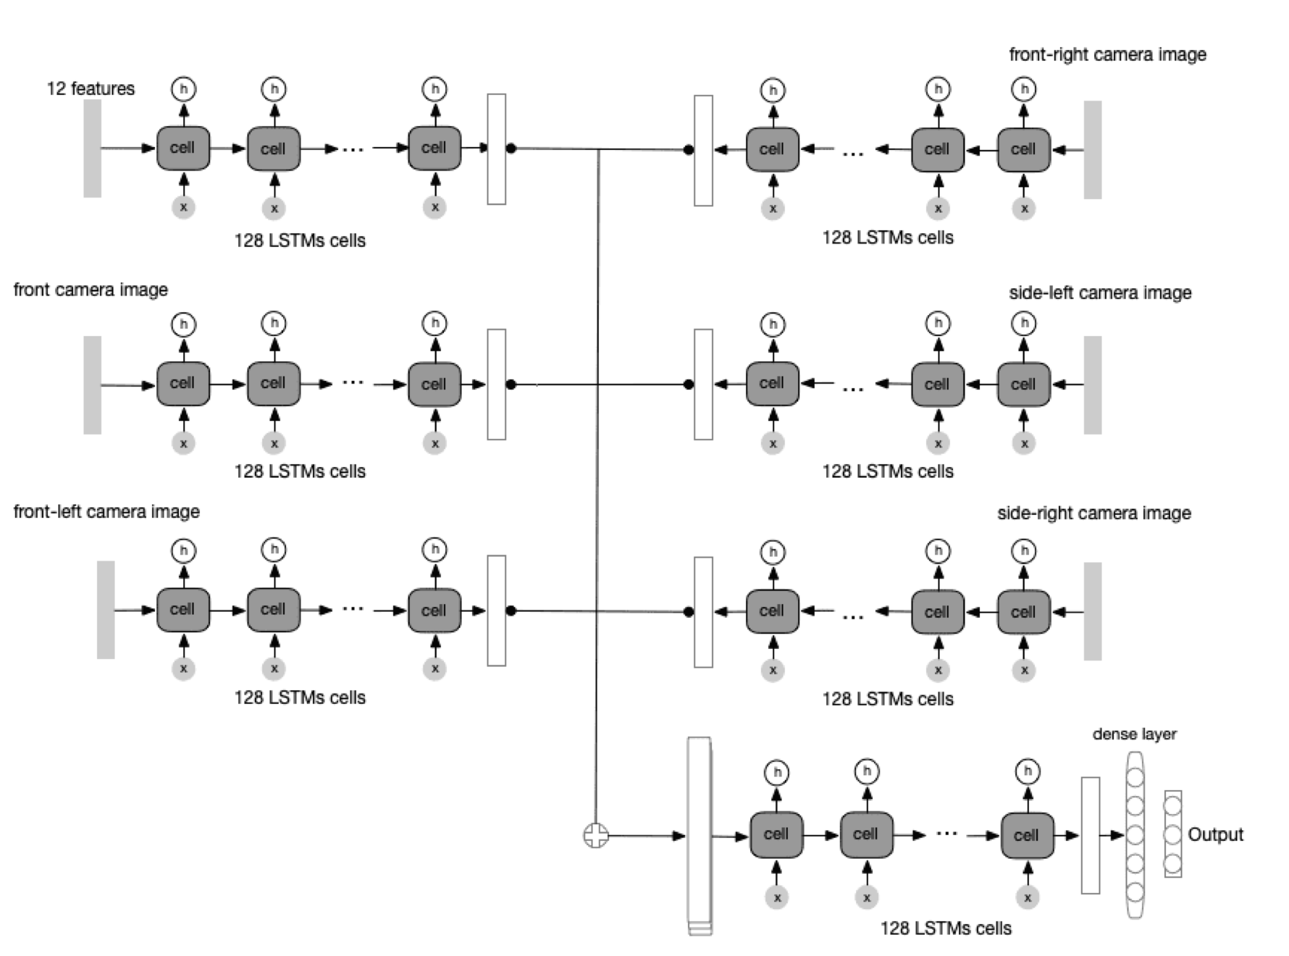

Slide 11
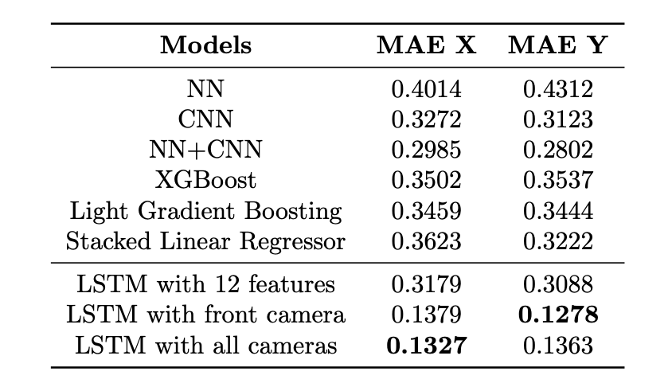
Results

Slide 12
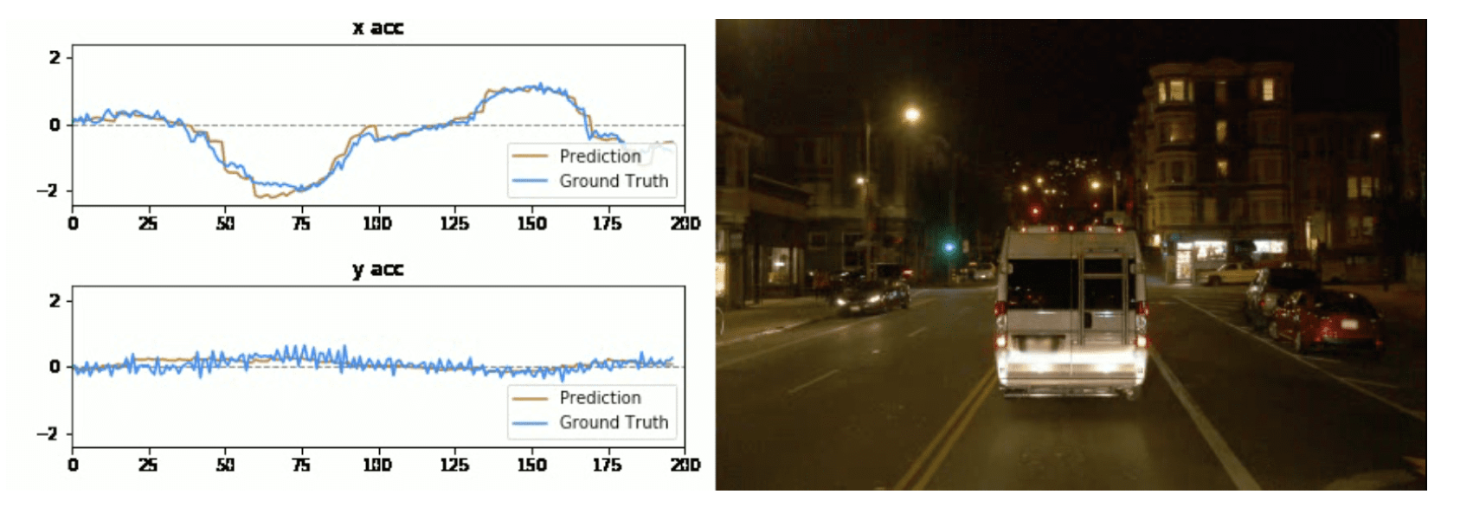

Slide 13
Summary
Learn a model of proprietary AV behaviour through sensor data
LSTM network works well for time-series problem of acceleration prediction
Task of predicting longitudinal/lateral acceleration is still far from a complete vehicle model
Proposed setup isn’t easily generalizable to other maneuvers (e.g. lane changes, merging)
Possible viable solution for AV modelling as more data is released by AV fleet testers

