Slide 1
ECE 576 – Power System Dynamics and Stability
Lecture 9: Synchronous Machines,
Reduced-Order Models
Prof. Tom Overbye
Dept. of Electrical and Computer Engineering
University of Illinois at Urbana-Champaign
overbye@illinois.edu

Slide 2
Announcements
Homework 2 is posted on the web; it is due on Thursday Feb 20
Read Chapter 5 and Appendix A
Read Chapter 6
A key paper for today's topic is P.V. Kokotovic, and P.W. Sauer, "Integral Manifold as a Tool for Reduced-Order Modeling of Nonlinear Systems: A Synchronous Machine Case Study," IEEE Trans. Circuits and Sys., March 1989
"Make it as simple as possible but not simpler"

Slide 3
Determining δ without Saturation
Recalling the relation between δ and the stator values
And from 3.215 and 3.216 (in steady-state)
Then use 3.222 and 3.223 to replace

Slide 4
Determining δ without Saturation
And use 3.219 to eliminate E'_{d}

Slide 5
Determining δ without Saturation
Which can be rewritten as

Slide 6
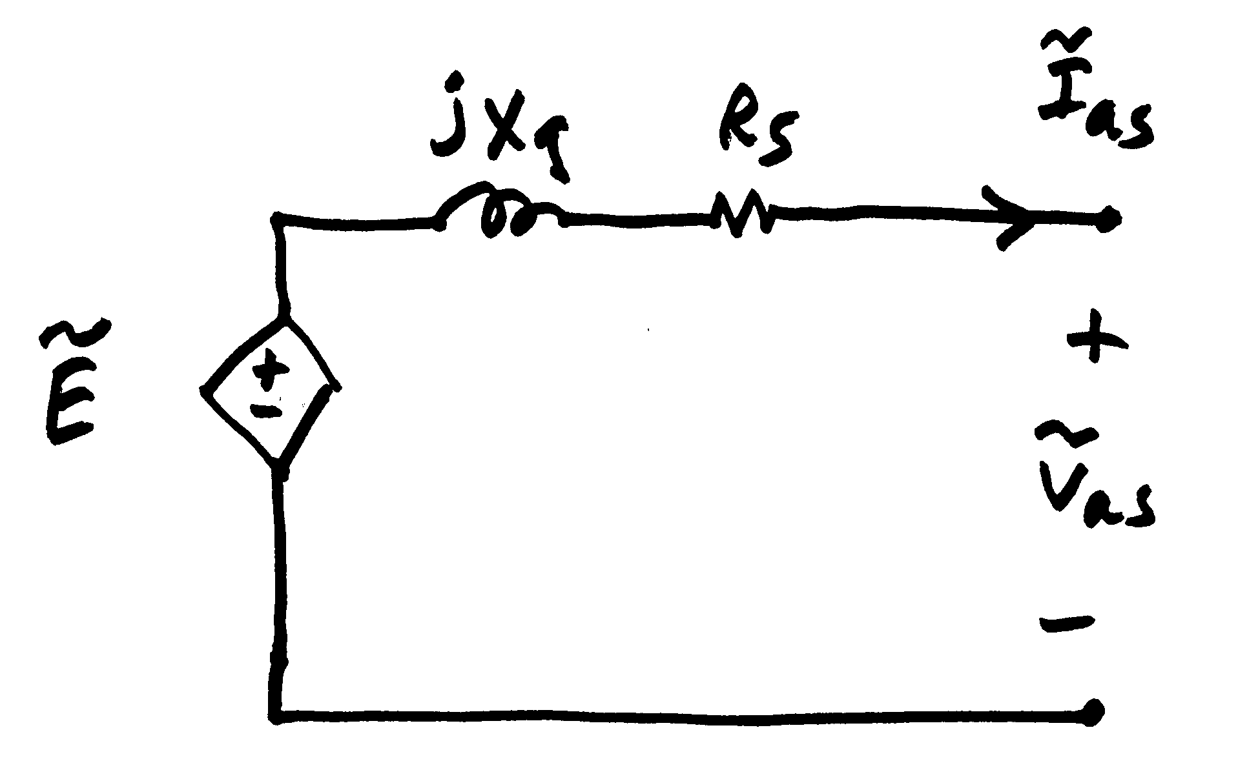
Determining δ without Saturation
Then in terms of the terminal values

Slide 7
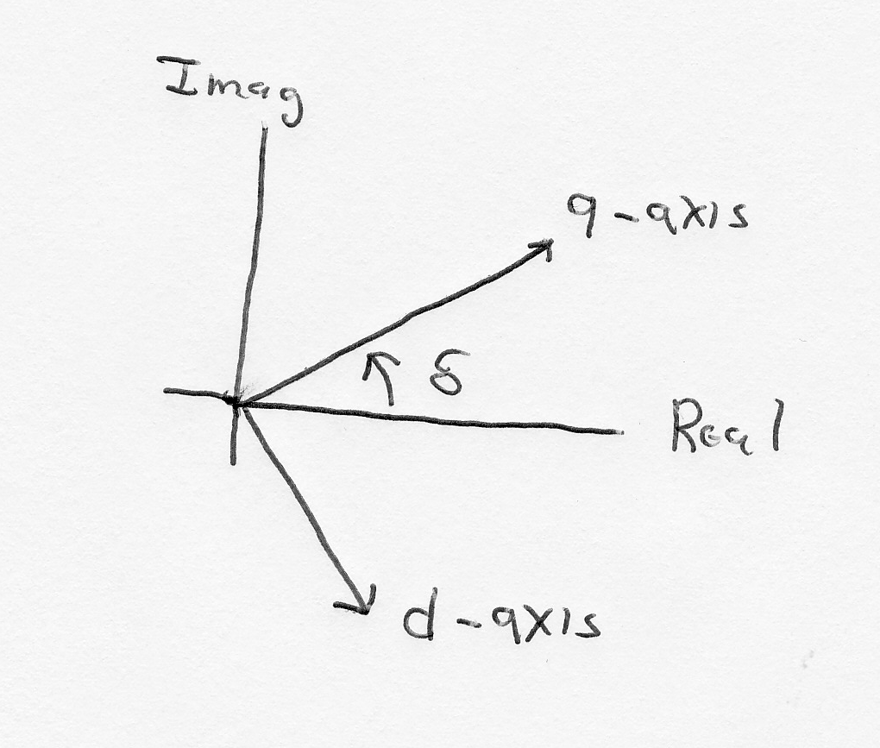
D-q Reference Frame
Machine voltage and current are “transformed” into the d-q reference frame using the rotor angle, δ
Terminal voltage in network (power flow) reference frame are V_{S} = V_{t} = V_{r} +jV_{i}

Slide 8
A Steady-State Example
Assume a generator is supplying 1.0 pu real power at 0.95 pf lagging into an infinite bus at 1.0 pu voltage through the below network. Generator pu values are R_{s}=0, X_{d}=2.1, X_{q}=2.0, X'_{d}=0.3, X'_{q}=0.5

Slide 9
A Steady-State Example, cont.
First determine the current out of the generator from the initial conditions, then the terminal voltage

Slide 10
A Steady-State Example, cont.
We can then get the initial angle and initial dq values
Or

Slide 11
A Steady-State Example, cont.
The initial state variable are determined by solving with the differential equations equal to zero.

Slide 12
PowerWorld Two-Axis Model
Numerous models exist for synchronous machines, some of which we'll cover in-depth. The following is a relatively simple model that represents the field winding and one damper winding; it also includes the generator swing eq.
For a salient pole machine, with X_{q}=X'_{q}, then E'_{d} would rapidly decay to zero

Slide 13
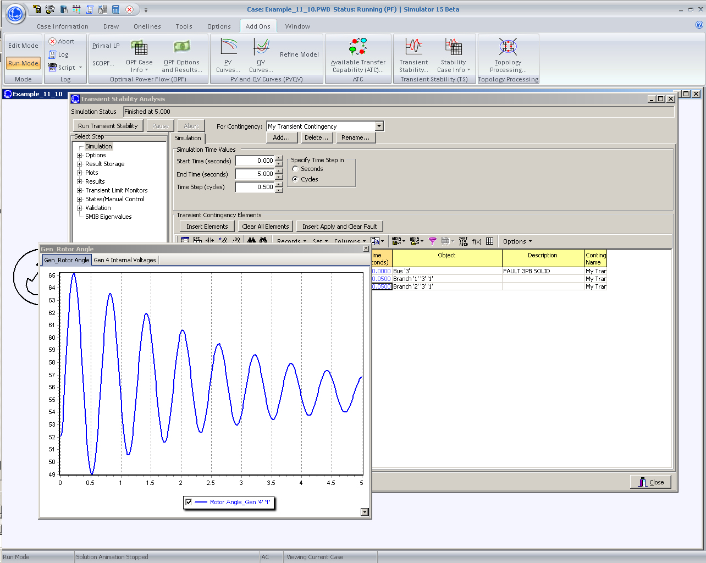
PowerWorld Solution of 11.10

Slide 14
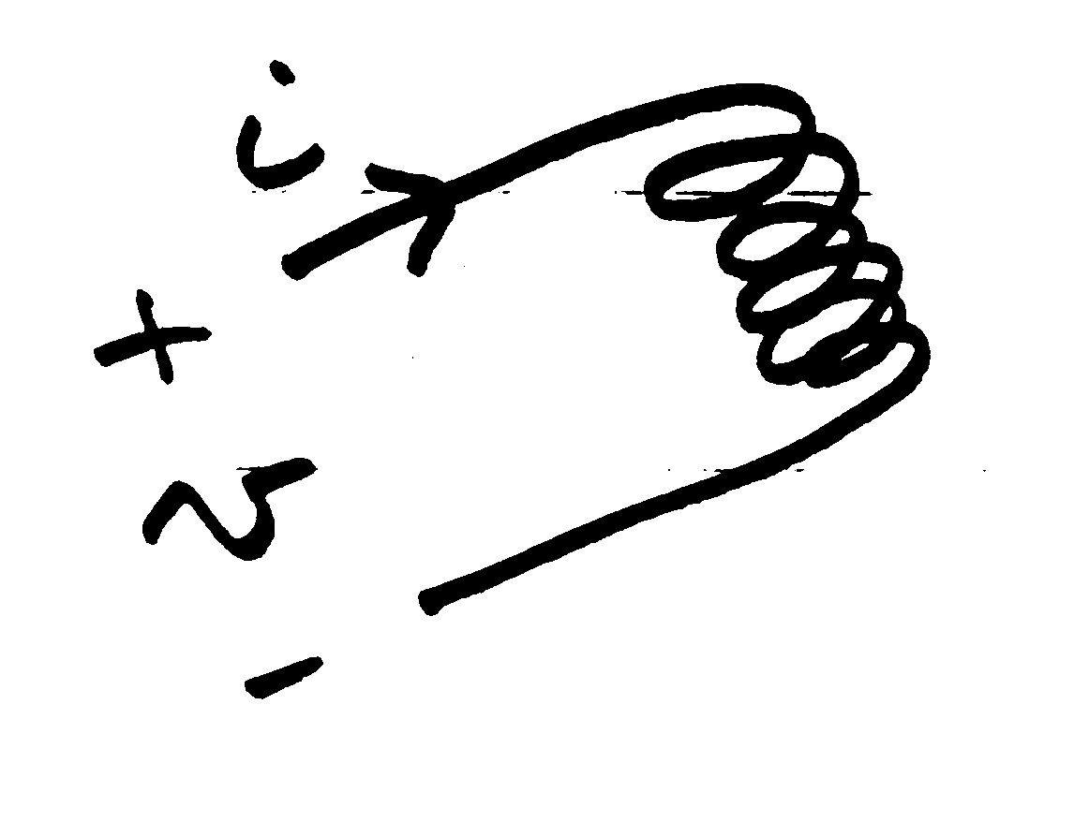
Nonlinear Magnetic Circuits
Nonlinear magnetic models are needed because magnetic materials tend to saturate; that is, increasingly large amounts of current are needed to increase the flux density
Linear

Slide 15
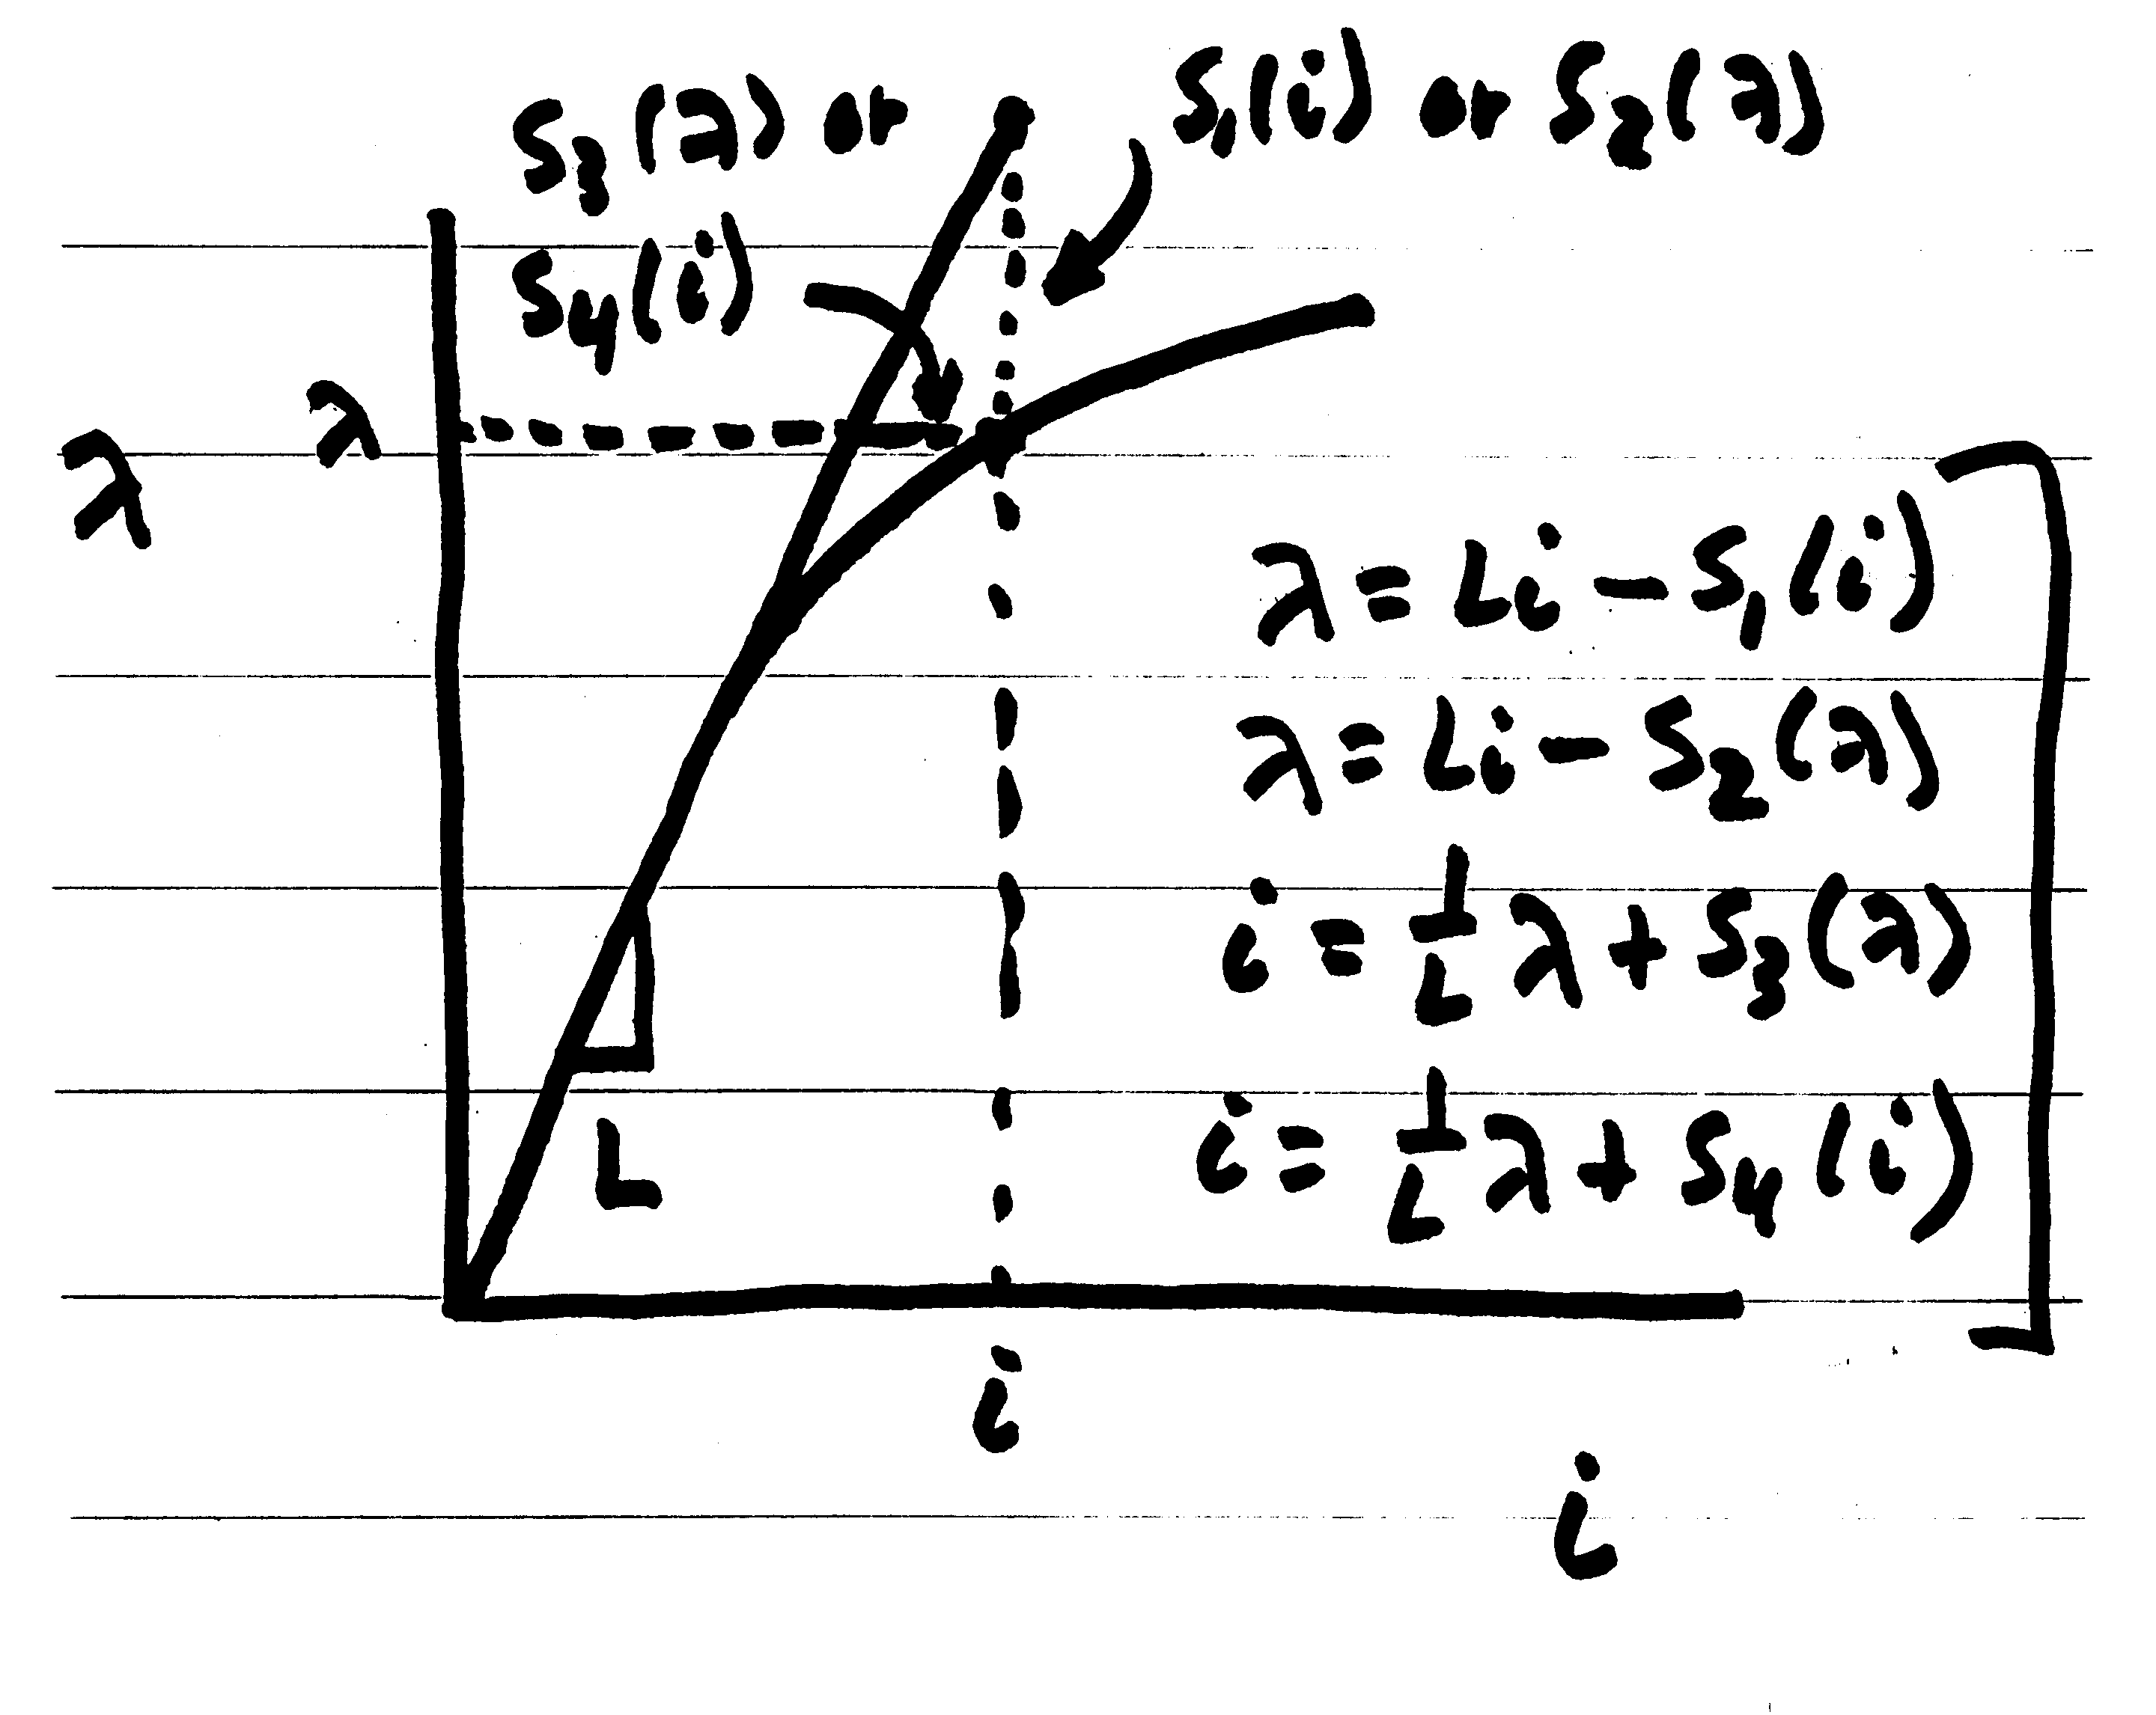
Saturation

Slide 16
Saturation Models
Many different models exist to represent saturation
There is a tradeoff between accuracy and complexity
Book presents the details of fully considering saturation in Section 3.5
One simple approach is to replace
With

Slide 17
Saturation Models
In steady-state this becomes
Hence saturation increases the required E_{fd} to get a desired flux
Saturation is usually modeled using a quadratic function, with the value of Se specified at two points (often at 1.0 flux and 1.2 flux)
A and B are determined from the two data points

Slide 18
Saturation Example
If Se = 0.1 when the flux is 1.0 and 0.5 when the flux is 1.2, what are the values of A and B using the

Slide 19
Implementing Saturation Models
When implementing saturation models in code, it is important to recognize that the function is meant to be positive, so negative values are not allowed
In large cases one is almost guaranteed to have special cases, sometimes caused by user typos
What to do if Se(1.2) < Se(1.0)?
What to do if Se(1.0) = 0 and Se(1.2) <> 0
What to do if Se(1.0) = Se(1.2) <> 0
Exponential saturation models have been used
We'll cover other common saturation approaches in Chapter 5

Slide 20
Reduced Order Models
Before going further, we will consider a formal approach to reduce the model complexity
Reduced order models
Idea is to approximate the behavior of fast dynamics without having to explicitly solve the differential equations
Essentially all models have fast dynamics that not explicitly modeled
Goal is a more easily solved model (i.e., a reduced order model) without significant loss in accuracy

Slide 21
Manifolds
Hard to precisely define, but "you know one when you see one"
Smooth surfaces
In one dimensions a manifold is a curve without any kinks or self-intersections (line, circle, parabola, but not a figure 8)

Slide 22
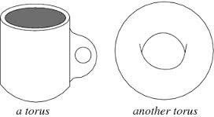
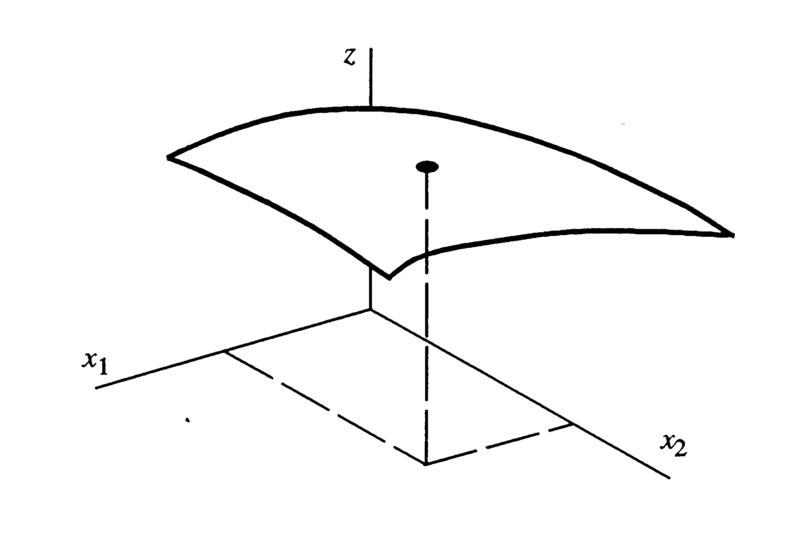
Two-Dimensional Manifolds
Images from book and mathworld.wolfram.com

Slide 23
Integral Manifolds
Desire is to express z as an
algebraic function of x, eliminating dz/dt
Suppose we could find z = h(x)

Slide 24
Integral Manifolds
Replace z by h(x)
Chain rule of differentiation
If the initial conditions satisfy h, so z₀ = h(x₀) then the reduced equation is exact

Slide 25
Integral Manifold Example
Assume two differential equations with z considered "fast" relative to x

Slide 26
Integral Manifold Example
For this simple system we can get the exact solution

Slide 27
Solve for Equilibrium (Steady-state ) Values

Slide 28
Solve for Remaining Constants
Use the initial conditions and derivatives at t=0 to solve for the remaining constants

Slide 29
Solve for Remaining Constants

Slide 30
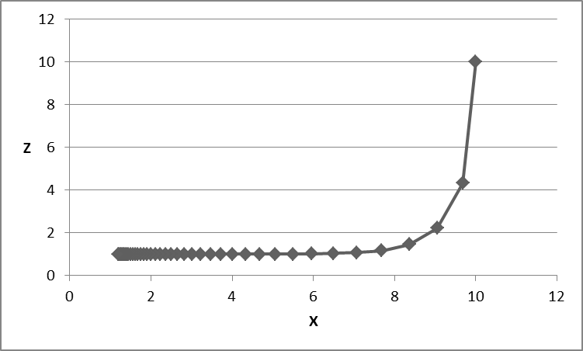
Solution Trajectory in x-z Space
Below image shows some of the solution trajectories of this set of equations in the x z space
z rapidly decays to 1.0

Slide 31
Candidate Manifold Function
Consider a function of the form z = h(x) = mx + c
We would then have
One equation and two unknowns: One solution is m=0, c=1

Slide 32
Candidate Manifold Function
With the manifold z = 1 we have an exact solution if z = 1.0 since dz/dt = -10z+10 is always zero
With this approximation then we simplify as
This is exact only if z⁰ = 1.0
Exact solution

Slide 33
Linear Function, Full Coupling
Now consider the linear function

Slide 34
Linear Function, Full Coupling
Which has an equilibrium point at the origin, eigenvalues λ₁ = -2.3 (the slow mode) and λ₂ = -8.7 (the fast mode), and a solution of the form
Using x⁰ = 10 and z⁰ = 10, the solution is

Slide 35
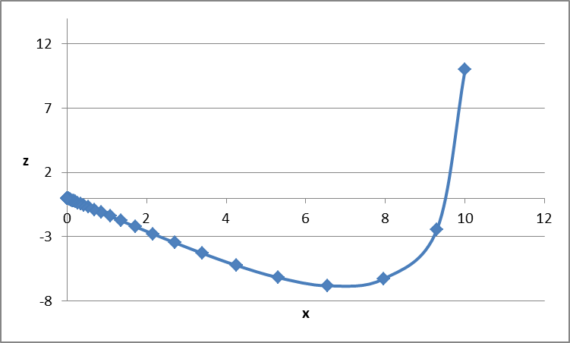
Solution Trajectory in x-z Space

Slide 36
Linear Function, Full Coupling
Same function but change the initial condition to x⁰ = 0 and z⁰ = 10
Solving for the constants gives
In general

Slide 37
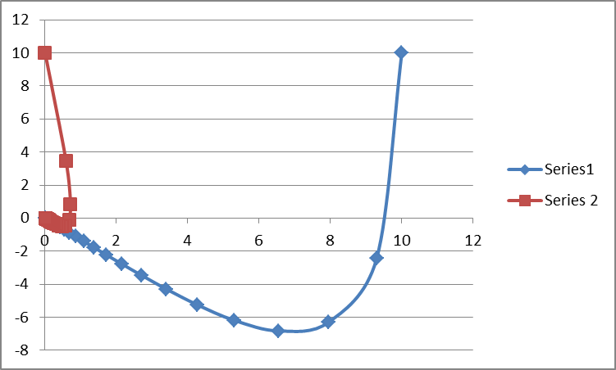
Solution Trajectories in x-z Space

Slide 38
Candidate Manifold Function
Trajectories appear to be heading to origin along a single axis
Again consider a candidate manifold function z = h(x) = mx + c
Again solve for m dx/dt

Slide 39
Candidate Manifold Function

Slide 40
Candidate Manifold Function
The two solutions correspond to the two modes
The one we've observed is z = -1.3x
The other is z = -7.7x
To observe this mode select x⁰ = 1 and z⁰ = -7.7
Zeroing out c₁ and c₃ is clearly a special case

Slide 41
Eliminating the Fast Mode
Going with z = -1.3x we just have the equation
This is a simpler model, with the application determining whether it is too simple

Slide 42
Formal Two Time-Scale Analysis
This can be more formalized by introducing a parameter ε
In the previous example we had ε = 0.1

Slide 43
Formal Two Time-Scale Analysis
Using the previous process to get an expression for dx/dt we have
For c(ε) = 0
Result is complex for larger values since system has complex eigenvaues

Slide 44
Formal Two Time-Scale Analysis
If z is infinitely fast (ε = 0) then z = -x, h(ε) = −1
To compute for small ε use a power series

Slide 45
Formal Two Time-Scale Analysis
Solving for the coefficients

Slide 46
Applying to the Previous Example
Note the slow mode eigenvalue approximation has changed from -2.3 to -2.2

Slide 47
General two-time-scale linear system
To generalize assume
Expression for z is the equilibrium manifold; D must be nonsingular

Slide 48
Application to Nonlinear Systems
For machine models this needs to be extended to nonlinear systems
In general solution is difficult, but there are special cases similar to the stator transient problem

Slide 49
Example

Slide 50
Example
Solving we get

