Slide 1
ECE 576 – Power System Dynamics and Stability
Lecture 7: Transient Stability Intro
Prof. Tom Overbye
Dept. of Electrical and Computer Engineering
University of Illinois at Urbana-Champaign
overbye@illinois.edu

Slide 2
Announcements
Read Chapter 3, skip 3.7 for now
Skim Chapter 4; we'll be returning to this in greater detail later
  Commercial transient stability packages uses a number of different models to represent types of exciters and governors
Homework 2 is posted on the web; it is due on Thursday Feb 20

Slide 3
Transient Stability Results
Once the transient stability run finishes, the “Results” page provides both a minimum/maximum summary of values from the simulation, and time step values for the fields selected to view.
The Time Values and Minimum/Maximum Values tabs display standard PowerWorld Simulator case information displays, so the results can easily be transferred to other programs (such as Excel) by right-clicking on a field and selecting “Copy/Paste/Send”

Slide 4
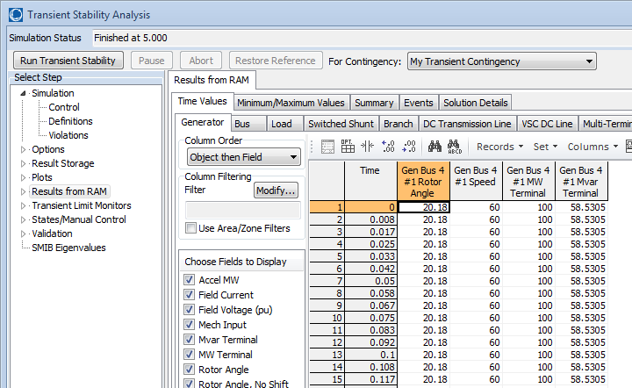
Results: Time Values
Lots of
options
are
available
for
showing
and
filtering
the
results.
By default the results are shown for each time step. Results can be saved
saved every “n” timesteps using an option on the Results Storage Page

Slide 5
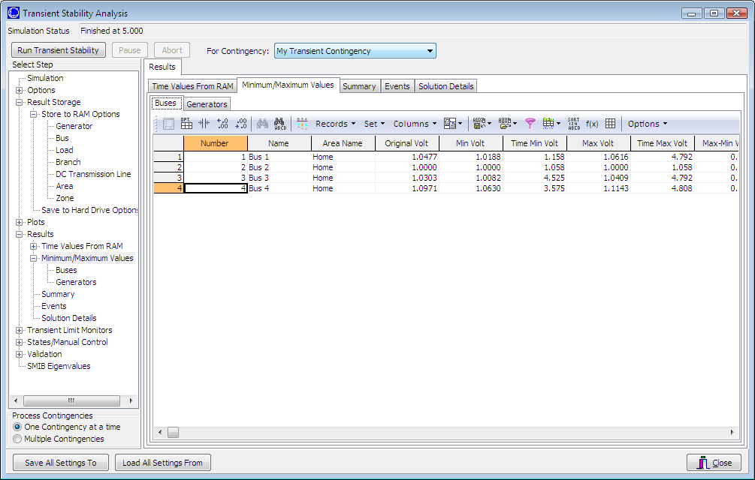
Results: Minimum and Maximum Values
Minimum
and
maximum
values are
available
for all
generators
and buses

Slide 6
Quickly Plotting Results
Time value results can be quickly plotted by using the standard case information display plotting capability.
  Right-click on the desired column
  Select Plot Columns
  Use the Column Plot Dialog to customize the results.
  Right-click on the plot to save, copy or print it.
More comprehensive plotting capability is provided using the Transient Stability “Plots” page; this will be discussed later.

Slide 7
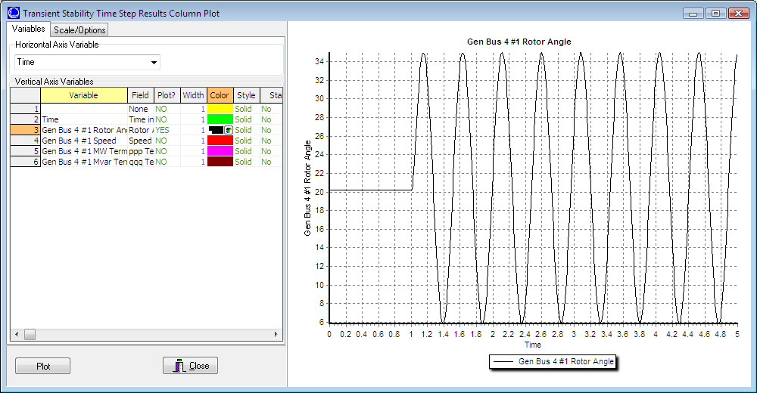
Generator 4 Rotor Angle Column Plot
Notice that
the result
is undamped;
damping is
provided by
damper windings
Change line color here
And re-plot by clicking
here
Starting the event at t = 1.0 seconds allows for verification of
an initially stable operating point. The small angle oscillation
indicates the system is stable, although undamped.
7
Notes:
7
7

Slide 8
Changing the Case
PowerWorld Simulator allows for easy modification of the study system. As a next example we will duplicate example 13.4 from earlier editions of the Glover/Sarma Power System Analysis and Design Book.
Back on the one-line, right-click on the generator and use the Stability/Machine models page to change the Xdp field from 0.2 to 0.3 per unit.
On the Transient Stability Simulation page, change the contingency to be a solid three phase fault at Bus 3, cleared by opening both the line between buses 1 and 3 and the line between buses 2 and 3 at time = 1.34 seconds.

Slide 9
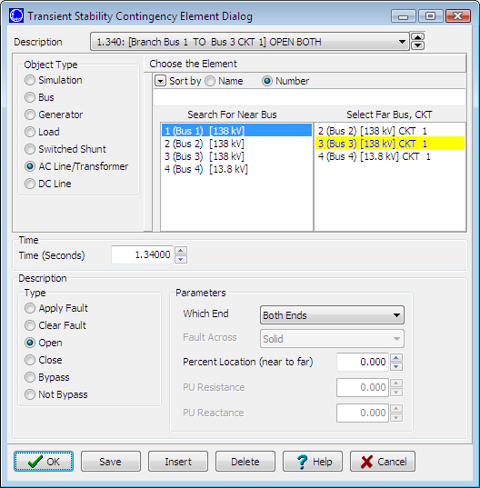
Changing the Contingency Elements
Change object type to AC Line/Transformer, select the right line,
and change the element type to “Open”.

Slide 10
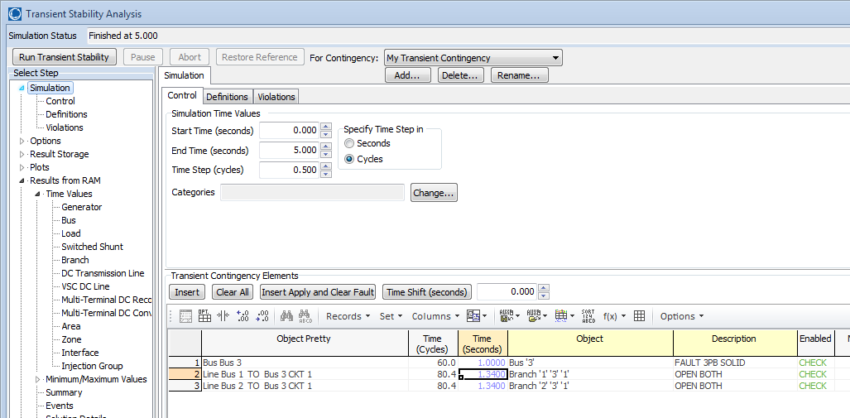
Changing the Contingency Elements
Contingency Elements displays should eventually look like this.
Note fault is at bus 3, not at bus 1.
Case Name: Example_13_4_Bus3Fault

Slide 11
Results: On Verge of Instability
Also note
that the
oscillation
frequency
has
decreased

Slide 12
A More Realistic Generator Model
The classical model is consider in section 5.6 of the book, as the simplest but also the hardest to justify
  Had been widely used, but is not rapidly falling from use
PowerWorld Simulator includes a number of much more realistic models that can be easily used
  Coverage of these models is beyond the scope of this intro
To replace the classical model with a detailed solid rotor, subtransient model, go to the generator dialog Machine Models, click “Delete” to delete the existing model, select “Insert” to display the Model Type dialog and select the GENROU model; accept the defaults.

Slide 13
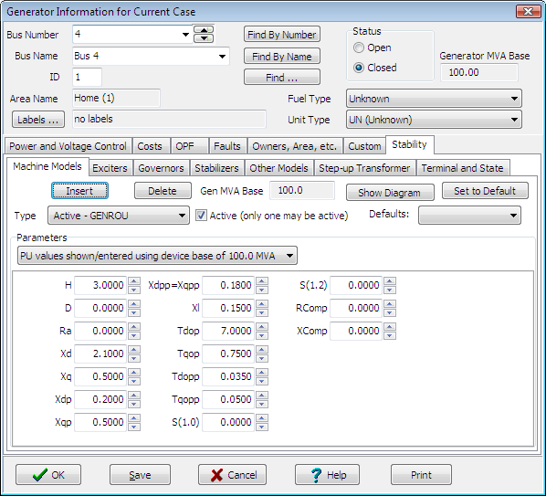
GENROU Model
The GENROU model
provides a good
approximation for the
behavior of a synchronous
generator over the dynamics
of interest during a
transient stability study
(up to about 10 Hz).
It is used to represent a
solid rotor machine with
three damper windings.
13
Notes:
13
13

Slide 14
Repeat of Example 13.1 with GENROU
This plot repeats the previous example with the bus 3 fault. The generator response is now damped due to the damper windings included in the GENROU model. Case is saved in examples as Example_13_4_GENROU.

Slide 15
Saving Results Every n Timesteps
Before moving on it will be useful to save some additional fields. On the Transient Stability Analysis form select the “Result Storage” page. Then on the Generator tab toggle the generator 4 “Field Voltage” field to Yes. On the Bus tab toggle the bus 4 “V (pu)” field to Yes.
At the top of the “Result Storage” page, change the “Save Results Every n Timesteps” to 6.
  PowerWorld Simulator allows you to store as many fields as desired. On large cases one way to save on memory is to save the field values only every n timesteps with 6 a typical value (i.e., with a ½ cycle time step 6 saves 20 values per second)

Slide 16
Plotting Bus Voltage
Change the end time to 10 seconds on the “Simulation” page, and rerun the previous. Then on “Results” page, “Time Values from RAM”, “Bus”, plot the bus 4 per unit voltage. The results are shown below.
Notice following
the fault the
voltage does
not recover to
its pre-fault value.
This is because
we have not
yet modeled an
exciter.

Slide 17
Adding a Generator Exciter
The purpose of the generator excitation system (exciter) is to adjust the generator field current to maintain a constant terminal voltage.
PowerWorld Simulator includes many different types of exciter models. One simple exciter is the IEEET1. To add this exciter to the generator at bus 4 go to the generator dialog, “Stability” tab, “Exciters” page. Click Insert and then select IEEET1 from the list. Use the default values.
Exciters will be covered in the first part of Chapter 4

Slide 18
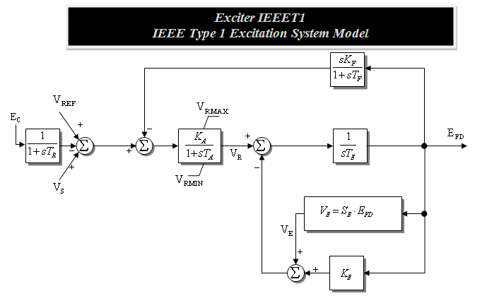
IEEET1 Exciter
Once you have inserted the IEEET1 exciter you can view its block diagram by clicking on the “Show Diagram” button. This opens a PDF file in Adobe Reader to the page with that block diagram. The block diagram for this exciter is also shown below.
The input to the exciter, E_{c},is usually the terminal
voltage. The output, E_{FD}, is the machine field voltage.

Slide 19
Voltage Response with Exciter
Re-do the run. The terminal time response of the terminal voltage is shown below. Notice that now with the exciter it returns to its pre-fault voltage.
Case Name: Example_13_4_GenROU_IEEET1

Slide 20
Defining Plots
Because time plots are commonly used to show transient stability results, PowerWorld Simulator makes it easy to define commonly used plots.
  Plot definitions are saved with the case, and can be set to automatically display at the end of a transient stability run.
To define some plots on the Transient Stability Analysis form select the “Plots” page. Initially we’ll setup a plot to show the bus voltage.
  Use the Plot Designer to choose a Device Type (Bus), Field, (Vpu), and an Object (Bus 4). Then click the “Add” button. Next click on the Plot Series tab (far right) to customize the plot’s appearance; set Color to black and Thickness to 2.

Slide 21
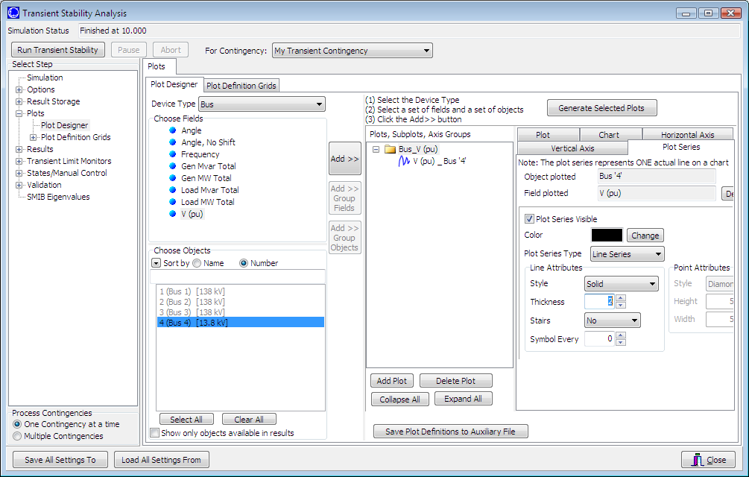
Defining Plots
Plot Designer tab
Plot Series tab
Plots Page
Customize
the plot
line.
Device
Type
Field
Object; note multiple objects and/or fields can be simultaneously
selected.
21
Notes:
21
21

Slide 22
Adding Multiple Axes
Once the plot is designed, save the case and rerun the simulation. The plot should now automatically appear.
In order to compare the time behavior of various fields an important feature is the ability to show different values using different y-axes on the same plot.
To add a new Vertical Axis to the plot, close the plot, go back to the “Plots” page, select the Vertical Axis tab (immediately to the left of the Plot Series tab). Then click “Add Axis Group”. Next, change the Device Type to Generator, the Field to Rotor Angle, and choose the Bus 4 generator as the Object. Click the “Add” button. Customize as desired. There are now two axis groups.

Slide 23
A Two Axes Plot
The resultant plot is shown below. To copy the plot to the windows clipboard, or to save the plot, right click towards the bottom of the plot. You can re-do the plot without re-running the simulation by clicking on “Generate Selected Plots” button.
Many plot options
are available
This case is saved as
Example_13_4_WithPlot

Slide 24
Setting the Angle Reference
Infinite buses do not exist, and should not usually be used except for small, academic cases.
  An infinite bus has a fixed frequency (e.g. 60 Hz), providing a convenient reference frame for the display of bus angles.
Without an infinite bus the overall system frequency is allowed to deviate from the base frequency
  With a varying frequency we need to define a reference frame
  PowerWorld Simulator provides several reference frames with the default being average of bus frequency.
  Go to the “Options”, “Power System Model” page. Change Infinite Bus Model to “No Infinite Buses”; Under “Options, Result Options”, set the Angle Reference to “Average of Generator Angles.”

Slide 25
Setting Models for the Bus 2 Gen
Without an infinite bus we need to set up models for the generator at bus 2. Use the same procedure as before, adding a GENROU machine and an IEEET1 exciter.
  Accept all the defaults, except set the H field for the GENROU model to 30 to simulate a large machine.
  Go to the Plot Designer, click on PlotVertAxisGroup2 and use the “Add” button to show the rotor angle for Generator 2. Note that the object may be grayed out but you can still add it to the plot.
  Without an infinite bus the case is no longer stable with a 0.34 second fault; on the main Simulation page change the event time for the opening on the lines to be 1.10 seconds (you can directly overwrite the seconds field on the display).
  Case is saved as Example_13_4_NoInfiniteBus

Slide 26
No Infinite Bus Case Results
Plot shows the
rotor angles for
the generators
at buses 2 and 4, along with the
voltage at bus 1.
Notice the two
generators
are swinging
against each other.

Slide 27
WSCC Nine Bus, Three Machine Case
As a next step in complexity we consider the WSCC (now WECC) nine bus case, three machine case.
  This case is described in several locations including EPRI Report EL-484 (1977), the Anderson/Fouad book (1977). Here we use the case as presented as Example 7.1 in the Sauer/Pai text except the generators are modeled using the subtransient GENROU model, and data is in per unit on generator MVA base (see next slide).
  The Sauer/Pai book contains a derivation of the system models, and a fully worked initial solution for this case.
Case Name: WSCC_9Bus

Slide 28
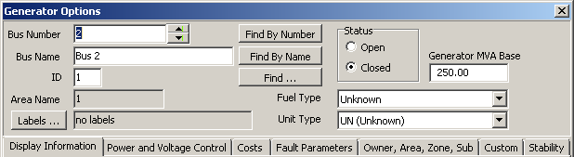
Generator MVA Base
Like most transient stability programs, generator transient stability data in PowerWorld Simulator is entered in per unit using the generator MVA base.
The generator MVA base can be modified in the “Edit Mode” (upper left portion of the ribbon), using the Generator Information Dialog. You will see the MVA Base in “Run Mode” but not be able to modify it.

Slide 29
WSCC Case One-line

Slide 30
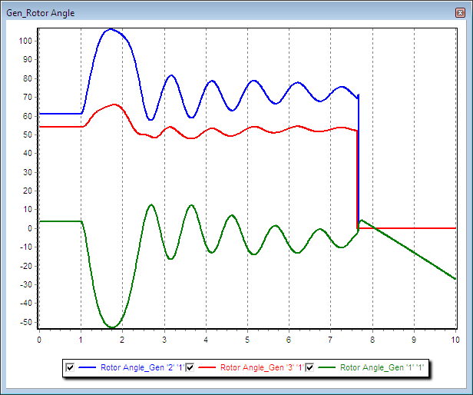
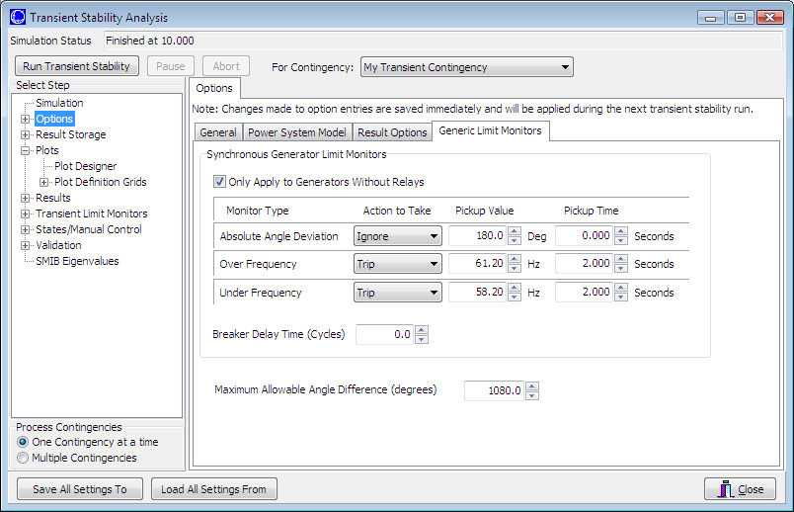
Automatic Generator Tripping
Sometimes unseen errors may lurk in a simulation!
Because this case has no governors and no infinite bus, the bus frequency keeps rising throughout the simulation, even though the rotor angles are stable. Users may set the generators to automatically trip in “Options”, “Generic Limit Monitors”.

Slide 31
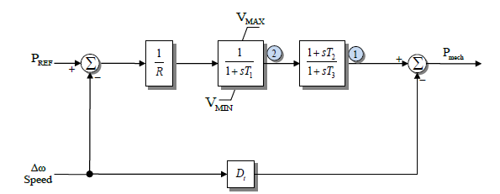
Generator Governors
Governors are used to control the generator power outputs, helping the maintain a desired frequency
Covered in sections 4.4 and 4.5
As was the case with machine models and exciters, governors can be entered using the Generator Dialog.
Add TGOV1 models for all three generators using the default values.

Slide 32
Additional WSCC Case Changes
Use the “Add Plot” button on the plot designer to insert new plots to show 1) the generator speeds, and 2) the generator mechanical input power.
Change contingency to be the opening of the bus 3 generator at time t=1 second. There is no “fault” to be cleared in this example, the only event is opening the generator. Run case for 20 seconds.
Case Name: WSCC_9Bus_WithGovernors

Slide 33
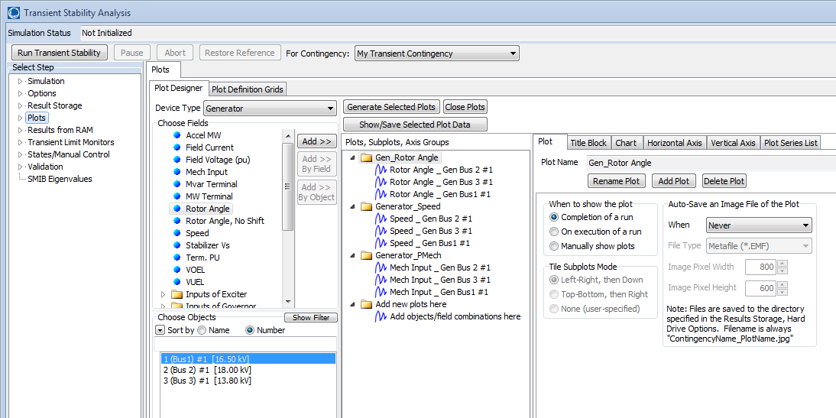
Plot Designer with New Plots
Note that when new plots are added using “Add Plot”, new Folders appear in the plot list. This will result in separate plots for each group

Slide 34
Gen 3 Open Contingency Results
The left figure shows the generator speed, while the right figure shows the generator mechanical power inputs for the loss of generator 3. This is a severe contingency since more than 25% of the system generation is lost, resulting in a frequency dip of almost one Hz. Notice frequency does not return to 60 Hz.

Slide 35
Angle Response Depends on Reference
The below graph shows the generator rotor angles, values that always depend upon an assumed reference point; value set on the Options, Result Options page

Slide 36
Gen 3 Open Contingency with Hydro Models
The slower hydro governors now result in a much more severe
frequency dip of more than 1.5 Hz. Of course in actual operation this
frequency decline may have been interrupted by the action of
under-frequency relays (which can be modeled in Simulator but this
example does not meet the specified criteria of 58.2 Hz).
36
Notes:
36
36

Slide 37
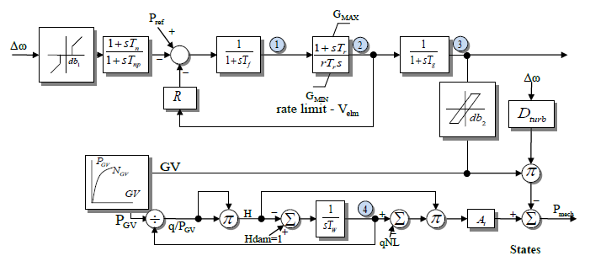
Gen 3 Open with Hydro Governors
How quickly the generator governor responds depends upon the type of unit and its governor settings
Thermal units usually respond quicker than hydro units
The next slide repeats the generator 3 open contingency, except
the other two
generators are
modified to use the
HYGOV governor
Case Name: WSCC_9Bus_Hydro

Slide 38
Gen 3 Open with Hydro Governors
The slower hydro governors now result in a much more severe
frequency dip of more than 1.5 Hz. Of course in actual operation this
frequency decline may have been interrupted by the action of
under-frequency relays (which can be modeled in Simulator but this
example does not meet the specified criteria of 58.2 Hz).

