Slide 1
ECE 576 – Power System Dynamics and Stability
Lecture 5: Symmetrical Components, Transient Stability Intro
Prof. Tom Overbye
Dept. of Electrical and Computer Engineering
University of Illinois at Urbana-Champaign
overbye@illinois.edu

Slide 2
Announcements
Read Chapter 3, skip 3.7 for now
Homework 1 is due Feb 6; it is on the website
Two good references for the modeling of unbalanced transmission lines and symmetrical components are
W.H. Kersting, Distribution System Modeling and Analysis, third edition, 2012
Glover, Sarma, Overbye, Power System Analysis and Design, fifth edition, 2011
this one also has EMTP coverage in Chapter 13
We'll be using the derivations from these two references

Slide 3
Untransposed Lines with Ground Conductors
To model untransposed lines, perhaps with grounded neutral wires, we use the approach of Carson (from 1926) of modeling the earth return with equivalent conductors located in the ground under the real wires
Earth return conductors have the same GMR of their above ground conductor (or bundle) and carry the opposite current
Distance between conductors is

Slide 4
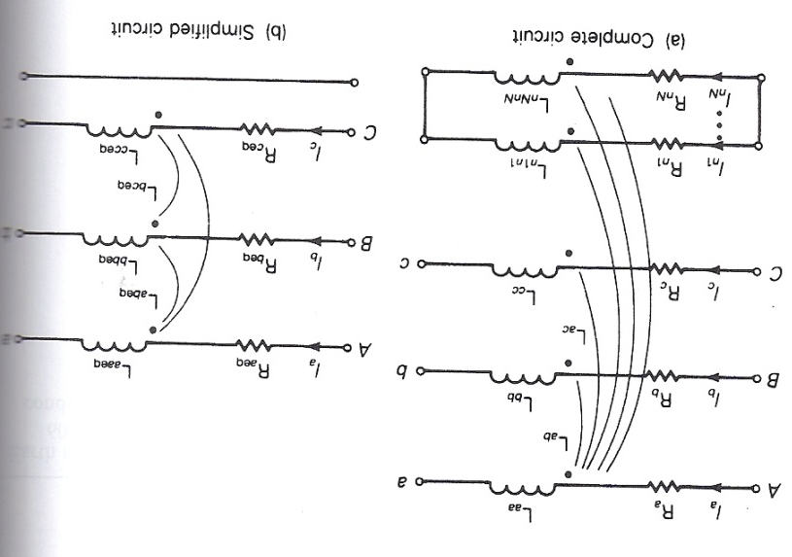
Untransposed Lines with Ground Conductors
The resistance of the equivalent conductors is R_{k'}=9.869×10⁻⁷×f Ω/m with f in Hz, which is also added in series to the R of the actual conductors
Conductors are mutually coupled; we'll be assuming three phase conductors and N grounded neutral wires
Total current in all conductors sums to zero

Slide 5
Untransposed Lines with Ground Conductors
The relationships between voltages and currents per unit length is
The diagonal resistances are the conductor resistance plus R_{k'} and the off-diagonals are all R_{k'}
The inductances are with D_{kk} just the GMR for the conductor (or bundle)
D_{kk'} is large so D_{km'} ≈ D_{kk'}

Slide 6
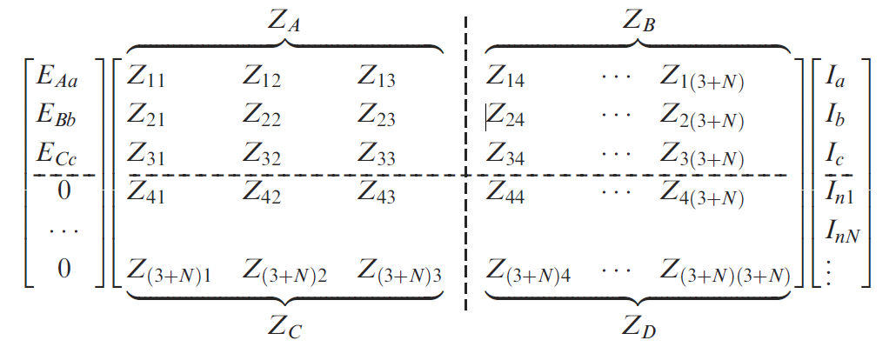
Untransposed Lines with Ground Conductors
This then gives an equation of the form
Which can be reduced to just the phase values
We'll use Z_{p} with symmetrical components

Slide 7


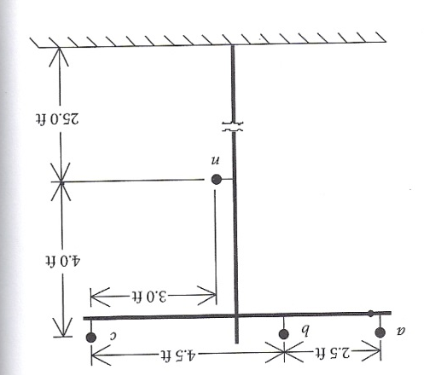
Example (from 4.1 in Kersting Book)
Given a 60 Hz overhead distribution line with the tower configuration (N=1 neutral wire) with the phases using Linnet conductors and the neutral 4/0 6/1 ACSR, determine Z_{p} in ohms per mile
Linnet has a GMR = 0.0244ft, and R = 0.306Ω/mile
4/0 6/1 ACSR has GMR=0.00814 ft and R=0.592Ω/mile
R_{k'}=9.869×10⁻⁷×f Ω/m is 0.0953 Ω/mile at 60 Hz
Phase R diagonal values are 0.306 + 0.0953 = 0.401 Ω/mile
Ground is 0.6873 Ω/mile
Figure 4.7 from Kersting

Slide 8
Example (from 4.1 in Kersting Book)
Example inductances are worked with ρ = 100Ω-m
Note at 2789 ft, D_{kk'} is much, much larger than the distances between the conductors, justifying the above assumption

Slide 9
Example (from 4.1 in Kersting Book)
Working some of the inductance values
Phases a and b are separated by 2.5 feet, while it is 5.66 feet between phase a and the ground conductor
Even though the distances are worked here in feet, the result is in H/m because of the units on μ₀

Slide 10
Example (from 4.1 in Kersting Book)
Continue to create the 4 by 4 symmetric L matrix
Then Z = R + jωL
Partition the matrix and solve
The result in Ω/mile is

Slide 11
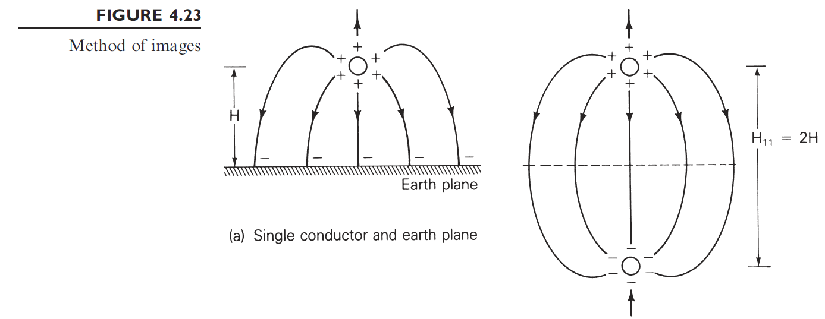
Modeling Line Capacitance
For capacitance the earth is typically modeled as a perfectly conducting horizontal plane; then the earth plane is replaced by mirror image conductors
If conductor is distance H above ground, mirror image conductor is distance H below ground, hence their distance apart is 2H

Slide 12
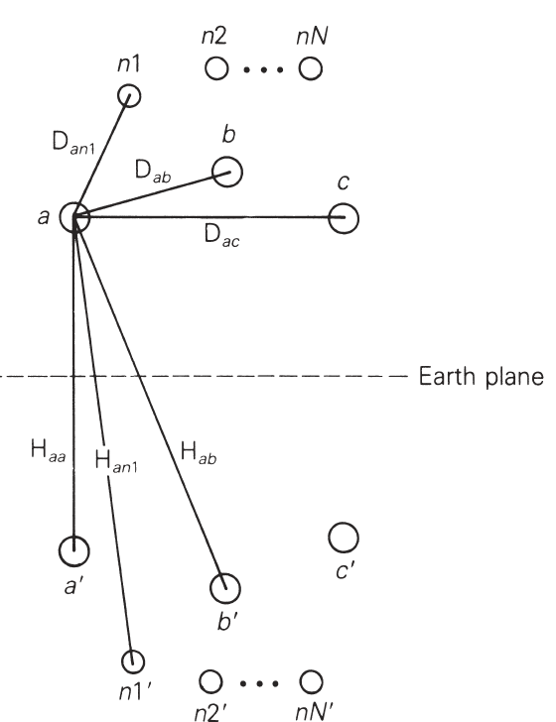
Modeling Line Capacitance
The relationship between the voltage to neutral and charges are then given as
P's are called potential coefficients
Where D_{km} is the distance between the conductors, H_{km} is the distance to a mirror image conductor and

Slide 13
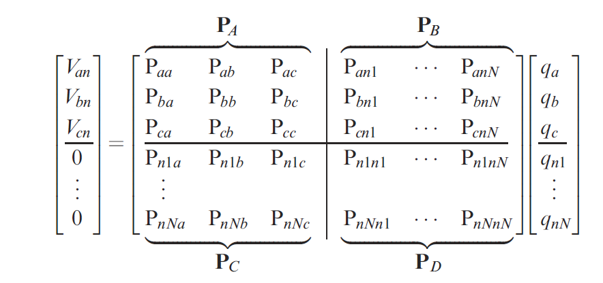
Modeling Line Capacitance
Then we setup the matrix relationship
And solve

Slide 14
Continuing the Previous Example
In example 4.1, assume the below conductor radii
Calculating some values

Slide 15
Continuing the Previous Example
Solving we get

Slide 16
Frequency Dependence
We might note that the previous derivation for L assumed a frequency. For steady-state and transient stability analysis this is just the power grid frequency
As we have seen in EMTP there are a number of difference frequencies present, particularly during transients
Coverage is beyond the scope of 576
An early paper is J.K. Snelson, "Propagation of Travelling on Transmission Lines: Frequency Dependent Parameters," IEEE Trans. Power App. and Syst., vol. PAS-91, pp. 85-91, 1972

Slide 17
Analysis with Symmetrical Components
Next several slides briefly review the application of symmetrical components, which we will also use in transient stability analysis

Slide 18
Symmetric Components
The key idea of symmetrical component analysis is to decompose a three-phase system into three sequence networks. The networks are then coupled only at the point of the unbalance (e.g., a fault)
System itself is assumed to be balanced (e.g., lines with nonsymmetric tower configurations are assumed to be uniformly transposed)
The three sequence networks are known as the
positive sequence (this is the one we’ve been using)
negative sequence
zero sequence

Slide 19
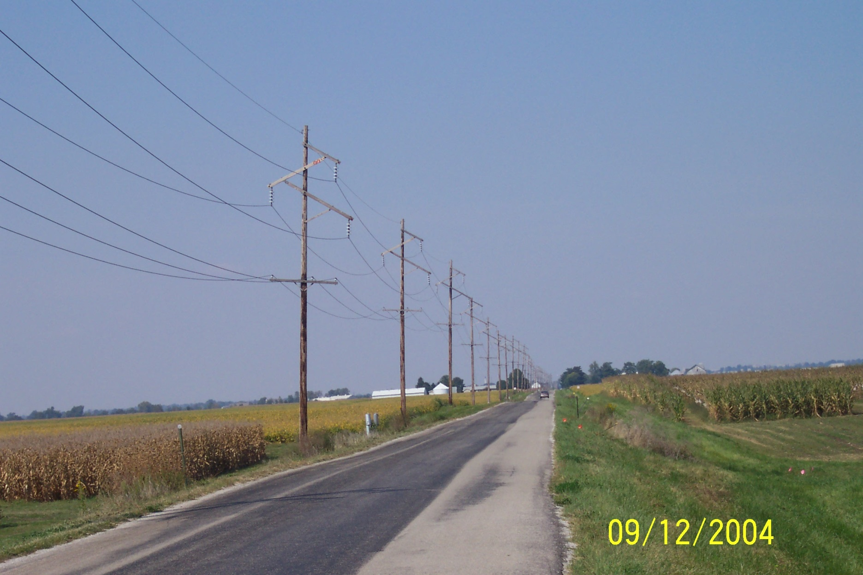
Symmetric Line Spacing – 69 kV

Slide 20
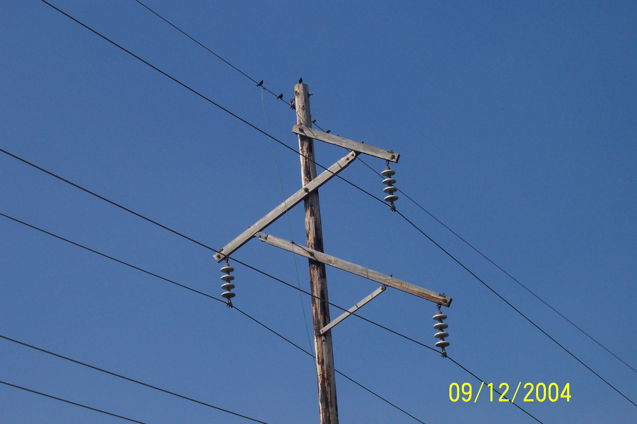
Birds Do Not Sit on the Conductors

Slide 21
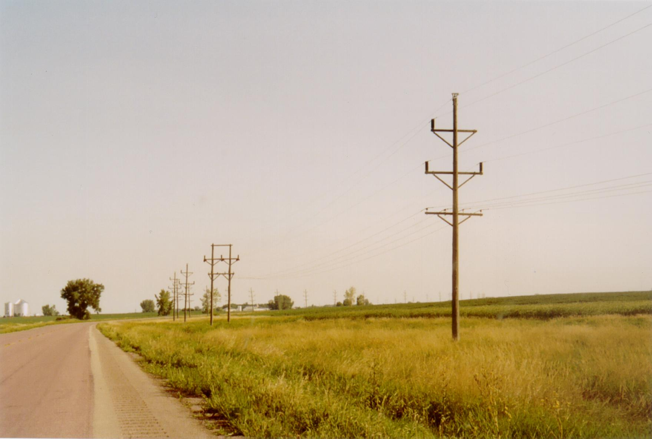
Line Transposition Example

Slide 22
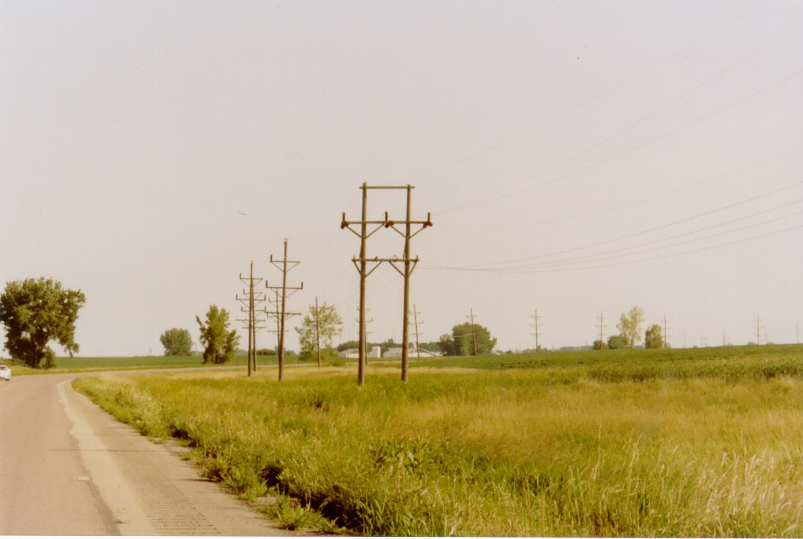
Line Transposition Example

Slide 23

Positive Sequence Sets
The positive sequence sets have three phase currents/voltages with equal magnitude, with phase b lagging phase a by 120°, and phase c lagging phase b by 120°.
We’ve been studying positive sequence sets
Positive sequence
sets have zero
neutral current

Slide 24

Negative Sequence Sets
The negative sequence sets have three phase currents/voltages with equal magnitude, with phase b leading phase a by 120°, and phase c leading phase b by 120°.
Negative sequence sets are similar to positive sequence, except the phase order is reversed
Negative sequence
sets have zero
neutral current

Slide 25
Zero Sequence Sets
Zero sequence sets have three values with equal magnitude and angle.
Zero sequence sets have neutral current

Slide 26
Sequence Set Representation
Any arbitrary set of three phasors, say I_{a}, I_{b}, I_{c} can be represented as a sum of the three sequence sets

Slide 27
Conversion from Sequence to Phase

Slide 28
Conversion Sequence to Phase

Slide 29
Conversion Phase to Sequence

Slide 30
Symmetrical Component Example 1

Slide 31
Symmetrical Component Example 2

Slide 32
Symmetrical Component Example 3

Slide 33
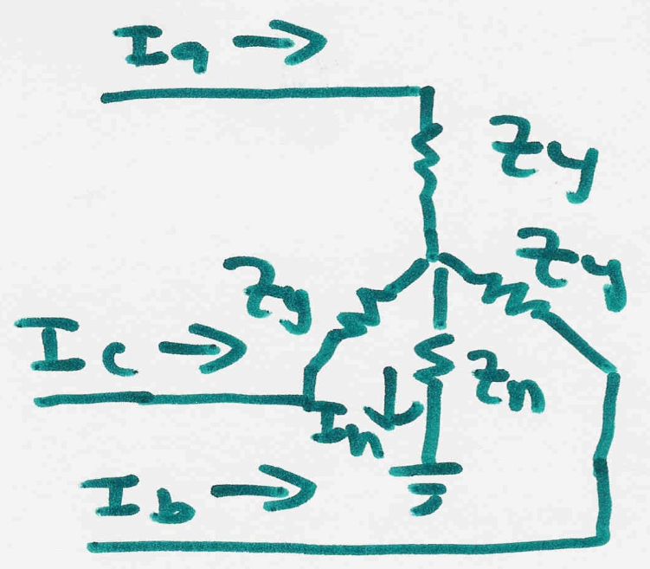
Use of Symmetrical Components
Consider the following wye-connected load:

Slide 34
Use of Symmetrical Components

Slide 35

Networks are Now Decoupled

Slide 36
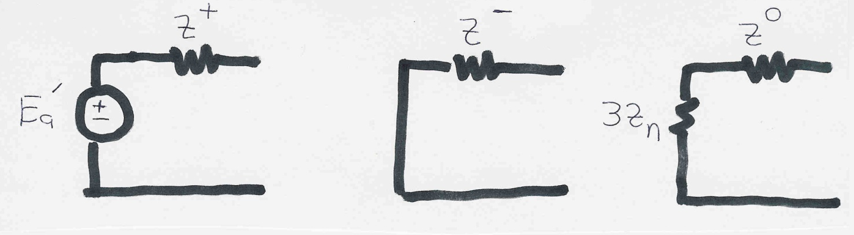
Sequence diagrams for generators
Key point: generators only produce positive sequence voltages; therefore only the positive sequence has a voltage source
During a fault Z⁺ ≈ Z⁻ ≈ X_{d}”. The zero sequence impedance is usually substantially smaller. The value of Z_{n} depends on whether the generator is grounded

Slide 37
Sequence Diagrams for Transmission Lines
If a three-phase line is uniformly transposed we can represent its inductance and capacitance as

Slide 38
Sequence Diagrams for Transmission Lines
Using a similar approach as for loads we get
For the general, untransposed case with neutral wires these networks will not be decoupled

Slide 39
Sequence Solutions
If the sequence networks are independent then they can be solved simultaneously, with the final phase solution determined by multiplying the sequence values by the A matrix
Since propagation speed is given by this value varies for the different sequence networks, with the zero sequence propagation speed slower

Slide 40
Power System Overvoltages
Line switching can cause transient overvoltages
Resistors (200 to 800Ω) are preinserted in EHV circuit breakers to reduce over voltages, and subsequently shorted
Common overvoltage cause is lightning strikes
Lightning strikes themselves are quite fast, with rise times of 1 to 20 μs, with a falloff to ½ current within less than 100 μs
Peak current is usually less than 100kA
Shield wires above the transmission line greatly reduce the current that gets into the phase conductors
EMTP studies can show how these overvoltage propagate down the line

Slide 41
Insulation Coordination
Insulation coordination is the process of correlating electric equipment insulation strength with expected overvoltages
The expected overvoltages are time-varying, with a peak value and a decay characteristic
Transformers are particularly vulnerable
Surge arrestors are placed in parallel (phase to ground) to cap the overvoltages
They have high impedance during normal voltages, and low impedance during overvoltages; airgap devices have been common, though gapless designs are also used

Slide 42
Transient Stability Overview
In next several lectures we'll be deriving models used primarily in transient stability analysis (covering from cycles to dozens of seconds)
Goal is to provide a good understanding of 1) the theoretical foundations, 2) applications and 3) some familiarity the commercial packages
Next several slides provide an overview using PowerWorld Simulator
Learning by doing!

Slide 43
PowerWorld Simulator
Class will make extensive use of PowerWorld Simulator. If you do not have a copy of v17, the free 42 bus student version is available for download at
http://www.powerworld.com/gloversarmaoverbye
Start getting familiar with this package, particularly the power flow basics. Transient stability aspects will be covered in class
Free training material is available at
http://www.powerworld.com/training/online-training

Slide 44
Power Flow to Transient Stability
With PowerWorld Simulator a power flow case can be quickly transformed into a transient stability case
This requires the addition of at least one dynamic model
PowerWorld Simulator supports many more than one hundred different dynamic models. These slides cover just a few of them
Default values are provided for most models allowing easy experimentation
Creating a new transient stability case from a power flow case would usually only be done for training/academic purposes; for commercial studies the dynamic models from existing datasets would be used.

Slide 45
Power Flow vs. Transient Stability
Power flow determines quasi-steady state solution and provides transient stability initial conditionsa
Transient stability is used to determine whether following a contingency the power system returns to a steady-state operating point
Goal is to solve a set of differential and algebraic equations, dx/dt = f(x,y), g(x,y) = 0
Starts in steady-state, and hopefully returns to steady-state.
Models reflect the transient stability time frame (up to dozens of seconds), with some values assumed to be slow enough to hold constant (LTC tap changing), while others are still fast enough to treat as algebraic (synchronous machine stator dynamics, voltage source converter dynamics).

Slide 46
First Example Case
Open the case Example_13_4_NoModels
Cases are on the class website
Add a dynamic generator model to an existing “no model” power flow case by:
In run mode, right-click on the generator symbol for bus 4, then select “Generator Information Dialog” from the local menu
This displays the Generator Information Dialog, select the “Stability” tab to view the transient stability models; none are initially defined.
Select the “Machine models” tab to enter a dynamic machine model for the generator at bus 4. Click “Insert” to enter a machine model. From the Model Type list select GENCLS, which represents a simple “Classical” machine model. Use the default values. Values are per unit using the generator MVA base.

Slide 47
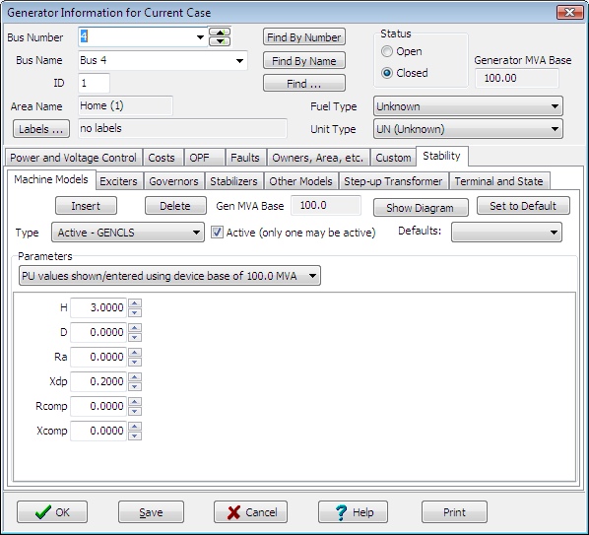
Adding a Machine Model
The GENCLS model represents the machine dynamics as a fixed voltage magnitude behind a transient impedance Ra + jXdp.
Hit “Ok” when done to save the data and close the dialog
47
Notes:
47
47

Slide 48
Transient Stability Form Overview
Most of the PowerWorld Simulator transient stability functionality is accessed using the Transient Stability Analysis form. To view this form, from the ribbon select “Add Ons”, “Transient Stability”
Key pages of form for quick start examples (listed under “Select Step”)
Simulation page: Used for specifying the starting and ending time for the simulation, the time step, defining the transient stability fault (contingency) events, and running the simulation
Options: Various options associated with transient stability
Result Storage: Used to specify the fields to save and where
Plots: Used to plot results
Results: Used to view the results (actual numbers, not plots)

Slide 49
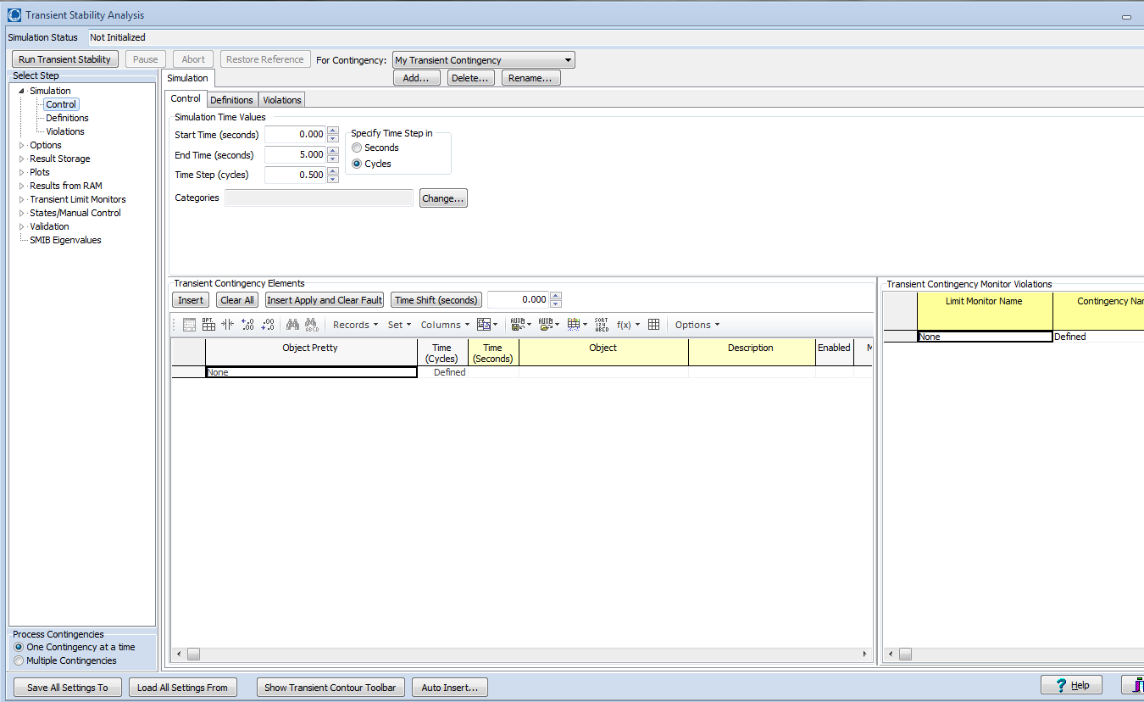
Transient Stability Overview Form

Slide 50
Infinite Bus Modeling
Before doing our first transient stability run, it is useful to discuss the concept of an infinite bus. An infinite bus is assumed to have a fixed voltage magnitude and angle; hence its frequency is also fixed at the nominal value.
In real systems infinite buses obviously do not exist, but they can be a useful concept when learning about transient stability.
By default PowerWorld Simulator does NOT treat the slack bus as an infinite bus, but does provide this as an option.
For this first example we will use the option to treat the slack bus as an infinite bus. To do this select “Options” from the “Select Step” list. This displays the option page. Select the “Power System Model” tab, and then set Infinite Bus Modeling to “Model the power flow slack bus(es) as infinite buses” if it is not already set to do so.

Slide 51
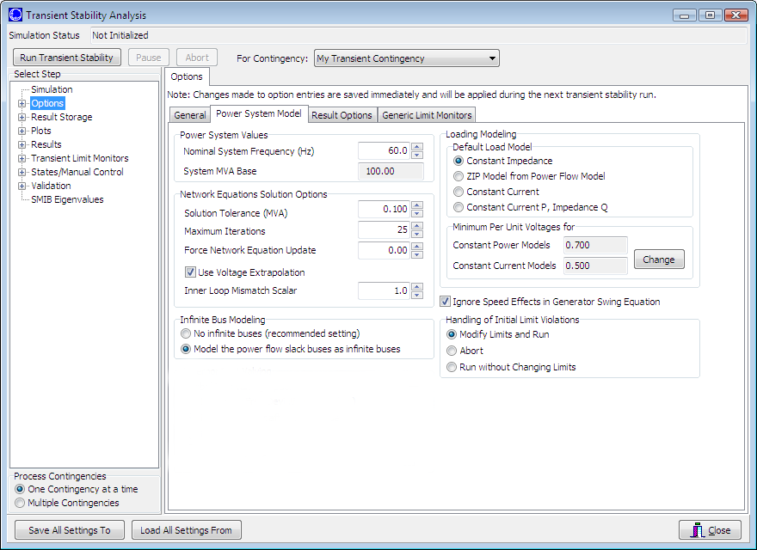
Transient Stability Options Page
Power System Model Page
Infinite Bus Modeling
This page is also used to specify the nominal system frequency
51
Notes:
51
51

Slide 52
Specifying the Fault Event
To specify the transient stability contingency go back to the “Simulation” page and click on the “Insert Elements” button. This displays the Transient Stability Contingency Element Dialog, which is used to specify the events that occur during the study.
Contingencies usually start at time > 0 to show case runs flat
The event for this example will be a self-clearing, balanced 3-phase, solid (no impedance) fault at bus 1, starting at time = 1.00 seconds, and clearing at time = 1.05 seconds.
For the first action just choose all the defaults and select “Insert.” Insert will add the action but not close the dialog.
For the second action simply change the Time to 1.05 seconds, and change the Type to “Clear Fault.” Select “OK,” which saves the action and closes the dialog.
52
Notes:
52
52

Slide 53
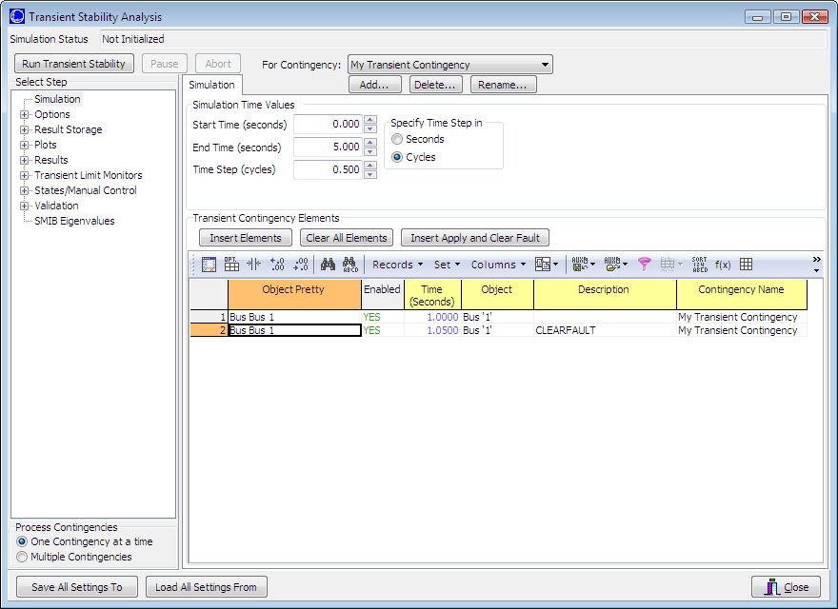
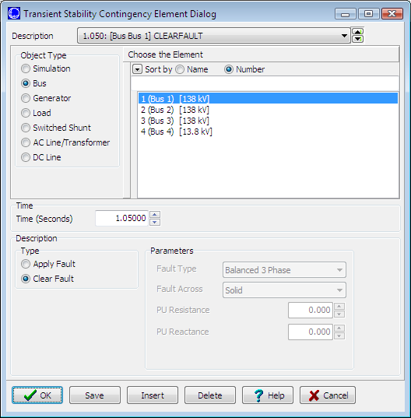
Inserting Transient Stability Contingency Elements
Click to insert new
elements
Summary of all elements in contingency and time of
action
Right click here
And select “show dialog”
To reopen this
Dialog box
Available element type will vary with different objects
53
Notes:
53
53

Slide 54
Determining the Results to View
For large cases, transient stability solutions can generate huge amounts of data. PowerWorld Simulator provides easy ways to choose which fields to save for later viewing. These choices can be made on the “Result Storage” page.
For this example we’ll save the generator 4 rotor angle, speed, MW terminal power and Mvar terminal power.
From the “Result Storage” page, select the generator tab and double click on the specified fields to set their values to “Yes”.

Slide 55
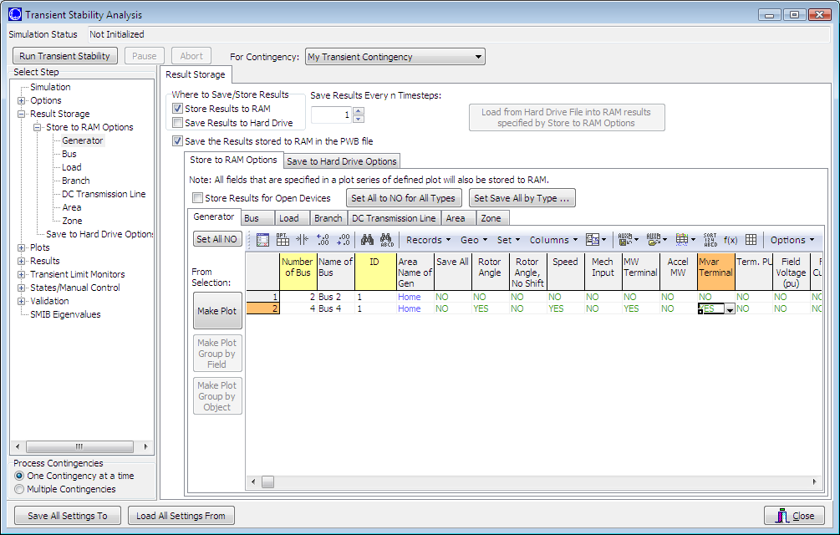
Result Storage Page
Result Storage Page
Generator Tab
Double Click on Fields (which sets them to yes) to Store Their Values
55
Notes:
55
55

Slide 56
Saving Changes and Doing Simulation
The last step before doing the run is to specify an ending time for the simulation, and a time step.
Go to the “Simulation” page, verify that the end time is 5.0 seconds, and that the Time Step is 0.5 cycles
PowerWorld Simulator allows the time step to be specified in either seconds or cycles, with 0.25 or 0.5 cycles recommended
Before doing your first simulation, save all the changes made so far by using the main PowerWorld Simulator Ribbon, select “Save Case As” with a name of “Example_13_4_WithCLSModel_ReadyToRun”
Click on “Run Transient Stability” to solve.

Slide 57
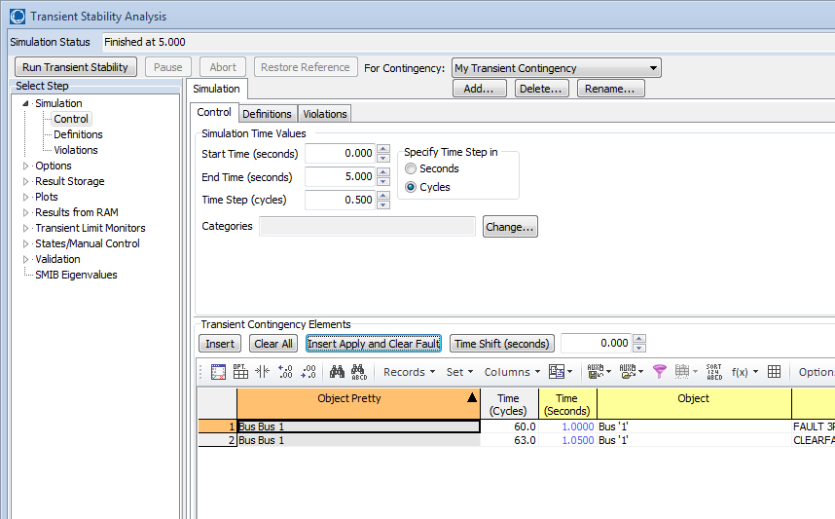
Doing the Run
Click to run the specified contingency
Once the contingency runs the “Results” page may be opened

Slide 58
Transient Stability Results
Once the transient stability run finishes, the “Results” page provides both a minimum/maximum summary of values from the simulation, and time step values for the fields selected to view.
The Time Values and Minimum/Maximum Values tabs display standard PowerWorld Simulator case information displays, so the results can easily be transferred to other programs (such as Excel) by right-clicking on a field and selecting “Copy/Paste/Send”

Slide 59
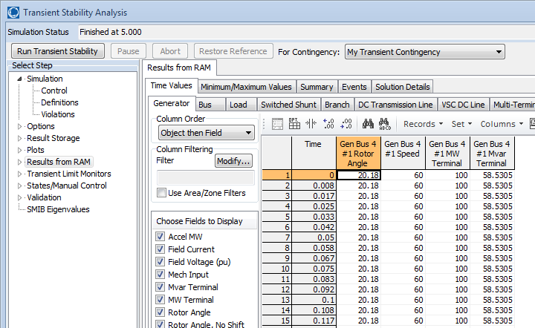
Results: Time Values
Lots of options are available for showing and filtering the results.
By default the results are shown for each time step. Results can be saved saved every “n” timesteps using an option on the Results Storage Page

Slide 60
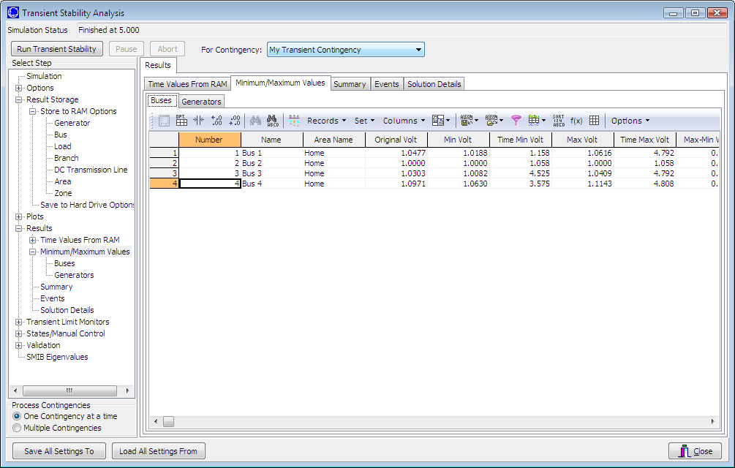
Results: Minimum and Maximum Values
Minimum and maximum values are available for all generators and buses

Slide 61
Quickly Plotting Results
Time value results can be quickly plotted by using the standard case information display plotting capability.
Right-click on the desired column
Select Plot Columns
Use the Column Plot Dialog to customize the results.
Right-click on the plot to save, copy or print it.
More comprehensive plotting capability is provided using the Transient Stability “Plots” page; this will be discussed later.

Slide 62
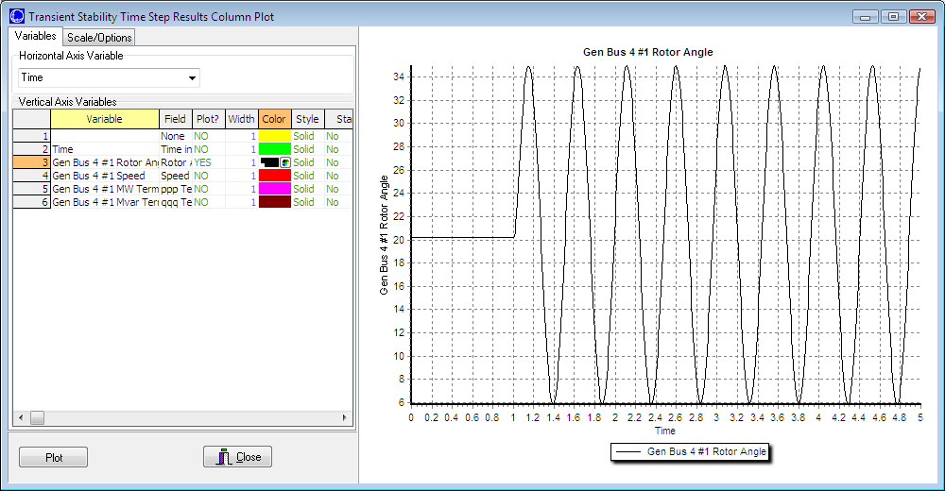
Generator 4 Rotor Angle Column Plot
Notice that the result is undamped; damping is provided by damper windings
Change line color here
And re-plot by clicking
here
Starting the event at t = 1.0 seconds allows for verification of an initially stable operating point. The small angle oscillation
indicates the system is stable, although undamped.
62
Notes:
62
62

