Slide 1
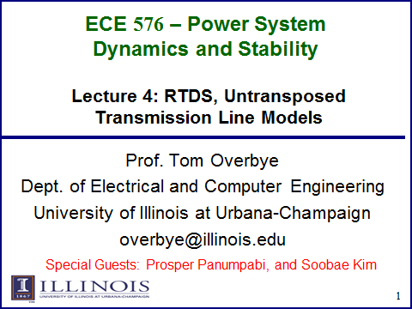

Slide 2
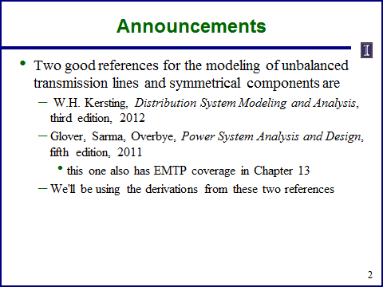

Slide 3
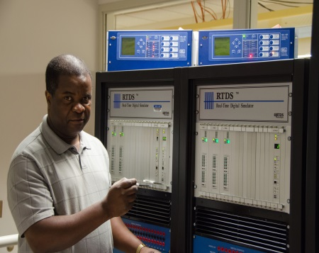
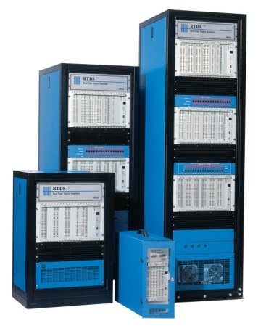
ECE 576 – Power System Dynamics and Stability
RTDS Simulator for Power Systems Simulation
Airline Industry
Flight Simulator
Power Industry
RTDS Simulator
Electromagnetic transient solution (EMTP type simulation)
Based on the Dommel algorithm
    Trapezoidal rule of integration
    New solution produced each timestep
    Dedicates high speed processing and signal
    communication required to achieve real-time
    Integration with physical hardware
    Dedicated high speed processing and high speed communication

Slide 4
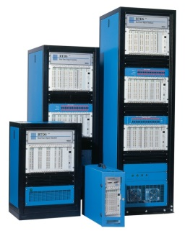
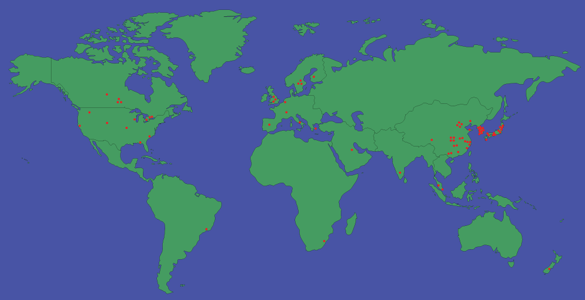
ECE 576 – Power System Dynamics and Stability
RTDS Simulator for Power Systems Simulation
Users:
Electrical Power Companies: Southern California Edison, Dominion Virginia Power,
KEPCO
Electrical Manufactures Companies: SEL,
Research and Educational Institutions: UIUC, Florida State University,
Clemson University, Quanta Tech,

Slide 5
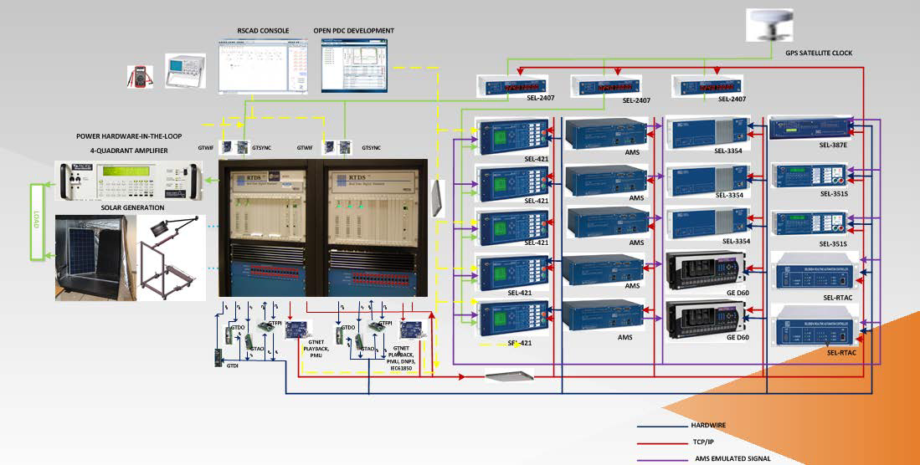
RTDS Testbed at University of Illinois at Urbana-Champaign
Two racks RTDS : PB5(3), GPC (2), GTWIF(2), GTDI (2), GTDO(2), GTAI (1), GTSYNC (2), GTFPI(2), GTAO (2),
GTNET: C37.118 (2), DNP3(1), IEC61850(1), Playback (2)

Slide 6
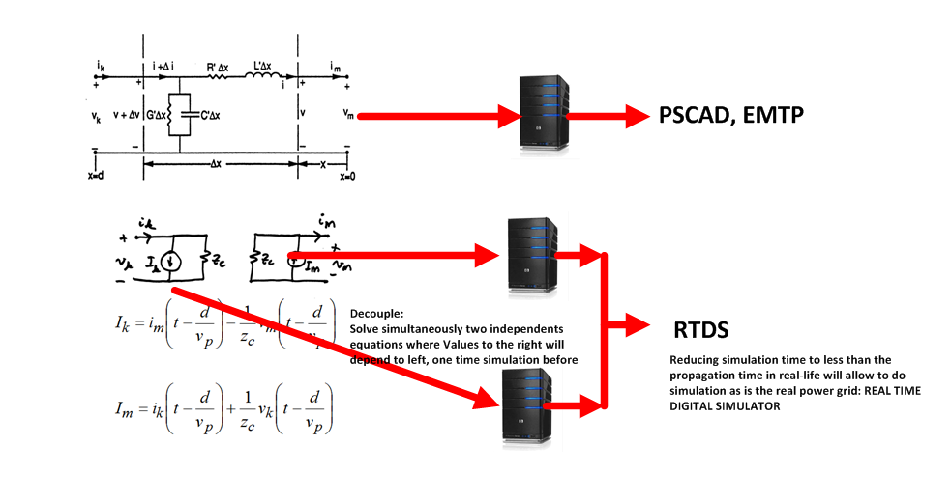
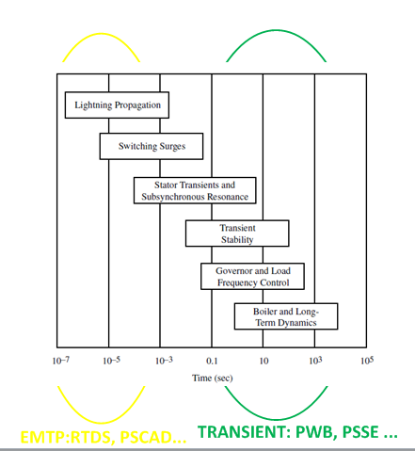
Fastest Electromagnetic Modeling in Power Lines

Slide 7
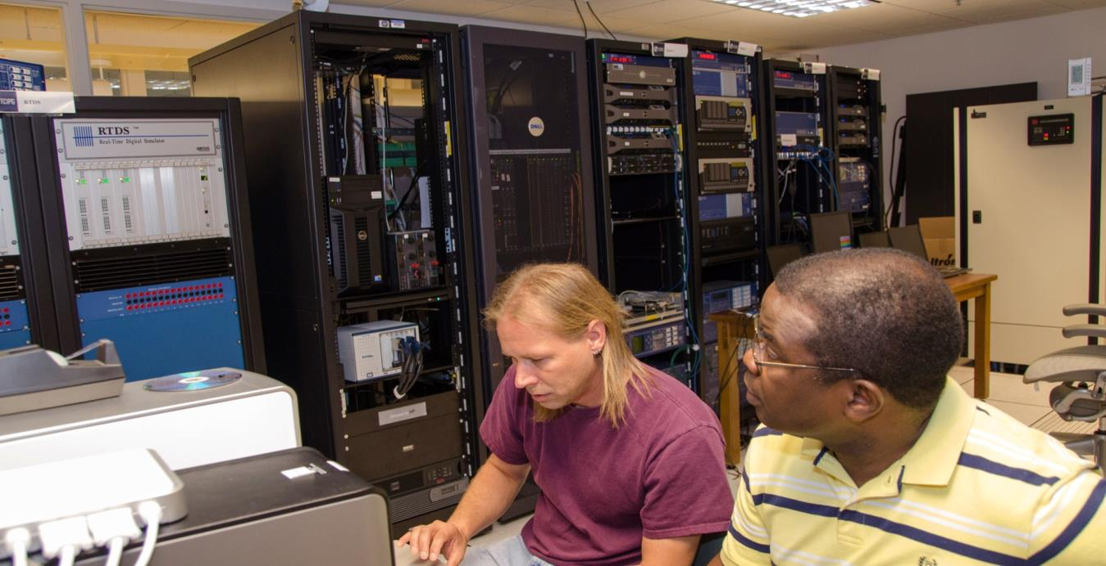
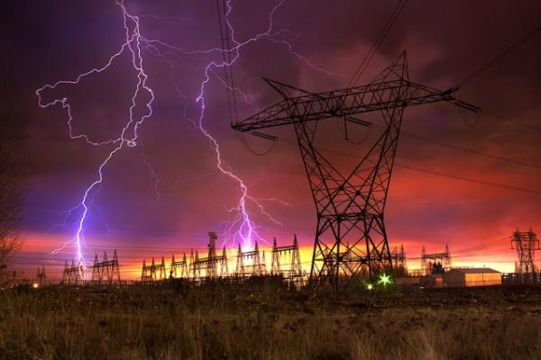
Fastest Electromagnetic Modeling in Power Lines
Distributed model using travelling wave: A voltage disturbance will travel almost at the speed the light till at the end of the line where it will be reflected: positive and negative waves
Three ways to represent the transmission lines:
  1. PI model: don`t capture any behave out of the fundamental frequency, suitable for short-lines
  2. Bergeron Model: Infinite number of Pi sections are represented (work for the fundamental frequency)
  3. Frequency Dependent Model: To be used for all frequencies studies as fundamental, transient over-voltages, harmonics, ..

Slide 8
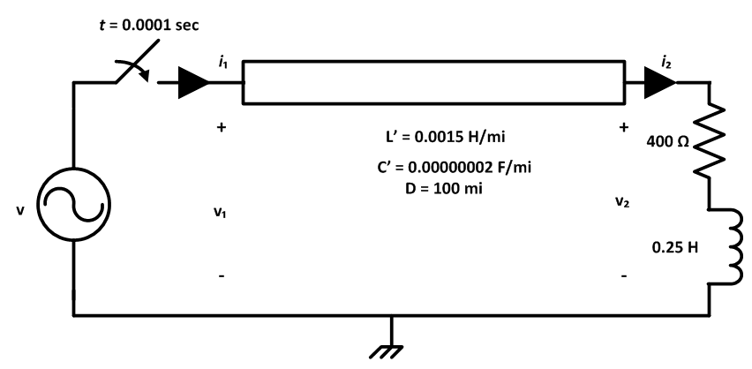
Fastest Electromagnetic Modeling in Power Lines
Consider a single-phase lossless transmission line below: Example 2.1.
Compute the values of voltages and current, at time t = 0.001, 0.002 and 0.007 sec

Slide 9
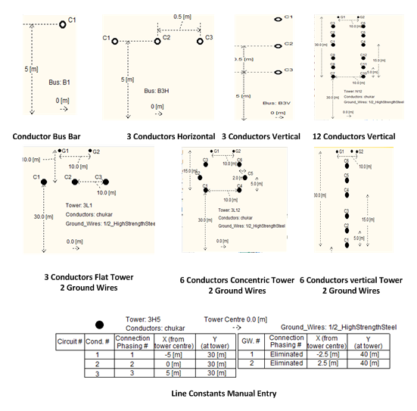
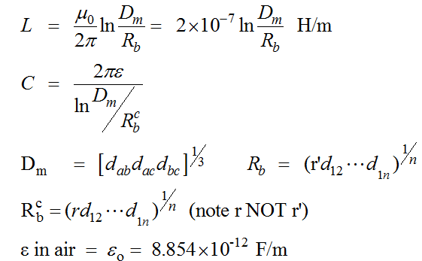
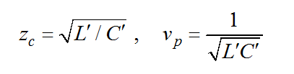
Fastest Electromagnetic Modeling in Power Lines

Slide 10
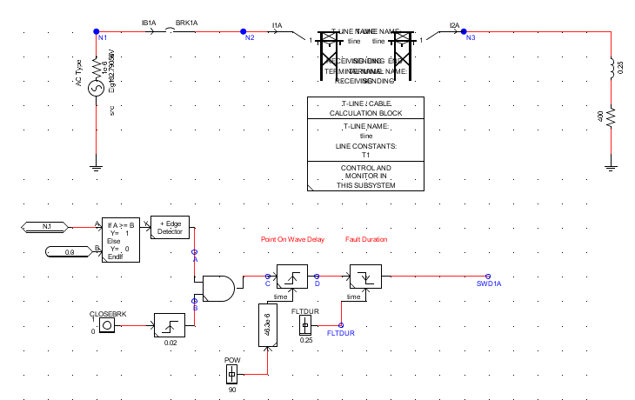

Fastest Electromagnetic Modeling in Power Lines
  The case has been modeled in RSCAD

Slide 11
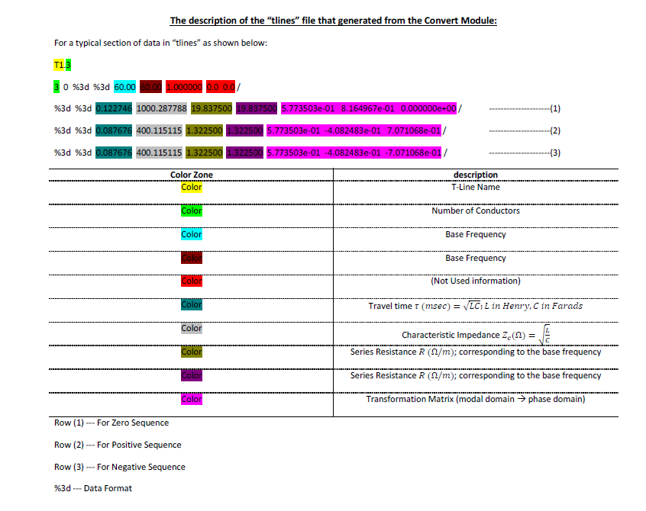
Fastest Electromagnetic Modeling in Power Lines
  The t-line Bergeron model has been compiled
  In PSSE and exported in RSCAD

Slide 12
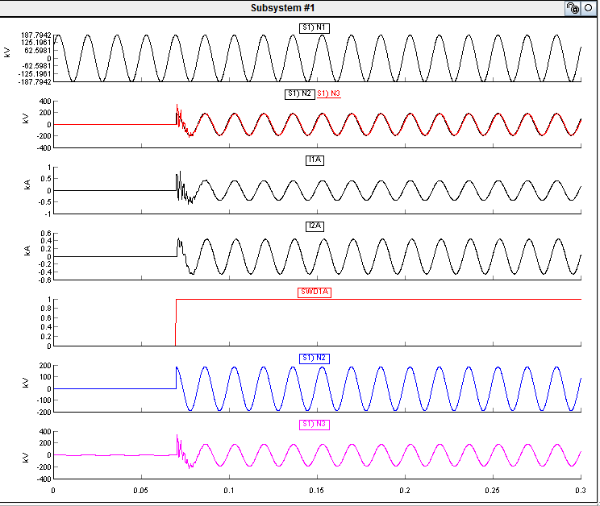
Fastest Electromagnetic Modeling in Power Lines
  Solving the case in the Run mode:

Slide 13
Fastest Electromagnetic Modeling in Power Lines
  Exporting RTDS results to an Excel Sheet
  Note: The RTDS simulation need a delay for components to solve, reason why the RTDS close the breaker at time 0.0663 and not 0.
Time |  | Breaker | v1 | v1 | v2 | i1 | i2
0.066 |  | 0 | 187.557 | 0.0821693 | 0.0798849 | 1.87E-04 | 1.80E-04
0.0661 |  | 0 | 187.779 | 0.0821309 | 0.0802444 | 1.87E-04 | 1.83E-04
0.0662 |  | 1 | 187.735 | 0.0819757 | 0.08049 | 1.88E-04 | 1.86E-04
0.0663 | t=0 | 1 | 187.424 | 187.423 | 0.0806212 | 1.88E-04 | 1.88E-04
0.0664 | t=0.0001 | 1 | 186.846 | 186.845 | 0.0806377 | 0.684264 | 1.90E-04
0.0665 | t=0.0002 | 1 | 186.003 | 186.002 | 0.0805396 | 0.682156 | 1.92E-04
0.0666 |  | 1 | 184.895 | 184.895 | 0.0803269 | 0.679078 | 1.93E-04
0.0667 |  | 1 | 183.525 | 183.525 | 0.0800001 | 0.675035 | 1.94E-04
0.0668 |  | 1 | 181.894 | 181.894 | 186.509 | 0.670034 | 1.95E-04
0.0669 |  | 1 | 180.005 | 180.004 | 339.439 | 0.66408 | 0.0347197
0.067 | t=0.0007 | 1 | 177.86 | 177.859 | 310.211 | 0.657182 | 0.126974

Slide 14
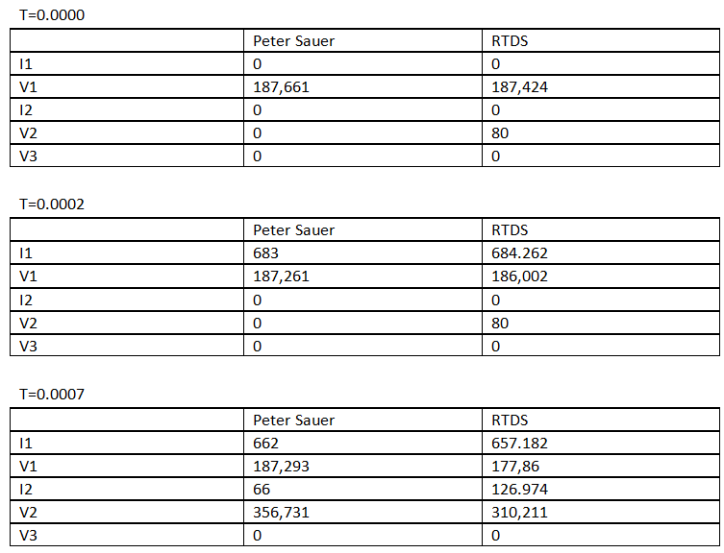
Fastest Electromagnetic Modeling in Power Lines
  Comparing Results with Peter Sauer solution:

Slide 15
Fastest Electromagnetic Modeling in Power Lines
  Zoom the first instant of simulation:

Slide 16
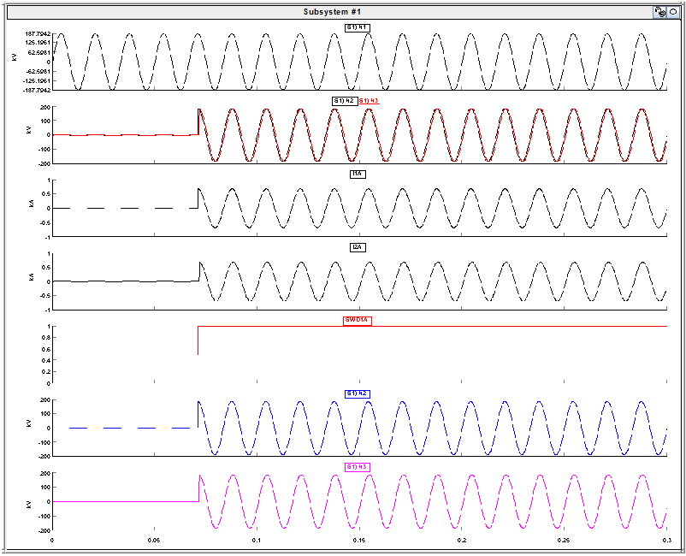
Fastest Electromagnetic Modeling in Power Lines
  Special Cases: Load Impedance = Characteristic Impedance
T1.1
1 0 %3d %3d 60.00 60.00 1.000000 0.0 0.0 / %3d %3d 0.54772 273.86 0.0 0.0 1.000000e+00 /
  NO REFLEXION

Slide 17
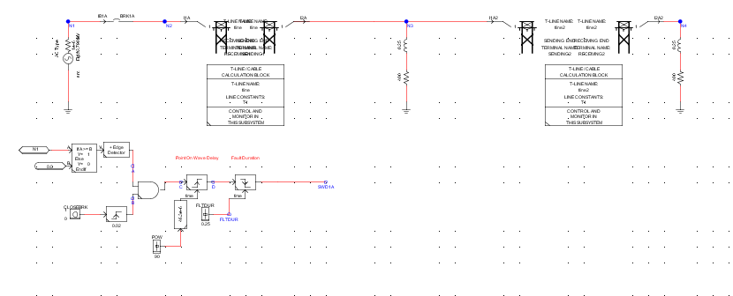
Fastest Electromagnetic Modeling in Power Lines
  Special Cases: Two adjacent lines

Slide 18
Fastest Electromagnetic Modeling in Power Lines
  Special Cases: Two adjacent lines
RTDS
Course

Slide 19
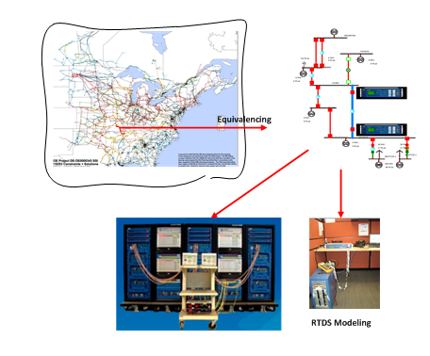
Fastest Electromagnetic Modeling in Power Lines
Studying a power
Line within a large
power system using
PowerWorld and RTDS

Slide 20


