Slide 1
ECE 576 – Power System Dynamics and Stability
Lecture 25: Distributed PV, Small Signal Stability
Prof. Tom Overbye
University of Illinois at Urbana-Champaign
overbye@illinois.edu

Slide 2
Announcements
Read Chapters 8 and 9
Homework 8 should be completed before final but need not be turned in
Final Exam is Wednesday May 14 at 7 to 10pm in classroom. Closed book, closed notes, your two previous note sheets and one new note sheet allowed, simple calculators allowed

Slide 3
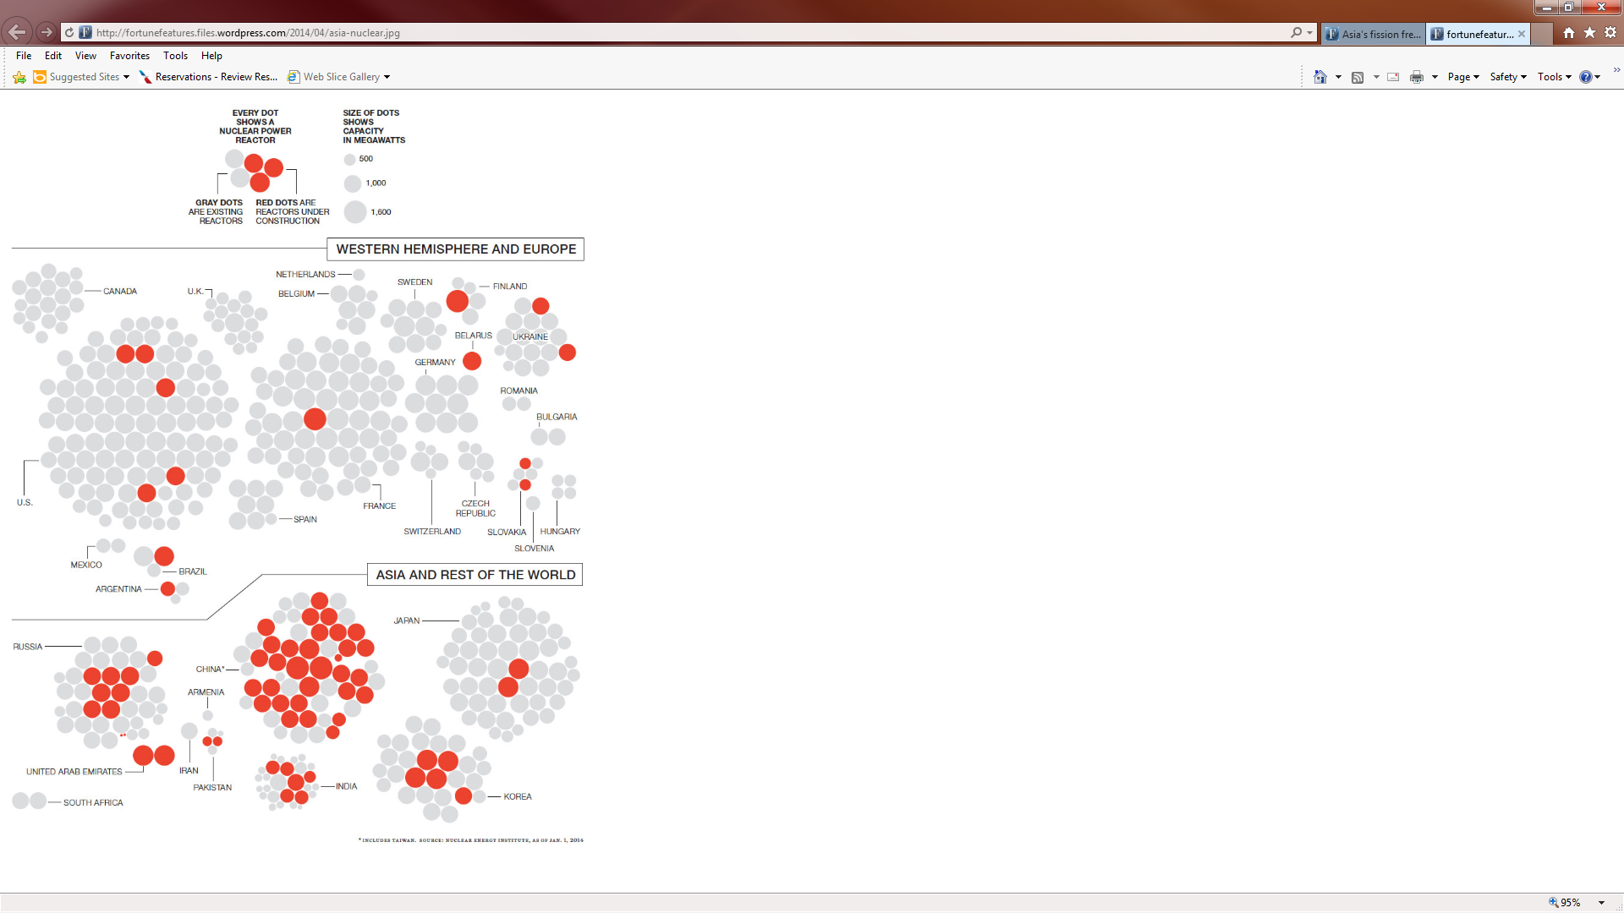
Status of Nuclear Power Worldwide
In the USA, the five reactors under construction (about 1200 MW each) are
two units at the Vogtle plant in Georgia (2017)
two units in South Carolina (2017/9)
TVA's Watts Bar Unit 2 (2015)
Source: Fortune Magazine, April 2014

Slide 4
Distributed PV System Modeling
PV in the distribution system is usually operated at unity power factor
There is research investigating the benefits of changing this
IEEE Std 1547 prevents voltage regulation, but would allow non-unity power factor
A simple model is just as negative constant power load
An issue is tripping on abnormal frequency or voltage conditions
IEEE Std 1547 says, "The DR unit shall cease to energize the Area EPS for faults on the Area EPS circuit to which it is connected.” (note EPS is electric power system)

Slide 5
Distributed PV System Modeling
An issue is tripping on abnormal frequency or voltage conditions
IEEE Std 1547 says, "The DR unit shall cease to energize the Area EPS for faults on the Area EPS circuit to which it is connected.” (note EPS is electric power system)
This is a key safety requirement!
Small units (less than 30kW) need to disconnect if the voltage is < 0.5 pu in 0.16 seconds, and in 2 seconds if between 0.5 and 0.88 pu; also in 1 second if between 1.1 and 1.2, and in 0.16 seconds if higher
Small units need to disconnect in 0.16 seconds if the frequency is > 60.5 Hz, or less than 59.3 Hz
Reconnection is after minutes

Slide 6
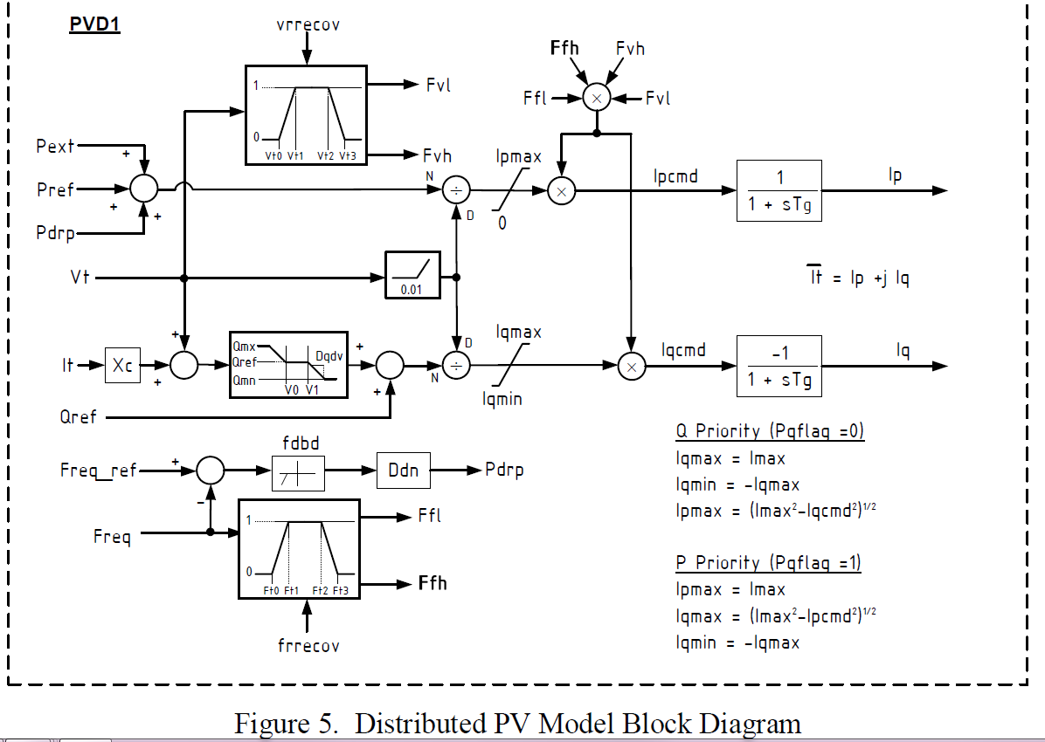
Distributed PV System Modeling
Below is a prototype model for distributed solar PV

Slide 7
Oscillations
An oscillation is just a repetitive motion that can be either undamped, positively damped (decaying with time) or negatively damped (growing with time)
If the oscillation can be written as a sinusoid then it has the form
And the damping ratio is defined as (see Kundur 12.46)
The percent damping is just the damping ratio multiplied by 100

Slide 8
Power System Oscillations
Power systems can experience a wide range of oscillations, ranging from highly damped and high frequency switching transients to sustained low frequency (< 2 Hz) inter-area oscillations affecting an entire interconnect
Types of oscillations include
Transients: Usually high frequency and highly damped
Local plant: Usually from 1 to 5 Hz
Inter-area oscillations: From 0.15 to 1 Hz
Slower dynamics: Such as AGC, less than 0.15 Hz
Subsynchronous resonance: 10 to 50 Hz (less than synchronous)

Slide 9
Example Oscillations
The below graph shows an oscillation that was observed during a 1996 WECC Blackout

Slide 10
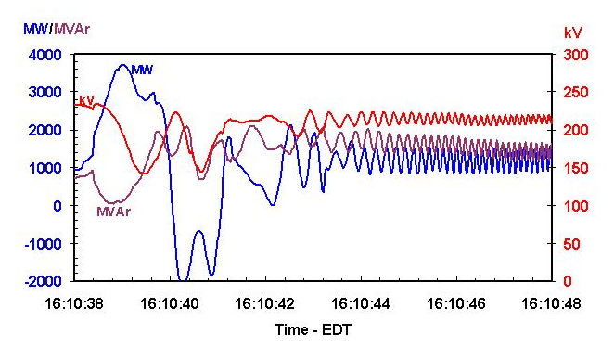
Example Oscillations
The below graph shows oscillations on the Michigan/Ontario Interface on 8/14/03

Slide 11
Small Signal Stability Analysis
Small signal stability is the ability of the power system to maintain synchronism following a small disturbance
System is continually subject to small disturbances, such as changes in the load
The operating equilibrium point (EP) obviously must be stable
Small system stability analysis (SSA) is studied to get a feel for how close the system is to losing stability and to get additional insight into the system response
There must be positive damping

Slide 12
Small Signal Stability Analysis
Model based SSA is performed by linearizing about an EP, and then calculating the associated eigenvalues (and other properties) of the linearized system
With the advent of PMUs, measurement based techniques are becoming increasingly common; this approach is typically broken into two types
Ringdown analysis is performed after the power system has experienced a significant disturbance that has moved it away from its EP
Ambient analysis is performed when the power system is operating in quasi-steady state

Slide 13
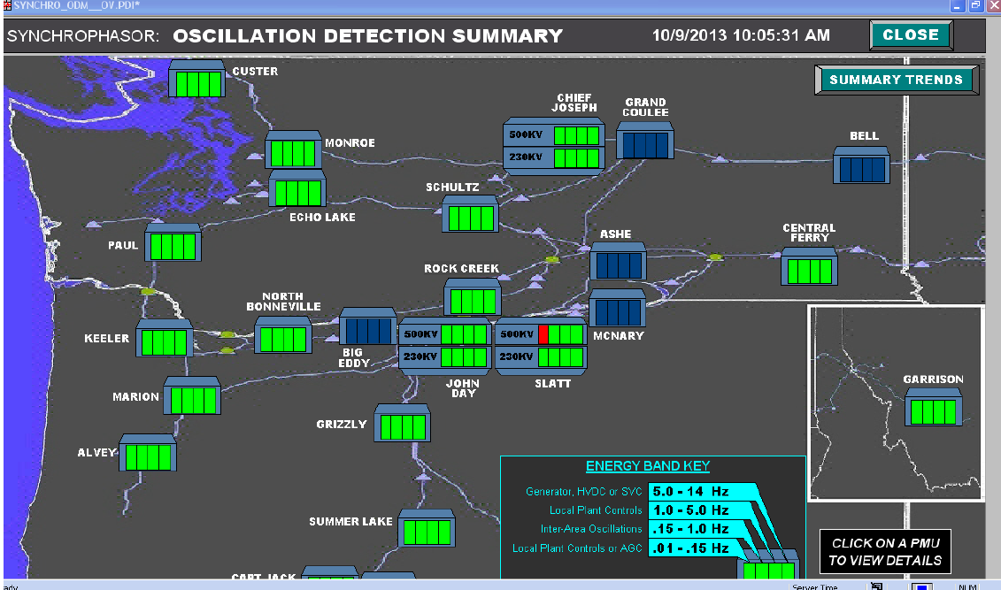
An On-line Oscillation Detection Tool
Image source: WECC Joint Synchronized Information Subcommittee Report, October 2013

Slide 14
Model Based SSA
Assume the power system is modeled as in our standard form as
The system can be linearized about an equilibrium point
Eliminating Δy gives
If there are just classical generator models then D is the power flow Jacobian;otherwise it also includes the stator algebraic equations

Slide 15
Model Based SSA
The matrix A_{sys} can be calculated doing a partial factorization, just like what was done with Kron reduction
SSA is done by looking at the eigenvalues (and other properties) of A_{sys}

Slide 16
SSA Two Generator Example
Consider the two bus, two classical generator system from lectures 18 and 20 with X_{d1}'=0.3, H₁=3.0, X_{d2}'=0.2, H₂=6.0
Essentially everything needed to calculate the A, B, C and D matrices was covered in lecture 20

Slide 17
SSA Two Generator Example
The A matrix is calculated differentiating f(x,y) with respect to x (where x is δ₁, Δω₁, δ₂, Δω₂)

Slide 18
SSA Two Generator Example
Giving
B, C and D are as calculated previously for the implicit integration, except the elements in B are not multiplied by Δt/2

Slide 19
SSA Two Generator Example
The C and D matrices are
Giving

Slide 20
SSA Two Generator
Calculating the eigenvalues gives a complex pair and two zero eigenvalues
The complex pair, with values of +/- j11.39 corresponds to the generators oscillating against each other at 1.81 Hz
One of the zero eigenvalues corresponds to the lack of an angle reference
Could be rectified by redefining angles to be with respect to a reference angle (see book 226) or we just live with the zero
Other zero is associated with lack of speed dependence in the generator torques

Slide 21
SSA Two Generator Speeds
The two generator system response is shown below for a small disturbance
Notice the actual response closely matches the calculated frequency

Slide 22
SSA Three Generator Example
The two generator system is extended to three generators with the third generator having H₃ of 8 and X_{d3}'=0.3

Slide 23
SSA Three Generator Example
Using SSA, two frequencies are identified: one at 2.02 Hz and one at 1.51 Hz
We next discuss modal
analysis to determine the contribution of each mode to each signal

Slide 24
Large System Studies
The challenge with large systems, which could have more than 100,000 states, is the shear size
Most eigenvalues are associated with the local plants
Computing all the eigenvalues is computationally challenging, order n³
Specialized approaches can be used to calculate particular eigenvalues of large matrices
See Kundur, Section 12.8 and associated references

Slide 25
Single Machine Infinite Bus
A quite useful analysis technique is to consider the small signal stability associated with a single generator connected to the rest of the system through an equivalent transmission line
Driving point impedance looking into the system is used to calculate the equivalent line's impedance
The Z_{ii} value can be calculated quite quickly using sparse vector methods
Rest of the system is assumed to be an infinite bus with its voltage set to match the generator's real and reactive power injection and voltage

Slide 26
Small SMIB Example
As a small example, consider the 4 bus system shown below, in which bus 2 really is an infinite bus
To get the SMIB for bus 4, first calculate Z₄₄
Z₄₄ is Z_{th} in parallel with jX'_{d,4} (which is j0.3) so Z_{th} is j0.22

Slide 27
Small SMIB Example
The infinite bus voltage is then calculated so as to match the bus i terminal voltage and current
In the example we have
While this was demonstrated on an extremely small system for clarity, the approach works the same for any size system

Slide 28
Calculating the A Matrix
The SMIB model A matrix can then be calculated either analytically or numerically
The equivalent line's impedance can be embedded in the generator model so the infinite bus looks like the "terminal"
This matrix is calculated in PowerWorld by selecting Transient Stability, SMIB Eigenvalues
Select Run SMIB to perform an SMIB analysis for all the generators in a case
Right click on a generator on the SMIB form and select Show SMIB to see the Generator SMIB Eigenvalue Dialog
These two bus equivalent networks can also be saved, which can be quite useful for understanding the behavior of individual generators

Slide 29
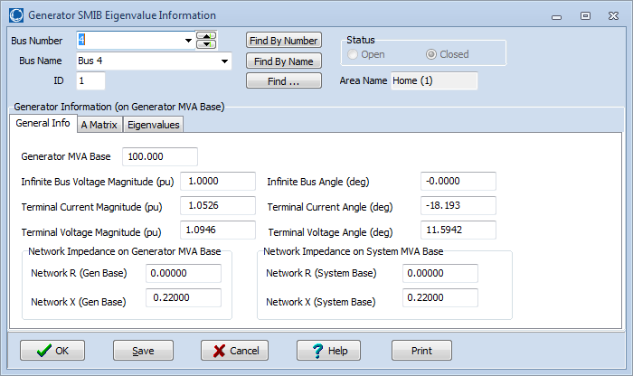
Example: Bus 4 SMIB Dialog
On the SMIB dialog, the General Information tab shows information about the two bus equivalent

Slide 30
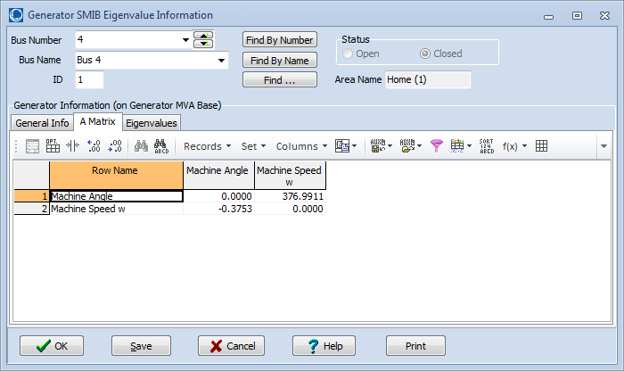
Example: Bus 4 SMIB Dialog
On the SMIB dialog, the A Matrix tab shows the A_{sys} matrix for the SMIB generator
In this example A₂₁ is showing

Slide 31
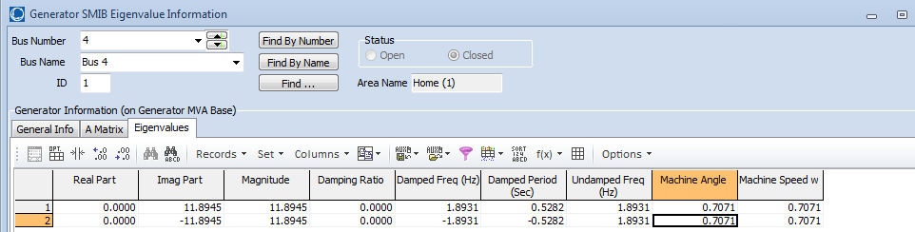
Example: Bus 4 SMIB Dialog
On the SMIB dialog, the Eigenvalues tab shows the A_{sys} matrix eigenvalues and participation factors (which we'll cover shortly)
Saving the two bus SMIB equivalent, and putting a short, self-cleared fault at the terminal shows the 1.89 Hz, undamped response

Slide 32
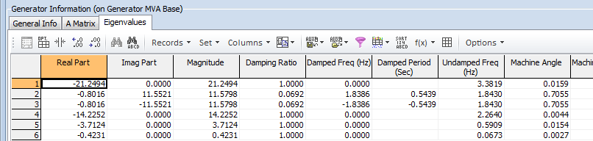
Example: Bus 4 with GENROU Model
The eigenvalues can be calculated for any set of generator models
This example replaces the bus 4 generator classical machine with a GENROU model
There are now six eigenvalues, with the dominate response coming from the electro-mechanical mode with a frequency of 1.83 Hz, and damping of 6.92%

