Slide 1
ECE 576 – Power System Dynamics and Stability
Lecture 22:Load Models
Prof. Tom Overbye
University of Illinois at Urbana-Champaign
overbye@illinois.edu

Slide 2
Announcements
Read Chapter 8
Homework 7 is due on Thursday April 24
Some good references on load modeling
L. Pereira, D. Kosterev, M. Mackin, D. Davies, J. Undrill, W. Zhu, “An Interim dynamic Induction Motor Model for Stability Studies in the WSCC,” IEEE Transactions on Power Systems, Vol. 17, No. 4, November 2002, pp. 1108-1115.
J.A. Diaz de Leon II, B. Kehrli, “The Modeling Requirements for Short-Term Voltage Stability Studies,” Proc. IEEE 2006 Power Systems Conference and Exposition (PSCE), Atlanta, GA, Oct. 2006, pp. 582-588
B. Lesieutre, et. al., Load Modeling Transmission Research, Lawrence Berkeley National Laboratory, March 2010. http://ciee-dev.eecs.berkeley.edu/piertrans/documents/LM_Final_Report_body.pdf

Slide 3
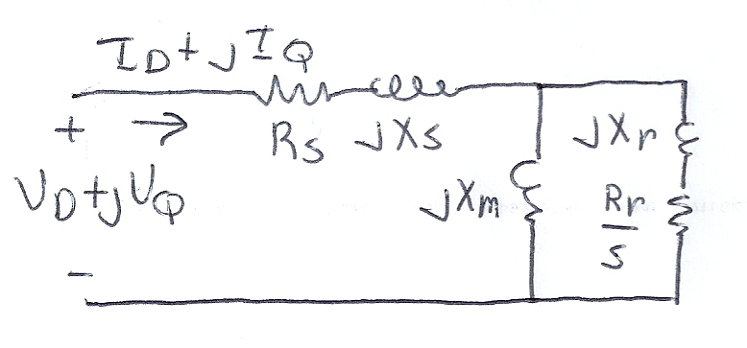
Basic Induction Machine Model
A basic (single cage) induction machine circuit model is given below
Model is derived in a class like ECE 330
Circuit is useful for understanding the static behavior of the machine
Effective rotor resistance (R_{r}/s) models the rotor electrical losses (R_{r}) and the mechanical power R_{r}(1-s)/s

Slide 4
Induction Machine Dynamics
Expressing all values in per unit (with the base covered later), the mechanical equation for a machine is
Similar to what was done for a synchronous machine, the induction machine can be modeled as an equivalent voltage behind a stator resistance and transient reactance (later we'll introduce, but not derived, the subtransient model)

Slide 5
Induction Machine Dynamics
Define
Also define the open circuit time constant

Slide 6
Induction Machine Dynamics
Electrically the induction machine is modeled similar to the classical generator model, except here we use the "motor convention" in which I_{D}+jI_{Q} is assumed positive into the machine
All calculations are done on the network reference frame
Correction to this equation from last time; posted notes are correct

Slide 7
Induction Machine Dynamics
The induction machine electrical torque, T_{E}, and terminal electrical load, P_{E}, are then
Similar to a synchronous machine, once the initial values are determined the differential equations are fairly easy to simulate
Key initial value needed is the slip
Recall we are using the motor convention so positive P_{E} represents load

Slide 8
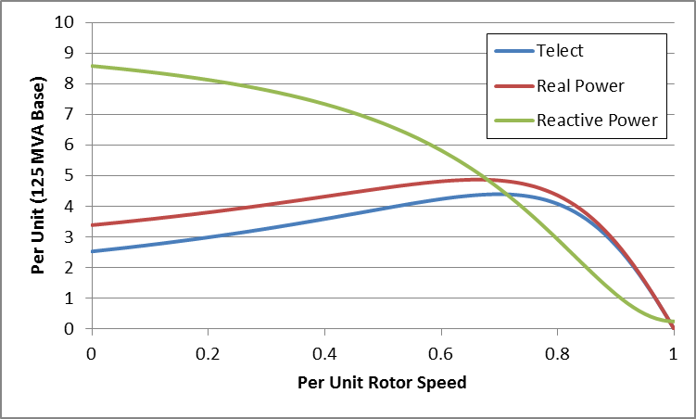
Induction Motor Example Torque-Speed Curves
Below graph shows the torque-speed curve for this induction machine; note the high reactive power consumption on starting (which is why the lights may dim when starting the dryer!)
From the graph you can see with a 100 MW load
(0.8 pu on the 125 MW base), the slip is about
0.025

Slide 9
Calculating the Initial Slip
One way to calculate the initial slip is to just solve the below five equations for five unknowns (s, I_{D}, I_{Q}, E'_{D},E'_{Q}) with P_{E}, V_{D} and V_{Q} inputs
These are nonlinear equations that can have multiple solutions so use Newton's method, with an initial guess of s small (say 0.01)
Initial slip in example is 0.0253

Slide 10
Double Cage Induction Machines
In the design of induction machines, there are various tradeoffs, such as between starting torque (obviously one needs enough to start) and operating efficiency
The highest efficiency possible is 1-slip, so operating at low slip is desirable
A common way to achieve high starting torque with good operating efficiency is to use a double cage design
E.g., the rotor has two embedded squirrel cages, one with a high R and lower X for starting, and one with lower R and higher X for running
Modeled by extending our model by having two rotor circuits in parallel; add subtransient values X" and T"_{o}

Slide 11
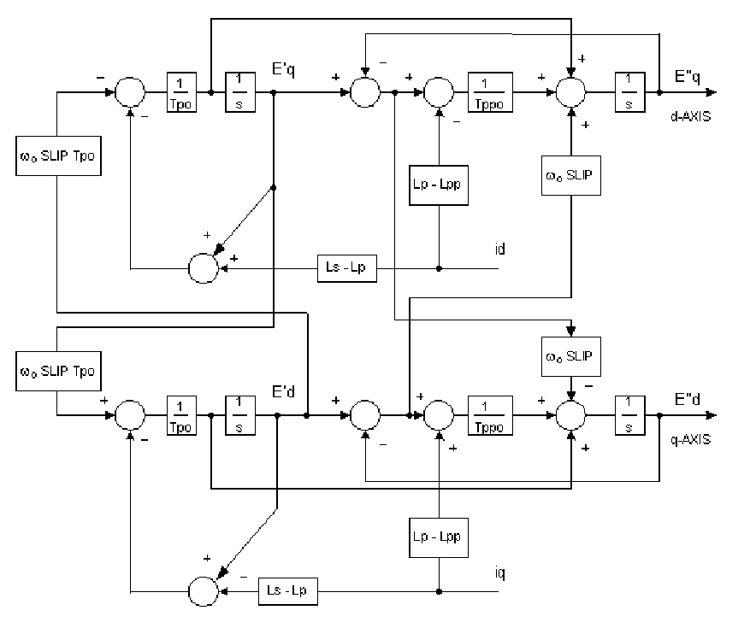
Example Double Cage Model
Double cage rotors are modeled by adding two additional differential equations
Some models also include saturation, a topic that we will skip
Image source: PSLF Manual, version 18.1_02; MotorW

Slide 12
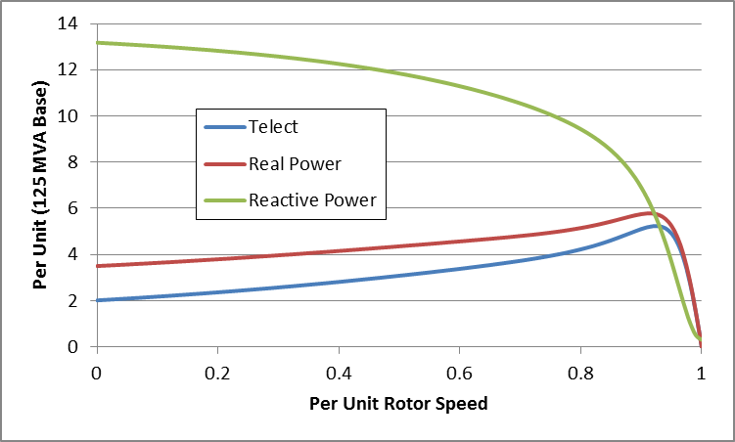
Double Cage Induction Motor Model
The previous example can be extended to model a double cage rotor by setting R₂=0.01, X₂=0.08
The below graph shows the modified curves, notice the increase in the slope by s=0, meaning it is operating with higher efficiency (s=0.0063 now!)
The additional winding does result in lower initial impedance and hence a higher starting reactive power

Slide 13
Induction Motor Mechanical Load
An induction motor is operating in steady-state when the electrical torque is equal to the mechanical torque
Mechanical torque depends on the type of load
Usually specified as function of speed, T_{M}=T_{base}(ω_{r})^{m}
Torque of fans and pumps varies with the square of the speed, conveyors and hoists tend to have a constant torque
Total power supplied to load is equal to torque times speed
Hence the exponent is m+1, with P_{M}=P_{base}(ω_{r})^{m}

Slide 14
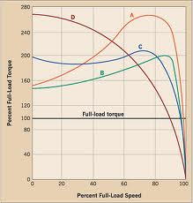
Induction Motor Classes
Four major classes of induction motors, based on application. Key values are starting torque, pull-out torque, full-load torque, and starting current
In steady-state the motor will operate on the right side of the curve at the point at which the electrical torque matches the mechanical torque
Image source: ecmweb.com/motors/understanding-induction-motor-nameplate-information

Slide 15
Induction Motor Stalling
Height of the torque-speed curve varies with the square of the terminal voltage
When the terminal voltage decreases, such as during a fault, the mechanical torque can exceed the electrical torque
This causes the motor to decelerate, perhaps quite clearly, with the rate proportional to the inertia
This deceleration causing the slip to increase, perhaps causing the motor to stall with s=1, resulting in a high reactive current draw
Too many stalled motors can prevent the voltage from recovering

Slide 16
Motor Stalling Example
Using case Problem7-6, which models the WSCC 9 bus case with 100% induction motor load
Change the fault scenario to say a fault midway between buses 5 and 7, cleared by opening the line
Results are for a 0.1 second fault
Usually motor load is much less than 100%

Slide 17
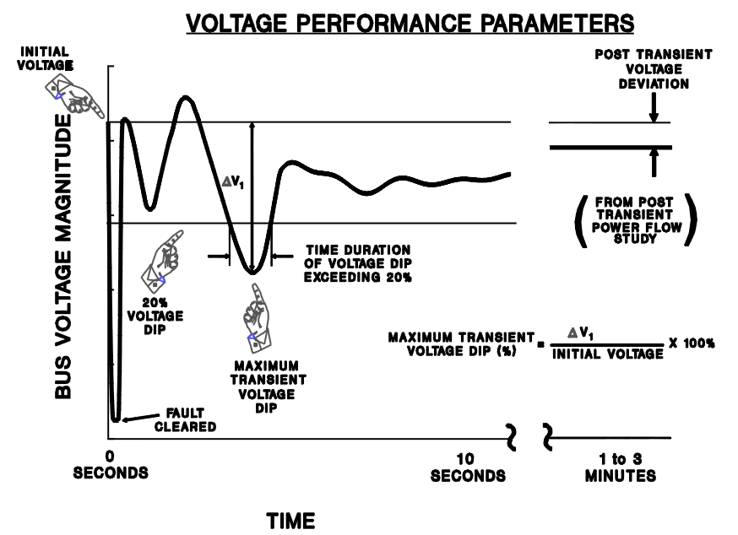
Transient Limit Monitors
There are different performance criteria that need to be met for a scenario
Similar performance criteria exist for frequency
deviations
Image from WECC Planning and Operating Criteria

Slide 18
Motor Starting
Motor starting analysis looks at the impacts of starting a motor or a series of motors (usually quite large motors) on the power grid
Examples are new load or black start plans
While not all transient stability motor load models allow the motor to start, some do
When energized, the initial condition for the motor is slip of 1.0
Motor starting can generate very small time constants

Slide 19
Motor Starting Example
Case WSCC_MotorStarting takes the previous WSCC case with 100% motor load, and considers starting the motor at bus 8
In the power flow the load at bus 8 is model as zero (open) with a CIM5
The contingency is to close the load
Broken into four loads to stagger the start (we can't start it all at once)
Since power flow load is zero, the CIM5 load must also specify the size of the motor
This is done in the Tnom field; also set Mbase (31.25 MVA for each motor)

Slide 20
Motor Starting Example
Below graph shows the bus voltages for starting one second apart

Slide 21
Motor Starting: Fast Dynamics
One issue with the starting of induction motors is the need to model relatively fast initial electrical dynamics
Below graph shows E'r for a motor at bus 8 as it is starting
Time scale is from 1.0 to 1.1 seconds

Slide 22
Motor Starting: Fast Dynamics
These fast dynamics can be seen to vary with slip in the ω_{s}s term
Simulating with the explicit method either requires a small overall Δt or the use of multi-rate methods

Slide 23
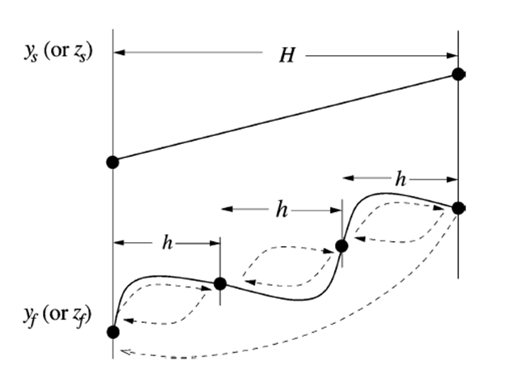
Multi-Rate Explicit Integration
Key idea is to integrate some differential equations with a potentially much faster time step then others
Faster variables are integrated with time step h, slower variable with time step H
Slower variables assumed fixed or interpolated during the faster time step integration
Figure from Jingjia Chen and M. L. Crow, "A Variable Partitioning Strategy for the Multirate Method in Power Systems," Power Systems, IEEE Transactions on, vol. 23, pp. 259-266, 2008.

Slide 24
Multi-Rate Explicit Integration
First proposed by C. Gear (at UIUC!) in 1974
Power systems use by M Crow in 1994 (UIUC alum)
In power systems usually applied to some exciters, stabilizers, and to induction motors when their slip is high
Subinterval length can be customized for each model based on its parameters (in range of 4 to 128 times the regular time step)
Tradeoff in computation
C. Gear, Multirate Methods for Ordinary Differential Equations, Univ. Illinois at Urbana-Champaign, Tech. Rep., 1974.
M. Crow and J. G. Chen, “The multirate method for simulation of power system dynamics,” IEEE Trans. Power Syst., vol. 9, no. 3, pp.1684–1690, Aug. 1994.

Slide 25
Single Phase Induction Motor Loads
A new load model is one that explicitly represents the behavior of single phase induction motors, which are quite small and stall very quickly
Single phase motors also start slower than an equivalent three phase machine
New single phase induction motor model (LD1PAC) is a static model (with the assumption that the dynamics are fast), that algebraically transitions between running and stalled behavior based on the magnitude of the terminal voltage

Slide 26
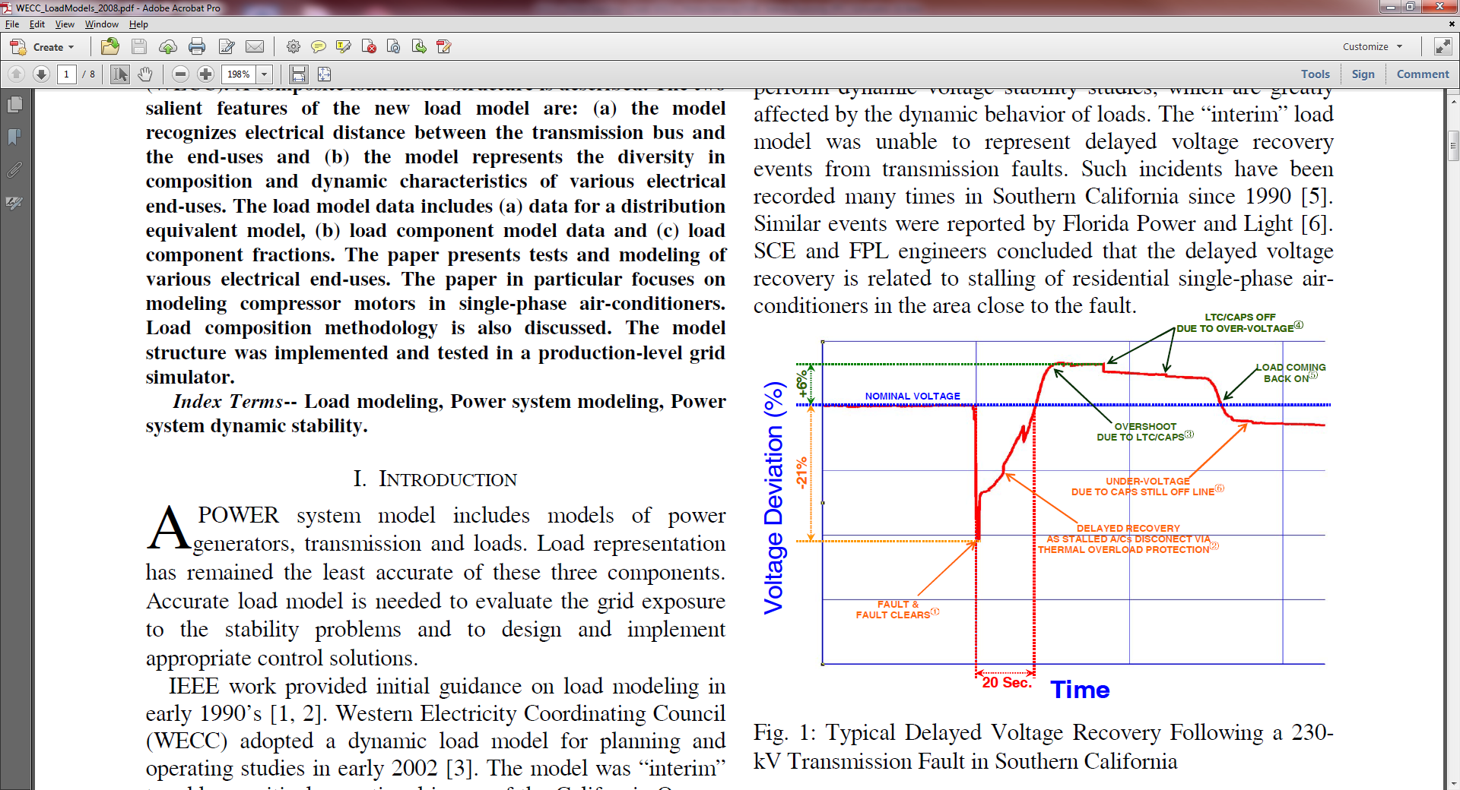
Single Phase Induction Motor Loads
Need is driven by the previous difficulty in modeling the delayed voltage recovery after some faults
Figure from D. Kosterev, et. al., "Load Modeling in Power System Studies: WECC Progress Update," IEEE PES 2008 General Meeting

Slide 27
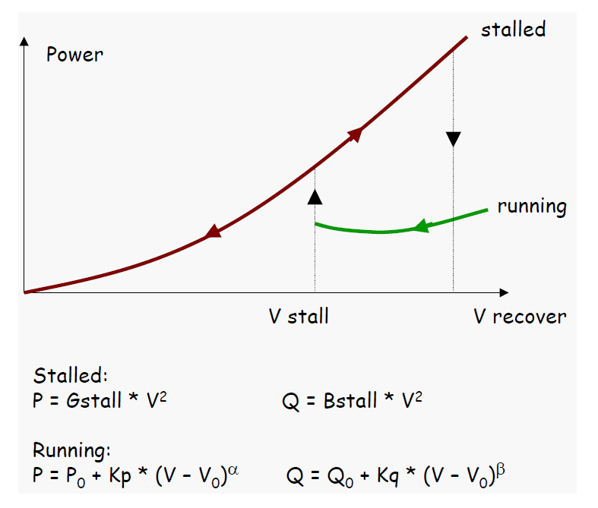
Single Phase Induction Motor Loads
Below image summarizes key performance
There are no explicit differential equations associated with the model
Image source: https://www.wecc.biz/committees/.../MVWG_111606_LasVegas.pdf
See also, D. Kosterev, et. al., "Load Modeling in Power System Studies: WECC Progress Update," IEEE PES 2008 General Meeting

Slide 28
Composite Load Models
Many aggregate loads are best represented by a combination of different types of load
Known as composite load models
Important to keep in mind the actual load is continually changing, so any aggregate load is at best an approximation
Hard to know load behavior to extreme disturbances without actually faulting the load
Early models included a number of loads at the transmission level buses (with the step-down transformer), with later models including a simple distribution system model

Slide 29
CLOD Model
The CLOD model represents the load as a combination of large induction motors, small induction motors, constant power, discharge lighting, and other

Slide 30
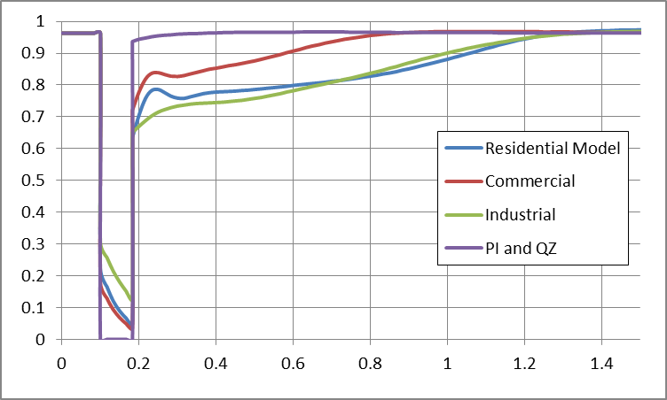
CLOD Model
Different load classes can be defined
Customer Class | Large Motor | Small Motor | Discharge Lighting | Constant Power | Remaining (PI, QZ)
Residential | 0.0 | 64.4 | 3.7 | 4.1 | 27.8
Agriculture | 10.0 | 45 | 20 | 4.5 | 19.5
Commercial | 0.0 | 46.7 | 41.5 | 4.5 | 7.3
Industrial | 65.0 | 15.0 | 10.0 | 5.0 | 4.0
Comparison of Voltage Recovery for Different Model Types

Slide 31
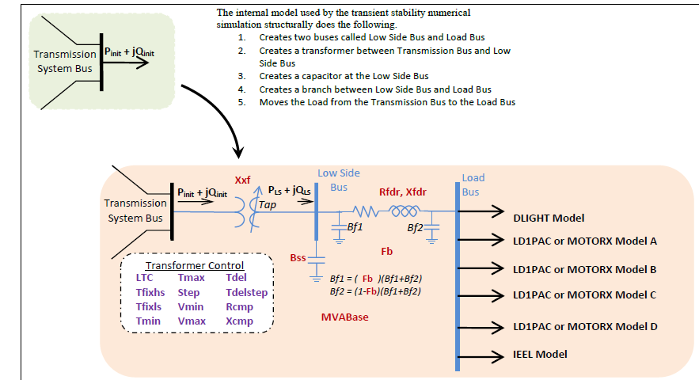
WECC Composite Load Model
Contains up to four motors or single phase induction motor models; also included potential for solar PV

Slide 32
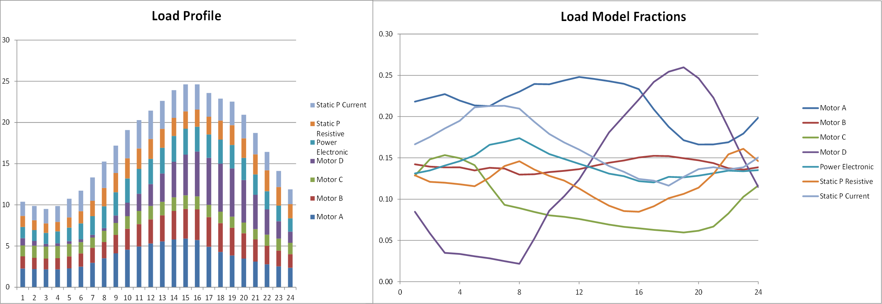
Modeling Time Variation in Load
Different time varying composite model parameters are now being used
Example varying composite load percentages

Slide 33
Current Research
Current topics for load modeling research include assessment of how much the load model maters
Another issue is how to determine the load model parameters – which ones are observable under what conditions
For example, motor stalling can not be observed except during disturbances that actually cause the motors to stall
Not important to precisely determine parameters that ultimately do not have much influence on the final problem solution; of course these parameters would be hard to observe
Correctly modeling embedded distribution level generation resources, such as PV, is important

