Slide 1
ECE 576 – Power System Dynamics and Stability
Lecture 21:Load Models, Including Induction Machines
Prof. Tom Overbye
University of Illinois at Urbana-Champaign
overbye@illinois.edu
Special Guest Lecture by
Dr. Jamie Weber, PowerWorld Corporation

Slide 2
Announcements
Read Chapter 8
Homework 6 is due now
Homework 7 is due on Thursday April 24

Slide 3
Load Modeling
Load modeling is certainly challenging!
For large system models an aggregate load can consist of many thousands of individual devices
The load is constantly changing, with key diurnal and temperature variations
  For example, a higher percentage of lighting load at night, more air conditioner load on hot days
Load model behavior can be quite complex during the low voltages that may occur in transient stability
Testing aggregate load models for extreme conditions is not feasible – we need to wait for disturbances!

Slide 4
Load Modeling
Traditionally load models have been divided into two groups
  Static: load is a algebraic function of bus voltage and sometimes frequency
  Dynamic: load is represented with a dynamic model, with induction motor models the most common
The simplest load model is a static constant impedance
  Has been widely used
  Allowed the Y_{bus} to be reduced, eliminating essentially all non-generator buses
  Presents no issues as voltage falls to zero
  Is rapidly falling out of favor

Slide 5
Load Modeling References
Many papers and reports are available!
A classic reference on load modeling is by the IEEE Task Force on Load Representation for Dynamic Performance, "Load Representation for Dynamic Performance Analysis," IEEE Trans. on Power Systems, May 1993, pp. 472-482
A more recent report that provides a good overview is
"Final Project Report Loading Modeling Transmission Research" from Lawrence Berkeley National Lab, March 2010

Slide 6
ZIP Load Model
Another common static load model is the ZIP, in which the load is represented as
Some models allow more general voltage dependence
The voltage exponent for reactive power is often > 2

Slide 7
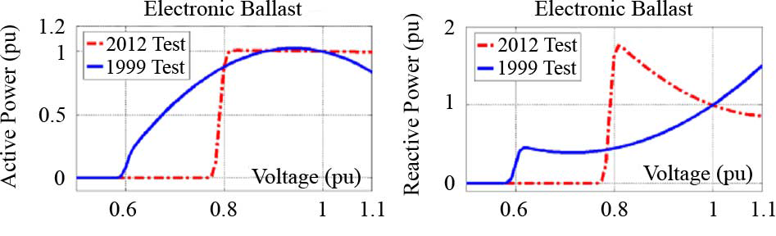
ZIP Model Coefficients
An interesting paper on the experimental determination of the ZIP parameters is A. Bokhari, et. al., "Experimental Determination of the ZIP Coefficients for Modern Residential and Commercial Loads, and Industrial Loads," IEEE Trans. Power Delivery, 2014
  Presents test results for loads as voltage is varied; also highlights that load behavior changes with newer technologies
    Below figure (part of fig 4 of paper), compares real and reactive behavior of light ballast

Slide 8
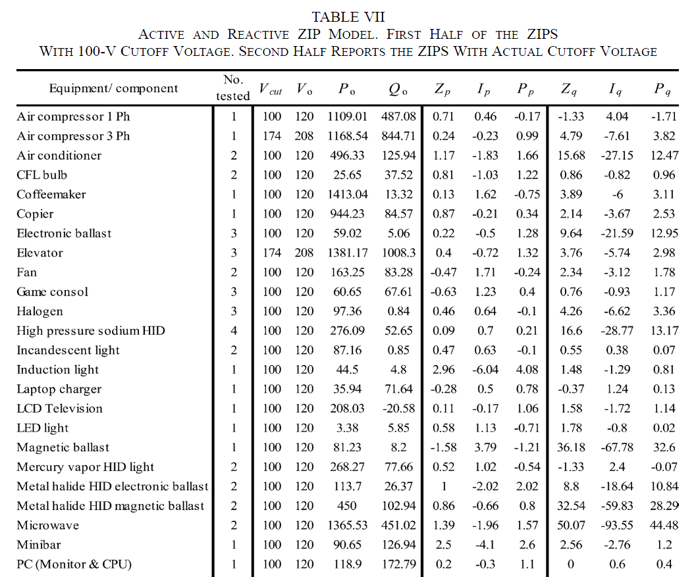
ZIP Model Coefficients
The Z,I,P
coefficients
sum to zero;
note that for
some models
the absolute
values of the
parameters
are quite large,
indicating
a difficult
fit
A portion of Table VII from Bokhari 2014 paper

Slide 9
Discharge Lighting Models
Discharge lighting (such as fluorescent lamps) is a major portion of the load (10-15%)
Discharge lighting has been modeled for sufficiently high voltage with a real power as constant current and reactive power with a high voltage dependence
  Linear reduction for voltage between 0.65 and 0.75 pu
  Extinguished (i.e., no load) for voltages below
May need to change
with newer electronic
ballasts – e.g., reactive
power increasing as
the voltage drops!

Slide 10
Static Load Model
Frequency Dependence
Frequency dependence is sometimes included, to recognize that the load could change with the frequency
Here f_{k} is the per unit bus frequency, which is calculated as
Typical values for P_{f} and Q_{f} are 1 and -1 respectively
A typical value for T is about 0.02
seconds. Some models just have
frequency dependence on the
constant power load

Slide 11
Aside: Voltage Stability
Next few slides are an aside on static voltage stability
Voltage Stability: The ability to maintain system voltage so that both power and voltage are controllable. System voltage responds as expected (i.e., an increase in load causes proportional decrease in voltage).
Voltage Instability: Inability to maintain system voltage. System voltage and/or power become uncontrollable. System voltage does not respond as expected.
Voltage Collapse: Process by which voltage instability leads to unacceptably low voltages in a significant portion of the system. Typically results in loss of system load.

Slide 12
Voltage Stability
Two good references are
  P. Kundur, et. al., “Definitions and Classification of Power System Stability,” IEEE Trans. on Power Systems, pp. 1387-1401, August 2004.
  T. Van Cutsem, “Voltage Instability: Phenomena, Countermeasures, and Analysis Methods,” Proc. IEEE, February 2000, pp. 208-227.
Classified by either size of disturbance or duration
  Small or large disturbance: small disturbance is just perturbations about an equilibrium point (power flow)
  Short-term (several seconds) or long-term (many seconds to minutes)

Slide 13
Small Disturbance Voltage Stability
Small disturbance voltage stability can be assessed using a power flow (maximum loadability)
Depending on the assumed load model, the power flow can have multiple (or now solutions)
PV curve is created by plotting power versus voltage
Assume V_{slack}=1.0
Where B is the line susceptance =-10, V∠θ is the load voltage

Slide 14
Small Disturbance Voltage Stability
Question: how do the power flow solutions vary as the load is changed?
A Solution: Calculate a series of power flow solutions for various load levels and see how they change
Power flow Jacobian

Slide 15
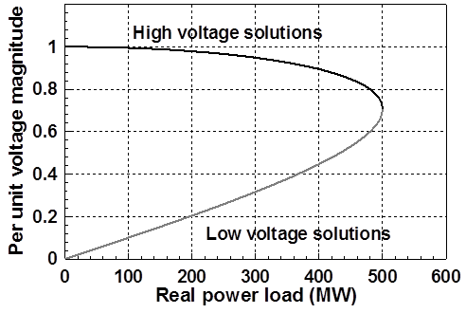
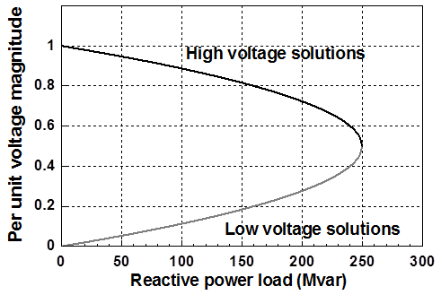
PV and QV Curves
PV curves can be traced by plotting the voltage as the real power is increased; QV curves as reactive power is increase
  At least the upper portion
Two bus example PV and QV curves

Slide 16
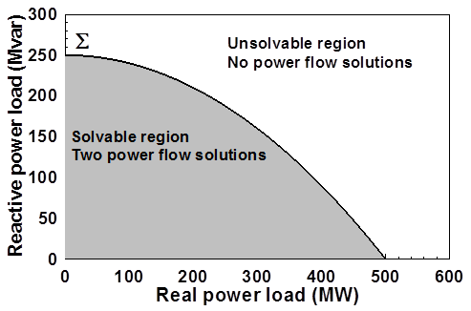
Load Parameter Space Representation
With a constant power flow there is a maximum loadability surface, Σ
  Defined as point in which the power flow Jacobian is singular
  For the lossless two bus system it can be determined as

Slide 17
Load Model Impact
With a static load model regardless of the voltage dependency the same PV curve is traced
  But whether a point of maximum loadability exists depends on the assumed load model
    If voltage exponent is > 1 then multiple solutions do not exist (see B.C. Lesieutre, P.W. Sauer and M.A. Pai “Sufficient conditions on static load models for network solvability,”NAPS 1992, pp. 262-271)

Slide 18
End Aside, Induction Motor Models
Induction motors, both three phase and single phase, make up a very large percentage of the load
Next several slides describe how induction motors are modeled in transient stability
  This model would not apply to induction motors controlled by ac drives, since the converter in the drive will make the motor's behavior independent of the source voltage (up to a point); it will look more like a constant power load
Originally invented independently by Galileo Ferraris (1885) and Nikola Tesla (1887)
  Tesla received the US patent in 1888
  Key to growth of ac, as opposed to dc, electric systems

Slide 19
Induction Machines
Term induction machine is used to indicate either generator or motor; most uses are as motors
Induction machines have two major components
  A stationary stator, which is supplied with an ac voltage; windings in stator create a rotating magnetic field
  A rotating rotor, in which an ac current is induced (hence the name)
Two basic design types based on rotor design
  Squirrel-cage: rotor consists of shorted conducting bars laid into magnetic material in a cage structure
  Wound-rotor: rotor has windings similar to stator, with slip rings used to provide external access to the rotor windings

Slide 20
Induction Machine Overview
Speed of rotating magnetic field (synchronous speed) depends on number of poles
Frequency of induced currents in rotor depends on frequency difference between the rotating magnetic field and the rotor

Slide 21
Induction Machine Slip
Key value is slip, s, defined as
As defined, when operating as a motor an induction machine will have a positive slip, slip is negative when operating as a generator
  Slip is zero at synchronous speed, a speed at which no rotor current is induced; s=1 at stand still

Slide 22
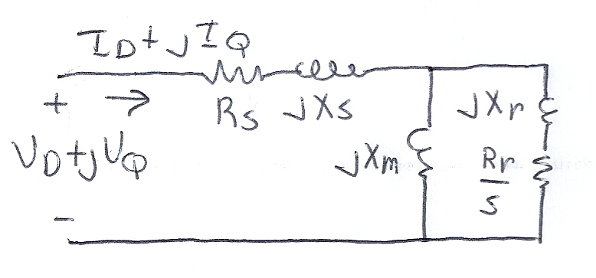
Basic Induction Machine Model
A basic (single cage) induction machine circuit model is given below
  Model is derived in a class like ECE 330
Circuit is useful for understanding the static behavior of the machine
Effective rotor resistance (R_{r}/s) models the rotor electrical losses (R_{r}) and the mechanical power R_{r}(1-s)/s

Slide 23
Induction Machine Dynamics
Expressing all values in per unit (with the base covered later), the mechanical equation for a machine is
Similar to what was done for a synchronous machine, the induction machine can be modeled as an equivalent voltage behind a stator resistance and transient reactance (later we'll introduce, but not derived, the subtransient model)

Slide 24
Induction Machine Dynamics
Define
Also define the open circuit time constant

Slide 25
Induction Machine Dynamics
Electrically the induction machine is modeled similar to the classical generator model, except here we use the "motor convention" in which I_{D}+jI_{Q} is assumed positive into the machine
All calculations
are done on
the network
reference
frame

Slide 26
Induction Machine Dynamics
The induction machine electrical torque, T_{E}, and terminal electrical load, P_{E}, are then
Similar to a synchronous machine, once the initial values are determined the differential equations are fairly easy to simulate
  Key initial value needed is the slip
Recall we are
using the motor
convention so positive
P_{E} represents load

Slide 27
Specifying Induction Machine Parameters
In transient stability packages induction machine parameters are specified in per unit
  If unit is modeled as a generator in the power flow (such as CIMTR1 or GENWRI) then use the generator's MVA base (as with synchronous machines)
  With loads it is more complicated.
    Sometimes an explicit MVA base is specified. If so, then use this value. But this can be cumbersome since often the same per unit machine values are used for many loads
    The default is to use the MW value for the load, often scaled by a multiplier (say 1.25)

Slide 28
Determining the Initial Values
Do determine the initial values, it is important to recognize that for a fixed terminal voltage there is only one independent value: the slip, s
  For a fixed slip, the model is just
  a simple circuit with resistances
  and reactances
The initial slip is chosen to match the power flow real power value. Then to match the reactive power value (for either a load or a generator), the approach is to add a shunt capacitor in parallel with the induction machine
We'll first consider torque-speed curves, then return to determining the initial slip

Slide 29
Torque-Speed Curves
To help understand the behavior of an induction machine it is useful to plot varies values as a function of speed (or equivalently, slip)
  Solve the equivalent circuit for a specified terminal voltage, and varying values of slip
  Plot results
  Recall torque times speed = power
    Here speed is the rotor speed
  When using per unit, the per unit speed is just 1-s

Slide 30
Induction Motor Example
Assume the below 60 Hz system, with the entire load modeled as a single cage induction motor with per unit values on a 125 MVA base of H=1.0, R_{s}=0.01, X_{s}=0.06, X_{m}=4.0, R_{r}=0.03, X_{r}=0.04
  In the CIM5 model R₁=R_{r} and X₁=X_{r}
PowerWorld case B2_IndMotor

Slide 31
Induction Motor Example
With a terminal voltage of 0.995∠0°
we can solve the circuit for
specified values of s
The input impedance and current are
Then with s=1 we get
Note, values are per
unit on a 125 MVA base

Slide 32
Induction Motor Example
PowerWorld allows for display of the variation in various induction machine values with respect to speed
  Right click on load, select Load Information Dialog, Stability
  On bottom of display click Show Torque Speed Dialog
  Adjust the terminal voltage and pu scalar as desired; set v=0.995 and the pu scalar to 1.0 to show values on the 125 MVA base used in the previous solution
  Right click on column and select Set/Toggle/Columns, Plot Column to plot the column

Slide 33
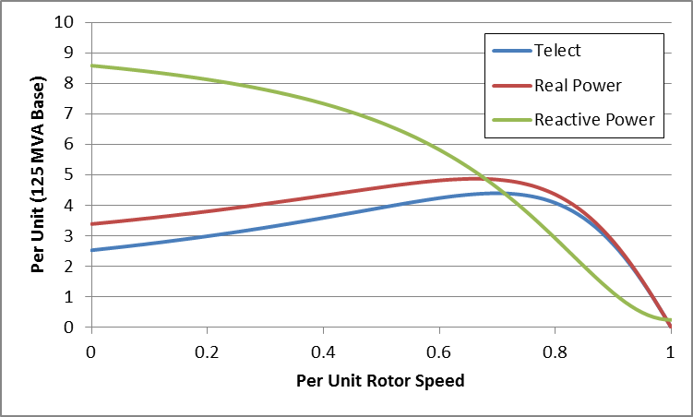
Induction Motor Example
Torque-Speed Curves
Below graph shows the torque-speed curve for this induction machine; note the high reactive power consumption on starting (which is why the lights may dim when starting the dryer!)
From the graph
you can see with
a 100 MW load
(0.8 pu on the
125 MW base),
the slip is about
0.025

Slide 34
Calculating the Initial Slip
One way to calculate the initial slip is to just solve the below five equations for five unknowns (s, I_{D}, I_{Q}, E'_{D},E'_{Q}) with P_{E}, V_{D} and V_{Q} inputs
These are
nonlinear equations
that can have
multiple solutions
so use Newton's
method, with an
initial guess of
s small (say 0.01)
Initial slip in example is 0.0253

Slide 35
Double Cage Induction Machines
In the design of induction machines, there are various tradeoffs, such as between starting torque (obviously one needs enough to start) and operating efficiency
  The highest efficiency possible is 1-slip, so operating at low slip is desirable
A common way to achieve high starting torque with good operating efficiency is to use a double cage design
  E.g., the rotor has two embedded squirrel cages, one with a high R and lower X for starting, and one with lower R and higher X for running
  Modeled by extending our model by having two rotor circuits in parallel; add subtransient values X" and T"_{o}

Slide 36
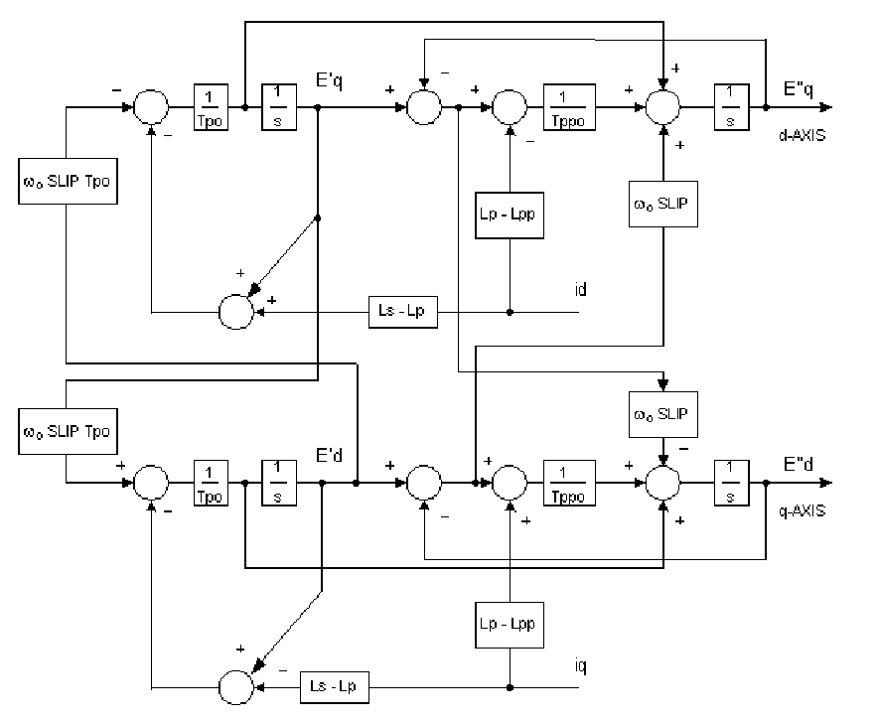
Example Double Cage Model
Double cage rotors are modeled by adding two additional differential equations
Some models
also include
saturation, a
topic that we
will skip
Image source: PSLF Manual, version 18.1_02; MotorW

Slide 37
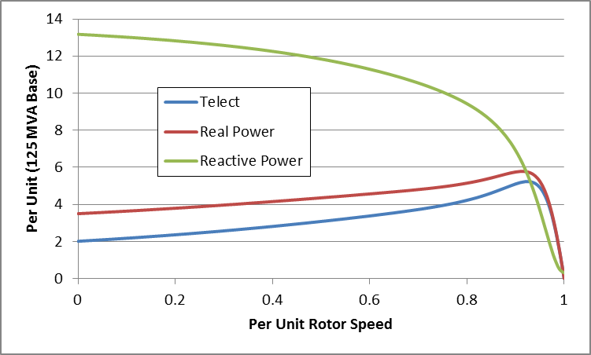
Double Cage Induction
Motor Model
The previous example can be extended to model a double cage rotor by setting R₂=0.01, X₂=0.08
  The below graph shows the modified curves, notice the increase in the slope by s=0, meaning it is operating with higher efficiency (s=0.0063 now!)
The additional
winding does
result in lower initial impedance and hence a higher starting reactive power

