Slide 1
ECE 576 – Power System Dynamics and Stability
Lecture 20: Multimachine Simulation
Prof. Tom Overbye
Dept. of Electrical and Computer Engineering
University of Illinois at Urbana-Champaign
overbye@illinois.edu

Slide 2
Announcements
Read Chapter 7
Homework 6 is due on Tuesday April 15

Slide 3
Simultaneous Implicit
The other major solution approach is the simultaneous implicit in which the algebraic and differential equations are solved simultaneously
This method has the advantage of being numerically stable

Slide 4
Simultaneous Implicit
Recalling the first lecture, we covered two common implicit integration approaches for solving
  Backward Euler
  Trapezoidal
We'll just consider trapezoidal, but for nonlinear cases

Slide 5
Nonlinear Trapezoidal
We can use Newton's method to solve with
the trapezoidal
We are solving for x(t+Δt); x(t) is known
The Jacobian matrix is
Right now we
are just
considering
the differential
equations;
we'll introduce
the algebraic
equations
shortly

Slide 6
Nonlinear Trapezoidal using
Newton's Method
The full solution would be at each time step
  Set the initial guess for x(t+Δt) as x(t), and initialize the iteration counter k = 0
  Determine the mismatch at each iteration k as
  Determine the Jacobian matrix
  Solve
  Iterate until done

Slide 7
Infinite Bus GENCLS Implicit Solution
Assume a solid three phase fault is applied at the generator terminal, reducing P_{E1} to zero during the fault, and then the fault is self-cleared at time T^{clear}, resulting in the post-fault system being identical to the pre-fault system
  During the fault-on time the equations reduce to
That is, with a solid fault on the terminal of the generator, during
the fault P_{E1} = 0

Slide 8
Infinite Bus GENCLS Implicit Solution
The initial conditions are
Let Δt = 0.02 seconds
During the fault the Jacobian is
Set the initial guess for x(0.02) as x(0), and

Slide 9
Infinite Bus GENCLS Implicit Solution
Then calculate the initial mismatch
With x(0.02)⁽⁰⁾ = x(0) this becomes
Then

Slide 10
Infinite Bus GENCLS Implicit Solution
Repeating for the next iteration
Hence we have converged with

Slide 11
Infinite Bus GENCLS Implicit Solution
Iteration continues until t = T^{clear}, assumed to be 0.1 seconds in this example
At this point, when the fault is self-cleared, the equations change, requiring a re-evaluation of f(x(T^{clear}))

Slide 12
Infinite Bus GENCLS Implicit Solution
With the change in f(x) the Jacobian also changes
Iteration for x(0.12) is as before, except using the new function and new Jacobian
This also converges quickly, with one or two iterations

Slide 13
Computational Considerations
As presented for a large system most of the computation is associated with updating and factoring the Jacobian. But the Jacobian actually changes little and hence seldom needs to be rebuilt/factored
Rather than using x(t) as the initial guess for x(t+Δt), prediction can be used when previous values are available

Slide 14
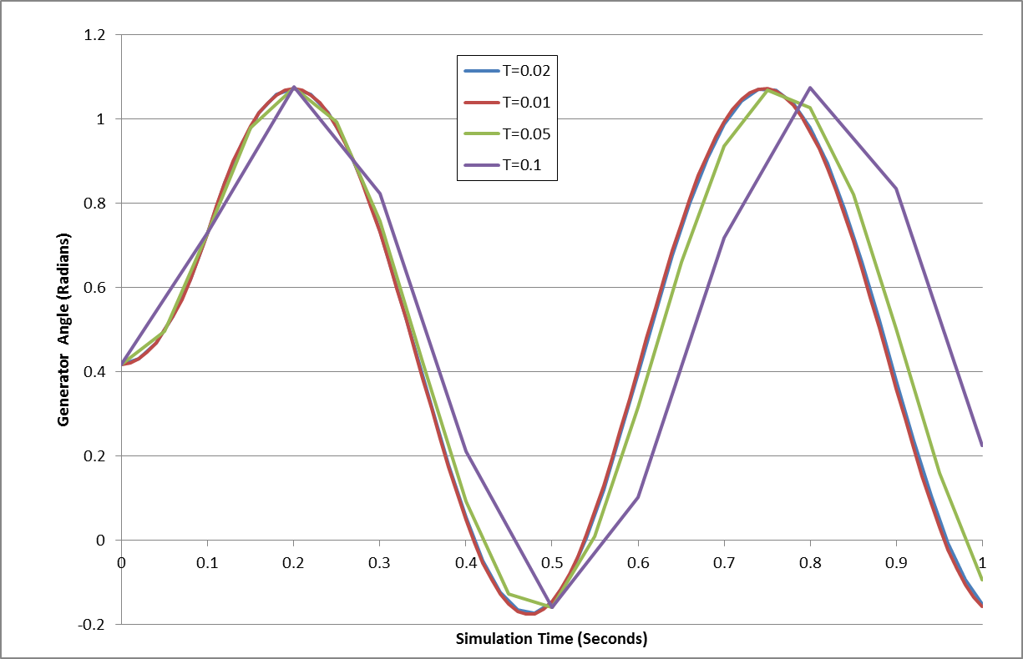
Two Bus Results
The below graph shows the generator angle for varying values of Δt; recall the implicit method is numerically
stable

Slide 15
Adding the Algebraic Constraints
Since the classical model can be formulated with all the values on the network reference frame, initially we just need to add the network equations
We'll again formulate the network equations using the form
As before the complex equations will be expressed using two real equations, with voltages and currents expressed in rectangular coordinates

Slide 16
Adding the Algebraic Constraints
The network equations are as before

Slide 17
Classical Model Coupling of x and y
In the simultaneous implicit method x and y are determined simultaneously; hence in the Jacobian we need to determine the dependence of the network equations on x, and the state equations on y
With the classical model the Norton current depends on x as

Slide 18
Classical Model Coupling of x and y
The in the state equations the coupling with y is recognized by noting

Slide 19
Variables and Mismatch Equations
In solving the Newton algorithm the variables now include x and y (recalling that here y is just the vector of the real and imaginary bus voltages
The mismatch equations now include the state integration equations
And the algebraic equations

Slide 20
Jacobian Matrix
Since the h(x,y) and g(x,y) are coupled, the Jacobian is
  With the classical model the coupling is the Norton current at bus i depends on δ_{i} (i.e., x) and the electrical power (P_{Ei}) in the swing equation depends on V_{Di} and V_{Qi} (i.e., y)

Slide 21
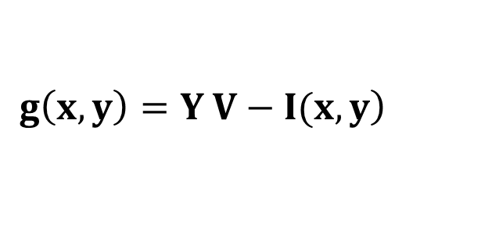
Jacobian Matrix Entries
The dependence of the Norton current injections on δ is
  In the Jacobian the sign is flipped because we defined
$$\left.g\left(x,y\right)=Y V−Ι(x,y\right)$$

Slide 22
Jacobian Matrix Entries
The dependence of the swing equation on the generator terminal voltage is

Slide 23
Two Bus, Two Gen GENCLS Example
We'll reconsider the two bus, two generator case from Lecture 18; fault at Bus 1, cleared after 0.06 seconds
  Initial conditions and Y_{bus} are as covered in Lecture 18
PowerWorld Case B2_CLS_2Gen

Slide 24
Two Bus, Two Gen GENCLS Example
Initial terminal voltages are

Slide 25
Two Bus, Two Gen Initial Jacobian

Slide 26
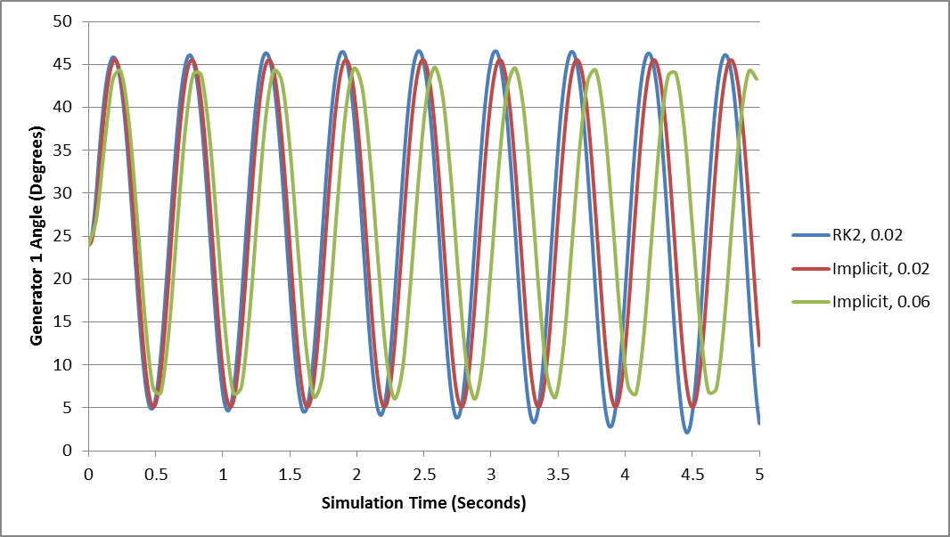
Results Comparison
The below graph compares the angle for the generator at bus 1 using Δt=0.02 between RK2 and the Implicit Trapezoidal; also Implicit with Δt=0.06

Slide 27
Four Bus Comparison

Slide 28
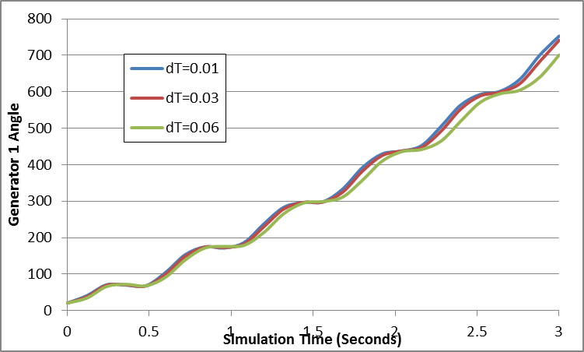
Four Bus Comparison
Fault at Bus 3 for 0.12 seconds; self-cleared

