Slide 1
ECE 576 – Power System Dynamics and Stability
Lecture 19: Multimachine Simulation
Prof. Tom Overbye
Dept. of Electrical and Computer Engineering
University of Illinois at Urbana-Champaign
overbye@illinois.edu

Slide 2
Announcements
Read Chapter 7
Homework 6 is due on Tuesday April 15
A useful reference is B. Stott, "Power System Dynamic Response Calculations," Proc. IEEE, vol. 67, pp. 219-241
Another key reference is J.M. Undrill, "Structure in the Computation of Power-System Nonlinear Dynamic Response," IEEE Trans. Power App. and Syst., vol. 88, pp. 1-6, January 1969.

Slide 3
Angle Reference
The initial angles are given by the angles from the power flow, which are based on the slack bus's angle
As presented the transient stability angles are with respect to a synchronous reference frame
Sometimes this is fine, such as for either shorter studies, or ones in which there is little speed variation
Oftentimes this is not best since the when the frequencies are not nominal, the angles shift from the reference frame
Other reference frames can be used, such as with respect to a particular generator's value, which mimics the power flow approach; the selected reference has no impact on the solution

Slide 4
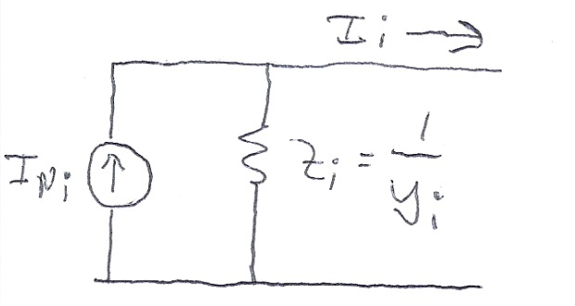
Subtransient Models
The Norton current injection approach is what is commonly used with subtransient models in industry
If subtransient saliency is neglected (as is the case with GENROU and GENSAL in which X"_{d}=X"_{q}) then the current injection is
Subtransient saliency can be handled with this approach, but it is more involved (see Arrillaga, Computer Analysis of Power Systems, section 6.6.3)

Slide 5
Subtransient Models
Note, the values here are on the dq reference frame
We can now extend the approach introduced for the classical machine model to subtransient models
Initialization is as before, which gives the δ's and other state values
Each time step is as before, except we use the δ's for each generator to transfer values between the network reference frame and each machine's dq reference frame
The currents provide the coupling

Slide 6
Two Bus Example with Two GENROU Machine Models
Use the same system as before, except with we'll model both generators using GENROUs
For simplicity we'll make both generators identical except set H₁=3, H₂=6; other values are X_{d}=2.1, X_{q}=0.5, X'_{d}=0.2, X'_{q}=0.5, X"_{q}=X"_{d}=0.18, X_{l}=0.15, T'_{do} = 7.0, T'_{qo}=0.75, T"_{do}=0.035, T"_{qo}=0.05; no saturation
With no saturation the value of the δ's are determined (as per Lecture 11) by solving
Hence for generator 1

Slide 7
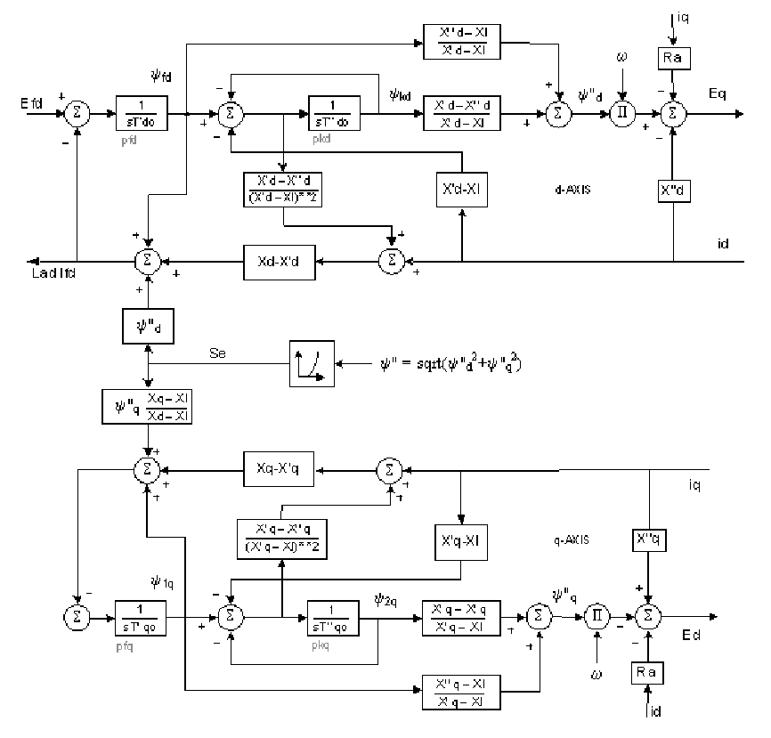
GENROU Block Diagram
E'_{q}
E'_{d}

Slide 8
Two Bus Example with Two GENROU Machine Models
Using the approach from Lecture 11 the initial state vector is
Note that this is a salient pole machine with X'_{q}=X_{q}; hence E'_{d} will always be zero
The initial currents in the dq reference frame are I_{d1}=0.7872, I_{q1}=0.6988, I_{d2}=0.2314, I_{q2}=-1.0269
Initial values of ψ"_{q1}= -0.2236, and ψ"_{d1} = 1.179

Slide 9
Solving with Euler's
We'll again solve with Euler's, except with Δt set now to 0.01 seconds (because now we have a subtransient model with faster dynamics)
We'll also clear the fault at t=0.05 seconds
For the more accurate subtransient models the swing equation is written in terms of the torques
Other equations are solved based upon the block diagram

Slide 10
Norton Equivalent Current Injections
The initial Norton equivalent current injections on the dq base for each machine are
Recall the dq values are on the machine's reference frame and the DQ values are on the system reference
frame

Slide 11
Moving between DQ and dq
Recall
And
The currents provide the key coupling between the two reference
frames

Slide 12
Bus Admittance Matrix
The bus admittance matrix is as from before for the classical models, except the diagonal elements are augmented using

Slide 13
Algebraic Solution Verification
To check the values solve (in the network reference frame)

Slide 14
Results
The below graph shows the results for four seconds of simulation, using Euler's with Δt=0.01 seconds
PowerWorld case is
B2_GENROU_2GEN_EULER

Slide 15
Results for Longer Time
Simulating out 10 seconds indicates an unstable solution, both using Euler's and RK2 with Δt=0.005, so it is really unstable!
Euler's with Δt=0.01
RK2 with Δt=0.005

Slide 16
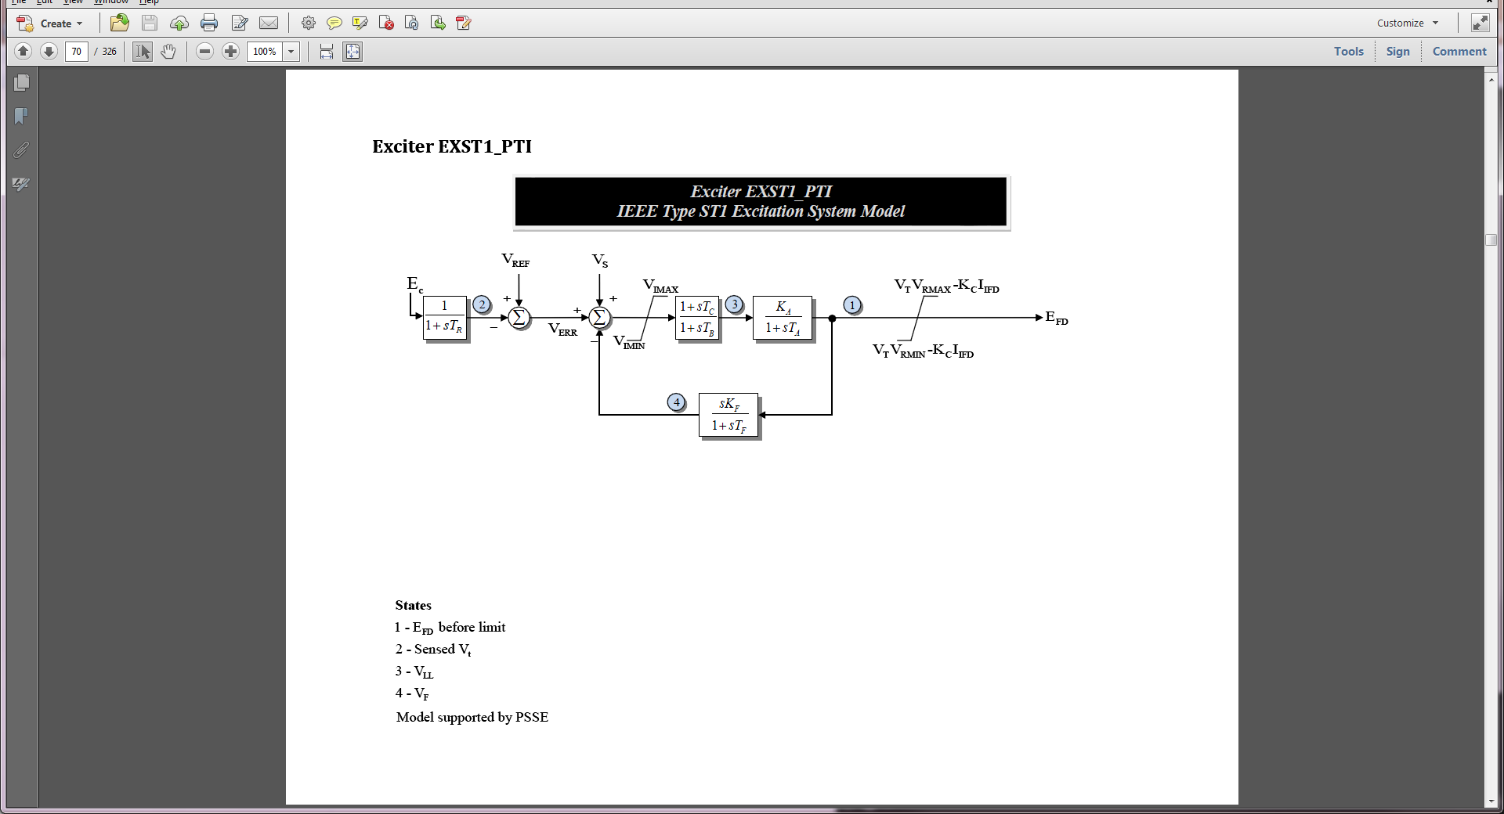
Adding More Models
In this situation the case is unstable because we have not modeled exciters
To each generator add an EXST1 with T_{R}=0, T_{C}=T_{B}=0, K_{f}=0, K_{A}=100, T_{A}=0.1
This just adds one differential equation per generator

Slide 17
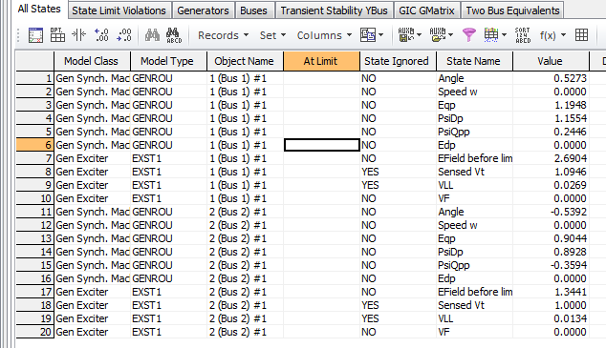
Two Bus, Two Gen With Exciters
Below are the initial values for this case from PowerWorld
Because of the zero values the other differential equations for the exciters are included but treated as ignored
Case is B2_GENROU_2GEN_EXCITER

Slide 18
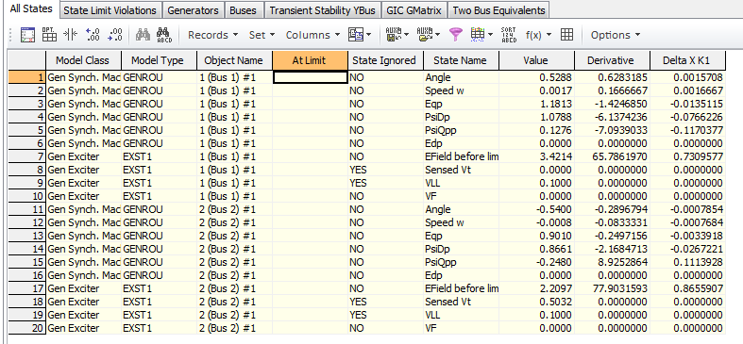
Viewing the States
PowerWorld allows one to single-step through a solution, showing the f(x) and the K₁ values
This is mostly used for education or model debugging
Derivatives shown are evaluated at the end of the time step

Slide 19
Two Bus Results with Exciters
Below graph shows the angles with Δt=0.01 and a fault clearing at t=0.05 using Euler's
With the addition of the exciters case is now stable

Slide 20
Constant Impedance Loads
The simplest approach for modeling the loads is to treat them as constant impedances, embedding them in the bus admittance matrix
Only impact the Ybus diagonals
The admittances are set based upon their power flow values, scaled by the inverse of the square of the power flow bus voltage
In PowerWorld the default load model is specified on Transient Stability, Options, Power System Model

Slide 21
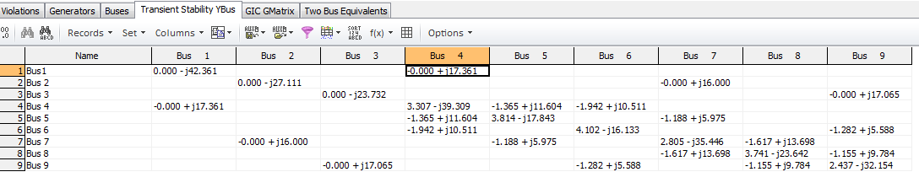
Example 7.4 Case (WSCC 9 Bus)
PowerWorld Case Example_7_4 duplicates the example 7.4 case from the book, with the exception of using different generator models

Slide 22
Nonlinear Network Equations
With constant impedance loads the network equations can usually be written with I independent of V, then they can be solved directly (as we've been doing)
In general this is not the case, with constant power loads one common example
Hence a nonlinear solution with Newton's method is used
We'll generalize the dependence on the algebraic variables, replacing V by y since they may include other values beyond just the bus voltages

Slide 23
Nonlinear Network Equations
Just like in the power flow, the complex equations are rewritten, here as a real current and a reactive current YV – I(x,y) = 0
The values for bus i are
For each bus we add two new variables and two new equations
If an infinite bus is modeled then its variables and equations are omitted since its voltage is fixed
This is a rectangular formulation; we also could have written the equations in polar form

Slide 24
Nonlinear Network Equations
The network variables and equations are then

Slide 25
Nonlinear Network Equation Newton Solution

Slide 26
Network Equation Jacobian Matrix
The most computationally intensive part of the algorithm is determining and factoring the Jacobian matrix, J(y)

Slide 27
Network Jacobian Matrix
The Jacobian matrix can be stored and computed using a 2 by 2 block matrix structure
The portion of the 2 by 2 entries just from the Y_{bus} are
The major source of the current vector voltage sensitivity comes from non-constant impedance loads; also dc transmission lines
The "hat" was added to the g functions to
indicate it is just the portion from the Y_{bus}

Slide 28
Example: Constant Current and Constant Power Load
As an example, assume the load at bus k is represented with a ZIP model
The constant impedance portion is embedded in the Y_{bus}
Usually solved in per unit on network MVA base
The base load values are set from the power flow

Slide 29
Example: Constant Current and Constant Power Load
The current is then
Multiply the numerator and denominator by V_{DK}+jV_{QK} to write as the real current and the reactive current

Slide 30
Example: Constant Current and Constant Power Load
The Jacobian entries are then found by differentiating with respect to V_{DK} and V_{QK}
Only affect the 2 by 2 block diagonal values
Usually constant current and constant power models are replaced by a constant impedance model if the voltage goes too low, like during a fault

Slide 31
Example: 7.4.ZIP Case
Example 7.4 is modified so the loads are represented by a model with 30% constant power, 30% constant current and 40% constant impedance
In PowerWorld load models can be entered in a number of different ways; a tedious but simple approach is to specify a model for each individual load
Right click on the load symbol to display the Load Options dialog, select Stability, and select WSCC to enter a ZIP model, in which p1&q1 are the normalized about of constant impedance load, p2&q2 the amount of constant current load, and p3&q3 the amount of constant power load
Case is Example_7_4_ZIP

Slide 32
Example 7.4.ZIP One-line

Slide 33
Example 7.4.ZIP Bus 8 Load Values
As an example the values for bus 8 are given (per unit, 100 MVA base)

Slide 34
Example: 7.4.ZIP Case
For this case the 2 by 2 block between buses 8 and 7 is
And between 8 and 9 is
The 2 by 2 block for the bus 8 diagonal is
These entries are easily checked with the Y_{bus}
The check here is left for the student

Slide 35
Additional Comments
When coding Jacobian values, a good way to check that the entries are correct is to make sure that for a small perturbation about the solution the Newton's method has quadratic convergence
When running the simulation the Jacobian is actually seldom rebuilt and refactored
If the Jacobian is not too bad it will still converge
To converge Newton's method needs a good initial guess, which is usually the last time step solution
Convergence can be an issue following large system disturbances, such as a fault

