Slide 1
ECE 576 – Power System Dynamics and Stability
Lecture 18: Multimachine Simulation: Explicit Methods
Prof. Tom Overbye
Dept. of Electrical and Computer Engineering
University of Illinois at Urbana-Champaign
overbye@illinois.edu

Slide 2
Announcements
Read Chapter 7
Homework 5 is due today
Homework 6 is due on April 10
A useful reference is B. Stott, "Power System Dynamic Response Calculations," Proc. IEEE, vol. 67, pp. 219-241
Another key reference is J.M. Undrill, "Structure in the Computation of Power-System Nonlinear Dynamic Response," IEEE Trans. Power App. and Syst., vol. 88, pp. 1-6, January 1969.

Slide 3
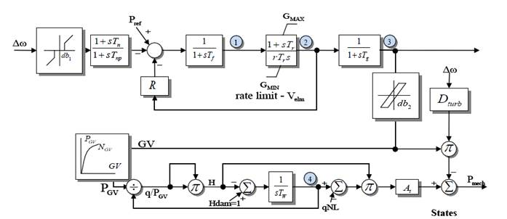
Question about HYGOV

Slide 4
Power Grid Physical Vulnerabilities
About one year ago (4/16/13) there was a sniper attack on the PGE Metcalf substation
Considered a sophisticated attack partially because they disabled communication first; shooting lasted for 19 minutes, with 17 transformers knocked out (some 500/230 kV ones) but they were not permanently damaged
On 3/12/14 the Wall Street Journal (WSJ) reported that a power flow study by FERC reported that all three grids could be collapsed by knocking out 4 substations in the EI, 3 in WECC and 2 in ERCOT
The WSJ was criticized by FERC, NERC and EEI for mentioning this vulnerability (though they did not mention the substations)

Slide 5
Euler's Solution
At t = T^{clear} the fault is self-cleared, with the equations changing to
The integration continues using the new equations

Slide 6
Euler's Solution Results (Δt=0.02)
The below table gives the results using Δt = 0.02 for the beginning time steps
Time | Gen 1 Rotor Angle, Degrees | Gen 1 Speed (Hz)
0 | 23.9462 | 60
0.02 | 23.9462 | 60.2
0.04 | 25.3862 | 60.4
0.06 | 28.2662 | 60.6
0.08 | 32.5862 | 60.8
0.1 | 38.3462 | 61
0.1 | 38.3462 | 61
0.12 | 45.5462 | 60.8943
0.14 | 51.9851 | 60.7425
0.16 | 57.3314 | 60.5543
0.18 | 61.3226 | 60.3395
0.2 | 63.7672 | 60.1072
0.22 | 64.5391 | 59.8652
0.24 | 63.5686 | 59.6203
0.26 | 60.8348 | 59.3791
0.28 | 56.3641 | 59.1488
This is saved as
PowerWorld case B2_CLS_Infinite. The integration method is set to Euler's on the Transient Stability, Options, Power System Model page

Slide 7
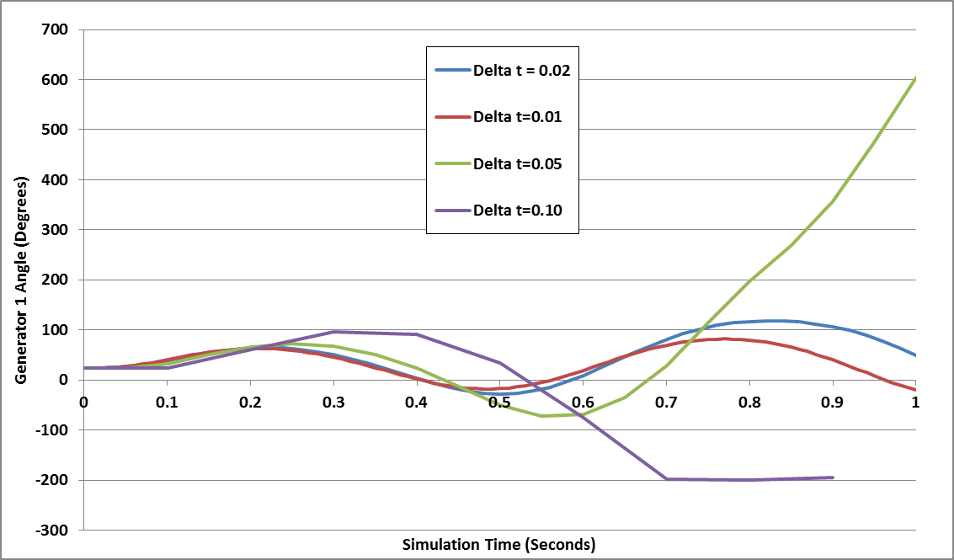
Generator 1 Delta: Euler's
The below graph shows the generator angle for varying values of Δt; numerical instability is clearly seen

Slide 8
Second Order Runge-Kutta
Runge-Kutta methods improve on Euler's method by evaluating f(x) at selected points over the time step
One approach is a second order method (RK2) in which
That is, k₁ is what we get from Euler's; k₂ improves on this by reevaluating at the estimated end of the time step
Error varies with the cubic of the time step
This is also known as Heun's method or as the Improved Euler's or Modified Euler's Method

Slide 9
Second Order Runge-Kutta (RK2)
Again Assuming a time step Δt = 0.02 seconds, and a T^{clear} of 0.1 seconds, then using Heun's approach

Slide 10
RK2 Solution Results (Δt=0.02)
The below table gives the results using Δt = 0.02 for the beginning time steps
Time | Gen 1 Rotor Angle, Degrees | Gen 1 Speed (Hz)
0 | 23.9462 | 60
0.02 | 24.6662 | 60.2
0.04 | 26.8262 | 60.4
0.06 | 30.4262 | 60.6
0.08 | 35.4662 | 60.8
0.1 | 41.9462 | 61
0.1 | 41.9462 | 61
0.12 | 48.6805 | 60.849
0.14 | 54.1807 | 60.6626
0.16 | 58.233 | 60.4517
0.18 | 60.6974 | 60.2258
0.2 | 61.4961 | 59.9927
0.22 | 60.605 | 59.7598
0.24 | 58.0502 | 59.5343
0.26 | 53.9116 | 59.3241
0.28 | 48.3318 | 59.139
This is saved as
PowerWorld case B2_CLS_Infinite. The integration method should be changed to Second Order Runge-Kutta on the Transient Stability, Options, Power System Model page

Slide 11
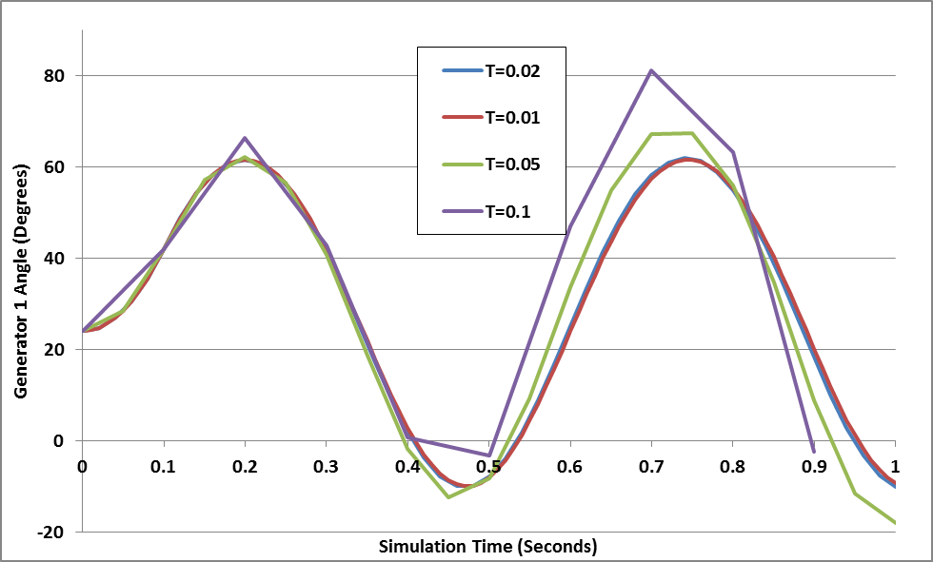
Generator 1 Delta: RK2
The below graph shows the generator angle for varying values of Δt; much better than Euler's but still the beginning of numerical instability with larger values of Δt

Slide 12
Adding Network Equations
Previous slides with the network equations embedded in the differential equations were a special case
In general with the explicit approach we'll be alternating between solving the differential equations and solving the algebraic equations
Voltages and currents in the network reference frame can be expressed using either polar or rectangular coordinates
In rectangular with the book's notation we have

Slide 13
Adding Network Equations
Network equations will be written as Y V- I(x,V) = 0
Here Y is as from the power flow, except augmented to include the impact of the generator's internal impedance
Constant impedance loads are also embedded in Y; non-constant impedance loads are included in I(x,V)
If I is independent of V then this can be solved directly: V = Y⁻¹I(x)
In general an iterative solution is required, which we'll cover shortly, but initially we'll go with just the direct solution

Slide 14
Two Bus Example, Except with No Infinite Bus
To introduce the inclusion of the network equations, the previous example is extended by replacing the infinite bus at bus 2 with a classical model with X_{d2}'=0.2, H₂=6.0
PowerWorld Case B2_CLS_2Gen

Slide 15
Bus Admittance Matrix
The network admittance matrix is
This is augmented to represent the Norton admittances associated with the generator models (X_{d1}'=0.3, X_{d2}'=0.2)
In PowerWorld you can see this matrix by selecting Transient Stability, States/Manual Control, Transient Stability Ybus

Slide 16
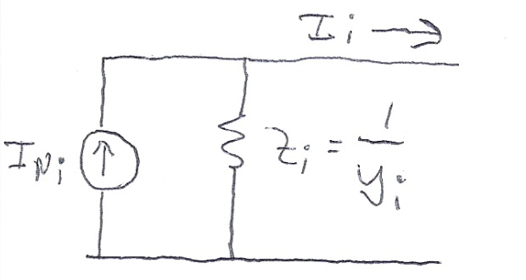
Current Vector
For the classical model the Norton currents are given by
The initial values of the currents come from the power flow solution
As the states change (δ_{i} for the classical model), the Norton current injections also change

Slide 17
B2_CLS_Gen Initial Values
The internal voltage for generator 1 is as before
We likewise solve for the generator 2 internal voltage
The Norton Current Injections are then
Keep in mind the Norton current injections are not the current out of the generator

Slide 18
B2_CLS_Gen Initial Values
To check the values, solve for the voltages, with the values matching the power flow values

Slide 19
Swing Equations
With the network constraints modeled, the swing equations are modified to represent the electrical power in terms of the generator's state and current values
Then swing equation is then
I_{Di}+jl_{Qi} is the current being injected into the network by the generator

Slide 20
Two Bus, Two Generator Differential Equations
The differential equations for the two generators are
In this example P_{M1} = 1 and P_{M2} = -1

Slide 21
Solution at t=0.02
Usually a time step begins by solving the differential equations. However, in the case of an event, such as the solid fault at the terminal of bus 1, the network equations need to be first solved
Solid faults can be simulated by adding a large shunt at the fault location
Amount is somewhat arbitrary, it just needs to be large enough to drive the faulted bus voltage to zero
With Euler's the solution after the first time step is found by first solving the differential equations, then resolving the network equations

Slide 22
Solution at t=0.02
Using Y_{fault} = 1000, the fault-on conditions become

Slide 23
Solution at t=0.02
Then the differential equations are evaluated, using the new voltages and currents
These impact the calculation of P_{Ei} with P_{E1}=0, P_{E2}=0
If solving with Euler's this is the final state value; using these state values the network equations are resolved, with the solution the same here since the δ's didn't vary

Slide 24
Solution Values Using Euler's
The below table gives the results using Δt = 0.02 for the beginning time steps
Time (Sec) | Gen 1 Rotor Angle | Gen 1 Speed (Hz) | Gen 2 Rotor Angle | Gen2 Speed (Hz)
0 | 23.9462 | 60 | -12.0829 | 60
0.02 | 23.9462 | 60.2 | -12.0829 | 59.9
0.04 | 25.3862 | 60.4 | -12.8029 | 59.8
0.06 | 28.2662 | 60.6 | -14.2429 | 59.7
0.08 | 32.5862 | 60.8 | -16.4029 | 59.6
0.1 | 38.3462 | 61 | -19.2829 | 59.5
0.1 | 38.3462 | 61 | -19.2829 | 59.5
0.12 | 45.5462 | 60.9128 | -22.8829 | 59.5436
0.14 | 52.1185 | 60.7966 | -26.169 | 59.6017
0.16 | 57.8541 | 60.6637 | -29.0368 | 59.6682
0.18 | 62.6325 | 60.5241 | -31.426 | 59.7379
0.2 | 66.4064 | 60.385 | -33.3129 | 59.8075
0.22 | 69.1782 | 60.2498 | -34.6988 | 59.8751
0.24 | 70.9771 | 60.1197 | -35.5982 | 59.9401
0.26 | 71.8392 | 59.9938 | -36.0292 | 60.0031
0.28 | 71.7949 | 59.8702 | -36.0071 | 60.0649

Slide 25
Solution at t=0.02 with RK2
With RK2 the first part of the time step is the same as Euler's, that is solving the network equations with
Then calculate k2 and get a final value for x(t+Δt)
Finally solve the network equations using the final value for x(t+Δt)

Slide 26
Solution at t=0.02 with RK2
From the first half of the time step
Then

Slide 27
Solution at t=0.02 with RK2
The final value for x(0.02) is
Since the δ's have changed, the internal voltages are updated, resulting in new Norton currents, and hence new voltages
δ₁(0.02) = 24.7 °, δ₂(0.02) =-12.4°

Slide 28
Solution at t=0.02 with RK2
The new values for the Norton currents are

Slide 29
Solution Values Using RK2
The below table gives the results using Δt = 0.02 for the beginning time steps
Time (Sec) | Gen 1 Rotor Angle | Gen 1 Speed (Hz) | Gen 2 Rotor Angle | Gen2 Speed (Hz)
0 | 23.9462 | 60 | -12.0829 | 60
0.02 | 24.6662 | 60.2 | -12.4429 | 59.9
0.04 | 26.8262 | 60.4 | -13.5229 | 59.8
0.06 | 30.4262 | 60.6 | -15.3175 | 59.7008
0.08 | 35.4662 | 60.8 | -17.8321 | 59.6008
0.1 | 41.9462 | 61 | -21.0667 | 59.5008
0.1 | 41.9462 | 61 | -21.0667 | 59.5008
0.12 | 48.7754 | 60.8852 | -24.4759 | 59.5581
0.14 | 54.697 | 60.7538 | -27.4312 | 59.6239
0.16 | 59.6315 | 60.6153 | -29.8931 | 59.6931
0.18 | 63.558 | 60.4763 | -31.8509 | 59.7626
0.2 | 66.4888 | 60.3399 | -33.3109 | 59.8308
0.22 | 68.4501 | 60.2071 | -34.286 | 59.8972
0.24 | 69.4669 | 60.077 | -34.789 | 59.9623
0.26 | 69.5548 | 59.9481 | -34.8275 | 60.0267
0.28 | 68.7151 | 59.8183 | -34.4022 | 60.0916

Slide 30
Angle Reference
The initial angles are given by the angles from the power flow, which are based on the slack bus's angle
As presented the transient stability angles are with respect to a synchronous reference frame
Sometimes this is fine, such as for either shorter studies, or ones in which there is little speed variation
Oftentimes this is not best since the when the frequencies are not nominal, the angles shift from the reference frame
Other reference frames can be used, such as with respect to a particular generator's value, which mimics the power flow approach; the selected reference has no impact on the solution

