Slide 1
ECE 576 – Power System Dynamics and Stability
Lecture 17: Governors and Multimachine Simulation
Prof. Tom Overbye
Dept. of Electrical and Computer Engineering
University of Illinois at Urbana-Champaign
overbye@illinois.edu

Slide 2
Announcements
Read Chapter 7
Homework 5 is due on April 3
A useful reference is B. Stott, "Power System Dynamic Response Calculations," Proc. IEEE, vol. 67, pp. 219-241
Another key reference is J.M. Undrill, "Structure in the Computation of Power-System Nonlinear Dynamic Response," IEEE Trans. Power App. and Syst., vol. 88, pp. 1-6, January 1969.

Slide 3
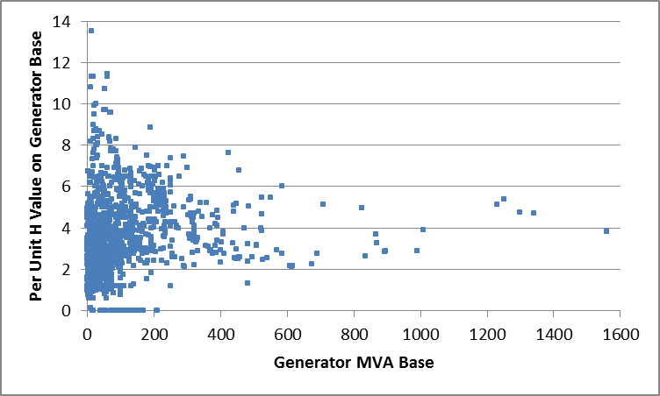
Generator MVA versus H
Figure plots per unit H (on generator base) versus generator MVA base for more than 3000 generators

Slide 4
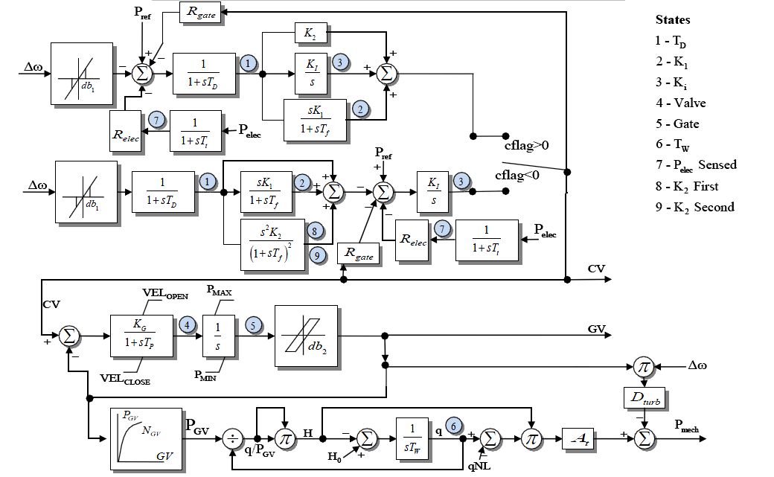
HYG3
The HYG3 models either a PID or a double derivative
Looks more complicated than it is since depending on cflag only one of the upper paths is used

Slide 5
Non-windup Limits
An important open question is whether the governor PI controllers should be modeled with non-windup limits
Currently models show no limit, but transient stability verification seems to indicate limits are being enforced
This could be an issue if frequency goes low, causing governor PI to "windup" and then goes high (such as in an islanding situation)
How fast governor backs down depends on whether the limit winds up

Slide 6
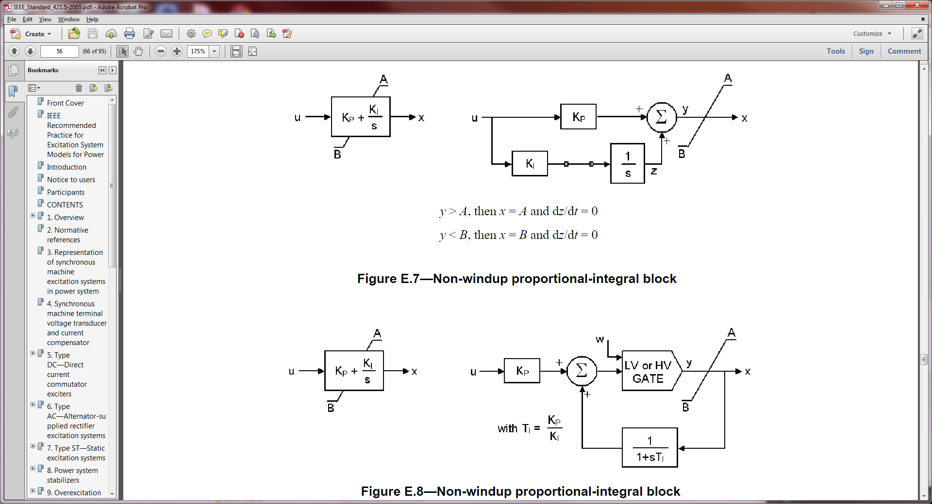
PI Non-windup Limits
There is not a unique way to handle PI non-windup limits; the below shows two approaches from IEEE Std 421.5
Another common approach is to cap the output and put a non- windup limit on the integratore

Slide 7
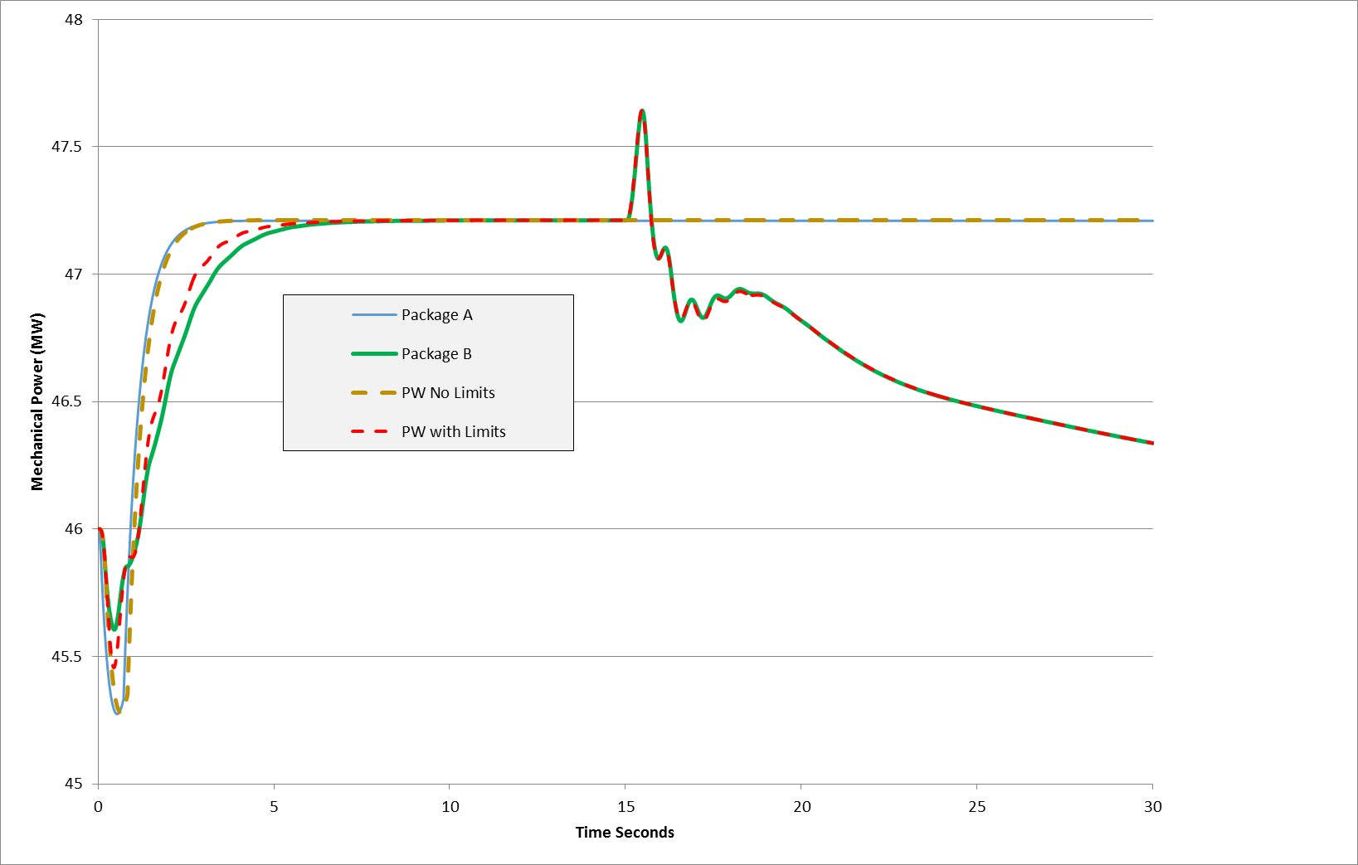
PIDGOV Model Results
Below graph compares the Pmech response for a two bus system for a frequency change, between three transient stability packages
Packages A and B both say they have no governor limits, but B seems to;
PW can do either approach

Slide 8
GGOV1
GGOV1 is a newer governor model introduced in early 2000's by WECC for modeling thermal plants
Existing models greatly under-estimated the frequency drop
GGOV1 is now the most common WECC governor, used with about 40% of the units
A useful reference is L. Pereira, J. Undrill, D. Kosterev, D. Davies, and S. Patterson, "A New Thermal Governor Modeling Approach in the WECC," IEEE Transactions on Power Systems, May 2003, pp. 819-829

Slide 9
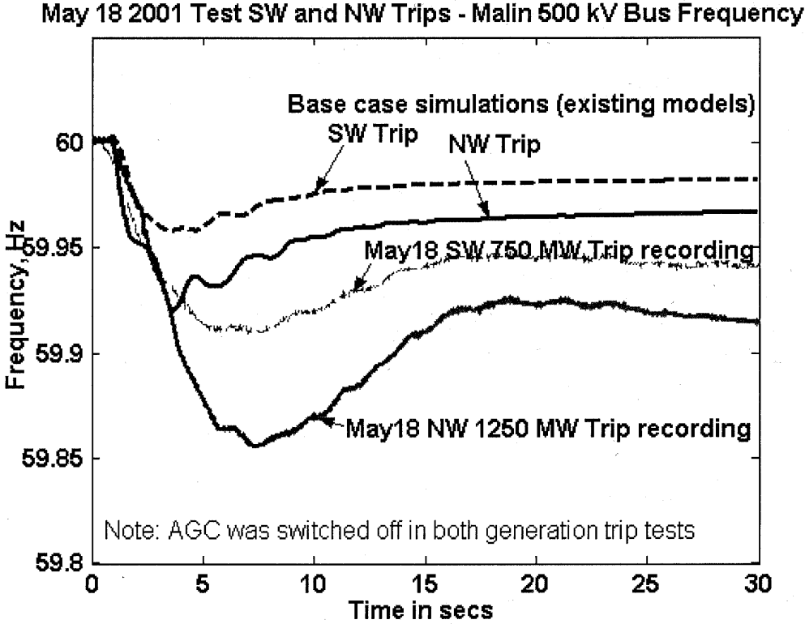
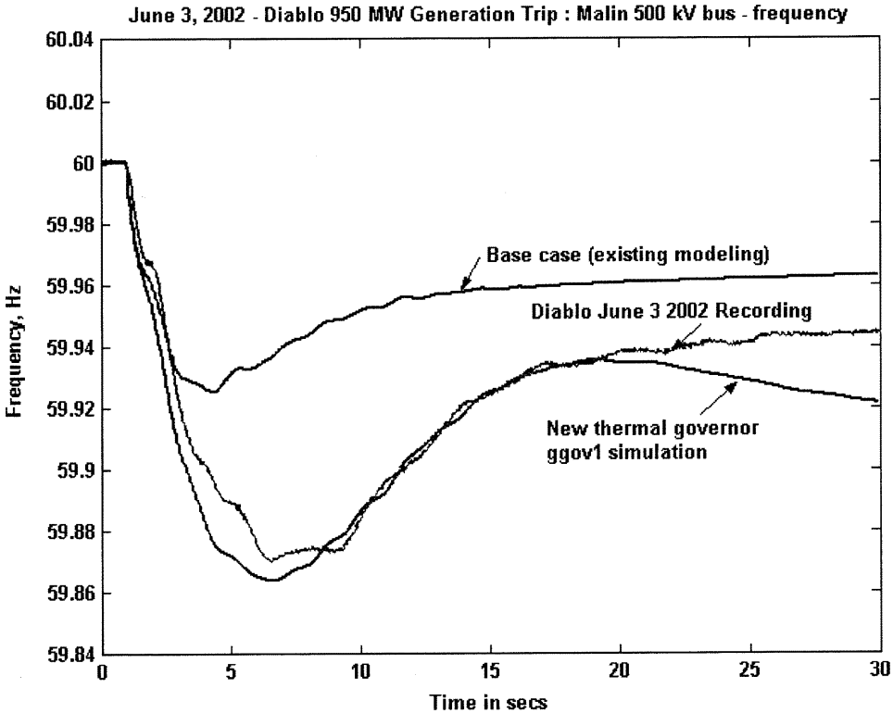
GGOV1: Selected Figures from 2003 Paper
Fig. 1. Frequency recordings of the SW and NW trips on May 18, 2001. Also shown are simulations with existing modeling (base case).
Governor model verification—950-MW Diablo generation trip on June 3, 2002.

Slide 10
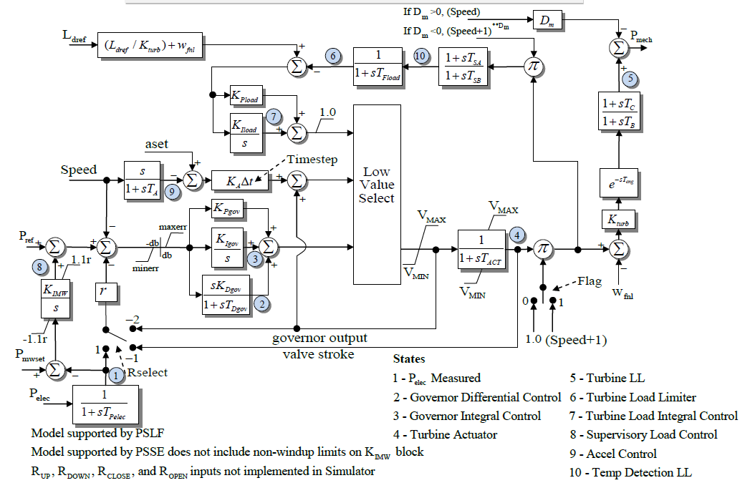
GGOV1 Block Diagram

Slide 11
Transient Stability Multimachine Simulations
Next, we'll be putting the models we've covered so far together
Later we'll add in new model types such as stabilizers, loads and wind turbines
By way of history, prior to digital computers, network analyzers were used for system stability studies as far back as the 1930's (perhaps earlier)
For example see, J.D. Holm, "Stability Study of A-C Power Transmission Systems," AIEE Transactions, vol. 61, 1942, pp. 893-905
Digital approaches started appearing in the 1960's

Slide 12
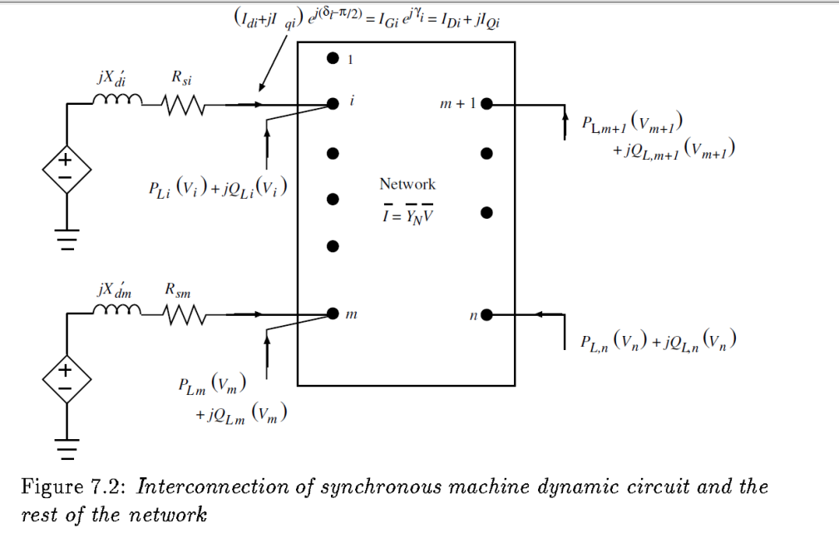
Transient Stability Multimachine Simulations
The general structure is as a set of differential-algebraic equations
Differential equations describe the behavior of the machines (and the loads and other dynamic devices)
Algebraic equations representing the network constraints
In EMTP applications the transmission line delays decouple the machines; in transient stability they are assumed to be coupled together by the algebraic network equations

Slide 13
General Form
The general form of the problem is solving

Slide 14
Transient Stability General Solution
General solution approach is
Solve power flow to determine initial conditions
Back solve to get initial states, starting with machine models, then exciters, governors, stabilizers, loads, etc
Set t = t_{start}, time step = Δt, abort = false
While (t <= tend) and (not abort) Do Begin
Apply any contingency event
Solve differential and algebraic equations
If desired store time step results and check other conditions (that might cause the simulation to abort)
t = t + Δt
End while

Slide 15
Algebraic Constraints
The g vector of algebraic constraints is similar to the power flow equations, but usually rather than formulating the problem like in the power flow as real and reactive power balance equations, it is formulated in the current balance form
Simplest cases can have I independent of x and V, allowing a direct solution; otherwise we need to iterate

Slide 16
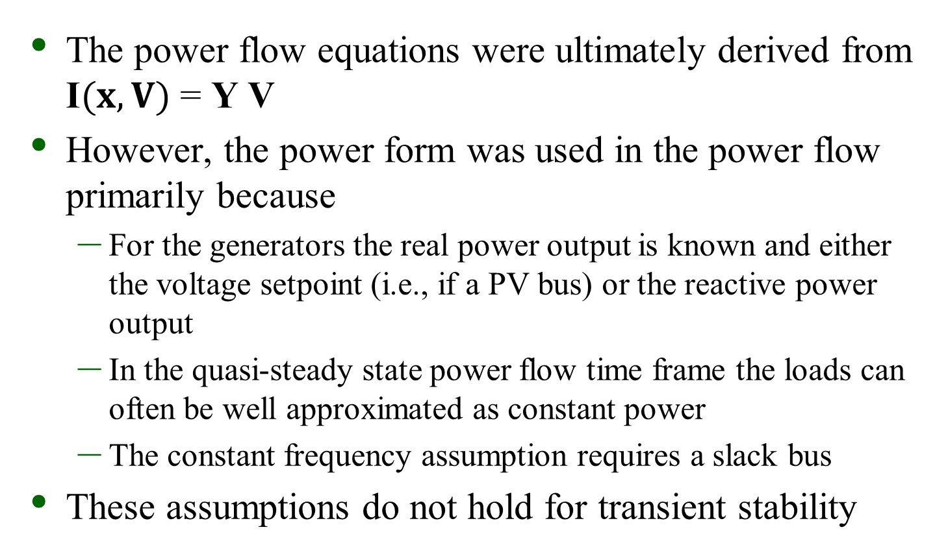
Why Not Use the Power Flow Equations?
The power flow equations were ultimately derived from I$(x,V)$ = Y V
However, the power form was used in the power flow primarily because
For the generators the real power output is known and either the voltage setpoint (i.e., if a PV bus) or the reactive power output
In the quasi-steady state power flow time frame the loads can often be well approximated as constant power
The constant frequency assumption requires a slack bus
These assumptions do not hold for transient stability

Slide 17
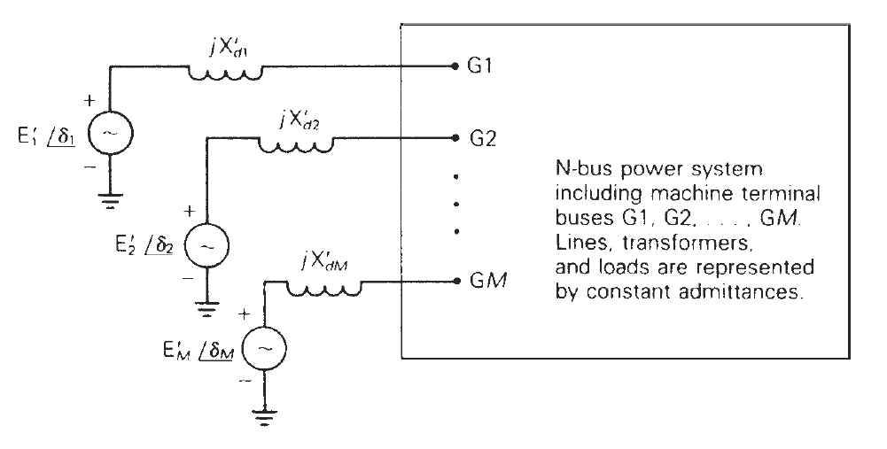
Algebraic Equations for Classical Model
To introduce the coupling between the machine models and the network constraints, consider a system modeled with just classical generators and impedance loads
In this example because we are using the classical model all values are on the network reference frame
We'll extend the figure slightly to include stator resistances, R_{s,i}
Image Source: Fig 11.15, Glover, Sarma, Overbye, Power System Analysis and Design, 5th Edition, Cengage Learning, 2011

Slide 18
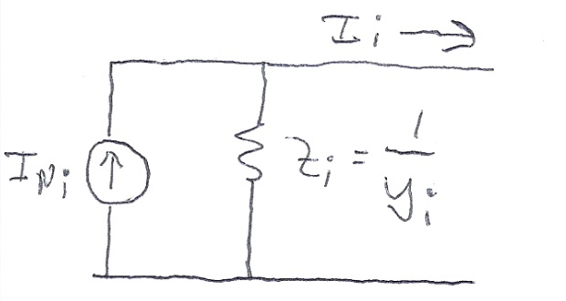
Algebraic Equations for Classical Model
Replace the internal voltages and their impedances by their Norton Equivalent
This same approach will be used later with the other, more detailed generator machine models
Current injections at the non-generator buses are zero since the constant impedance loads are included in Y
We'll modify this later when we talk about dynamic loads
The algebraic constraints are then Y V- I(x,V) = 0

Slide 19
Swing Equation
Two first two differential equations for any machine correspond to the swing equation
In this approach the angle is in radians, ω in radians/second; ω can also be expressed as per unit

Slide 20
Swing Equation Speed Effects
There is often confusion about these equations because of whether speed effects are included
Recognizing that often ω ≈ ω_{s} (which is one per unit), some transient stability books have neglected speed effects
For a rotating machine with a radial torque, power = torque times speed
For a subtransient model

Slide 21
Classical Swing Equation
Often in an introductory coverage of transient stability with the classical model the assumption is ω ≈ ω_{s} so the swing equation for the classical model is given as
We'll use this simplification for our initial example
As an example of this initial approach see Anderson and Fouad, Power System Control and Stability, 2nd Edition, Chapter 2

Slide 22
Numerical Solution
There are two main approaches for solving
Partitioned-explicit: Solve the differential and algebraic equations separately (alternating between the two) using an explicit integration approach
Simultaneous-implicit: Solve the differential and algebraic equations together using an implicit integration approach

Slide 23
Outline for Next Several Slides
The next several slides will provide basic coverage of the solution process, partitioned explicit, then the simultaneous-implicit approach
We'll start out with a classical model supplying an infinite bus, which can be solved by embedded the algebraic constraint into the differential equations

Slide 24
Classical Swing Equation with Embedded Power Balance
With an classical generator at bus i supplying an infinite bus with voltage magnitude V_{inf}, we can write the problem without algebraic constraints as
Note we are using the per unit speed approach

Slide 25
Explicit Integration Methods
As covered on the first day of class, there are a wide variety of explicit integration methods
We considered Forward Euler, Runge-Kutta, Adams-Bashforth
Here we will just consider Euler's, which is easy to explain but not too useful and a second order Runge-Kutta, which is commonly used

Slide 26
Forward Euler
Recall the Forward Euler approach is approximate
Error with Euler's varies with the square of the time step

Slide 27
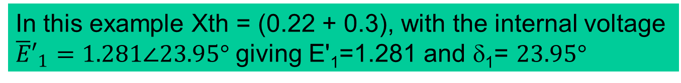
Infinite Bus GENCLS Example using the Forward Euler's Method
Use the four bus system from before, except now gen 4 is modeled with a classical model with X_{d}'=0.3, H=3 and D=0; also we'll reduce to two buses with equivalent line reactance, moving the gen from bus 4 to 1
In this example Xth = (0.22 + 0.3), with the internal voltage ${\overline{E}′}_{1}=1.281∠23.95°$ giving E'₁=1.281 and δ₁= $23.95°$

Slide 28
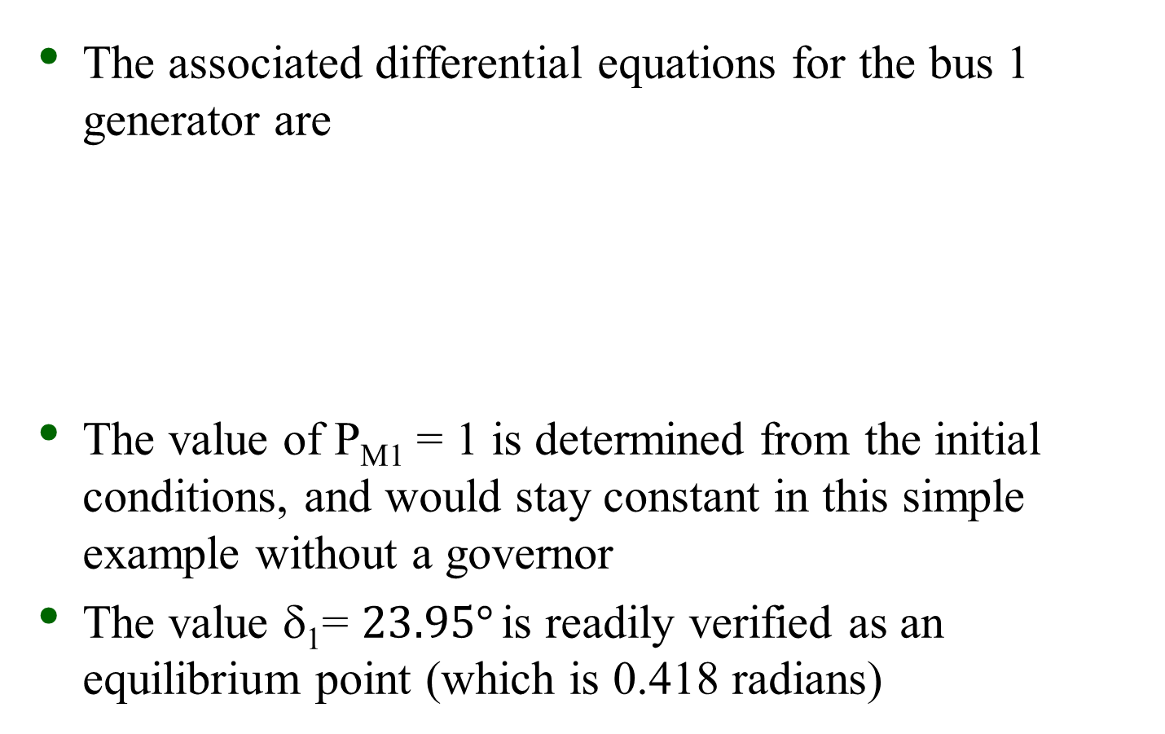
Infinite Bus GENCLS Example
The associated differential equations for the bus 1 generator are
The value of P_{M1} = 1 is determined from the initial conditions, and would stay constant in this simple example without a governor
The value δ₁= $23.95°$ is readily verified as an equilibrium point (which is 0.418 radians)

Slide 29
Infinite Bus GENCLS Example
Assume a solid three phase fault is applied at the generator terminal, reducing P_{E1} to zero during the fault, and then the fault is self-cleared at time T^{clear}, resulting in the post-fault system being identical to the pre-fault system
During the fault-on time the equations reduce to
That is, with a solid fault on the terminal of the generator, during the fault P_{E1} = 0

Slide 30
Euler's Solution
The initial value of x is
Assuming a time step Δt = 0.02 seconds, and a T^{clear} of 0.1 seconds, then using Euler's
Iteration continues until t = T^{clear}
Note Euler's assumes δ stays constant during the first time step

Slide 31
Euler's Solution
At t = T^{clear} the fault is self-cleared, with the equations changing to
The integration continues using the new equations

Slide 32
Euler's Solution Results (Δt=0.02)
The below table gives the results using Δt = 0.02 for the beginning time steps
Time | Gen 1 Rotor Angle, Degrees | Gen 1 Speed (Hz)
0 | 23.9462 | 60
0.02 | 23.9462 | 60.2
0.04 | 25.3862 | 60.4
0.06 | 28.2662 | 60.6
0.08 | 32.5862 | 60.8
0.1 | 38.3462 | 61
0.1 | 38.3462 | 61
0.12 | 45.5462 | 60.8943
0.14 | 51.9851 | 60.7425
0.16 | 57.3314 | 60.5543
0.18 | 61.3226 | 60.3395
0.2 | 63.7672 | 60.1072
0.22 | 64.5391 | 59.8652
0.24 | 63.5686 | 59.6203
0.26 | 60.8348 | 59.3791
0.28 | 56.3641 | 59.1488
This is saved as
PowerWorld case B2_CLS_Infinite. The integration method is set to Euler's on the Transient Stability, Options, Power System Model page

