Slide 1
ECE 576 – Power System Dynamics and Stability
Lecture 15: Governors
Prof. Tom Overbye
Dept. of Electrical and Computer Engineering
University of Illinois at Urbana-Champaign
overbye@illinois.edu

Slide 2
Announcements
Midterm exam is on March 13 in class
  Closed book, closed notes
  You may bring one 8.5 by 11" note sheet
    You do not have to write down model block diagram or the synchronous machine differential equations – I'll supply those if needed
  Simple calculators allowed
Covers up to and including exciters, but not governors
After test read Chapter 7

Slide 3
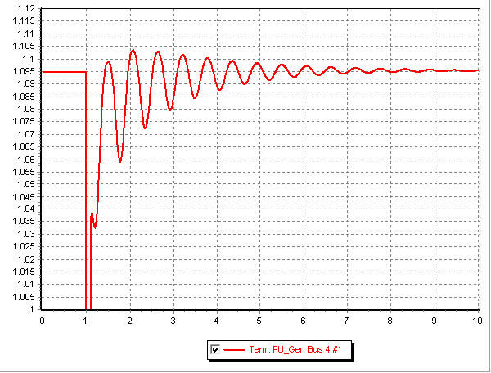
Best HW4 Result

Slide 4
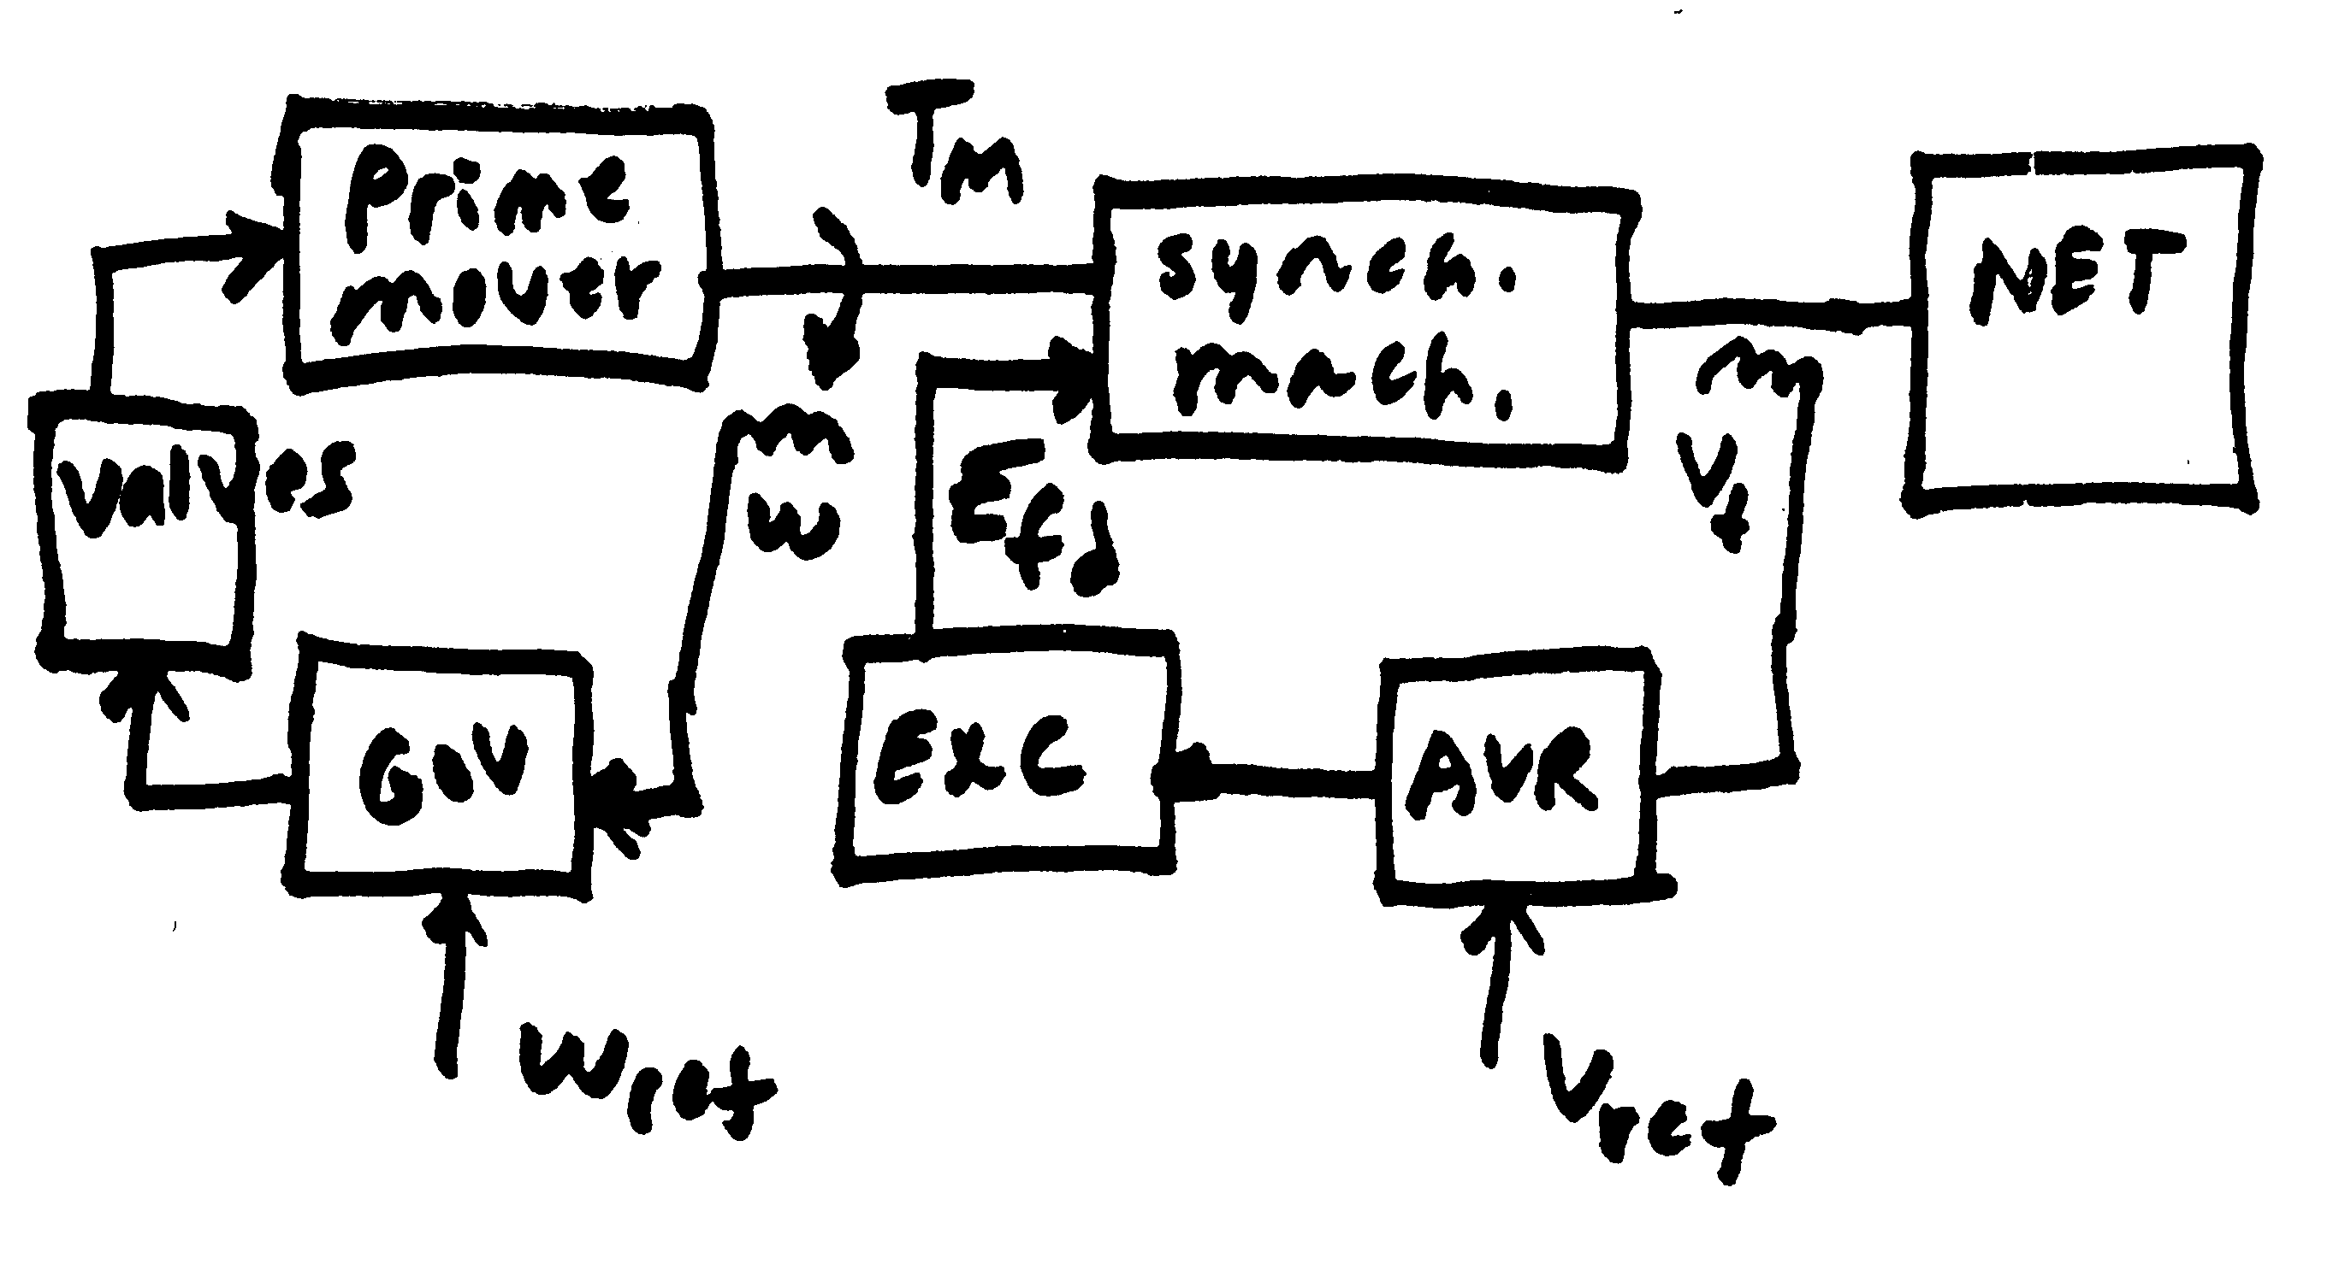
Speed and Voltage Control

Slide 5
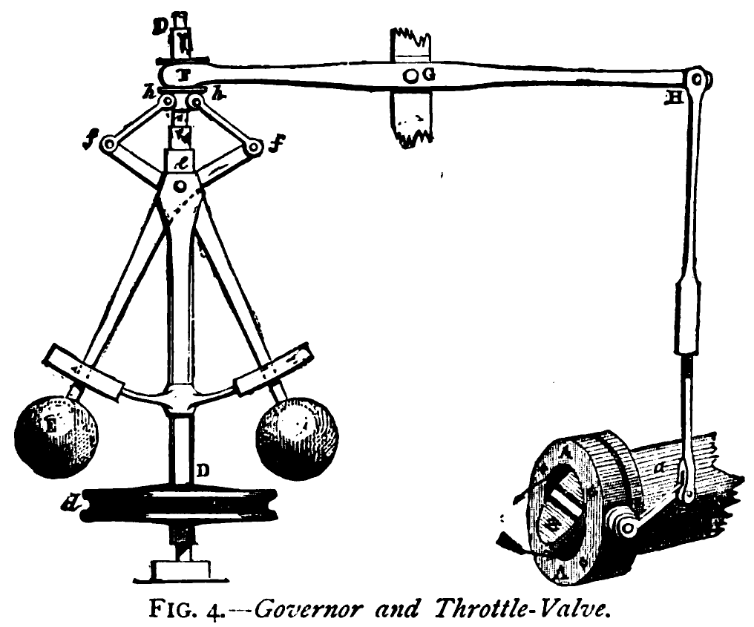
Prime Movers and Governors
Synchronous generator is used to convert mechanical energy from a rotating shaft into electrical energy
The "prime mover" is what converts the orginal energy source into the mechanical energy in the rotating shaft
Possible sources: 1) steam (nuclear, coal, combined cycle, solar thermal), 2) gas turbines, 3) water wheel (hydro turbines), 4) diesel/
gasoline, 5) wind
(which we'll cover separately)
The governor is used
to control the speed
Image source: http://upload.wikimedia.org/wikipedia/commons/
1/1e/Centrifugal_governor.png

Slide 6
Prime Movers and Governors
In transient stability collectively the prime mover and the governor are called the "governor"
As has been previously discussed, models need to be appropriate for the application
In transient stability the response of the system for seconds to perhaps minutes is considered
Long-term dynamics, such as those of the boiler and automatic generation control (AG), are usually not considered
These dynamics would need to be considered in longer simulations (e.g. dispatcher training simulator (DTS)

Slide 7
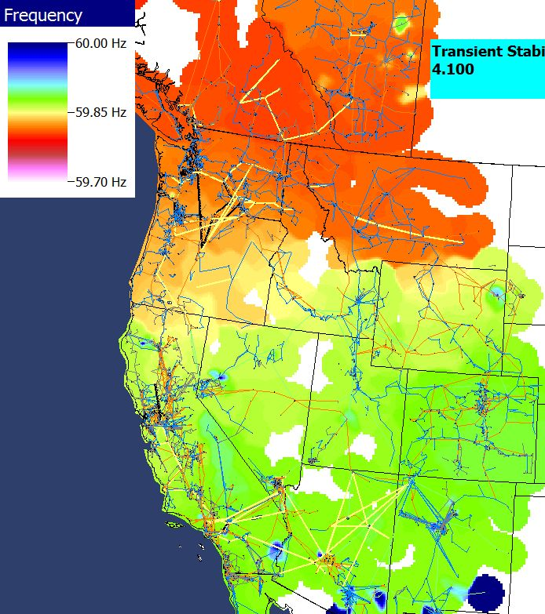
Power Grid Disturbance Example
Figures show the frequency change as a result of the sudden loss of a large amount of generation in the Southern WECC
Freq. Hz)
Time in Seconds
Frequency Contour

Slide 8
Frequency Response for Generation Loss
In response to a rapid loss of generation, in the initial seconds the system frequency will decrease as energy stored in the rotating masses is transformed into electric energy
  Solar PV has no inertia, and for most new wind turbines the inertia is not seen by the system
Within seconds governors respond, increasing the power output of controllable generation
  Many conventional units are operated so they only respond to over frequency situations
  Solar PV and wind are usually operated in North America at maximum power so they have no reserves to contribute

Slide 9
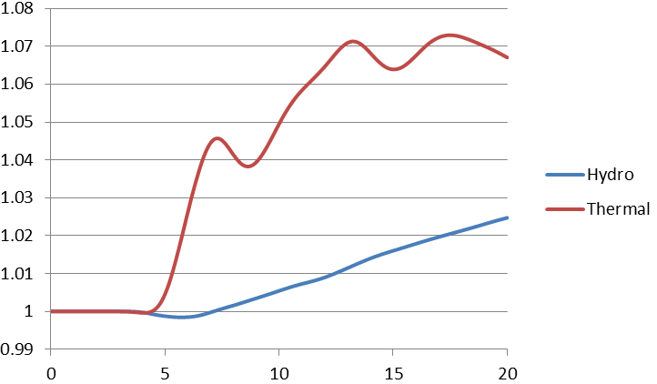
Governor Response:
Thermal Versus Hydro
Thermal units respond quickly, hydro ramps slowly (and goes down initially), wind and solar usually do not respond. And many units are set to not respond!
Normalized
output
Time in Seconds

Slide 10
Some Good References
Kundur, Power System Stability and Control, 1994
Wood, Wollenberg and Sheble, Power Generation, Operation and Control (2nd edition, 1996, 3rd in 2013)
IEEE PES, "Dynamic Models for Turbine-Governors in Power System Studies," Jan 2013
"Dynamic Models for Fossil Fueled Steam Units in Power System Studies," IEEE Trans. Power Syst., May 1991, pp. 753-761
"Hydraulic Turbine and Turbine Control Models for System Dynamic Studies," IEEE Trans. Power Syst., Feb 1992, pp. 167-179

Slide 11
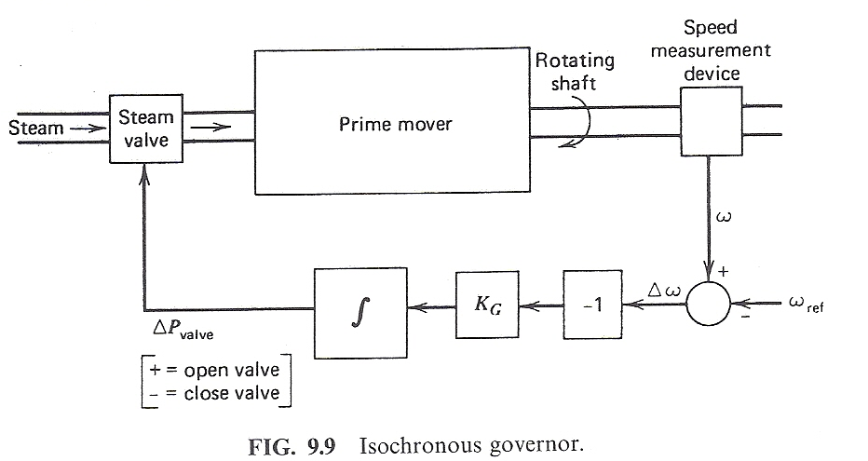
Control of Generation Overview
Goal is to maintain constant frequency with changing load
If there is just a single generator, such with an emergency generator or isolated system, then an isochronous governor is used
  Integrates frequency error to insure frequency goes back to
  the desired value
  Cannot be used with
  interconnected systems
  because of "hunting"
Image source: Wood/Wollenberg, 2nd edition

Slide 12
Generator “Hunting”
Control system “hunting” is oscillation around an equilibrium point
Trying to interconnect multiple isochronous generators will cause hunting because the frequency setpoints of the two generators are never exactly equal
  One will be accumulating a frequency error trying to speed up the system, whereas the other will be trying to slow it down
  The generators will NOT share the power load proportionally.

Slide 13
Isochronous Gen Example
WSCC 9 bus from before, gen 3 dropping (85 MW)
  No infinite bus, gen 1 is modeled with an isochronous generator (new PW v18 ISOGov1 model)
Gen 2 is modeled with no governor, so its mechanical power stays fixed

Slide 14
Isochronous Gen Example
Graph shows the change in the mechanical output
All the change
in MWs due
to the loss of
gen 3 is
being picked
up by
gen 1

Slide 15
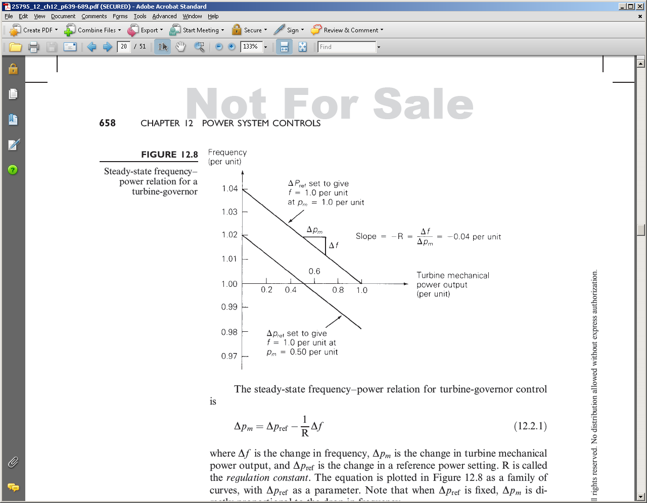
Droop Control
To allow power sharing between generators the solution is to use what is known as droop control, in which the desired set point frequency is dependent upon the generator’s output
R is known as the
regulation constant
or droop; a typical
value is 4 or 5%.
At 60 Hz and a 5% droop, each 0.1 Hz change would change the output by 0.1/(60*0.05)=
3.33%

Slide 16
WSCC 9 Bus Droop Example
Assume the previous gen 3 drop contingency (85 MW), and that gens 1 and 2 have ratings of 500 and 250 MVA respectively and governors with a 5% droop. What is the final frequency (assuming no change in load)?

Slide 17
WSCC 9 Bus Droop Example
The below graphs compare the mechanical power and generator speed; note the steady-state values match the calculated 59.66 Hz value
Case is wscc_9bus_TGOV1

Slide 18
Quick Interconnect Calculation
When studying a system with many generators, each with the same (or close) droop, then the final frequency deviation is
The online generator summation should only include generators that actually have governors that can respond, and does not take into account generators hitting their limits
The online generators
obviously does not
include the contingency
generator(s)

Slide 19
Larger System Example
As an example, consider the 37 bus, nine generator example from earlier; assume one generator with 42 MW is opened. The total MVA of the remaining generators is 1132. With R=0.05
Case is Bus37_TGOV1

Slide 20
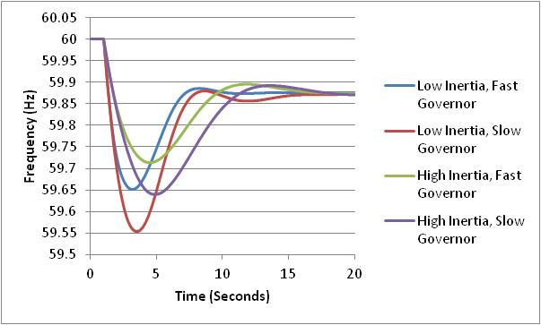
Impact of Inertia (H)
Final frequency is determined by the droop of the responding governors
How quickly the frequency drops depends upon the generator inertia values
The least
frequency
deviation
occurs with
high inertia
and fast
governors

Slide 21
Restoring Frequency to 60 (or 50) Hz
In an interconnected power system the governors to not automatically restore the frequency to 60 Hz
Rather this is done via the ACE (area control area calculation). Previously we defined ACE as the difference between the actual real power exports from an area and the scheduled exports. But it has an additional term
ACE = P_{actual} - P_{sched} – 10β(freq_{act} - freq_{sched})
β is the balancing authority frequency bias in MW/0.1 Hz with a negative sign. It is about 0.8% of peak load/generation

Slide 22
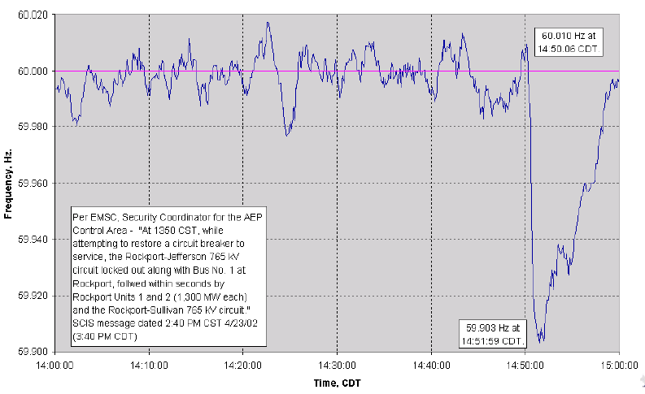
2600 MW Loss Frequency Recovery
Frequency recovers in about ten minutes

Slide 23
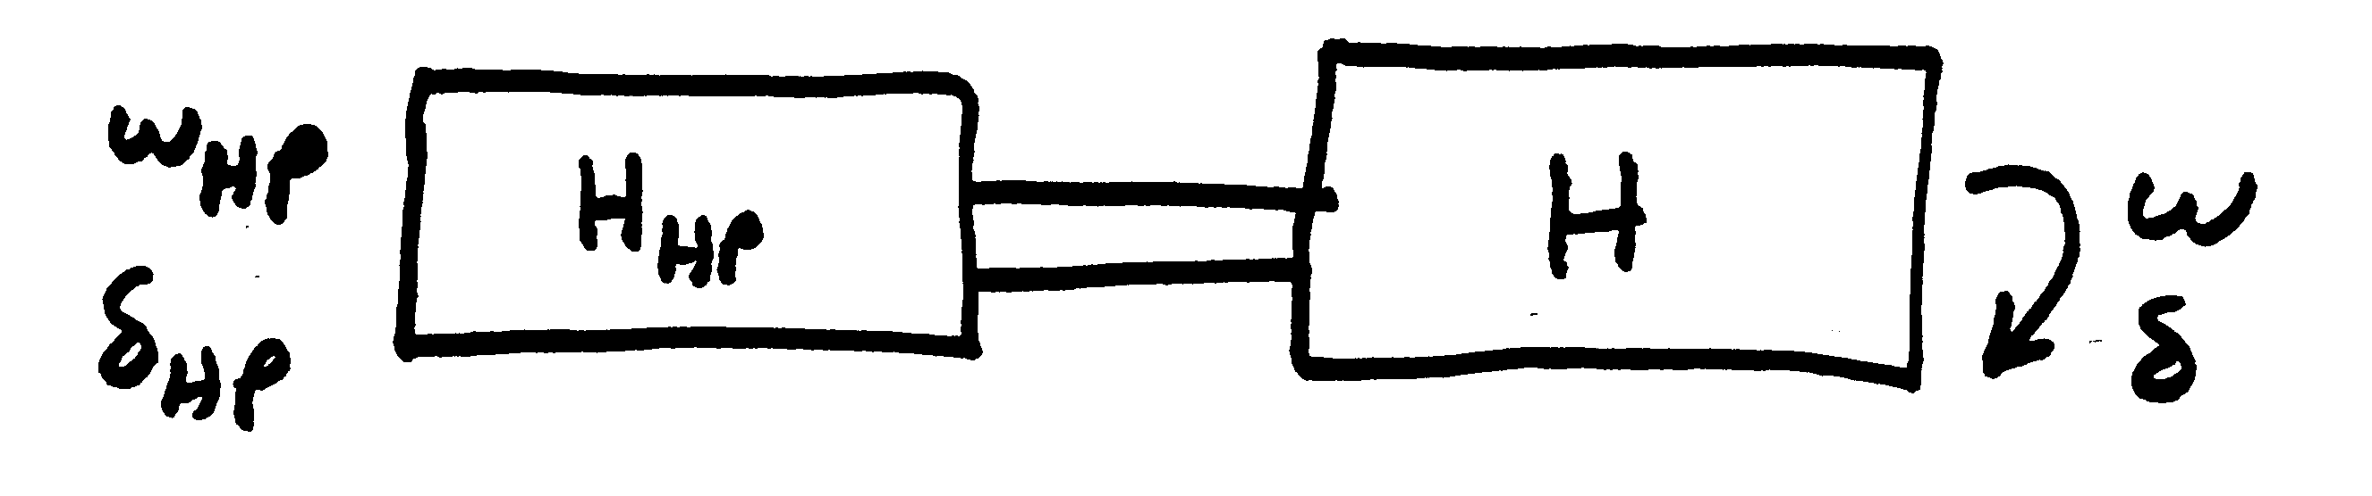
Turbine Models
model shaft “squishiness” as a spring
Usually shaft dynamics
are neglected
High-pressure turbine shaft dynamics

Slide 24
Steam Turbine Models
Boiler supplies a "steam chest" with the steam then
entering the turbine through a value
We are assuming
δ=δ_{HP} and
ω=ω_{HP}

Slide 25
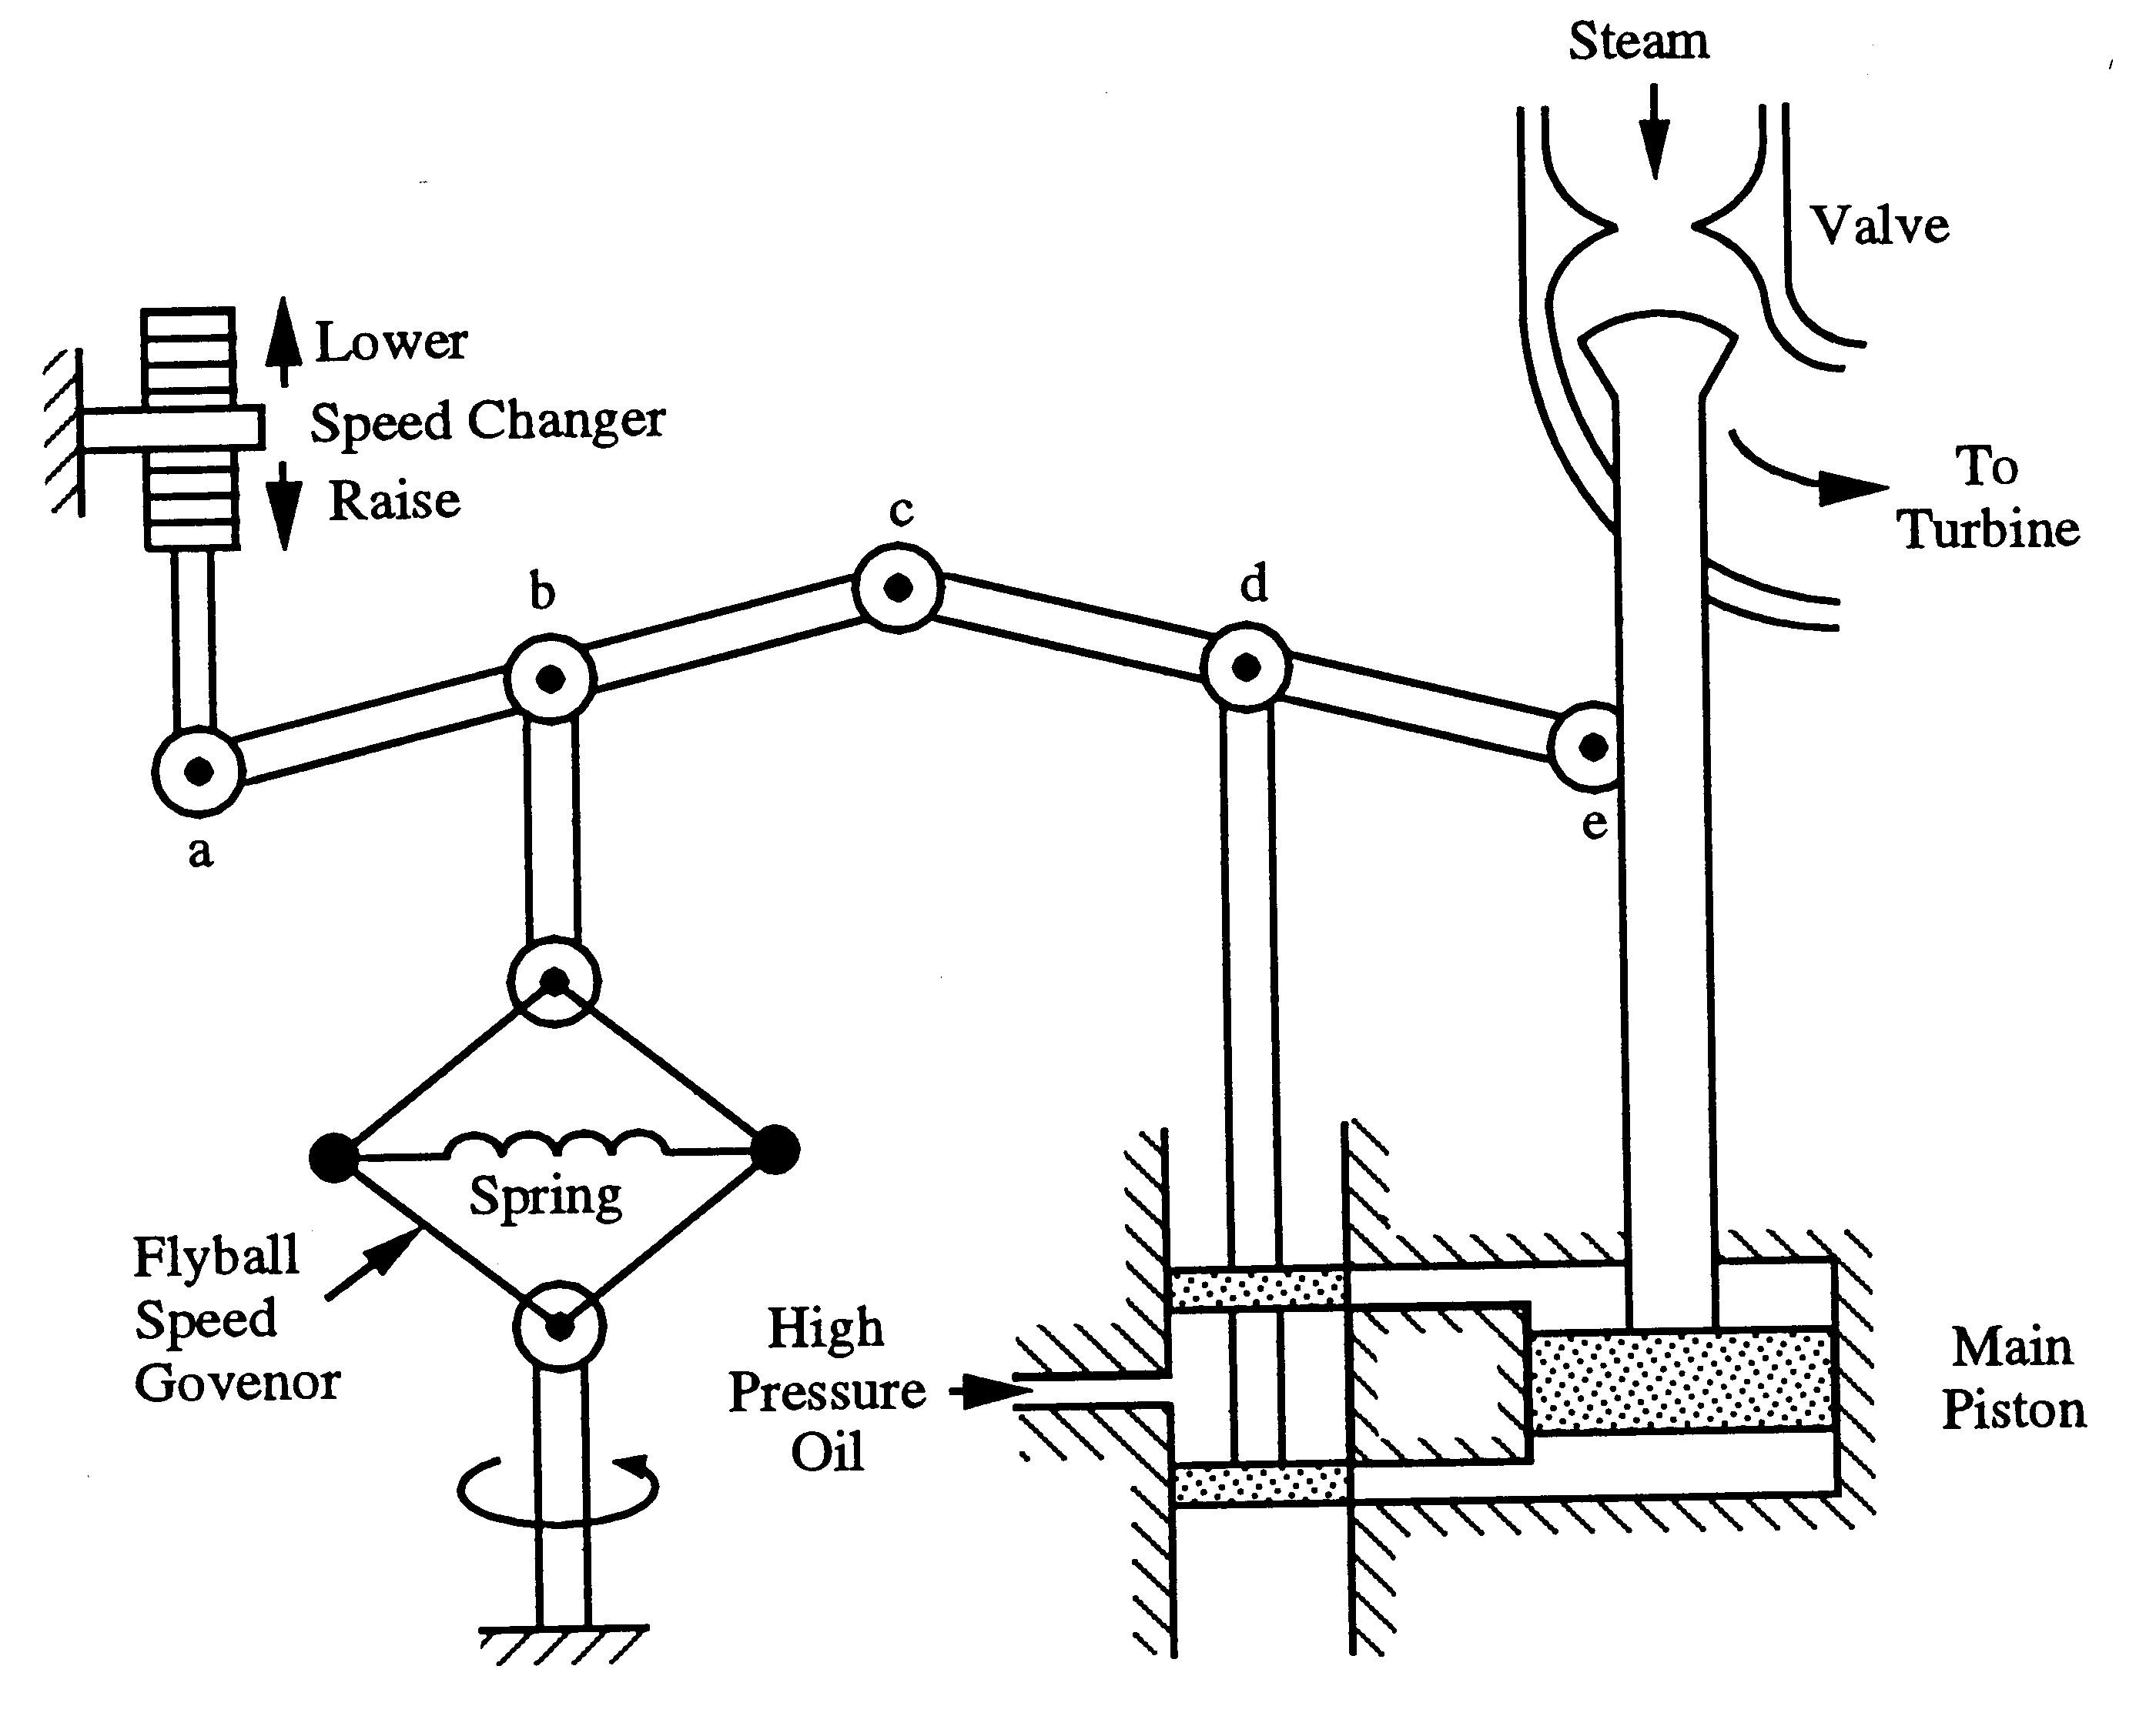
Steam Governor Model

Slide 26
Steam Governor Model
Steam valve limits
R = .05 (5% droop)

Slide 27
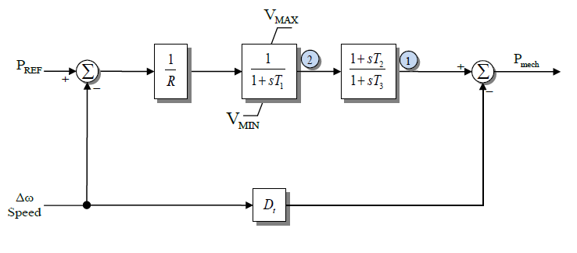
TGOV1 Model
Standard model that is close to this is TGOV1
Here T₁ corresponds to T_{SV} and T₃ to T_{CH}
TGOV1 is not commonly used because it is too simple,
but it is a good place to start; D_{t} is used to model
turbine damping and is often zero

Slide 28
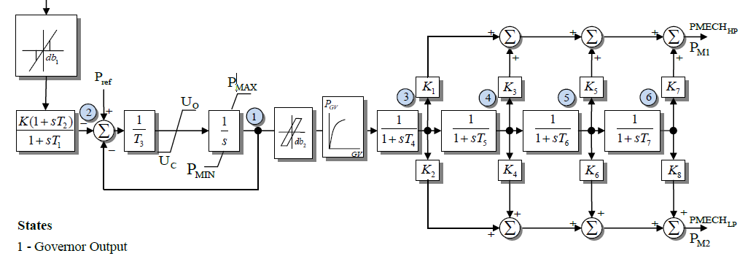
IEEEG1
A common stream turbine model, is the IEEEG1, originally introduced in the below 1973 paper
In this model K=1/R
It can be used to represent
cross-compound units, with
high and low pressure steam
U_{o} and U_{c} are rate limits
IEEE Committee Report, “Dynamic Models for Steam and Hydro Turbines in Power System Studies,” Transactions in Power Apparatus & Systems, volume 92, No. 6, Nov./Dec. 1973, pp 1904-15

