Slide 1
ECE 576 – Power System Dynamics and Stability
Lecture 14: Exciters
Prof. Tom Overbye
Dept. of Electrical and Computer Engineering
University of Illinois at Urbana-Champaign
overbye@illinois.edu

Slide 2
Announcements
Homework 4 is due today
Read Chapter 4
Midterm exam is on March 13 in class
Closed book, closed notes
Covers up to end of today's lecture
You may bring one 8.5 by 11" note sheet
You do not have to write down model block diagram or the synchronous machine differential equations – I'll supply those if needed
Simple calculators allowed

Slide 3
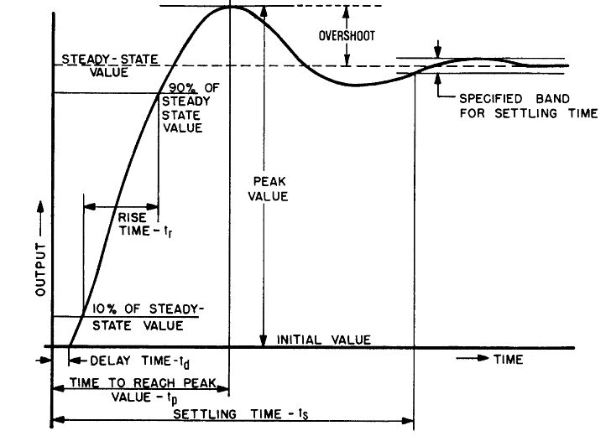
Transient Response
Figure shows typical transient response performance to a step change in input
Image Source: IEEE Std 421.2-1990, Figure 3

Slide 4
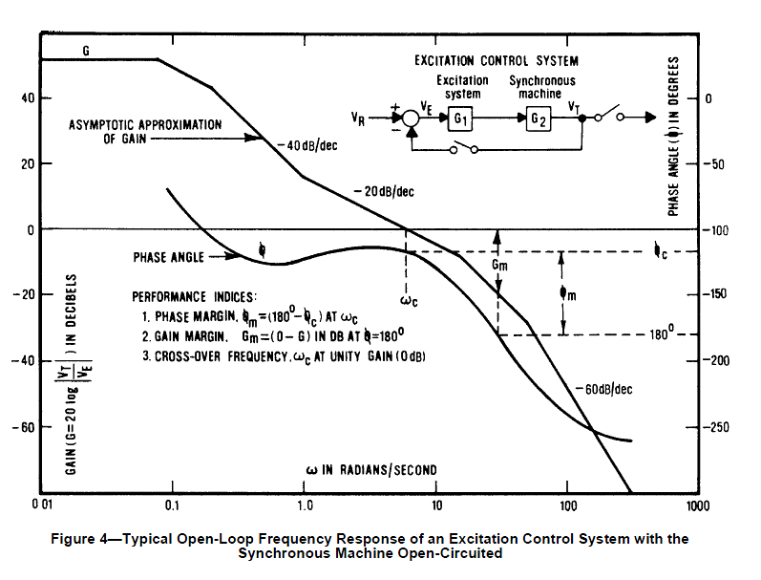
Small Signal Performance
Small signal performance can be assessed by either the time responses, frequency response, or eigenvalue analysis
Figure shows the typical open loop performance of an exciter and machine in the frequency domain
Image Source: IEEE Std 421.2-1990, Figure 4

Slide 5
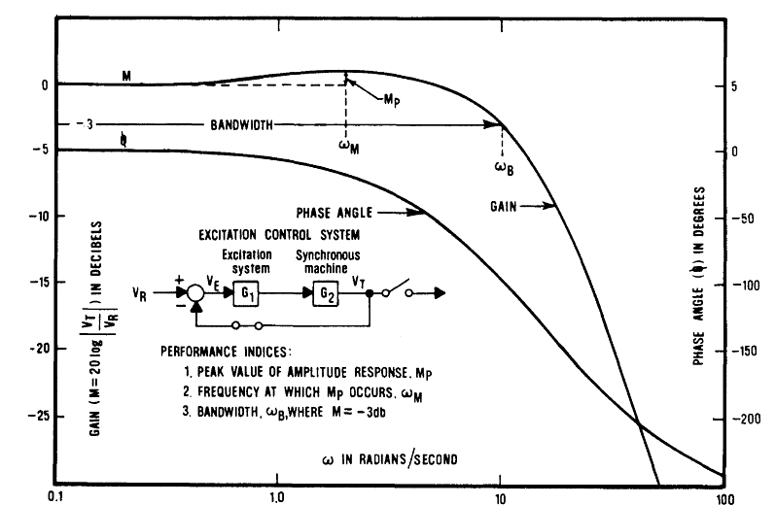
Small Signal Performance
Figure shows typical closed-loop performance
Peak value of M_{p} indicates relative stability; too large a value indicates overshoot
Note system connection is open
We will return to this when we talk about oscillations
Image Source: IEEE Std 421.2-1990, Figure 5

Slide 6
AC Exciters
Almost all new exciters use an ac source with an associated rectifier (either from a machine or static)
AC exciters use an ac generator and either stationary or rotating rectifiers to produce the field current
In stationary systems the field current is provided through slip rings
In rotating systems since the rectifier is rotating there is no need for slip rings to provide the field current
Brushless systems avoid the anticipated problem of supplying high field current through brushes, but these problems have not really developed

Slide 7
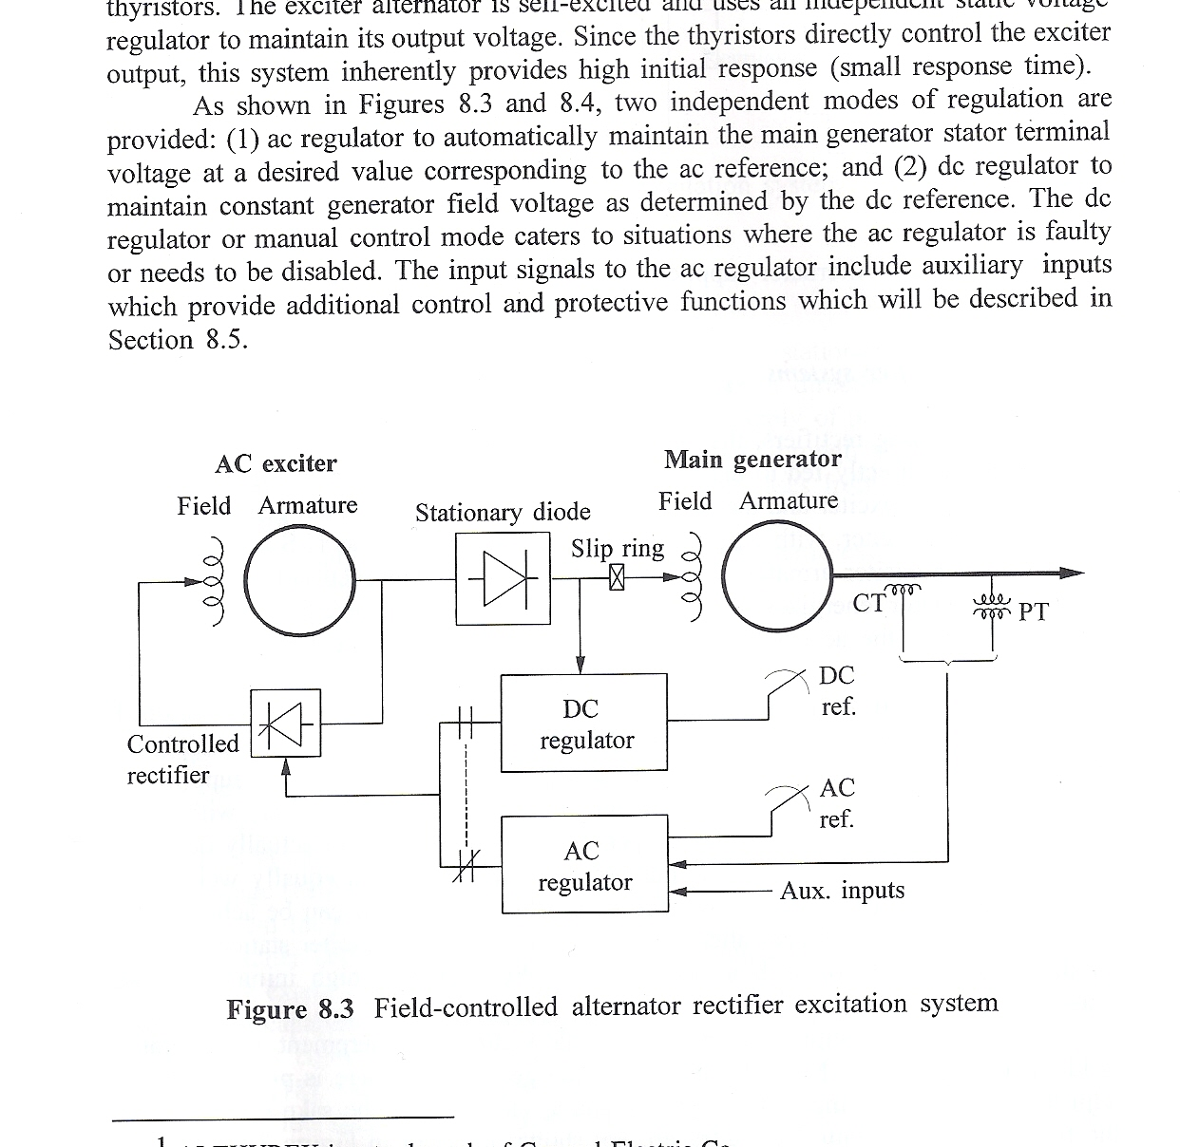
AC Exciter System Overview
Image source: Figures 8.3 of Kundur, Power System Stability and Control, 1994

Slide 8
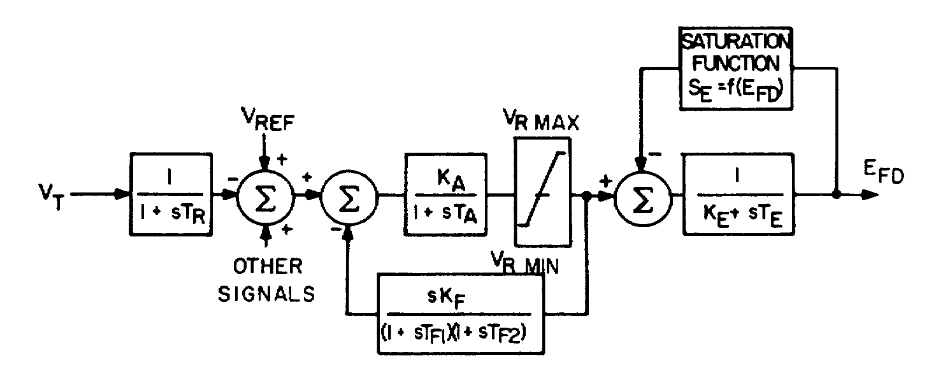
AC Exciter Modeling
Originally represented by IEEE T2 shown below
Exciter model is quite similar to IEEE T1
Image Source: Fig 2 of "Computer Representation of Excitation Systems," IEEE Trans. Power App. and Syst., vol. PAS-87, pp. 1460-1464, June 1968

Slide 9
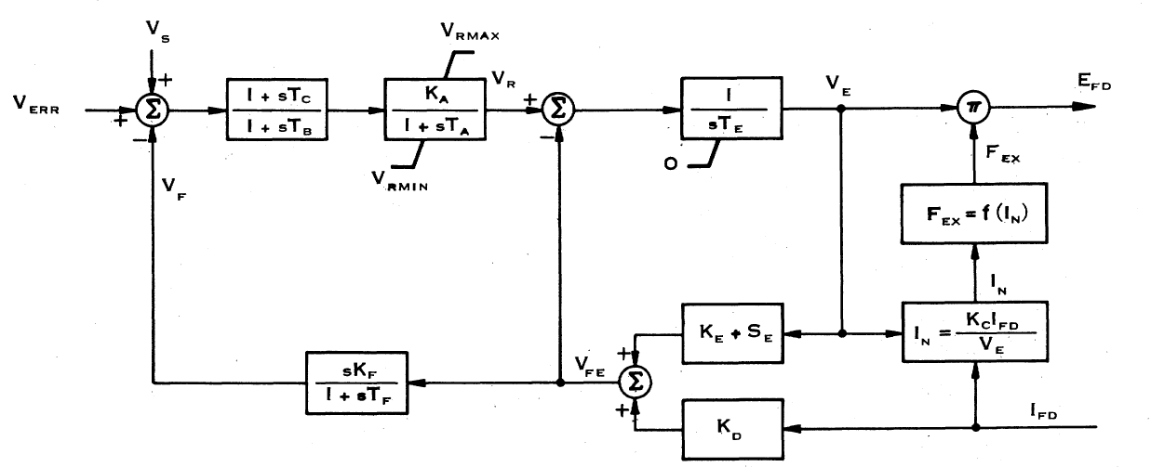
EXAC1 Exciter
The F_{EX} function represent the rectifier regulation, which results in a decrease in output voltage as the field current is increased
About 5% of WECC exciters are EXAC1
K_{D} models the exciter machine reactance
Image Source: Fig 6 of "Excitation System Models for Power Stability Studies," IEEE Trans. Power App. and Syst., vol. PAS-100, pp. 494-509, February 1981

Slide 10
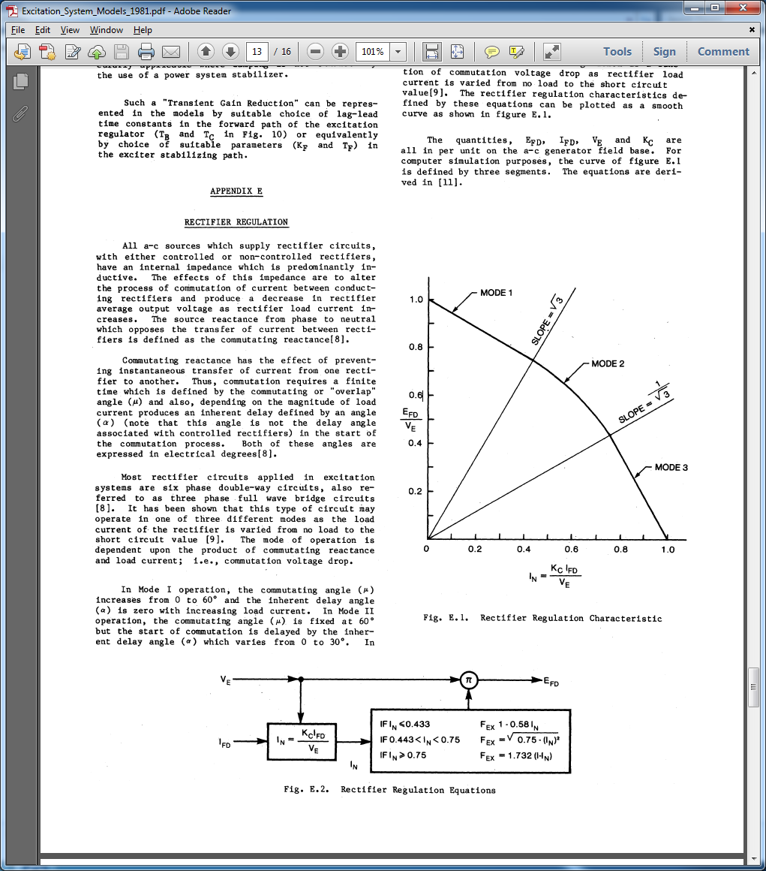
EXAC1 Rectifier Regulation
Kc represents the commuting reactance
There are about 6 or 7 main types of ac exciter models
Image Source: Figures E.1 and E.2 of "Excitation System Models for Power Stability Studies," IEEE Trans. Power App. and Syst., vol. PAS-100, pp. 494-509, February 1981

Slide 11
Initial State Determination, EXAC1
To get initial states E_{fd} and I_{fd} would be known and equal
Solve V_{e}*F_{ex}(I_{fd},V_{e}) = E_{fd}
Easy if Kc=0, then In=0 and F_{ex} =1
Otherwise the F_{EX} function is represented by three piecewise functions; need to figure out the correct segment; for example for Mode 3
Need to check to make sure we are on this segment

Slide 12
Static Exciters
In static exciters the field current is supplied from a three phase source that is rectified (i.e., there is no separate machine)
Rectifier can be either controlled or uncontrolled
Current is supplied through slip rings
Response can be quite rapid

Slide 13
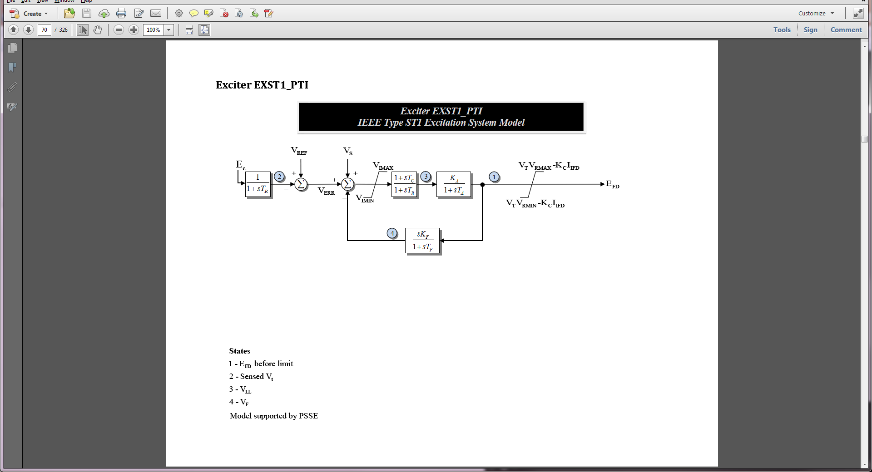
EXST1 Block Diagram
The EXST1 is intended to model rectifier in which the power is supplied by the generator's terminals via a transformer
Potential-source controlled-rectifier excitation system
The exciter time constants are assumed to be so small they are not represented
Most common exciter in WECC with about 29% modeled with this type
Kc represents the commuting reactance

Slide 14
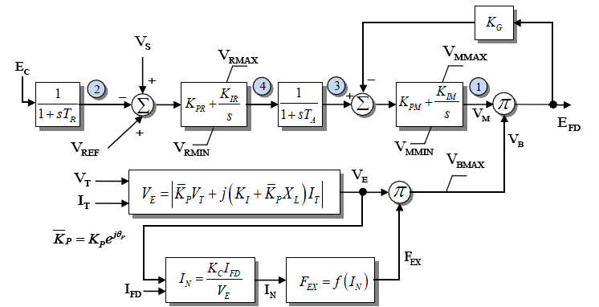
EXST4B
EXST4B models a controlled rectifier design; field voltage loop is used to make output independent of supply voltage
Second most common exciter in WECC with about 13% modeled with this type, though V_{e} is almost always independent of I_{T}

Slide 15
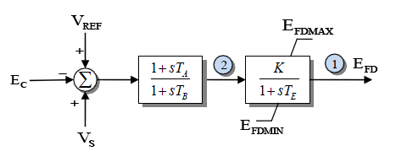
Simplified Excitation System Model
A very simple model call Simplified EX System (SEXS) is available
Not now commonly used; also other, more detailed models, can match this behavior by setting various parameters to zero

Slide 16
Compensation
Often times it is useful to use a compensated voltage magnitude value as the input to the exciter
Compensated voltage depends on generator current; usually Rc is zero
PSLF and PowerWorld model compensation with the machine model using a minus sign
Specified on the machine base
PSSE requires a separate model with their COMP model also using a negative sign
Sign convention is from IEEE 421.5

Slide 17
Compensation
Using the negative sign convention
if X_{c} is negative then the compensated voltage is within the machine; this is known as droop compensation, which is used reactive power sharing among multiple generators at a bus
If X_{c} is positive then the compensated voltage is partially through the step-up transformer, allowing better voltage stability
A nice reference is C.W. Taylor, "Line drop compensation, high side voltage control, secondary voltage control – why not control a generator like a static var compensator," IEEE PES 2000 Summer Meeting

Slide 18
Compensation Example 1
Added EXST1 model to 4 bus GENROU case with compensation of 0.05 pu (on gen's 100 MVA base) (using negative sign convention)
This is looking into step-up transformer
Initial voltage value is
Case is b4_comp1

Slide 19
Compensation Example 2
B4 case with two identical generators, except one in Xc = -0.1, one with Xc=-0.05; in the power flow the Mvars are shared equally (i.e., the initial value)
Plot shows the reactive power output of the two units, which start out equal, but diverage because of the difference values for X_{c}
Case is b4_comp2

Slide 20
Compensation Example 3
B4 case with two identical generators except with slightly different Xc values (into net) (0.05 and 0.048)
Below graphs show reactive power output if the currents from the generators not coordinated (left) or are coordinated (right); PowerWorld always does the right

Slide 21
Initial Limit Violations
Since many models have limits and the initial state variables are dependent on power flow values, there is certainly no guarantee that there will not be initial limit violations
If limits are not changed, this does not result in an equilibrium point solution
PowerWorld has several options for dealing with this, with the default value to just modify the limits to match the initial operating point
If the steady-state power flow case is correct, then the limit must be different than what is modeled

