Slide 1
ECE 576 – Power System Dynamics and Stability
Lecture 13: Exciters, Block Diagrams
Prof. Tom Overbye
Dept. of Electrical and Computer Engineering
University of Illinois at Urbana-Champaign
overbye@illinois.edu

Slide 2
Announcements
Homework 4 is on the website and is due March 6
Read Chapter 4
Midterm exam is on March 13 in class
Closed book, closed notes
You may bring one 8.5 by 11" note sheet
You do not have to write down model block diagram or the synchronous machine differential equations – I'll supply those if needed
Simple calculators allowed

Slide 3
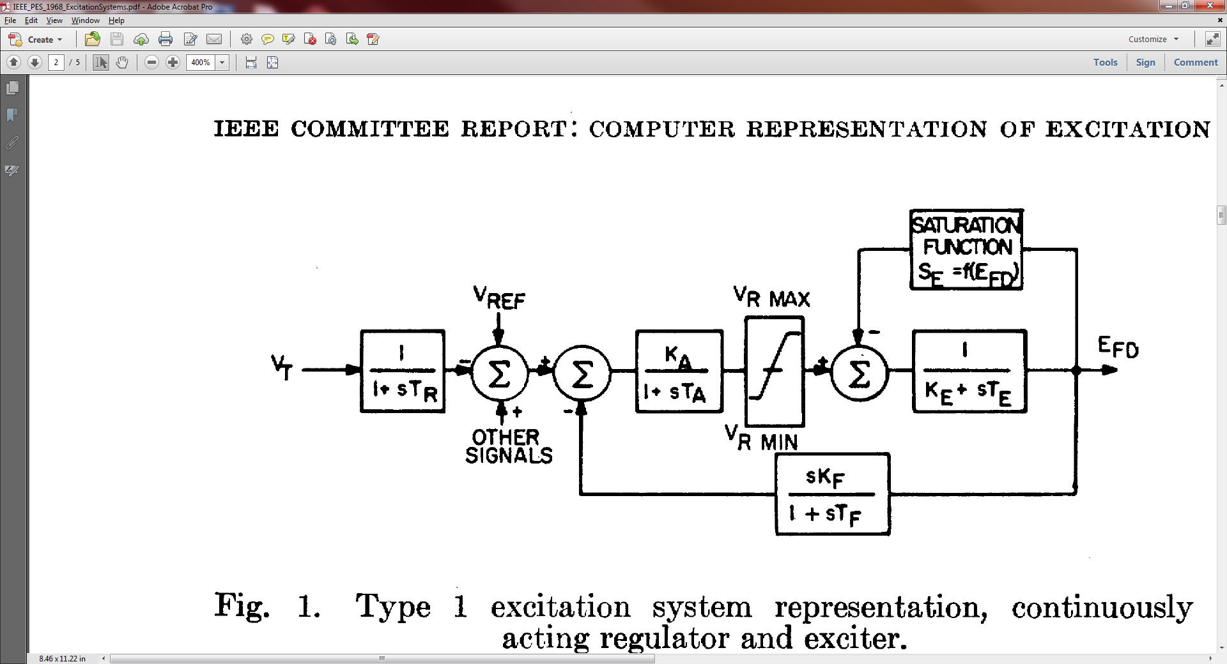
IEEE T1 Exciter
This model was standardized in the 1968 IEEE Committee Paper with Fig 1 shown below

Slide 4
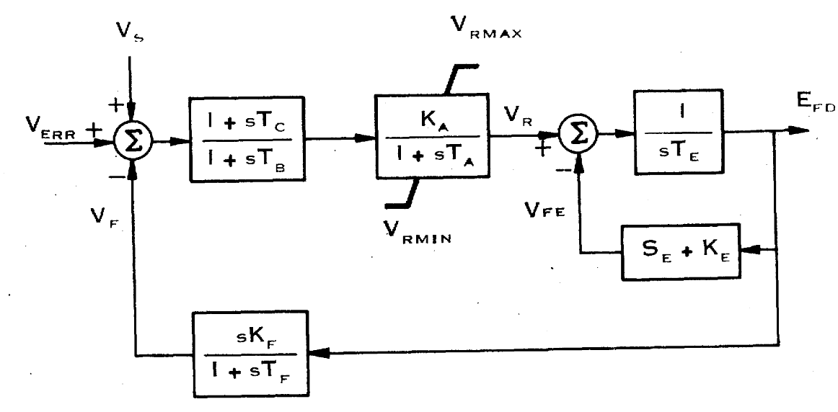
IEEE T1 Evolution
This model has been subsequently modified over the years, called the DC1 in a 1981 IEEE paper (modeled as the EXDC1 in stability packages)
Note, K_{E} in the feedback is the same as the 1968
approach
Image Source: Fig 3 of "Excitation System Models for Power Stability Studies," IEEE Trans. Power App. and Syst., vol. PAS-100, pp. 494-509, February 1981

Slide 5
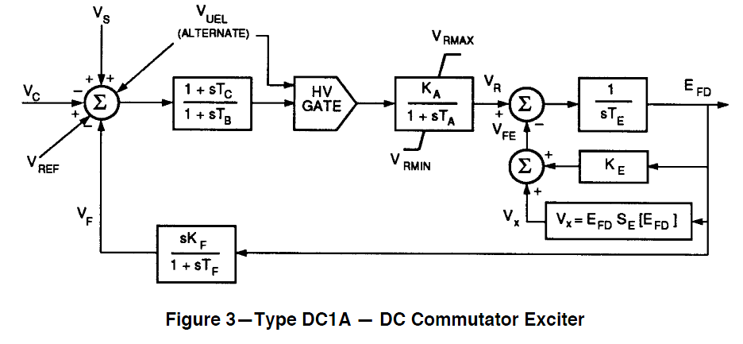
IEEE T1 Evolution
In 1992 IEEE Std 421.5-1992 slightly modified it, calling it the DC1A (modeled as ESDC1A)
V_{UEL} is a signal from an under- excitation limiter, which we'll cover later
Same model is in 421.5-2005
Image Source: Fig 3 of IEEE Std 421.5-1992

Slide 6
Initialization and Coding: Block Diagram Basics
To simulate a model represented as a block diagram, the equations need to be represented as a set of first order differential equations
Also the initial state variable and reference values need to be determined
Next several slides quickly cover the standard block diagram elements

Slide 7
Integrator Block
Equation for an integrator with u as an input and y as an output is
In steady-state with an initial output of y₀, the initial state is y₀ and the initial input is zero
u
y

Slide 8
First Order Lag Block
Equation with u as an input and y as an output is
In steady-state with an initial output of y₀, the initial state is y₀ and the initial input is y₀/K
Commonly used for measurement delay (e.g., T_{R} block with IEEE T1)
Input
u
y
Output of Lag Block

Slide 9
Derivative Block
Block takes the derivative of the input, with scaling K_{D} and a first order lag with T_{D}
Physically we can't take the derivative without some lag
In steady-state the output of the block is zero
State equations require a more general approach
u
y

Slide 10
State Equations for More Complicated Functions
There is not a unique way of obtaining state equations for more complicated functions with a general form
To be physically realizable we need n >= m

Slide 11
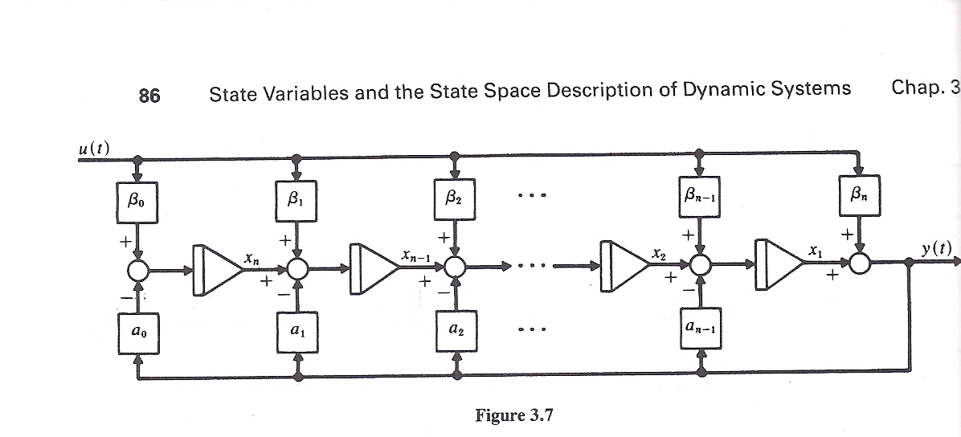
General Block Diagram Approach
One integration approach is illustrated in the below block diagram
Image source: W.L. Brogan, Modern Control Theory, Prentice Hall, 1991, Figure 3.7

Slide 12
Derivative Example
Write in form
Hence β₀=0, β₁=K_{D}/T_{D}, α₀=1/T_{D}
Define single state variable x, then
Initial value of x is found by recognizing y is zero so x = -β₁u

Slide 13
Lead-Lag Block
In exciters such as the EXDC1 the lead-lag block is used to model time constants inherent in the exciter; the values are often zero (or equivalently equal)
In steady-state the input is equal to the output
To get equations write in form with β₀=1/T_{B}, β₁=T_{A}/T_{B}, α₀=1/T_{B}
input
u
y
Output of Lead/Lag

Slide 14
Lead-Lag Block
The equations are with then
β₀=1/T_{B}, β₁=T_{A}/T_{B}, α₀=1/T_{B}
The steady-state requirement that u = y is readily apparent

Slide 15
Limits: Windup versus Nonwindup
When there is integration, how limits are enforced can have a major impact on simulation results
Two major flavors: windup and non-windup
Windup limit for an integrator block
L_{max}
The value of v is NOT limited, so its value can "windup" beyond the limits, delaying backing off of the limit
v
u
y
L_{min}
If L_{min} ≤ v ≤ L_{max} then y = v
else If v < L_{min} then y = L_{min}, else if v > L_{max} then y = L_{max}

Slide 16
Non-Windup Limits Integrator Block
With non-windup limits, the value of the integral (v previously) is prevented from exceeding its limit. Thus it can immediately back off its limits
L_{max}
u
y
L_{min}

Slide 17
Limits on First Order Lag
Windup and non-windup limits are handled in a similar manner for a first order lag
L_{max}
v
If L_{min} ≤ v ≤ L_{max} then y = v
else If v < L_{min} then y = L_{min}, else if v > L_{max} then y = L_{max}
u
y
L_{min}
Again the value of v is NOT limited, so its value can "windup" beyond the limits, delaying backing off of the limit

Slide 18
Non-Windup Limit First Order Lag
With a non-windup limit, the value of y is prevented from exceeding its limit
L_{max}
u
y
L_{min}

Slide 19
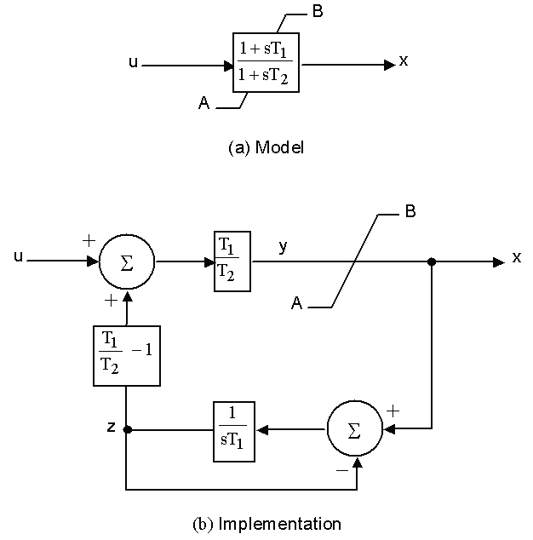
Lead-Lag Non-Windup Limits
There is not a unique way to implement non-windup limits for a lead-lag. This is the one from IEEE 421.5-1995 (Figure E.6)
T₂ > T₁, T₁ > 0, T₂ > 0
If y > A, then x = A
If y < B, then x = B
If A ≥y ≥ B, then x = y

Slide 20
Ignored States
When integrating block diagrams often states are ignored, such as a measurement delay with T_{R}=0
In this case the differential equations just become algebraic constraints
Example: For block at right, as T→0, v=Ku
With lead-lag it is quite common for T_{A}=T_{B}, resulting in the block being ignored
L_{max}
v
u
y
L_{min}

Slide 21
IEEE T1 Example
Assume previous GENROU case with saturation. Then add a IEEE T1 exciter with Ka=50, Ta=0.04, Ke=-0.06, Te=0.6, Vr_{max}=1.0, Vr_{min}= -1.0 For saturation assume Se(2.8) = 0.04, Se(3.73)=0.33
Saturation function is 0.1621(Efd-2.303)² (for Efd > 2.303); otherwise zero
Efd is initially 3.22
Se(3.22)*Efd=0.437
(Vr-Se*Efd)/Ke=Efd
Vr =0.244
Vref = 2.44/Ka +Vt = 0.0488 + 1.0946=1.1434

Slide 22
IEEE T1 Example
For 0.1 second fault (from before), plot of Efd and the terminal voltage is given below
Initial V₄=1.0946, final V₄=1.0973
Steady-state error depends on the value of Ka

Slide 23
IEEE T1 Example
Same case, except with Ka=500 to decrease steady-state error, no Vr limits; this case is actually unstable

Slide 24
IEEE T1 Example
With Ka=500 and rate feedback, Kf=0.05, Tf=0.5
Initial V₄=1.0946, final V₄=1.0957

Slide 25
WECC Case Type 1 Exciters
In a recent WECC case with 2782 exciters, 58 are modeled with the IEEE T1, 257 with the EXDC1 and none with the ESDC1A
Graph shows K_{E} value for the EXDC1 exciters in case; about 1/3 are separately excited, and the rest self excited
Value of K_{E} equal zero indicates code should set K_{E} so V_{r} initializes to zero; this is used to mimic the operator action of trimming this value

Slide 26
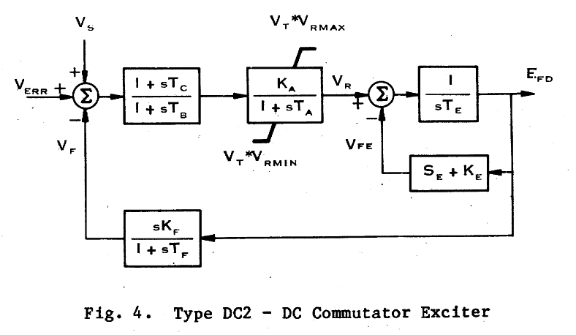
DC2 Exciters
Other dc exciters exist, such as the EXDC2, which is quite to the EXDC1; about 41 WECC exciters are of this type
Vr limits are multiplied by the terminal voltage
Image Source: Fig 4 of "Excitation System Models for Power Stability Studies," IEEE Trans. Power App. and Syst., vol. PAS-100, pp. 494-509, February 1981

Slide 27
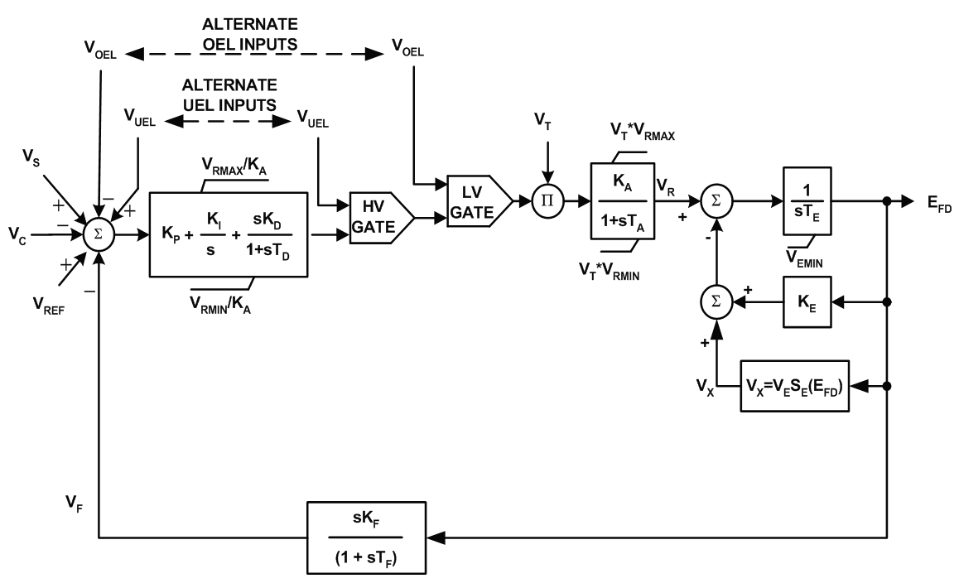
ESDC4B
Newer dc model introduced in 421.5-2005 in which a PID controller is added; might represent a retrofit
Image Source: Fig 5-4 of IEEE Std 421.5-2005

Slide 28
Desired Performance
A discussion of the desired performance of exciters is contained in IEEE Std. 421.2-1990
Concerned with
large signal performance: large, often discrete change in the voltage such as due to a fault; nonlinearities are significant
Limits can play a significant role
small signal performance: small disturbances in which close to linear behavior can be assumed
Increasingly exciters have inputs from power system stabilizers, so performance with these signals is important

Slide 29
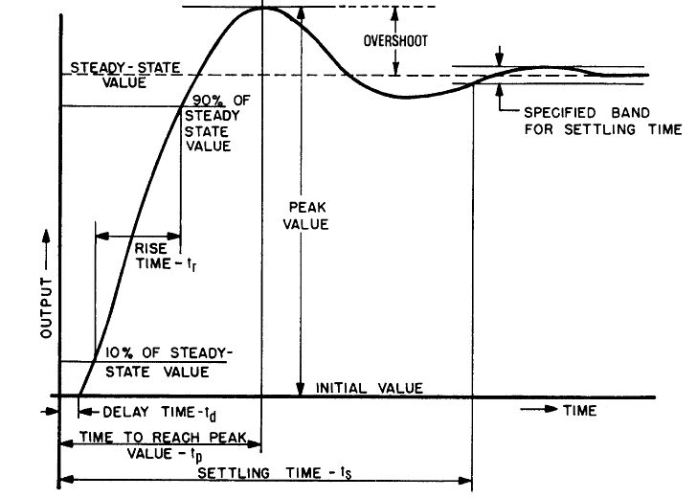
Transient Response
Figure shows typical transient response performance to a step change in input
Image Source: IEEE Std 421.2-1990, Figure 3

Slide 30
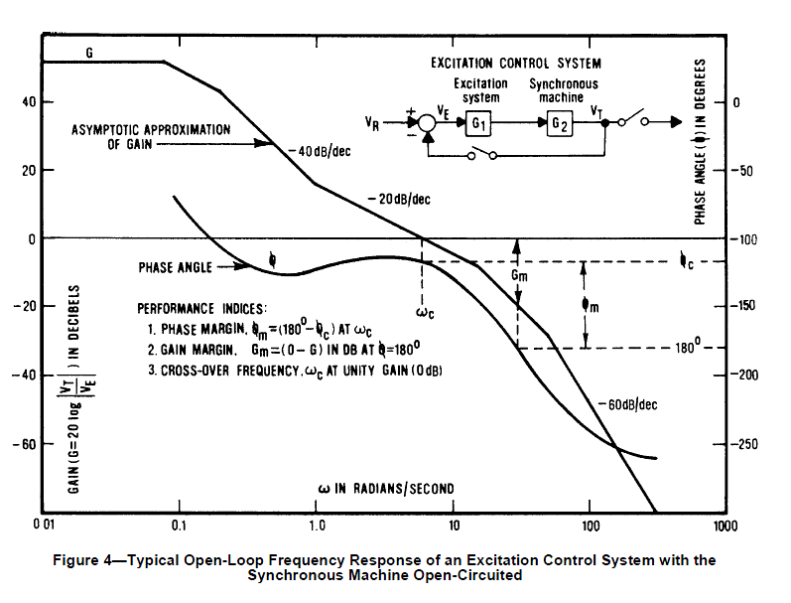
Small Signal Performance
Small signal performance can be assessed by either the time responses, frequency response, or eigenvalue analysis
Figure shows the typical open loop performance of an exciter and machine in the frequency domain
Image Source: IEEE Std 421.2-1990, Figure 4

Slide 31
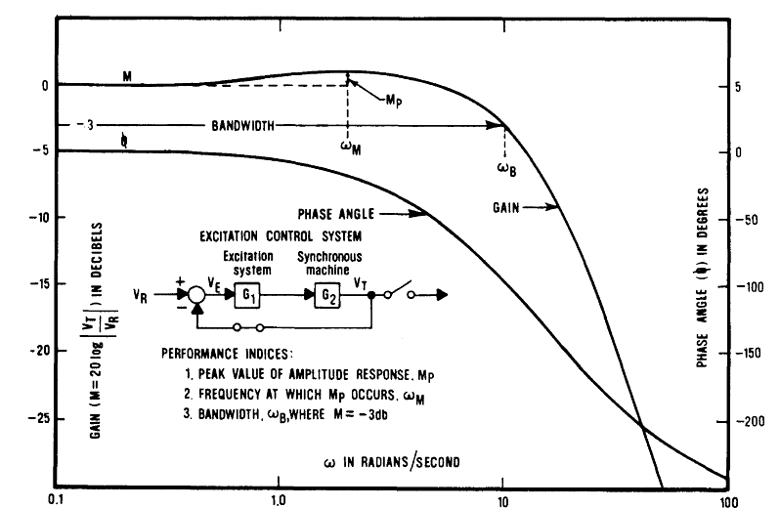
Small Signal Performance
Figure shows typical closed-loop performance
Peak value of M_{p} indicates relative stability; too large a value indicates overshoot
Note system connection is open
We will return to this when we talk about oscillations
Image Source: IEEE Std 421.2-1990, Figure 5

