Slide 1
ECE 576 – Power System Dynamics and Stability
Lecture 12: Exciters
Prof. Tom Overbye
Dept. of Electrical and Computer Engineering
University of Illinois at Urbana-Champaign
overbye@illinois.edu

Slide 2
Announcements
Homework 3 is due now
Homework 4 is on the website and is due on March 6
Read Chapter 4
Midterm exam is on March 13 in class
Closed book, closed notes
You may bring one 8.5 by 11" note sheet
You do not need to write down block diagrams or the detailed synchronous machine equations; I'll give you what you need here
Simple calculators allowed

Slide 3
Wind Cut-outs, 2/17/14
Graph provided by Tracy Rolstad, Avista

Slide 4
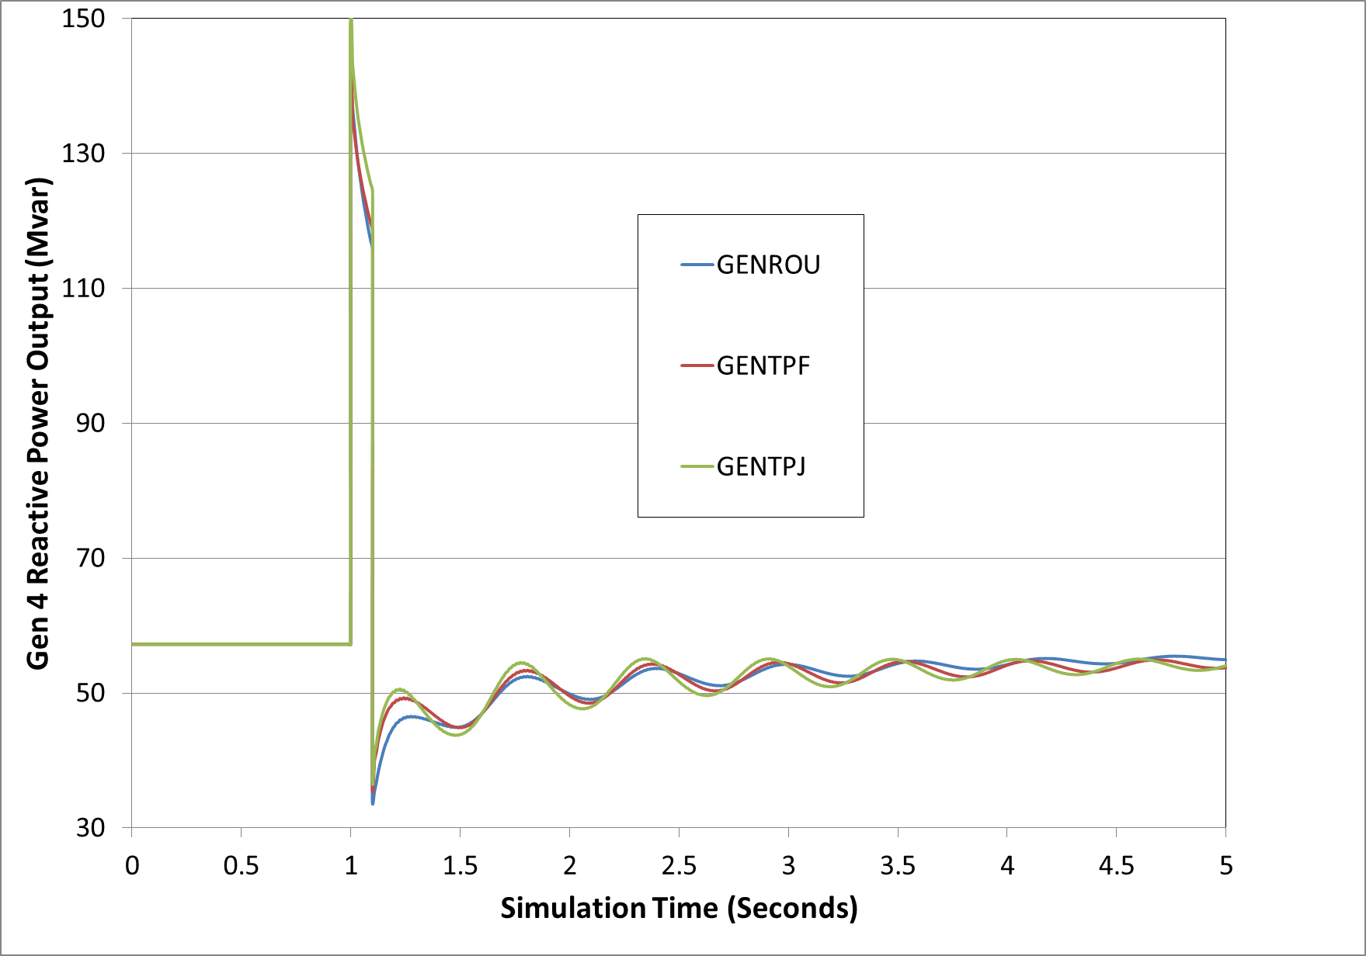
GenRou, GenTPF, GenTPJ
Figure compares gen 4 reactive power output for the 0.1 second fault

Slide 5
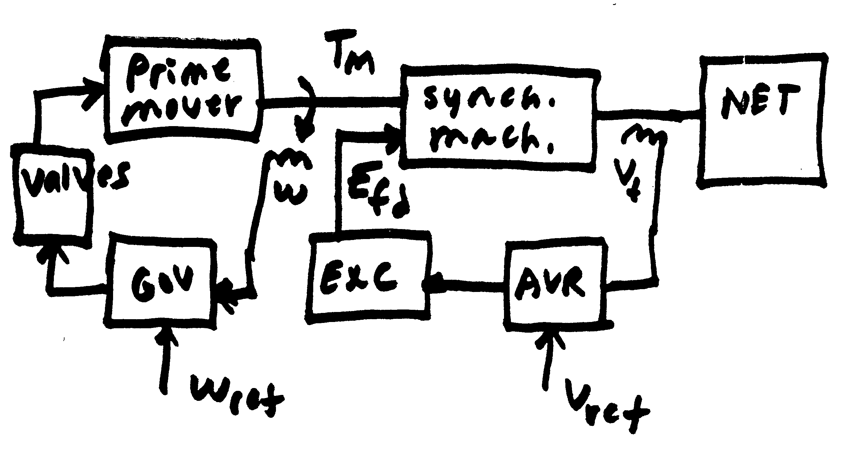
Voltage and Speed Control

Slide 6
Exciters, Including AVR
Exciters are used to control the synchronous machine field voltage and current
Usually modeled with automatic voltage regulator included
A useful reference is IEEE Std 421.5-2005
Covers the major types of exciters used in transient stability simulations
Continuation of standard designs started with "Computer Representation of Excitation Systems," IEEE Trans. Power App. and Syst., vol. pas-87, pp. 1460-1464, June 1968
Another reference is P. Kundur, Power System Stability and Control, EPRI, McGraw-Hill, 1994
Exciters are covered in Chapter 8 as are block diagram basics

Slide 7
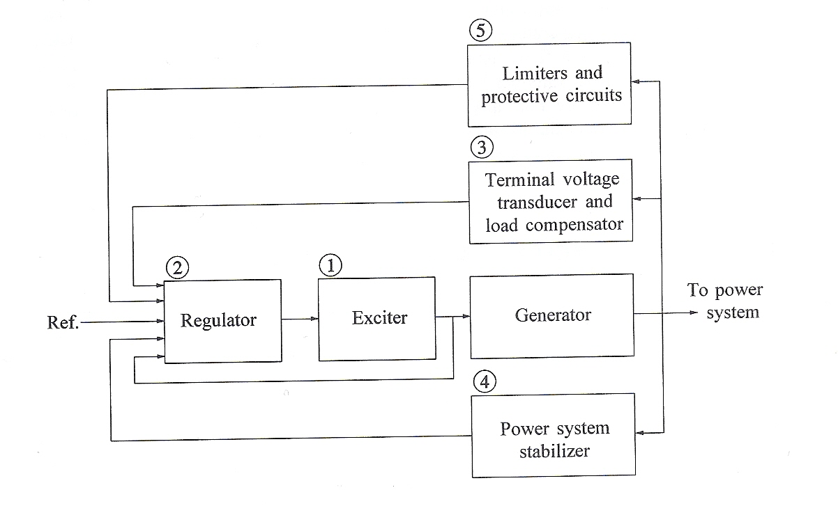
Functional Block Diagram
Image source: Fig 8.1 of Kundur, Power System Stability and Control

Slide 8
Types of Exciters
None, which would be the case for a permanent magnet generator
primarily used with wind turbines with ac-dc-ac converters
DC: Utilize a dc generator as the source of the field voltage through slip rings
AC: Use an ac generator on the generator shaft, with output rectified to produce the dc field voltage; brushless with a rotating rectifier system
Static: Exciter is static, with field current supplied through slip rings

Slide 9
Brief Review of DC Machines
Prior to widespread use of machine drives, dc motors had a important advantage of easy speed control
On the stator a dc machine has either a permanent magnet or a single concentrated winding
Rotor (armature) currents are supplied through brushes and commutator
Equations are
The f subscript refers to the field, the a to the armature; ω is the machine's speed, G is a constant. In a permanent magnet machine the field flux is constant, the field equation goes away, and the field impact is embedded in a equivalent constant to Gi_{f}
Taken mostly from ECE 330 book, M.A. Pai, Power Circuits and Electromechanics

Slide 10
Types of DC Machines
If there is a field winding (i.e., not a permanent magnet machine) then the machine can be connected in the following ways
Separately-excited: Field and armature windings are connected to separate power sources
For an exciter, control is provided by varying the field current (which is stationary), which changes the armature voltage
Series-excited: Field and armature windings are in series
Shunt-excited: Field and armature windings are in parallel

Slide 11
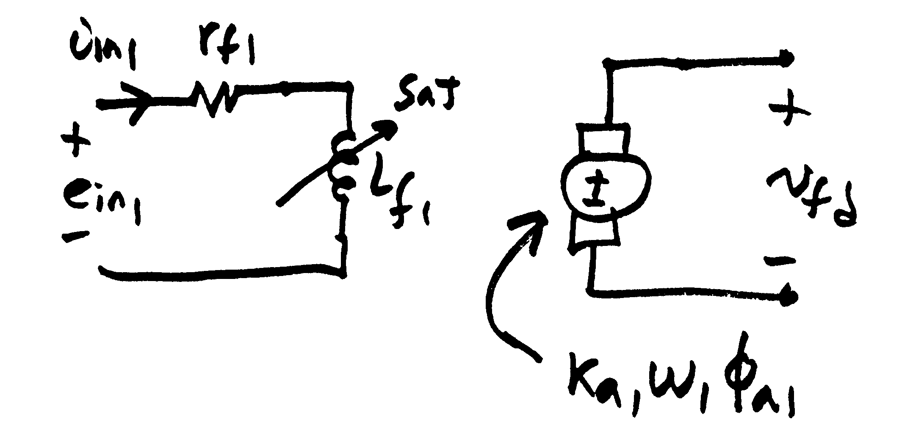
Separately Excited DC Exciter
(to sync
mach)
σ₁ is coefficient of dispersion, modeling the flux leakage

Slide 12
Separately Excited DC Exciter
Relate the input voltage, e_{in1}, to v_{fd}
Assuming a constant speed ω₁

Slide 13
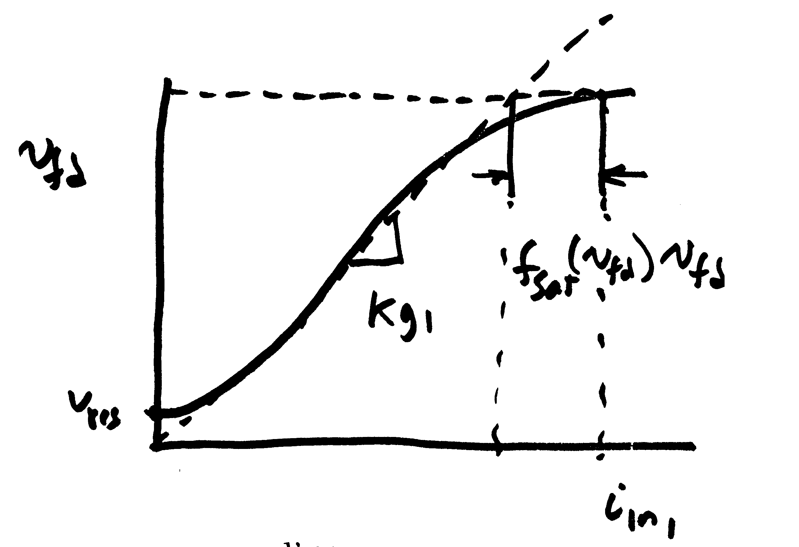
Separately Excited DC Exciter
If it was a linear magnetic circuit, then v_{fd} would be proportional to i_{n1}; for a real system we need to account for saturation
Without saturation we can write

Slide 14
Separately Excited DC Exciter
This equation is then scaled based on the synchronous machine base values

Slide 15
Separately Excited Scaled Values
V_{r} is the scaled output of the voltage regulator amplifier
Thus we have

Slide 16
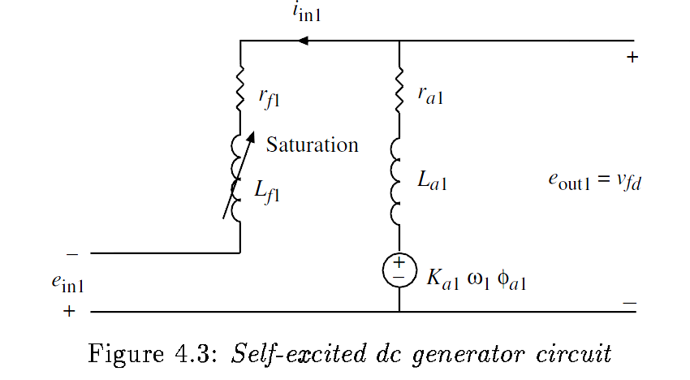
The Self-Excited Exciter
When the exciter is self-excited, the amplifier voltage appears in series with the exciter field
Note the additional E_{fd} term on the end

Slide 17
Self and Separated Excited Exciters
The same model can be used for both by just modifying the value of K_{E}

Slide 18
Saturation
A number of different functions can be used to represent the saturation
The quadratic approach is now quite common
Exponential function could also be used

Slide 19
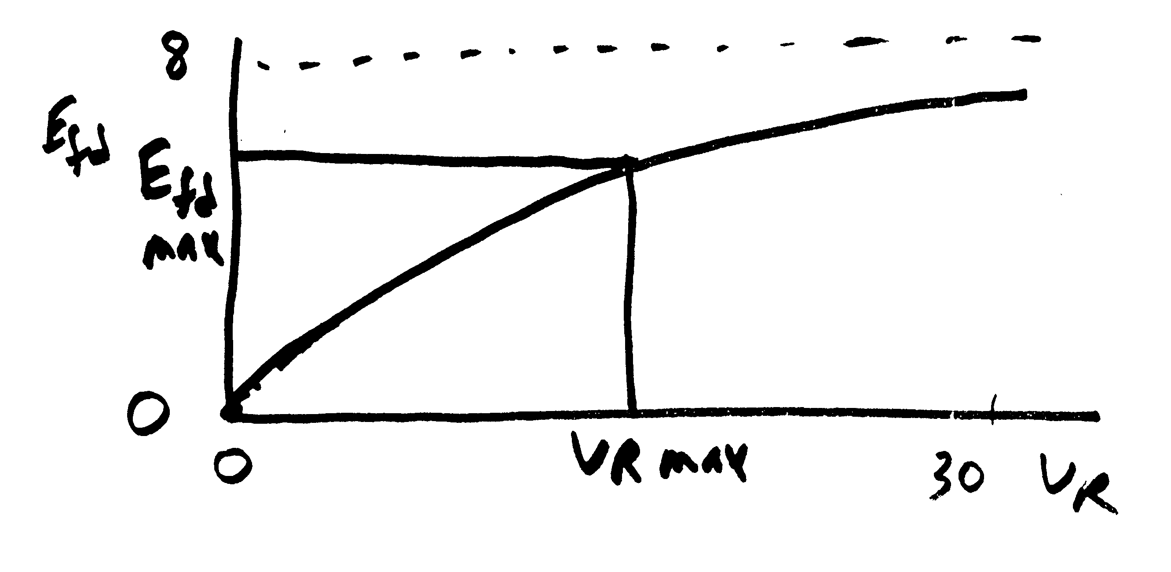
Exponential Saturation
Steady state

Slide 20
Exponential Saturation Example
Given:
Find:

Slide 21
Voltage Regulator Model
Amplifier
Modeled as a first order differential equation
In steady state
Big
There is often a droop in regulation

Slide 22
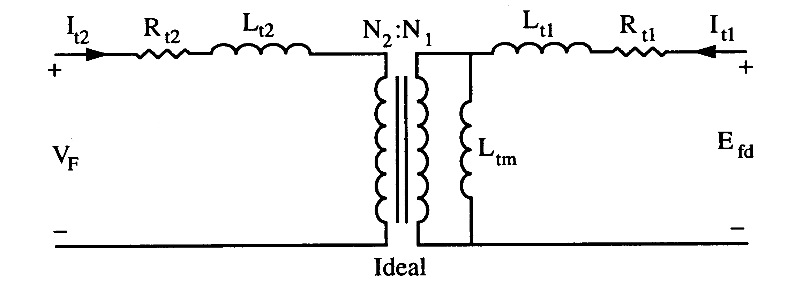
Feedback
This control system can often exhibit instabilities, so some type of feedback is used
One approach is a stabilizing transformer
Large L_{t2} so I_{t2} ≈ 0

Slide 23
Feedback

Slide 24
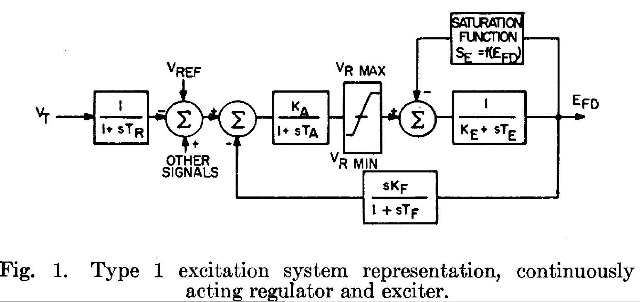
IEEE T1 Exciter
This model was standardized in the 1968 IEEE Committee Paper with Fig 1 shown below

Slide 25
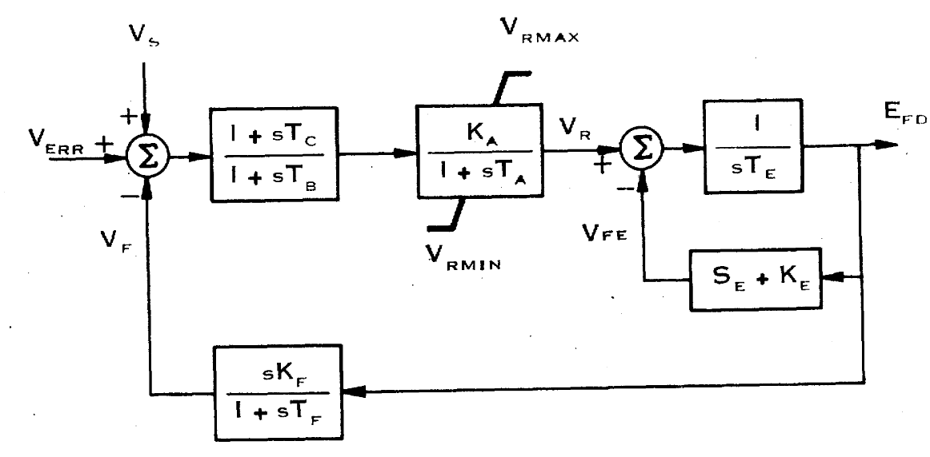
IEEE T1 Evolution
This model has been subsequently modified over the years, called the DC1 in a 1981 IEEE paper (modeled as the EXDC1 in stability packages)
Note, K_{E} in the feedback is the same as the 1968
approach
Image Source: Fig 3 of "Excitation System Models for Power Stability Studies," IEEE Trans. Power App. and Syst., vol. PAS-100, pp. 494-509, February 1981

Slide 26
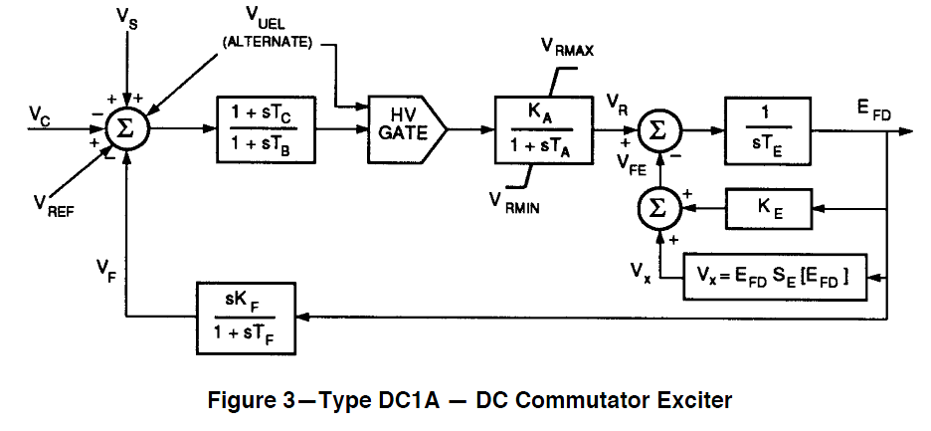
IEEE T1 Evolution
In 1992 IEEE Std 421.5-1992 slightly modified it, calling it the DC1A (modeled as ESDC1A)
V_{UEL} is a signal from an under- excitation limiter, which we'll cover later
Same model is in 421.5-2005
Image Source: Fig 3 of IEEE Std 421.5-1992

