Slide 1
ECE 576 – Power System Dynamics and Stability
Lecture 11: Synchronous Machines Models and Exciters
Prof. Tom Overbye
Dept. of Electrical and Computer Engineering
University of Illinois at Urbana-Champaign
overbye@illinois.edu

Slide 2
Announcements
Homework 3 is on the website and is due on Feb 27
Read Chapters 6 and 4
Midterm exam is on March 13 in class
Closed book, closed notes
You may bring one 8.5 by 11" note sheet
Simple calculators allowed

Slide 3
Summary of Five Book Models
Full model with stator transients
Sub-transient model
Two-axis model
One-axis model
Classical model (const. E behind
)

Slide 4
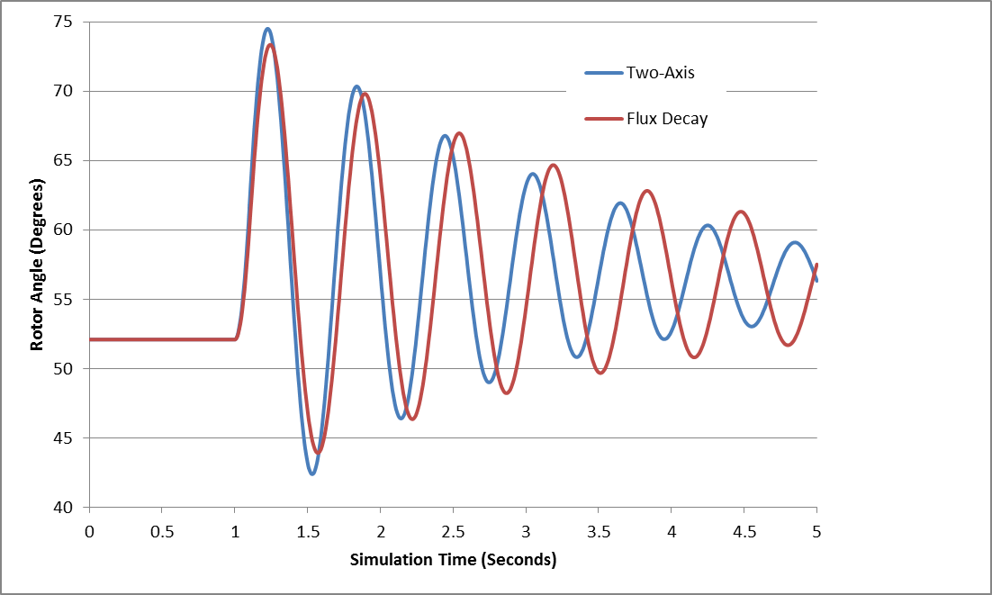
Two-Axis vs Flux Decay
For 4 bus system, figure compares gen 4 rotor angle for bus 3 fault, cleared at t=1.1 seconds

Slide 5
Industrial Models
There are just a handful of synchronous machine models used in North America
GENSAL
Salient pole model
GENROU
Round rotor model that has X"_{d} = X"_{q}
GENTPF
Round or salient pole model that allows X"_{d} <> X"_{q}
GENTPJ
Just a slight variation on GENTPF
We'll briefly cover each one

Slide 6
Subtransient Models
The two-axis model is a transient model
Essentially all commercial studies now use subtransient models
First models considered are GENSAL and GENROU, which require X"_{d}=X"_{q}
This allows the internal, subtransient voltage to be represented as

Slide 7
Subtransient Models
Usually represented by a Norton Injection with
May also be shown as
In steady-state ω = 1.0

Slide 8
GENSAL
The GENSAL model has been widely used to model salient pole synchronous generators
In the 2010 WECC cases about 1/3 of machine models were GENSAL; in 2013 essentially none are, being replaced by GENTPF or GENTPJ
In salient pole models saturation is only assumed to affect the d-axis

Slide 9
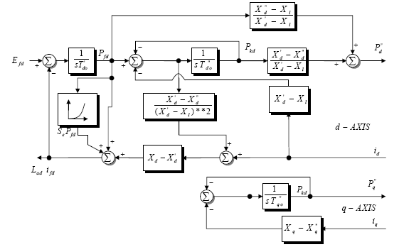
GENSAL Block Diagram (PSLF)
A quadratic saturation function is used. For initialization it only impacts the Efd value

Slide 10
GENSAL Initialization
To initialize this model
Use S(1.0) and S(1.2) to solve for the saturation coefficients
Determine the initial value of δ with
Transform current into dq reference frame, giving i_{d} and i_{q}
Calculate the internal subtransient voltage as
Convert to dq reference, giving P"_{d}+jP"_{q}= ψ "_{d}+ ψ "_{q}
Determine remaining elements from block diagram by recognizing in steady-state input to integrators must be zero

Slide 11
GENSAL Example
Assume same system as before, but with the generator parameters as H=3.0, D=0, R_{a} = 0.01, X_{d} = 1.1, X_{q} = 0.82, X'_{d} = 0.5, X"_{d}=X"_{q}=0.28, X_{l} = 0.13, T'_{do} = 8.2, T"_{do} = 0.073, T"_{qo} =0.07, S(1.0) = 0.05, and S(1.2) = 0.2.
Same terminal conditions as before
Current of 1.0-j0.3286 and generator terminal voltage of 1.072+j0.22 = 1.0946 ∠11.59 °
Use same equation to get initial δ

Slide 12
GENSAL Example
Then And

Slide 13
GENSAL Example
Giving the initial fluxes (with ω = 1.0)
To get the remaining variables set the differential equations equal to zero, e.g.,
Solving the d-axis requires solving two linear equations for two unknowns

Slide 14
GENSAL Example
Once E'_{q} has been determined, the initial field current (and hence field voltage) are easily determined by recognizing in steady-state the derivative of E'_{q} is zero
Saturation coefficients were determined from the two initial values
Saved as case B4_GENSAL

Slide 15
GENROU
The GENROU model has been widely used to model round rotor machines
Saturation is assumed to occur on both the d-axis and the q-axis, making initialization slightly more difficult

Slide 16
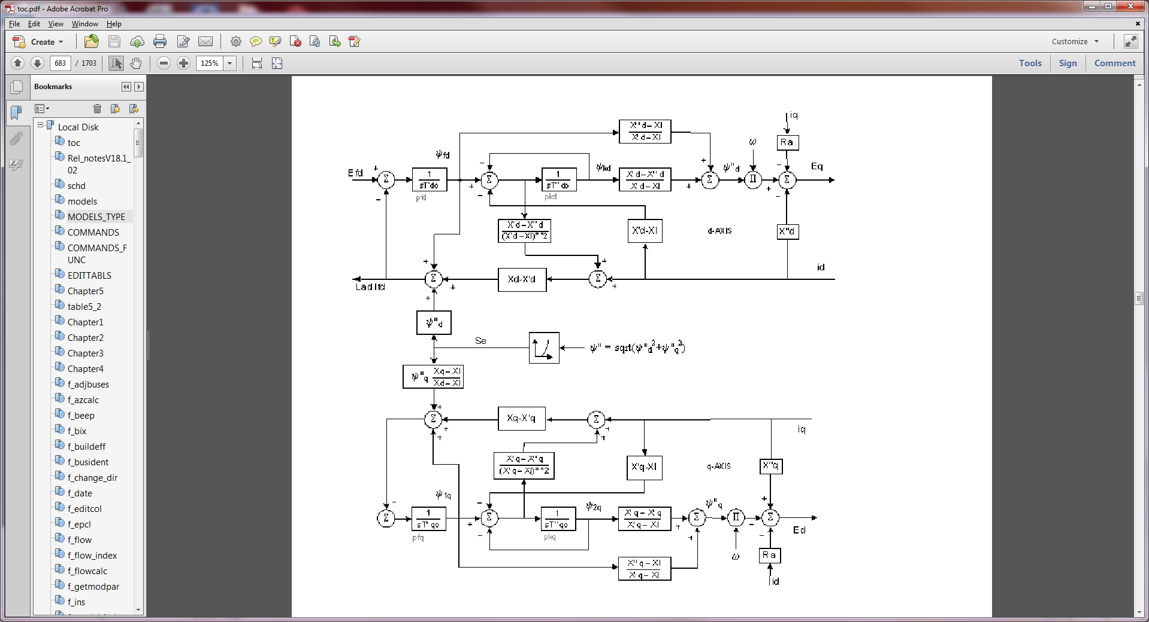
GENROU Block Diagram (PSLF)
The d-axis is similar to that of the GENSAL; the q-axis is now similar to the d-axis. Note saturation affects both axes

Slide 17
GENROU Initialization
Because saturation impacts both axes, the simple approach will no longer work
Key insight for determining initial δ is that the magnitude of the saturation depends upon the magnitude of ψ", which is independent of δ
Solving for δ requires an iterative approach; first get a guess of δ using 3.229 from the book

Slide 18
GENROU Initialization
Then solve five nonlinear equations from five unknowns
The five unknowns are δ, E'_{q}, E'_{d}, ψ '_{q}, and ψ '_{d}
Five equations come from the terminal power flow constraints (giving voltage and current) and from the differential equations initially evaluating to zero
Two differential equations for the q-axis, one for the d-axis (the other equation is used to set the field voltage

Slide 19
GENROU Initialization
Use dq transform to express terminal current as
Get expressions for ψ "_{q} and ψ "_{d} in terms of the initial terminal voltage and δ
Use dq transform to express terminal voltage as
Then from
These values will change during the iteration as δ changes
Recall X_{d}"=X_{q}"=X" and ω=1 (in steady-state)
Expressing complex equation as two real equations

Slide 20
GENROU Initialization Example
Extend the two-axis example
For two-axis assume H = 3.0 per unit-seconds, R_{s}=0, X_{d} = 2.1, X_{q} = 2.0, X'_{d}= 0.3, X'_{q} = 0.5, T'_{do} = 7.0, T'_{qo} = 0.75 per unit using the 100 MVA base.
For subtransient fields assume X"_{d}=X"_{q}=0.28, X_{l} = 0.13, T"_{do} = 0.073, T"_{qo} =0.07
for comparison we'll initially assume no saturation
From two-axis get a guess of δ

Slide 21
GENROU Initialization Example
And the network current and voltage in dq reference
Which gives initial subtransient fluxes (with Rs=0),

Slide 22
GENROU Initialization Example
Without saturation this is the exact solution
Initial values are: δ = 52.1, E'_{q}=1.1298, E'_{d}=0.533, ψ '_{q} =0.6645, and ψ '_{d}=0.9614
Efd=2.9133
Saved as case B4_GENROU_NoSat

Slide 23
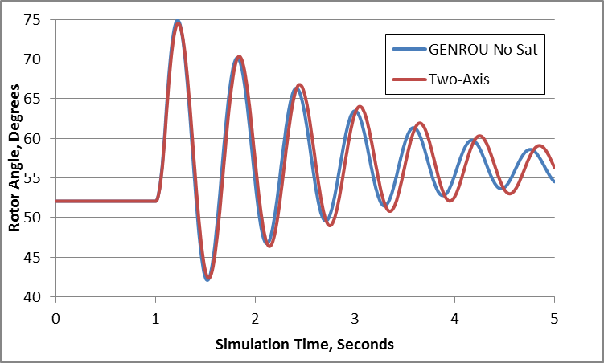
Two-Axis versus GENROU Response
Figure compares rotor angle for bus 3 fault, cleared at t=1.1 seconds

Slide 24
GENROU with Saturation
Nonlinear approach is needed in common situation in which there is saturation
Assume previous GENROU model with S(1.0) = 0.05, and S(1.2) = 0.2.
Initial values are: δ = 49.2, E'_{q}=1.1591, E'_{d}=0.4646, ψ '_{q} =0.6146, and ψ '_{d}=0.9940
Efd=3.2186
Saved as case B4_GENROU_Sat

Slide 25
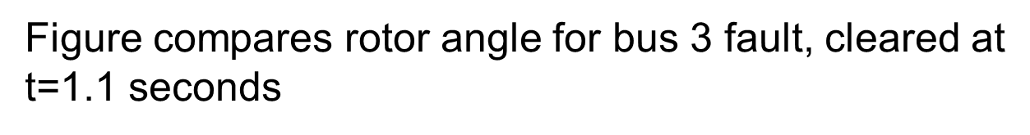
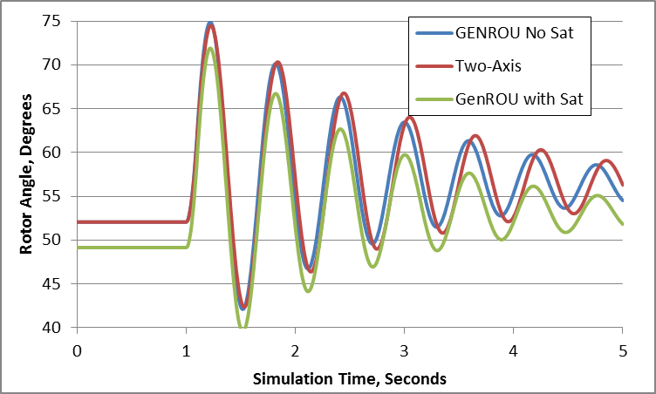
Two-Axis versus GENROU Response

Slide 26
GENTPF and GENTPJ Models
These models were introduced by PSLF in 2009 to provide a better match between simulated and actual system results for salient pole machines
Desire was to duplicate functionality from old BPA TS code
Allows for subtransient saliency (X"_{d} <> X"_{q})
Can also be used with round rotor, replacing GENSAL and GENROU
Useful reference is available at below link; includes all the equations, and saturation details
http://www.wecc.biz/library/WECC%20Documents/Documents%20for%20Generators/Generator%20Testing%20Program/gentpj-typej-definition.pdf

Slide 27
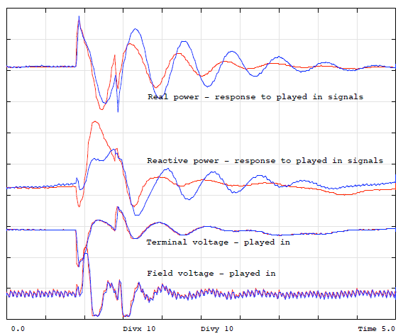
GENSAL Results
Chief Joseph
disturbance playback
GENSAL
BLUE = MODEL
RED = ACTUAL
Image source :https://www.wecc.biz/library/WECC%20Documents/Documents%20for %20Generators/Generator%20Testing%20Program/gentpj%20and%20gensal%20morel.pdf

Slide 28
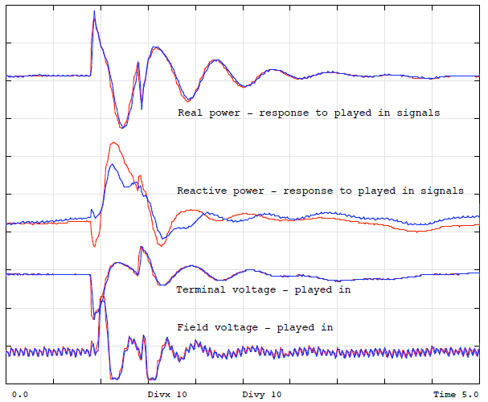
GENTPJ Results
Chief Joseph
disturbance playback
GENTPJ
BLUE = MODEL
RED = ACTUAL

Slide 29
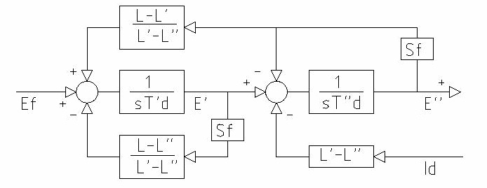
GENTPF and GENTPJ Models
GENTPF/J d-axis block diagram
GENTPJ allows saturation function to include a component that depends on the stator current
Most of WECC machine models are now GENTPF or GENTPJ
Se = 1 + fsat(ψ _{ag} + Kis*It)
If nonzero, Kis typically ranges from 0.02 to 0.12

Slide 30
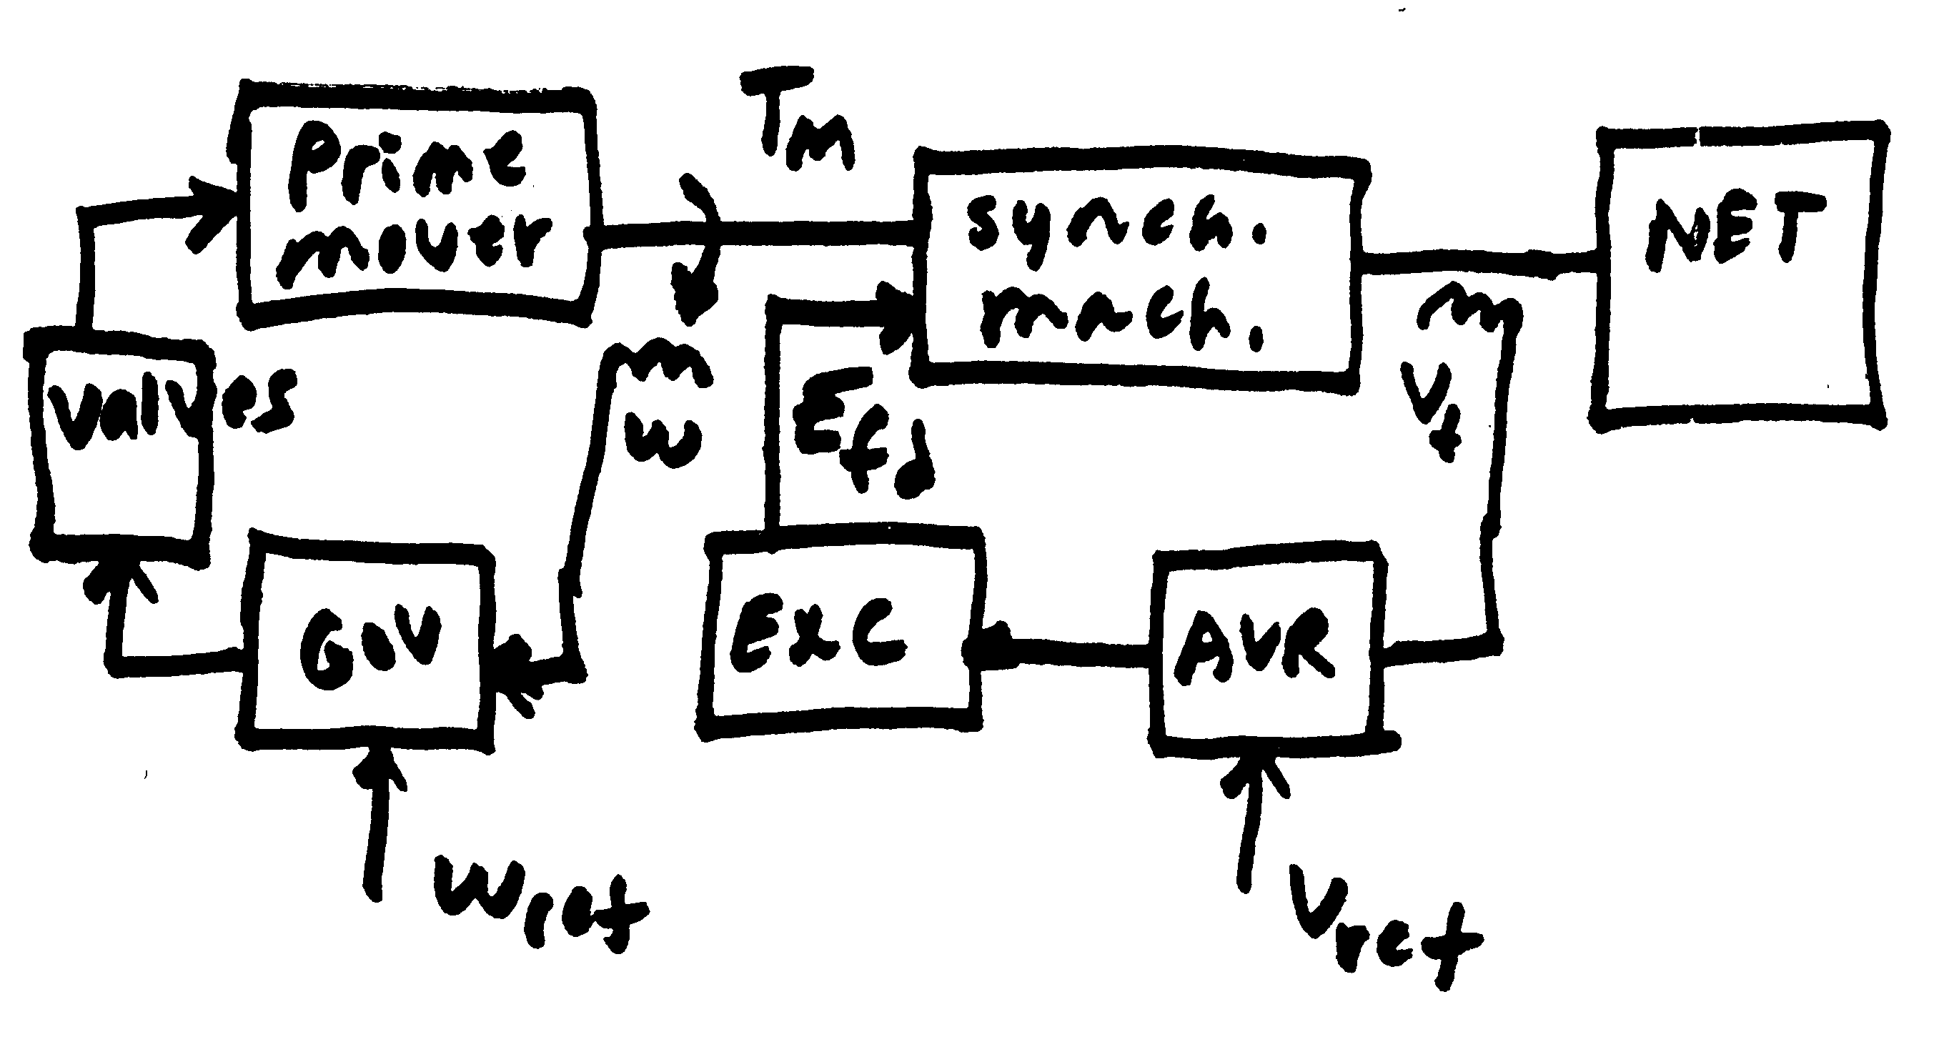
Voltage and Speed Control

Slide 31
Exciters, Including AVR
Exciters are used to control the synchronous machine field voltage and current
Usually modeled with automatic voltage regulator included
A useful reference is IEEE Std 421.5-2005
Covers the major types of exciters used in transient stability simulations
Continuation of standard designs started with "Computer Representation of Excitation Systems," IEEE Trans. Power App. and Syst., vol. pas-87, pp. 1460-1464, June 1968
Another reference is P. Kundur, Power System Stability and Control, EPRI, McGraw-Hill, 1994
Exciters are covered in Chapter 8 as are block diagram basics

Slide 32
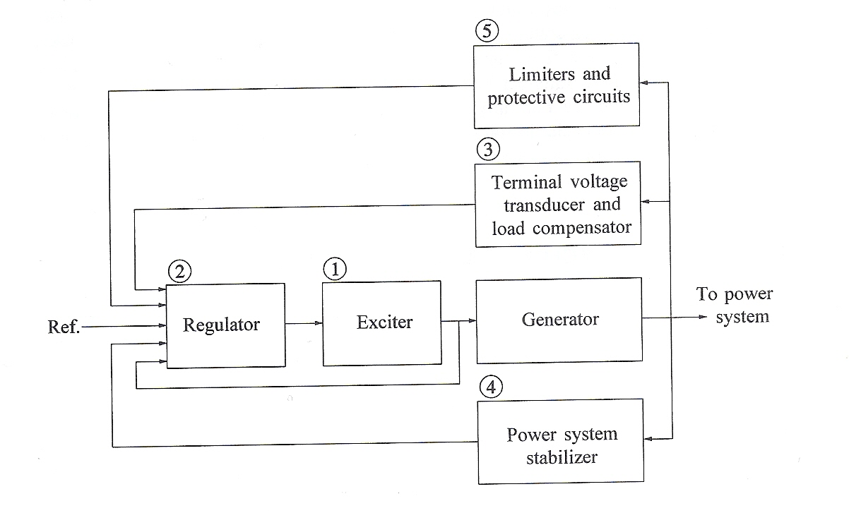
Functional Block Diagram
Image source: Fig 8.1 of Kundur, Power System Stability and Control

Slide 33
Types of Exciters
None, which would be the case for a permanent magnet generator
primarily used with wind turbines with ac-dc-ac converters
DC: Utilize a dc generator as the source of the field voltage through slip rings
AC: Use an ac generator on the generator shaft, with output rectified to produce the dc field voltage; brushless with a rotating rectifier system
Static: Exciter is static, with field current supplied through slip rings

Slide 34
Brief Review of DC Machines
Prior to widespread use of machine drives, dc motors had a important advantage of easy speed control
On the stator a dc machine has either a permanent magnet or a single concentrated winding
Rotor (armature) currents are supplied through brushes and commutator
Equations are
The f subscript refers to the field, the a to the armature; ω is the machine's speed, G is a constant. In a permanent magnet machine the field flux is constant, the field equation goes away, and the field impact is embedded in a equivalent constant to Gi_{f}
Taken mostly from ECE 330 book, M.A. Pai, Power Circuits and Electromechanics

Slide 35
Types of DC Machines
If there is a field winding (i.e., not a permanent magnet machine) then the machine can be connected in the following ways
Separately-excited: Field and armature windings are connected to separate power sources
For an exciter, control is provided by varying the field current (which is stationary), which changes the armature voltage
Series-excited: Field and armature windings are in series
Shunt-excited: Field and armature windings are in parallel

Slide 36
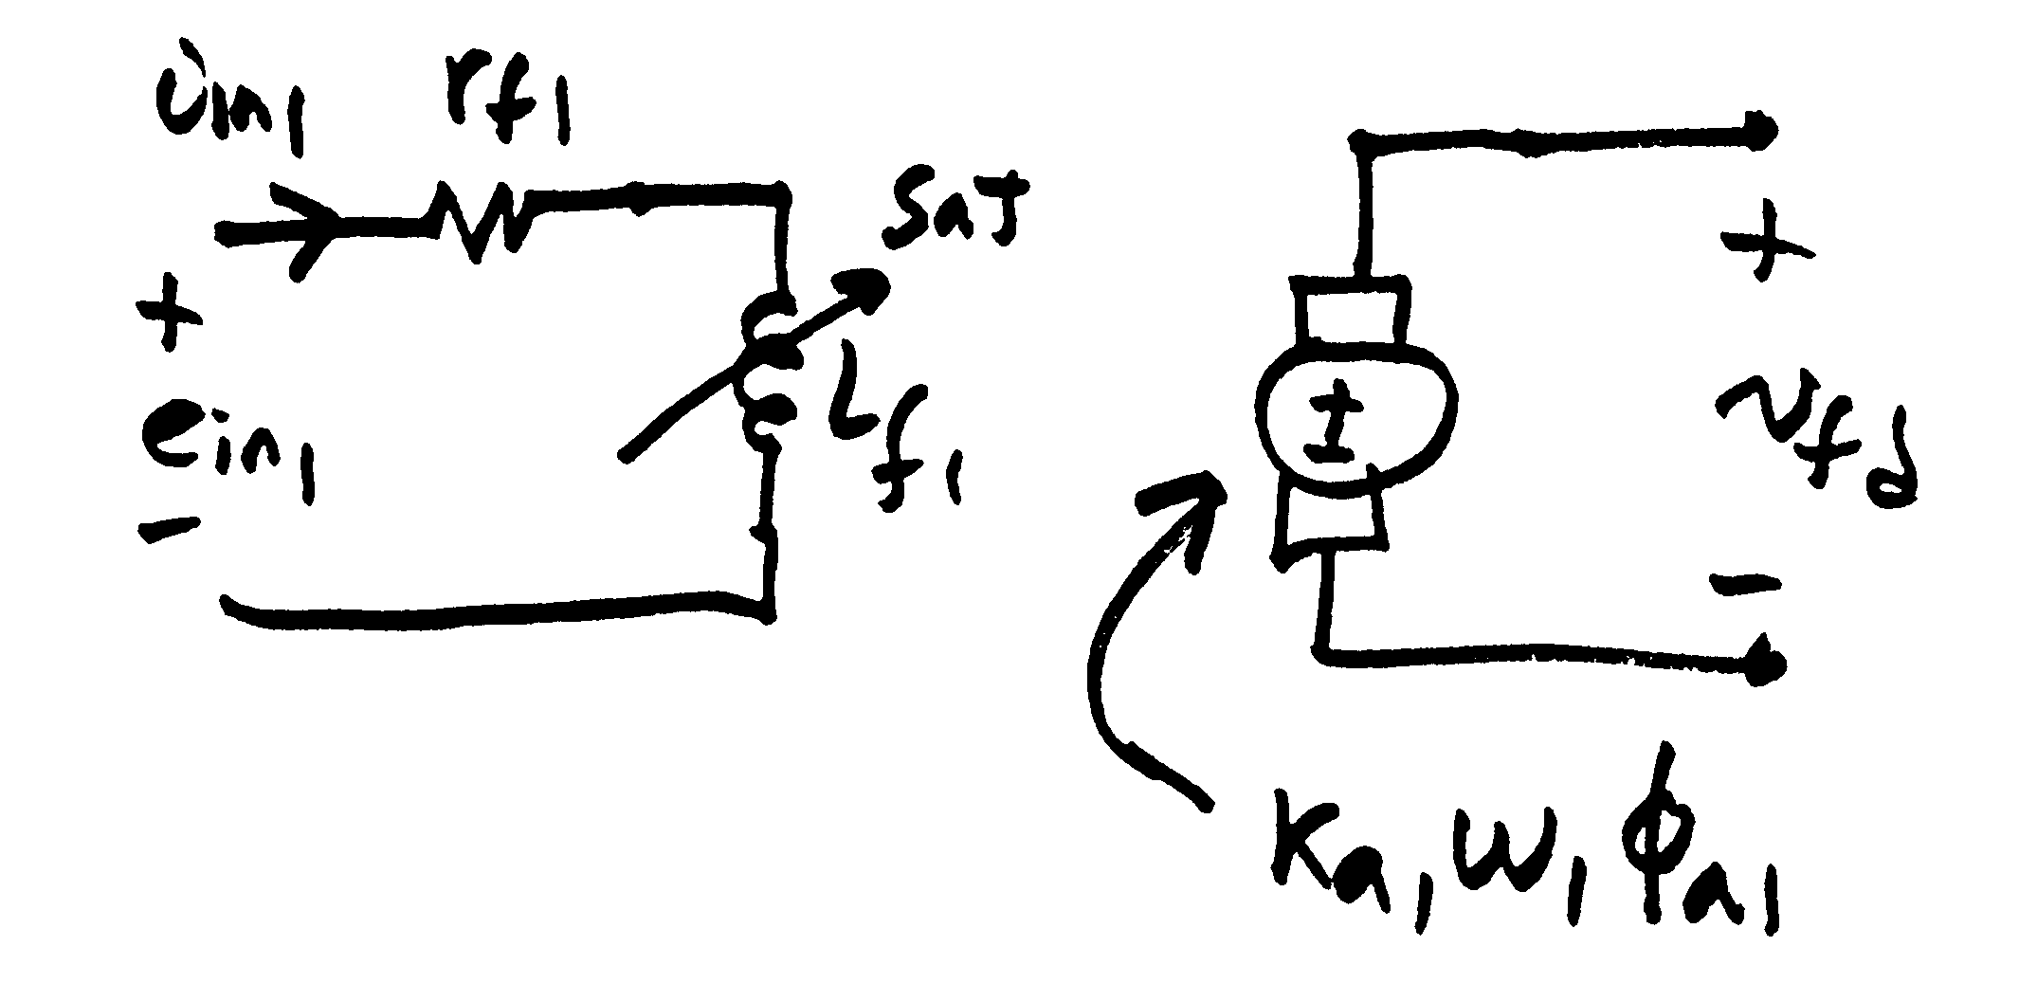
Separately Excited DC Exciter
(to sync
mach)
σ₁ is coefficient of dispersion, modeling the flux leakage

Slide 37
Separately Excited DC Exciter
Relate the input voltage, e_{in1}, to v_{fd}
Assuming a constant speed ω₁

Slide 38
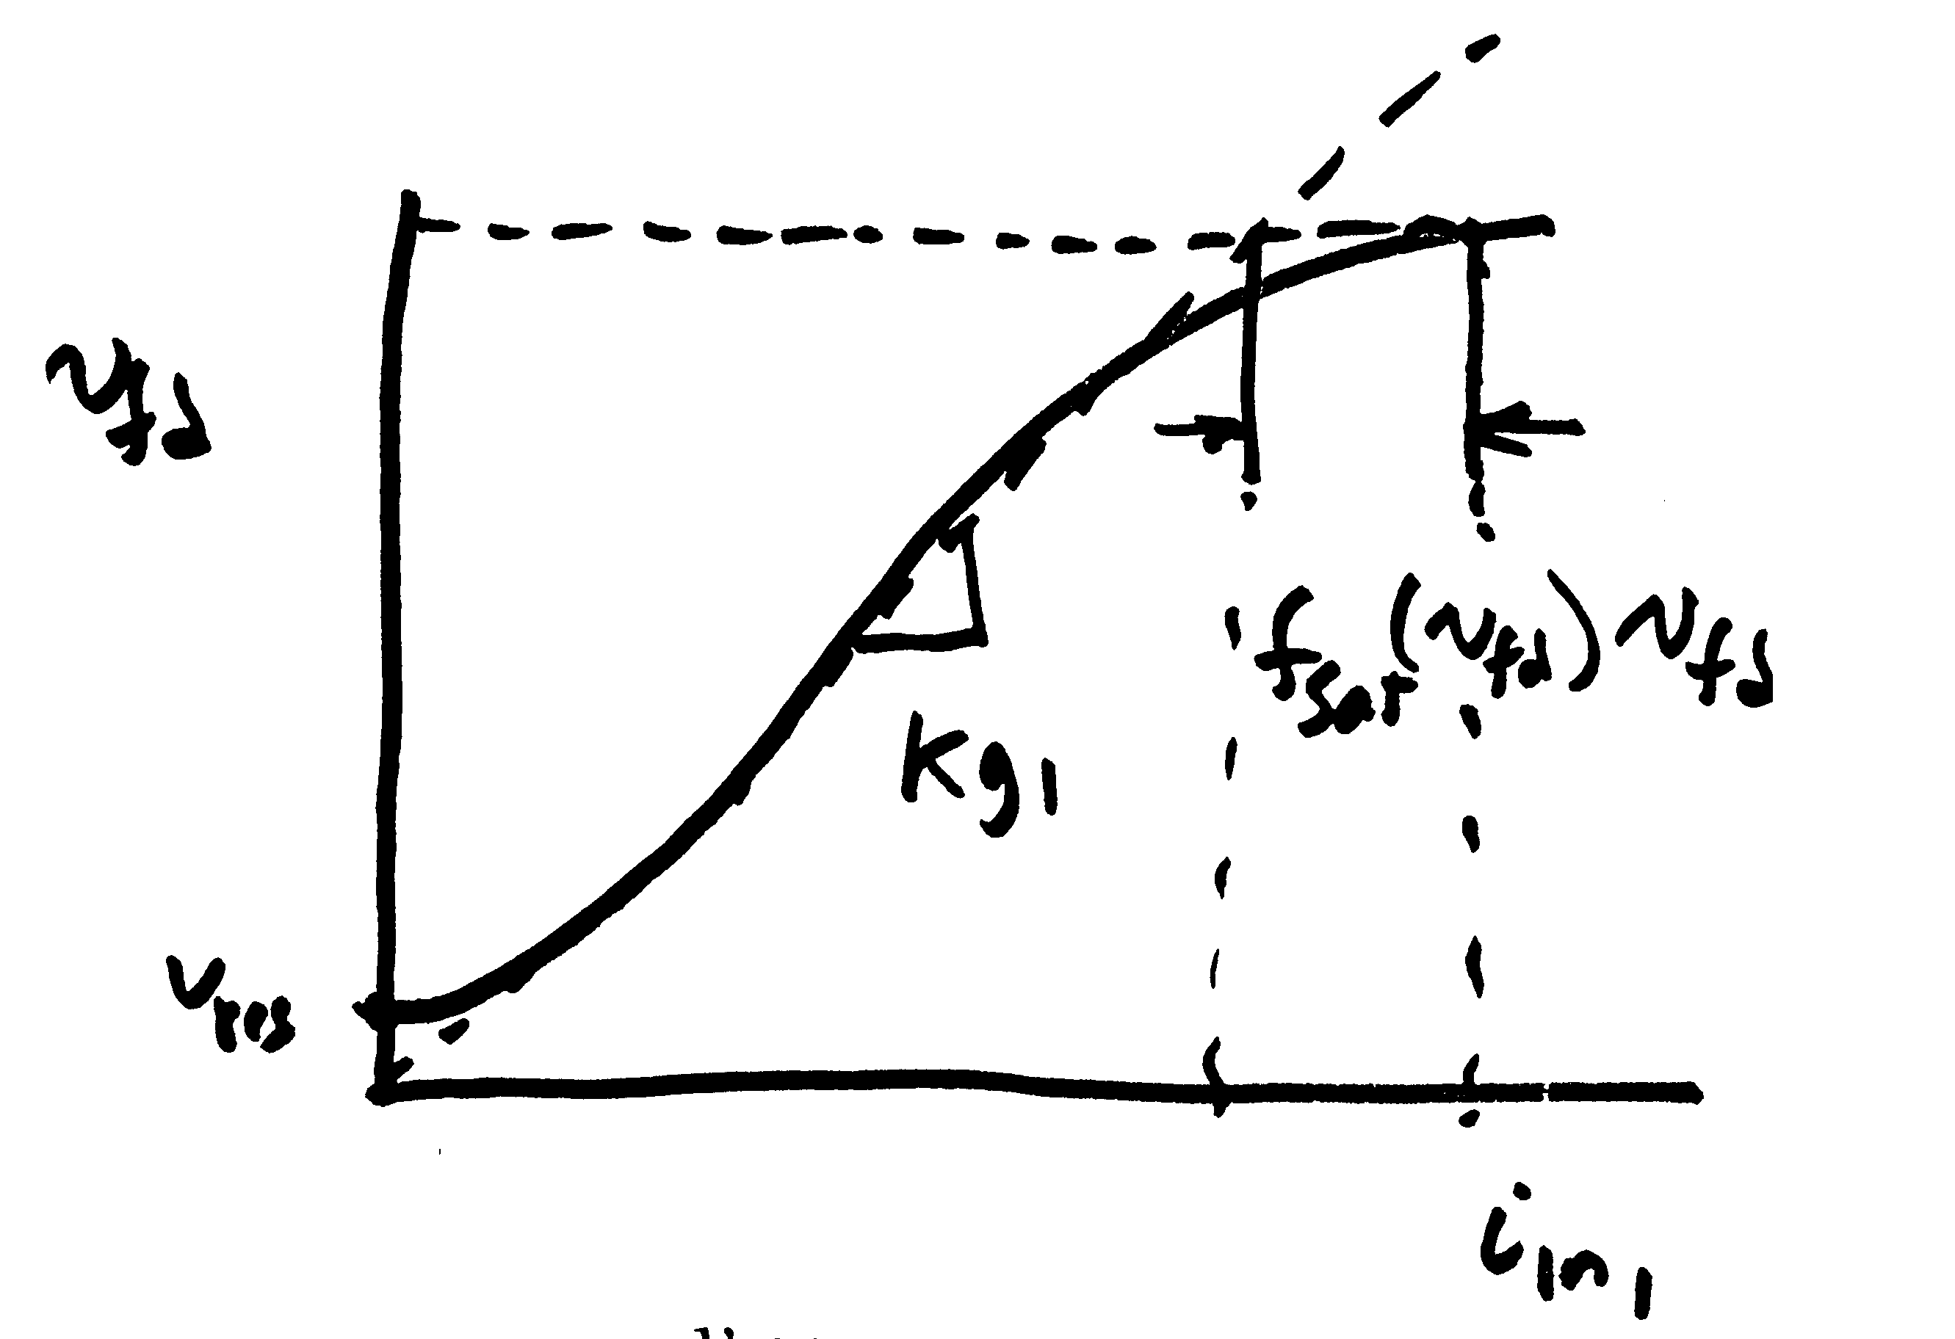
Separately Excited DC Exciter
If it was a linear magnetic circuit, then v_{fd} would be proportional to i_{n1}; for a real system we need to account for saturation
Without saturation we can write

Slide 39
Separately Excited DC Exciter
This equation is then scaled based on the synchronous machine base values

Slide 40
Separately Excited Scaled Values
V_{r} is the scaled output of the voltage regulator amplifier
Thus we have

Slide 41
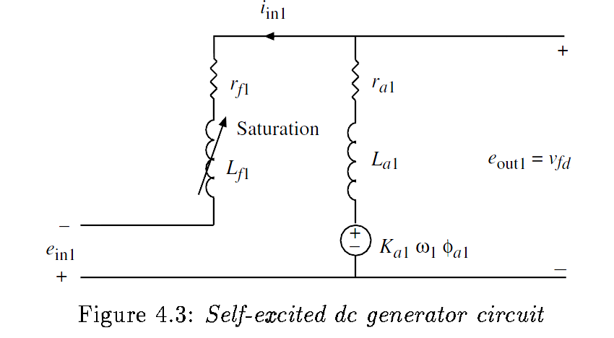
The Self-Excited Exciter
When the exciter is self-excited, the amplifier voltage appears in series with the exciter field
Note the additional E_{fd} term on the end

Slide 42
Self and Separated Exciter Exciters
The same model can be used for both by just modifying the value of K_{E}

