Slide 1
ECE 576 – Power System Dynamics and Stability
Lecture 1: Numeric Solution of Differential Equations
Prof. Tom Overbye
Dept. of Electrical and Computer Engineering
University of Illinois at Urbana-Champaign
overbye@illinois.edu
Special Guest: TA Soobae Kim

Slide 2
Announcements
Prof. Overbye is out of town today. He'll be back on Thursday, and will give a course introduction then
Today's lecture reviews integration of differential equations, mostly material covered in prerequisite classes such as ECE 530

Slide 3
Differential Algebraic Equations
Many problems, including many in the power area, can be formulated as a set of differential, algebraic equations (DAE) of the form
A power example is transient stability, in which f represents (primarily) the generator dynamics, and g (primarily) the bus power balance equations
We'll initially consider the simpler problem of just

Slide 4
Ordinary Differential Equations (ODEs)
Assume we have a problem of the form
This is known as an initial value problem, since the initial value of x is given at some time t₀
We need to determine x(t) for future time
Initial value, x₀, must be either be given or determined by solving for an equilibrium point, f(x) = 0
Higher-order systems can be put into this first order form
Except for special cases, such as linear systems, an analytic solution is usually not possible – numerical methods must be used

Slide 5
Equilibrium Points
An equilibrium point x* satisfies
An equilibrium point is stable if the response to a small disturbance remains small
This is known as Lyapunov stability
Formally, if for every ε > 0, there exists a δ = δ(ε) > 0 such that if x(0) – x* < δ, then x(t) – x* < ε for t ≥ 0
An equilibrium point has asymptotic stability if there exists a δ > 0 such that if x(0) – x* < δ, then

Slide 6
Power System Application
A typical power system application is to assume the power flow solution represents an equilibrium point
Back solve to determine the initial state variables, x(0)
At some point a contingency occurs, perturbing the state away from the equilibrium point
Time domain simulation is used to determine whether the system returns to the equilibrium point

Slide 7

Initial value Problem Examples

Slide 8
Numerical Solution Methods
Numerical solution methods do not generate exact solutions; they practically always introduce some error
Methods assume time advances in discrete increments, called a stepsize (or time step), Δt
Speed accuracy tradeoff: a smaller Δt usually gives a better solution, but it takes longer to compute
Numeric roundoff error due to finite computer word size
Key issue is the derivative of x, f(x) depends on x, the value we are trying to determine
A solution exists as long as f(x) is continuously differentiable

Slide 9
Numerical Solution Methods
There are a wide variety of different solution approaches, we will only touch on several
One-step methods: require information about solution just at one point, x(t)
Forward Euler
Runge-Kutta
Multi-step methods: make use of information at more than one point, x(t), x(t-Δt), x(t-Δ2t)…
Adams-Bashforth
Predictor-Corrector Methods: implicit
Backward Euler

Slide 10
Error Propagation
At each time step the total round-off error is the sum of the local round-off at time and the propagated error from steps 1, 2 , … , k − 1
An algorithm with the desirable property that local round-off error decays with increasing number of steps is said to be numerically stable
Otherwise, the algorithm is numerically unstable
Numerically unstable algorithms can nevertheless give quite good performance if appropriate time steps are used
This is particularly true when coupled with algebraic equations

Slide 11
Forward Euler’s Method
The simplest technique for numerically integrating such equations is known as the Euler's Method (sometimes the Forward Euler's Method)
Key idea is to approximate
In general, the smaller the Δt, the more accurate the solution, but it also takes more time steps

Slide 12
Euler’s Method Algorithm

Slide 13
Euler’s Method Example 1

Slide 14
Euler’s Method Example 1, cont’d
t | x^{actual}(t) | x(t) Δt=0.1 | x(t) Δt=0.05
0 | 10 | 10 | 10
0.1 | 9.048 | 9 | 9.02
0.2 | 8.187 | 8.10 | 8.15
0.3 | 7.408 | 7.29 | 7.35
… | … | … | …
1.0 | 3.678 | 3.49 | 3.58
… | … | … | …
2.0 | 1.353 | 1.22 | 1.29

Slide 15
Euler’s Method Example 2

Slide 16
Euler's Method Example 2, cont'd

Slide 17
Euler's Method Example 2, cont'd
t | x₁^{actual}(t) | x₁(t) Δt=0.25
0 | 1 | 1
0.25 | 0.9689 | 1
0.50 | 0.8776 | 0.9375
0.75 | 0.7317 | 0.8125
1.00 | 0.5403 | 0.6289
… | … | …
10.0 | -0.8391 | -3.129
100.0 | 0.8623 | -151,983
Since we know from the exact solution that x1 is bounded between -1 and 1, clearly the method is numerically unstable

Slide 18
Euler's Method Example 2, cont'd
Below is a comparison of the solution values for x₁(t)
at time t = 10 seconds
Δt | x₁(10)
actual | -0.8391
0.25 | -3.129
0.10 | -1.4088
0.01 | -0.8823
0.001 | -0.8423

Slide 19
Second Order Runge-Kutta Method
Runge-Kutta methods improve on Euler's method by evaluating f(x) at selected points over the time step
Simplest method is the second order method in which
That is, k₁ is what we get from Euler's; k₂ improves on this by reevaluating at the estimated end of the time step

Slide 20
Second Order Runge-Kutta Algorithm
t = 0, x(0) = x₀, Δt = step size
While t ≤ t^{final} Do
k1 = Δt f(x(t))
k2 = Δt f(x(t) + k1)
x(t+Δt) = x(t) + ( k1 + k2)/2
t = t + Δt
End While

Slide 21
RK2 Oscillating Cart
Consider the same example from before the position of a cart attached to a lossless spring. Again, with initial conditions of x₁(0) =1 and x₂(0) = 0, the analytic solution is x₁(t) = cos(t)
With Δt=0.25 at t = 0

Slide 22
RK2 Oscillating Cart

Slide 23
Comparison
The below table compares the numeric and exact solutions for x1(t) using the RK2 algorithm
time | actual x₁(t) | x₁(t) with RK2 Δt=0.25
0 | 1 | 1
0.25 | 0.9689 | 0.969
0.50 | 0.8776 | 0.876
0.75 | 0.7317 | 0.728
1.00 | 0.5403 | 0.533
10.0 | -0.8391 | -0.795
100.0 | 0.8623 | 1.072

Slide 24
Comparison of x₁(10) for varying Δt
The below table compares the x₁(10) values for different values of Δt; recall with Euler's with Δt=0.1 was -1.41 and with 0.01 was -0.8823
Δt | x₁(10)
actual | -0.8391
0.25 | -0.7946
0.10 | -0.8310
0.01 | -0.8390
0.001 | -0.8391

Slide 25
RK2 Versus Euler's
RK2 requires twice the function evaluations per iteration, but gives much better results
With RK2 the error tends to vary with the cube of the step size, compared with the square of the step size for Euler's
The smaller error allows for larger step sizes compared to Eulers

Slide 26
Fourth Order Runge-Kutta
Other Runge-Kutta algorithms are possible, including the fourth order

Slide 27
RK4 Oscillating Cart Example
RK4 gives much better results, with error varying with the time step to the fifth power
time | actual x₁(t) | x₁(t) with RK4 Δt=0.25
0 | 1 | 1
0.25 | 0.9689 | 0.9689
0.50 | 0.8776 | 0.8776
0.75 | 0.7317 | 0.7317
1.00 | 0.5403 | 0.5403
10.0 | -0.8391 | -0.8392
100.0 | 0.8623 | 0.8601

Slide 28
Multistep Methods
Euler's and Runge-Kutta methods are single step approaches, in that they only use information at x(t) to determine its value at the next time step
Multistep methods take advantage of the fact that using we have information about previous time steps x(t-Δt), x(t-2Δt), etc
These methods can be explicit or implicit (dependent on x(t+Δt) values; we'll just consider the explicit Adams-Bashforth approach

Slide 29
Multistep Motivation
In determining x(t+Δt) we could use a Taylor series expansion about x(t)
(note Euler's is just the first two terms on the right-hand side)

Slide 30
Adams-Bashforth
What we derived is the second order Adams-Bashforth approach. Higher order methods are also possible, by approximating subsequent derivatives. Here we also present the third order Adams-Bashforth

Slide 31
Adams-Bashforth Versus Runge-Kutta
The key Adams-Bashforth advantage is the approach only requires one function evaluation per time step while the RK methods require multiple evaluations
A key disadvantage is when discontinuities are encountered, such as with limit violations;
Another method needs to be used until there are sufficient past solutions
They also have difficulties if variable time steps are used

Slide 32
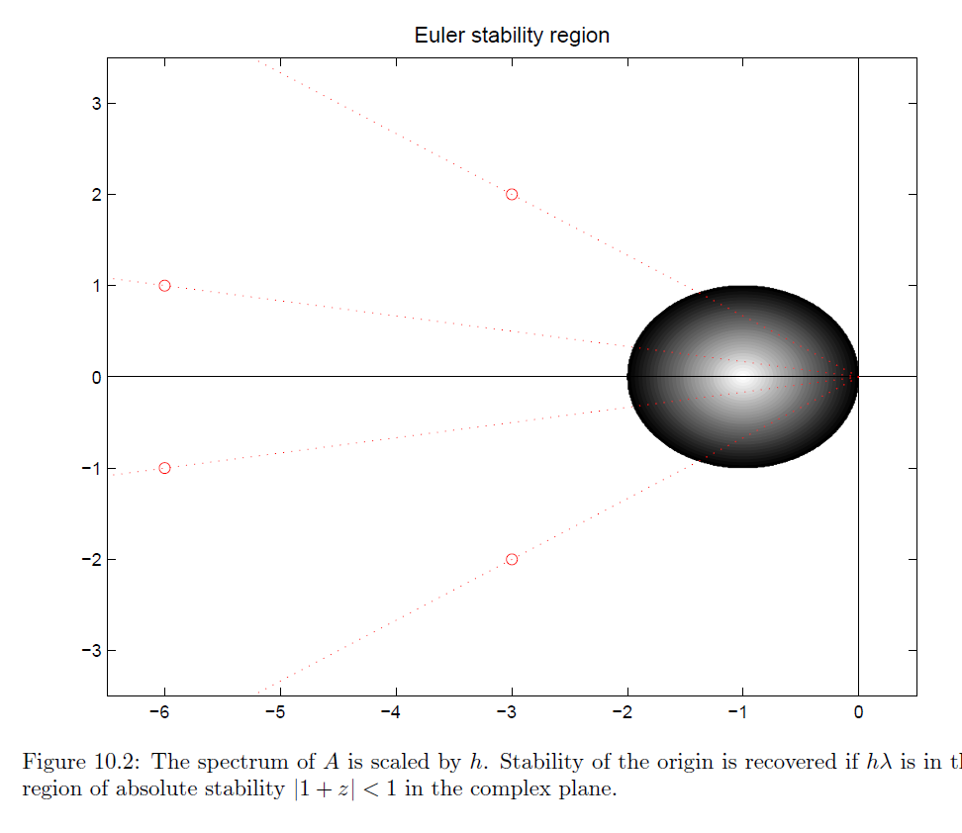
Numerical Instability
All explicit methods can suffer from numerical instability if the time step is not correctly chosen for the problem eigenvalues
Values are scaled by the time step; the shape for RK2 has similar dimensions but is closer to a square. Key point is to make sure the time step is small enough relative to the eigenvalues
Image source: http://www.staff.science.uu.nl/~frank011/Classes/numwisk/ch10.pdf

Slide 33
Stiff Differential Equations
Stiff differential equations are ones in which the desired solution has components the vary quite rapidly relative to the solution
Stiffness is associated with solution efficiency: in order to account for these fast dynamics we need to take quite small time steps

Slide 34
Implicit Methods
Implicit solution methods have the advantage of being numerically stable over the entire left half plane
Only methods considered here are the is the Backward Euler and Trapezoidal

Slide 35
Implicit Methods
The obvious difficulty associated with these methods is x(t) appears on both sides of the equation
Easiest to show the solution for the linear case:

Slide 36
Backward Euler Cart Example
Returning to the cart example

Slide 37
Backward Euler Cart Example
Results with Δt = 0.25 and 0.05
time | actual x₁(t) | x₁(t) with Δt=0.25 | x₁(t) with Δt=0.05
0 | 1 | 1 | 1
0.25 | 0.9689 | 0.9411 | 0.9629
0.50 | 0.8776 | 0.8304 | 0.8700
0.75 | 0.7317 | 0.6774 | 0.7185
1.00 | 0.5403 | 0.4935 | 0.5277
2.00 | -0.416 | -0.298 | -0.3944
Note: Just because the method is numerically stable doesn't mean it is doesn't have errors! RK2 is more accurate than backward Euler.

Slide 38
Trapezoidal Linear Case
For the trapezoidal with a linear system we have

Slide 39
Trapezoidal Cart Example
Results with Δt = 0.25, comparing between backward Euler and trapezoidal
time | actual x₁(t) | Backward Euler | Trapezoidal
0 | 1 | 1 | 1
0.25 | 0.9689 | 0.9411 | 0.9692
0.50 | 0.8776 | 0.8304 | 0.8788
0.75 | 0.7317 | 0.6774 | 0.7343
1.00 | 0.5403 | 0.4935 | 0.5446
2.00 | -0.416 | -0.298 | -0.4067

