Slide 1
Variations on Theme by Huffman
Paper by Robert G Gallager
Presentation by Rutvik Choudhary and Carl Xu

Slide 2
The Sibling Property: An Equivalence of Huffman Code
Recall:
Every binary prefix code (e.g., binary Huffman code) can be represented as a binary code tree.
Huffman code is optimal in encoding single strings.
Root
Is this code tree a Huffman code tree?
0
1
0.6
0.4
0
1
0
1
0.3
0.3
0.2
0.2
0
1
0
1
0.15
0.15
0.15
0.05

Slide 3
The Sibling Property: An Equivalence of Huffman Code
Definition: (The Sibling Property)
We say a binary code tree has the sibling property if each non-root node has a sibling, and all non-root nodes can be listed in order of non-increasing probability such that each node is adjacent to its sibling.
Node | Probability
A | 0.6
B | 0.4
C | 0.3
D | 0.3
E | 0.2
F | 0.2
G | 0.15
H | 0.15
I | 0.15
J | 0.05
Root
0
1
A: 0.6
B: 0.4
0
1
0
1
C: 0.3
D: 0.3
E: 0.2
F: 0.2
0
1
0
1
G: 0.15
H: 0.15
I: 0.15
J: 0.05

Slide 4
The Sibling Property: An Equivalence of Huffman Code
Theorem:
A binary prefix code is a Huffman code if and only if the code tree has the sibling property.
Root
0
1
A: 0.6
B: 0.4
0
1
0
1
C: 0.3
D: 0.3
E: 0.2
F: 0.2
0
1
0
1
G: 0.15
H: 0.15
I: 0.15
J: 0.05

Slide 5
The Sibling Property: An Equivalence of Huffman Code
Node | Probability
A | 0.6
B | 0.4
C | 0.3
D | 0.3
E | 0.2
F | 0.2
G | 0.15
H | 0.15
I | 0.15
J | 0.05
Sketch of Proof:
(IF) Suppose the sibling property holds. Then the last 2 elements in the list must be leaves and siblings. Remove the 2 nodes from the tree. The probability of the parent node is the sum of the probabilities of the 2 removed nodes. The sibling property still holds in the trimmed tree. By iterating the above steps, we are doing exactly the same thing as we implement the Huffman code. Therefore, sibling property implies Huffman.
Root
0
1
A: 0.6
B: 0.4
0
1
0
1
C: 0.3
D: 0.3
E: 0.2
F: 0.2
0
1
0
1
G: 0.15
H: 0.15
I: 0.15
J: 0.05

Slide 6
The Sibling Property: An Equivalence of Huffman Code
Node | Probability
A | 0.6
B | 0.4
C | 0.3
D | 0.3
E | 0.2
F | 0.2
G | 0.15
H | 0.15
I | 0.15
J | 0.05
Sketch of Proof (Continued):
(ONLY IF) Suppose a binary code tree is a Huffman code. Consider an empty list. For each “combining” step in Huffman coding, append (in ascending order) the 2 sibling nodes’ probabilities to the list. Also notice that the probability of a parent node is no less than any of its child node’s probability. Hence, the list is monotone.
Root
0
1
A: 0.6
B: 0.4
0
1
0
1
C: 0.3
D: 0.3
E: 0.2
F: 0.2
0
1
0
1
G: 0.15
H: 0.15
I: 0.15
J: 0.05

Slide 7
The Sibling Property: An Equivalence of Huffman Code
Node | Probability
A | 0.6
B | 0.4
C | 0.3
D | 0.3
E | 0.2
F | 0.2
G | 0.15
H | 0.15
I | 0.15
J | 0.05
An Enhanced Corollary:
A binary prefix code is an ordered Huffman code if and only if the code tree is lexicographically ordered.
Definition:
A Huffman code is ordered if every sibling pairs have 0 assigned to the more possible node.
A code tree is lexicographically ordered if the probability of every lower-level node is no less than the probability of every higher-level node, and the probabilities of nodes at the same level are non-increasing in the binary number corresponding to their paths.
Root
0
1
A: 0.6
B: 0.4
0
1
0
1
C: 0.3
D: 0.3
E: 0.2
F: 0.2
0
1
0
1
G: 0.15
H: 0.15
I: 0.15
J: 0.05

Slide 8
Adaptive Huffman Coding: Estimating Varying Statistics
Recall:
Huffman code needs a probability mass function, which is usually not available in real-world implementations.
Statistics of a stream of source code can change.
Huffman coding is optimal for the *current* estimation.
It is computationally costly to re-compute Huffman code for every source update in the stream
We want to efficiently adjust the Huffman code according to the source statistics.

Slide 9
Adaptive Huffman Coding: Estimating Varying Statistics
Algorithm Flow:
Use counting instead of frequency to estimate the probability mass.
Hyper-parameters $\left(N,α\right)∈ℕ×(0,1)$: multiply each counter with $α$ after every $N$ source input. They control how fast the code “learns” and “forgets”.
Data structures: store siblings together; use pointers to indicate the code tree’s structure.
Update rules: compare and/or swapping between siblings after updating counters by the source input. Instead of re-computing the Huffman code tree, we manipulate the data structure to reduce computational cost.

Slide 10
Adaptive Huffman Coding: Estimating Varying Statistics
Algorithm Flow Chart:
$$α∗counts$$
Yes
$$N|\left(total input\right)?$$
No
Yes
Source | Count
A | 2
B | 2 + 1
C | 2
Source | Count
B | 3
A | 2
C | 2
Source input B
More symbols?
No
Output code
0
root
1
0
root
1
?
3
A: 2
3
B: 3
0
1
0
1
B: 2
C: 1
A: 2
C: 1

Slide 11
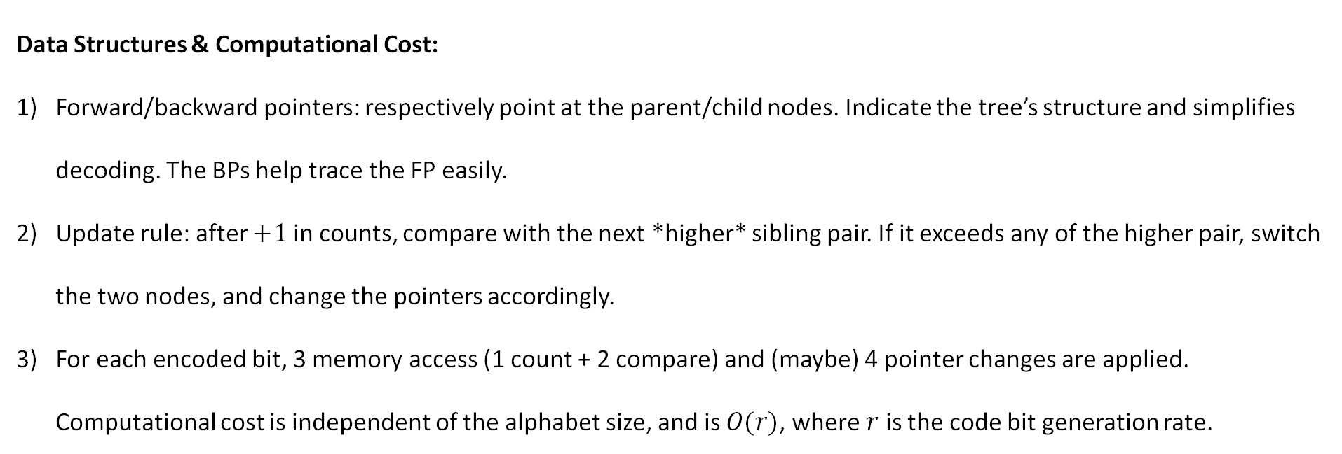
Adaptive Huffman Coding: Estimating Varying Statistics
Data Structures & Computational Cost:
Forward/backward pointers: respectively point at the parent/child nodes. Indicate the tree’s structure and simplifies decoding. The BPs help trace the FP easily.
Update rule: after $+1$ in counts, compare with the next *higher* sibling pair. If it exceeds any of the higher pair, switch the two nodes, and change the pointers accordingly.
For each encoded bit, 3 memory access (1 count + 2 compare) and (maybe) 4 pointer changes are applied. Computational cost is independent of the alphabet size, and is $O(r)$, where $r$ is the code bit generation rate.
0
root
1
0
root
1
?
3
A: 2
3
B: 3
0
1
0
1
B: 2
C: 1
A: 2
C: 1

Slide 12
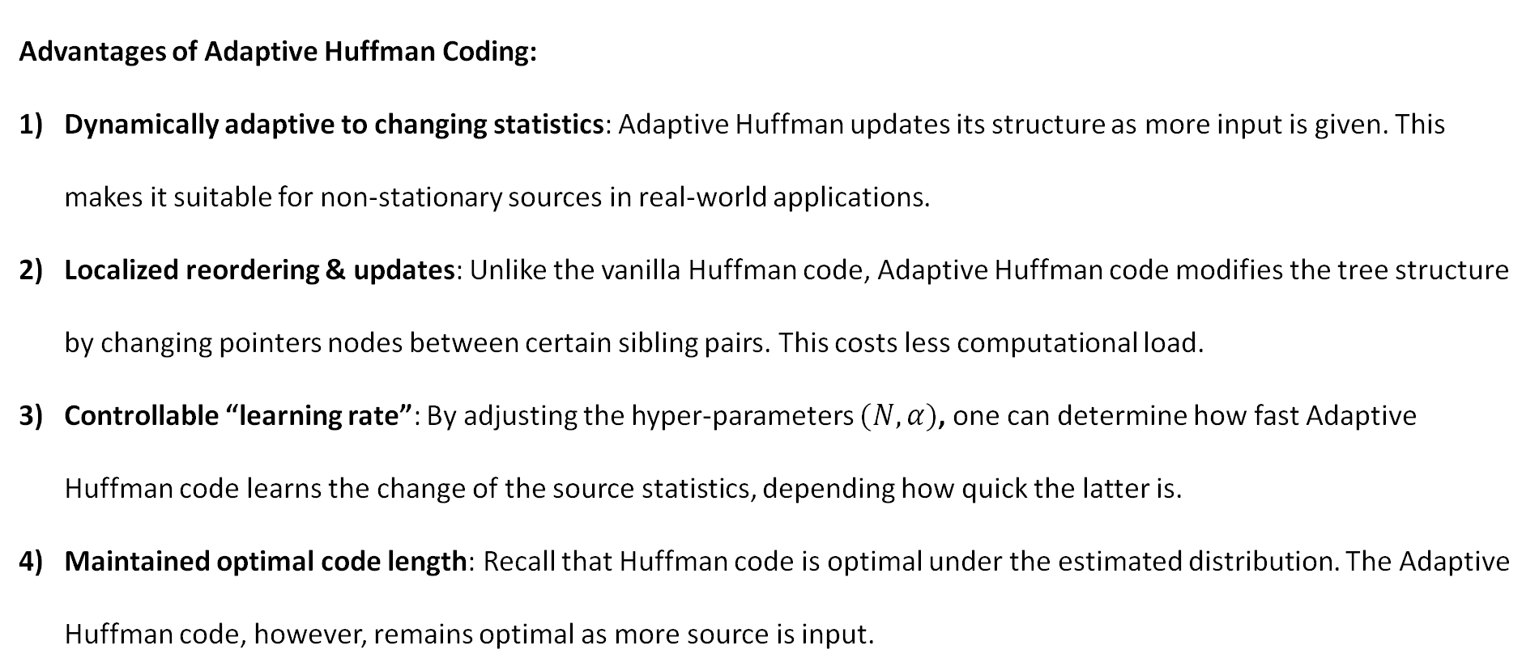
Adaptive Huffman Coding: Estimating Varying Statistics
Advantages of Adaptive Huffman Coding:
Dynamically adaptive to changing statistics: Adaptive Huffman updates its structure as more input is given. This makes it suitable for non-stationary sources in real-world applications.
Localized reordering & updates: Unlike the vanilla Huffman code, Adaptive Huffman code modifies the tree structure by changing pointers nodes between certain sibling pairs. This costs less computational load.
Controllable “learning rate”: By adjusting the hyper-parameters $(N,α)$, one can determine how fast Adaptive Huffman code learns the change of the source statistics, depending how quick the latter is.
Maintained optimal code length: Recall that Huffman code is optimal under the estimated distribution. The Adaptive Huffman code, however, remains optimal as more source is input.

Slide 13
Note: We’re going to be working with a binary code alphabet!
Let $X$ be a source random variable with $K$ symbols. Denote the probabilities of each symbol as $p_{1}, …,p_{K}$ (where $p_{1}≥p_{2}≥…≥p_{K}$) and denote the codeword lengths of each symbol as $n_{1},…, n_{K}$.
We saw in class that the average code length
$$E\left(n\right)=\sum_{i=1}^{K}{p_{i}n_{i}}$$
of an optimal code is bounded as follows $$H\left(X\right)≤E\left(n\right)≤H\left(X\right)+1$$
We define the redundancy of a code as $r=E\left(n\right)−H\left(X\right)$. See that trivially $0≤r≤1.$
CLAIM: we can tighten the upper bound on the redundancy as $r≤p_{1}+σ$ where $σ=1−\log{e}+\log{\log{e}}≈0.086$. If $p_{1}≥1/2$, then $r≤p_{1}$.

Slide 14
Per the sibling property, we can create a list of the $2K−2$ nodes in the Huffman tree such that for any $1≤k≤K−1$, nodes $2k$ and $2k−1$ are siblings.
Another way of writing the expected length is $$E\left(n\right)=\sum_{k=1}^{2K−2}{q_{k}}$$
To see this, look at the Huffman tree on the right
$$p_{3}$$
$$p_{4}$$
$$q_{7}$$
$$q_{8}$$
$$q_{9}$$
$$q_{10}$$
$$p_{1}$$
$$p_{3}+p_{4}$$
$$q_{3}$$
$$q_{4}$$
$$q_{5}$$
$$q_{6}$$
$$q_{1}$$
$$q_{2}$$
$$p_{1}+p_{3}+p_{4}$$

Slide 15
We can also rewrite the entropy as follows $$H\left(X\right)=\sum_{k=1}^{K−1}{\left(q_{2k}+q_{2k−1}\right) ℋ\left(\frac{q_{2k}}{q_{2k}+q_{2k−1}}\right)}$$ where $ℋ$ denotes the binary choice entropy function.
Recall that nodes $2k$ and $2k−1$ are siblings. So $q_{2k}+q_{2k−1}$ represents the probability of picking the parent of these two siblings, and $ℋ\left(\frac{q_{2k}}{q_{2k}+q_{2k−1}}\right)$ represents the entropy associated with the choice of which child given the parent was chosen.
So this is essentially an application of the grouping property of entropy.

Slide 16

We can now rewrite the redundancy of the code as follows
$$r=\sum_{k=1}^{2K−2}{q_{k}}−\sum_{k=1}^{K−1}{\left(q_{2k}+q_{2k−1}\right) ℋ\left(\frac{q_{2k}}{q_{2k}+q_{2k−1}}\right)}$$
Notice that
$$\sum_{k=1}^{2K−2}{q_{k}=\sum_{k=1}^{K−1}{q_{2k}+q_{2k−1}}}$$
Thus
$$r=\sum_{k=1}^{K−1}{\left(q_{2k}+q_{2k−1}\right) \left[1−ℋ\left(\frac{q_{2k}}{q_{2k}+q_{2k−1}}\right)\right]}$$

Slide 17
What we’re going to do now is split the $K−1$ terms of the summation into two parts.
Let $l$ denote a level of the tree that is “full” (i.e. it has $L=2^{l}$ nodes) AND for which there exists a level $l+1$.
Let $m$ be an integer such that node $2m−1$ is in level $l+1$. Let $q_{1}^{′}, …,q_{L}^{′}$ denote the probabilities of the nodes at level $l$. For a visualization, see the tree at the bottom right.
Let’s treat all the nodes in level $l$ and above as their own sub-code. See that since level $l$ is full, all levels above must be as well. When you have a full binary tree, all the codewords are in the leaf nodes, and all leaf nodes have codeword length $l$. So $E\left(n\right)=l$ for this sub-code. Furthermore, the entropy of this sub-code is simple $H\left(q_{1}^{′},…,q_{L}^{′}\right)$. Therefore the redundancy of the sub-code is $l−H\left(q_{1}^{′},…,q_{L}^{′}\right)$.
Thus the redundancy of the full code is
$$r=l −H\left(q_{1}^{′},…,q_{L}^{′}\right)+\sum_{k=m}^{K−1}{\left(q_{2k}+q_{2k−1}\right) \left[1−ℋ\left(\frac{q_{2k}}{q_{2k}+q_{2k−1}}\right)\right]}$$
$$m=4$$
$$q_{7}$$
$$q_{8}$$
$$q_{9}$$
$$q_{10}$$
$$q_{3}$$
$$q_{4}$$
$$q_{5}$$
$$q_{3}^{′}$$
$$q_{6}$$
$$q_{1}^{′}$$
$$q_{2}^{′}$$
$$q_{4}^{′}$$
$$l=2$$
$$L=4$$
$$q_{1}$$
$$q_{2}$$

Slide 18
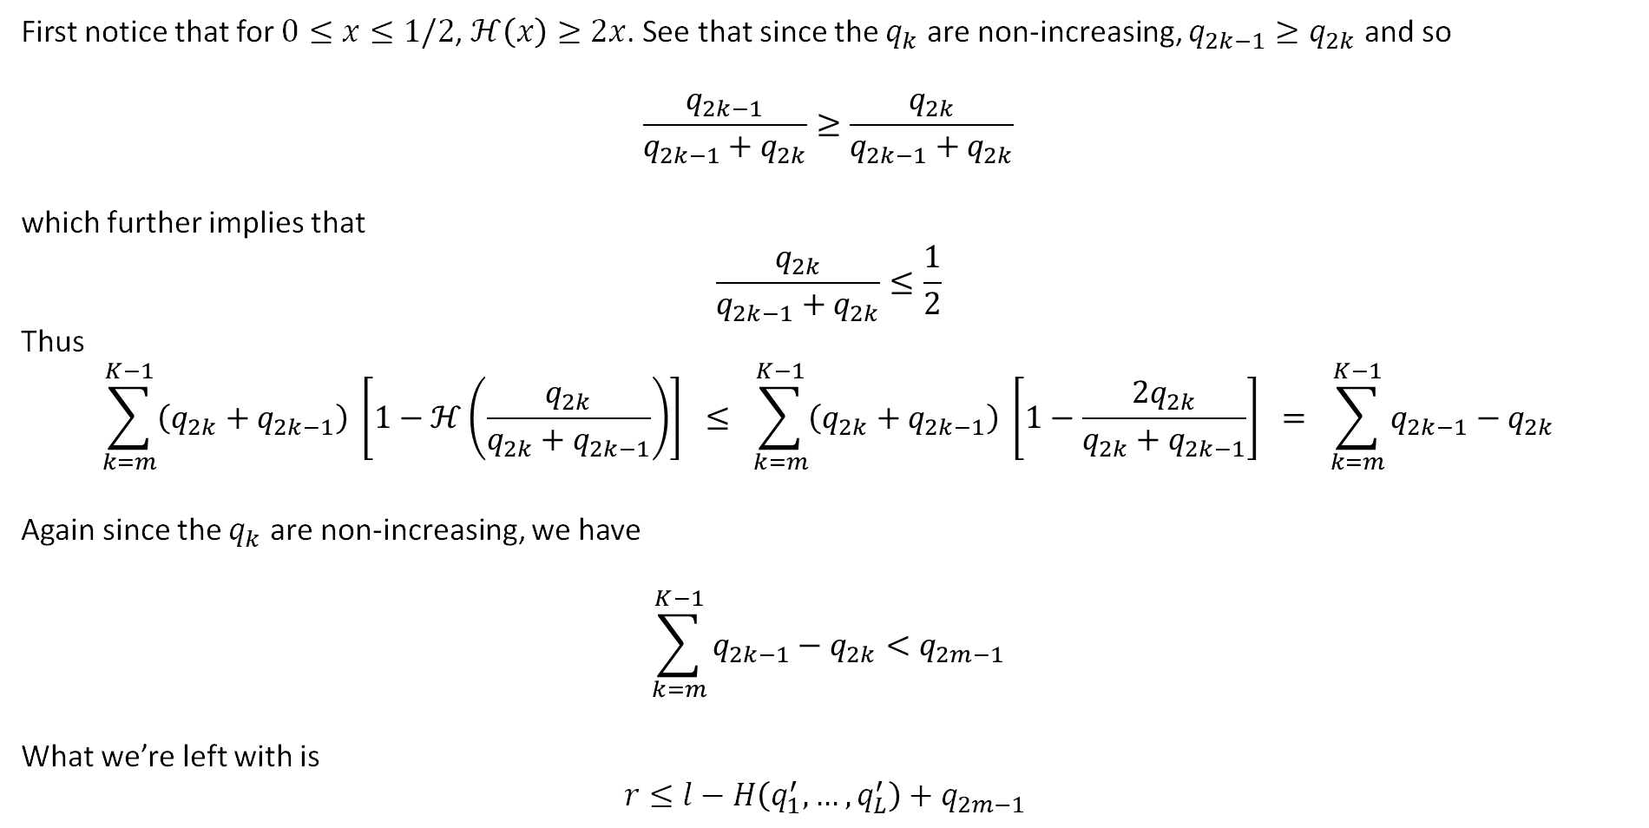
First notice that for $0≤x≤1/2$, $ℋ\left(x\right)≥2x$. See that since the $q_{k}$ are non-increasing, $q_{2k−1}≥q_{2k}$ and so $$\frac{q_{2k−1}}{q_{2k−1}+q_{2k}}≥\frac{q_{2k}}{q_{2k−1}+q_{2k}}$$
which further implies that $$\frac{q_{2k}}{q_{2k−1}+q_{2k}}≤\frac{1}{2}$$
Thus $$\sum_{k=m}^{K−1}{\left(q_{2k}+q_{2k−1}\right) \left[1−ℋ\left(\frac{q_{2k}}{q_{2k}+q_{2k−1}}\right)\right]} ≤ \sum_{k=m}^{K−1}{\left(q_{2k}+q_{2k−1}\right) \left[1−\frac{{2q}_{2k}}{q_{2k}+q_{2k−1}}\right]} = \sum_{k=m}^{K−1}{q_{2k−1}−q_{2k}}$$
Again since the $q_{k}$ are non-increasing, we have
$$\sum_{k=m}^{K−1}{q_{2k−1}−q_{2k}}<q_{2m−1}$$
What we’re left with is $$r≤l−H\left(q_{1}^{′},…,q_{L}^{′}\right)+q_{2m−1}$$

Slide 19
Now let’s first assume $p_{1}≥1/2$. Then $n_{1}=1$. If we take $l=1$, we have $r≤1−ℋ\left(p_{1}\right)+q_{2m−1}$.
Now since $q_{2m−1}≤1−p_{1}$, we have $r≤2−ℋ\left(p_{1}\right)−p_{1}$.
Now when $p_{1}=1/2$ or when $p_{1}=1$, we have $2−ℋ\left(p_{1}\right)−p_{1}≤p_{1}$. By convextity, this inequality must hold for all values of $p_{1}$ in between.
See trivially that if $r≤p_{1}$ then $r≤p_{1}+σ$
Thus we’ve proven the result for $p_{1}≥1/2$.

Slide 20
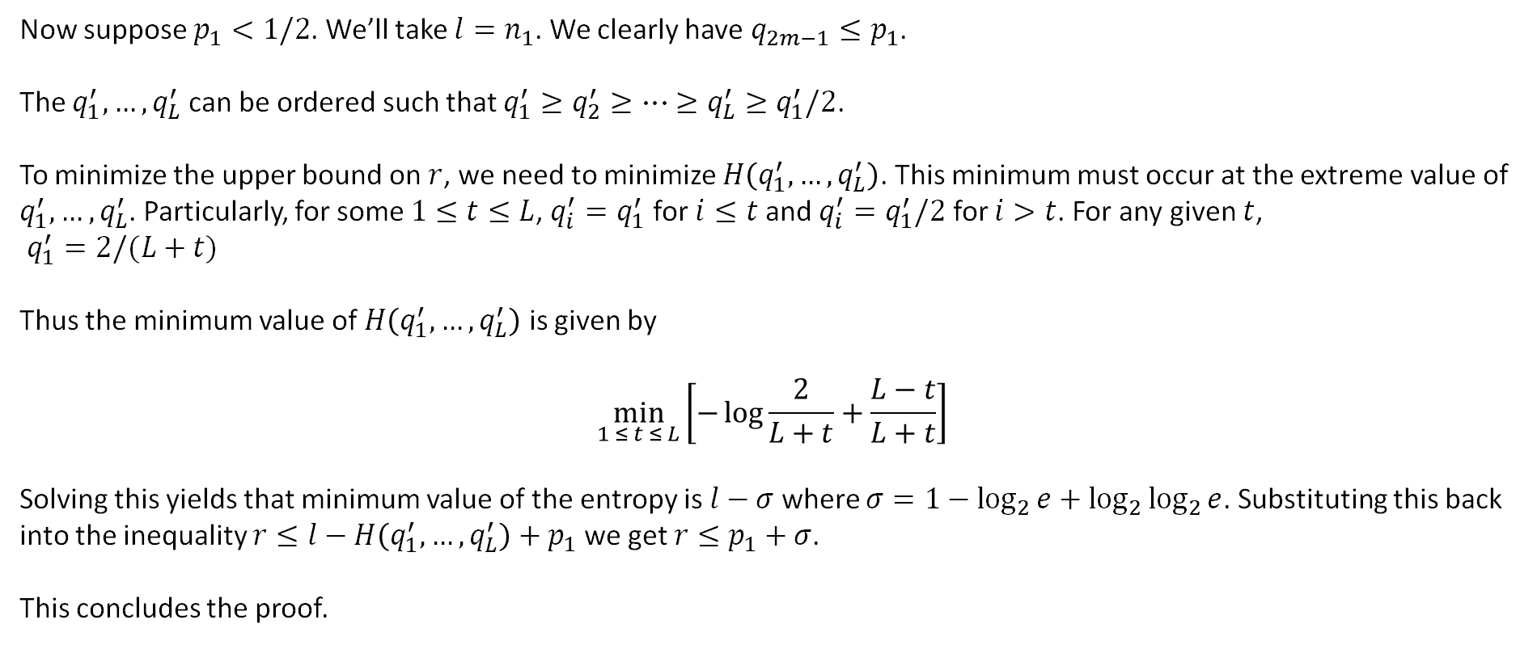
Now suppose $p_{1}<1/2$. We’ll take $l=n_{1}$. We clearly have $q_{2m−1}≤p_{1}$.
The $q_{1}^{′},…,q_{L}^{′}$ can be ordered such that $q_{1}^{′}≥q_{2}^{′}≥…≥q_{L}^{′}≥q_{1}^{′}/2$.
To minimize the upper bound on $r$, we need to minimize $H\left(q_{1}^{′},…,q_{L}^{′}\right)$. This minimum must occur at the extreme value of $q_{1}^{′}, …, q_{L}^{′}$. Particularly, for some $1≤t≤L$, $q_{i}^{′}=q_{1}^{′}$ for $i≤t$ and $q_{i}^{′}=q_{1}^{′}/2$ for $i>t$. For any given $t$, $q_{1}^{′}=2/(L+t)$
Thus the minimum value of $H\left(q_{1}^{′},…,q_{L}^{′}\right)$ is given by $$\min_{1 ≤ t ≤ L}\left[−\log{\frac{2}{L+t}}+\frac{L−t}{L+t}\right]$$
Solving this yields that minimum value of the entropy is $l−σ$ where $σ=1−\log_{2}{e}+\log_{2}{\log_{2}{e}}$. Substituting this back into the inequality $r≤l−H\left(q_{1}^{′},…,q_{L}^{′}\right)+p_{1}$ we get $r≤p_{1}+σ$.
This concludes the proof.

Slide 21
Claim: For every finite discrete source, there exists a prefix code with an unused codeword of length 2 and redundancy $r≤1$
The first step is to construct the Huffman code for the source.
Then take the less probable node at level one (WLOG assume it to be node two) and push it down to level two. It’s sibling will be a reserved codeword. See that every codeword stemming from node two will be lengthened by one.
Let $q_{1}$ and $q_{2}$ denote the probabilities of the original level-one nodes with $q_{1}≥q_{2}$. If $r$ is the redundancy of the original code and $r^{′}$ is the redundancy of the new code, we have that $r^{′}=r+q_{2}$.
From the bound on redundancy we have $$r≤1−ℋ\left(q_{2}\right)+q_{2} \\ r′≤1−ℋ\left(q_{2}\right)+{2q}_{2}$$
Since we must have $q_{2}≤1/2$, it follows that $r^{′}≤1$.

