Slide 1
Recitation Nov 9, 2022
Information Theory
Cover and Thomas
Lecture Material from Aarti Singh

Slide 2
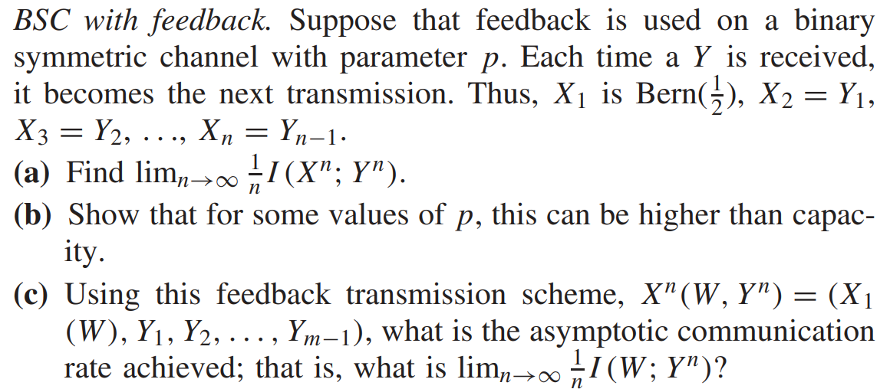
Thomas and Cover Problem 7.33

Slide 3
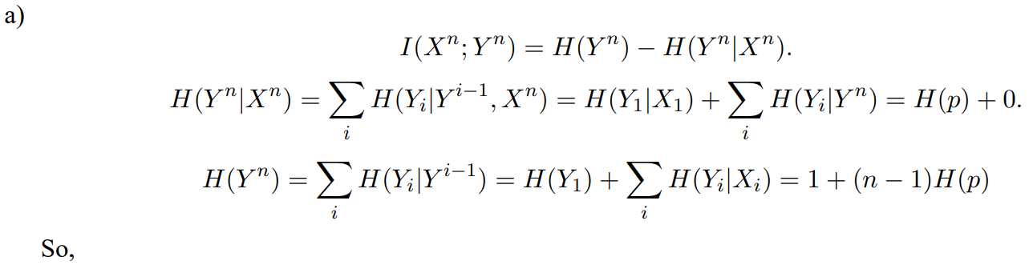
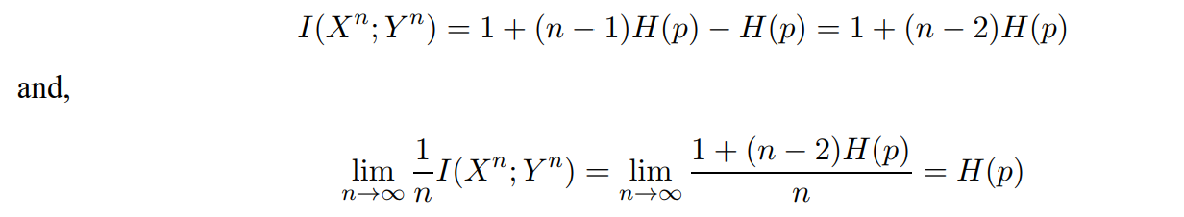
Solution

Slide 4
Solution cont.

Slide 5
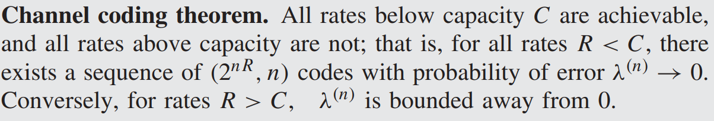
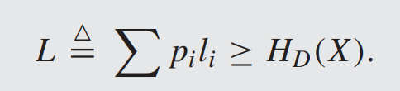










Joint Source-Channel Coding Theorem
$$f^{s}$$
$$f^{c}$$
$$g^{c}$$
$$g^{s}$$
$$W$$
$$\hat{W}$$
$$\hat{v}$$
Source
Compress
Encode
Channel
Decode
Decompress
$$v^{n}=(v_{1},v_{2},…,v_{n})$$
$$x^{m}=(x_{1},x_{2},…,x_{m})$$
$$y^{m}=(y_{1},y_{2},…,y_{m})$$
Source Coding Theorem
Channel Coding Theorem

Slide 6
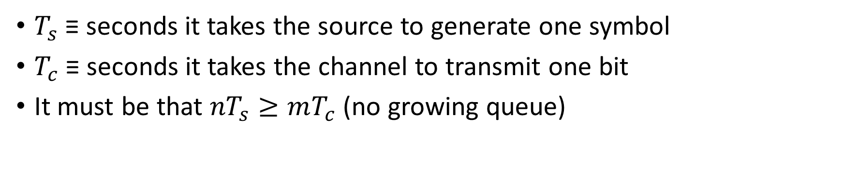
Joint Source-Channel Coding Theorem
$$f^{s}$$
$$f^{c}$$
$$g^{c}$$
$$g^{s}$$
$$W$$
$$\hat{W}$$
$$\hat{v}$$
Source
Compress
Encode
Channel
Decode
Decompress
$$v^{n}=(v_{1},v_{2},…,v_{n})$$
$$x^{m}=(x_{1},x_{2},…,x_{m})$$
$$y^{m}=(y_{1},y_{2},…,y_{m})$$
$T_{s}$ ≡ seconds it takes the source to generate one symbol
$T_{c}$ ≡ seconds it takes the channel to transmit one bit
It must be that ${nT}_{s}≥mT_{c}$ (no growing queue)
lec17-feedback_contCh.pdf (cmu.edu)

Slide 7
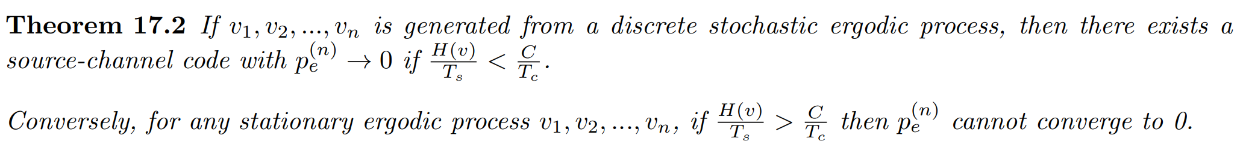
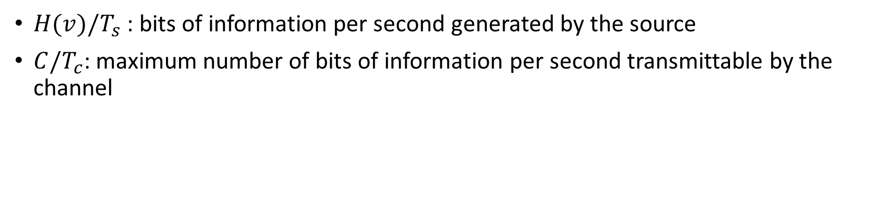
Joint Source-Channel Coding Theorem
$H(v)/T_{s}$ : bits of information per second generated by the source
$C/T_{c}$: maximum number of bits of information per second transmittable by the channel
lec17-feedback_contCh.pdf (cmu.edu)

Slide 8
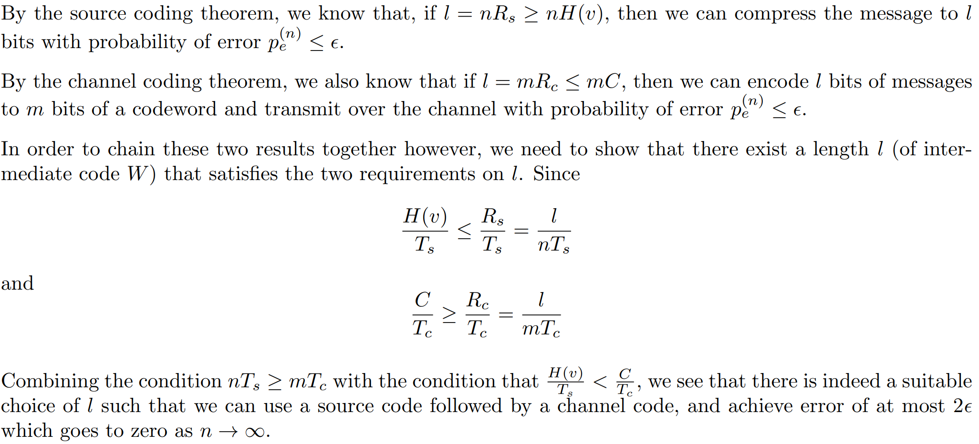
Proof
lec17-feedback_contCh.pdf (cmu.edu)

Slide 9
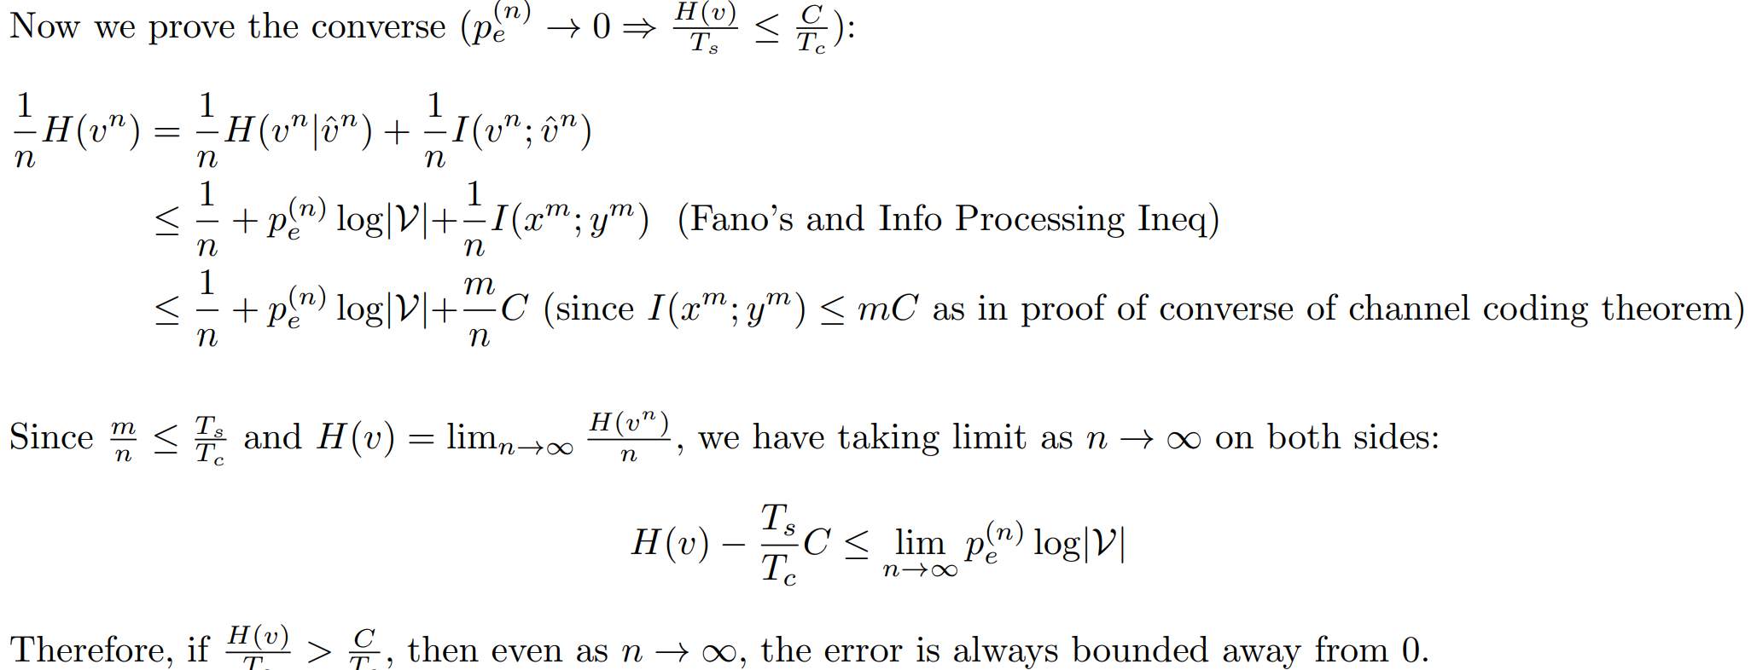
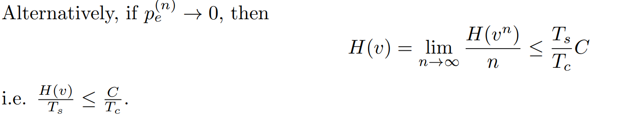
Proof
lec17-feedback_contCh.pdf (cmu.edu)

