Slide 1
Midterm #2 Prep

Slide 2
Quiz Answers
1. What is Little's Law? (choose one)
a) Mean time in system equals arrival rate times mean service time
b) Mean number in system equals arrival rate times mean time in system
c) Mean number in queue equals arrival rate times mean time in system
2. If the arrival rate to a queue is A and the mean service time is S,
then the long-term probability that the queue has at least one job present is
(choose one)
a) A x S
b) A/S
c) S/A
The probability that the queue has at least one job present is always equal to the server utilization, which is the arrival rate A divided by the service rate 1/S = A x S

Slide 3
Quiz Answers
3. Suppose you have some simulation output and have constructed a confidence interval for your favorite
confidence level that has half-width H, and sample mean m based on 100 replications. We want the ratio
of the half-width to sample mean ( H/m ) to be no larger than 0.01, and with 100 replications
we have H/m = 0.05. Assuming that as we increase the number of replications that the sample
mean and sample variance do not change very much, how many MORE replications will we need to
do to reach our goal of H/m = 0.01 ?
a) 100
b) 900
c) 1900
d) 2400
e) 12400

Slide 4
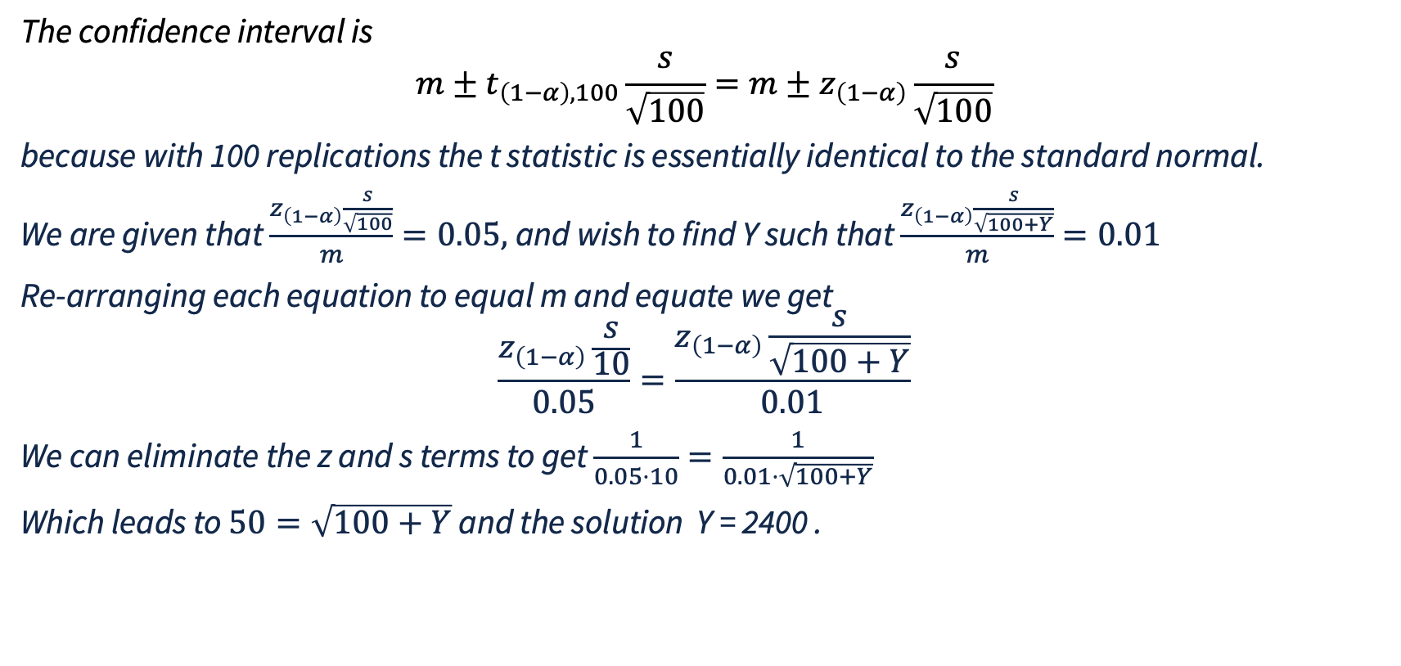
Quiz Answers
The confidence interval is
$$m±t_{\left(1−α\right),100}\frac{s}{\sqrt{100}}=m±z_{\left(1−α\right)}\frac{s}{\sqrt{100}}$$
because with 100 replications the t statistic is essentially identical to the standard normal.
We are given that $\frac{z_{\left(1−α\right)}\frac{s}{\sqrt{100}}}{m}=0.05,$and wish to find Y such that $\frac{z_{\left(1−α\right)}\frac{s}{\sqrt{100+Y}}}{m}=0.01$
Re-arranging each equation to equal m and equate we get
$$\frac{z_{\left(1−α\right)}\frac{s}{10}}{0.05}=\frac{z_{\left(1−α\right)}\frac{s}{\sqrt{100+Y}}}{0.01}$$
We can eliminate the z and s terms to get $\frac{1}{0.05⋅10}=\frac{1}{0.01⋅\sqrt{100+Y}}$
Which leads to $50=\sqrt{100+Y}$ and the solution Y = 2400 .

Slide 5
Quiz Answers
4. I want to develop a simulation model that estimates the probability of a network dropping more than 10% of its packets, under a long period of heavy load.
T/F A non-terminating simulation would be suitable for this model
The emphasis here is on ‘long period’ and the metric measured during it.
5. I want to develop a simulation model that estimates the probability that emergency communications fail
during a critical event.
T/F A non-terminating simulation would be suitable for this model
The simulation will terminate either when the communication systems fail or when the mission time during which the communiation system might fail is fully simulated.

Slide 6
Class Problem Answers
1. A table of CDF values for a Normal distribution can be found at
https://archive.math.arizona.edu/jwatkins/normal-table.pdf
Use this to identify the critical threshold for an 80% confidence interval
constructed using 100 data elements from a Gaussian distribution.
80% is the amount of probability under the curve between two critical values. The CDF F(-x) gives the area under the pdf curve to the left of -x, which we need to be 10% because we need the area under the pdf curve to the right of 1-CDF(x) to give the amount of probability under the curve for values z > x. So we search the normal table for the table en

Slide 7
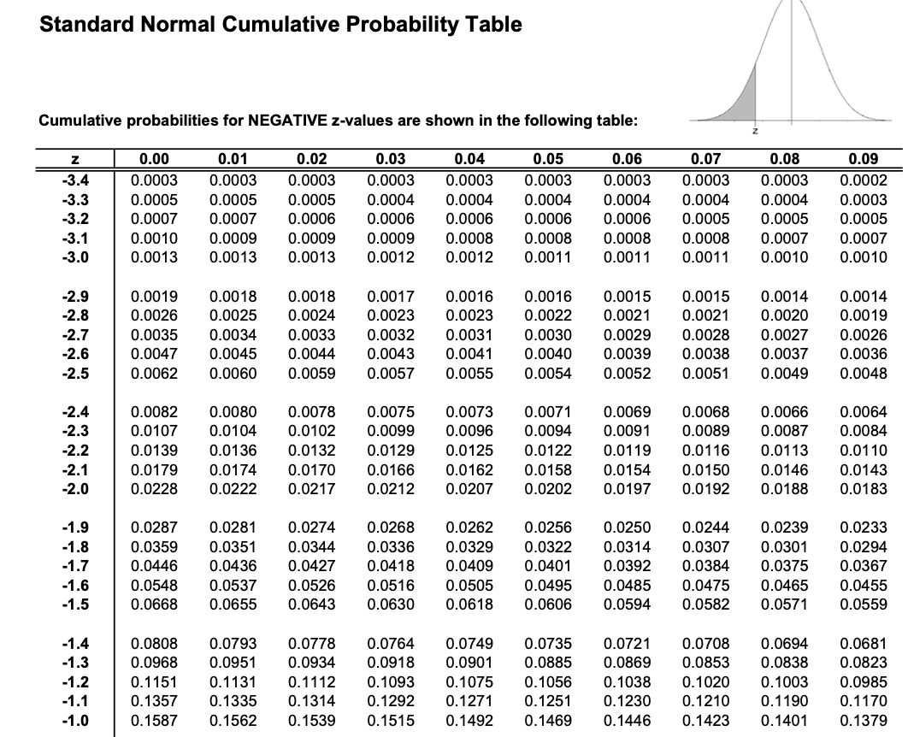
Quiz Answers
With 100 replications we can use Z critical thresholds rather than T critical thresholds
  Essentially the same
Find entry closest to 0.1, critical threshold is -1.28, symmetry says other critical threshold is 1.28

Slide 8
Class Problem Answers
2. Imagine a queueing system that limits the number of jobs in the system to no more than K.
What impact does this have on Little's Law?

Slide 9
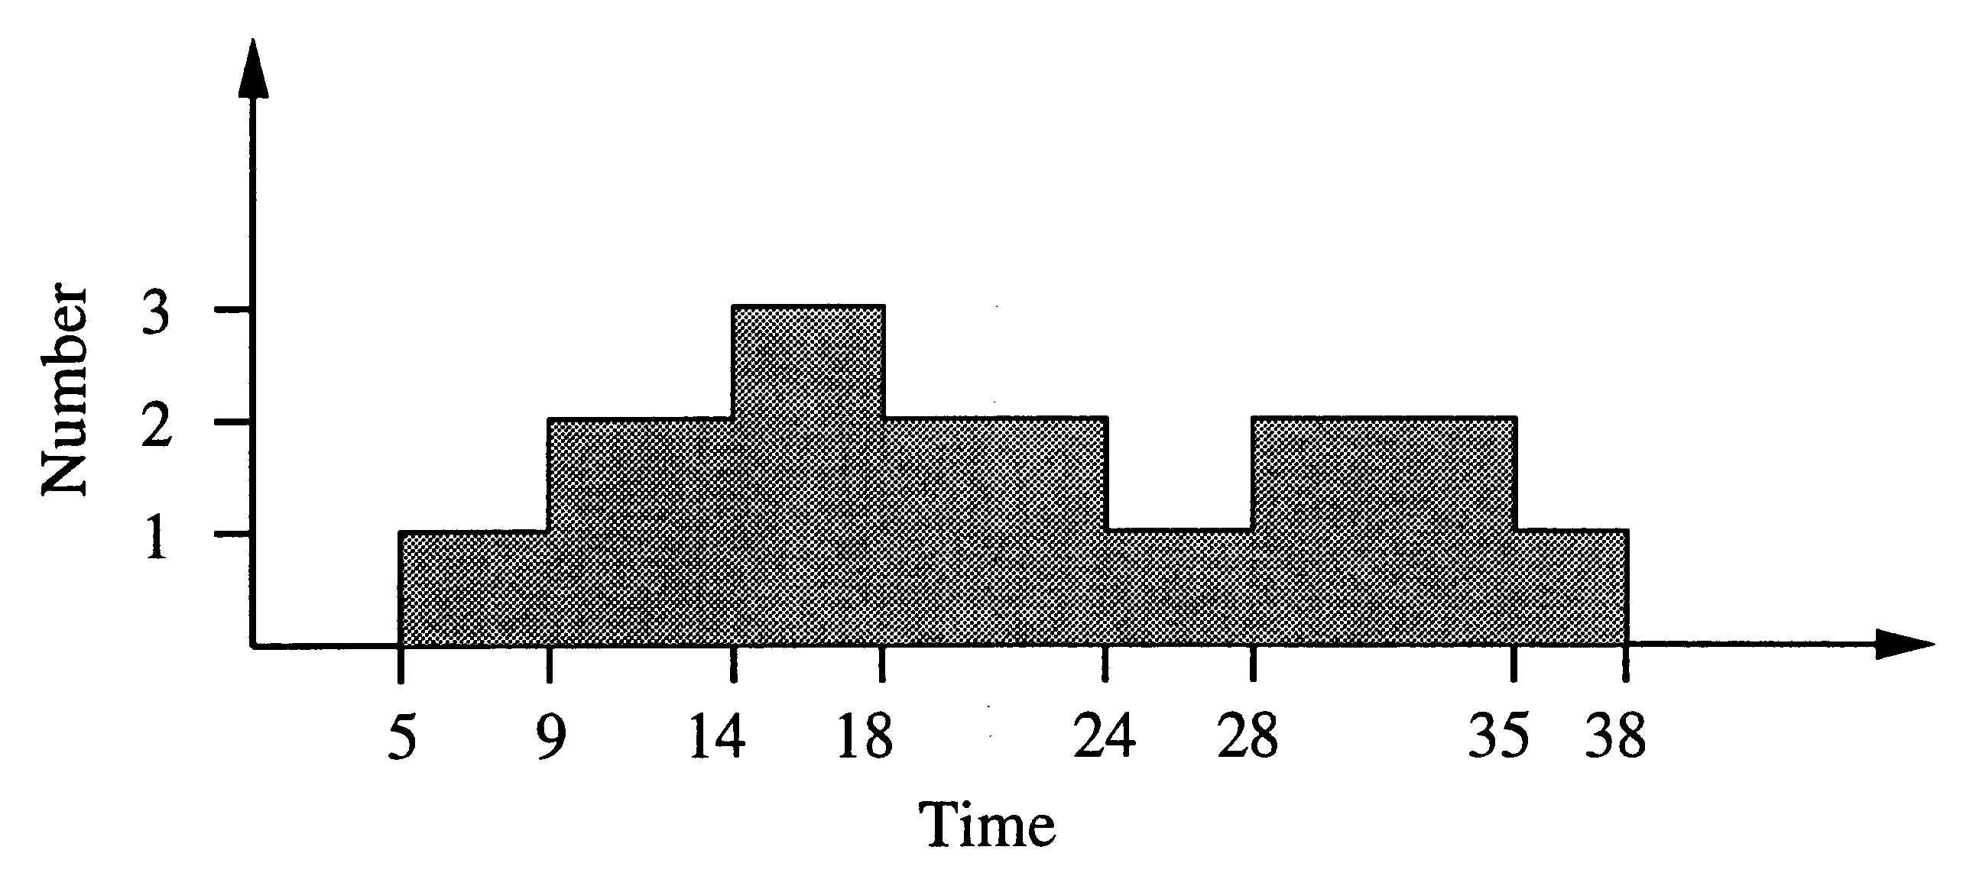
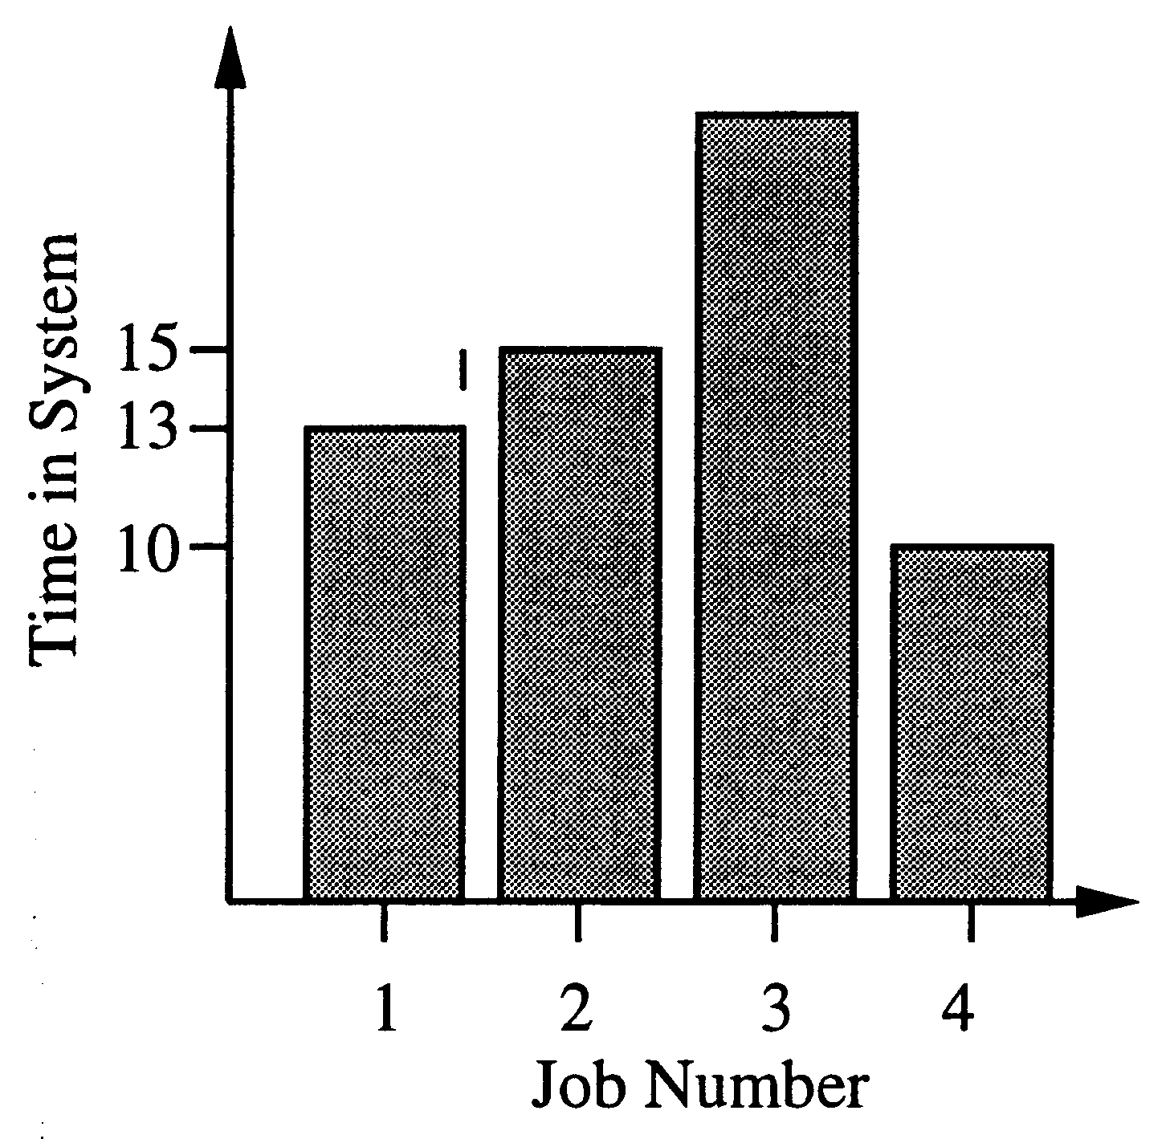
Quiz Answers
Sketch of proof (of steady-state case):
  During a long interval, arrivals ≈ departures (else no stability)
  Area under the curve is total job time units
  Mean queue length N is average curve height (area/time)
  Mean time in system W is area/arrivals
  Mean arrival rate is arrivals/time
A very general result:
  No assumptions about arrival or service processes
  Holds for any queueing discipline (simply charge the area differently)
N = λ W
(jobs x time)
arrival
rate
jobs x time
=
jobs
x
jobs x time
time
time
jobs
Avg number in system
Avg time in system

Slide 10
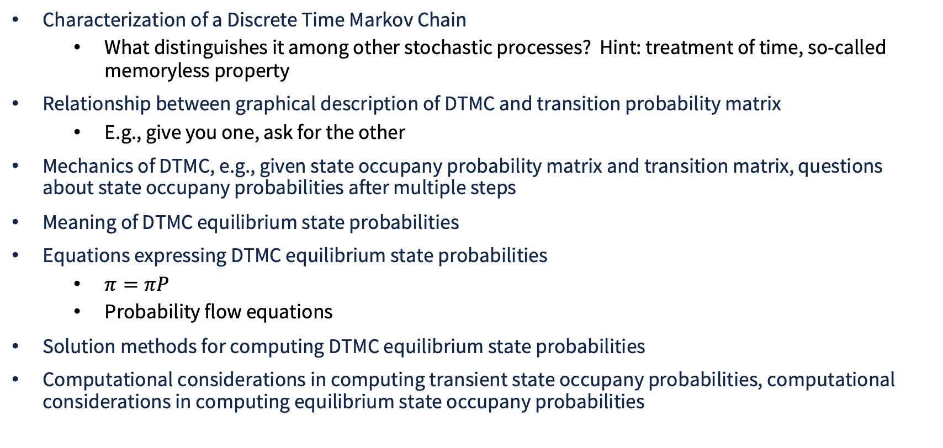
Things to Know
Characterization of a Discrete Time Markov Chain
  What distinguishes it among other stochastic processes? Hint: treatment of time, so-called memoryless property
Relationship between graphical description of DTMC and transition probability matrix
  E.g., give you one, ask for the other
Mechanics of DTMC, e.g., given state occupany probability matrix and transition matrix, questions about state occupany probabilities after multiple steps
Meaning of DTMC equilibrium state probabilities
Equations expressing DTMC equilibrium state probabilities
  $π=πP$
  Probability flow equations
Solution methods for computing DTMC equilibrium state probabilities
Computational considerations in computing transient state occupany probabilities, computational considerations in computing equilibrium state occupany probabilities

Slide 11
Things to Know
Definition / recognition of DTMC state attributes, e.g.,
  Accessibility, irreducible, periodicity, transient, positive recurrent, null recurrent, ergodic
Mapping of tuple-based expressions of DTMC state to integers, for application of standard equations
Use of state occupancy probability vectors in expressing system level metrics, e.g., mean number in system, job throughput, probability exactly one of four servers busy in queue with multiple servers, etc.
Meaning of ‘event’ in a discrete-event simulation (DES)
Rationale for using DES as a modeling/solution method
Virtual time expression in DES
  Data structures, rationale
Event list management
  Data structures, rationales, computational/storage costs

Slide 12
Things to Know
Event processing logic
  What typically happens when an event is executed?
In output analysis, relationship between samping distributions and distributions in system being simulated
Definition and meaning of a confidence interval
Definition and construction of standard confidence intervals, jackknifed confidence intervals, bootstrapped confidence intervals
Technical minutae in constructing a confidence interval, e.g.,
  Sample standard deviation
  Critical values
  Number of replications
  Width

