Slide 1
Random Number Generation

Slide 2

Pseudo-Random Number Generation
Some function that when queried gives a number in (0,1)
Desired Properties
  Statistical : Empirical CDF should look as though sampled from U(0,1)
  Independence (how to test?)
  Independent concurrent streams
1
0
Notes:
\sigma = \sqrt{ \frac{ \sum_{i=1}^n (X_i - \hat{\theta})^2 }{n-1} }

Slide 3
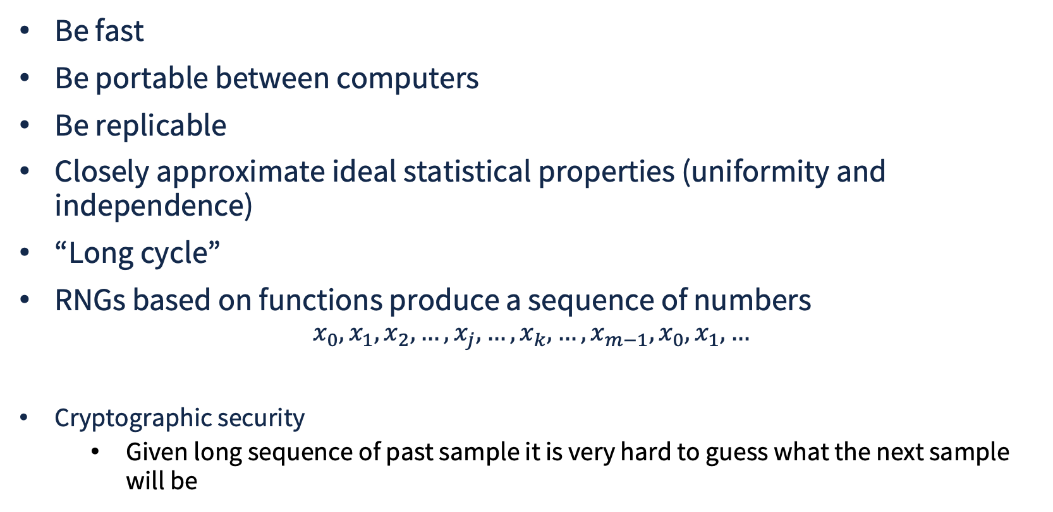
RNG Important Considerations
m = period of cycle
Notes:
\sigma = \sqrt{ \frac{ \sum_{i=1}^n (X_i - \hat{\theta})^2 }{n-1} }

Slide 4
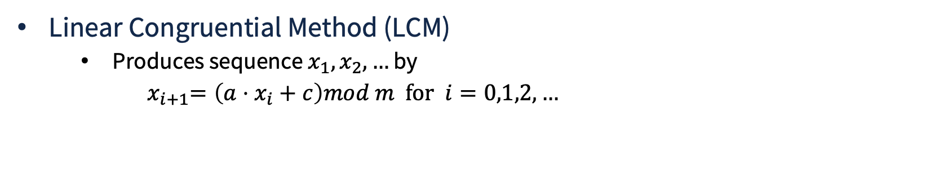
Common RNGs : LCM
multiplier
increment
modulus
Values chosen for a, c, m, x₀ have ENORMOUS impact on statistical properties and cycle length
Random numbers are in [0, m-1], converted to [0,1) by u_{i} = x_{i} / m
Notes:
\sigma = \sqrt{ \frac{ \sum_{i=1}^n (X_i - \hat{\theta})^2 }{n-1} }

Slide 5
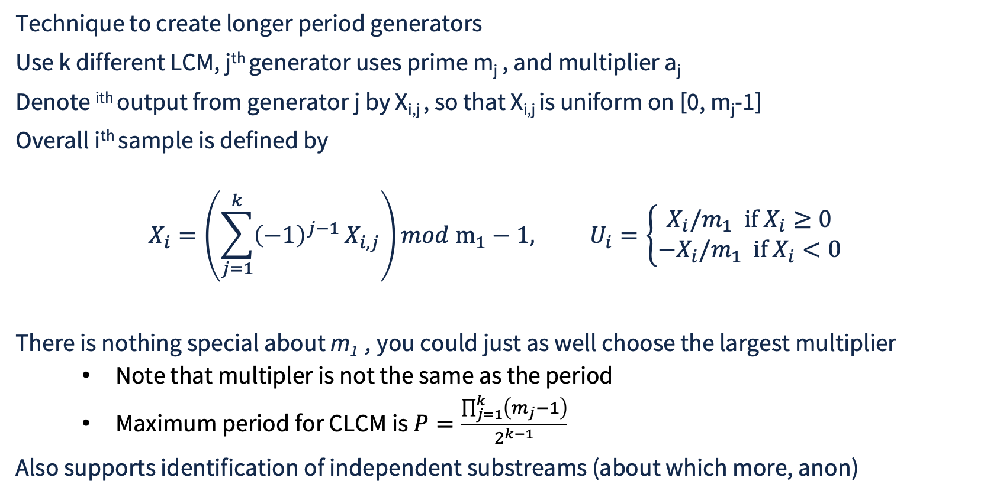
Common RNGs : Combined LCM
Notes:
\sigma = \sqrt{ \frac{ \sum_{i=1}^n (X_i - \hat{\theta})^2 }{n-1} }

Slide 6
Mersenne Twister
Created 1997
Period length: uses Mersenne prime 2¹⁹⁹³⁷ -1 for period
Provides equidistribution in 623 dimensions (i.e., data points with 623 coordinates)
Avoids slow multiplication and division, using instead bitwise shifts, and bitwise AND/OR and XOR operations
Is default RNG for Python, Ruby, MATLAC, R, C++
Internals
  State is array of 624 integers
  Sampling, the entire state array is updated in a “twist”, a matrix linear recurrence over a finite binary field using a twisted generalized feedback shift register
Limitations
  Not cryptographically secure…full state can be reconstructed after observing 624 consecutive outputs
Notes:
\sigma = \sqrt{ \frac{ \sum_{i=1}^n (X_i - \hat{\theta})^2 }{n-1} }

Slide 7
Mersenne Twister Innards
def twist(self):
"""Generate the next n values from the series x_i."""
for i in range(self.n):
# Concatenate the upper bits of the current element and the lower bits of the next element
x = (self.MT[i] & self.upper_mask) + (self.MT[(i + 1) % self.n] & self.lower_mask)
xA = x >> 1
if x % 2 != 0:
xA = xA ^ self.a
self.MT[i] = self.MT[(i + self.m) % self.n] ^ xA
self.index = 0
def extract_number(self) -> int:
"""Extract a tempered pseudorandom 32-bit integer."""
if self.index >= self.n:
self.twist()
y = self.MT[self.index]
self.index += 1
# Tempering operations
y ^= (y >> self.u) & self.d
y ^= (y << self.s) & self.b
y ^= (y << self.t) & self.c
y ^= (y >> self.l)
return y & 0xFFFFFFFF
class MersenneTwister:
def __init__(self, seed: int = 5489):
# Coefficients for MT19937
self.w, self.n, self.m, self.r = 32, 624, 397, 31
self.a = 0x9908B0DF
self.u, self.d = 11, 0xFFFFFFFF
self.s, self.b = 7, 0x9D2C5680
self.t, self.c = 15, 0xEFC60000
self.l = 18
self.f = 1812433253
# State array and index tracking
self.MT = [0] * self.n
self.index = self.n
# Upper and lower bitmasks
self.lower_mask = (1 << self.r) - 1
self.upper_mask = (~self.lower_mask) & 0xFFFFFFFF
self.seed(seed)
def seed(self, seed: int):
"""Initialize the generator from a seed."""
self.MT[0] = seed & 0xFFFFFFFF
for i in range(1, self.n):
self.MT[i] = (self.f * (self.MT[i - 1] ^ (self.MT[i - 1] >> (self.w - 2))) + i) & 0xFFFFFFFF
self.index = self.n
def random(self) -> float:
"""Generate a random float uniformly
in the semi-open range [0.0, 1.0)."""
return self.extract_number() / 4294967296.0
Notes:
\sigma = \sqrt{ \frac{ \sum_{i=1}^n (X_i - \hat{\theta})^2 }{n-1} }

Slide 8
Cryptographically Secure RNG (CRNG)
Should pass the “next bit” test
Given the 1st k bits of a random sequence, no polynomial time algorithm can predict the next bit with probability of success > 50%
Should pass “state compromise extensions”
In the event that some or all of the state is compromised, it should be impossible to reconstruct the stream of random numbers generated prior to the acquisition of state
(state of LCM is the last number generated, state of Mersenne Twister is 624 integers)
Notes:
\sigma = \sqrt{ \frac{ \sum_{i=1}^n (X_i - \hat{\theta})^2 }{n-1} }

Slide 9
Uses of CRNG
Cryptographic Key Generation
  Creating strong, secret, and unpredictable encryption keys for symmetric ciphers (such as AES) and asymmetric/public-key cryptosystems (such as RSA or Elliptic Curve Cryptography)
Nonces and Initialization Vectors (IVs)
  Generating unique, one-time numbers used in encryption modes and authentication protocols to prevent replay attacks and ensure identical plaintexts produce different ciphertexts
Digital Signatures
  Supplying high-entropy randomness required by signing algorithms (like ECDSA) so that private keys cannot be mathematically deduced or leaked
Session Identifiers and Tokens
  Creating secure, unguessable session IDs, CSRF (Cross-Site Request Forgery) tokens, and password reset tokens for web and mobile applications
Salting Passwords
  Generating random data (salts) to combine with user passwords before hashing, which stops attackers from using precomputed rainbow tables to crack credentials
Secure Communication Protocols
  Powering key exchanges and handshakes in protocols like TLS/SSL, SSH, and IPsec
Notes:
\sigma = \sqrt{ \frac{ \sum_{i=1}^n (X_i - \hat{\theta})^2 }{n-1} }

Slide 10
CRNG Number Generation
Combines high-entropy physical seed with one-way function
  Transforms observation into random number
System collects micro-level chaotic physical data from environment, feed into an “entropy pool”
Once entropy pool is large enough (e.g. 128 bits or more), it is used to create an initial seed
  Seed is the secret starting state
One-way function maps state to RNG sample (e.g. block cipher in counter mode, stream cipher, cryptographic hash functions
New bits from entropy pool are regularly injected into state
Backwards security assured because of one-way functions
Forward security rests on re-seeding and update of state from entropy pool
Notes:
\sigma = \sqrt{ \frac{ \sum_{i=1}^n (X_i - \hat{\theta})^2 }{n-1} }

Slide 11
Concurrent Random Number Streams
Frequently desirable to use multiple random number streams, particularly to support direct comparison of simulation parameter responses
  Simple example, compare average queue length of FCFS and Shortest-Job-First-Preemptive-Resum disciplines
SJFPR
u₀ used to sample 1st arrival time
Arrival when server empty
u₁ used to sample 1st service time
u₂ used to sample 2st arrival time
Arrival when server busy
u₃ used to sample service time
u₄ used to sample 3rd arrival time
FCFS
u₀ used to sample 1st arrival time
Arrival when server empty
u₁ used to sample 1st service time
u₂ used to sample 2st arrival time
Arrival when server busy
u₃ used to sample 3rd arrival time
Use of RNG falls out of sync, implying arrival times are different in FCFS and SJFPR
Using one RNG for arrivals and another for service times keeps arrivals times in sync, and supports direct comparison of systems against common input streams
Notes:
\sigma = \sqrt{ \frac{ \sum_{i=1}^n (X_i - \hat{\theta})^2 }{n-1} }

Slide 12

Concurrent Random Number Streams : A hack
Start here, and u₀ = x_{j}/m, u₁ = x_{j+1}/m etc.
Stream seed
Stream 3 seed
Stream 2 seed
Stream 1 seed
Practical problem of finding starting seed
  Hack that works for RNGs with huge period….randomly generate initial seeds
Notes:
\sigma = \sqrt{ \frac{ \sum_{i=1}^n (X_i - \hat{\theta})^2 }{n-1} }

Slide 13
Concurrent Random Number Streams : Use Math
There exist RNGs that are specifically constructed to support multiple independent streams
  Combined Linear Congruential Generator
    Structure permits computationally efficient identification of RNG state values that are far far apart, each such can see a substream
  Variants on Mersenne Twister, typically built into the API
Notes:
\sigma = \sqrt{ \frac{ \sum_{i=1}^n (X_i - \hat{\theta})^2 }{n-1} }

Slide 14
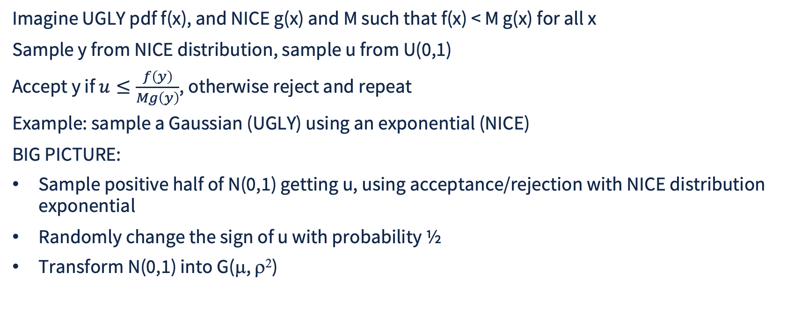
Acceptance/Rejection Method

Slide 15
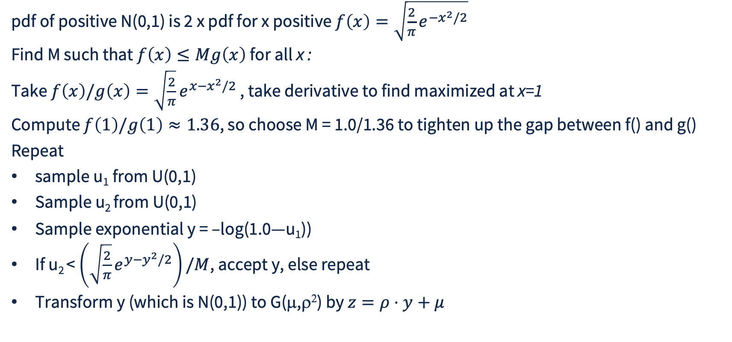
Acceptance/Rejection Example, Details

Slide 16
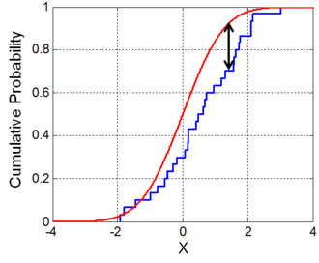

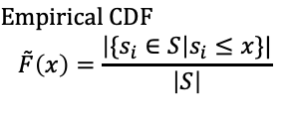
K-S Test for Statistical Uniformity
We have data and wish to test whether it is likely from a given “reference distribution”
  Saw this earlier in lecture on bootstrap estimation of variance
Idea is to compare the empirical CDF we create from the data with that of the reference distribution
Identify the largest deviation
Reference CDF F(x)
Notes:
\sigma = \sqrt{ \frac{ \sum_{i=1}^n (X_i - \hat{\theta})^2 }{n-1} }

Slide 17
One-Sided K-S Statistic
The maximum deviation has a probability distribution, D is a sample from it
Given number of data points n
H₀ : Data drawn from reference distribution
Select confidence level α
Look up K-S table
  See K-S table
Find critical value d(n,α) from table
Reject H₀ if d(n,α) < D
Notes:
\sigma = \sqrt{ \frac{ \sum_{i=1}^n (X_i - \hat{\theta})^2 }{n-1} }

Slide 18
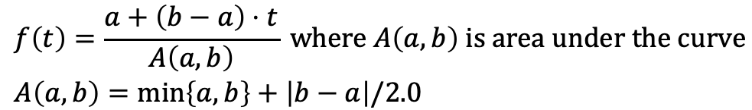
K-S Testing, Examples
Consider pdfs of distributions that can be “like” uniform
2
2
b
a
a
b
0
1
0
1
Notice that b=2.0-a, and that U(0,1) has a=b=1.0
Notes:
\sigma = \sqrt{ \frac{ \sum_{i=1}^n (X_i - \hat{\theta})^2 }{n-1} }

Slide 19
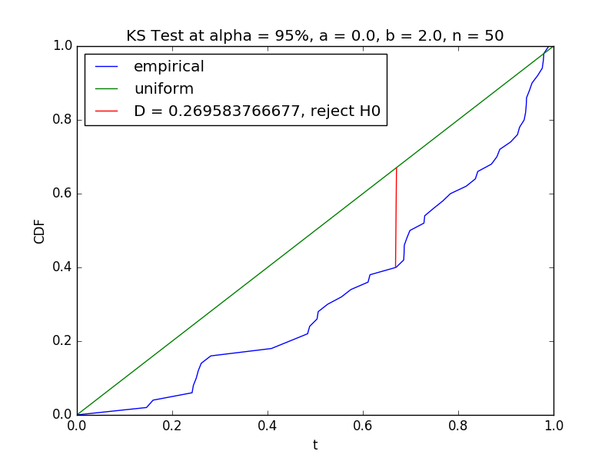
K-S Testing, a=0.0, b=2.0
Maximum deviation from uniform in this family
d(50, 0.05) = 0.192
Notes:
\sigma = \sqrt{ \frac{ \sum_{i=1}^n (X_i - \hat{\theta})^2 }{n-1} }

Slide 20
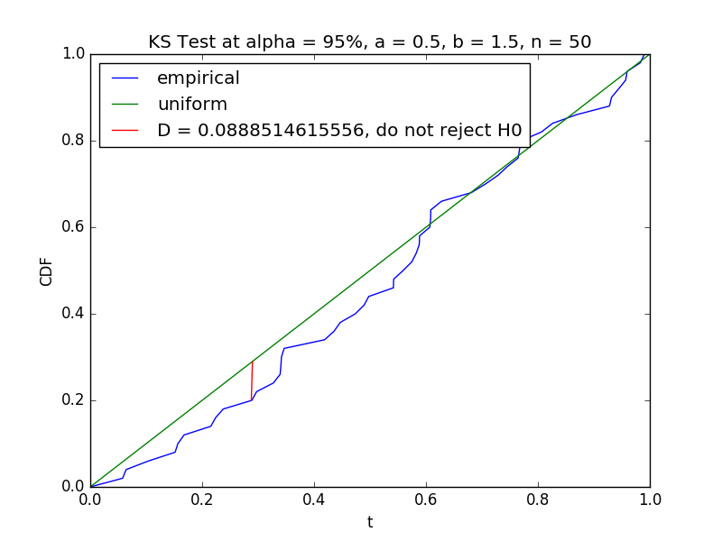
K-S Testing, a=0.5, b=1.5, n=50
Not insignificant deviation from uniform
d(50, 0.05) = 0.192
Notes:
\sigma = \sqrt{ \frac{ \sum_{i=1}^n (X_i - \hat{\theta})^2 }{n-1} }

Slide 21
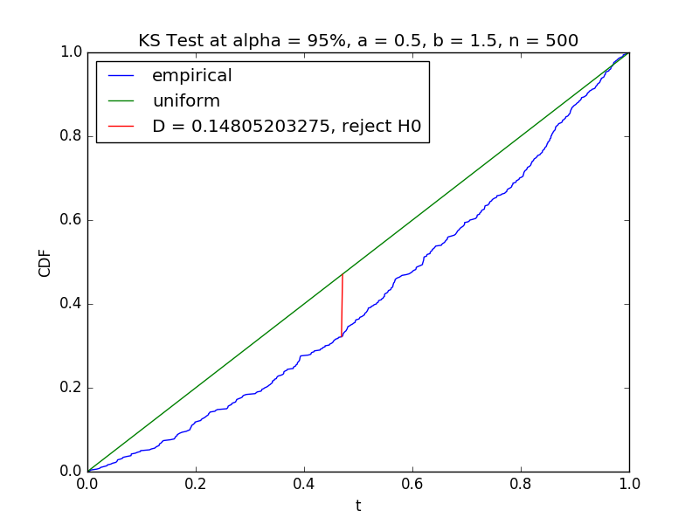
K-S Testing, a=0.5, b=1.5, n=500
Not insignificant deviation from uniform, many more samples than before
d(500, 0.05) = 0.062
(notice reduction in critical value from n=50 case)
Notes:
\sigma = \sqrt{ \frac{ \sum_{i=1}^n (X_i - \hat{\theta})^2 }{n-1} }

Slide 22
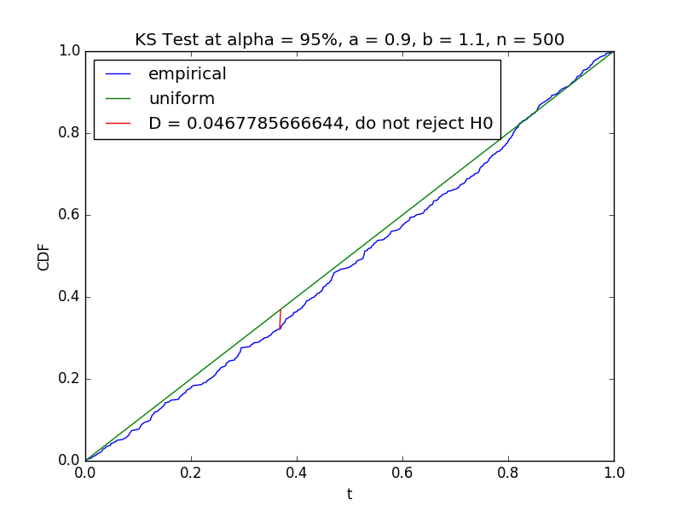
K-S Testing, a=0.9, b=1.1, n=500
Fairly close to uniform
d(500, 0.05) = 0.062
Notes:
\sigma = \sqrt{ \frac{ \sum_{i=1}^n (X_i - \hat{\theta})^2 }{n-1} }

Slide 23
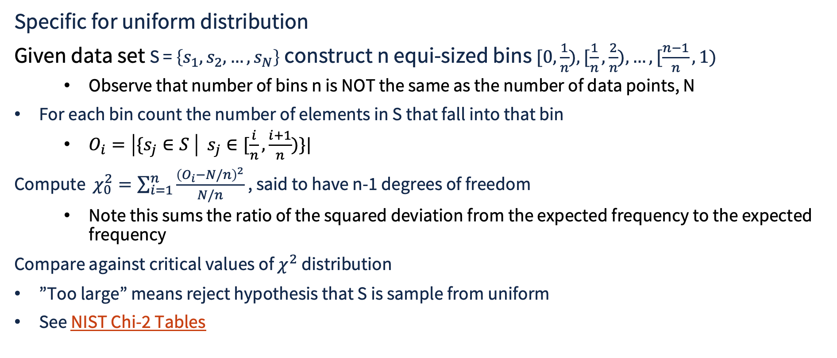
Notes:
\sigma = \sqrt{ \frac{ \sum_{i=1}^n (X_i - \hat{\theta})^2 }{n-1} }

Slide 24
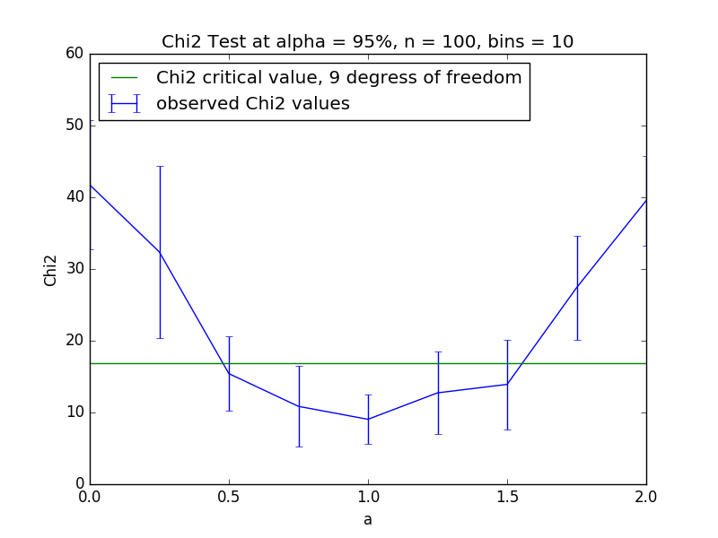
Using same distribution illustrating K-S test
100 samples for each value of a
Note 10 bins
REJECT H0
Notes:
\sigma = \sqrt{ \frac{ \sum_{i=1}^n (X_i - \hat{\theta})^2 }{n-1} }

Slide 25
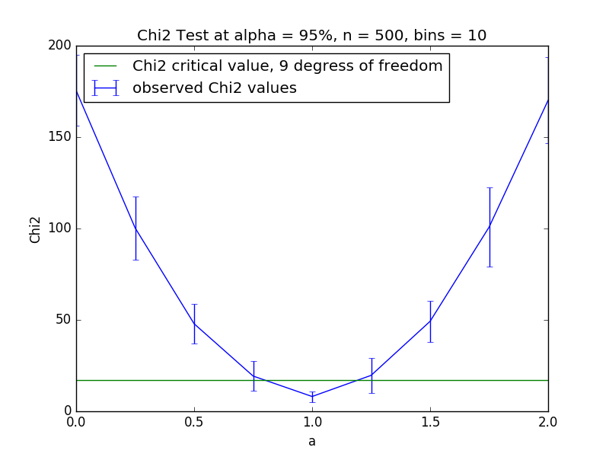
Using same distribution illustrating K-S test
500 samples for each value of a
More data means tighter assessment
REJECT H0
Notes:
\sigma = \sqrt{ \frac{ \sum_{i=1}^n (X_i - \hat{\theta})^2 }{n-1} }

Slide 26
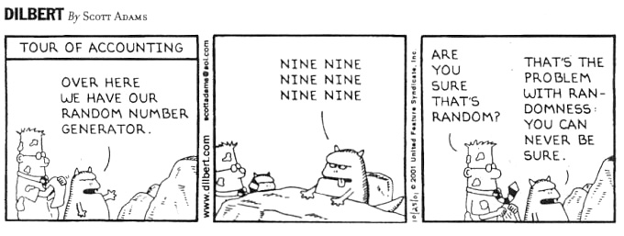
Testing for Independence
Notes:
\sigma = \sqrt{ \frac{ \sum_{i=1}^n (X_i - \hat{\theta})^2 }{n-1} }

Slide 27
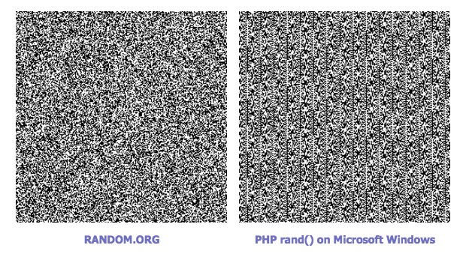
Testing in Two Dimensions
Plot successive pairs (u_{n-1}, u_{n} ) and observe visual structure
Notes:
\sigma = \sqrt{ \frac{ \sum_{i=1}^n (X_i - \hat{\theta})^2 }{n-1} }

Slide 28
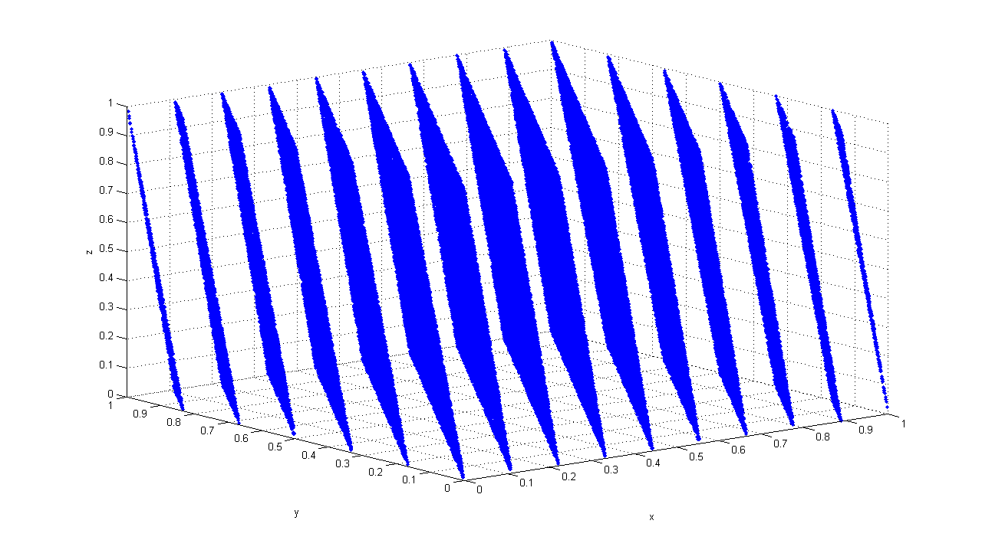
Testing in Three Dimensions
Plot successive triples
(u_{n-1}, u_{n ,} u_{n+1} ) from old rand() generator from early Unix
Notes:
\sigma = \sqrt{ \frac{ \sum_{i=1}^n (X_i - \hat{\theta})^2 }{n-1} }

Slide 29
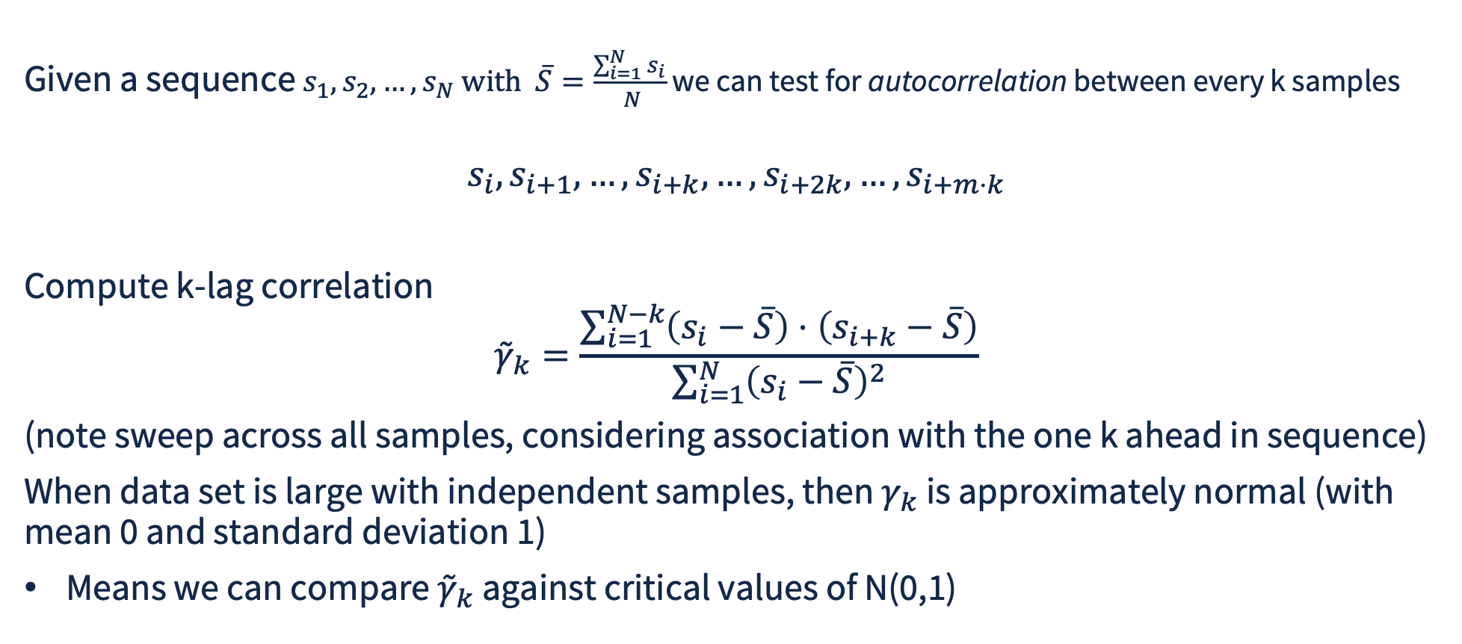
Test for Independence
Notes:
\sigma = \sqrt{ \frac{ \sum_{i=1}^n (X_i - \hat{\theta})^2 }{n-1} }

Slide 30
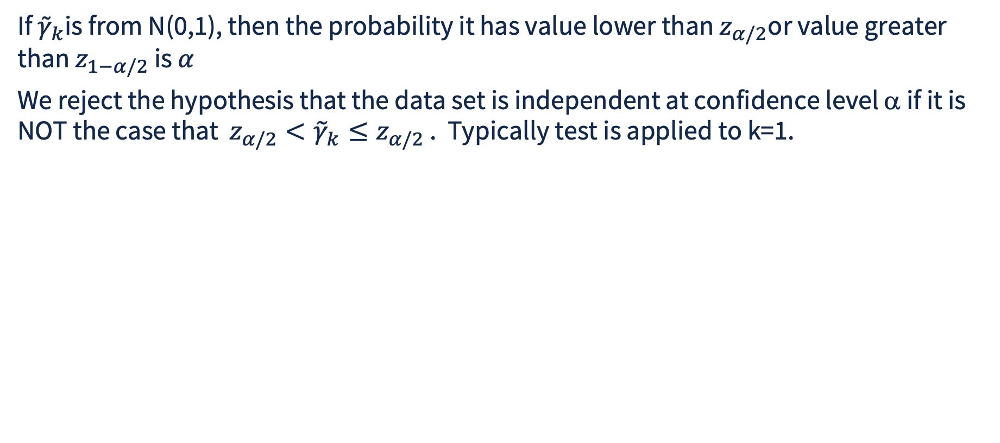
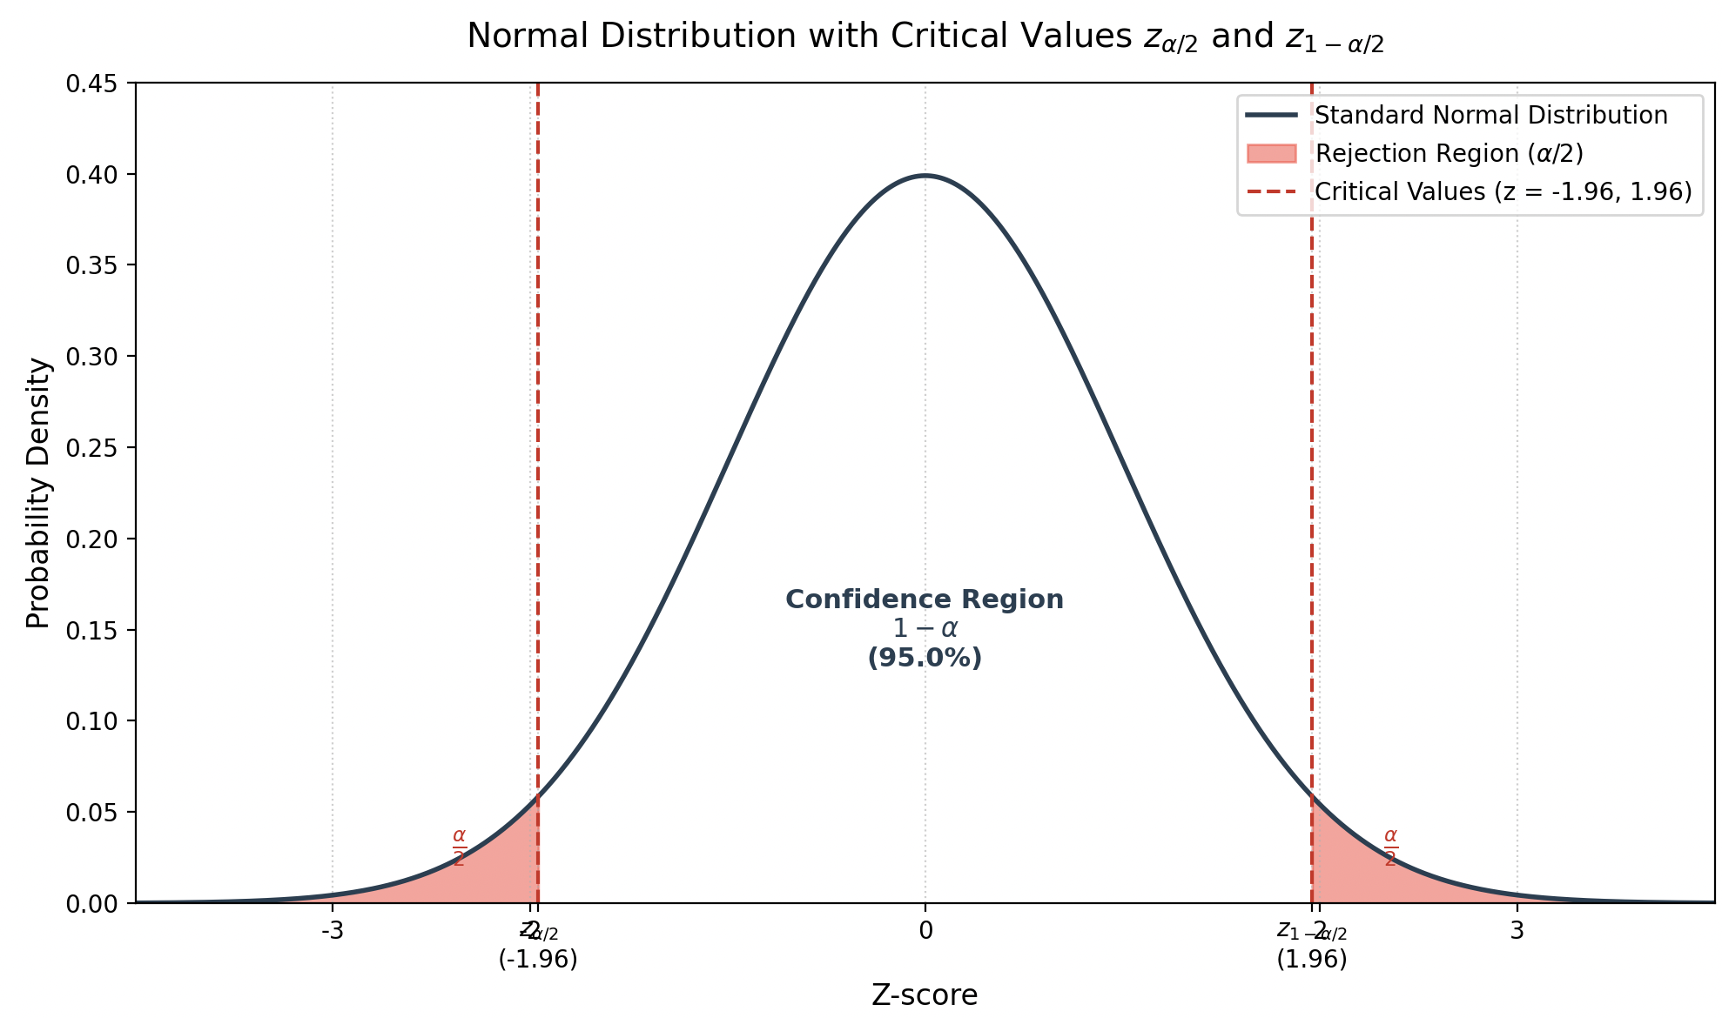
Test k-lag Correlation Against Standard Normal
Notes:
\sigma = \sqrt{ \frac{ \sum_{i=1}^n (X_i - \hat{\theta})^2 }{n-1} }

Slide 31
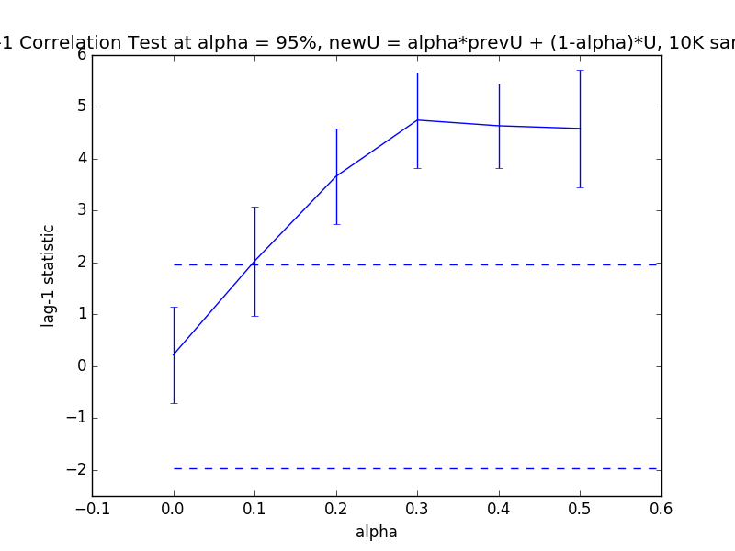
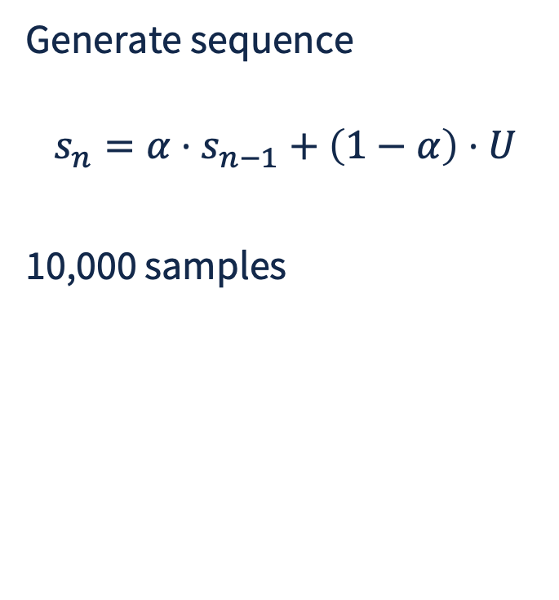
Test 1-lag Correlation, Example
REJECT H0
Critical threshold from Normal
Critical threshold from Normal
REJECT H0

