Slide 1
More Output Analysis

Slide 2
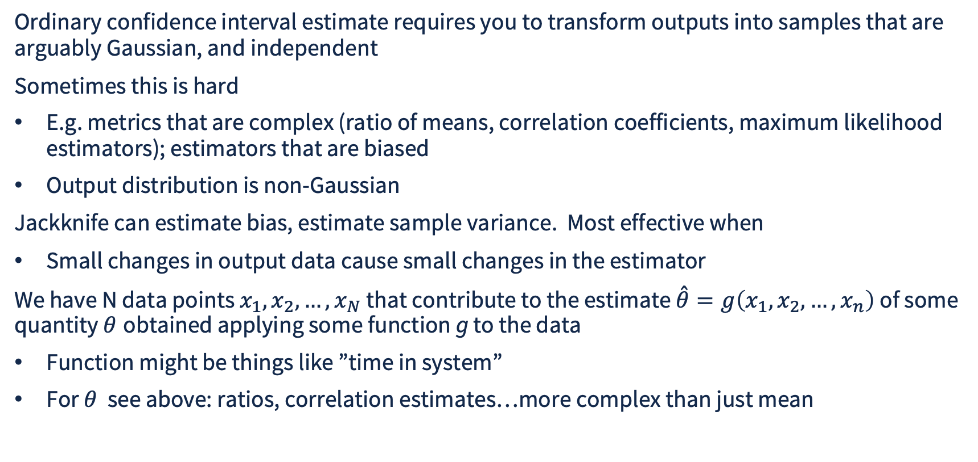
Jackknife Estimation
Ordinary confidence interval estimate requires you to transform outputs into samples that are arguably Gaussian, and independent
Sometimes this is hard
E.g. metrics that are complex (ratio of means, correlation coefficients, maximum likelihood estimators); estimators that are biased
Output distribution is non-Gaussian
Jackknife can estimate bias, estimate sample variance. Most effective when
Small changes in output data cause small changes in the estimator
We have N data points $x_{1},x_{2},…,x_{N}$that contribute to the estimate $\overset{ˆ}{θ}=g\left(x_{1},x_{2},…,x_{n}\right)$ of some quantity $θ$ obtained applying some function g to the data
Function might be things like ”time in system”
For $θ$ see above: ratios, correlation estimates…more complex than just mean

Slide 3
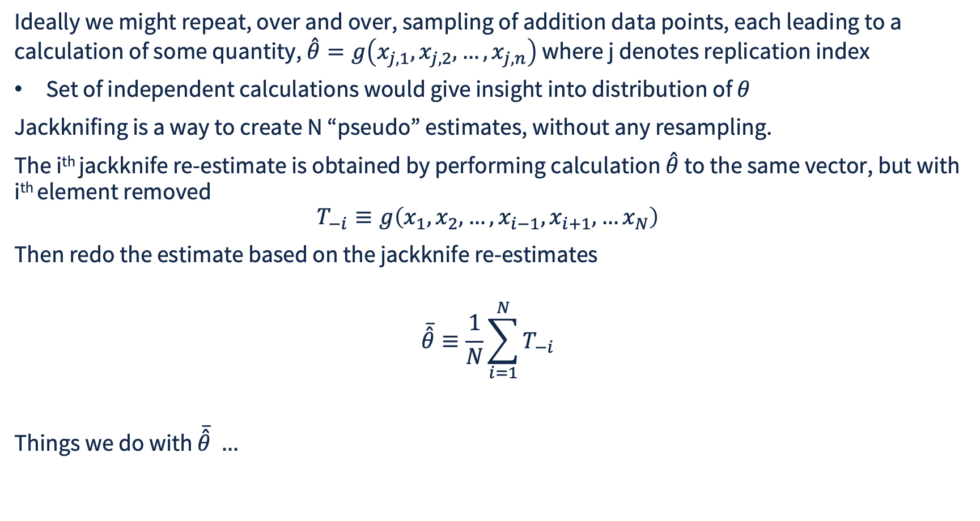
Jackknife Estimation
Ideally we might repeat, over and over, sampling of addition data points, each leading to a calculation of some quantity, $\overset{ˆ}{θ}=g\left(x_{j,1},x_{j,2},…,x_{j,n}\right)$ where j denotes replication index
Set of independent calculations would give insight into distribution of $θ$
Jackknifing is a way to create N “pseudo” estimates, without any resampling.
The i^{th} jackknife re-estimate is obtained by performing calculation $\overset{ˆ}{θ}$ to the same vector, but with i^{th} element removed
$$T_{−i}≡g\left(x_{1},x_{2},…,x_{i−1},x_{i+1},…x_{N}\right)$$
Then redo the estimate based on the jackknife re-estimates
$$\overline{\overset{ˆ}{θ}}≡\frac{1}{N}\sum_{i=1}^{N}{T_{−i}}$$
Things we do with $\overline{\overset{ˆ}{θ}} …$

Slide 4
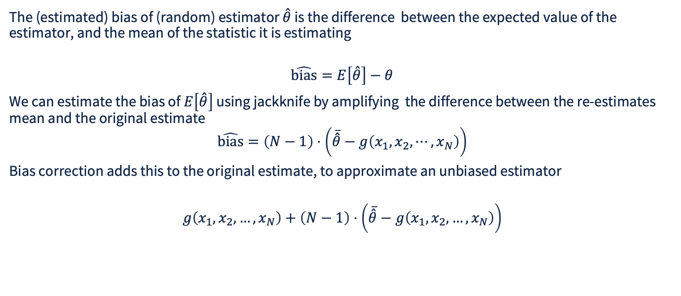
Bias Estimation
The (estimated) bias of (random) estimator $\overset{ˆ}{θ}$ is the difference between the expected value of the estimator, and the mean of the statistic it is estimating
$$\hat{\text{bias}}=E\left[\overset{ˆ}{θ}\right]−θ$$
We can estimate the bias of $E\left[\overset{ˆ}{θ}\right]$ using jackknife by amplifying the difference between the re-estimates mean and the original estimate
$$\hat{\text{bias}}=\left(N−1\right)⋅\left(\overline{\overset{ˆ}{θ}}−g\left(x_{1},x_{2},⋯,x_{N}\right)\right)$$
Bias correction adds this to the original estimate, to approximate an unbiased estimator
$$g\left(x_{1},x_{2},…,x_{N}\right)+\left(N−1\right)⋅\left(\overline{\overset{ˆ}{θ}}−g\left(x_{1},x_{2},…,x_{N}\right)\right)$$

Slide 5
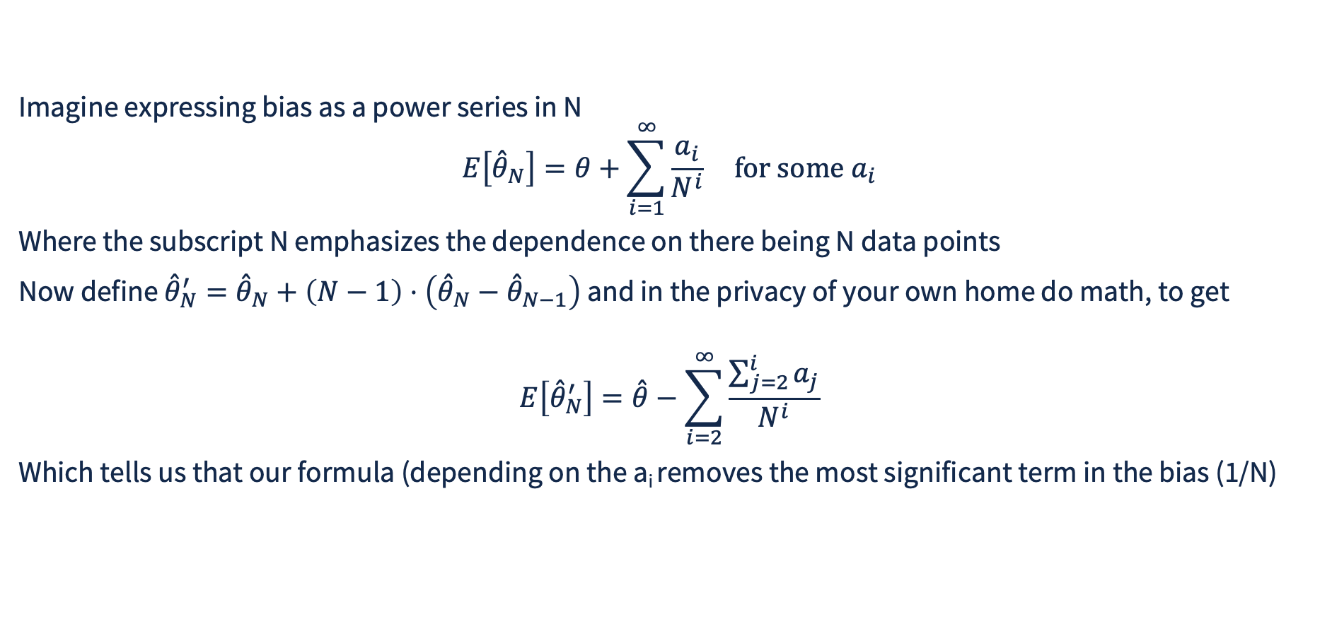
Bias Math
Imagine expressing bias as a power series in N
$$E\left[{\overset{ˆ}{θ}}_{N}\right]=θ+\sum_{i=1}^{∞}{\frac{a_{i}}{N^{i}}} \text{for some }a_{i}$$
Where the subscript N emphasizes the dependence on there being N data points
Now define ${\overset{ˆ}{θ}}_{N}^{′}={\overset{ˆ}{θ}}_{N}+\left(N−1\right)⋅\left({\overset{ˆ}{θ}}_{N}−{\overset{ˆ}{θ}}_{N−1}\right)$ and in the privacy of your own home do math, to get
$$E\left[{\overset{ˆ}{θ}}_{N}^{′}\right]=\overset{ˆ}{θ}−\sum_{i=2}^{∞}{\frac{\sum_{j=2}^{i}{a_{j}}}{N^{i}}}$$
Which tells us that our formula (depending on the a_{i} removes the most significant term in the bias (1/N)

Slide 6
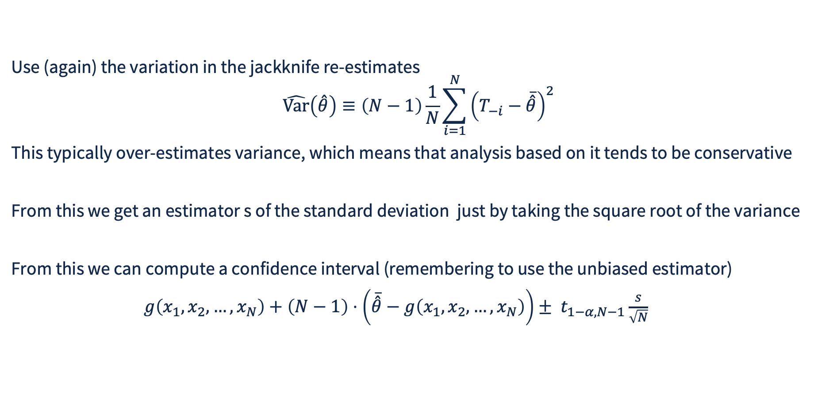
Estimating the Variance of the Estimator
Use (again) the variation in the jackknife re-estimates
$$\hat{\text{Var}}\left(\overset{ˆ}{θ}\right)≡\left(N−1\right)\frac{1}{N}\sum_{i=1}^{N}{{\left(T_{−i}−\overline{\overset{ˆ}{θ}}\right)}^{2}}$$
This typically over-estimates variance, which means that analysis based on it tends to be conservative
From this we get an estimator s of the standard deviation just by taking the square root of the variance
From this we can compute a confidence interval (remembering to use the unbiased estimator)
$g\left(x_{1},x_{2},…,x_{N}\right)+\left(N−1\right)⋅\left(\overline{\overset{ˆ}{θ}}−g\left(x_{1},x_{2},…,x_{N}\right)\right)± t_{1−α,N−1}\frac{s}{\sqrt{N}}$

Slide 7
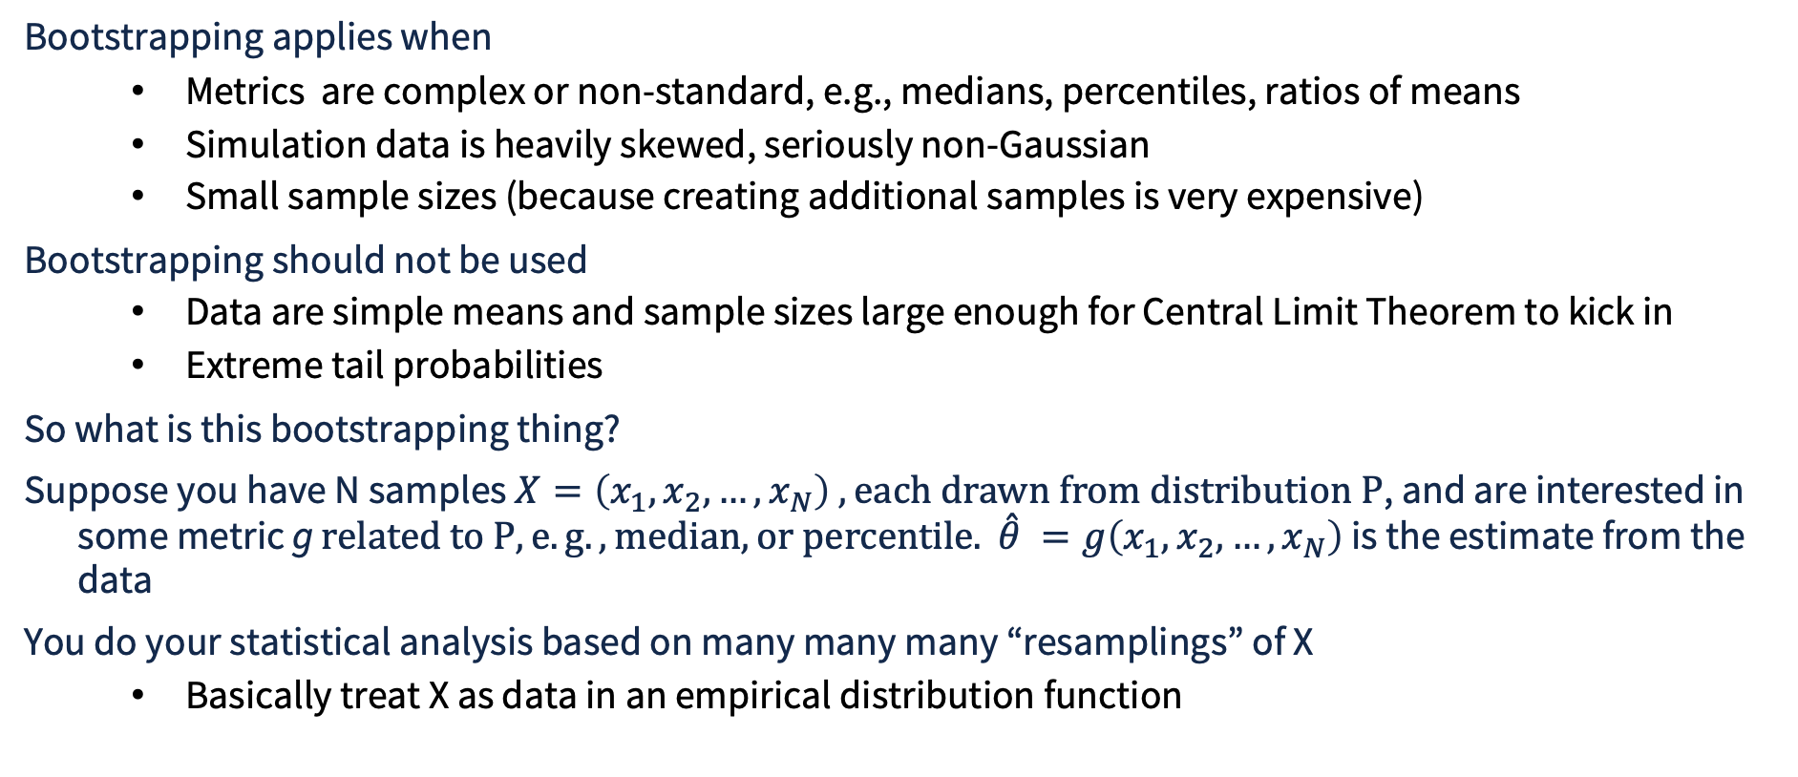
Bootstrap Construction of Confidence Intervals
Bootstrapping applies when
  Metrics are complex or non-standard, e.g., medians, percentiles, ratios of means
  Simulation data is heavily skewed, seriously non-Gaussian
  Small sample sizes (because creating additional samples is very expensive)
Bootstrapping should not be used
  Data are simple means and sample sizes large enough for Central Limit Theorem to kick in
  Extreme tail probabilities
So what is this bootstrapping thing?
Suppose you have N samples $X=\left(x_{1},x_{2},…,x_{N}\right) , each drawn from distribution P$, and are interested in some metric g $related to P, e.g., median, or percentile.$ $\overset{ˆ}{θ} =g\left(x_{1},x_{2},…,x_{N}\right)$ is the estimate from the data
You do your statistical analysis based on many many many “resamplings” of X
  Basically treat X as data in an empirical distribution function

Slide 8
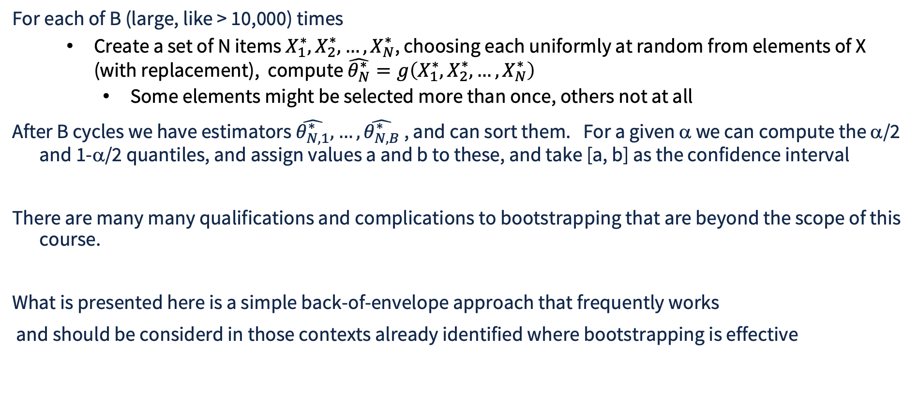
Bootstrap Resampling
For each of B (large, like > 10,000) times
  Create a set of N items $X_{1}^{∗},X_{2}^{∗},…,X_{N}^{∗}$, choosing each uniformly at random from elements of X (with replacement), compute $\hat{θ_{N}^{∗}}=g\left(X_{1}^{∗},X_{2}^{∗},…,X_{N}^{∗}\right)$
    Some elements might be selected more than once, others not at all
After B cycles we have estimators $\hat{θ_{N,1}^{∗}},…,\hat{θ_{N,B}^{∗}}$ , and can sort them. For a given α we can compute the α/2 and 1-α/2 quantiles, and assign values a and b to these, and take [a, b] as the confidence interval
There are many many qualifications and complications to bootstrapping that are beyond the scope of this course.
What is presented here is a simple back-of-envelope approach that frequently works
and should be considerd in those contexts already identified where bootstrapping is effective

Slide 9

Bootstrap Resampling in Python
Example: M/M/3/10 queue, λ = 0.5, μ = 1.0
Estimate 95% quantile of time in system
Sample 500 replications of running queue to time 1000
Measure arrivals and drops after first 25% of simulation time
  Output of a run is fraction of measured arrivals that were dropped
After 25% of termination time, every job’s time in system is measured, at end of simulation observed 95% quantile reported
Two approaches, (1) create averages of every 50 replication outputs, use classical CI approach, (2) bootstrap on all observations
Applied statistical tests to output for evidence of Gaussian distribution in both cases
% python sim.py
code

Slide 10
Bootstrap Resampling in Python, Example Output
% python sim.py
--- Statistical Normality Tests for averaged samples ---
Shapiro-Wilk Result: Fail to reject H0 (Data looks Gaussian/Normal)
K^2 Result: Fail to reject H0 (Data looks Gaussian/Normal)
95% Confidence Interval from averages: (np.float64(2.5714907581389546), np.float64(2.621676390257084))
--- Statistical Normality Tests on raw data ---
Shapiro-Wilk Result: Reject H0 (Data does NOT look Gaussian/Normal)
K^2 Result: Reject H0 (Data does NOT look Gaussian/Normal)
Bootstrap 95% Confidence Interval : (2.5819, 2.6128)

