Slide 1
Output Analysis

Slide 2
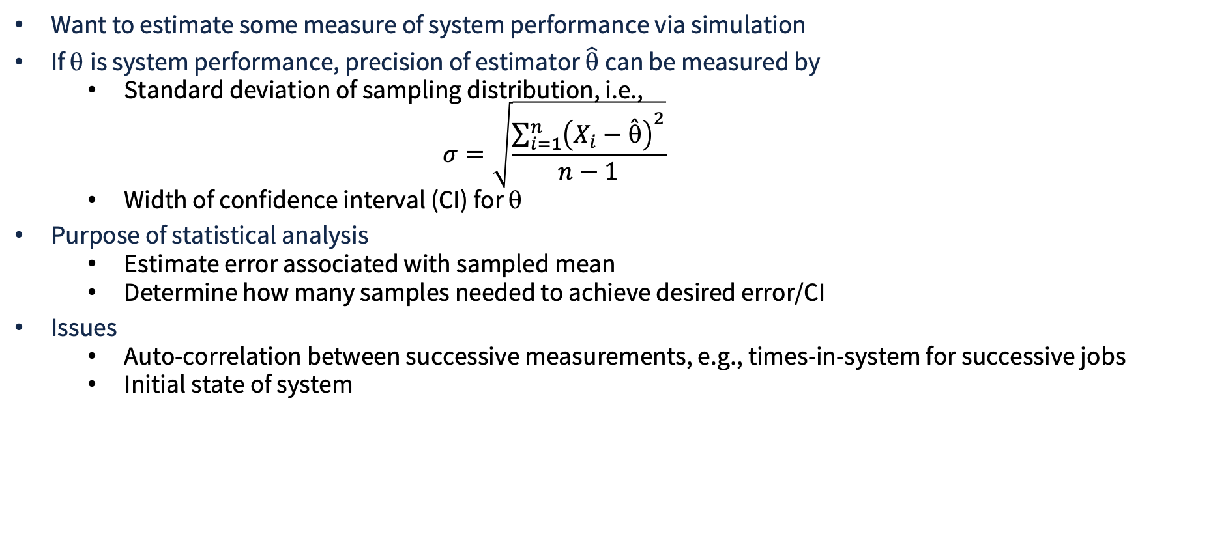
Purpose of Output Analysis
Want to estimate some measure of system performance via simulation
If θ is system performance, precision of estimator $\hat{\text{q}}$ can be measured by
  Standard deviation of sampling distribution, i.e.,
    $$σ=\sqrt{\frac{\sum_{i=1}^{n}{{\left(X_{i}−\overset{ˆ}{\text{q}}\right)}^{2}}}{n−1}}$$
  Width of confidence interval (CI) for θ
Purpose of statistical analysis
  Estimate error associated with sampled mean
  Determine how many samples needed to achieve desired error/CI
Issues
  Auto-correlation between successive measurements, e.g., times-in-system for successive jobs
  Initial state of system
Notes:
\sigma = \sqrt{ \frac{ \sum_{i=1}^n (X_i - \hat{\theta})^2 }{n-1} }

Slide 3
Outline of Lesson
Distinguish between transient and steady state simulation
Illustrate inherent variability in stochastic discrete-event simulation
Introduce statistical estimation of performance measures
Discuss analysis of transient simulations
Discussion analysis of steady-state simulations
Notes:
\sigma = \sqrt{ \frac{ \sum_{i=1}^n (X_i - \hat{\theta})^2 }{n-1} }

Slide 4
Terminating Simulations
Terminating simulation:
  Runs for some duration of time T_{E}, where E is a specified event that stops the simulation
  Starts at time zero under well-specified initial conditions
  Ends at stoping time T_{E}
  Example: Bank opens at 8:30 a.m. (time zero) with no customers and 8 of the 11 tellers (initial conditions), and closes at 4:30 p.m. (Time T_{E} = 480 minutes)
    Analyst views this as a terminating system because interest is in one day’s operation
  Flight system with component / sub-system failures
Notes:
\sigma = \sqrt{ \frac{ \sum_{i=1}^n (X_i - \hat{\theta})^2 }{n-1} }

Slide 5
Terminating Simulations: Key Aspects
The key things that distinguish a terminating (or transient) simulation are
  That the initial state matters, the output will depend on it and the nature of the dependence may be interesting to the analyst, e.g.,
    To be distinguished from a system parameter
    E.g., the number of initial jobs in the system when we wish to analyze a data farm’s ‘Probability of achieving contract service requirements’
  There is a specific time or event of interest that stops the simulation
    E.g., a flight mission must abort because of too many component failures
Notes:
\sigma = \sqrt{ \frac{ \sum_{i=1}^n (X_i - \hat{\theta})^2 }{n-1} }

Slide 6
Terminating Simulations: Monte Carlo
I_{A}
System
O₁
I_{B}
O₂
I_{C}
System is simulated until some termination event
  Required only that system model reports when it stops and its state when it stops
Simulation analysis is to stochastically vary inputs, observe and analyze outputs
Notes:
\sigma = \sqrt{ \frac{ \sum_{i=1}^n (X_i - \hat{\theta})^2 }{n-1} }

Slide 7
Non-Terminating Simulations
Non-terminating simulations
  Runs continuously, or at least over a very long period of time.
  Examples: assembly lines that shut down infrequently, telephone systems, hospital emergency rooms.
  Initial conditions defined by the analyst.
  Runs for some analyst-specified period of time T_{E}.
  Study the steady-state (long-run) properties of the system, properties that are not influenced by the initial conditions of the model.
Whether a simulation is considered to be terminating or non-terminating depends on both
  The objectives of the simulation study, and
  The nature of the system.
Notes:
\sigma = \sqrt{ \frac{ \sum_{i=1}^n (X_i - \hat{\theta})^2 }{n-1} }

Slide 8
Side-bar: Queues and System Measurements
Kendall-style queueing notation (campact label describing key assumptions)
  A / S / c / K / N / D
A – interarrival distribution
S– service time distribution
c – number of parallel servers
N – calling population size
K – maximum number allowed in system
D – queue discipline, e.g., FCFS, priority
Common shorthand
M = memoryless/exponential; D = deterministic; G = general
Notes:
\sigma = \sqrt{ \frac{ \sum_{i=1}^n (X_i - \hat{\theta})^2 }{n-1} }

Slide 9
Common Queue Examples
M / G/ 1
Poisson arrivals, general service times, one server. Used when service variability matters
M / M / m
Poisson arrivals, exponential service times, m parallel servers. Classic many-server model
Implicit defaults
Infinite buffer K = infinity
Infinite population
FCFS discipline
Notes:
\sigma = \sqrt{ \frac{ \sum_{i=1}^n (X_i - \hat{\theta})^2 }{n-1} }

Slide 10
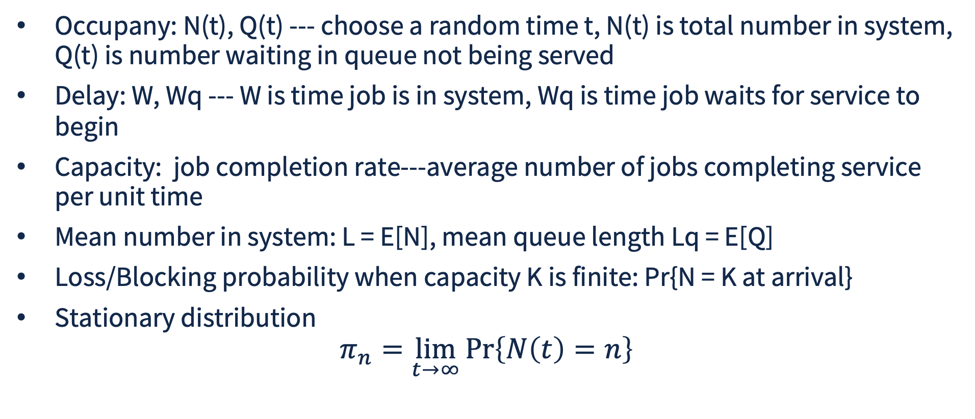
Commonly Studied Stationary Measurements
Occupany: N(t), Q(t) --- choose a random time t, N(t) is total number in system, Q(t) is number waiting in queue not being served
Delay: W, Wq --- W is time job is in system, Wq is time job waits for service to begin
Capacity: job completion rate---average number of jobs completing service per unit time
Mean number in system: L = E[N], mean queue length Lq = E[Q]
Loss/Blocking probability when capacity K is finite: Pr{N = K at arrival}
Stationary distribution
$$π_{n}=\lim_{t→∞}{\operatorname{Pr}\left\{N\left(t\right)=n\right\}}$$
Notes:
\pi_n = \lim_{t \rightarrow \infty} \Pr\{N(t) = n \}

Slide 11
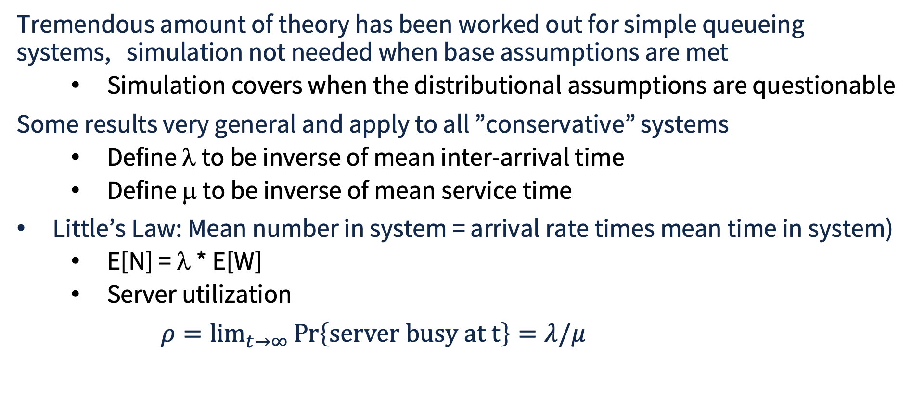
Analytic Results
Tremendous amount of theory has been worked out for simple queueing systems, simulation not needed when base assumptions are met
  Simulation covers when the distributional assumptions are questionable
Some results very general and apply to all ”conservative” systems
  Define λ to be inverse of mean inter-arrival time
  Define μ to be inverse of mean service time
Little’s Law: Mean number in system = arrival rate times mean time in system)
  E[N] = λ * E[W]
  Server utilization
$ρ=\lim{⁡_{t→∞}}\operatorname{Pr}\left\{\text{server} \text{busy} at t\right\}=λ/μ$
Notes:
\pi_n = \lim_{t \rightarrow \infty} \Pr\{N(t) = n \}

Slide 12
Stochastic Nature of Output Data
Model output consists of one or more random variables, because model is an input-output transformation and input variables are random variables
Example: M/G/1 queue
  Arrival rate of 0.1 jobs per minute, service time positive Gaussian (μ,σ)
  System performance: long-run mean queue length, Lq(t) as t grows to infinity
  Suppose we run a single simulation for a total of 5,000 minutes
    Divide the time interval into 5 equal subintervals of 1000 minutes each
    Define Y_{j} to be the average number of customers in queue from time (j-1)*1000 to j*1000
  Run three replications (each with different initial random number seed)
    Compute time-average number in system for each batch
      How?
Y₁
Y₂
Y₃
Y₄
Y₅
0 1000 2000 3000 4000 5000
Notes:
\sigma = \sqrt{ \frac{ \sum_{i=1}^n (X_i - \hat{\theta})^2 }{n-1} }

Slide 13
Average Number in System
L(t), number in system at time t, changes with each event
  Each event is an arrival or a departure
  Time average over [0,T] is area under L(t) curve divided by T
6
5
4
3
2
1
0
L(t)
time
T
Notes:
\sigma = \sqrt{ \frac{ \sum_{i=1}^n (X_i - \hat{\theta})^2 }{n-1} }

Slide 14
Computing Average Number in System
L(t), number in system at time t, changes with each event
  Each event is an arrival or a departure
Say the events happen at times t₀, t_{1,} …, t_{m}
Initially define A =0.0
  Processing event at time t_{k} (before changing state)
  d = (t_{k} – t_{k-1})*L(t_{k-1}) - the number in the system taken on at time t_{k-1} times the length of time it retained that value
  A += d
  On arrival event L(t_{k}) = L(t_{k-1})+1, on departure event L(t_{k}) = L(t_{k-1}) – 1
At time t_{m} estimate time average number in system as A/(t_{m}-t₀)
Notes:
\sigma = \sqrt{ \frac{ \sum_{i=1}^n (X_i - \hat{\theta})^2 }{n-1} }

Slide 15
Back to M/G/1 example
Define Y_{rj} to be the measured average number in system over in interval j ([(j-1)*1000, j*1000)) for replication r (and imagine 3 replications)
Inherent variability both within a single replication and across replications
Averages across replications are stochastically independent (e.g., Y₁₁, Y₂₁, Y₃₁) but averages within a replication (e.g., Y₁₁, Y₁₂, Y₁₃, Y₁₄, Y₁₅ ) are not
Batching Interval | j | 1, Y_{1j} | 2, Y_{2j} | 3, Y_{3j}
[0, 1000) | 1 | 3.61 | 2.91 | 7.97
[1000, 2000) | 2 | 3.21 | 9.00 | 19.53
[2000, 3000) | 3 | 2.18 | 16.15 | 20.36
[3000, 4000) | 4 | 6.92 | 24.53 | 8.11
[4000, 5000) | 5 | 2.82 | 25.19 | 12.62
[0, 5000) |  | 3.75 | 15.56 | 13.66
Notes:
\sigma = \sqrt{ \frac{ \sum_{i=1}^n (X_i - \hat{\theta})^2 }{n-1} }

Slide 16
Output Analysis : Big Picture
We run a simulation model, obtain a number of measurements, x₁, x₂, … , x_{n}
The observations are from an unknown probability distribution D
We would like to be able to say something quantitative about ‘attributes’ of that distribution
  Moments (e.g., mean, variance)
  Percentiles (e.g. measure of probability above or below thresholds, either specified (e.g. Pr{X > x_{high}} or probabilistic, e.g., smallest x_{high} such that Pr{X > x_{high}} < 0.99
There are things we can do if the observations are statistically independent
  When construct a different distribution D^{obs} from the data, make quantitative statements about D^{obs} and from these make inferences about D
  When we can assume that x_{i} are from Gaussian distribution we can use confidence intervals
  Otherwise we can jackknife or bootstrap to estimate variance
We consider confidence intervals first…
Notes:
\sigma = \sqrt{ \frac{ \sum_{i=1}^n (X_i - \hat{\theta})^2 }{n-1} }

Slide 17
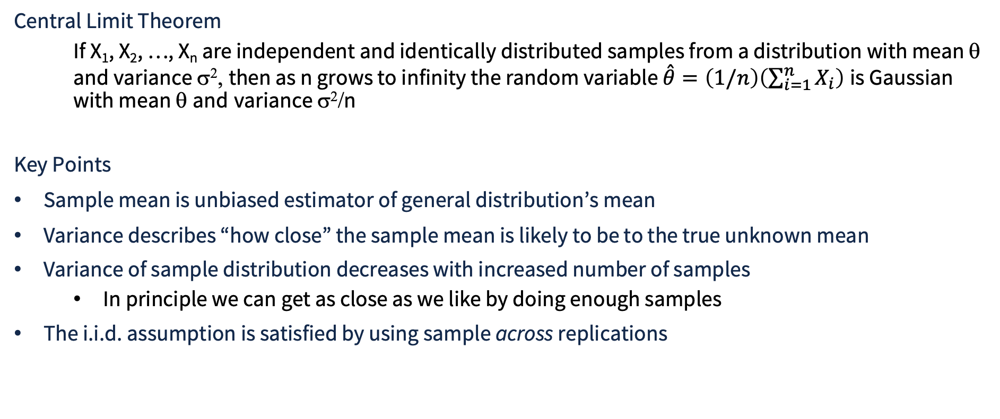
Basis For Confidence Interval Estimation (i.i.d. samples)
Central Limit Theorem
  If X₁, X₂, …, X_{n} are independent and identically distributed samples from a distribution with mean θ and variance σ², then as n grows to infinity the random variable $\overset{ˆ}{θ}=\left(1/n\right)\left(\sum_{i=1}^{n}{X_{i}}\right)$ is Gaussian with mean θ and variance σ²/n
Key Points
Sample mean is unbiased estimator of general distribution’s mean
Variance describes “how close” the sample mean is likely to be to the true unknown mean
Variance of sample distribution decreases with increased number of samples
  In principle we can get as close as we like by doing enough samples
The i.i.d. assumption is satisfied by using sample across replications
Notes:
$$\backslash hat\{\backslash theta\} = (1/n)(\backslash sum_\{i=1\}^n X_i)$$

Slide 18
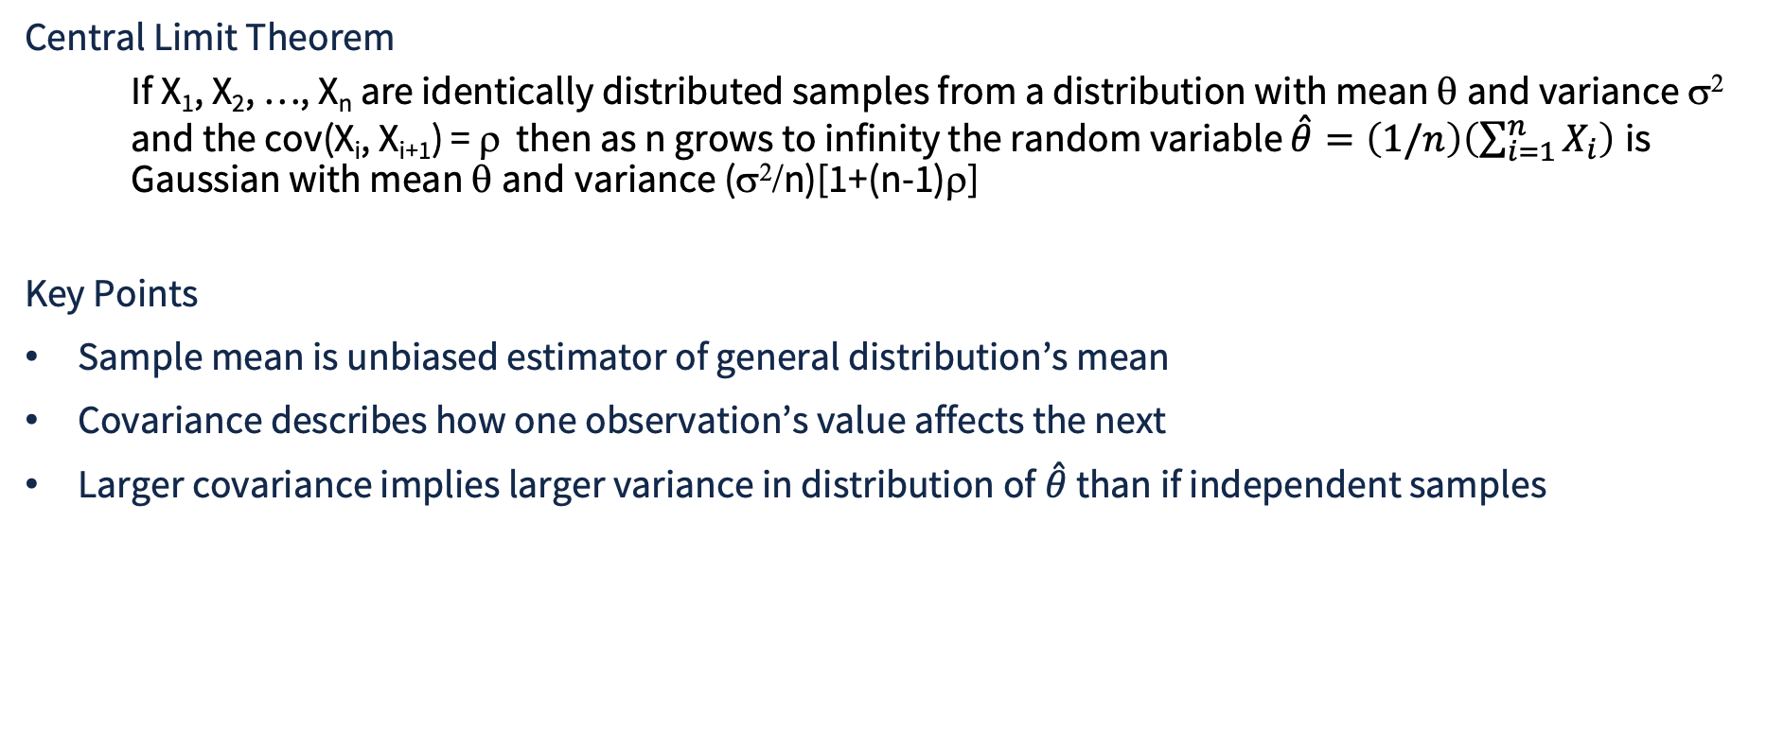
Basis For Confidence Interval Estimation (correlated samples)
Central Limit Theorem
  If X₁, X₂, …, X_{n} are identically distributed samples from a distribution with mean θ and variance σ² and the cov(X_{i}, X_{i+1}) = ρ then as n grows to infinity the random variable $\overset{ˆ}{θ}=\left(1/n\right)\left(\sum_{i=1}^{n}{X_{i}}\right)$ is Gaussian with mean θ and variance (σ²/n)[1+(n-1)ρ]
Key Points
Sample mean is unbiased estimator of general distribution’s mean
Covariance describes how one observation’s value affects the next
Larger covariance implies larger variance in distribution of$\overset{ˆ}{θ}$ than if independent samples
Notes:
$$\backslash hat\{\backslash theta\} = (1/n)(\backslash sum_\{i=1\}^n X_i)$$

Slide 19
Basis For Confidence Interval Estimation (i.i.d. samples)
Central Limit Theorem
  If X₁, X₂, …, X_{n} are independent and identically distributed samples from a distribution with mean θ and variance σ², then as n grows to infinity the random variable $\overset{ˆ}{θ}=\left(1/n\right)\left(\sum_{i=1}^{n}{X_{i}}\right)$ is Gaussian with mean θ and variance σ²/n
Key Points
Sample mean is unbiased estimator of general distribution’s mean
Variance describes “how close” the sample mean is likely to be to the true unknown mean
Variance of sample distribution decreases with increased number of samples
  In principle we can get as close as we like by doing enough samples
The i.i.d. assumption is satisfied by using sample across replications
Notes:
$$\backslash hat\{\backslash theta\} = (1/n)(\backslash sum_\{i=1\}^n X_i)$$

Slide 20
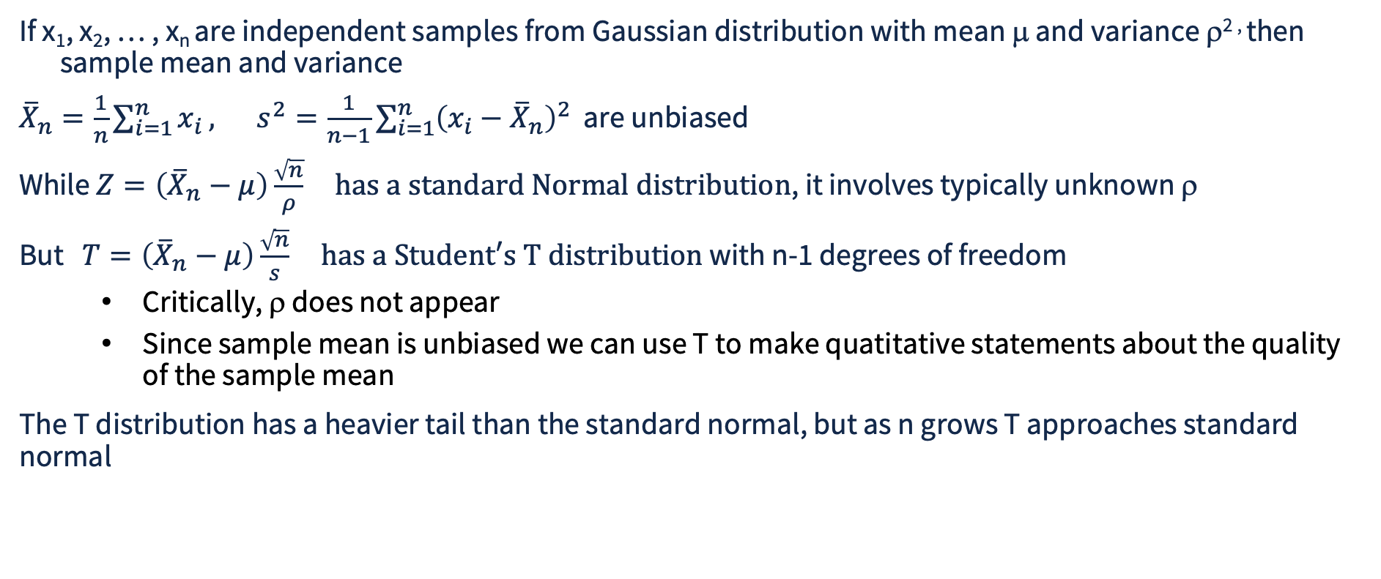
The Student T distribution
If x₁, x₂, … , x_{n} are independent samples from Gaussian distribution with mean μ and variance ρ^{2 ,} then sample mean and variance
${\overline{X}}_{n}=\frac{1}{n}\sum_{i=1}^{n}{x_{i}}, s^{2}=\frac{1}{n−1}\sum_{i=1}^{n}{{\left(x_{i}−{\overline{X}}_{n}\right)}^{2}}$ are unbiased
While $Z=\left({\overline{X}}_{n}−μ\right)\frac{\sqrt{n}}{ρ} \text{has a standard Normal distribution}$, it involves typically unknown ρ
But $T=\left({\overline{X}}_{n}−μ\right)\frac{\sqrt{n}}{s} \text{has a Student′s T distribution}$ with n-1 degrees of freedom
  Critically, ρ does not appear
  Since sample mean is unbiased we can use T to make quatitative statements about the quality of the sample mean
The T distribution has a heavier tail than the standard normal, but as n grows T approaches standard normal
Notes:
$$\backslash hat\{\backslash theta\} = (1/n)(\backslash sum_\{i=1\}^n X_i)$$

Slide 21
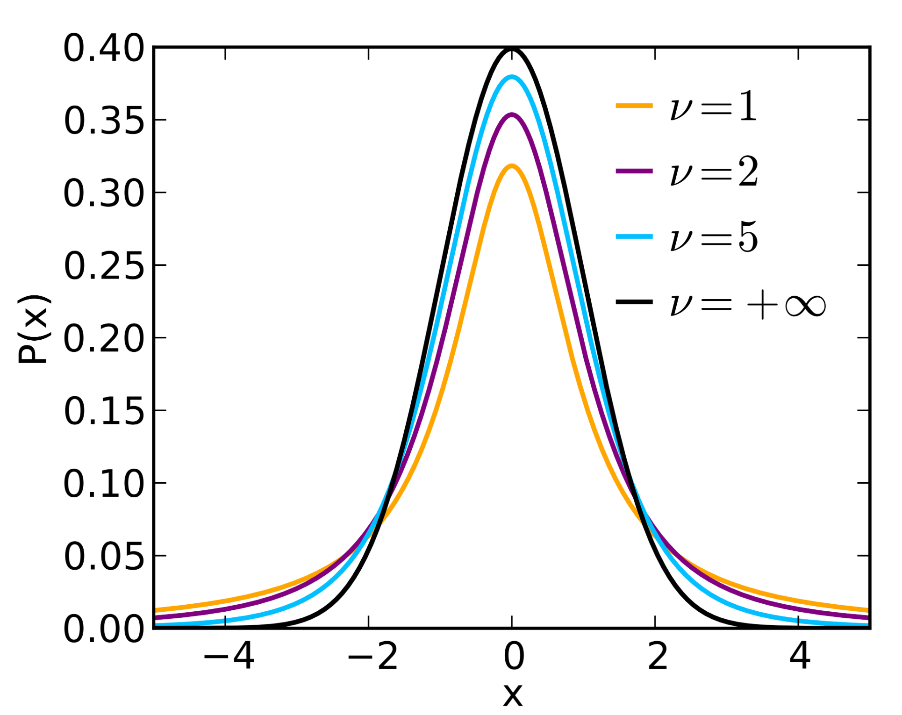
The Student T distribution
Notes:
$$\backslash hat\{\backslash theta\} = (1/n)(\backslash sum_\{i=1\}^n X_i)$$

Slide 22
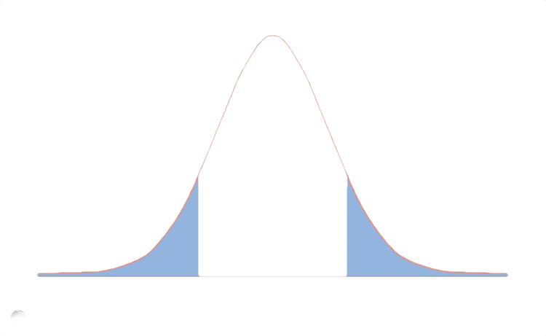

Confidence-Interval Estimation
Different sets of experiments will create difference confidence intervals
(1-α) percent of the time the CI will contain the true θ
θ
$${\overset{ˆ}{Y}}_{..}$$
Notes:
$$\backslash hat\{\backslash theta\} = (1/n)(\backslash sum_\{i=1\}^n X_i)$$

Slide 23

Confidence-Interval Estimation
Different sets of experiments will create difference confidence intervals
(1-α) percent of the time the CI will contain the true θ
$${\overset{ˆ}{Y}}_{..}$$
θ
Notes:
$$\backslash hat\{\backslash theta\} = (1/n)(\backslash sum_\{i=1\}^n X_i)$$

Slide 24

Confidence-Interval Estimation
Different sets of experiments will create difference confidence intervals
(1-α) percent of the time the CI will contain the true θ
$${\overset{ˆ}{Y}}_{..}$$
θ
Notes:
$$\backslash hat\{\backslash theta\} = (1/n)(\backslash sum_\{i=1\}^n X_i)$$

Slide 25
Confidence-Interval Estimation
Different sets of experiments will create difference confidence intervals
(1-α) percent of the time the CI will contain the true θ
θ
$${\overset{ˆ}{Y}}_{..}$$
Notes:
$$\backslash hat\{\backslash theta\} = (1/n)(\backslash sum_\{i=1\}^n X_i)$$

Slide 26
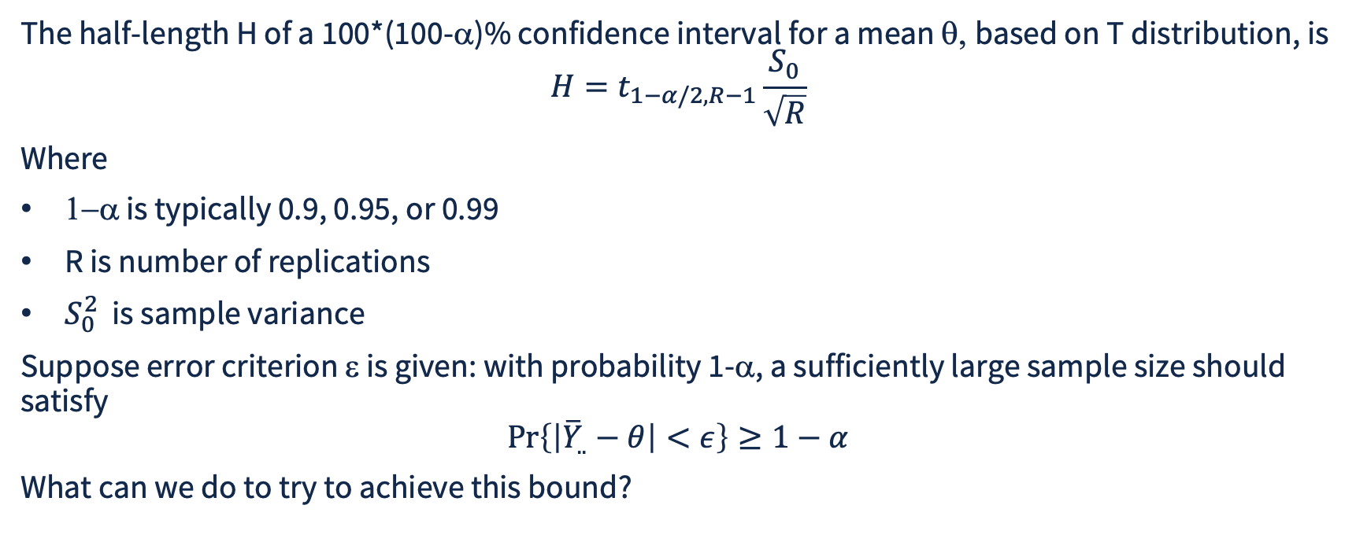
C.I. With Specified Precision
The half-length H of a 100*(100-α)% confidence interval for a mean θ, based on T distribution, is
$$H=t_{1−α/2,R−1}\frac{S_{0}}{\sqrt{R}}$$
Where
1−α is typically 0.9, 0.95, or 0.99
R is number of replications
$S_{0}^{2}$ is sample variance
Suppose error criterion ε is given: with probability 1-α, a sufficiently large sample size should satisfy
$$\operatorname{Pr}\left\{\left|{\overline{Y}}_{..}−θ\right|<ε\right\}≥1−α$$
What can we do to try to achieve this bound?

Slide 27
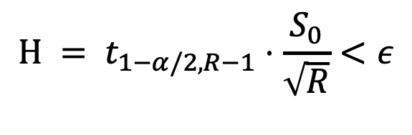
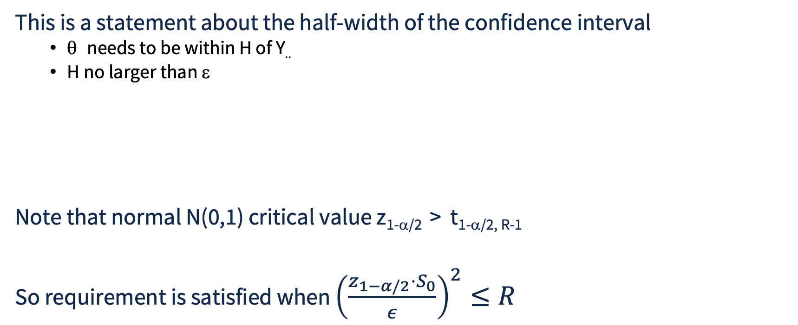
Impacting C.I. Half Width
This is a statement about the half-width of the confidence interval
  θ needs to be within H of Y..
  H no larger than ε
Note that normal N(0,1) critical value z_{1-α/2} > t_{1-α/2, R-1}
So requirement is satisfied when ${\left(\frac{z_{1−α/2}⋅S_{0}}{ε}\right)}^{2}≤R$
Y..
H
$${H = t}_{1−α/2,R−1}⋅\frac{S_{0}}{\sqrt{R}}<ε$$
< ε

Slide 28
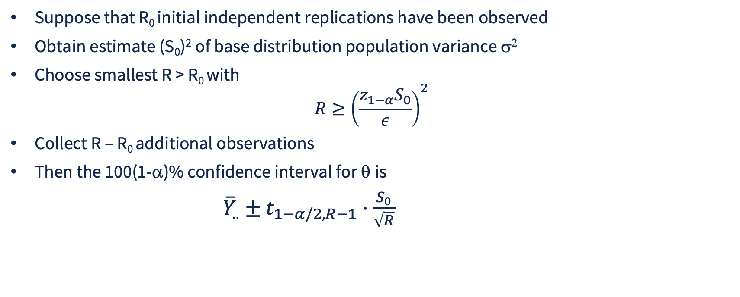
Choosing Number of Replications
Suppose that R₀ initial independent replications have been observed
Obtain estimate (S₀)² of base distribution population variance σ²
Choose smallest R > R₀ with
$$R≥{\left(\frac{z_{1−α}S_{0}}{ε}\right)}^{2}$$
Collect R – R₀ additional observations
Then the 100(1-α)% confidence interval for θ is
${\overline{Y}}_{..}±t_{1−α/2,R−1}⋅\frac{S_{0}}{\sqrt{R}}$

Slide 29
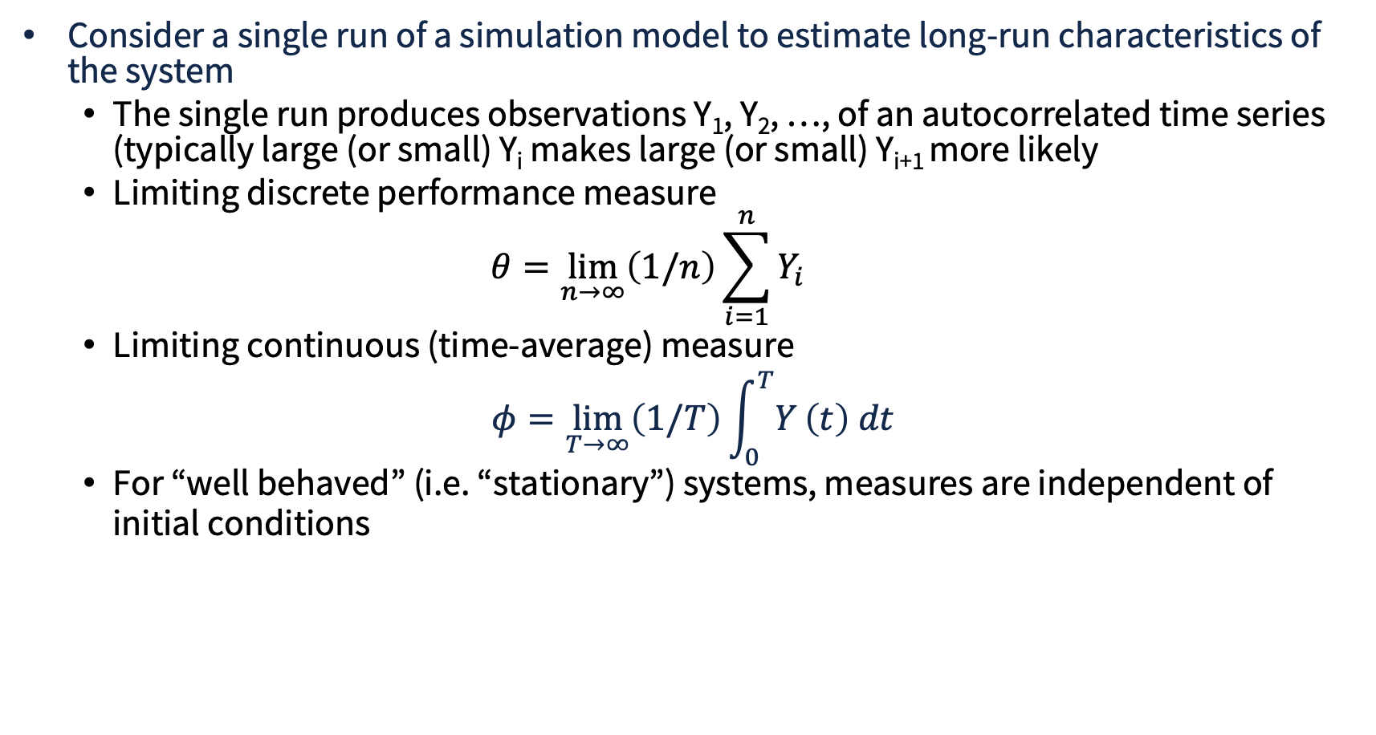
Output Analysis for Steady-State Simulation
Consider a single run of a simulation model to estimate long-run characteristics of the system
  The single run produces observations Y₁, Y₂, …, of an autocorrelated time series (typically large (or small) Y_{i} makes large (or small) Y_{i+1} more likely
  Limiting discrete performance measure
  $$θ=\lim_{n→∞}\left(1/n\right)\sum_{i=1}^{n}{Y_{i}}$$
  Limiting continuous (time-average) measure
$$φ=\lim_{T→∞}\left(1/T\right)\int_{0}^{T}{Y}\left(t\right) dt$$
  For “well behaved” (i.e. “stationary”) systems, measures are independent of initial conditions

Slide 30
Initialization Bias : Smart Initialization
If too few (or the wrong) samples are included in the analysis of output, the state of the system at time 0 can unduly impact estimates (“initialization bias”)
Solutions
  Intelligent initialization
  Divide simulation run into initialization phase and data-collection phase
Techniques for Intelligent Initialization
  Start system in state more representative of long-run conditions
  If modeling real system, collect and use data to create initial conditions
  If system can be simplified to representation that is mathematically solvable (e.g. queueing models), use model predictions to create initial state

Slide 31
Initialization Bias: Two Phases
Divide simulation run into
  An initialization phase, from time 0 to time T₀
  Data collection phase, from T₀ to stopping time T_{E}
  Choice of T₀ is important
    State of system at time T₀ needs to be representative of system in steady-state
      Meaning the distribution of the system state at T₀ should be close to the long-term distribution of system state
      But of course, how can you tell???

Slide 32
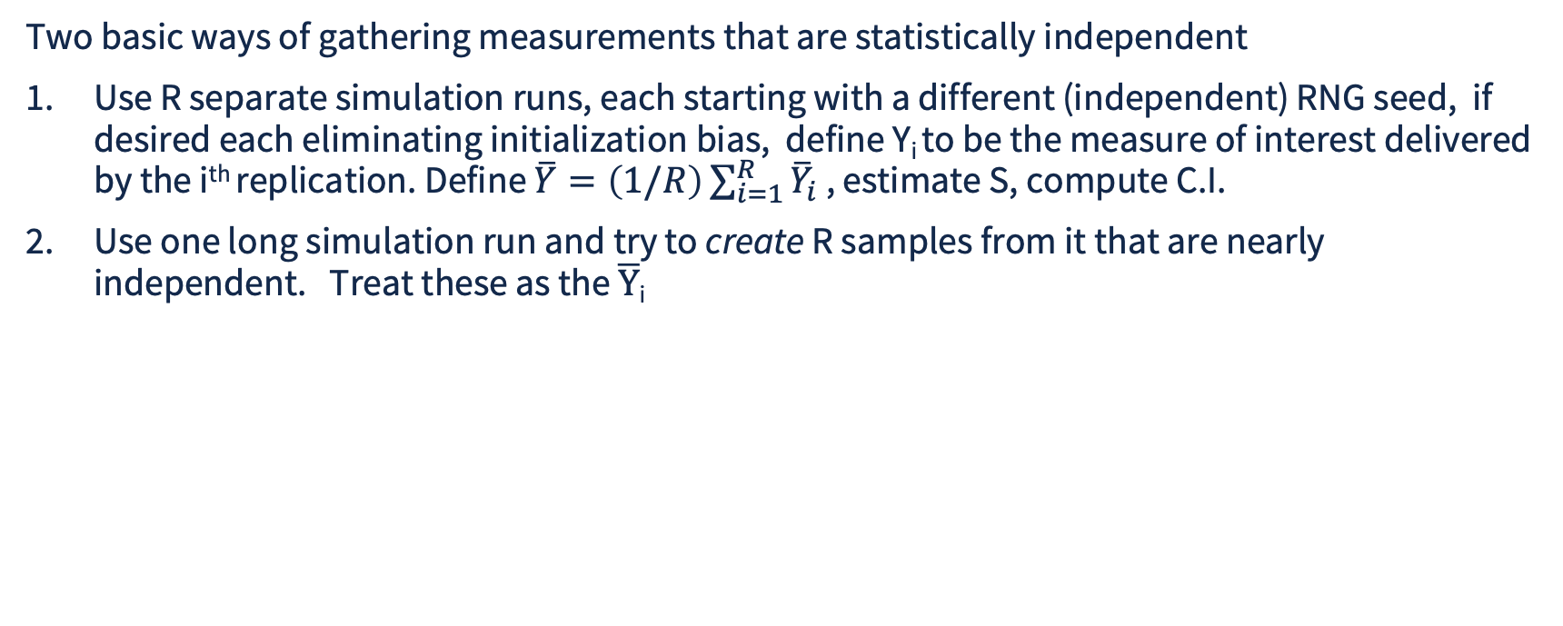
Ways of Achieving Independent Observations
Two basic ways of gathering measurements that are statistically independent
Use R separate simulation runs, each starting with a different (independent) RNG seed, if desired each eliminating initialization bias, define Y_{i} to be the measure of interest delivered by the i^{th} replication. Define $\overline{Y}=\left(1/R\right)\sum_{i=1}^{R}{{\overline{Y}}_{i}}$ , estimate S, compute C.I.
Use one long simulation run and try to create R samples from it that are nearly independent. Treat these as the $\overline{Y}$_{i}

Slide 33
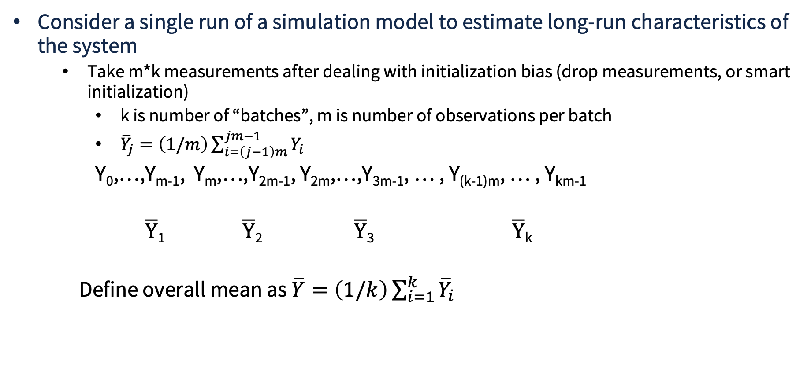
Batch Means for Long Single Runs
Consider a single run of a simulation model to estimate long-run characteristics of the system
  Take m*k measurements after dealing with initialization bias (drop measurements, or smart initialization)
    k is number of “batches”, m is number of observations per batch
    ${\overline{Y}}_{j}=\left(1/m\right)\sum_{i=\left(j−1\right)m}^{jm−1}{Y_{i}}$
    Y₀,…,Y_{m-1}, Y_{m},…,Y_{2m-1}, Y_{2m},…,Y_{3m-1}, … , Y_{(k-1)m}, … , Y_{km-1}
  $\overline{Y}$₁ $\overline{Y}$₂ $\overline{Y}$₃ $\overline{Y}$_{k}
  Define overall mean as $\overline{Y}=\left(1/k\right)\sum_{i=1}^{k}{{\overline{Y}}_{i}}$

Slide 34
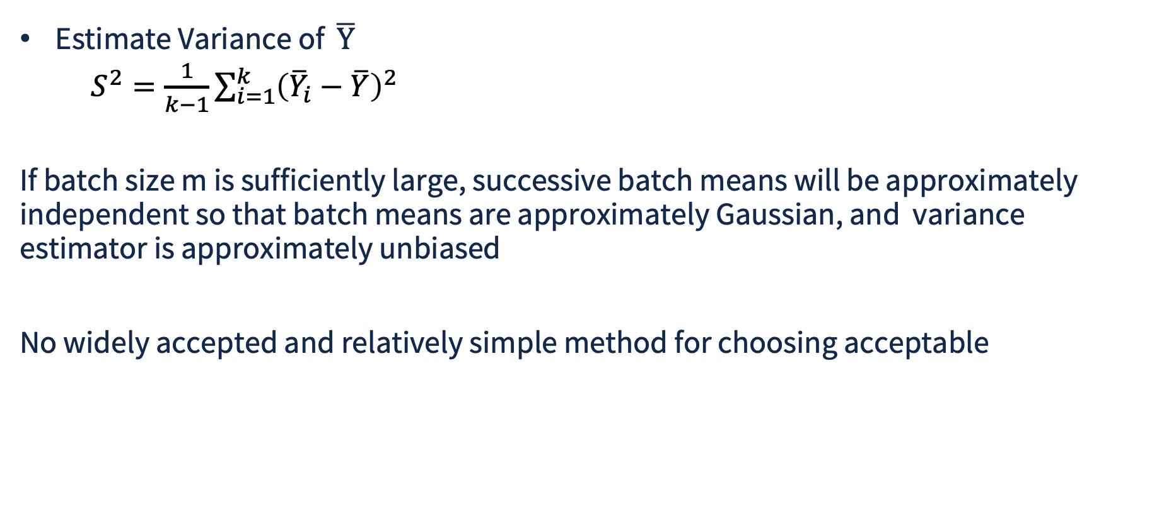
Sample Variance for Batch Means
Estimate Variance of $\overline{Y}$
  $S^{2}=\frac{1}{k−1}\sum_{i=1}^{k}{{\left({\overline{Y}}_{i}−\overline{Y}\right)}^{2}}$
If batch size m is sufficiently large, successive batch means will be approximately independent so that batch means are approximately Gaussian, and variance estimator is approximately unbiased
No widely accepted and relatively simple method for choosing acceptable

Slide 35
Tradeoffs: Pure Replications vs. Batch Means
Batch means suitable only for non-terminating models
Pure replications experiences initialization bias for every replication, batch means only one
Pure replications ensure independence of observations, batch means may suffer from autocorrelation
Pure replications admit to embarrassingly parallel implementation, batch means do not
Pure replication suffers overhead of setting up each run (loading state, etc.), done once for batch means
Comes down to personal assessment of degree of cost one is will to pay for the assurance of independent replications

