Slide 1
DTMC Classifications

Slide 2
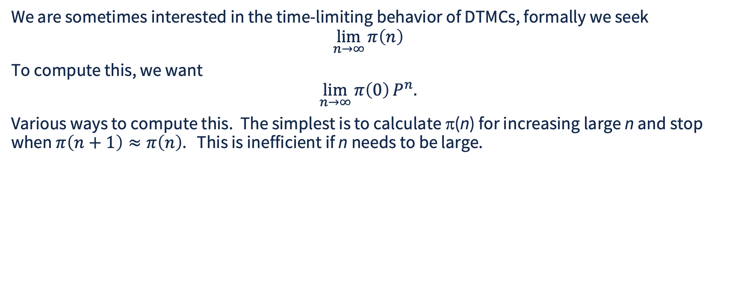
Limiting Behavior of DTMCs
We are sometimes interested in the time-limiting behavior of DTMCs, formally we seek
$$\lim_{n→∞}{π\left(n\right)}$$
To compute this, we want
$$\lim_{n→∞}{π\left(0\right)}P^{n}.$$
Various ways to compute this. The simplest is to calculate π(n) for increasing large n and stop when $π\left(n+1\right)≈π\left(n\right).$ This is inefficient if n needs to be large.

Slide 3
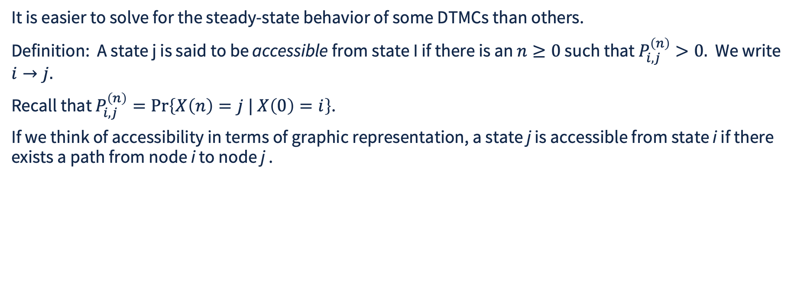
Accessibility of States in a DTMC
It is easier to solve for the steady-state behavior of some DTMCs than others.
Definition: A state j is said to be accessible from state I if there is an $n≥0$ such that $P_{i,j}^{\left(n\right)}>0.$ We write $i→j.$
Recall that $P_{i,j}^{\left(n\right)}=\operatorname{Pr}\left\{X\left(n\right)=j | X\left(0\right)=i\right\}$.
If we think of accessibility in terms of graphic representation, a state j is accessible from state i if there exists a path from node i to node j .
n₃
n₂
n₁
n₀
In the reliability example, there is no state accessible from the state n₀ representing failure

Slide 4
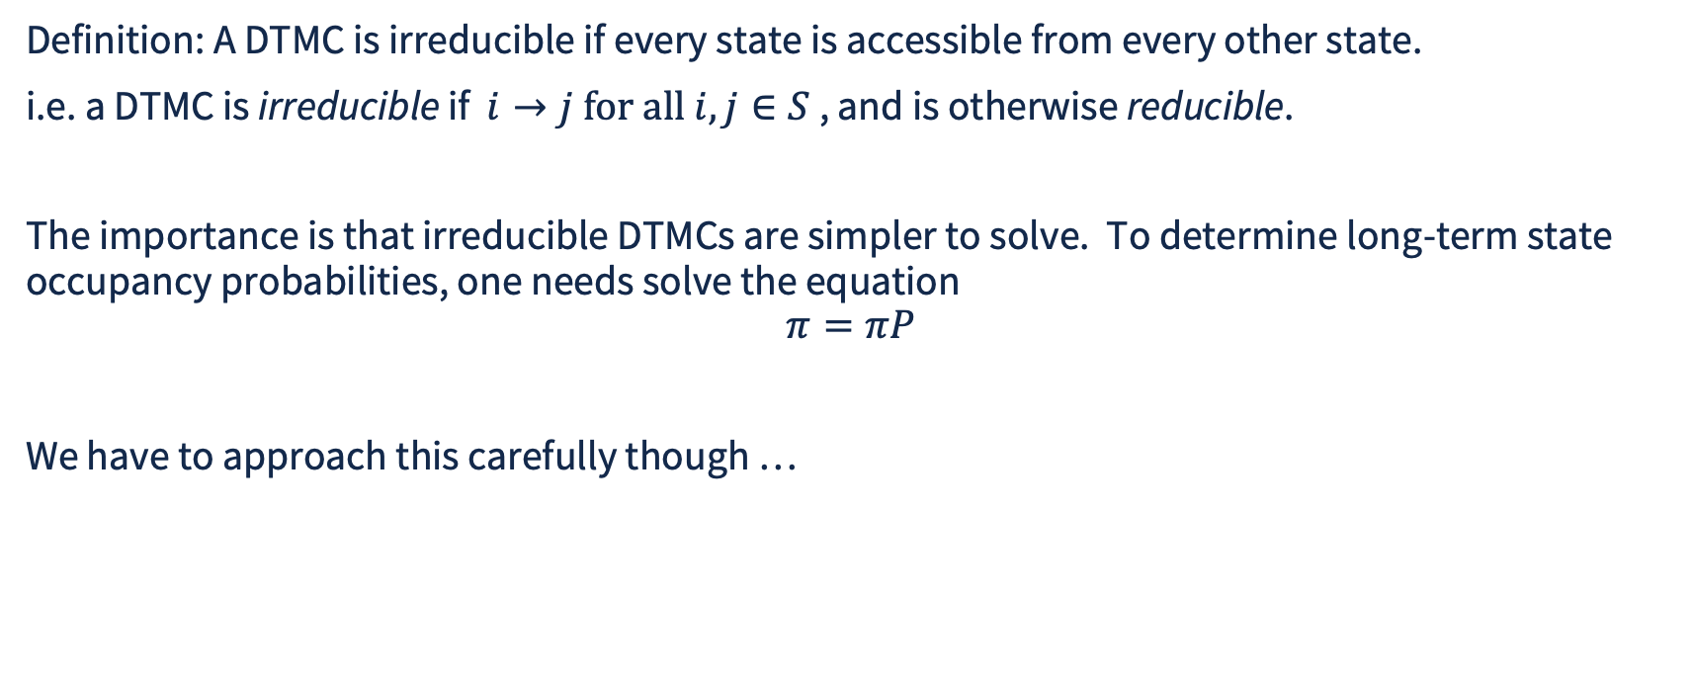
State Classification in DTMCs
Definition: A DTMC is irreducible if every state is accessible from every other state.
i.e. a DTMC is irreducible if $i→j \text{for all }i,j∈S$ , and is otherwise reducible.
The importance is that irreducible DTMCs are simpler to solve. To determine long-term state occupancy probabilities, one needs solve the equation
$$π=πP$$
We have to approach this carefully though …

Slide 5
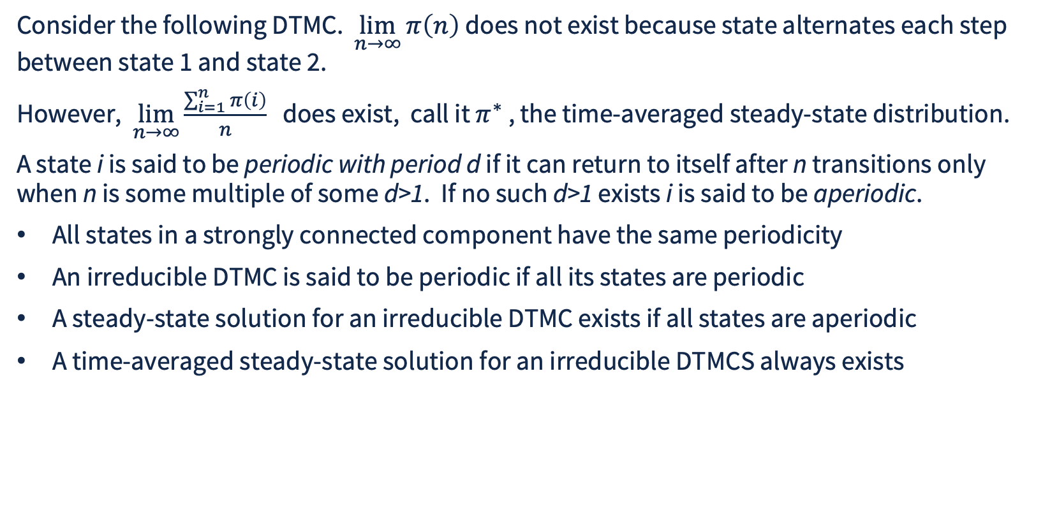
Periodicity
π(0) = [1.0, 0.0]
Consider the following DTMC. $\lim_{n→∞}{π\left(n\right)}$ does not exist because state alternates each step between state 1 and state 2.
However, $\lim_{n→∞}{\frac{\sum_{i=1}^{n}{π}\left(i\right)}{n}}$ does exist, call it $π^{∗}$ , the time-averaged steady-state distribution.
A state i is said to be periodic with period d if it can return to itself after n transitions only when n is some multiple of some d>1. If no such d>1 exists i is said to be aperiodic.
All states in a strongly connected component have the same periodicity
An irreducible DTMC is said to be periodic if all its states are periodic
A steady-state solution for an irreducible DTMC exists if all states are aperiodic
A time-averaged steady-state solution for an irreducible DTMCS always exists
1.0
1
2
1.0

Slide 6
Detecting Reducibility
You need to know the nature of the DTMC when choosing which analysis methods to use
Fortunately, there are python libraries that make this straightforward
A DTMC is irreducible if the number of connected components of the directed graph representing transitions is 1
from scipy.sparse.csgraph import connected_components
def isIrreducible(P):
n_components = connected_components(csgraph=g, directed=True, return_labels=False)
return (n_components == 1)

Slide 7
Detecting Periodicity
Any state that returns to itself has period 1, and periodicity is a property shared by all states in a connected component
The periodicity of a connected component is the greatest common divisor of all loops in the component. Let the network library do the heavy lifting
import networkx as nx
def isAperiodic(P):
G = nx.DiGraph(); n, _ = P.shape
for i in range(n):
for j in range(n):
if P[i,j]>0:
G.add_edge(i,j)
sccs = list(nx.strongly_connected_components(G))
for scc in sccs:
subgraph = G.subgraph(scc)
if not nx.is_aperiodic(subgraph)
return False
return True

Slide 8
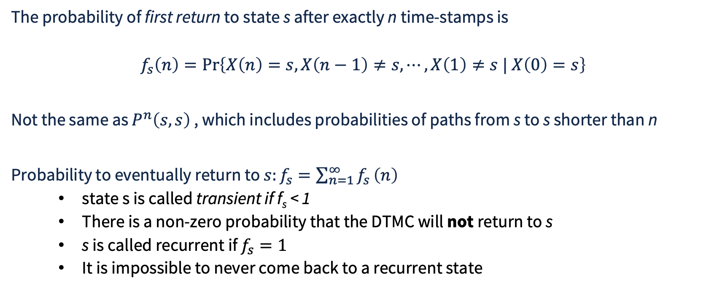
Transient and Recurrent States
The probability of first return to state s after exactly n time-stamps is
$$f_{s}\left(n\right)=\operatorname{Pr}\left\{X\left(n\right)=s,X\left(n−1\right)≠s,⋯,X\left(1\right)≠s | X\left(0\right)=s\right\}$$
Not the same as $P^{n}\left(s,s\right)$ , which includes probabilities of paths from s to s shorter than n
Probability to eventually return to $s:f_{s}=\sum_{n=1}^{∞}{f_{s}}\left(n\right)$
  state s is called transient if f_{s} < 1
  There is a non-zero probability that the DTMC will not return to s
  s is called recurrent if $f_{s}=1$
  It is impossible to never come back to a recurrent state

Slide 9
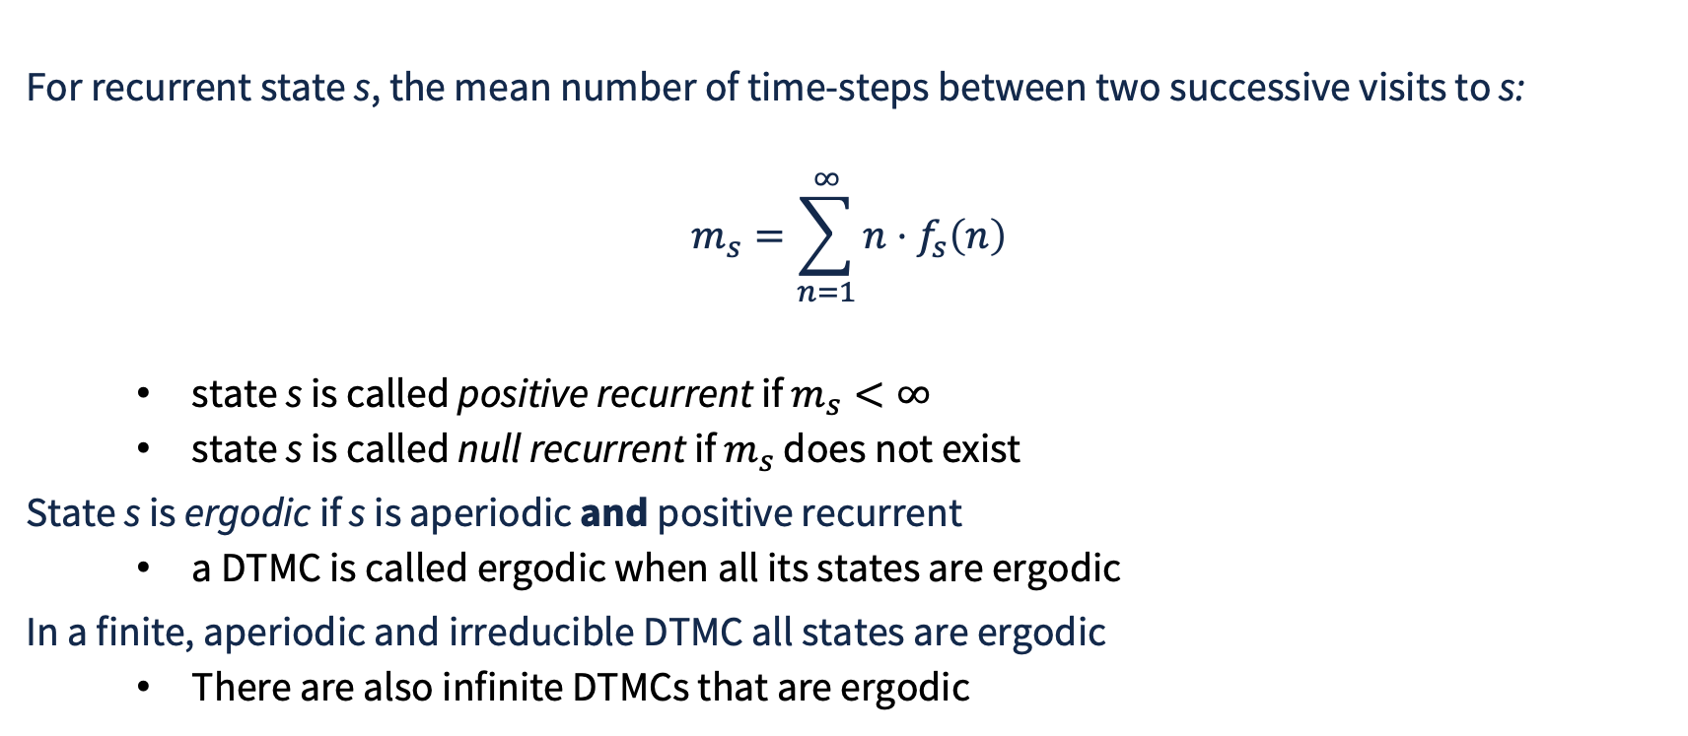
Mean Recurrence Time
For recurrent state s, the mean number of time-steps between two successive visits to s:
$$m_{s}=\sum_{n=1}^{∞}{n}⋅f_{s}\left(n\right)$$
  state s is called positive recurrent if $m_{s}<∞$
  state s is called null recurrent if $m_{s}$ does not exist
State s is ergodic if s is aperiodic and positive recurrent
  a DTMC is called ergodic when all its states are ergodic
In a finite, aperiodic and irreducible DTMC all states are ergodic
  There are also infinite DTMCs that are ergodic

Slide 10
Connected States and Type
Let s and s’ mutually reachable from each other. Then
  s is transient if and only if s’ is transient
  s is null-recurrent if and only if s’ is null-recurrent
  s is positive recurrent if and only if s’ is positive recurrent
  s has period d if and only if s’ has period d

Slide 11
Graphical Examples
Classify the reducibility and periodicity of each example below
0.5
0.5
0.5
1
2
1
2
1
2
0.5
0.5
0.5
0.5
0.5
0.5
0.5
0.5
0.5
0.5
0.5
0.5
0.5
1.0
1.0
3
4
3
4
3
4
0.5
0.5
1.0
(a)
(b)
(c)
Reducibility: consider connectivity
Periodicity: count number transitions back to self

Slide 12
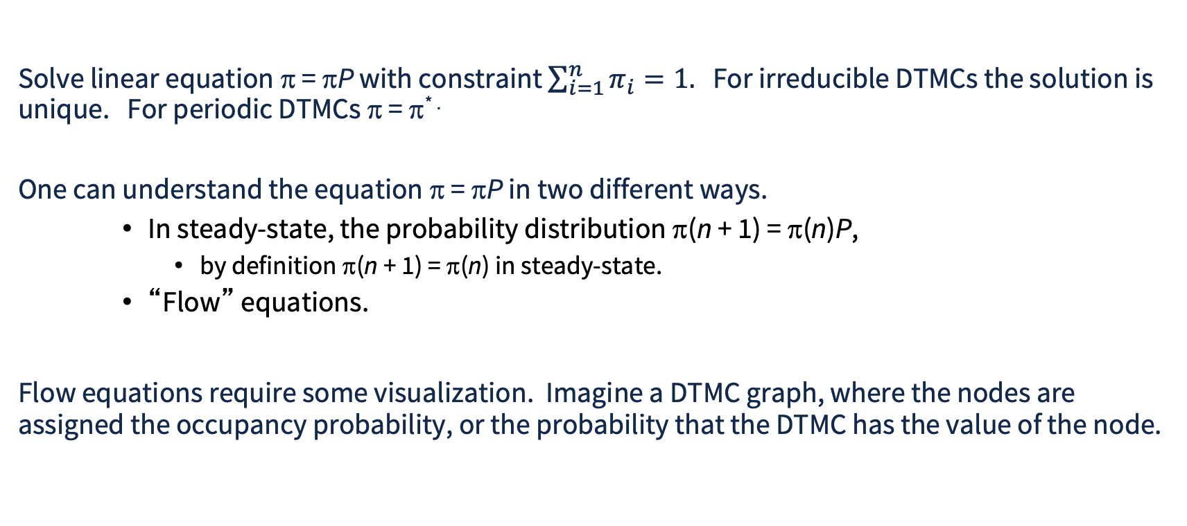
Steady-State Solution of DTMCs
Solve linear equation π = πP with constraint $\sum_{i=1}^{n}{π_{i}}=1.$ For irreducible DTMCs the solution is unique. For periodic DTMCs π = π* .
One can understand the equation π = πP in two different ways.
    In steady-state, the probability distribution π(n + 1) = π(n)P,
      by definition π(n + 1) = π(n) in steady-state.
    “Flow” equations.
Flow equations require some visualization. Imagine a DTMC graph, where the nodes are assigned the occupancy probability, or the probability that the DTMC has the value of the node.

Slide 13
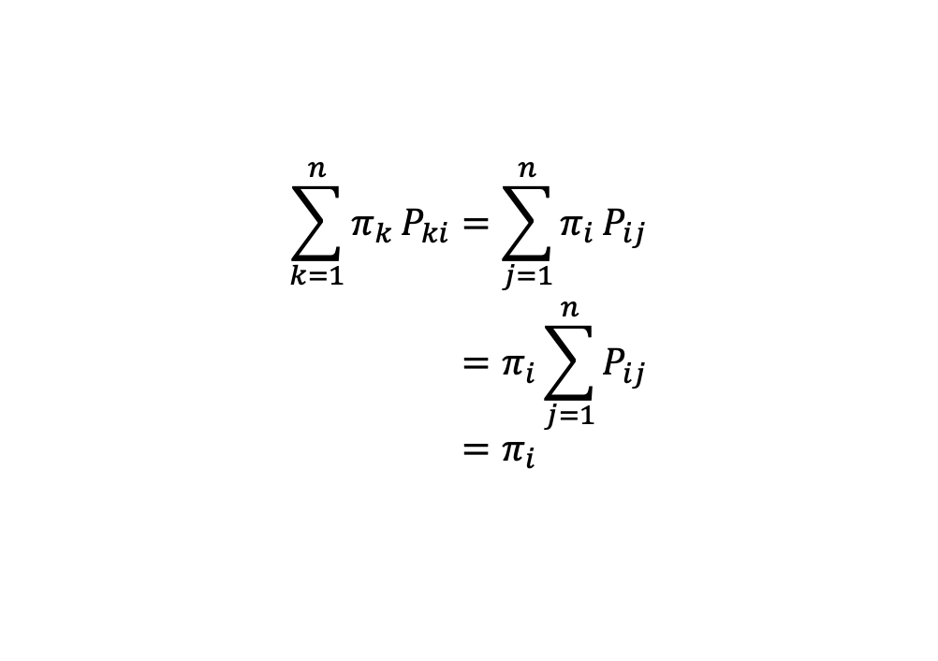
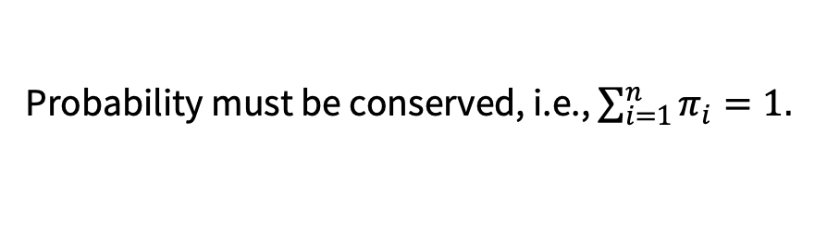
Flow Equations
Probability must be conserved, i.e., $\sum_{i=1}^{n}{π_{i}}=1.$
Let π_{k}P_{ki} be the “probability mass” that moves from state k to state i in one time-step. Since probability must be conserved, the probability mass entering a state must equal the probability mass leaving a state. For every state i, total probability mass in equals probability mass out
$$\begin{aligned}\sum_{k=1}^{n}{π_{k}}P_{ki}&=\sum_{j=1}^{n}{π_{i}}P_{ij} \\ &=π_{i}\sum_{j=1}^{n}{P_{ij}} \\ &=π_{i}\end{aligned}$$
. . .
i
. . .

Slide 14

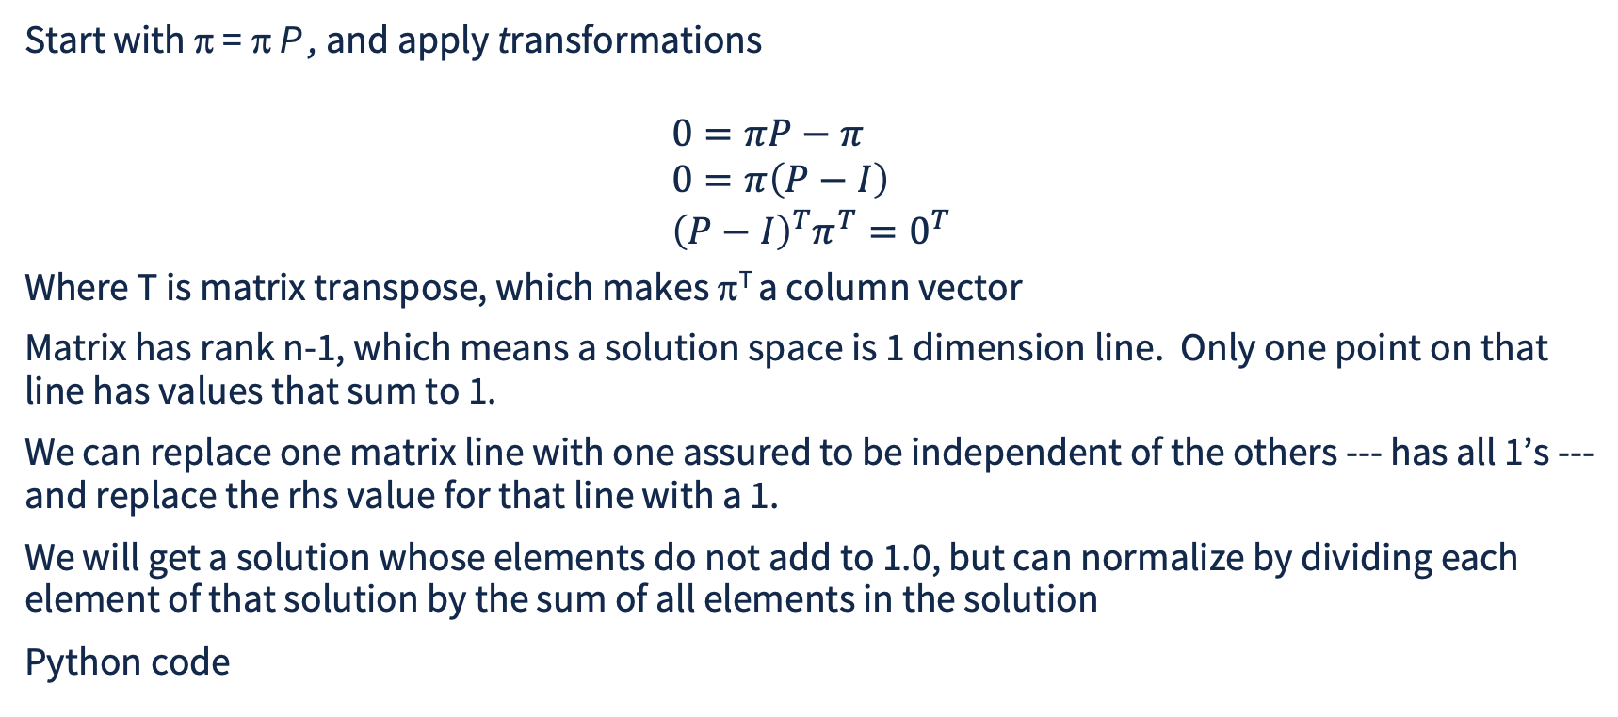
Solution of Steady State Equations
Start with π = π P , and apply transformations
$$\begin{aligned}&0=πP−π \\ &0=π\left(P−I\right) \\ &{\left(P−I\right)}^{T}π^{T}=0^{T}\end{aligned}$$
Where T is matrix transpose, which makes π^{T} a column vector
Matrix has rank n-1, which means a solution space is 1 dimension line. Only one point on that line has values that sum to 1.
We can replace one matrix line with one assured to be independent of the others --- has all 1’s ---and replace the rhs value for that line with a 1.
We will get a solution whose elements do not add to 1.0, but can normalize by dividing each element of that solution by the sum of all elements in the solution
Python code

Slide 15
Solution Example #1
1.0
Recall example
P = np.array( [
[0.75, 0.25, 0.0, 0.0],
[0.0, 0.0, 1.0, 0.0],
[0.0, 0.0, 0.9, 0.1],
[1.0, 0.0, 0.0, 0.0]])
v = stationary_distribution(P)
print(v)
% python equilibrium.py
v [0.25 0.0625 0.625 0.0625]
N.B. you could compute these numbers using the ON/OFF renewal model….
0.25
1.0
0.1
Idle
START
DATA
END
0.75
0.9

Slide 16
Solution Example #2
Consider a queueing system where the service time of a job is an integer number of time-steps between 1 and 4, the queue holds up to K jobs waiting for service, and each time step a new arrival appears with probability p_{A} and is rejected if the queue is full.
State is (s, q) where s is the remaining service time of a job in service, and q is the number of jobs in queue.
  For s>1 and q<K, (s, q) -> (s-1, q) with probability 1-p_{A}
  For s>1 and q<K, (s, q) -> (s-1, q+1) with probability p_{A}
  For s>1 and q=K, (s, K) -> (s-1,K) with probability 1.0
  For s=1 and 0<q, (1, q) -> (n, q-1) with probability (1-p_{A})*Pr{S=n}
  For s=1 and 0<q, (1, q) -> (n, q) with probability p_{A}*Pr{S=n}
  (1, 0) -> (0,0) with probability 1-p_{A}
  (1, 0) -> (n, 0) with probability p_{A*}Pr{S=n}
  (0,0) -> (0, 0) with probability 1-p_{A}
  (0,0) -> (n, 0) with probability p_{A*}Pr{S=n}

Slide 17
Solution Example #2: Transition Matrix
stationary_distribution(P) from solution code requires P to be a proper probability transition matrix
Sum of elements of every row must be 1.0, implies that if there are N rows, then every row corresponds to some actual state
While we can in principle with care create a 1-to-1 mapping from (s,q) to 1,2, …, N , in the general case it can be tricky.
General approach using programming: keep a counter of known states so far. With every state reference either give it ‘the next’ index, or return the index already allocated for it.

Slide 18
Solution Example #2: State Index Allocation
# each successive call for a state not yet seen
# assigns the next integer in the
# state index sequence
def getIdxForState(s, q):
# return one that has already been created
if (s,q) in state2Idx:
return state2Idx[(s,q)]
# save the assignment in both directions
stateIdx = getNxtStateIdx()
state2Idx[(s,q)] = stateIdx
idx2State[stateIdx] = (s,q)
return stateIdx
# function to manage state index allocation
state2Idx = {}
idx2State = {}
nxtState = 0
def getNxtStateIdx():
global nxtState
n = nxtState
nxtState += 1
return n

Slide 19
Solution Example #2: Building The Transition Matrix
Recall
p_{A} = Pr{arrival}
K is maximum Q size
Pr{S=n} is probability that a job entering service gets service time n
Code to build transition matrix
Condition on (s, q) | Transition state | Transition Probability
s>1 and q<K | (s-1, q) | 1-p_{A}
s>1 and q<K | (s, q) | p_{A}
s>1 and q=K | (s-1,K) | 1.0
s=1 and 0<q | (n, q-1) | (1-p_{A})*Pr{S=n}
s=1 and 0<q | (n, q) | p_{A}*Pr{S=n}
(1, 0) | (0, 0) | (1-p_{A})
(1, 0) | (n,0) | p_{A}*Pr{S=n}
(0, 0) | (0, 0) | (1-p_{A})
(0, 0) | (n, 0) | p_{A}*Pr{S=n}

Slide 20
Solution Example #2: Results
With p_{A} = 0.5, S=4, K=3
Pr((0,0)) = 0.0254
Pr((1,0)) = 0.0254
Pr((1,1)) = 0.0577
Pr((1,2)) = 0.1090
Pr((1,3)) = 0.1975
Pr((2,0)) = 0.0237
Pr((2,1)) = 0.0500
Pr((2,2)) = 0.0912
Pr((2,3)) = 0.1271
Ratio of mean inter-arrival time (2.0) to mean service (2.0) means dropped packets are significant
Pr{packet drop} = p_{A} * Pr{q==3 | S<4 }
= 0.5 * ( Pr((1,3)) + Pr((2,3)) + Pr((3,3) )
= 0.1965
Pr((3,0)) = 0.0203
Pr((3,1)) = 0.0380
Pr((3,2)) = 0.0678
Pr((3,3)) = 0.0685
Pr((4,0)) = 0.0135
Pr((4,1)) = 0.0208
Pr((4,2)) = 0.0383
Pr((4,3)) = 0.0246
Python code that builds and runs example

Slide 21
Solution Example #3: Communication Channel
Imagine a communication system with sender, receiver, and channel between
Sender has 4 levels of send rate, Receiver has 4 levels of load
  Receive level changes randomly, independent of send level
Sender’s level changes model congestion control
  “congestion” inferred if channel fails, or send level exceeds receive level
    Sender level returns to lowest, timer reset
  Increases after period of non-congestion
State is (sender level, time to sender level increase, receiver level)

Slide 22
Solution Example #3: Communication Channel Transitions
Timer levels per sender level: t[0] = 5, t[1] = 10, t[2] = 20, t[3] = 0 (no timer)
From (s, 1, r) with s<3
-> (s+1, t[s+1], r) if s<r and channel does not fail and receiver level does not change
-> (0, t[0], r) if channel fails and receiver level does not change
-> (0, t[0], r+1) if channel fails and r<3 and receiver level increases
-> (0, t[0], r-1) if channel fails or (channel does not fail and 0<r and receiver level decreases)
From (s, k, r) with k>1 and r>0
-> (s, k-1, r) channel does not fail and receiver level does not change
-> (s, k-1, r+1) channel does not fail and receiver level increases
-> (s, k-1, r-1) channel does not fail and s<r and receiver level decreases
-> (0, t[0], r-1) channel fails or (channel does not fail and s=4 and receiver level decreases)
From (3, 0, 3)
-> (3, 0, 3) channel does not fail and receiver level does not change
-> (0, t[0], 3) channel fails and receiver level does not change
-> (0, t[0], 2) receiver level decreases

Slide 23

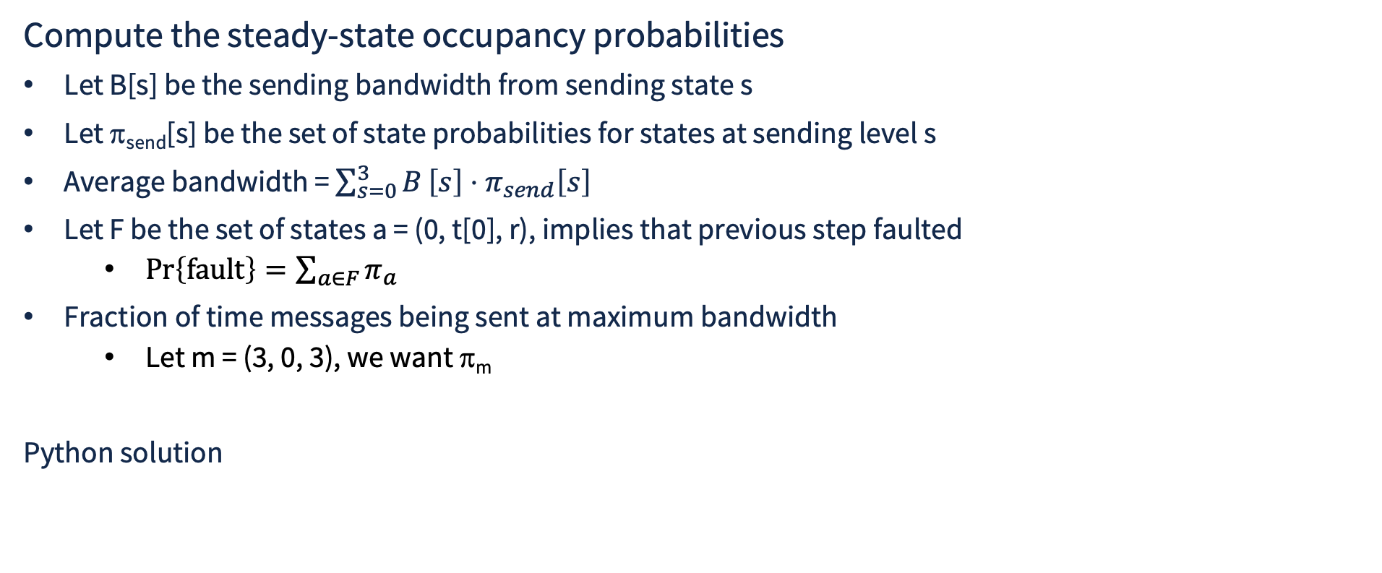
Solution Example #3: Communication Channel Analysis
Compute the steady-state occupancy probabilities
Let B[s] be the sending bandwidth from sending state s
Let π_{send}[s] be the set of state probabilities for states at sending level s
Average bandwidth = $\sum_{s=0}^{3}{B}\left[s\right]⋅π_{send}\left[s\right]$
Let F be the set of states a = (0, t[0], r), implies that previous step faulted
  $\operatorname{Pr}\left\{\text{fault}\right\}=\sum_{a∈F}{π_{a}}$
Fraction of time messages being sent at maximum bandwidth
  Let m = (3, 0, 3), we want π_{m}
Python solution

