Slide 1
Markov Processes

Slide 2
Markov Process, Informally
Informal Definition
Given the state X(t) of a Markov process X at time t, the future behavior of X can be described completely in terms of X(t)
Means that knowledge of X(t) completely encapsulates behavior of X at times s < t

Slide 3
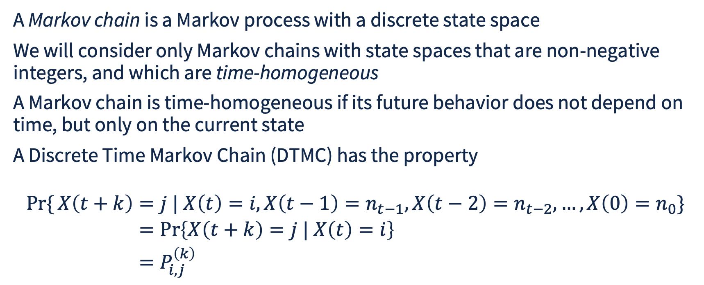
Markov Chain
A Markov chain is a Markov process with a discrete state space
We will consider only Markov chains with state spaces that are non-negative integers, and which are time-homogeneous
A Markov chain is time-homogeneous if its future behavior does not depend on time, but only on the current state
A Discrete Time Markov Chain (DTMC) has the property
$$\begin{aligned}\operatorname{Pr}{\{}X\left(t+k\right)&=j | X\left(t\right)=i,X\left(t−1\right)=n_{t−1},X\left(t−2\right)=n_{t−2},…,X\left(0\right)=n_{0}\} \\ &=\operatorname{Pr}\left\{X\left(t+k\right)=j | X\left(t\right)=i\right\} \\ &=P_{i,j}^{\left(k\right)}\end{aligned}$$

Slide 4
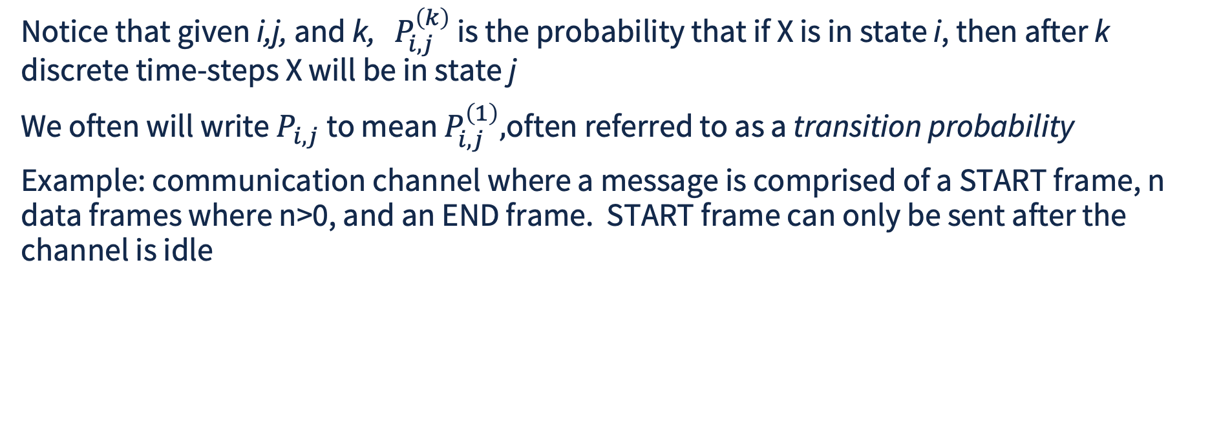
DTMCs
Notice that given i,j, and k, $P_{i,j}^{\left(k\right)}$ is the probability that if X is in state i, then after k discrete time-steps X will be in state j
We often will write $P_{i,j}$ to mean $P_{i,j}^{\left(1\right)},$often referred to as a transition probability
Example: communication channel where a message is comprised of a START frame, n data frames where n>0, and an END frame. START frame can only be sent after the channel is idle

Slide 5
DTMC Example
State Number | State Meaning | State Number | State Meaning
1 | Idle | 3 | DATA frame
2 | START frame | 4 | END frame
When Idle, a new message is initiated in the next frame with probability 0.25
When transmitting a data frame, the next frame transmitted is END with probability 0.1
1.0
0.25
1.0
0.1
Idle
START
DATA
END
0.75
0.9

Slide 6
Questions One Might Ask from this DTMC model
For each state, what is the long-term probability of being in that state (i.e., state occupancy probabilities)?
If the DTMC begins in the Idle state, what is the probability of transmitting at least 10 messages by the 100th time-step?
What is the throughput of this channel (i.e., mean number of messages completely transmitted per unit time)

Slide 7
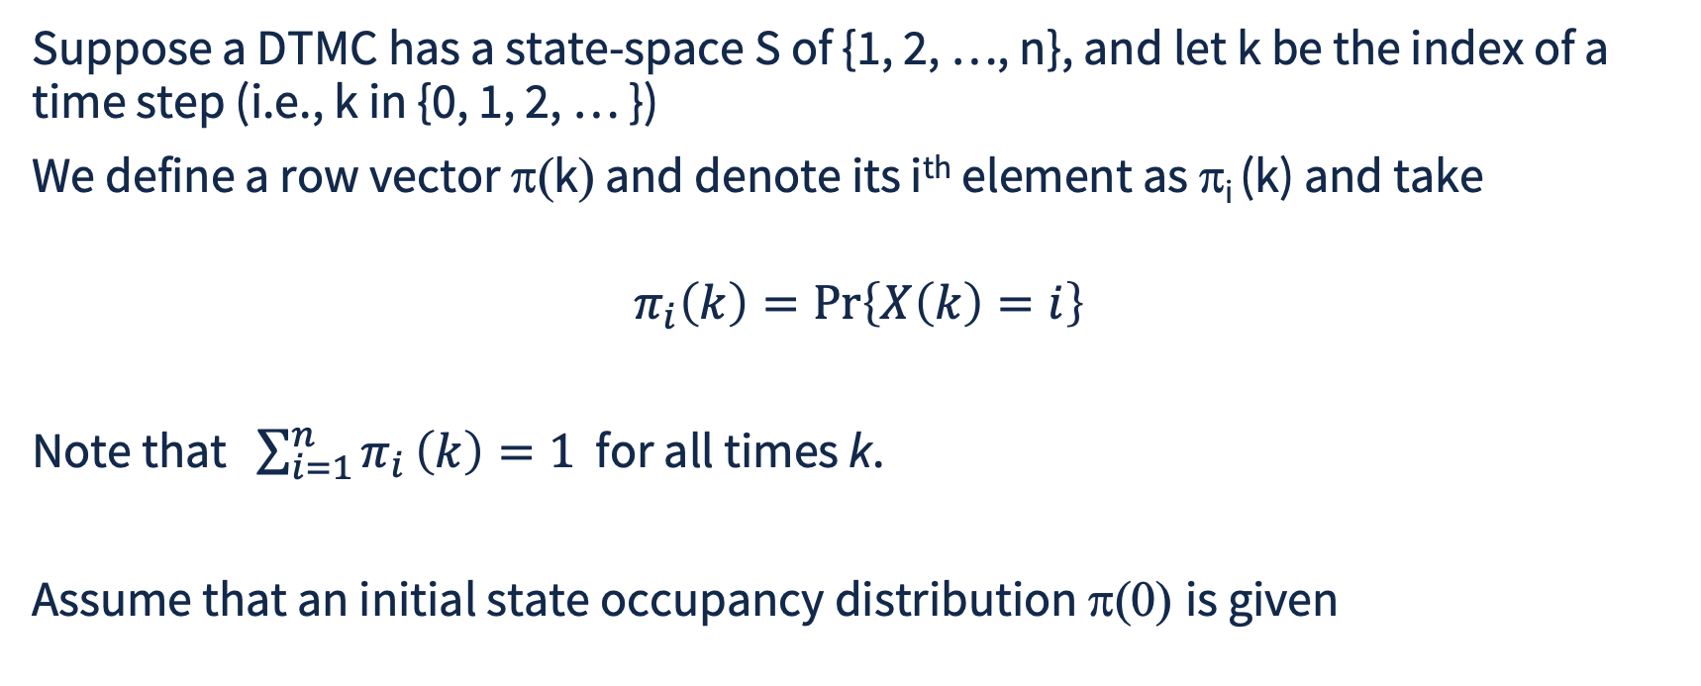
State Occupancy Probability Vector
Suppose a DTMC has a state-space S of {1, 2, …, n}, and let k be the index of a time step (i.e., k in {0, 1, 2, … })
We define a row vector π(k) and denote its i^{th} element as π_{i} (k) and take
$$π_{i}\left(k\right)=\operatorname{Pr}\left\{X\left(k\right)=i\right\}$$
Note that $\sum_{i=1}^{n}{π_{i}}\left(k\right)=1$ for all times k.
Assume that an initial state occupancy distribution π(0) is given

Slide 8
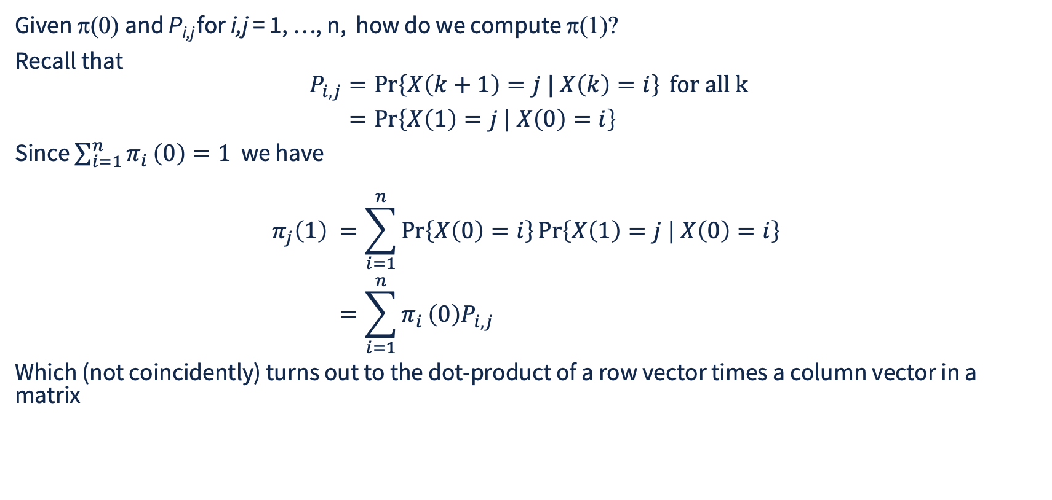
Computing State Occupancy Probability Vector Advance
Given π(0) and P_{i,j} for i,j = 1, …, n, how do we compute π(1)?
Recall that
$$\begin{aligned}P_{i,j}&=\operatorname{Pr}\left\{X\left(k+1\right)=j | X\left(k\right)=i\right\} \text{for all k} \\ &=\operatorname{Pr}\left\{X\left(1\right)=j | X\left(0\right)=i\right\}\end{aligned}$$
Since $\sum_{i=1}^{n}{π_{i}}\left(0\right)=1$ we have
$$\begin{aligned}π_{j}\left(1\right) &=\sum_{i=1}^{n}{\operatorname{Pr}\left\{X\left(0\right)=i\right\}}\operatorname{Pr}\left\{X\left(1\right)=j | X\left(0\right)=i\right\} \\ &=\sum_{i=1}^{n}{π_{i}}\left(0\right)P_{i,j} \end{aligned}$$
Which (not coincidently) turns out to the dot-product of a row vector times a column vector in a matrix

Slide 9
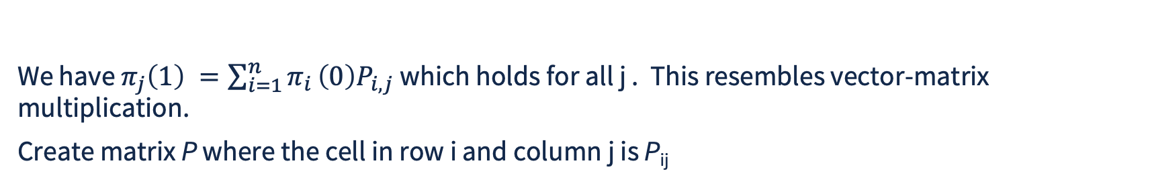
Transition Probability Matrix
We have $π_{j}\left(1\right) =\sum_{i=1}^{n}{π_{i}}\left(0\right)P_{i,j}$which holds for all j . This resembles vector-matrix multiplication.
Create matrix P where the cell in row i and column j is P_{ij}
P_{1,1} P_{1,2} … P_{1,j} … P_{1,n}
…
[ Π₁(0) Π₂(0) … Π_{n}(0) ]
P_{i,1} P_{i,2} … P_{i,j} … P_{i,(n-1)}
=
[ Π₁(1) Π₂(1) … Π_{j}(1) … Π_{n}(1) ]
…
P_{n,1} P_{n,2} … P_{n,j} … P_{n,n}
In matrix notation π(1) = π(0) P
Important consequence is that we can specify a DTMC in terms of occupancy vector π and a transition probability matrix P

Slide 10
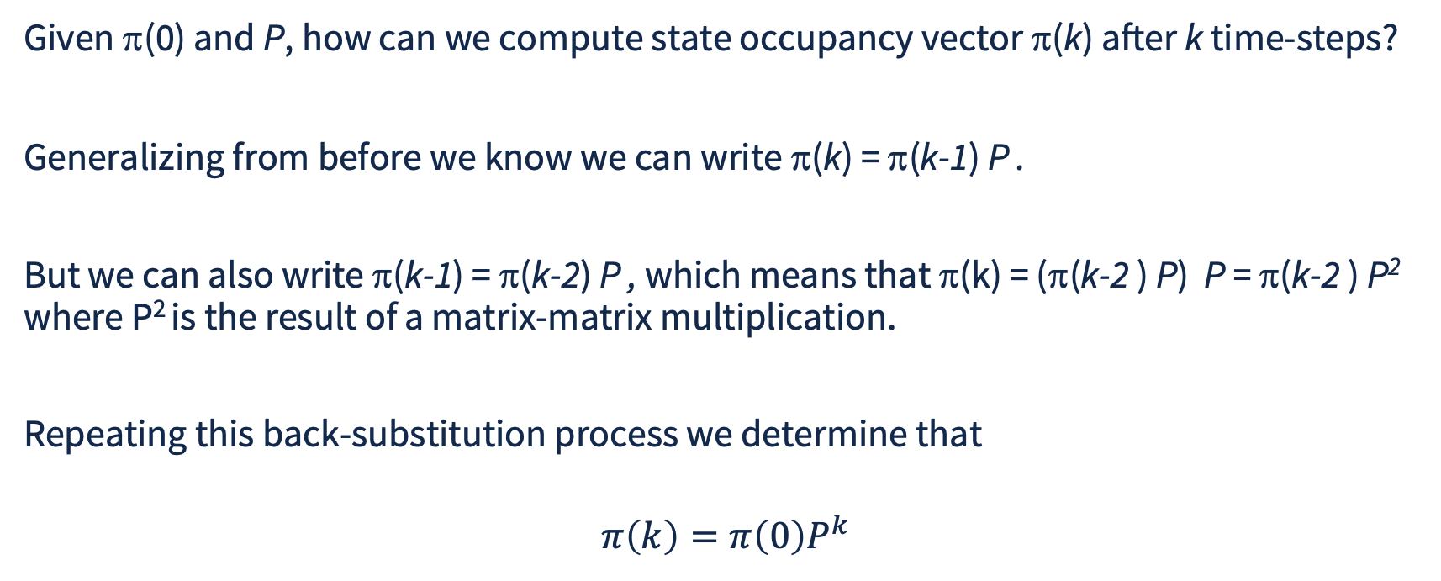
Transient Behavior of DTMC
Given π(0) and P, how can we compute state occupancy vector π(k) after k time-steps?
Generalizing from before we know we can write π(k) = π(k-1) P .
But we can also write π(k-1) = π(k-2) P , which means that π(k) = (π(k-2 ) P) P = π(k-2 ) P² where P² is the result of a matrix-matrix multiplication.
Repeating this back-substitution process we determine that
$$π\left(k\right)=π\left(0\right)P^{k}$$

Slide 11
Back to DTMC Example
1.0
Evidently the transition probability matrix P is given by
0.25
1.0
0.1
Idle
START
DATA
END
0.75 0.25 0.0 0.0
0.0 0.0 1.0 0.0
0.0 0.0 0.9 0.1
1.0 0.0 0.0 0.0
0.75
0.9
P =
If the system starts in the Idle state (1), what is the probability that after 32 time-steps it will be transmitting data (in state 3)?

Slide 12
Computation for Example DTMC
We want π(32), and we know that π(32) = π(0) P³² and π(0) = [1.0 0 0 0]. Use a program
  import numpy as np
  P = np.array( [ [0.75, 0.25, 0.0, 0.0], [0.0, 0.0, 1.0, 0.0],
  [0.0, 0.0, 0.9, 0.1], [1.0, 0.0, 0.0, 0.0], ])
  pi0 = np.array([1.0, 0.0, 0.0, 0.0])
  P2 = P @ P; P4 = P2 @ P2
  P16 = P4 @ P4; P32 = P2 @ P16
  pi32 = pi0 @ P32
  print(pi32[2]) # note offset between state index and array index
  % python3 pi32.py
  0.6230575227636719

Slide 13
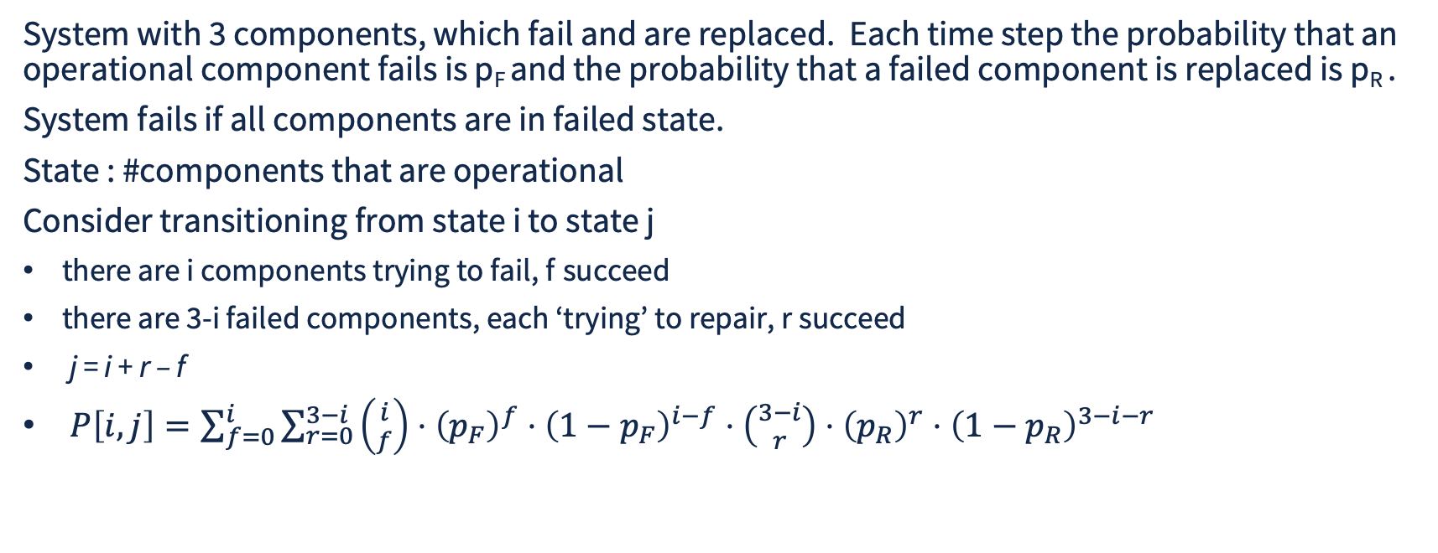
Reliability Example
System with 3 components, which fail and are replaced. Each time step the probability that an operational component fails is p_{F} and the probability that a failed component is replaced is p_{R} .
System fails if all components are in failed state.
State : #components that are operational
Consider transitioning from state i to state j
there are i components trying to fail, f succeed
there are 3-i failed components, each ‘trying’ to repair, r succeed
j = i + r – f
$P\left[i,j\right]=\sum_{f=0}^{i}{\sum_{r=0}^{3−i}{\left({i \atop f}\right)}}⋅{\left(p_{F}\right)}^{f}⋅{\left(1−p_{F}\right)}^{i−f}⋅\left({3−i \atop r}\right)⋅{\left(p_{R}\right)}^{r}⋅{\left(1−p_{R}\right)}^{3−i−r}$
n₃
n₂
n₁
n₀
Let p_{F} = 0.001, p_{R} = 0.01 . Probability of system failure within 10000 steps is found by computing π₀(10000)

Slide 14

Reliability Example Computation
Imagine wanting to compute π₀(k) for k=1,2, …, 10000
Two equivalent ways
For each k compute P^{k} , then π(k) = π(0) P^{k} , save π₀(k)
For each k compute π(k) = π(k-1) P
See code

Slide 15
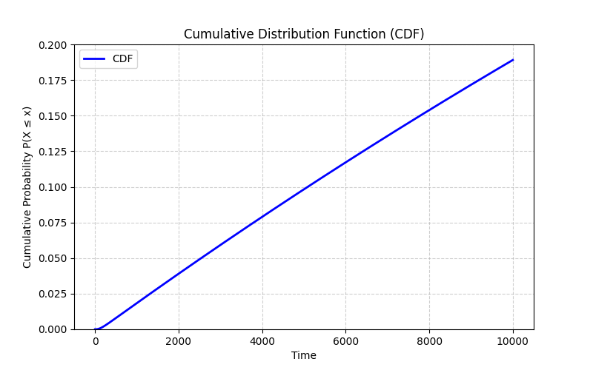
Graphical Display of Time to Failure CDF
Plot π₀(k) as a function of k

Slide 16
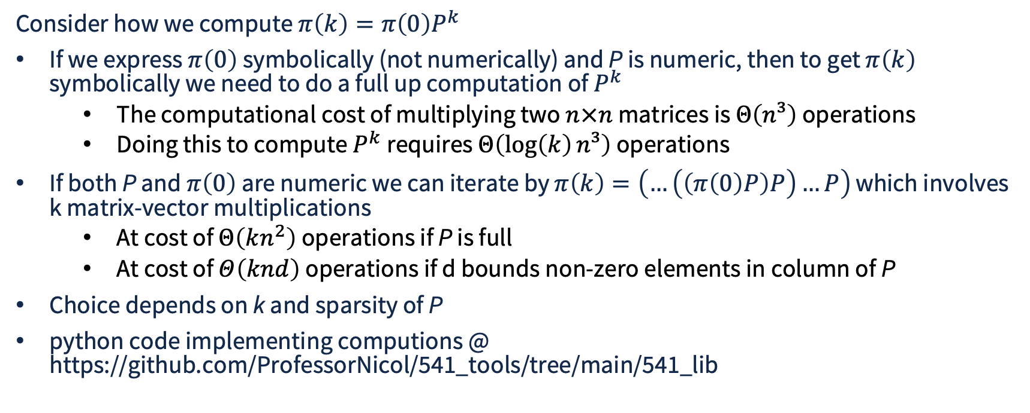
Computational Considerations
Consider how we compute $π\left(k\right)=π\left(0\right)P^{k}$
If we express $π\left(0\right)$ symbolically (not numerically) and P is numeric, then to get $π\left(k\right)$ symbolically we need to do a full up computation of $P^{k}$
  The computational cost of multiplying two $n×n$ matrices is $Θ\left(n³\right)$ operations
  Doing this to compute $P^{k}$requires $Θ\left(\log\left(k\right)n³\right)$ operations
If both P and $π\left(0\right)$ are numeric we can iterate by $π\left(k\right)=\left(…\left(\left(π\left(0\right)P\right)P\right)…P\right)$ which involves k matrix-vector multiplications
  At cost of $Θ\left(kn^{2}\right)$ operations if P is full
  At cost of $Θ\left(knd\right)$ operations if d bounds non-zero elements in column of P
Choice depends on k and sparsity of P
python code implementing computions @ https://github.com/ProfessorNicol/541_tools/tree/main/541_lib

Slide 17
python Support for Sparse Linear Algebra
import numpy as np
from scipy.sparse import csc_array
from scipy.sparse.linalg import spsolve
Numpy provides arrays that permit efficient library code, common ops below
pi = np.zeros(n) # create numpy array of n zeros
Q = np.asarray(P, dtype=float) # create numpy array from python list
R = np.array([[1, 1, 0, 0], [0, 1, 1, 0], [0, 0, 1, 1], [1, 0, 0, 1]]) # from explicit lists
v = pi @ P # vector-matrix multiplication
Z = Q @ R # matrix multiplication
z = np.linalg.solve(Q, b) # exact solution with full matrix Q, 1D np array b
S = csc_array(R) # sparse representation of np array R
z = spsolve(S, b) # exact solution with sparse matrix
python code supporting Markov Chain analysis @ https://github.com/ProfessorNicol/541_tools/tree/main/541_lib

