Slide 1
Experimental Design

Slide 2
What an Experimental Design Specifies
Factors
  Inputs deliberately varied, e.g., queue capacity, queuing discipline, arrival rate, job mix
Design points
  Combination of factor settings for each simulation run
Responses
  Outputs used to evaluate performance, e.g., end-to-end delay, throughput, utilization, cost
A design is a run plan
  Input parameters, replications, evidence needed to answer decision
Good design prevents common failures
  Running too many uninformative scenarios
  Running too few scenarios to support a defensible conclusion

Slide 3
A Practical Workflow
1
2
3
4
5
Define goal
List factors
& responses
Choose design
family
Run & analyze
Confirm
& iterate
Start with the question to be answered, not the method used to answer it
  Screening, comparison, metamodeling, and optimization require different designs. The goal determines the design family and the analysis.
Plan sequentially
  A first experiment can identify important factors, a second can model response to inputs, a third can confirm recommended setting

Slide 4
System Metrics of Interest
p_{B}
λ
service mean 1.0/μ₁ with probability p_{S}
otherwise 1.0/μ₂
1-p_{B}
K
Imagine you have identified N factors you set for each experiment, e.g.
  Arrival rate λ, branching probability p_{B}, maximum number K in system, job mix probability p_{S ,} mean service times 1.0/μ₁ and 1.0/μ₂
What responses are we interested in?
  E[W] : Mean time between when a job arrives and when it departs
  E[N] : Mean time-averaged number of jobs in the system
  ρ : server utilization
  Pr{arrival is dropped}
How do these measures respond to changing λ?
One can fix all other parameters, e.g., K=4, pS=0.5, pB = 0.225, 1.0/μ₁ = 1.0, 1.0/μ₂ = 2.0 , vary λ:

Slide 5
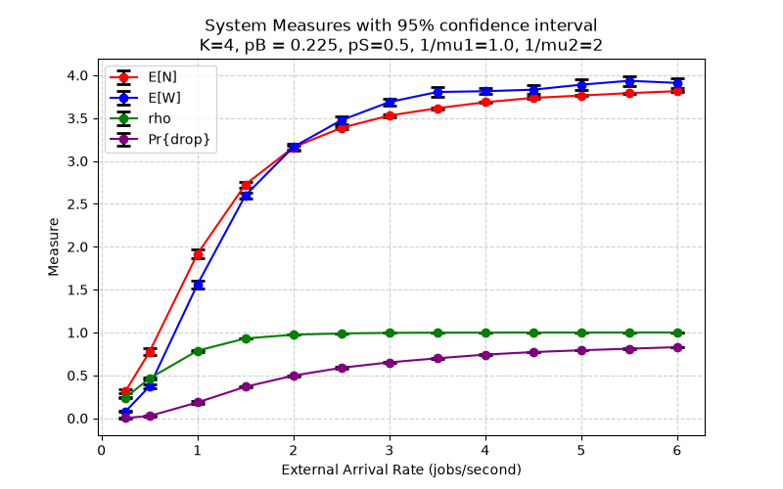
System Metrics of Interest as Function of λ when K=4
p_{B}
λ
1-p_{B}
K
service mean 1.0/μ₁ with probability p_{S}
otherwise 1.0/μ₂
What do we learn about the system?
  Flattening of response under large λ after Pr{drop} gets high --- the system is just doing what it can in a saturated state

Slide 6
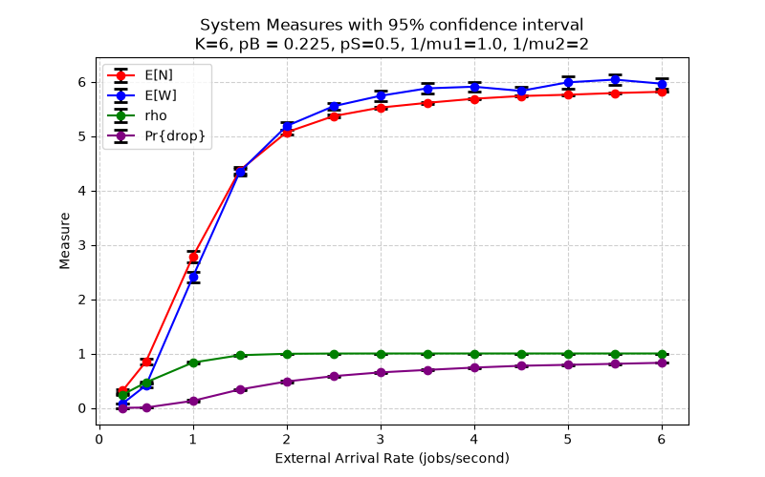
System Metrics of Interest as Function of λ when K=6
p_{B}
λ
1-p_{B}
K
service mean 1.0/μ₁ with probability p_{S}
otherwise 1.0/μ₂
Increased K just means more things in the system when saturated

Slide 7
Full Factorial Example
p_{B}
λ
service mean 1.0/μ₁ with probability p_{S}
otherwise 1.0/μ₂
1-p_{B}
K
Factor | Low Value | High Value
λ | 1.0 jobs/sec | 5.0 jobs/sec
K | 3 jobs | 10 jobs
pB | 0.05 Pr{branch back} | 0.5 Pr{branch back}
pS | 0.0 Pr{choose exp service} | 1.0 Pr{choose exp service}
1.0/μ1 | 0.5 E[exp service time] | 2.0 E[exp service time]
1.0/μ2 | 0.5 Constant service time | 2.0 Constant service time

Slide 8
Full Factorial Design
Imagine you have identified factors you set for each experiment, e.g.
  Arrival rate λ, branching probability p_{B}, maximum number K in system, job mix probability p_{S}
  For each factor set a ‘high’ value and ‘low’ value. There are 16 combinations of high and low selections, 0 selects “low” and 1 selects “high” (frequently ‘-’ and ‘+’ used)
Every row defines value assignments, simulation establishes estimate (with desired accuracy)
Number of combinations of factors adds up fast
p_{B}
λ
service mean 1.0/μ₁ with probability p_{S}
otherwise 1.0/μ₂
1-p_{B}
K
K p_{B} p_{S}
- - - -
- - - +
- - + -
- - + +
K p_{B} p_{S}
- + - -
- + - +
- + + -
- + + +
K p_{B} p_{S}
+ - - -
+ - - +
+ - + -
+ - + +
K p_{B} p_{S}
+ + - -
+ + - +
+ + + -
+ +. + +

Slide 9
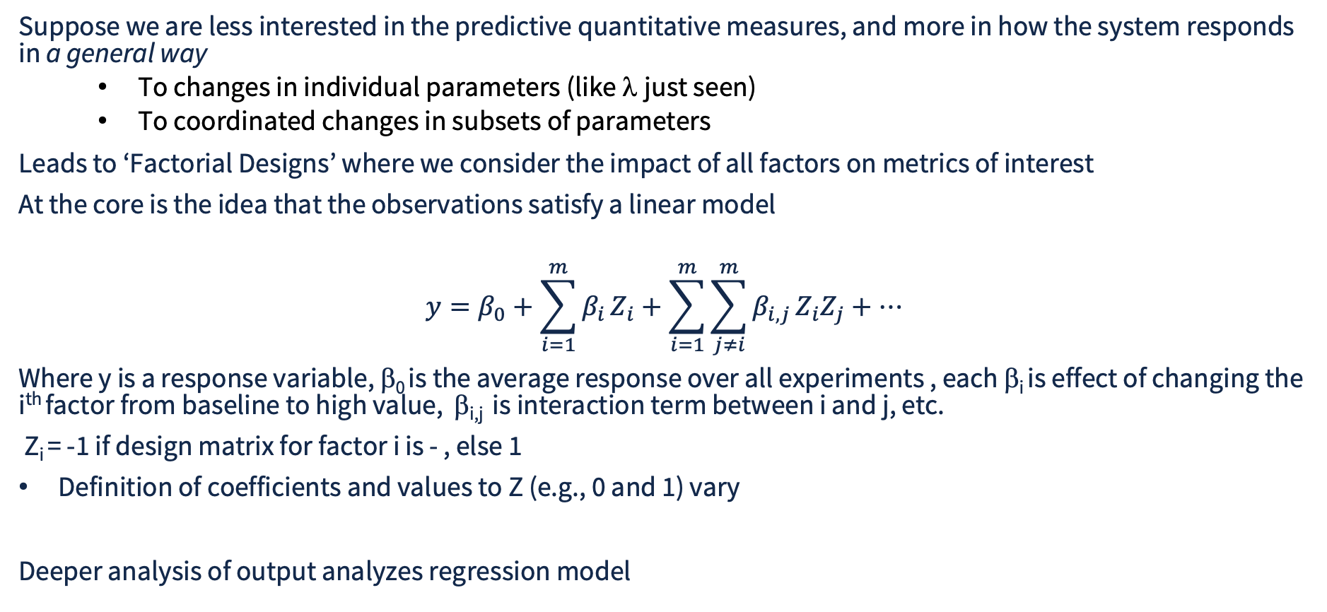
System Response to Changes in Factors
Suppose we are less interested in the predictive quantitative measures, and more in how the system responds in a general way
  To changes in individual parameters (like λ just seen)
  To coordinated changes in subsets of parameters
Leads to ‘Factorial Designs’ where we consider the impact of all factors on metrics of interest
At the core is the idea that the observations satisfy a linear model
$$y=β_{0}+\sum_{i=1}^{m}{β_{i}}Z_{i}+\sum_{i=1}^{m}{\sum_{j≠i}^{m}{β_{i,j}}}Z_{i}Z_{j}+…$$
Where y is a response variable, β₀ is the average response over all experiments , each β_{i} is effect of changing the i^{th} factor from baseline to high value, β_{i,j} is interaction term between i and j, etc.
Z_{i} = -1 if design matrix for factor i is - , else 1
Definition of coefficients and values to Z (e.g., 0 and 1) vary
Deeper analysis of output analyzes regression model

Slide 10
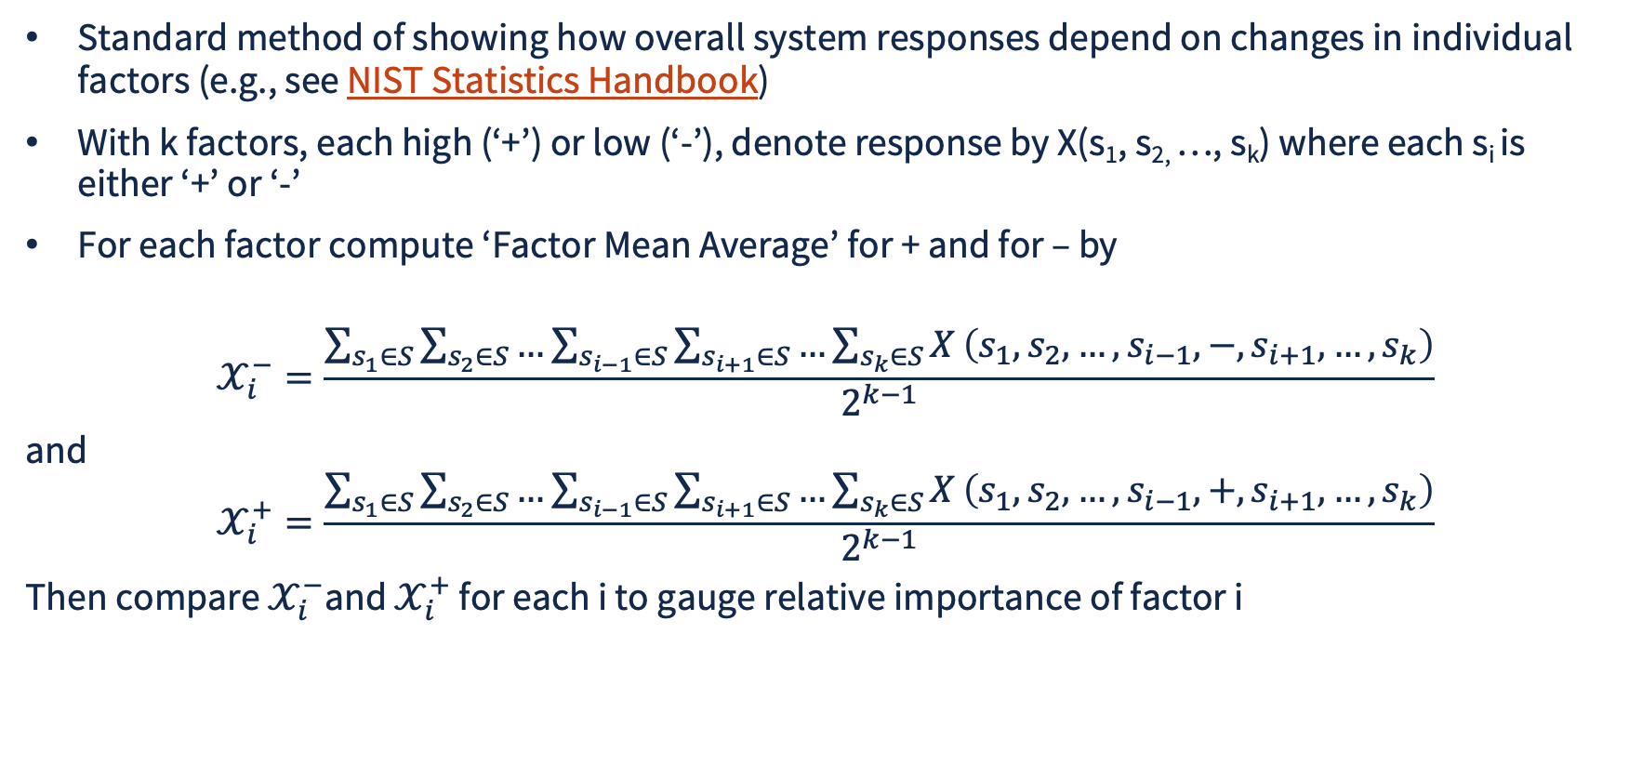
Design of Experiments Mean Plot
Standard method of showing how overall system responses depend on changes in individual factors (e.g., see NIST Statistics Handbook)
With k factors, each high (‘+’) or low (‘-’), denote response by X(s₁, s_{2,} …, s_{k}) where each s_{i} is either ‘+’ or ‘-’
For each factor compute ‘Factor Mean Average’ for + and for – by
$$𝒳_{i}^{−}=\frac{\sum_{s_{1}∈S}{\sum_{s_{2}∈S}{…}}\sum_{s_{i−1}∈S}{\sum_{s_{i+1}∈S}{…}}\sum_{s_{k}∈S}{X}\left(s_{1},s_{2},…,s_{i−1},−,s_{i+1},…,s_{k}\right)}{2^{k−1}}$$
and
$$𝒳_{i}^{+}=\frac{\sum_{s_{1}∈S}{\sum_{s_{2}∈S}{…}}\sum_{s_{i−1}∈S}{\sum_{s_{i+1}∈S}{…}}\sum_{s_{k}∈S}{X}\left(s_{1},s_{2},…,s_{i−1},+,s_{i+1},…,s_{k}\right)}{2^{k−1}}$$
Then compare $𝒳_{i}^{−}$and $𝒳_{i}^{+}$ for each i to gauge relative importance of factor i

Slide 11
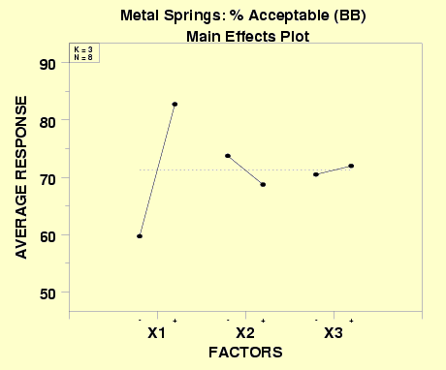
Design of Experiments Mean Plot Example

Slide 12

Workflow Generating Full Factorial Design
gen_args.json
args
@vector
gen_sim.py gen_args.json
output.json
append
main.py –is args
gen_sim.py generates input file and runs main.py for every combination of factors in gen_args.json
Each call to simulator (main.py) computes C.I. for response variables, and appends output.json with description of input and output

Slide 13
gen_args.json
{
"-arrival_rate": [1.0, 5.0],
"-termination": [100000],
"-K": [3, 10],
"-seed": [624356],
"-pB": [0.05, 0.5],
"-pS": [0.0, 1.0],
"-inv_mu1": [0.5, 2.0],
"-inv_mu2": [0.5, 2.0],
"-skip": [0.25],
"-batches": [25]
}
Always allow for some branching
Consider completely deterministic service
Work out temporal length of batch-means intervals from number of batches, skip fraction, and termination time

Slide 14
gen_sim.py args Creation for Each Run
import sys
import os
import json
from itertools import product
import subprocess
def generate_vectors( choices ):
yield from product(*choices.values())
with open(sys.argv[1],'r') as rf:
args_dict = json.load(rf)
# keys from gen_args.json dictionary
keys = list(args_dict)
os.remove("output.json")
for vector in generate_vectors(args_dict):
# create dictionary with one number per value
result = dict(zip(keys, vector))
# turn dictionary entry into one line in args file
with open("args", "w") as wf:
for key, value in result.items():
line = f"{key} {value}\n"
wf.write(line)

Slide 15
gen_sim.py args Process Creation
# prepare for process creation
cmdList = ["python", "main.py", "-is", "args"]
process = subprocess.Popen(cmdList,
stdout=subprocess.PIPE, stderr=subprocess.PIPE, text=True)
stdout, stderr = process.communicate()
if process.returncode != 0:
print("Error from simulation run")
if len(stdout) > 0:
print(stdout)
if len(stderr) > 0 :
print(stderr)

Slide 16
output.json
[
{
"evt_per_interval": 6047.72,
"conf_level": 0.95,
"accepted": 0.9657066666666667,
"accepted_H": 0.0069696916963234296,
"num_sys": 0.7130819896960797,
"num_sys_H": 0.007361403999488287,
"time_sys": 0.738020615026693,
"time_sys_H": 0.0036076549137529224,
"util_sys": 0.5081045059899466,
"util_sys_H": 0.003743507808196814,
"drop_pr": 0.03398511882956277,
"drop_pr_H": 0.0011923622059595634,
"-arrival_rate": 1.0,
"-pS": 0.0,
"-pB": 0.05,
"-inv_mu1": 0.5,
"-inv_mu2": 0.5,
"-termination": 100000.0,
"-K": 3,
"-skip_frac": 0.25,
"-batches": 25,
"-seed": "624356"
},
Output record of one run

Slide 17
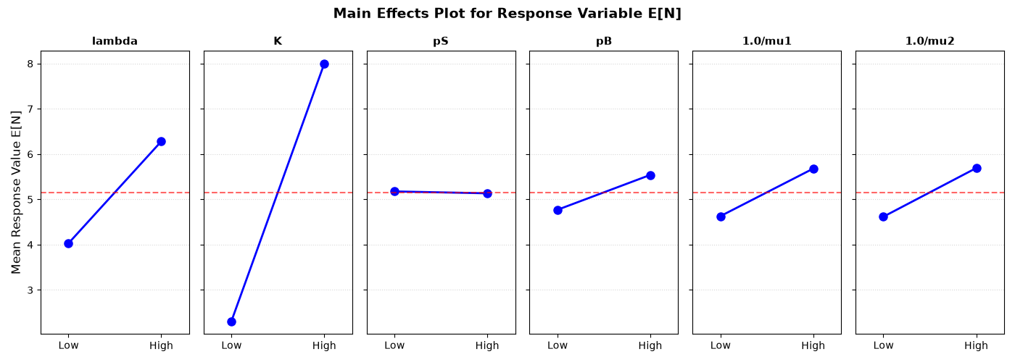
Response of E[N]
Insenstive to pS, K has greatest impact on response

Slide 18
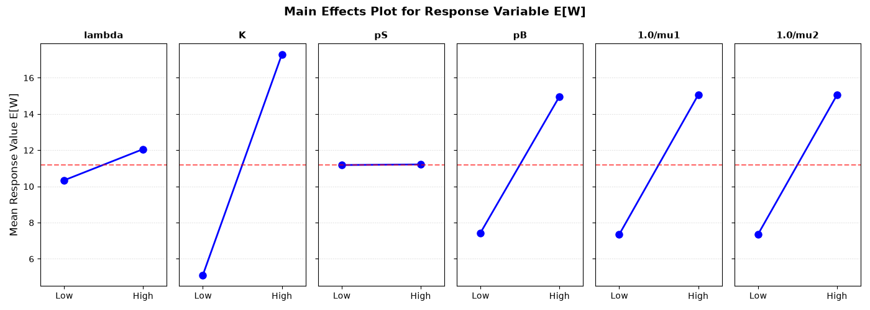
Response of E[W]
Insenstive to pS, K has greatest impact on response; pB, 1.0/mu1, 1.0/mu2 equivalent and significant

Slide 19
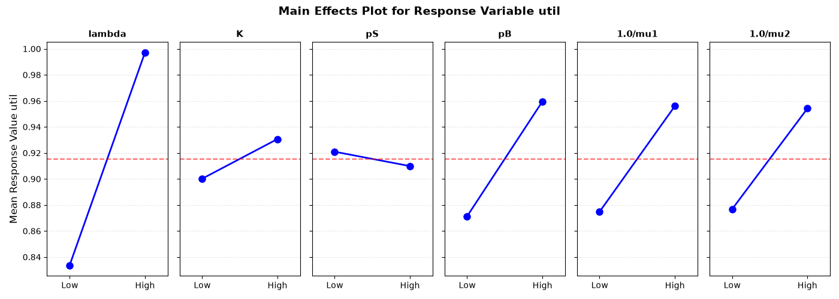
Response of ρ
lamba has greatest impact on response, equivalence of pB, 1.0/mu1, 1.0/mu2, comparative insensitivity to K

Slide 20
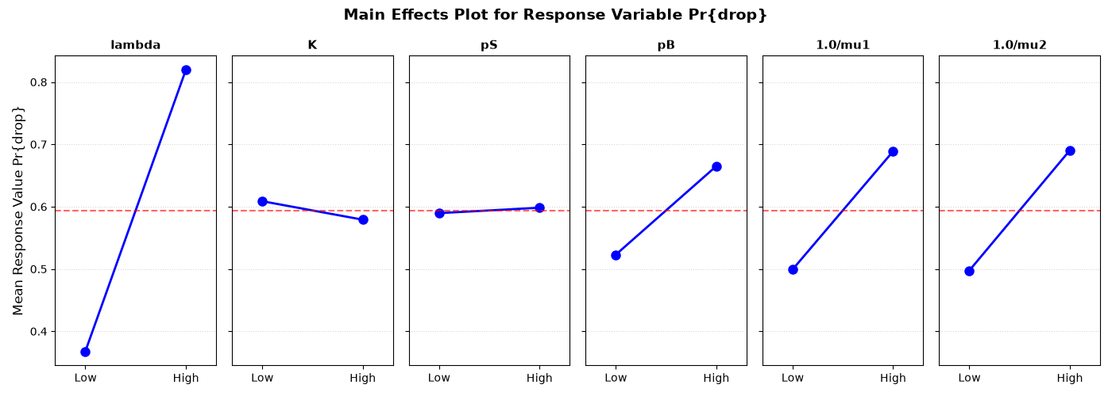
Response of Pr{drop}
lamba has greatest impact on response, equivalence of pB, 1.0/mu1, 1.0/mu2, comparative insensitivity to K

Slide 21
Interaction Terms
Interaction terms quantify scenarios where the effect of one factor (e.g., temperature) on a response depends on the level of another factor
pS showed up as insignificant when averaged over all other parameter values
  But what if pS is high AND 1.0/μ1 is high???
    Service time when switch not made is constant
So consider average measure values when changes to pS and 1.0/μ1 are coordinated

Slide 22
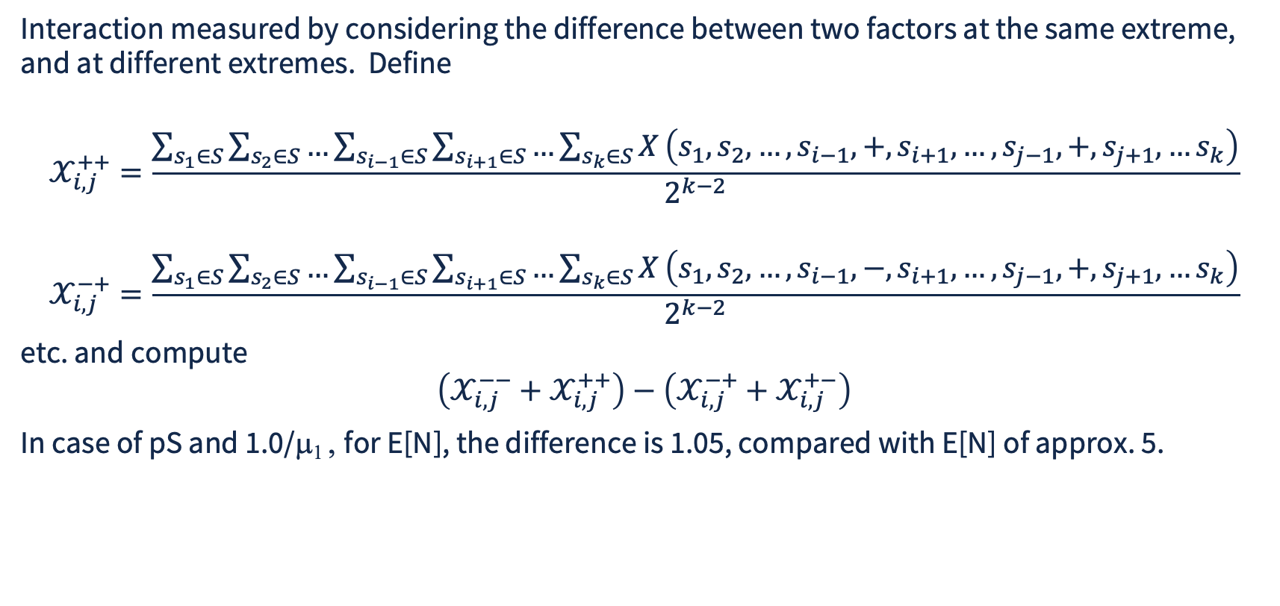
Interaction Plot
Interaction measured by considering the difference between two factors at the same extreme, and at different extremes. Define
$$𝒳_{i,j}^{++}=\frac{\sum_{s_{1}∈S}{\sum_{s_{2}∈S}{…}}\sum_{s_{i−1}∈S}{\sum_{s_{i+1}∈S}{…}}\sum_{s_{k}∈S}{X}\left(s_{1},s_{2},…,s_{i−1},+,s_{i+1},…,s_{j−1},+,s_{j+1},…s_{k}\right)}{2^{k−2}}$$
$$𝒳_{i,j}^{−+}=\frac{\sum_{s_{1}∈S}{\sum_{s_{2}∈S}{…}}\sum_{s_{i−1}∈S}{\sum_{s_{i+1}∈S}{…}}\sum_{s_{k}∈S}{X}\left(s_{1},s_{2},…,s_{i−1},−,s_{i+1},…,s_{j−1},+,s_{j+1},…s_{k}\right)}{2^{k−2}}$$
etc. and compute
$$\left(𝒳_{i,j}^{−−}+𝒳_{i,j}^{++}\right)−\left(𝒳_{i,j}^{−+}+𝒳_{i,j}^{+−}\right)$$
In case of pS and 1.0/μ₁ , for E[N], the difference is 1.05, compared with E[N] of approx. 5.
When lines are parallel, the system response does not depend on coordination between the factors, when lines intersect, they do, and strength of interaction reflected in slope of lines

Slide 23
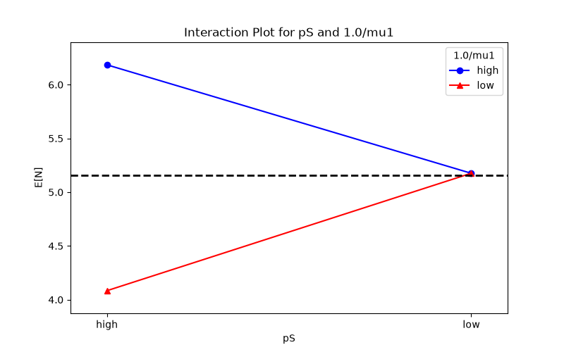
Impact on E[N] from interaction between pS and 1.0/μ1
Tells us that the response E[N] is sensitive to the joint values of pS and 1.0/μ1

Slide 24
Fractional Factorial Designs
Investigates impact of factors on response variables
A factor is investigated at different levels, response measured at different factors at different levels
Designs aim to control which/how interactions among factors are confounded (ideally ones that are not interdependent or significant)
Fractional factorial design created by choosing an alias structure
Specifies which effects will be confounded (e.g., not distinguished) from each other
Original fractional factorials reduce number of combinations by factor of 1/2^{k} for some k
How to choose which factor assignments to leave out?

Slide 25
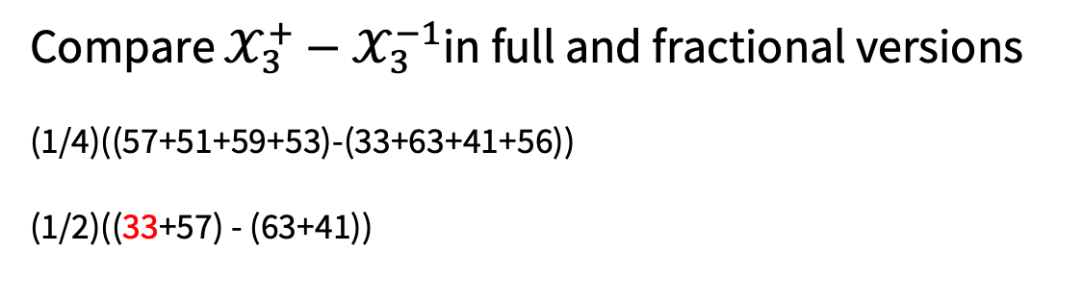
Fractional Factorial Designs
Example: A full factorial table for 3 factors is
Code factors for full factorial on X₁ and X₂
Add code factor from X₁ * X₂ but call it X₃
 | X₁ | X₂ | X₃ | y_{i}
1 | - | - | - | 33
2 | + | - | - | 63
3 | - | + | - | 41
4 | + | + | - | 57
5 | - | - | + | 56
6 | + | - | + | 51
7 | - | + | + | 59
8 | + | + | + | 53
 | X₁ | X₂ |  | y_{i}
1 | - | - |  | 33
2 | + | - |  | 63
3 | - | + |  | 41
4 | + | + |  | 57
 | X₁ | X₂ | X₃ | y_{i}
1 | - | - | + | 33
2 | + | - | - | 63
3 | - | + | - | 41
4 | + | + | + | 57
N.B. Factor code operator: - - = +, -+ = - , +- = -, ++ = +
Compare $𝒳_{3}^{+}−𝒳_{3}^{−1}$in full and fractional versions
(1/4)((57+51+59+53)-(33+63+41+56))
(1/2)((33+57) - (63+41))

Slide 26
Desirable Principles of Fractional Factorial
Balanced: each factor’s levels appear an equal number of times across all runs.
Analysis not biased by over-representation of a factor.
Orthogonal: Estimates of one effect are not distorted by correlations with other effects.
Two factors are independent if the sum of the products of their design matrix columns is zero, use algebra below
mult | - | +
- | 1 | 0
+ | 0 | 1
add | 0 | 1
0 | 0 | 1
1 | 1 | 0

