Slide 1

Indoor Semantic Localization
(SurroundSense)

Slide 2
GPS: Latitude, Longitude
Starbucks, RadioShack, Museum, Library
Many emerging location based apps
do not care about the physical location
Instead, they need the user’s logical location
Notes:
Well, as I have exemplified before, applications care more about the place of the user than the physical coordinates at which he might be.
That is they care whether the user is in a Starbucks ….. and not about knowing the latitude and longitude numbers.
This is because knowing the symbolic location of the user, LBAs have the opportunity to provide personalized service.
We call knowing the user’s place logical localization.
2

Slide 3
Why not convert from
Physical to Logical Locations?

Slide 4

Physical Location
Error
Notes:
And Unfortunately several meters of error is too much for accurate logical localization …
Let me argue this through an illustration …
4

Slide 5
Starbucks
RadioShack
Physical Location
Error
The dividing-wall problem
Notes:
We call this the dividing wall problem and argue that because of this problem converting form physical to logical localization is error prone
Observe that localization based on WiFi signals is not sufficient, because WiFi signals pass through walls and they are overheard in both locations.
This is also why WiFi doesn’t work …
5

Slide 6
Hypothesis
It is possible to localize phones by
sensing the ambience
such as sound, light, color, movement, WiFi …
Notes:
6
The hypothesis behind SurroundSense is that it’s possible to localize mobile phones based on ambience sensing.
By ambience we refer to sound, light, color, movement and WiFi.
Consider these three pictures form adjacent shops.
The bookstore to the left is well lit, the clothing shop in the middle is darker while the sports bar in the right is the darkest of the three.
Furthermore, looking at the floor colors we see that the bookstore is covered with green carpet, while the clothing shop has a grey carpet and the sports bar is covered with black wood floor.
In terms of sound the bookstore will be quiet, the clothing shop may play some music in the background, while the sports bar will include humans chatting and fans cheering.
Furthermore, the layout of a store and the nature of the business will force people to walk in different patterns. In the bookstore people will have a relaxed stroll interrupted by long standing periods while browsing through a book. In the clothing store the pace will be faster --with people moving from isle to isle-- while the standing periods will be smaller while checking some garment. Lastly, in the sports bar, people will be mostly static seating at the bar or at a table.
Lastly we can think also that the overheard access points in these locations are different for each location.
All these ambience information can be sensed through the mobile phone sensors, the microphone, the camera, the accelerometer and the WiFi card.

Slide 7
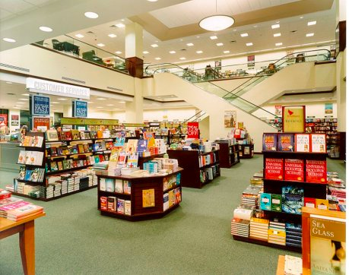
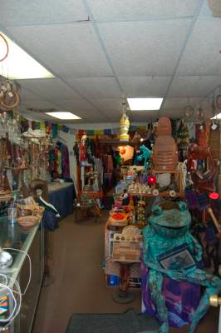
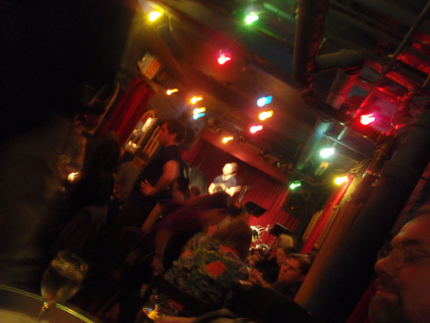
Hypothesis
It is possible to localize phones by
sensing the ambience
such as sound, light, color, movement, WiFi …
Notes:
7
The hypothesis behind SurroundSense is that it’s possible to localize mobile phones based on ambience sensing.
By ambience we refer to sound, light, color, movement and WiFi.
Consider these three pictures form adjacent shops.
The bookstore to the left is well lit, the clothing shop in the middle is darker while the sports bar in the right is the darkest of the three.
Furthermore, looking at the floor colors we see that the bookstore is covered with green carpet, while the clothing shop has a grey carpet and the sports bar is covered with black wood floor.
In terms of sound the bookstore will be quiet, the clothing shop may play some music in the background, while the sports bar will include humans chatting and fans cheering.
Furthermore, the layout of a store and the nature of the business will force people to walk in different patterns. In the bookstore people will have a relaxed stroll interrupted by long standing periods while browsing through a book. In the clothing store the pace will be faster --with people moving from isle to isle-- while the standing periods will be smaller while checking some garment. Lastly, in the sports bar, people will be mostly static seating at the bar or at a table.
Lastly we can think also that the overheard access points in these locations are different for each location.
All these ambience information can be sensed through the mobile phone sensors, the microphone, the camera, the accelerometer and the WiFi card.

Slide 8

Any one dimension may not be unique,
but put together, they may provide a
unique fingerprint
Notes:
Based on our empirical observations we reached 2 conclusions
1.
2. Even if each dimension may not be unique, by putting them together we can get a unique fingerprint for each location.
8

Slide 9
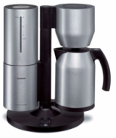
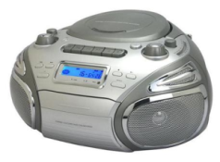
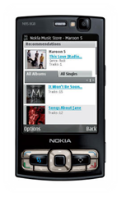
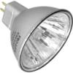
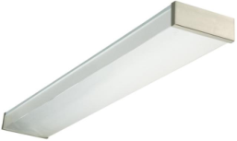
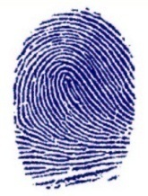

SurroundSense
Starbucks
RadioShack
Wall
SurroundSense Server
Multi-dimensional fingerprint
  Based on ambient sound/light/color/movement/WiFi
Notes:
Fluorescent light … however by the nature of this locations we can imagine that Starbucks has some coffee grinding machines noises while RadioShack may have some loud music in the background
9

Slide 10
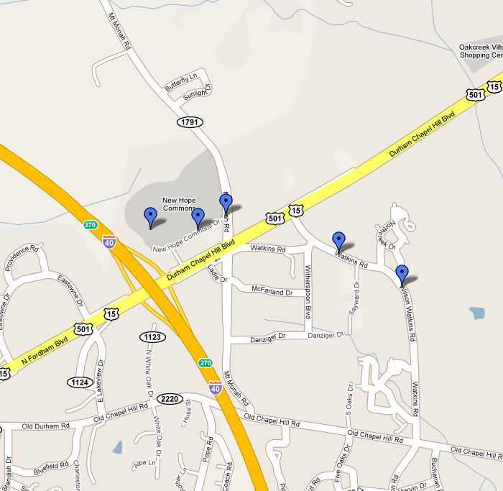
Should Ambiences be Unique Worldwide?
J
I
P
H
A
Q
K
C
B
D
E
Q
L
M
N
R
F
O
G
Notes:
10
The next question is does surrounsense require ambiences to be unique worldwide.
That is do we require that each individual shop has a unique ambience that can be distinguishable from any other location.

Slide 11
Should Ambiences be Unique Worldwide?
GSM provides macro location (e.g., strip mall) …
SurroundSense refines to Starbucks
J
I
P
H
A
Q
K
C
B
D
E
Q
L
M
N
R
F
O
G
Notes:
11
Well, no, Surroundsense has a much weaker constraint.
We require the ambiences be different in a small region around a rough estimate of the phone location obtained through GSM localization.
The phone localizes itself using GSM, shortlists all the shops within the GSM localization error, these shops become the candidate shops and SS tries to localize the phone within one of these shops.
In other words, GSM will provide a macro location such as a strip mall, while SurroundSense will refine the location to a certain shop within the candidate shops.

Slide 12
But Clustered Locations Need to be Unique …
Economics forces nearby businesses to be different
  Not profitable to have 3 coffee shops
  with same lighting, music, color, layout, etc.
  SurroundSense exploits this ambience diversity
The Intuition:
Notes:
12

Slide 13
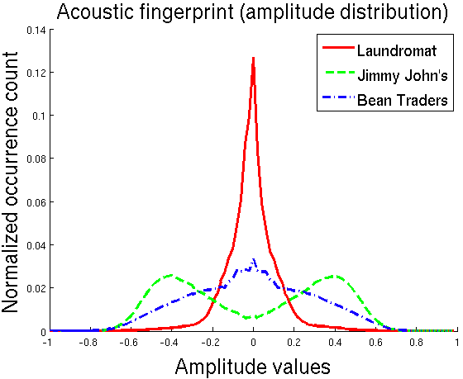
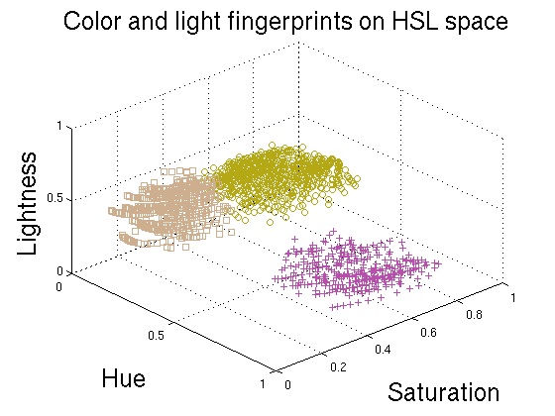
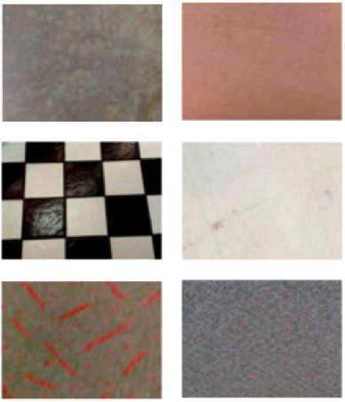
Fingerprints
Sound:
Color:

Slide 14
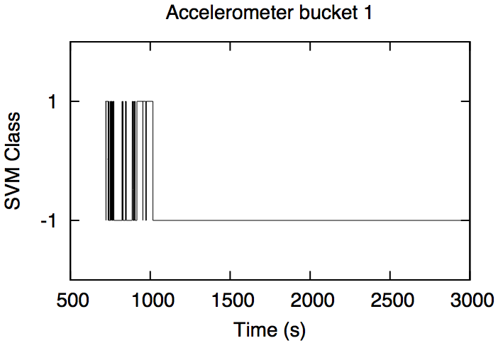
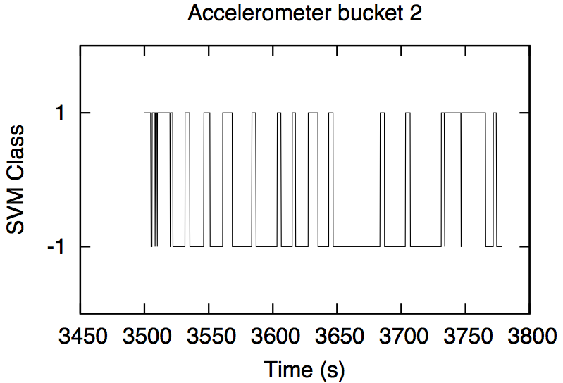
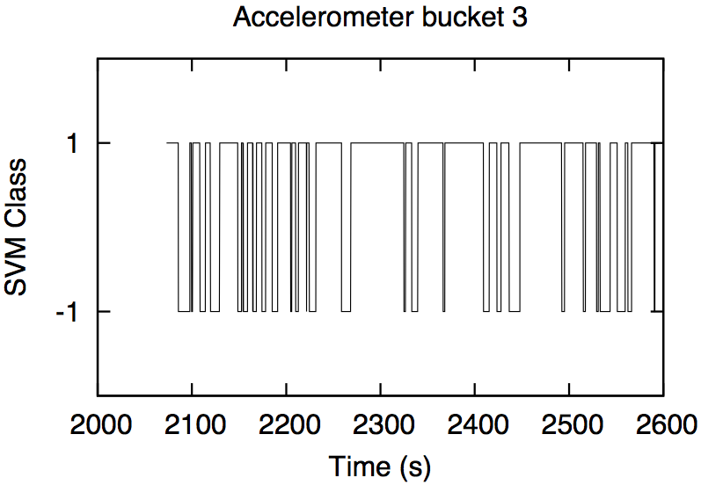
Fingerprints
Light:
Movement:

Slide 15

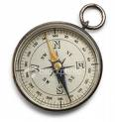
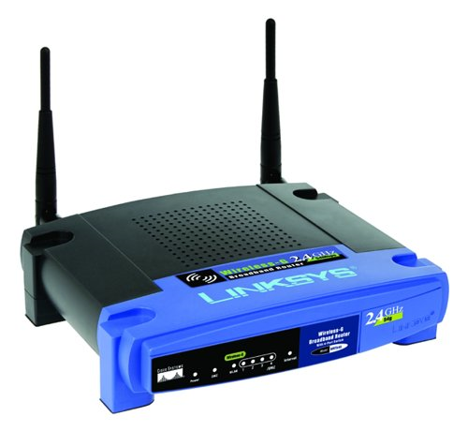

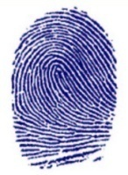
Architecture
Ambience Fingerprinting
Fingerprint Filtering &
Matching
Sound
Test Fingerprint
Color/Light
+
Compass
=
RF/Acc.
Fingerprint
Database
Logical
Location
Macro
Location
Candidate Fingerprints

Slide 16
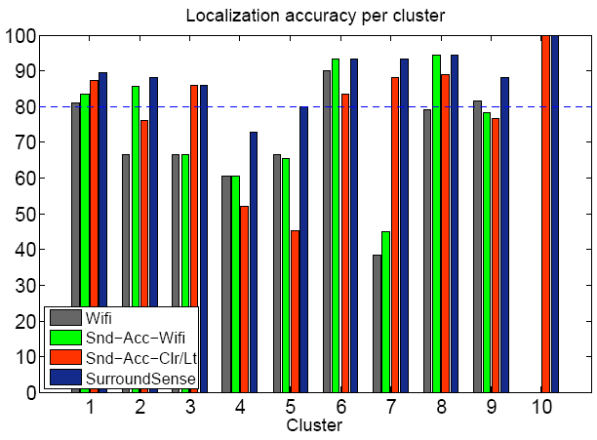
Evaluation: Per-Cluster Accuracy
Cluster
No. of Shops
1 | 2 | 3 | 4 | 5 | 6 | 7 | 8 | 9 | 10
4 | 7 | 3 | 7 | 4 | 5 | 5 | 6 | 5 | 5
Localization accuracy per cluster
Accuracy (%)
Cluster
Notes:
Here we have a summary of our results. We have organized the results in terms of per-cluster accuracy. By cluster we mean a GSM macro-location covering several shops. In the table we represent the GSM macrolocation given by the cluster number and how many candidate shops were in each of these GSM macro-locations.
We tested 4 combinations of sensors representative of several usage scenarios.
16

Slide 17
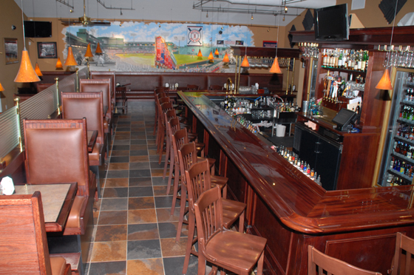

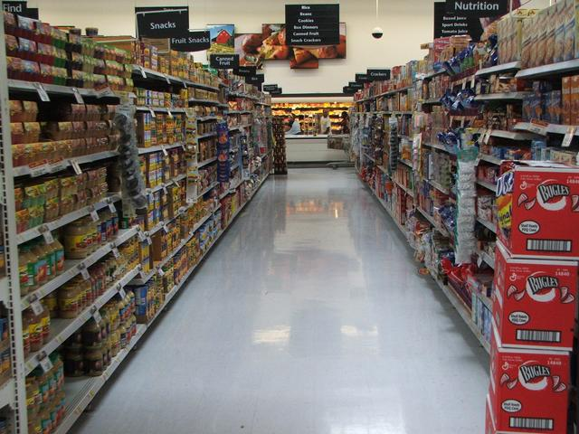

Issues and Opportunity
Cameras may be inside pockets
  Now, we detect when its taken out
  Activate cameras, and take pictures
  Future phones will be flexible (wrist watch) - see Nokia Morph
Electroic compasses can fingerprint layout
  Tables and shelves laid out in different orientations
  Users forced to orient in those ways

Slide 18
Summary
  Ambience can be a great clue about location
  Ambient Sound, light, color, movement …
  None of the individual sensors good enough
Combined they may be unique
Uniqueness facilitated by economic incentive
  Businesses benefit if they are mutually diverse in ambience
  Ambience diversity helps SurroundSense

